Slide 1
Near Detectors for Long Baseline Oscillation Experiments
Asher Kaboth
10 April 2019

Slide 2
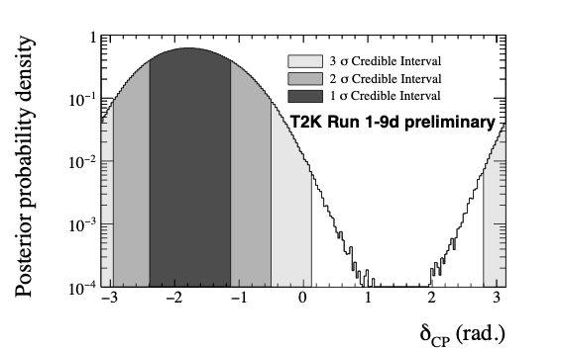

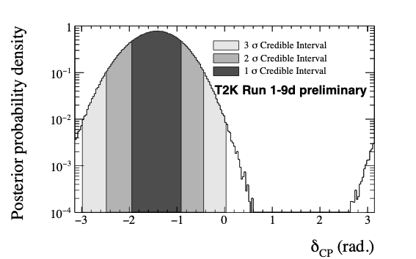
CP Violation
Results shown are for with reactor constraint; T2K only in back up
NH
IH
There is a hint from T2K that δCP is not 0/π
Should we trust this result?

Slide 3
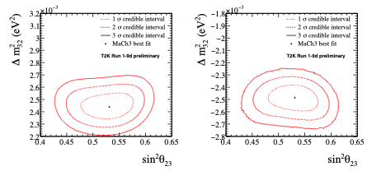
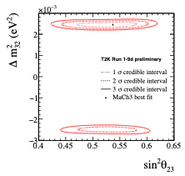


Disappearance Sector
NH
IH
both
T2K prefers NH with a Bayes factor of 8.0, assuming an equal prior between NH and IH
T2K is consistent with sin²θ23=0.5
Best fit value of sin²θ23=0.537 (NH)
Best fit value of ∆m²32=2.46x10⁻³ eV² (NH)
 | sin²(θ23)<0.5 | sin²(θ23)>0.5 | Sum
NH | 0.184 | 0.705 | 0.889
IH | 0.021 | 0.090 | 0.111
Sum | 0.205 | 0.795 | 1

Slide 4
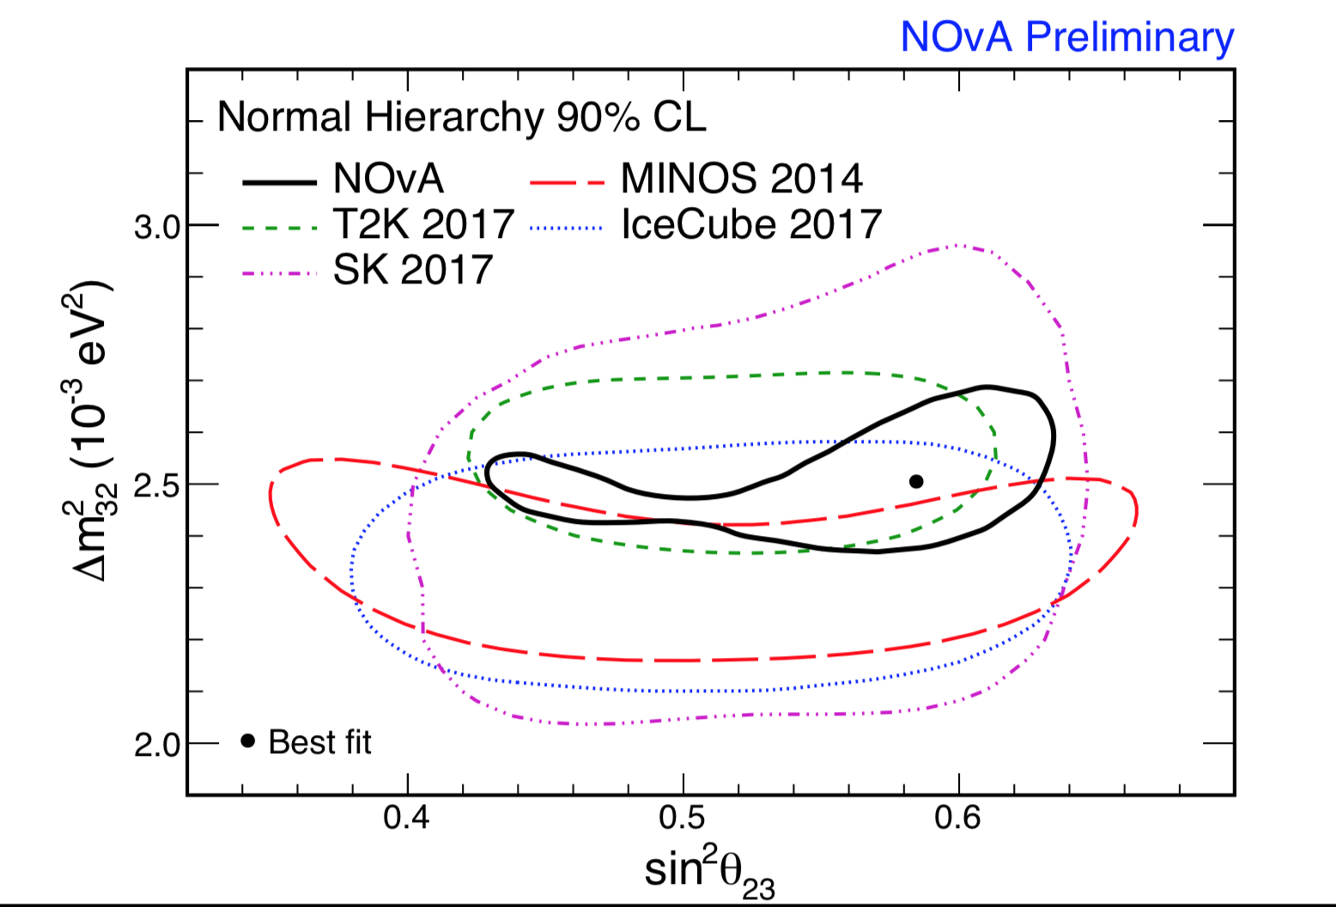
Disappearance Sector
NOvA results prefer non-maximal mixing
Very narrow result in ∆m²32
Should we trust this result?
Prefer NH at 1.8σ
(T2K similar)

Slide 5
Oscillation Experiments in a Nutshell
Far Detector
ν beam
Near Detector
10²⁻³ of km
How many να here?
N = Φ × σ × ε × P(να→νβ)
How many νβ here?

Slide 6

Why Is This Hard?
Non-perturbative!
Ancient data!
Axial currents!
Effective parameters!
A-scaling is hard!

Slide 7
Oscillation Experiments in a Nutshell
Far Detector
ν beam
Near Detector
10²⁻³ of km
How many να here?
Nn = Φn × σn × εn
Nf = Φf × σf × εf × P(να→νβ)
How many νβ here?

Slide 8
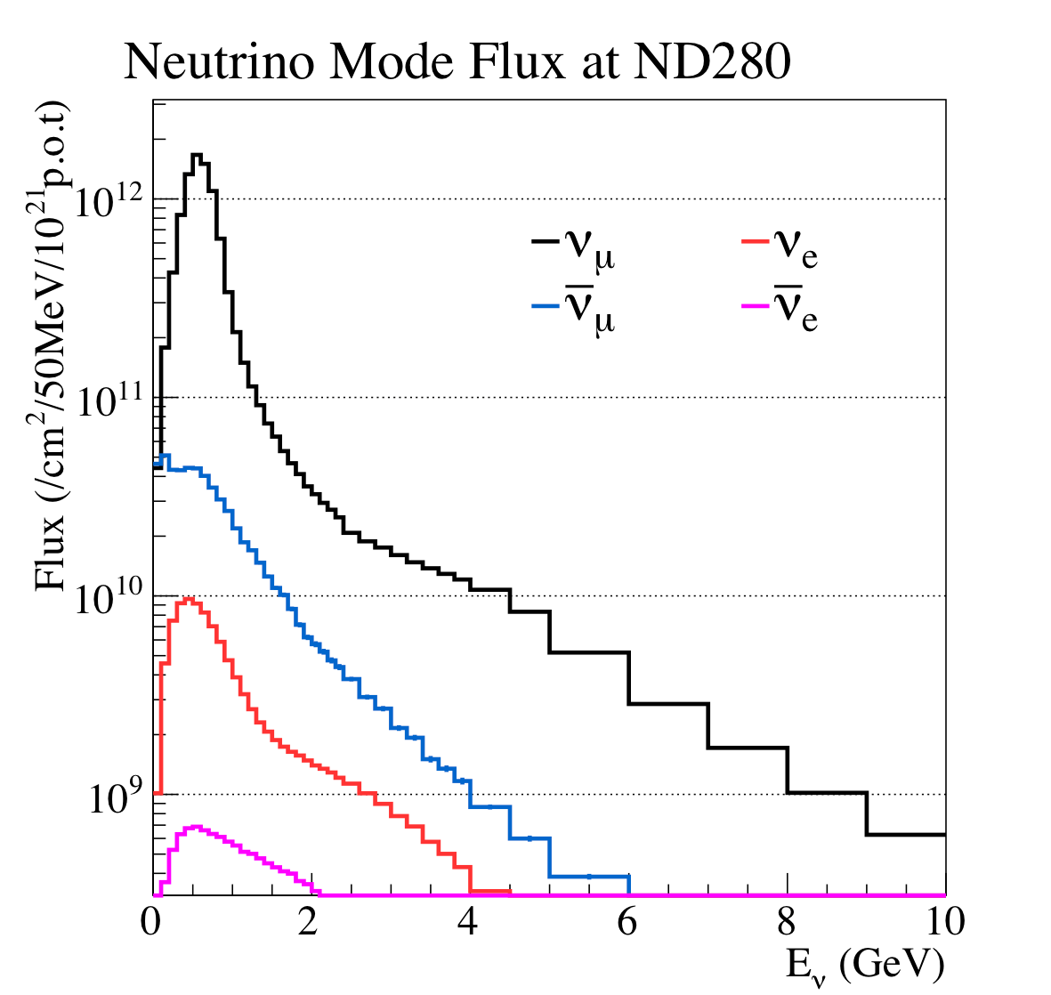
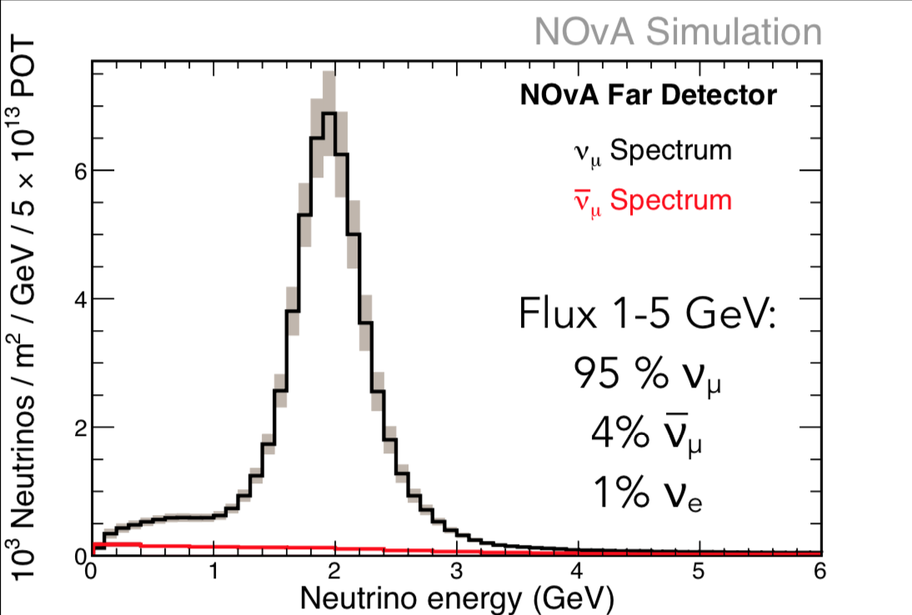
Neutrino Beam
QCD Lives Here

Slide 9
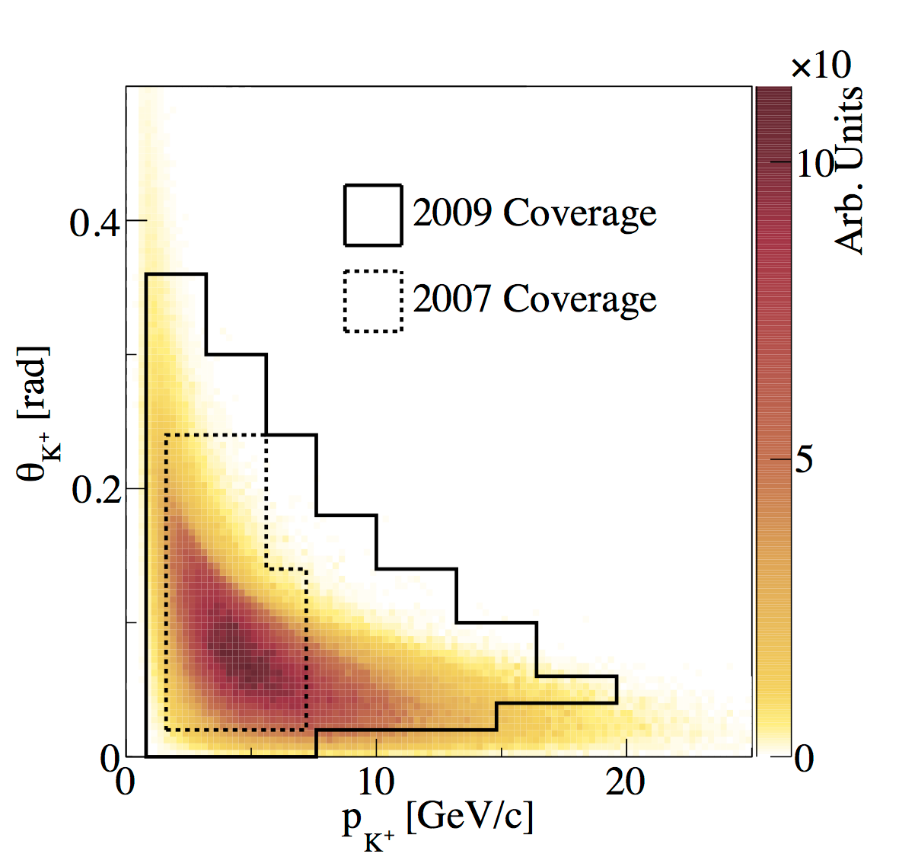
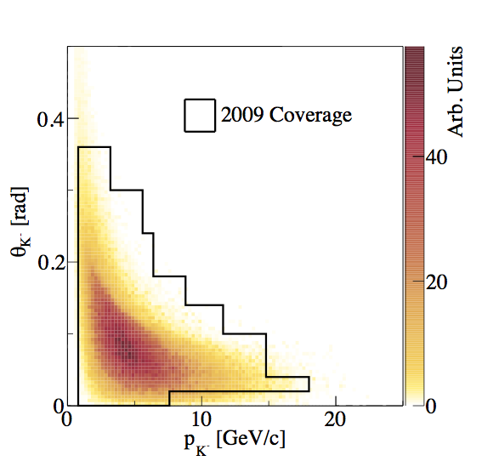
Hadronic Uncertainties
Long baseline experiments use associated hadronic production experiments (e.g. NA61/SHINE) to constrain pion/kaon production
Still need to extrapolate from phase space of associated experiments to full beam line

Slide 10
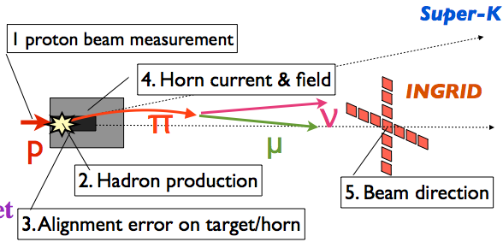
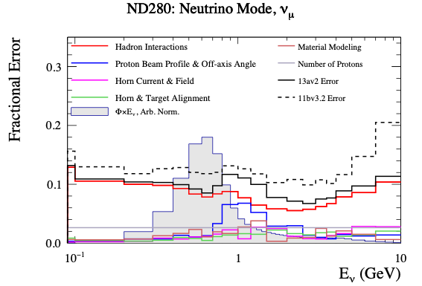
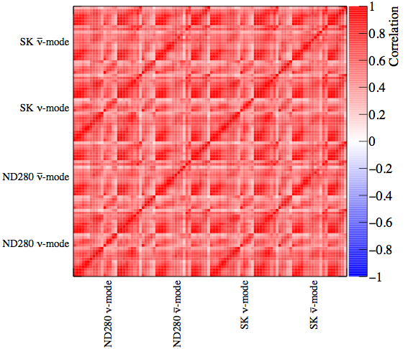
Beam Uncertainties
1. Proton beam measurement
4. Horn current and field
2. Hadron production
5. Beam direction
3. Horn and beam alignment

Slide 11
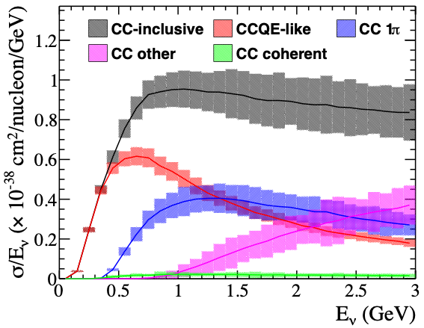
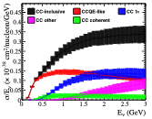
ν-N Cross Section Model
Uncertainties come from underlying model parameters and normalizations
Charged current quasi-elastic
Charged current multinucleon
ν on C
νμ
μ
νμ
μ
W
W
a.k.a. 2p-2h or MEC
n
p
n
p
n/p
n/p
Deep Inelastic Scattering
Charged Current 1π
νμ
μ/νμ
νμ
μ/νμ
ν̅ on C
W/Z
W/Z
π,etc
N
N’
N
N’
π

Slide 12
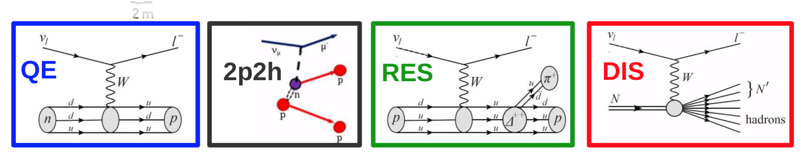

Slide 13
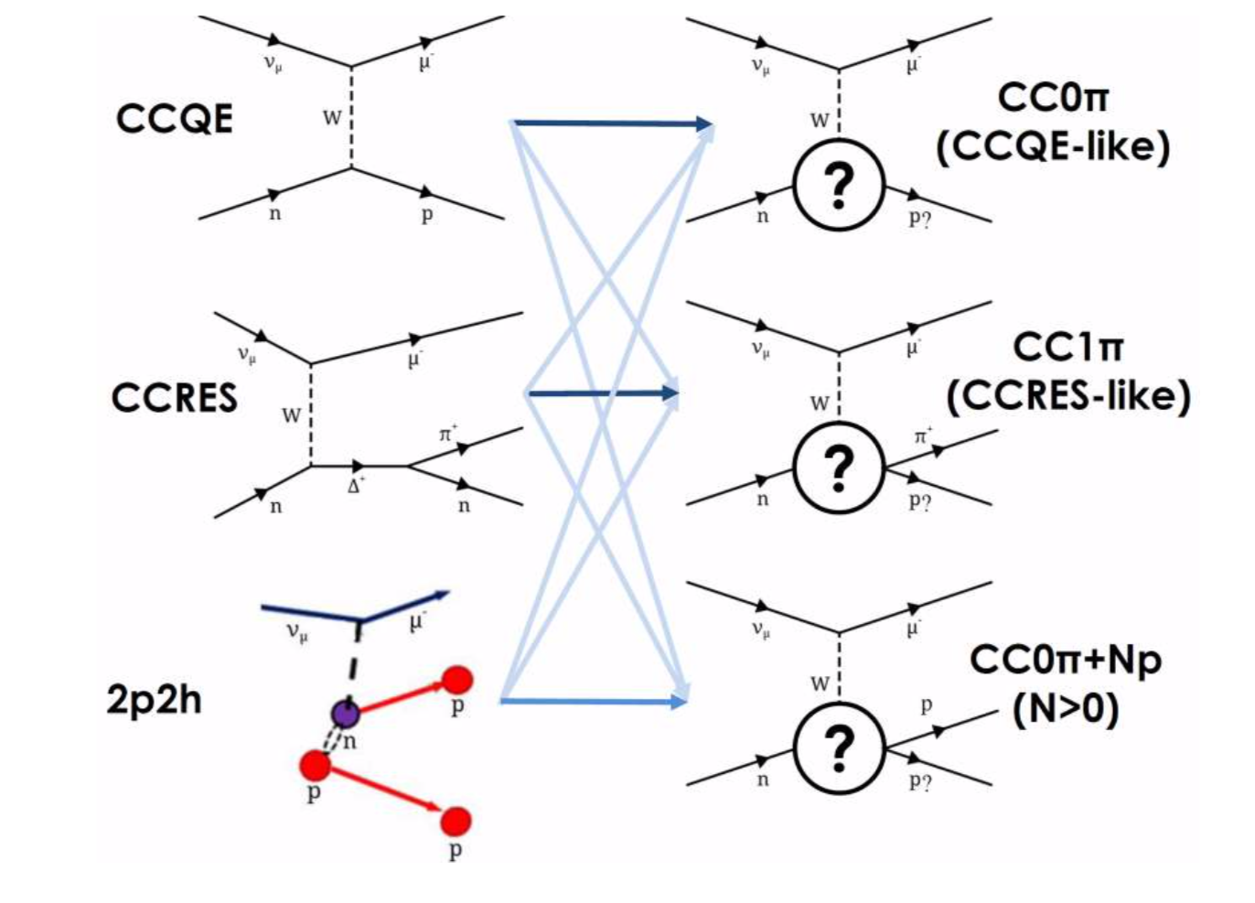
Mode vs Topology

Slide 14
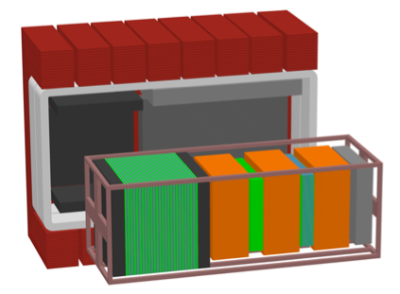
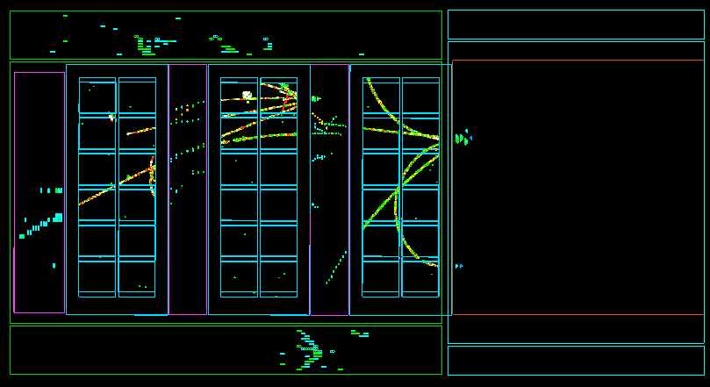
T2K Off-Axis Near Detector
Beam
Fine Grained
Detectors (FGDs)
Side Muon Range Detector
UA1 Magnet
Primary Interaction Material: Carbon
Secondary Interaction Materials: Oxygen, Lead, Brass, Argon
P0D ECal
Electromagnetic
Calorimeter (ECal)
Interaction in P0D
π⁰ detector
(P0D)
ECal
Interaction in FGD1
Time Projection
Chambers (TPCs)
Strategy:
Parameterize underlying models
Select data samples to optimize constraints
Propagate uncertainties through parameters
Beam
Interaction in ECal

Slide 15
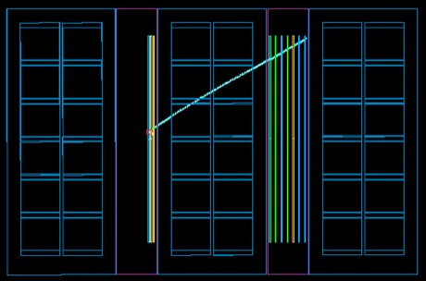
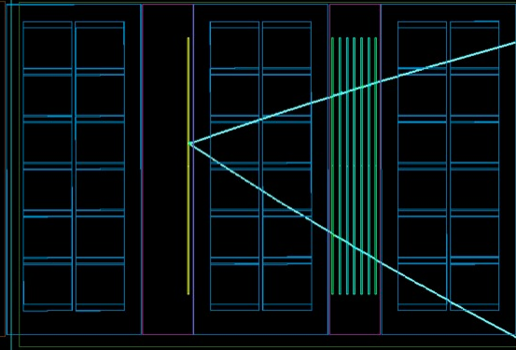
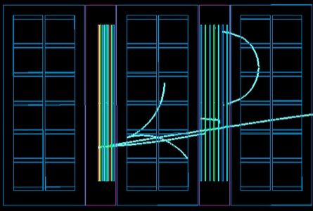
CC0π
CC1π⁺
data
data
μ⁻
νμ
μ
νμ
μ
μ⁻
W
W
n
p
N
N’
π
TPC
FGD
TPC
FGD
TPC
TPC
FGD
TPC
FGD
TPC
π⁺
CC other
data
νμ
μ
Beam
W
π,etc
μ⁻
N
N’
TPC
FGD
TPC
FGD
TPC

Slide 16
ND280 ν-mode samples
FGD1 samples shown;
FGD2 similar
CC1π
CC0π
CCother
Stacked histograms are MC
before data fit
Three samples allow sensitivity to different beam energies and cross section interaction modes
High statistics in neutrino mode provide strong constraints

Slide 17
CC0π Samples
Before analysis
After analysis
Clear that data is in better agreement after the analysis
Adjustment comes through all the modes
T2K is no longer statistically limited at the near detector!

Slide 18
Propagation of Uncertainty

Slide 19
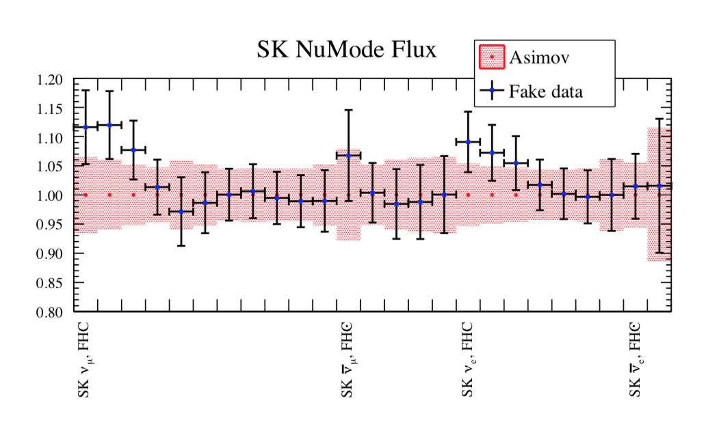
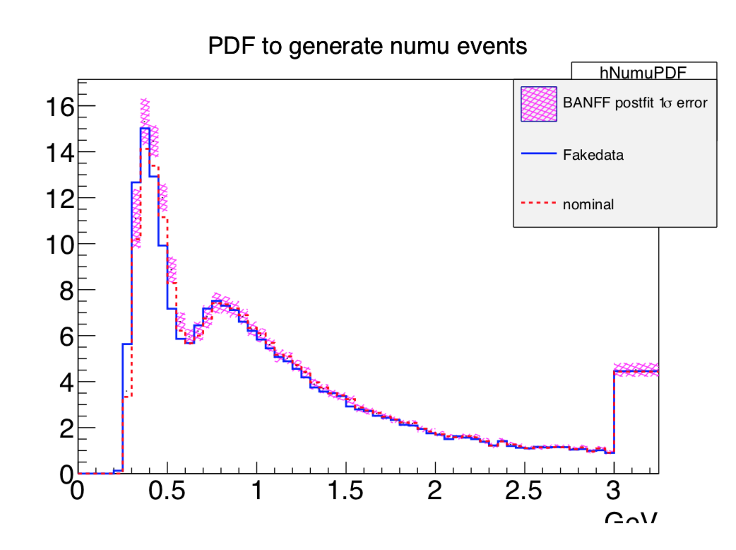
‘Fake Data’ Analyses
Generate ‘fake data’ from alternative models
Perform full analysis
Example: Binding energy in nuclei
Check if the analysis is sensitive to this

Slide 20
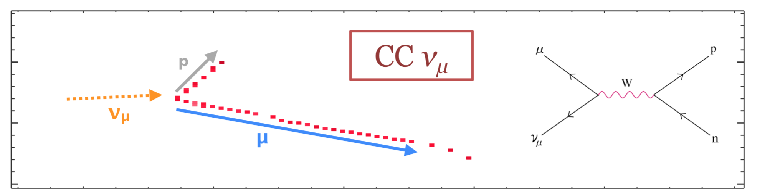
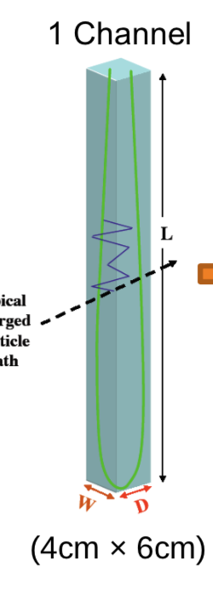
NOvA ND
Primary Interaction Material: Carbon
Scintillator units
Muon catcher

Slide 21
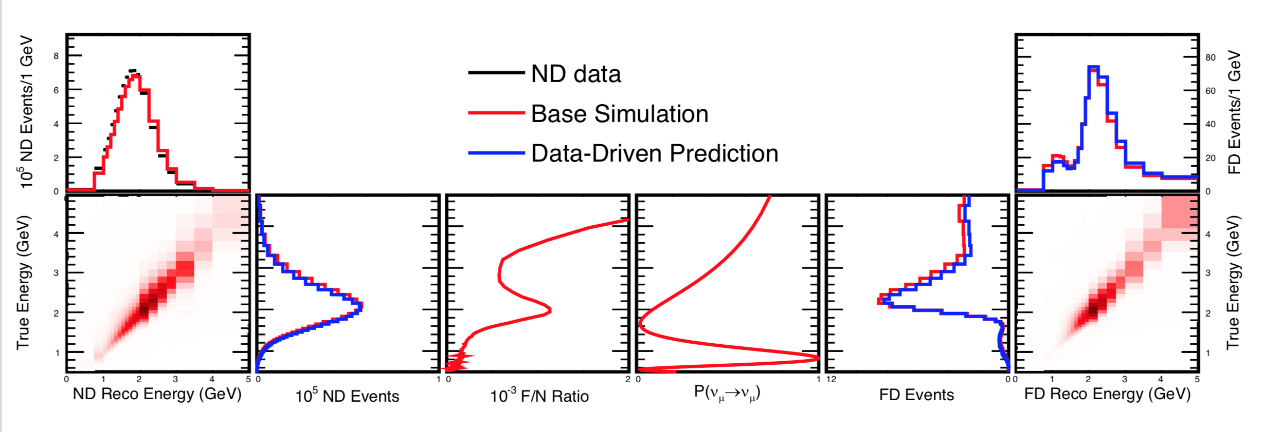
NOvA ND
Strategy:
Unfold ND data to predict true energy spectrum
Apply Far/Near ratio and oscillations
Fold back to reconstructed energy
Systematics are applied as variations on the true-reconstructed matrices

Slide 22
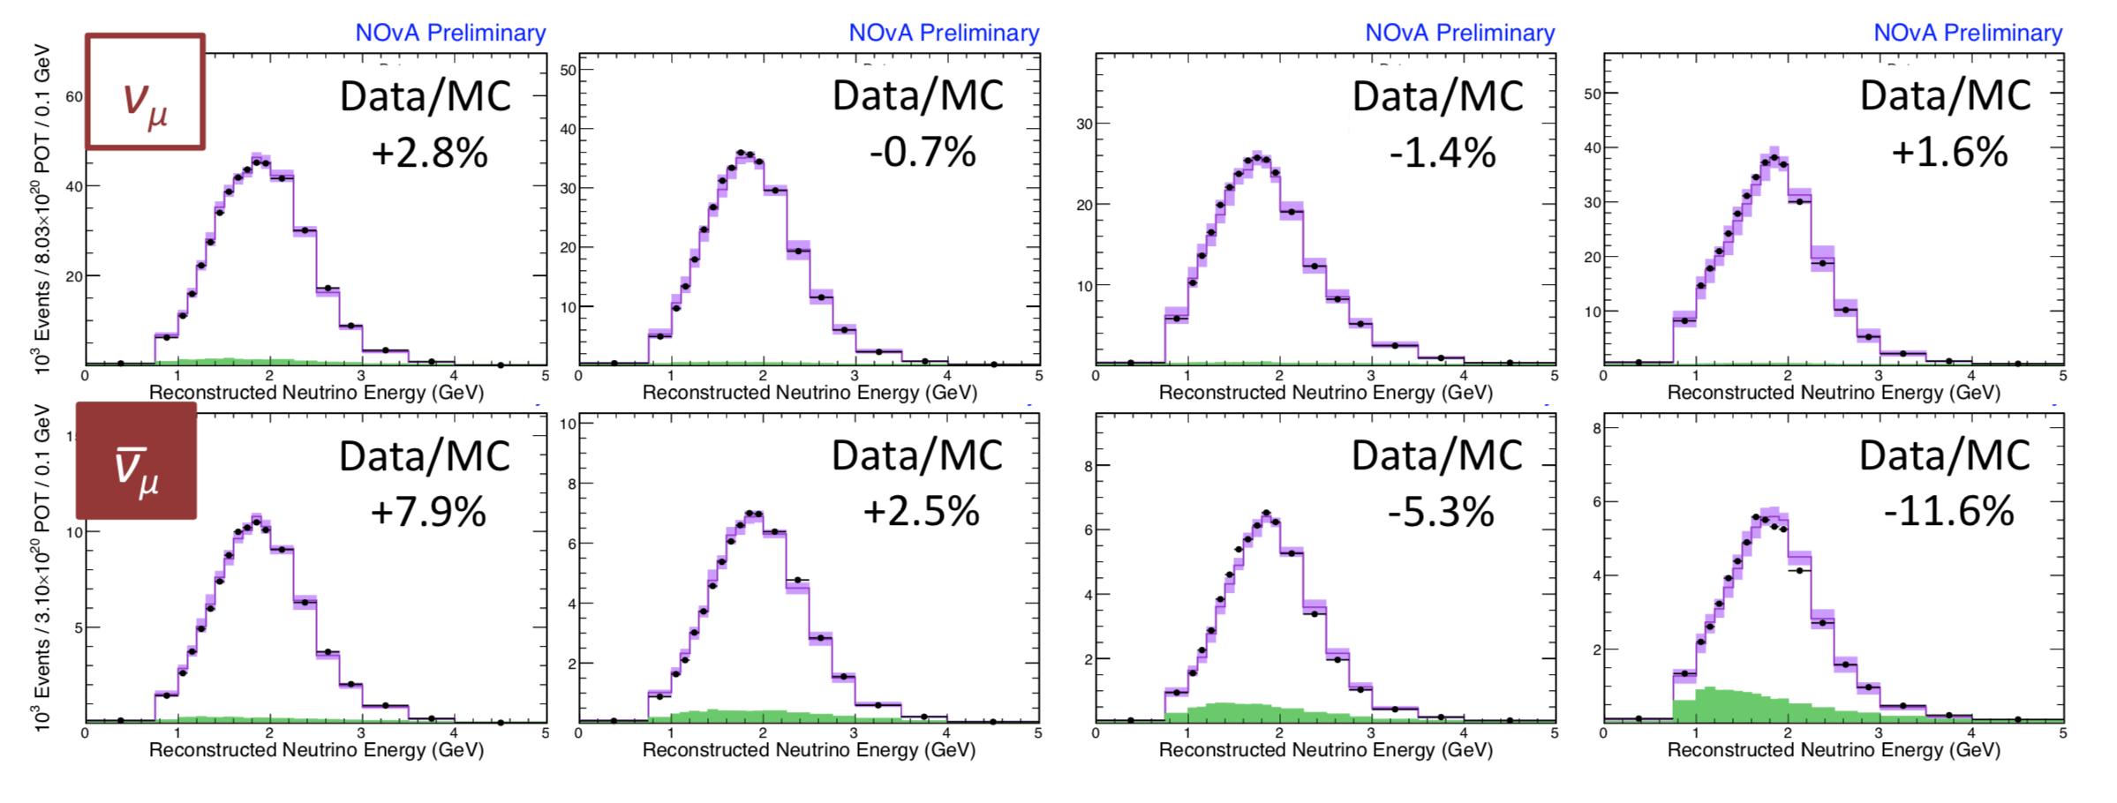
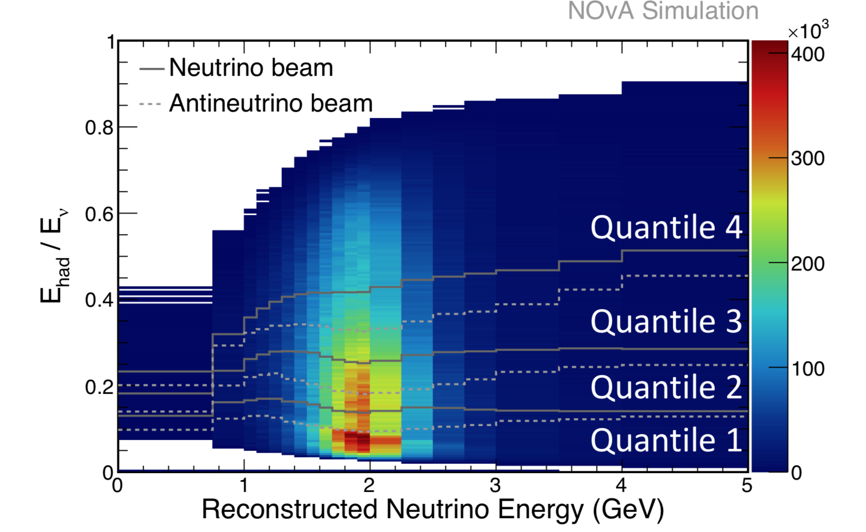
NOvA ND
Split into bins of hadronic energy
This reflects different energy resolutions

Slide 23
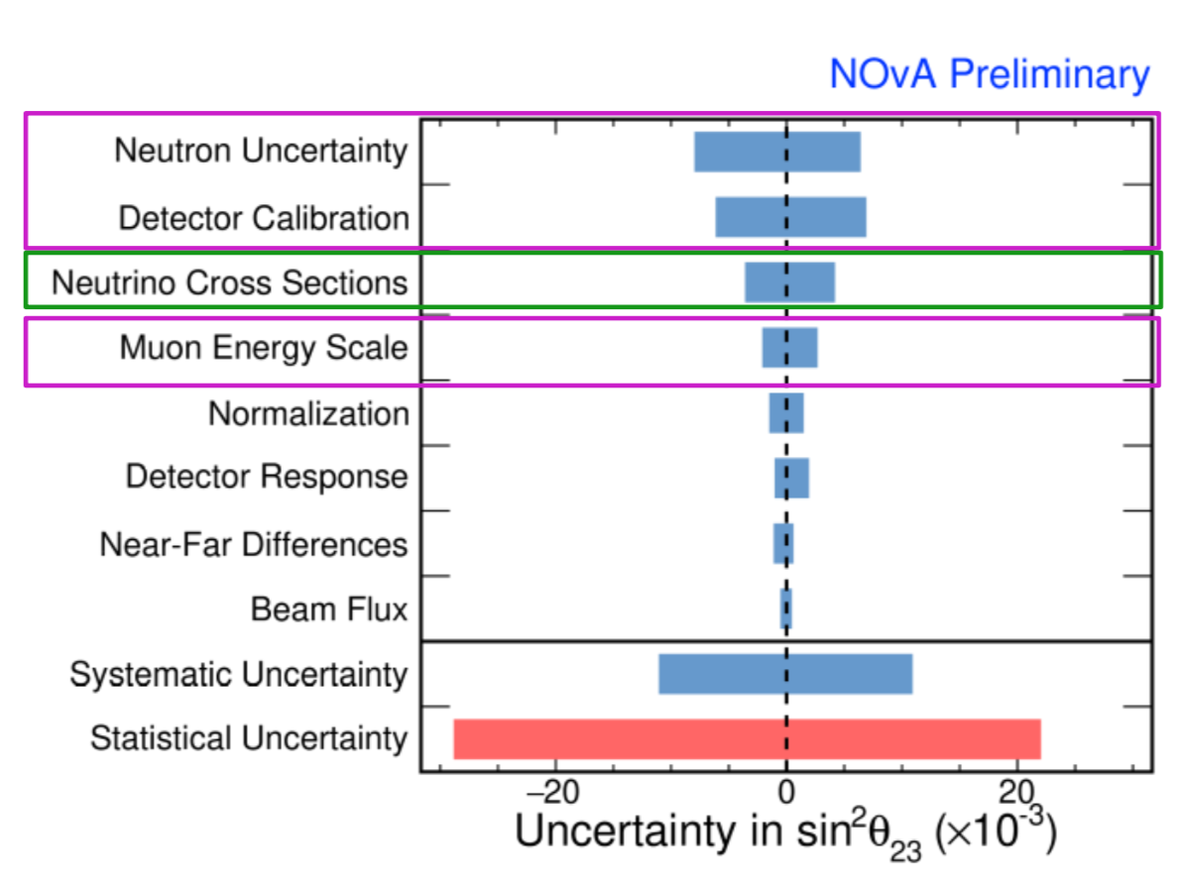
Propagation of Uncertainty
Statistical uncertainty still dominates for NOvA
Nevertheless, as datasets increase, this will become increasingly important

Slide 24
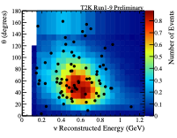
Problems: Phase Space
Near detectors typically have a restricted phase space relative to their far detectors
Uncertainties in Q² can badly affect this!
T2K FD sample

Slide 25
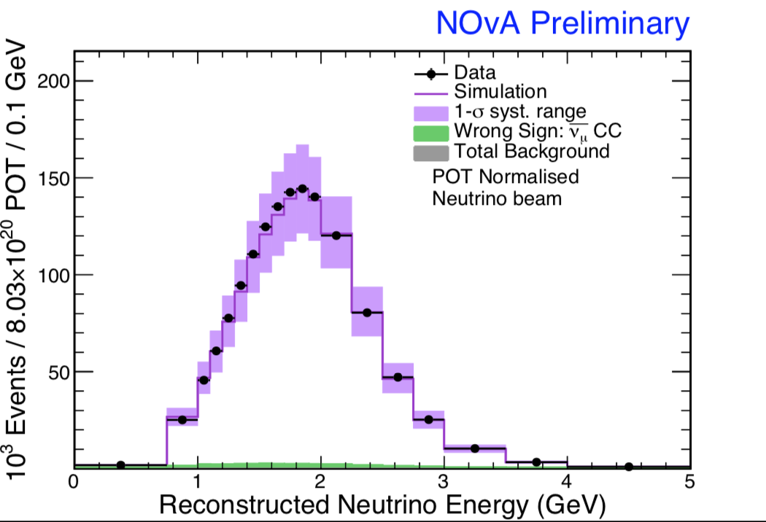
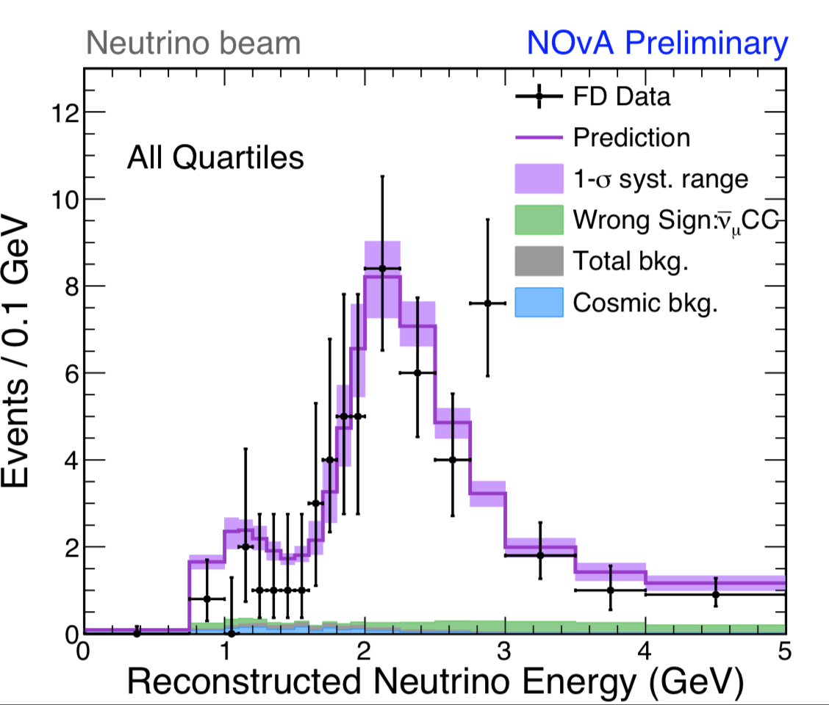
Problems: Energy Spectrum
Near and far do not see identical fluxes
Different modes have different energy resolution/biases
If this is wrong—can produce biases in osc. parameters

Slide 26
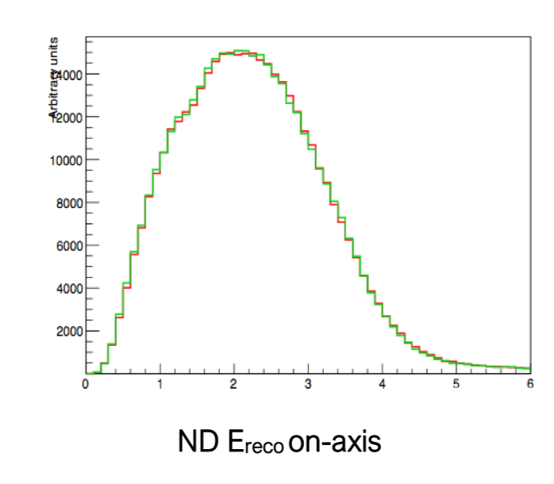
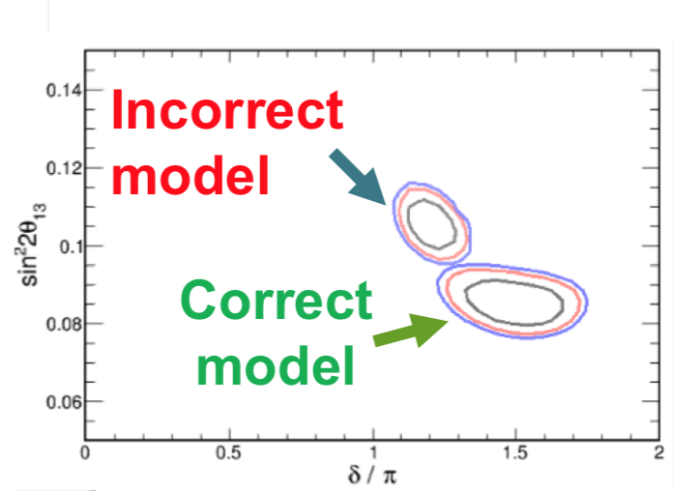
Problem: Model Degeneracy
Example: can shift energy from protons to neutrons and the ND spectrum looks fine via other model compensations
Impact on oscillation contours is large

Slide 27
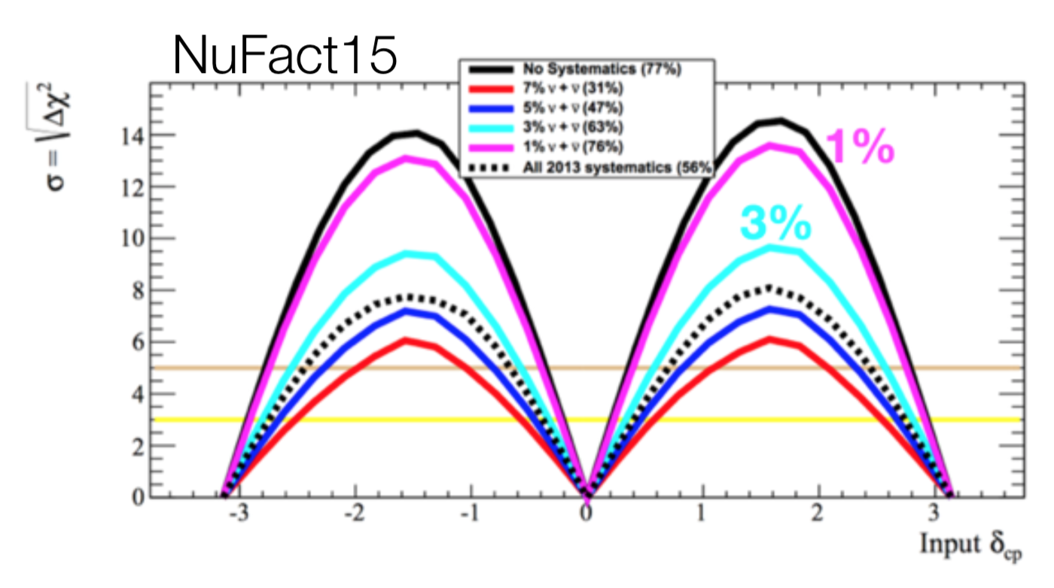
Next Generation
HK
Systematic uncertainties have a huge effect on the sensitivity of future LBL experiments
We have to do much better!

Slide 28
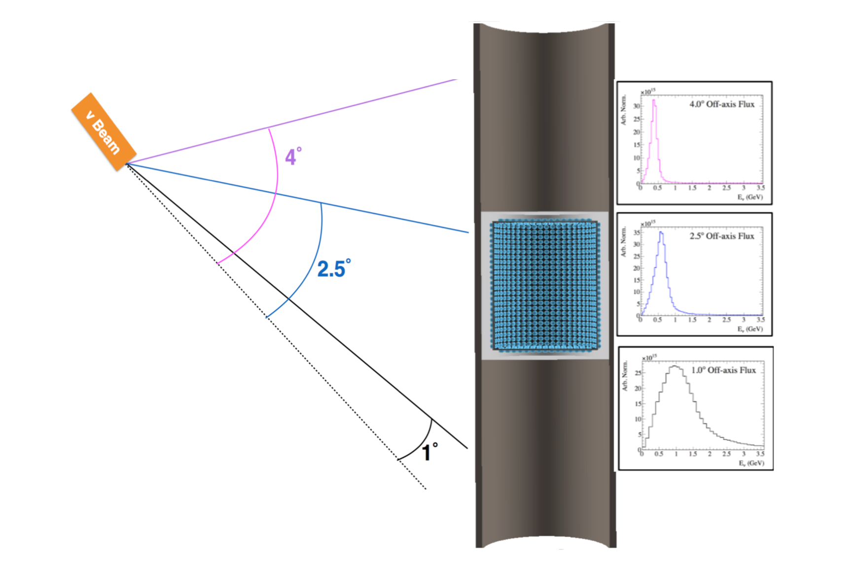
New Concepts: PRISM
Use the off-axis effect to generate different energy neutrino beams
Systematics are low ‘bin-to-bin’

Slide 29
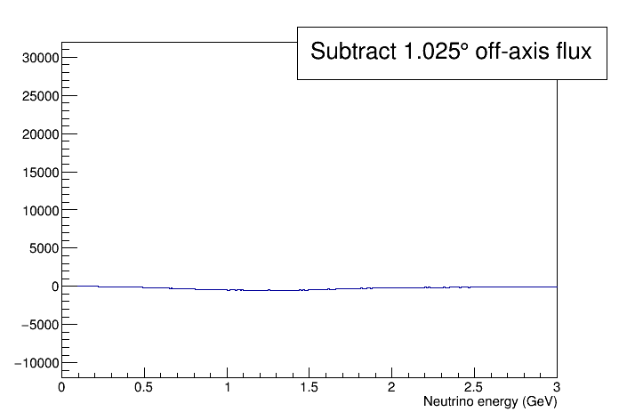
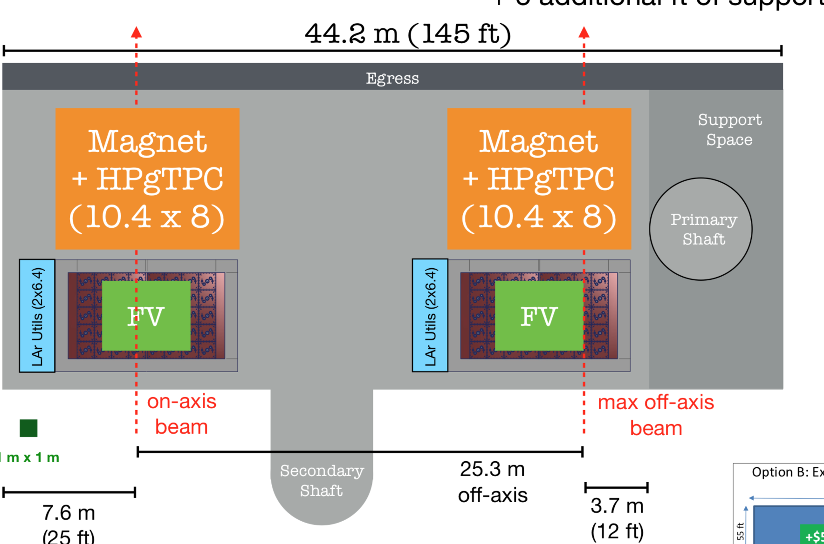
New Concepts: PRISM
Can construct ‘monoenergetic’ beams
Can construct ‘pre-oscillated’ beams
Both HK and DUNE have plans for a PRISM detector

Slide 30
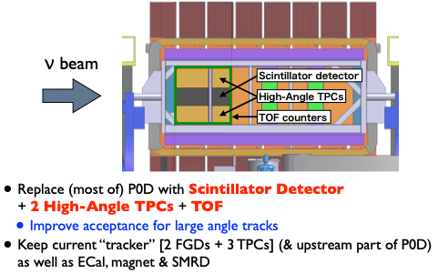
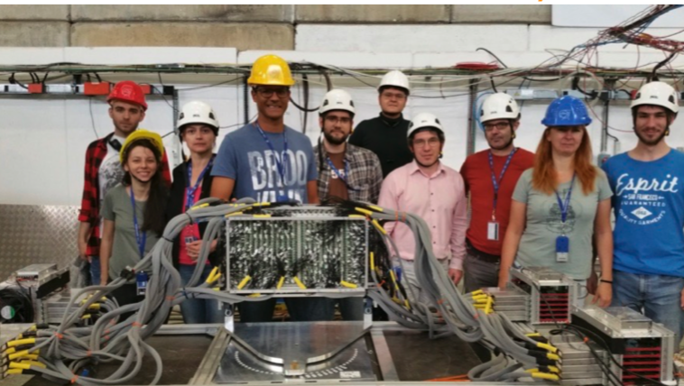
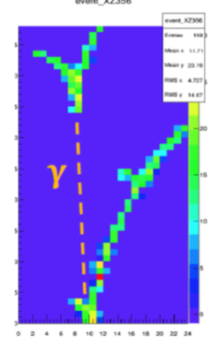
New Concepts: Low Threshold
Upgrade to T2K ND280 to increase efficiency at high angles
New detector target with much finer granularity

Slide 31
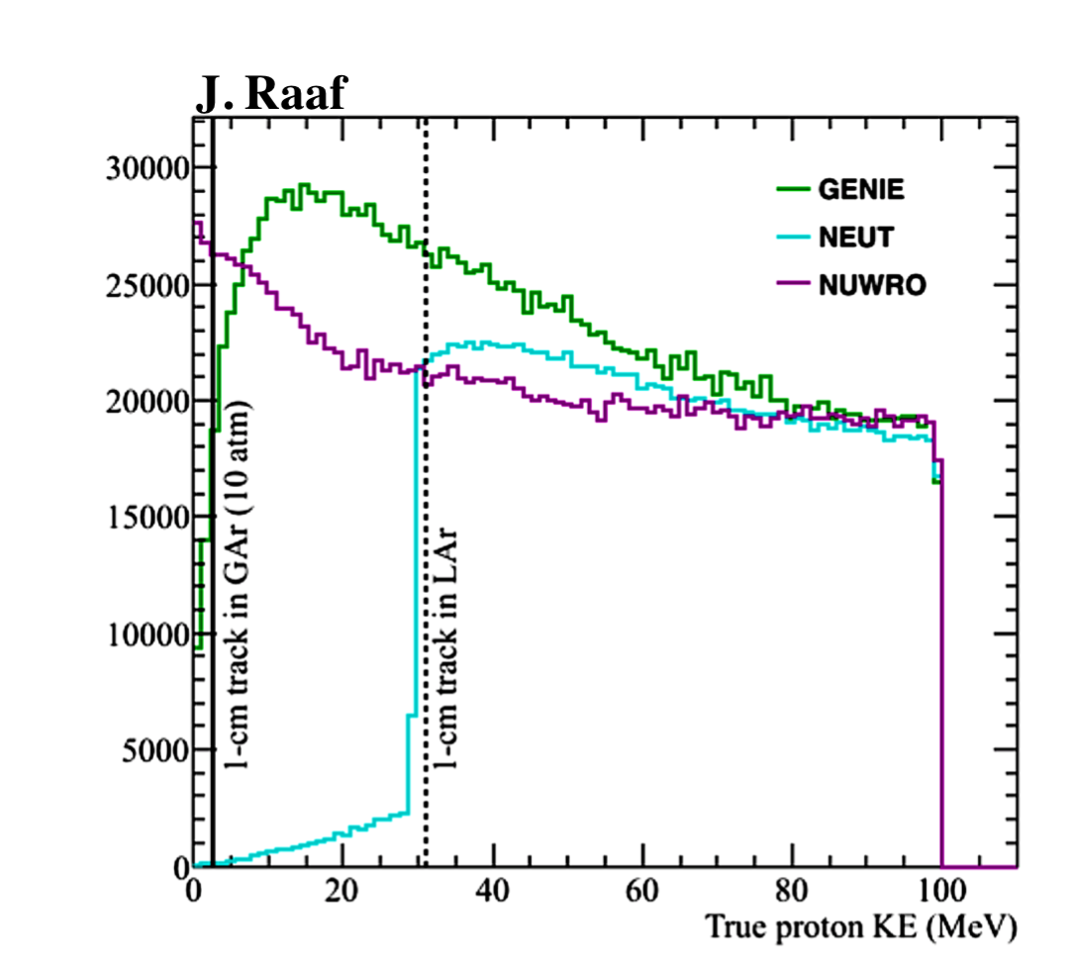
New Concepts: Low Threshold
Resolution only gets us so far—to do better, need lower density
Proposal: High pressure gas TPC
Begin to distinguish low energy hadrons—better mode determination, model constraint

Slide 32
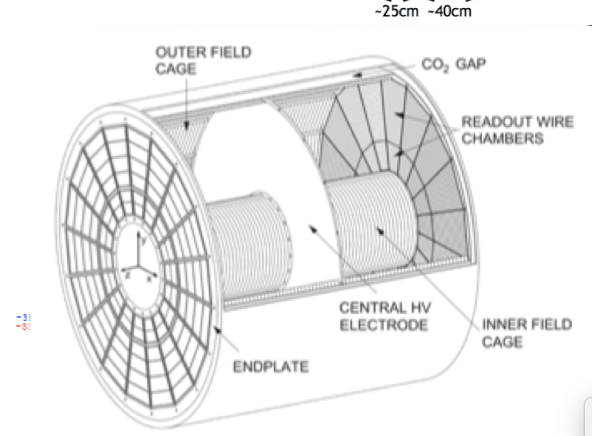
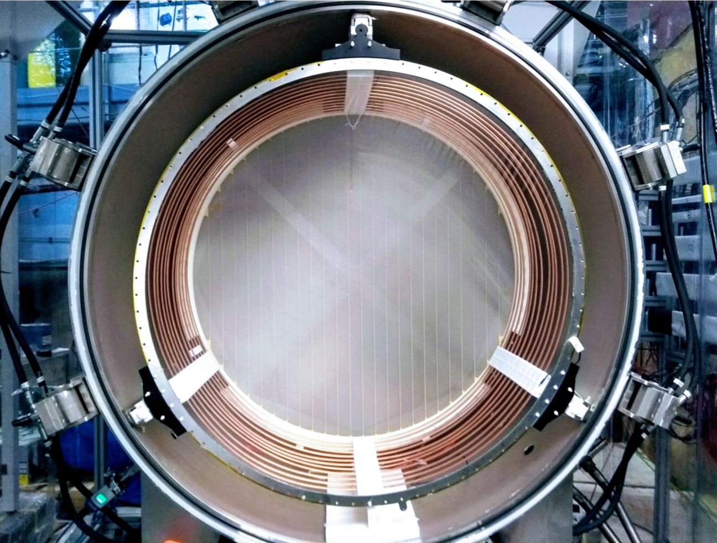
New Concepts: Low Threshold
DUNE plans to build a HPgTPC a part of the near detector complex
Prototype detectors are underway both at FNAL and RHUL

Slide 33
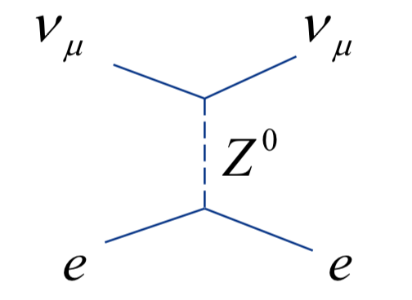
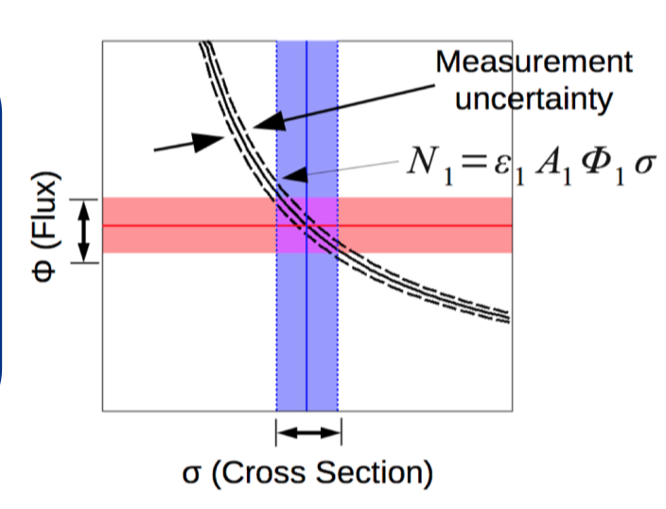
New Concepts: Beam
Major problem is the fact that near detectors measure flux times cross section
Separation of the two is desirable!
Enter electron scattering!

Slide 34
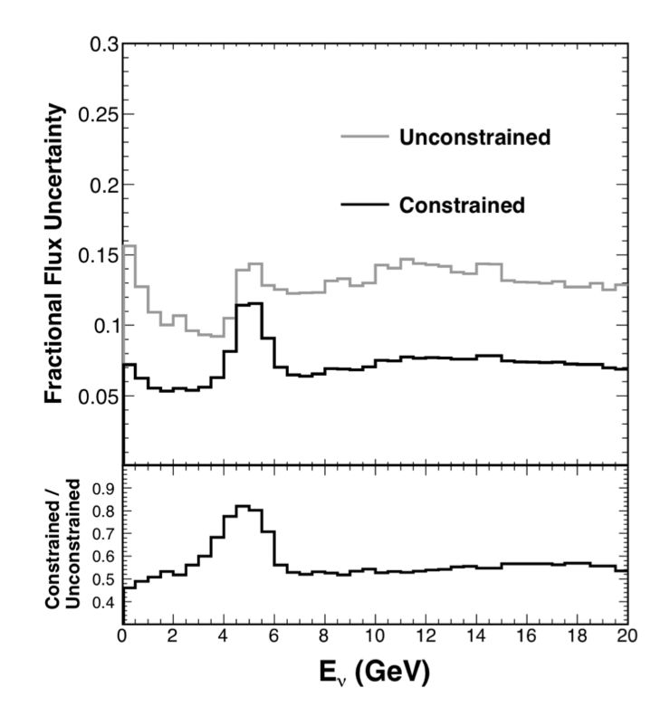
New Concepts: Beam
MINERvA has show a proof-of-concept analysis of this technique
Difficulty lies in separating events from intrinsic beam nue, tiny cross section
Future experiments thinking about ways to include this measurement in NDs

Slide 35
Conclusions
The difficulty of QCD modeling produces complex challenges for neutrino physics
The current generation of near detectors do a great job for their experiments
Novel techniques and analyses are needed to drive the next generation of experiments

