Slide 1

The ongoing evolution of Trigger Electronics
AT CMS
IOP 2019 – Imperial College London
Andrew W. Rose, Imperial College London
awr01@imperial.ac.uk

Slide 2
Science: The basics
Science is the art of knowing what to record, and when

Slide 3
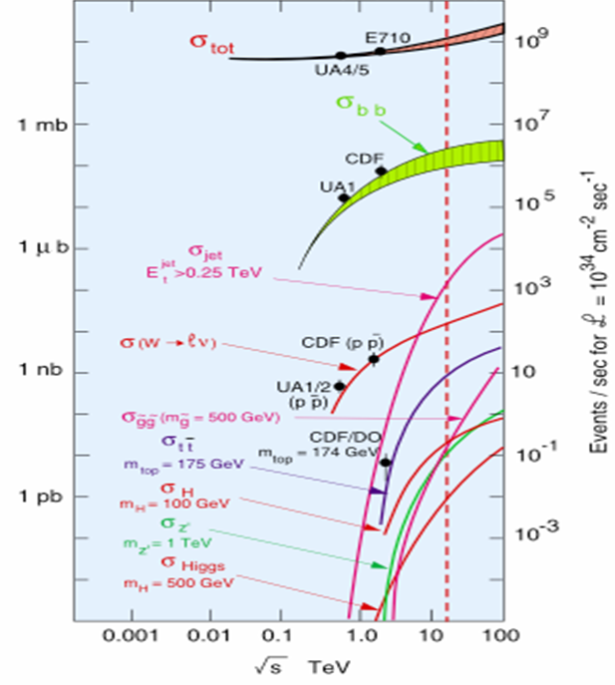
Science: The basics
Science is the art of knowing what to record, and when
With CMS & ATLAS in “discovery mode”, we care about the Higgs Boson or rarer
  Higgs Boson production is ten orders of magnitude below the total interaction rate
  That is a needle in a haystack the same mass as the
  Empire State Building
And we want statistics, a lot of statistics
Ten orders of magnitude

Slide 4
Unfortunately, Statistics requires data
The LHC’s 40MHz crossing rate and 10³⁴ cm⁻² s⁻¹ luminosity was chosen to provide
1 billion interactions per second
Unfortunately, 40MHz on a 70 million channel tracker produces the equivalent of 25Pbit/s of data
And 10³⁴ cm⁻² s⁻¹ luminosity produces ~25 times more background in your detector than signal, making selection tricky
  And every time the LHC improves its performance, this gets worse

Slide 5
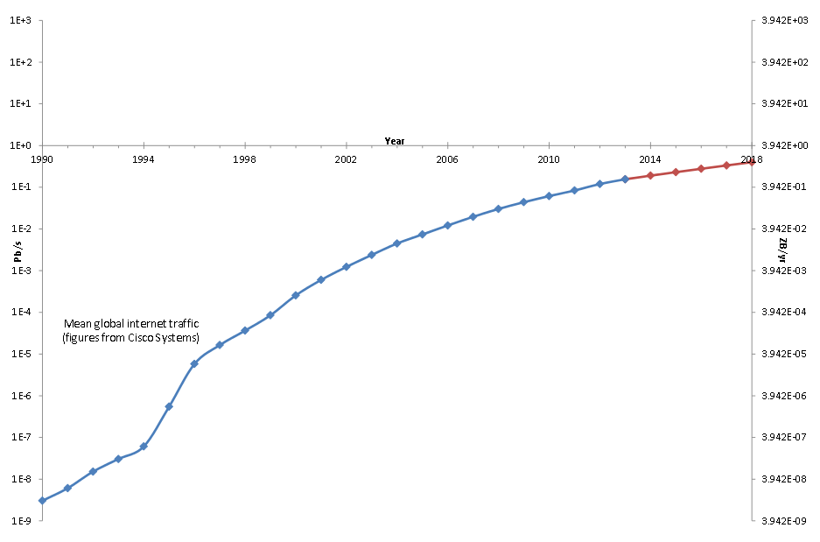
How much data???!
CMS Raw
CMS compressed
CMS tape-store

Slide 6
How much data???!
1,000,000,000× Home broadband
CMS Raw
CMS compressed
1,000,000×
Home broadband
1,000×
Home broadband
CMS tape-store
1×
Home broadband

Slide 7
Data-taking requirements
Basic requirements for data-taking systems
  Need high efficiency for selecting data for later analysis
  Need large reduction of rate from unwanted high-rate processes
  Needs to be robust for consistency of data
  Must be highly flexible to react to changing conditions
  Must be affordable

Slide 8
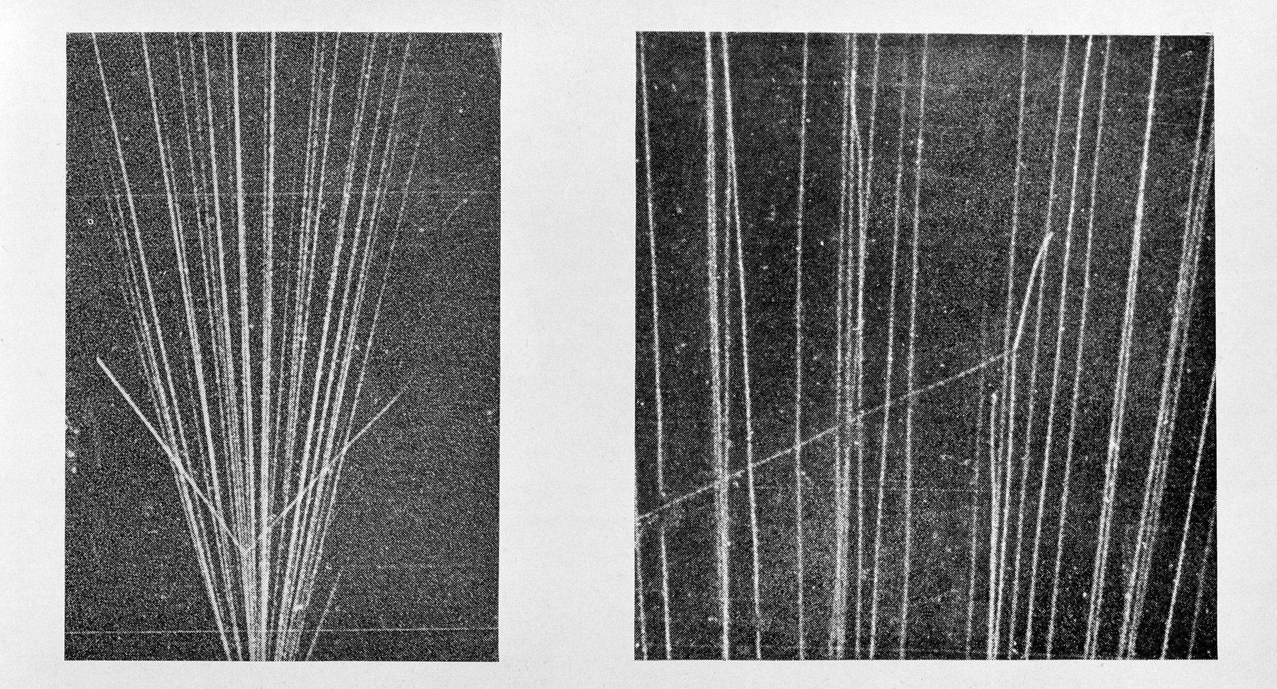
The earliest trigger
Cloud-chamber images recorded on film
Need some way to trigger the camera

Slide 9
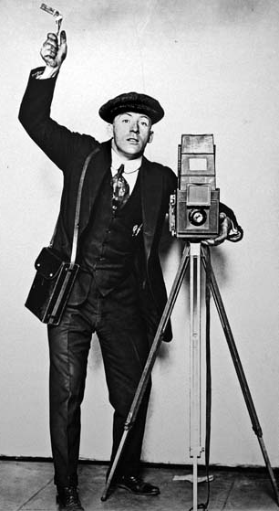
The earliest trigger
Grad student
Cloud-chamber images recorded on film
Need some way to trigger the camera
Not the best trigger system
  High efficiency
  Large rate reduction
  Robust
  Highly flexible
†Artist’s impression
Depends on the student

Slide 10

The earliest trigger
Grad student
Cloud-chamber images recorded on film
Need some way to trigger the camera
Not the best trigger system
  High efficiency
  Large rate reduction
  Robust
  Highly flexible
  Affordable
†Artist’s impression
Depends on the student
✓

Slide 11
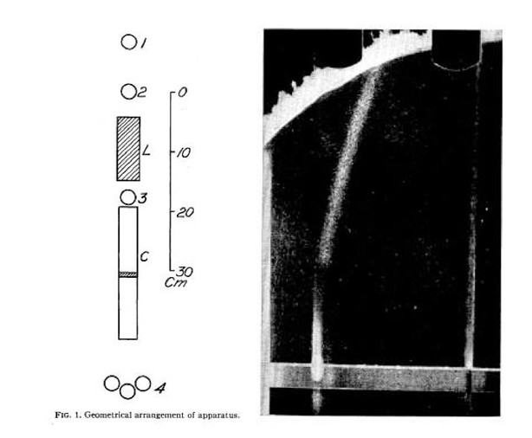
The earliest trigger
Blackett pioneered a technique to trigger the camera of cloud chambers (and got the Nobel prize for this and other work)
Just missed out on discovering the positron in 1932
Stevenson and Street used this to confirm the discovery of the muon in 1937

Slide 12
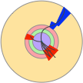
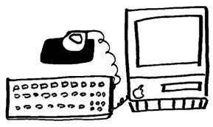

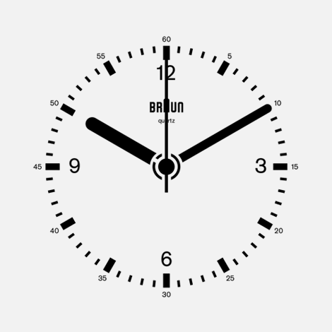
A Simple modern trigger system
LOGIC
Fast links
Trigger system
Accept
Storage
FE
FE
FE
AND
OR
NOT
FE
Front-Ends
ADCs
Digital delay
A PIPELINE
Mux

Slide 13
A Simple modern trigger system
Fast links
Trigger system
High event rate
Large data volume
Accept
Storage
FE
FE
Lower event rate
Smaller data volume (normally)
FE
FE
Front-Ends
ADCs
Digital delay
A PIPELINE
Mux

Slide 14
A simple modern trigger system
Fast links
Trigger system
Trigger system
Accept
Accept
Storage
FE
FE
FE
FE
Front-Ends
ADCs
Digital delay
A PIPELINE
Filter
Digital delay
A PIPELINE
Filter
Each successive layer doing increasingly complex operations on ever decreasing event rates

Slide 15


A simple modern trigger system
Fast links
Trigger system
Trigger system
Accept
Accept
Storage
FE
FE
FE
FE
Front-Ends
ADCs
Digital delay
A PIPELINE
Filter
RAM
Filter
If your input rate is low enough…

Slide 16
Of course, “Low Enough” is Relative
Fast links
Trigger system
Trigger system
Accept
Accept
Storage
FE
20 Tbit/s @ 40MHz event rate
~2,000,000 × Home Broadband
400 Gbit/s @ 100kHz event rate
~40,000 × Home Broadband
FE
FE
FE
Front-Ends
ADCs
Digital delay
A PIPELINE
Filter
RAM
Filter
CMS: Runs 1 & 2

Slide 17
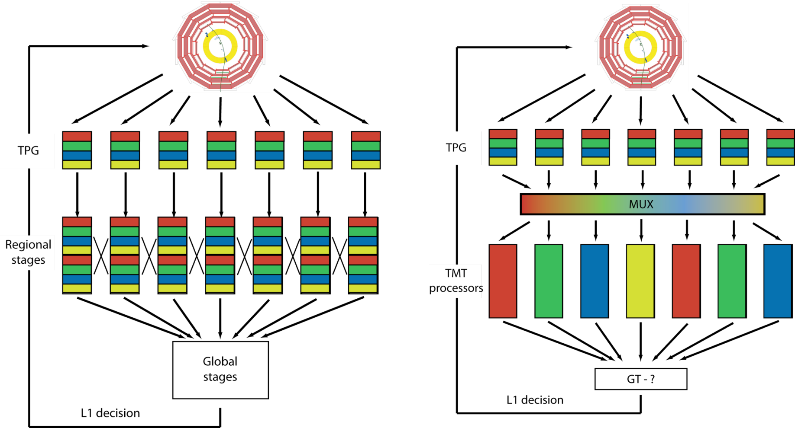
Conventional Architecture
Each subsystem is regionally segmented
  Each region must talk to its neighbour
Each region compresses, suppresses, summarizes or otherwise reduces its data and passes it on to the next level, which is less regionally segmented
Repeat until you have a global “yes/no” answer
Detector data ordering
Globally
laterally connected system

Slide 18
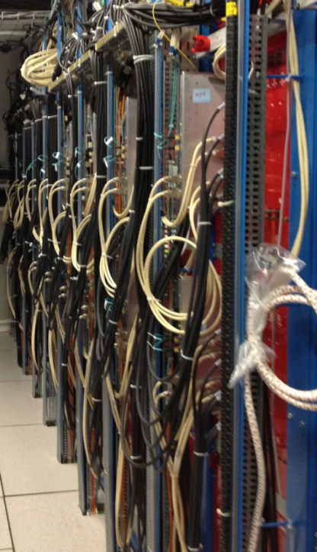
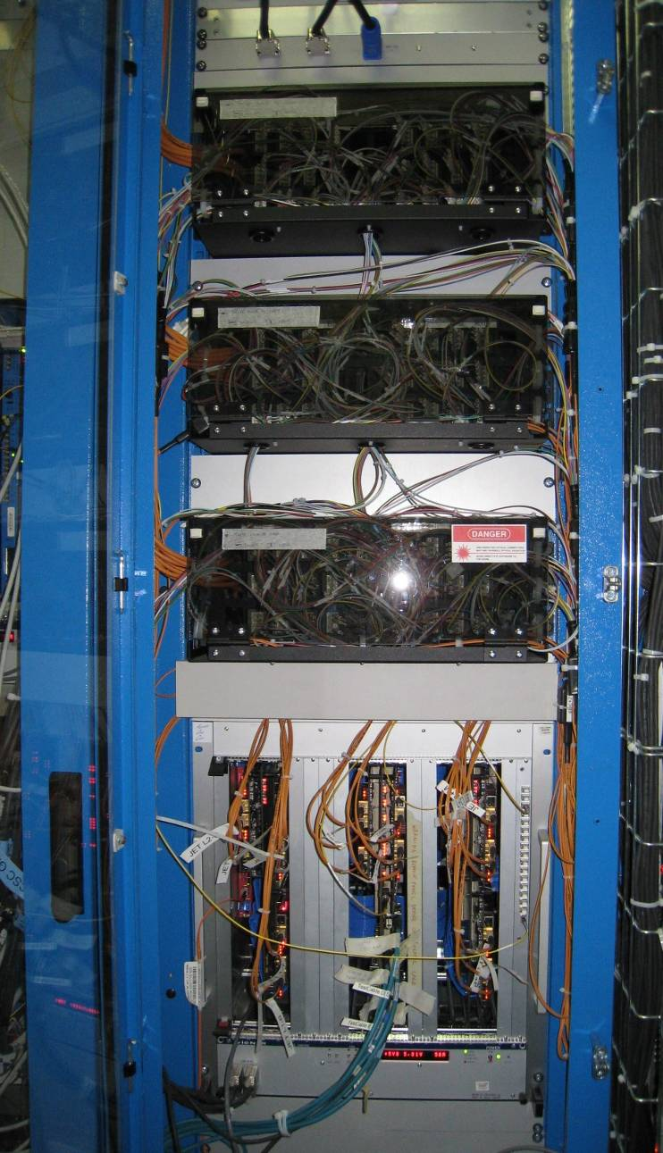
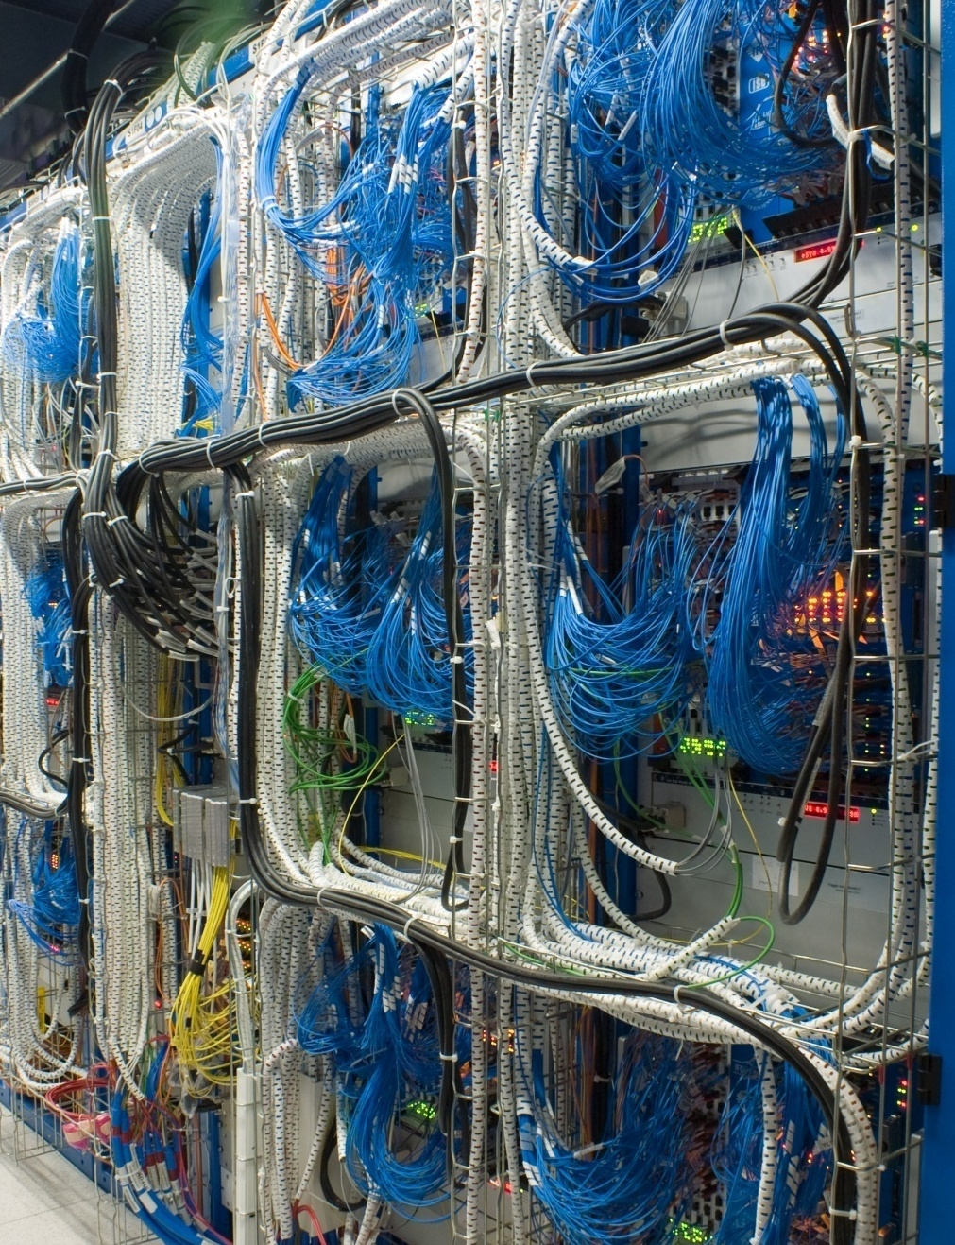
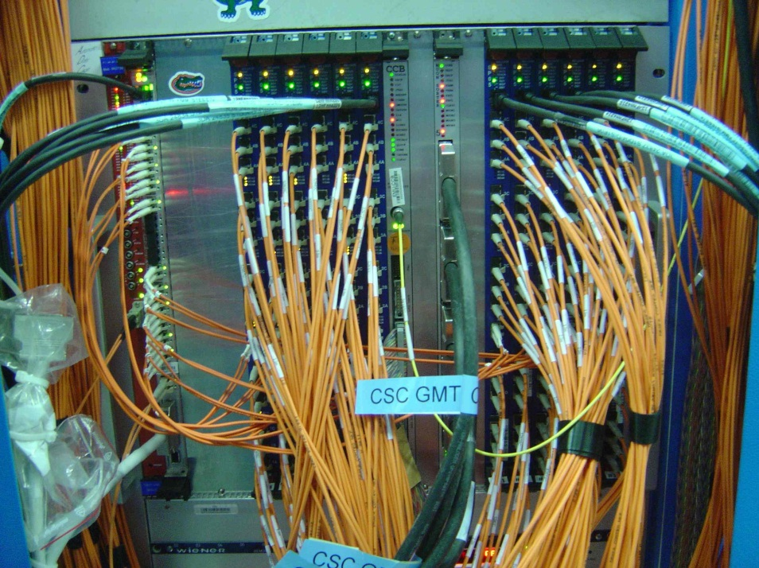
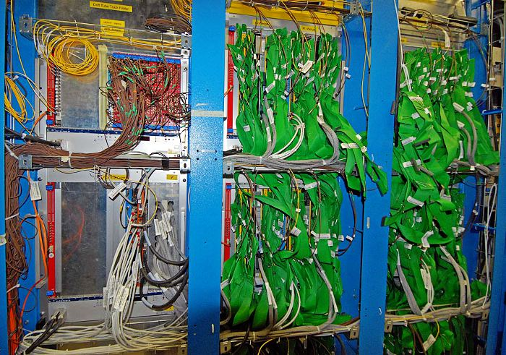
Runs 0 & 1: How we processed data

Slide 19
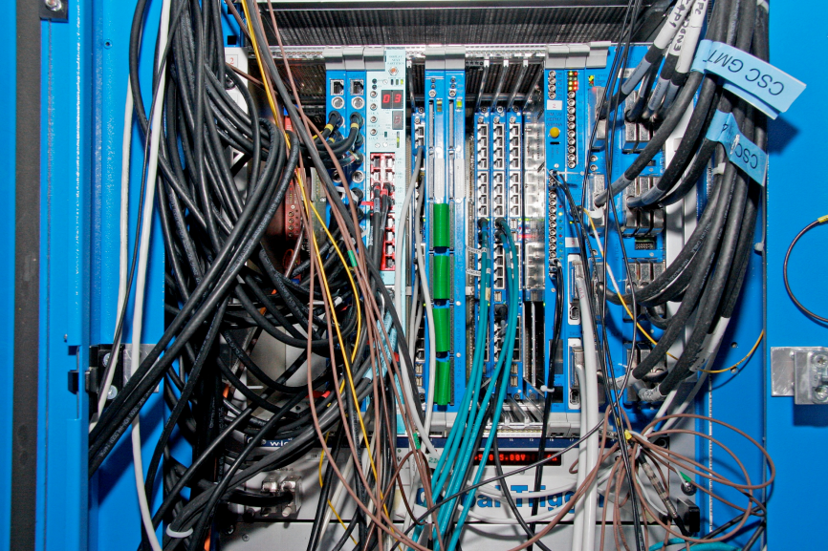
Runs 0 & 1: How we processed data

Slide 20
An Aside: The Prophetic Witticism
By 2015, every board in the [CMS] trigger will be identical and, after that, they will only get
more similar
Andy Rose, 2010

Slide 21
Why All the Different boards?
Each board had to perform a very specific task
  But there were many different board “flavours” with fully programmable logic
  Why?

Slide 22
Why All the Different boards?
Each board had to perform a very specific task
  But there were many different board “flavours” with fully programmable logic
  Why?
The “meaning” of regional segmentation is different for each system and it is boundary handling which results in different board flavours

Slide 23

Time-multiplexed Architecture
Buffer data and stream it out optimized for processing
Spread processing over time
  Stream-processing rather than combinatorial-logic
  Maximise reuse of logic resources
  Easiest for FPGA design tools to route and meet timing
Detector data ordering
Self-contained
event processing nodes

Slide 24
Why Time-multiplex?
Parallel processing is hard
  Parallel processing 20Tb/s with a 1μs latency limit is really hard
How you structure your data is the most important decision you will ever make
“The parallel approach to computing does require that some original thinking be done about numerical analysis and data management in order to secure efficient use. In an environment which has represented the absence of the need to think as the highest virtue this is a decided disadvantage.”
Daniel Slotnick, 1967
“I will, in fact, claim that the difference between a bad programmer and a good one is whether he considers his code or his data structures more important”
Linus Torvalds, 2006

Slide 25
Time-multiplexed Architecture
No longer required to throw away data at any given step
No lateral sharing, fully flow-forward
  Total equality of data
Each board now
  Receives parallel streams of data
  Processes parallel streams of data
  Outputs parallel streams of data
Detector data ordering
Self-contained
event processing nodes

Slide 26
The Prophetic Witticism
And if each board now
  Receives parallel streams of data
  Processes parallel streams of data
  Outputs parallel streams of data
Coupled with industry trends
The variation between boards disappears
  Hence the prophecy
PCB
Multi Gbit TX
Multi Gbit TX
Multi Gbit TX
RAM
RAM
Large FPGA
DAQ and Control interface
Powering,
etc.
Multi Gbit RX
Multi Gbit RX
Multi Gbit RX

Slide 27
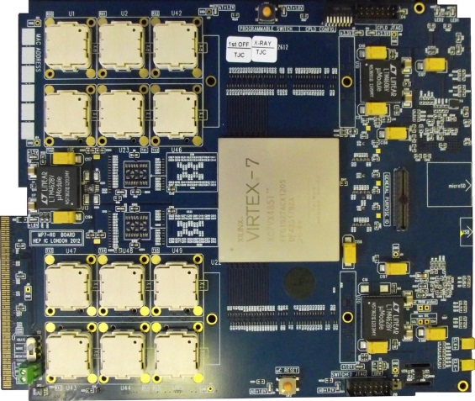
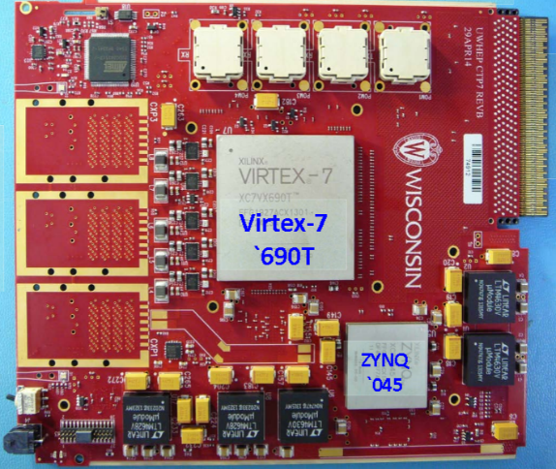
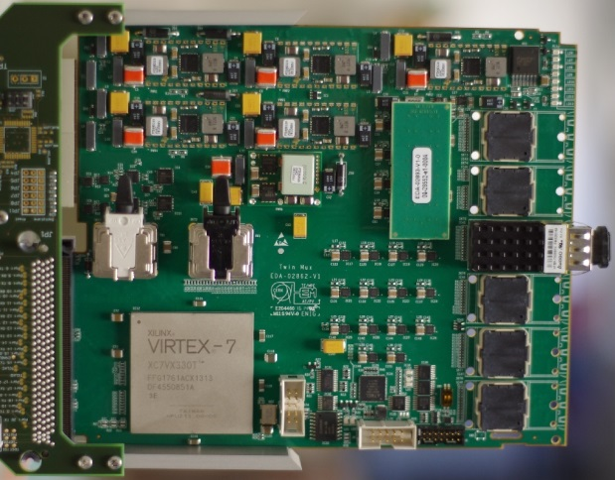

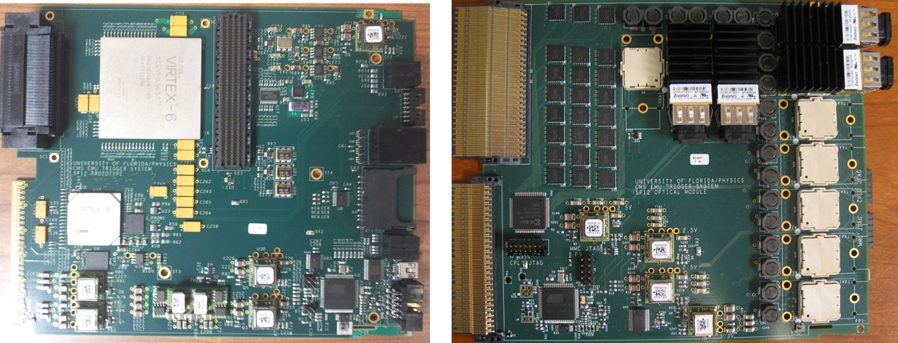
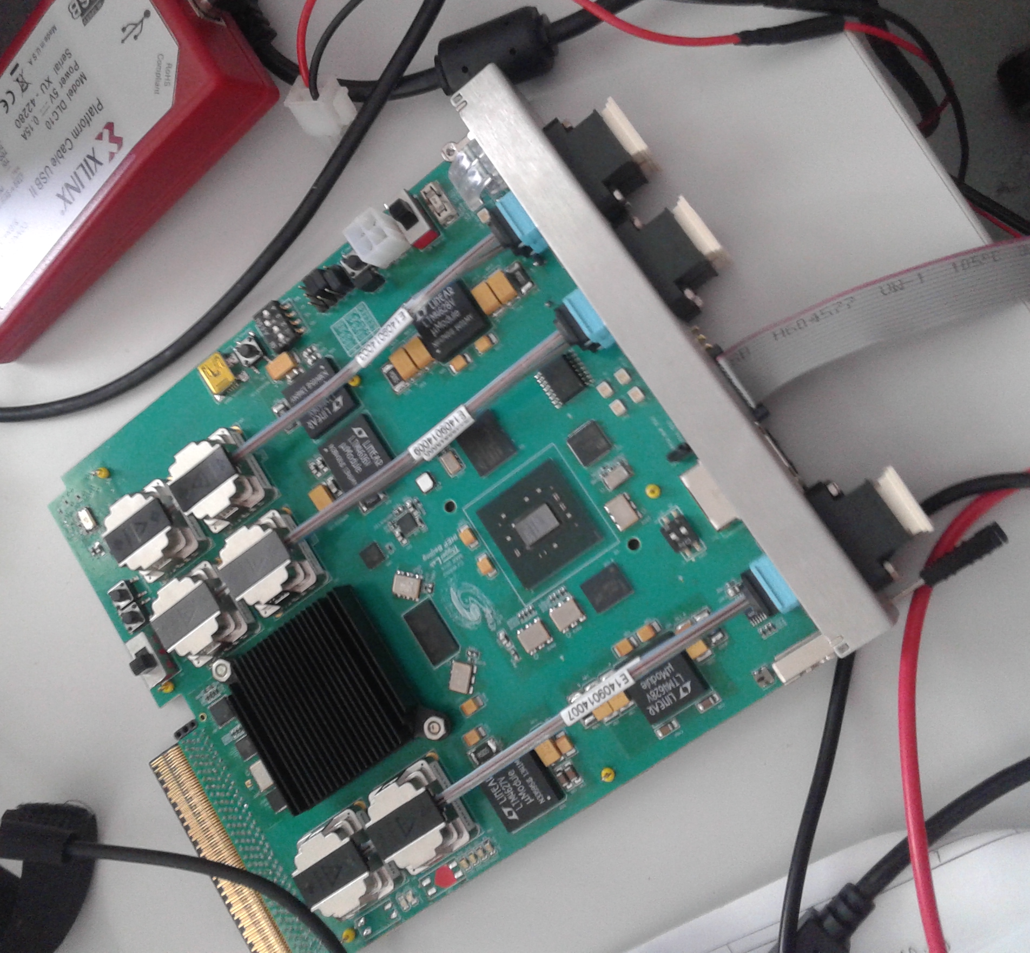
The Prophetic Witticism: 2015 upgrades
Avago Optics
Avago Optics
Avago Optics
Virtex-7 690T
Avago Optics
Avago Optics
Virtex-7 690T
CTP7
TwinMux
Avago Optics
Virtex-7 690T
Avago Optics
Virtex-7 690T
Avago Optics
MTF7
CPPF
(MTF6 shown)

Slide 28
And the similarity continues into the chip
SerDes & Buffers
Control
Payload
DAQ
SerDes & Buffers

Slide 29
And the similarity continues into the chip
Can separate the payload from the infrastructure by standardizing the interfaces
  A Firmware operating system!
Requires a build-tool to allow anyone to build their design in “unfamiliar hardware”
SerDes & Buffers
Control
Payload
DAQ
SerDes & Buffers

Slide 30
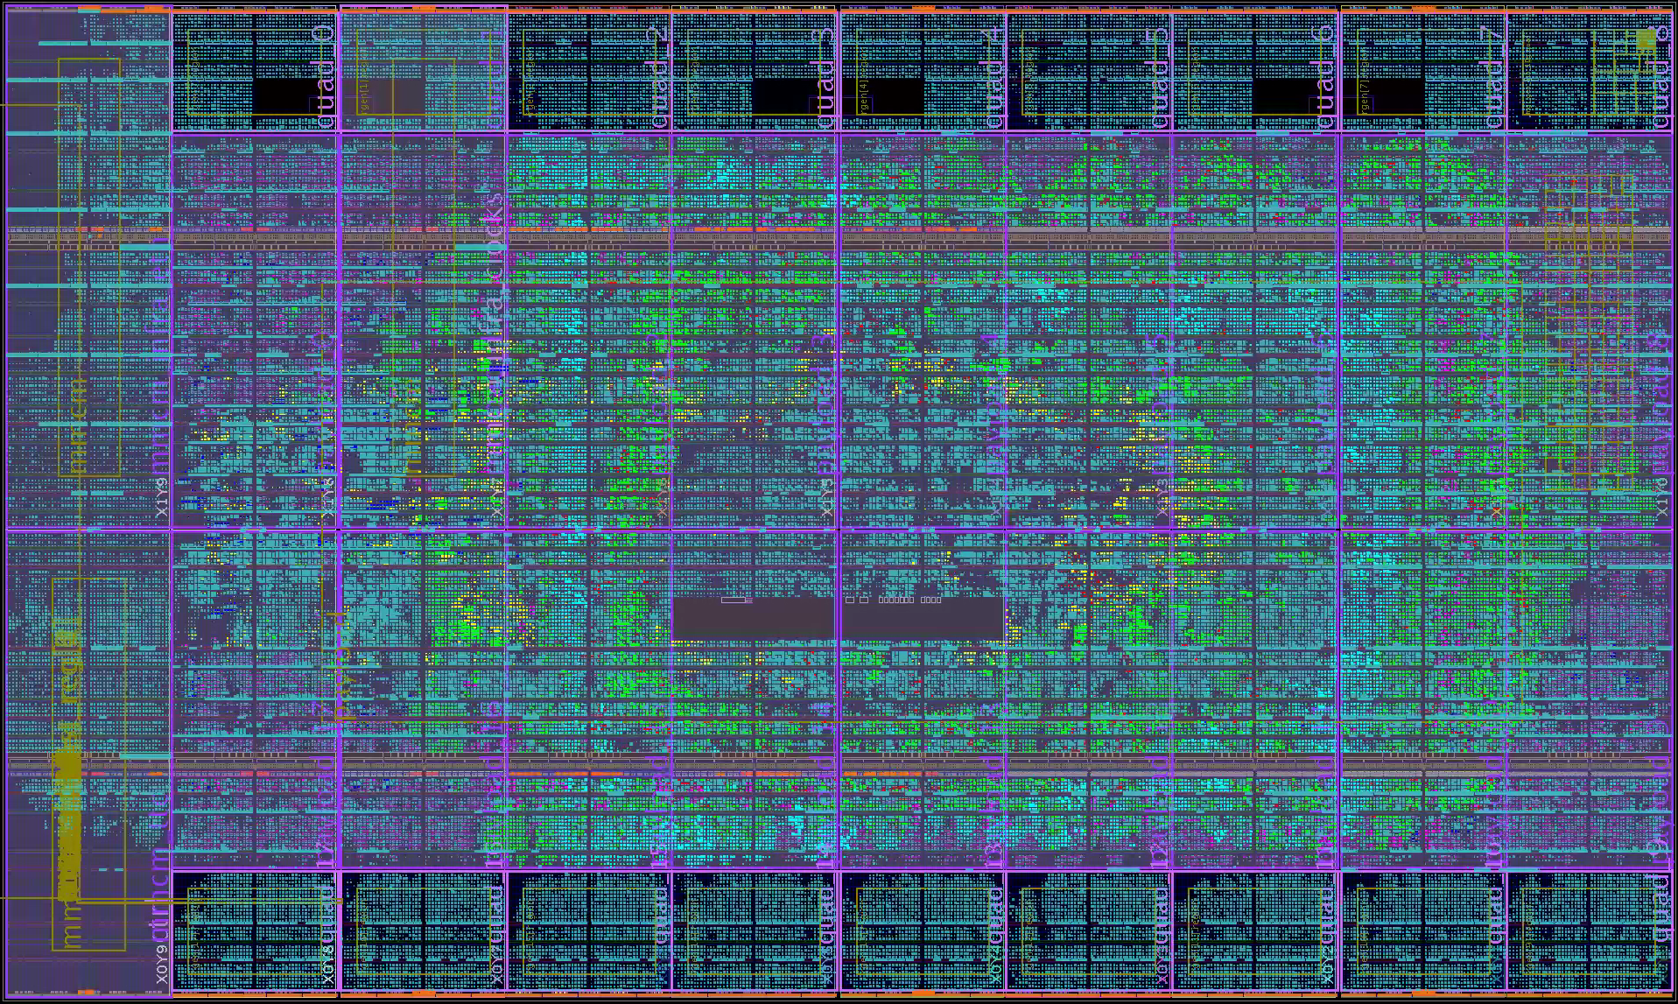
And the similarity continues into the chip
Can separate the payload from the infrastructure by standardizing the interfaces
  A Firmware operating system!
Requires a build-tool to allow anyone to build their design in “unfamiliar hardware”
User free to focus on the algorithms
SerDes and DAQ buffers
Communication
Algorithms
DAQ
SerDes and DAQ buffers

Slide 31
2015 upgrade: Conclusion
The UK-originated concepts of
  Time-multiplexing (& fully stream-oriented trigger processing)
  Generic hardware
  The “firmware operating system”
Have all been shown to provide enormous benefit and have gained traction in the CMS collaboration

Slide 32
Common X-ware: What Benefits?
Risk mitigated
  More time/resources to validate
  More users become experts – fewer critical people
Maximal reuse of software & firmware (Minimal reinvention of the wheel)
  More cost-effective
  More time to spend on “physics” algorithms
Common hardware is cheaper
  Fewer production runs
  Bulk buying (Bigger Pack – Better Value)

Slide 33
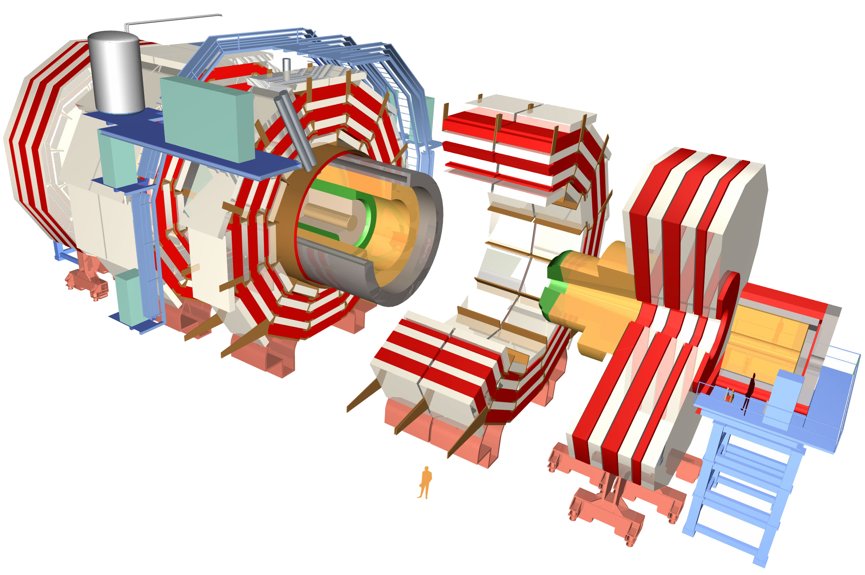
The CMS Detector after 2025
Full granularity Ecal included in trigger
New CSC electronics
New RPC/GEM layers
New pixel layers
Tracking included in trigger
Complete replacement of endcap Ecal & Hcal
30ps timing resolution
Replace HPD with SiPM in Barrel HCAL
Depth info into trigger
MIP timing layer
30ps timing resolution
Signal:Background becomes 1:200

Slide 34
The CMS Trigger System after 2025
Fast links
Trigger system
Trigger system
Accept
Accept
Storage
FE
300 Tbit/s @ 40MHz event rate
~30,000,000 × Home Broadband
FE
FE
FE
Front-Ends
ADCs
Digital delay
A PIPELINE
Filter
RAM
Filter
Signal:Background becomes 1:200

Slide 35
The CMS Detector after 2025: UK Roles
Full granularity Ecal included in trigger
New CSC electronics
New RPC/GEM layers
New pixel layers
Tracking included in trigger
Complete replacement of endcap Ecal & Hcal
30ps timing resolution
Replace HPD with SiPM in Barrel HCAL
Depth info into trigger
MIP timing layer
30ps timing resolution
L1 Trigger
Signal:Background becomes 1:200
Barrel muon electronics?

Slide 36
The CMS Detector after 2025: UK Roles
Full granularity Ecal included in trigger
Oh… and we are only 4 institutes
Putting our money where our mouth is:
A list of projects like that requires taking the
common X-ware concept to the extreme
New CSC electronics
New RPC/GEM layers
New pixel layers
Tracking included in trigger
Complete replacement of endcap Ecal & Hcal
30ps timing resolution
Replace HPD with SiPM in Barrel HCAL
Depth info into trigger
MIP timing layer
30ps timing resolution
L1 Trigger
Signal:Background becomes 1:200
Barrel muon electronics?

Slide 37
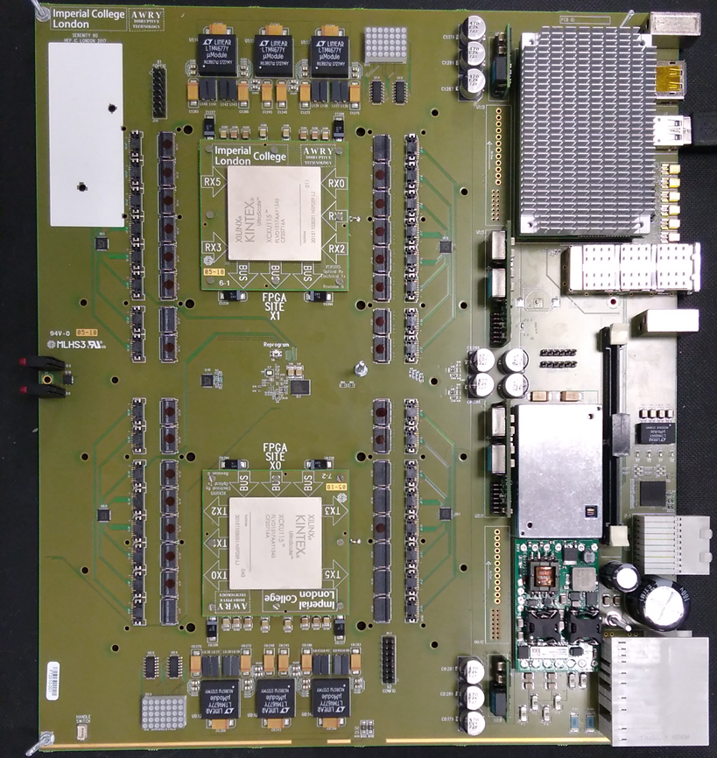
Common HW:
Serenity
ATCA Development Platform
Generic optical stream processor
  Up to 5.375 + 5.375 Tb/s Optical I/O
  Nothing specific to any subsystem
    In fact, nothing specific to CMS
Carrier Card provides board services
Daughter Cards host
data-processing FPGAs

Slide 38
Conclusion
Common Hardware, Software & Firmware has provided significant gains for 2015 upgrades of CMS
  The UK has been pivotal in moving the CMS off-detector electronics away from highly customized hardware towards a common X-ware
  These developments are also already providing benefits for other experiments
The triggering challenges posed by the 2025 upgrades are extreme
  Ad hoc approaches will fail, best-practice is not optional
  The common X-ware allows for more effort to be focused on the physics

Slide 39
Thanks For listening!
Any questions?

Slide 40
Spares

Slide 41
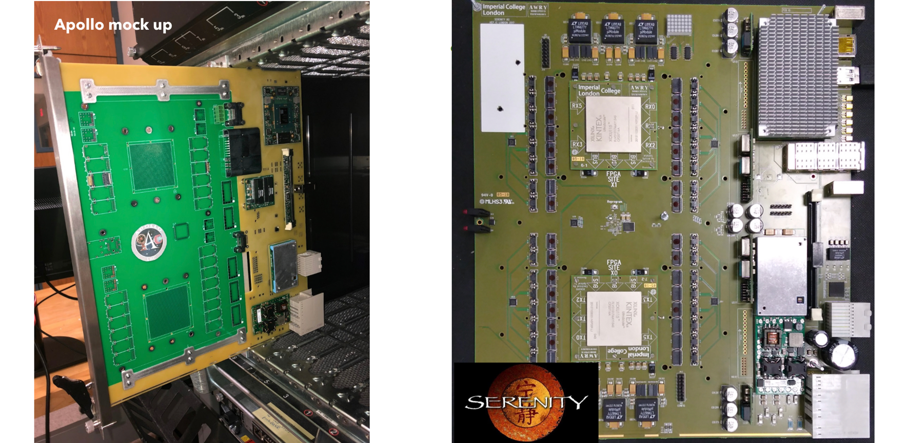
The Prophetic witticism: 2019

Slide 42
The tyranny of the links
$$N_{bits}= N_{links}×N_{channels/link}×Linespeed×ε_{encoding}×τ_{transmission}$$
Restricted by available space
Restricted by technology available
Restricted by only feasible architecture
Question:
So, what can you do?
Answer:
Chose the best available technology you can and then throw out as
much data as you can get away with until you satisfy your bit-limit
Imagine a “card” with 4 input links and up to 4 output links…

Slide 43
The conventional architecture
3
4
3
1
4
2
1
2
Thrown away enough data now!
3
4
3
1
4
2
1
2
3
4
3
1
4
2
1
2
3
4
3
1
4
2
1
2
4
4
1
2
1
2
3
3
3
4
4
1
2
1
2
3
3
4
3
1
4
2
1
2
BX:1
BX:2
BX:3
BX:4
3
4
4
1
2
1
2
3

Slide 44

Can the tyranny be broken?
$$N_{bits}= N_{cables}×N_{channels/cable}×Linespeed×ε_{encoding}×τ_{transmission}$$
Restricted by available space
Restricted by technology available
Restricted by only feasible architecture
Maybe it’s time to start questioning the received wisdom…
Can we increase $τ_{transmission}$?
This requires a completely new architecture
In order that every BX is processed, we require as many processing “nodes” as the number of bunch-crossings the data is transmitted over
Imagine a “card” with 4 input links and up to 4 output links…

Slide 45
The time-multiplexed architecture
Well… this doesn’t look like a great start – but we’ll come back to it in a minute…

Slide 46
The time-multiplexed architecture
1
5
1
5
1
5
1
5
All data for 1bx from all regions in a single card!
Everything you need!
1
6
6
6
6
2
2
2
2
7
7
7
7
3
3
3
3
4
4
4
4
1
5
1
5
1
5
1
5
2
All data for 1bx from all regions in a single card!
Everything you need!
6
2
6
6
6
2
2
2
7
3
7
3
7
7
3
3
4
4
4
4
1
5
1
5
1
5
1
5
All data for 1bx from all regions in a single card!
Everything you need!
6
6
2
2
6
6
2
2
7
7
3
3
7
7
3
3
4
4
4
4
1
5
1
5
1
1
5
5
6
6
6
6
2
2
2
2
BX:6
BX:1
BX:2
BX:3
BX:4
BX:5
BX:7
7
7
7
7
3
3
3
3
4
4
4
4
46

Slide 47
Three neat time-multiplexing tricks
Within a TM node, can daisy-chain physical boards/FPGAs with enormous bandwidth

Slide 48
Three neat time-multiplexing tricks
Same daisy-chaining technique applies equally when combining multiple systems with the same time-multiplexing period

Slide 49
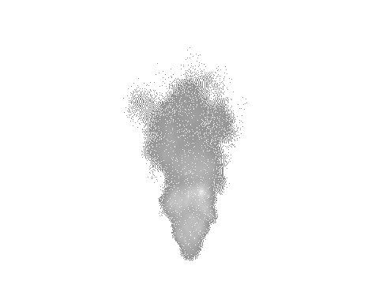
Three neat time-multiplexing tricks
Imagine a system with N nodes
We lose a node due to hardware failure
  In a conventional trigger losing a board means degrading (or losing!) every event!
  With TM, we lose 1 BX in N – a (inadvertent) trigger prescale!
But we have a final card up our sleeve!
For an additional 1/Nth of the cost we can have a spare node which we can switch in at run-time
  Efficiency restored!

Slide 50
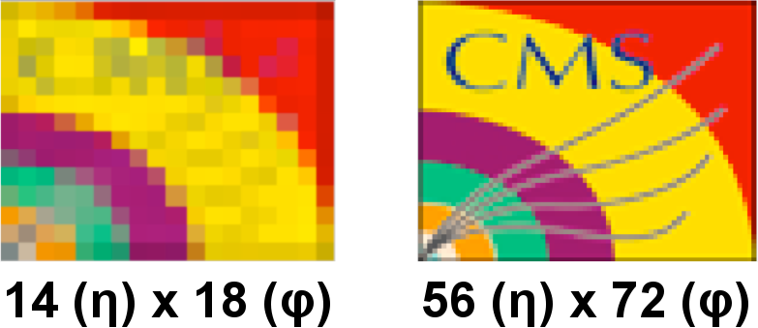
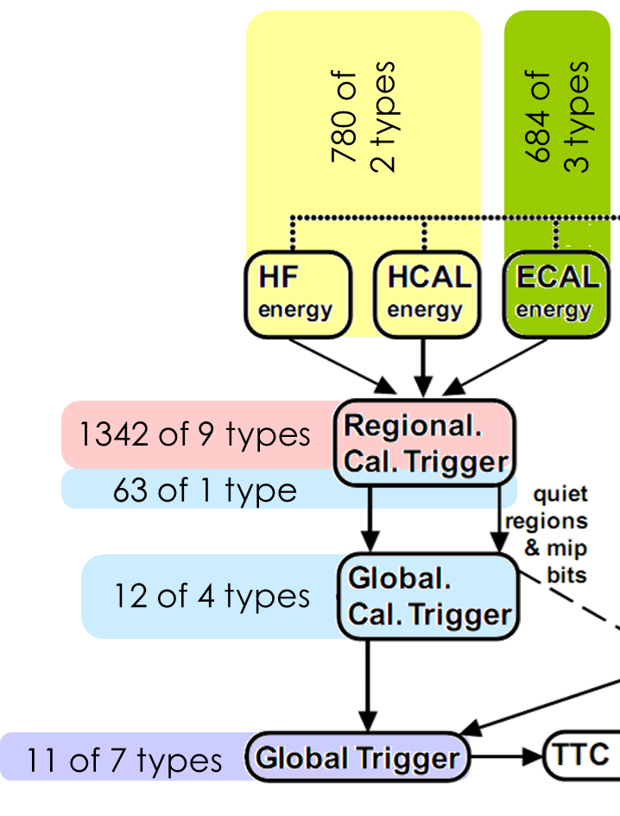
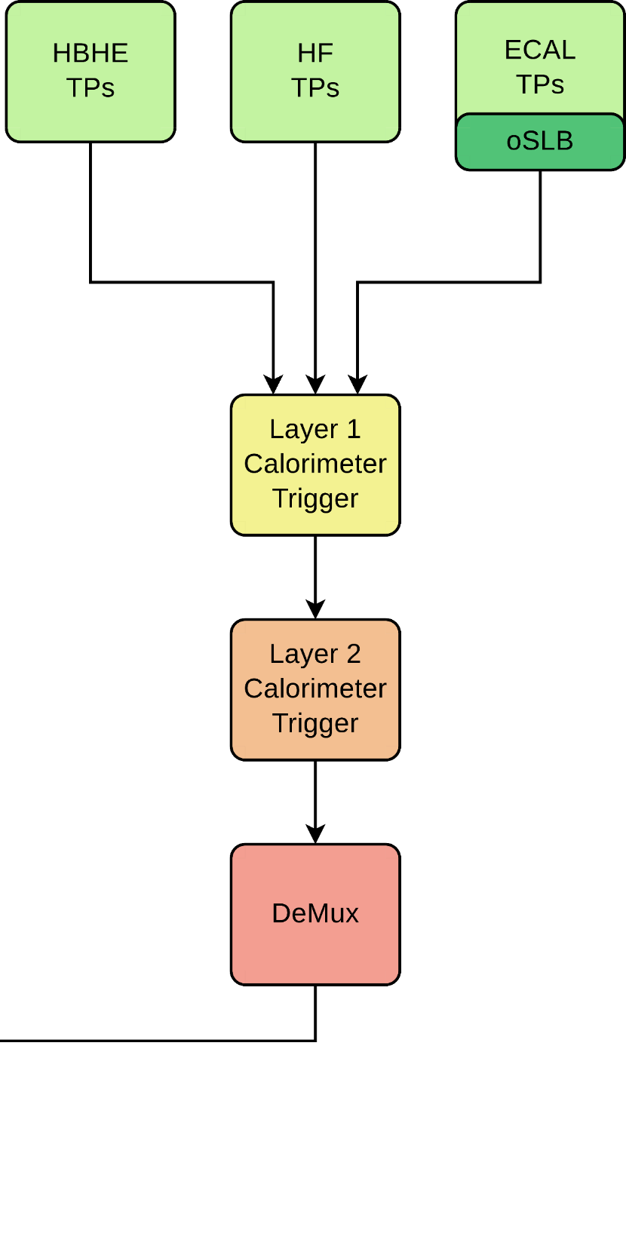
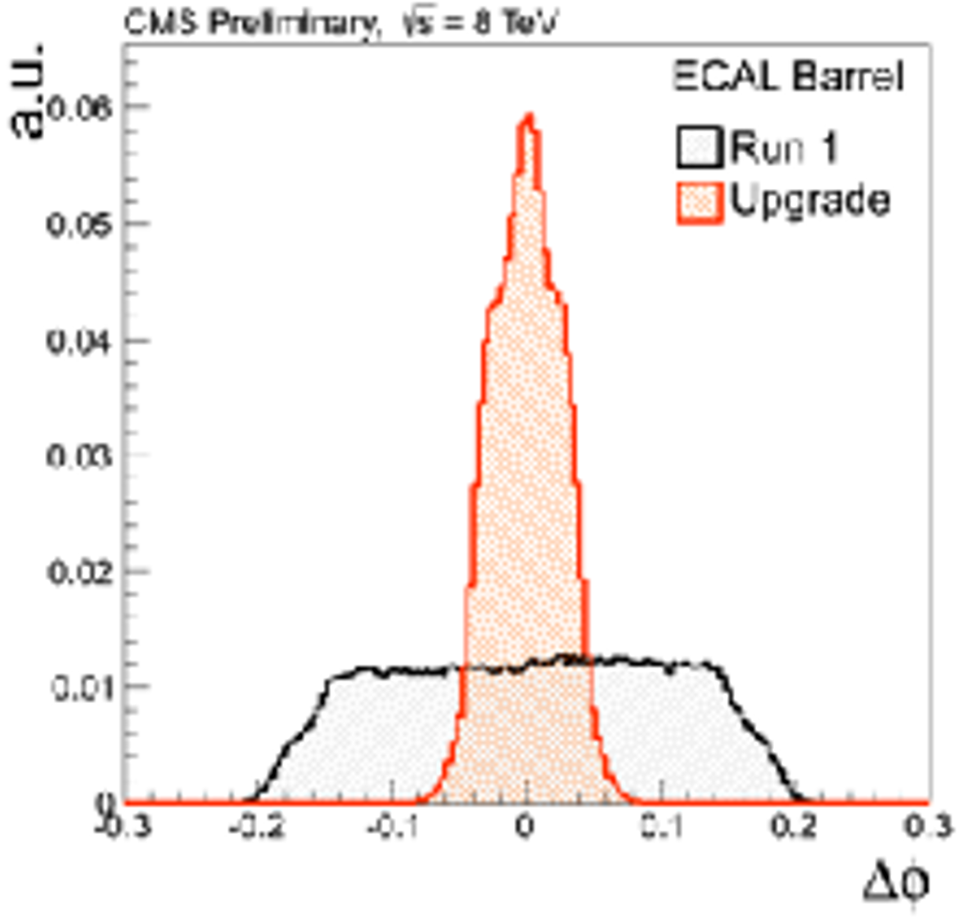
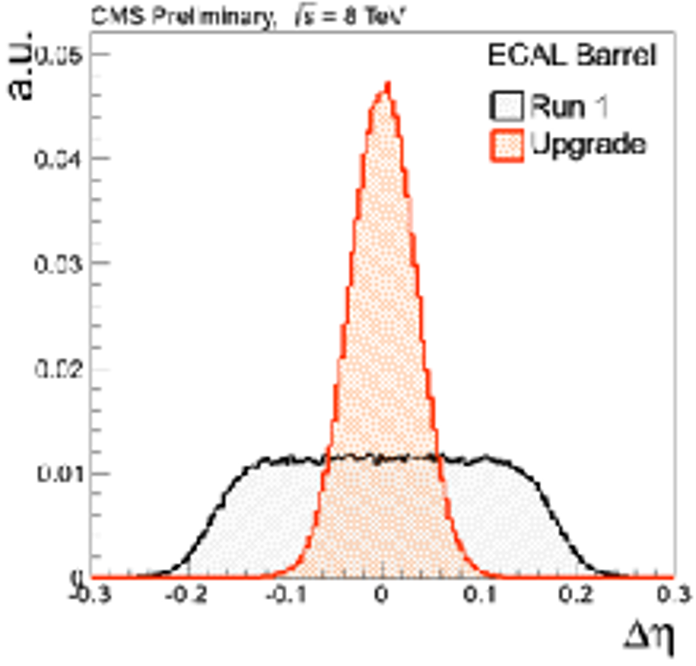
Does TM actually work?
Run 0
Run 1
18 of 1 type
9 of 1 type

Slide 51
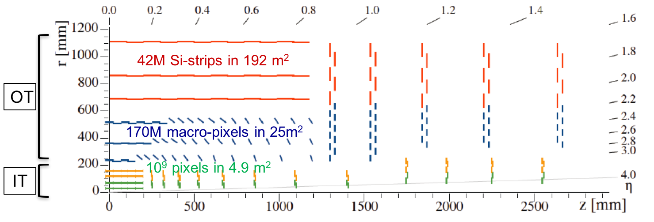
Tracker
Inner Tracker (pixel) design to extend coverage to η ≃ 3.8
OT Si-sensors ≃ 200µm thick - 90/100µm pitch - 2.5/5cm strips
OT Si-sensors ≃ 200µm thick - 90/100µm pitch - 1.5 mm macro-pixels
IT Si-silicon sensors ≤ 150µm thickness - 50x50 to 25x100µm²

Slide 52
Tracker
Inner Tracker (pixel) design to extend coverage to η ≃ 3.8
Outer Tracker design driven by ability to provide tracks at 40 MHz to L1-trigger
-

Slide 53
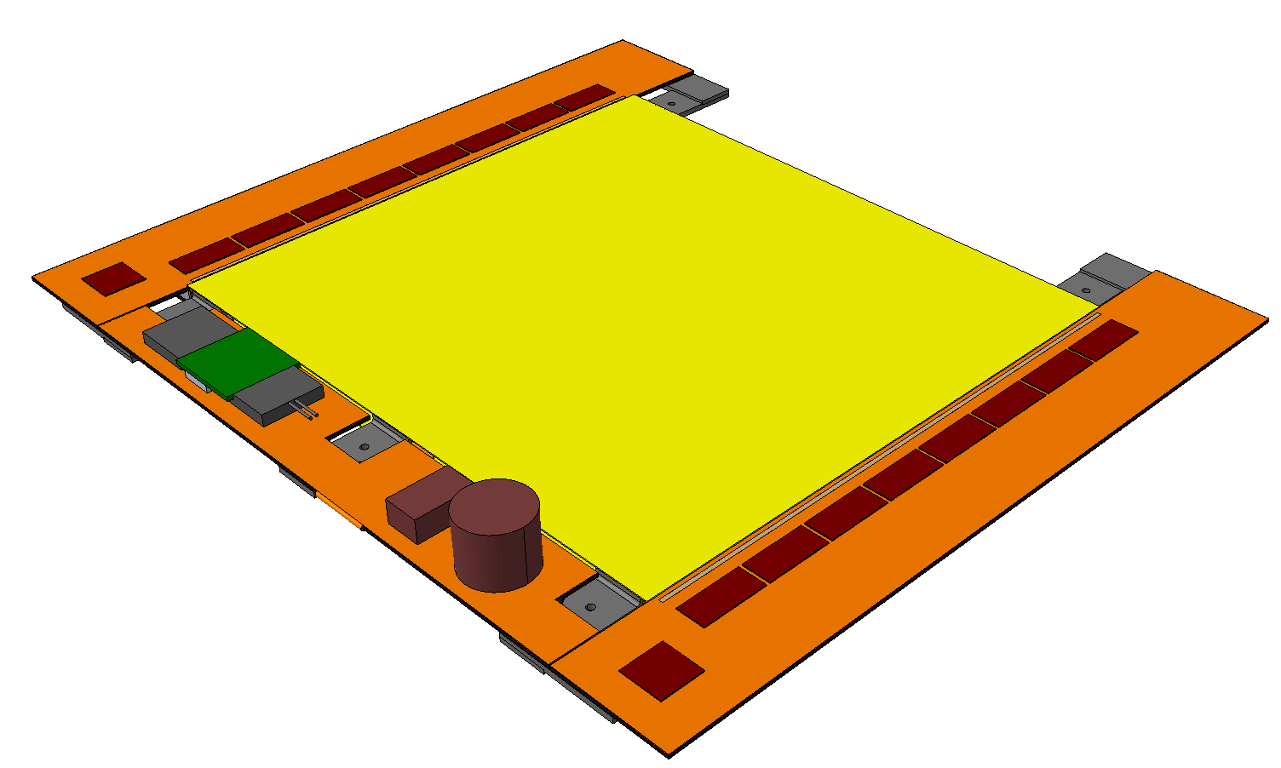
Outer tracker 2S modules
Silicon sensors
CBC
Flex PCB Hybrid
Outer
½ Module
Front End
Hybrid
Inner
Bridge
CF Stiffener
500µm CF Support
Double-Layer
Si Strip Detectors
2S Modules: Two-strip double-layers
~10k modules
42M channels
LP-GBT &
Optical VTRx
10 cm
Each 2S Module:
Sensor Area ~100 cm²
16 CBCs, each reading 254 strips
(127 from top & bottom sensors)
4064 Channels in total
Readout both L1 triggered data & Primitive trigger data
5 cm
127 Strips/CBC
~5,000 modules @ 10Gb/s
+ ~10,000 modules @ 5Gb/s
= 100Tb/s = 394 EB/yr
8 CBCs per side
DC-DC
Converter
IC & RAL
CIC
1 per side
Service Hybrid

Slide 54
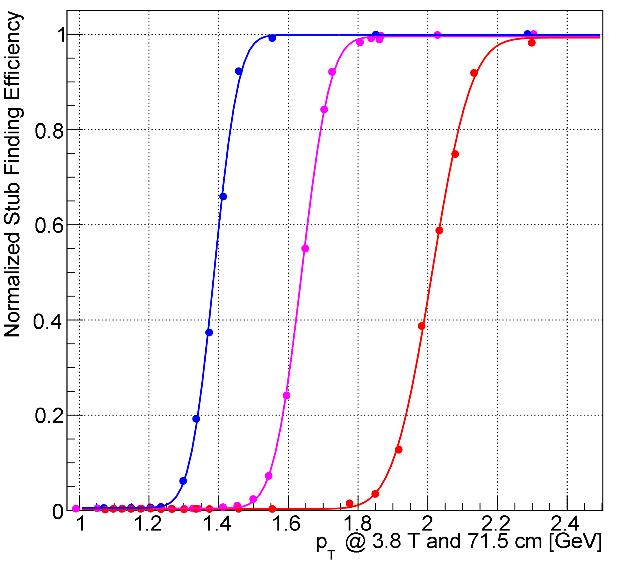
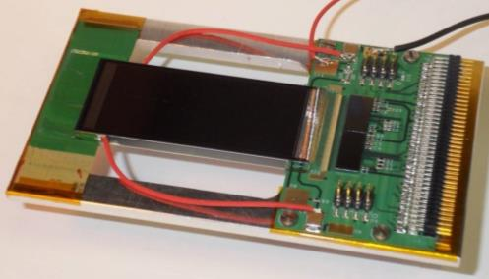
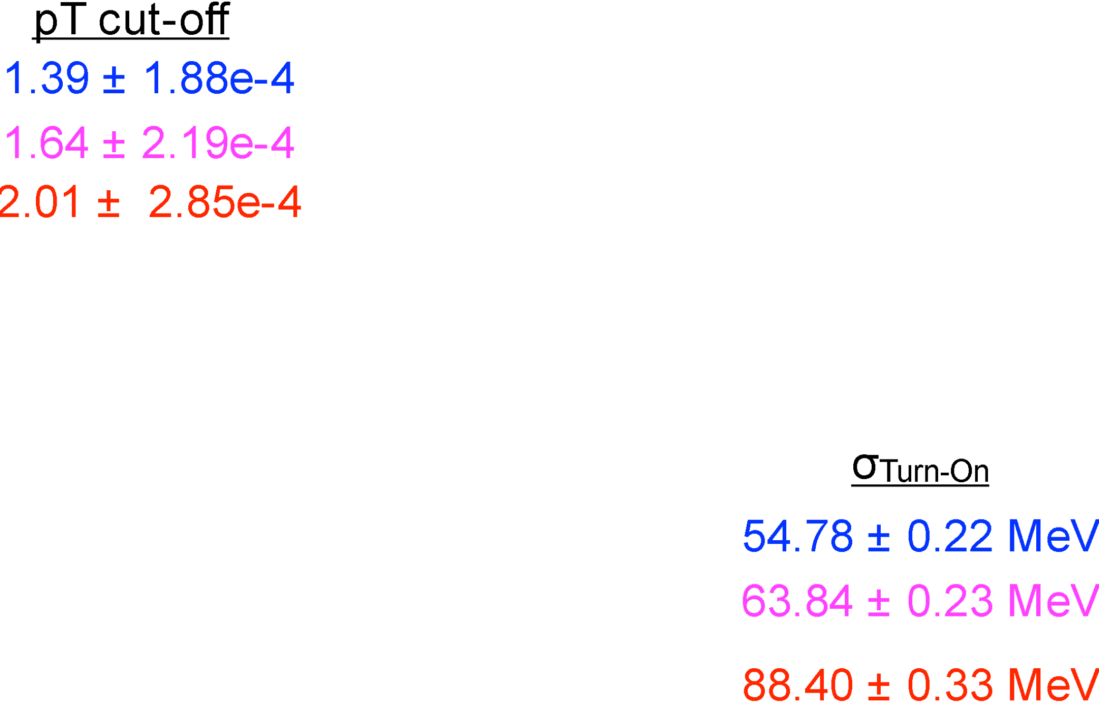
Outer tracker 2S modules: Do they work?
Stub turn-on curve for 2CBC mini-module at FNAL test-beam
Upper Sensor
2× CBC2
Lower Sensor

Slide 55
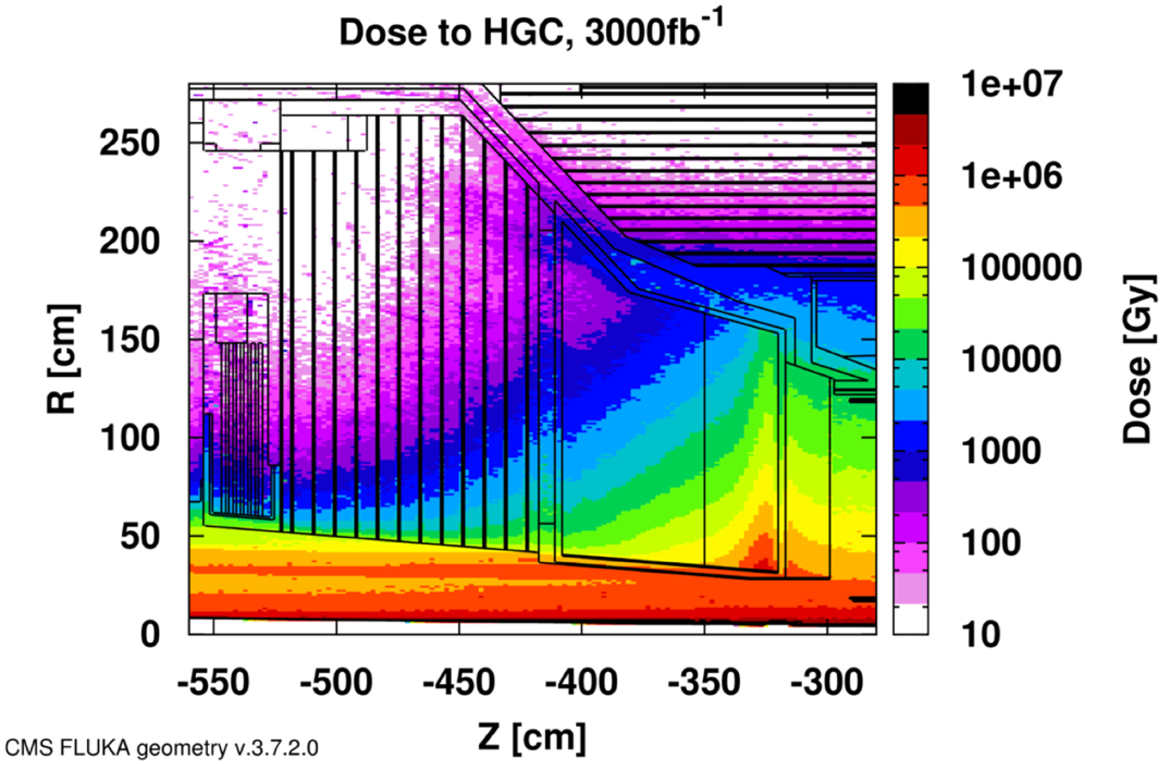

Calorimeter Endcap design
3D shower topology and time resolution of ~30ps
Electromagnetic Endcap (EE)
  28 layers of Silicon sensors in W/Pb absorber (25 X₀, 1.7λ)
Hadronic Endcap (EH)
  24 layers: 8 silicon + 16 silicon/scint. tiles at high/low η in stainless steel absorber (9λ)
253 tonnes
Total power at end of life = 160-180 kW @-30C
520m² Scint. Tiles
2x2 and 5x5 cm² + SiPM
~400k channels
Facing a MegaGray Dose
10¹⁶ cm⁻² 1MeV Neutron equivalent fluence
600 m², 25000 modules , of hexagonal 8” sensors
~6M channels of area 0.5 and 1 cm²

Slide 56
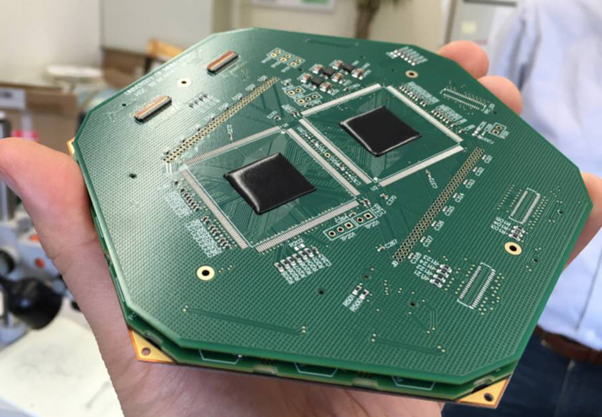
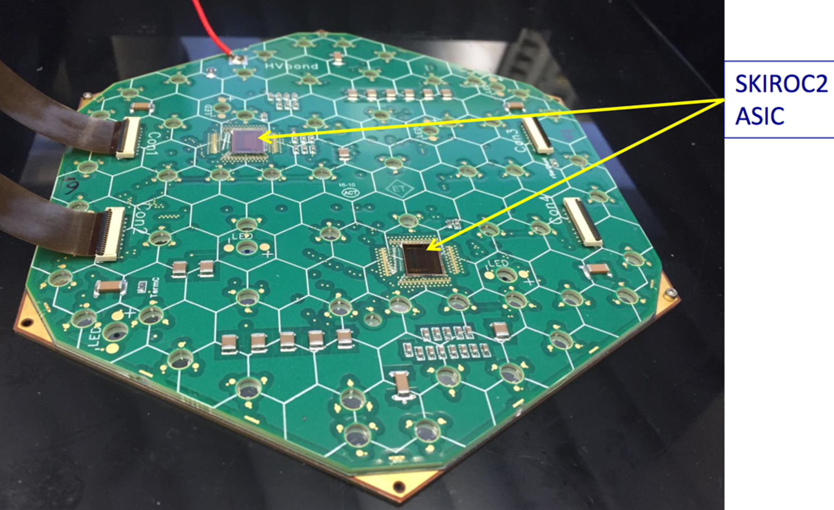
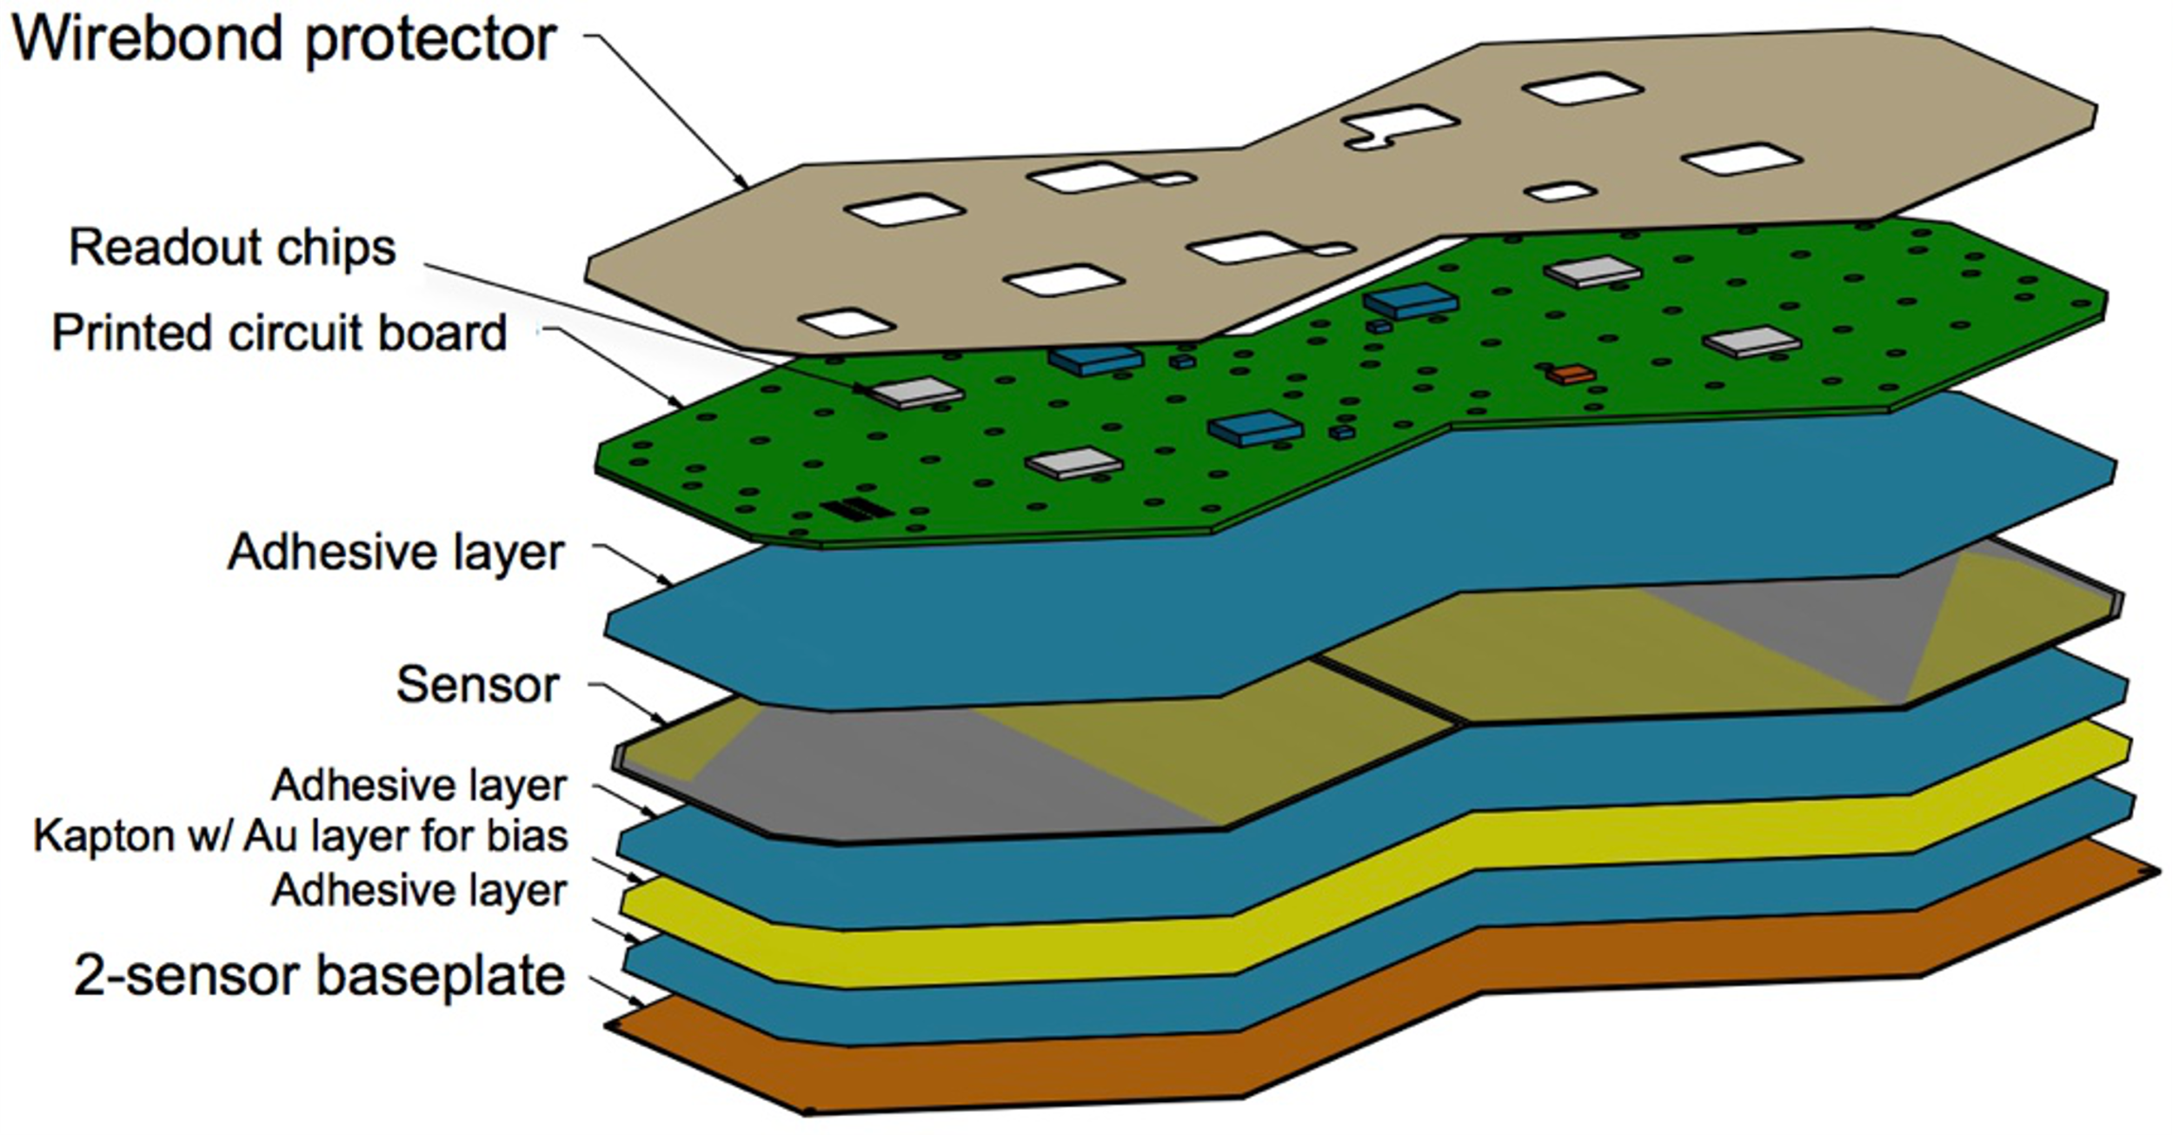
Calorimeter Endcap modules
593 m2 of silicon
6M ch, 0.5 or 1 cm2 cell-size
21,660 modules (8” or 2x6” sensors)
92,000 front-end ASICS
7,500 modules @ 10Gb/s = 75Tb/s ≈ 300 EB/yr
(Trigger data only, L1 accepted data on separate fibres)

Slide 57
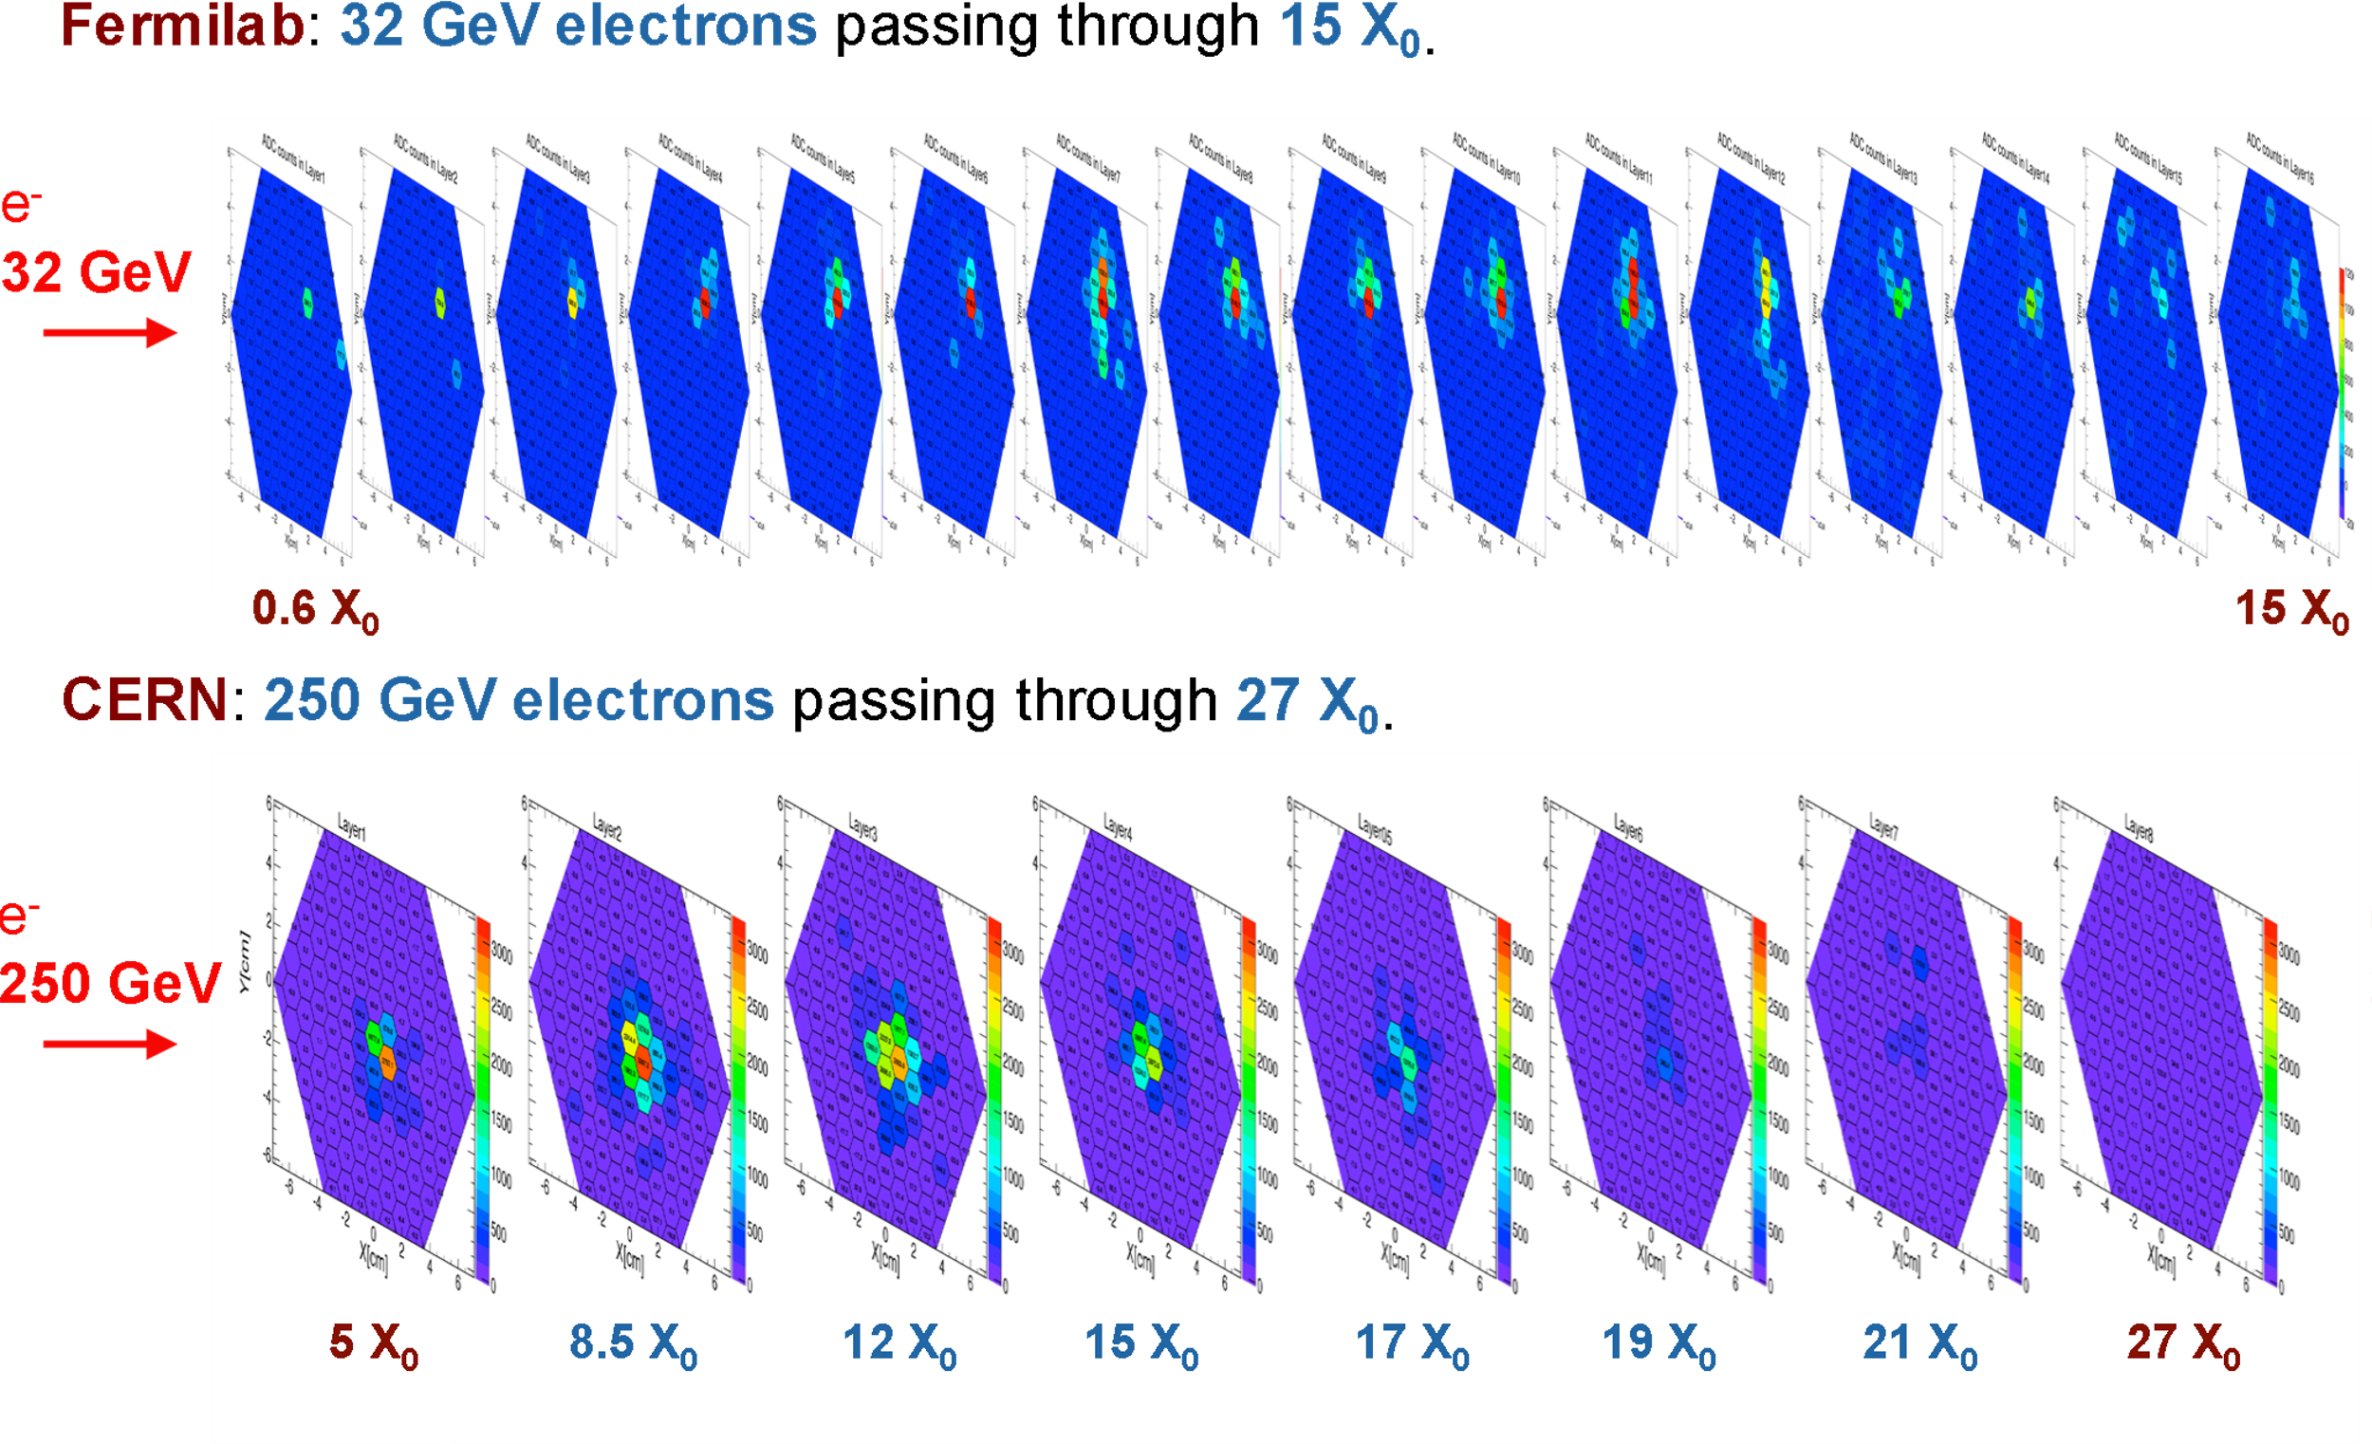
Calorimeter Endcap modules: Do they work?

Slide 58
What are the firmware challenges at Phase-II?
You mean, apart from the small matter of 300Tb/s of data?
So much data it has to be zero-suppressed
  No (or, at least, limited) geometric timing which can be utilized
  Variable data-volume
    Do you handle the worst case? Very inefficient
    Do you handle the average? How do you handle overflows?
We did such a good job at Phase-I, people have very high expectations…

Slide 59
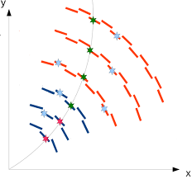
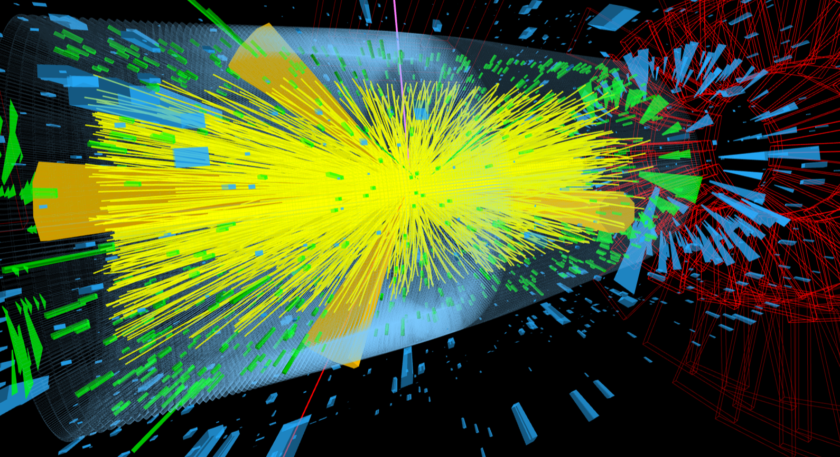
What are the firmware challenges at Phase-II?
Real-time track-finding and fitting

Slide 60
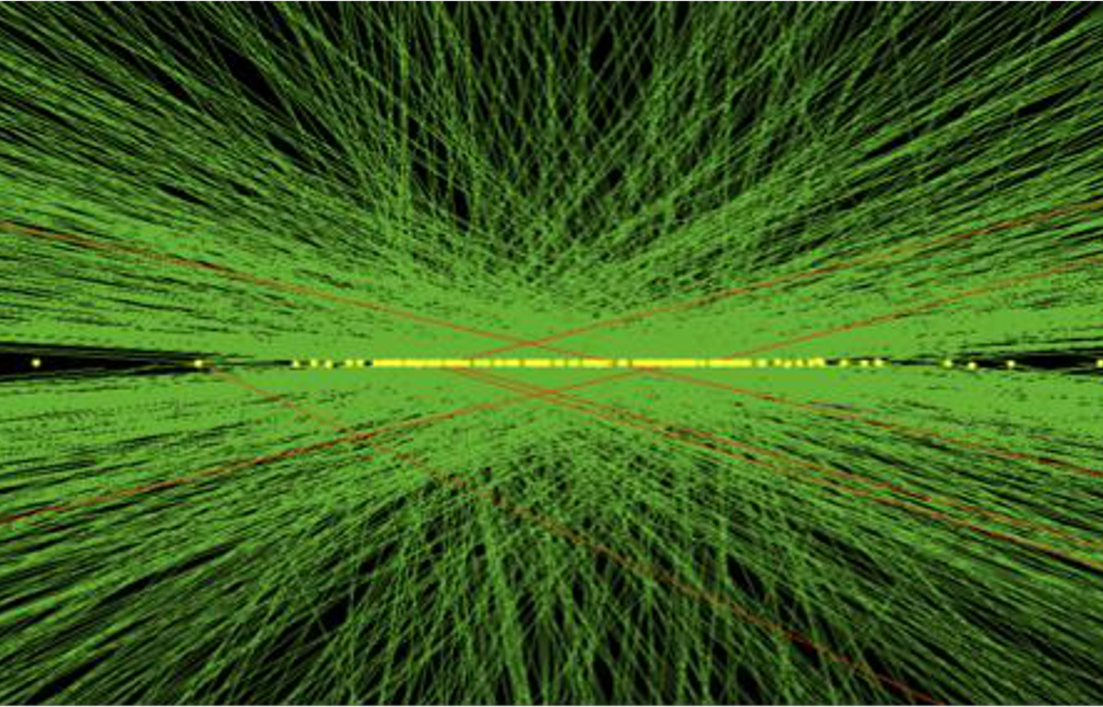
What are the firmware challenges at Phase-II?
Real-time track-finding and fitting
Real-time vertex-finding

Slide 61
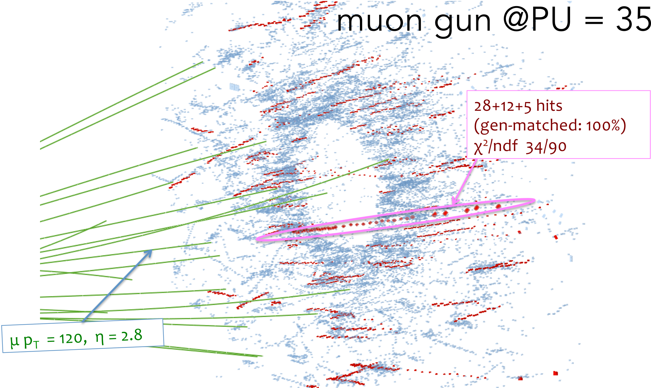
What are the firmware challenges at Phase-II?
Real-time track-finding and fitting
Real-time vertex-finding
3D cluster-finding in endcap

Slide 62
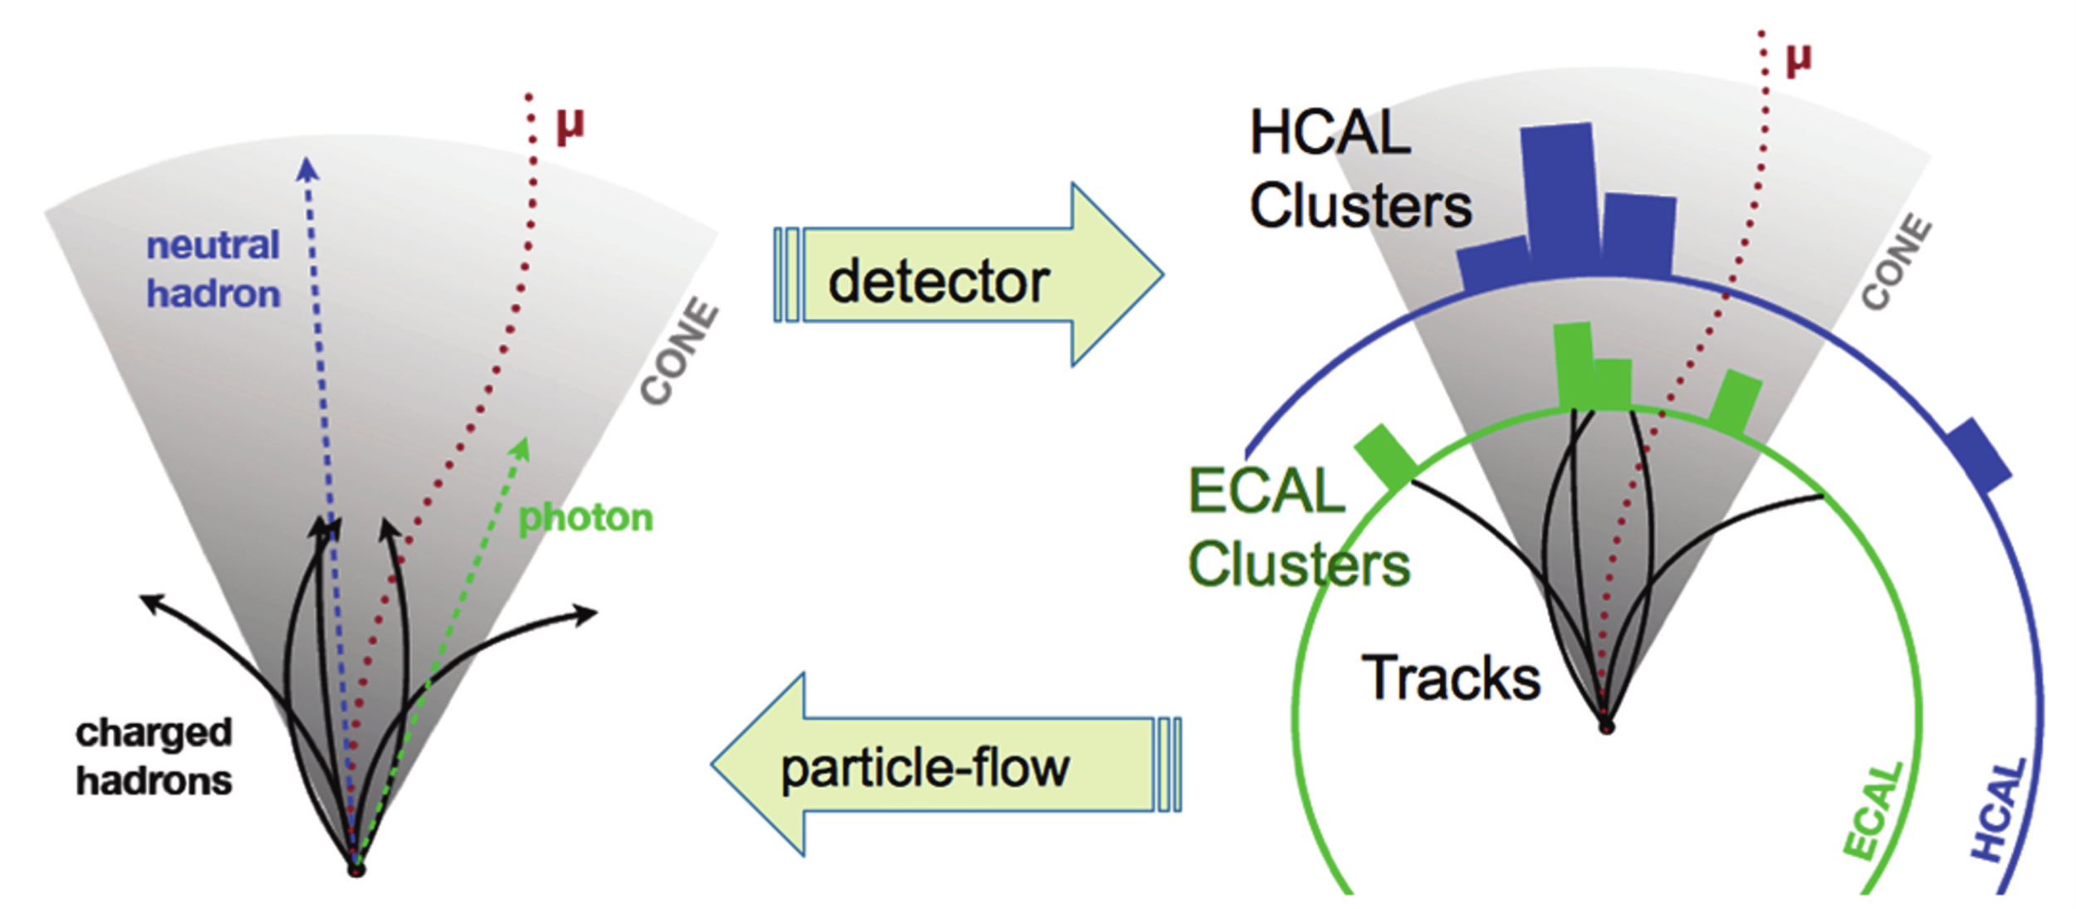
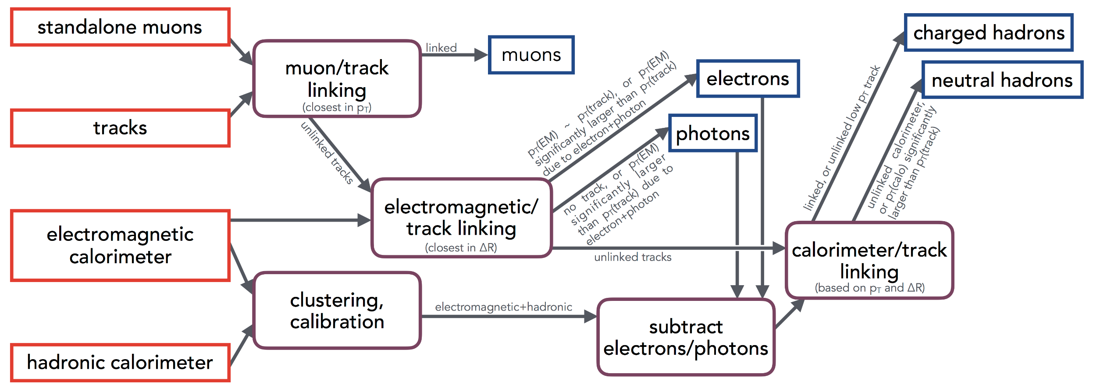
What are the firmware challenges at Phase-II?
Real-time track-finding and fitting
Real-time vertex-finding
3D cluster-finding in endcap
Particle-flow

Slide 63
What are the firmware challenges at Phase-II?
Real-time track-finding and fitting
Real-time vertex-finding
3D cluster-finding in endcap
Particle-flow
So, basically, they want event reconstruction

Slide 64
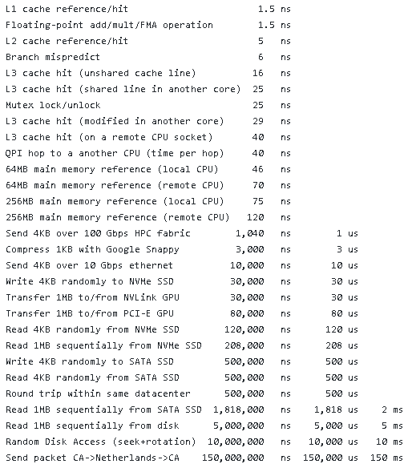
What are the firmware challenges at Phase-II?
Real-time track-finding and fitting
Real-time vertex-finding
3D cluster-finding in endcap
Particle-flow
So, basically, they want event reconstruction
  in under 10μs

Slide 65
And we have stepped up to the plate!
I used to give the following firmware advice to my students on preserving their sanity:
  Avoid iterative algorithms
  Avoid combinatorics
  Make the data-flow deterministic
  Division is hard, resource hungry and latency intensive
  Floating-point is hard, resource hungry and latency intensive

Slide 66
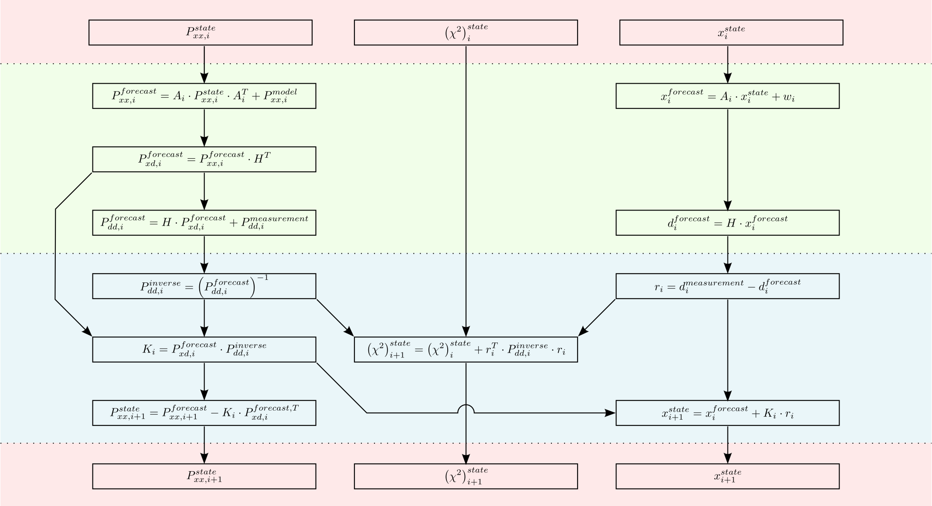
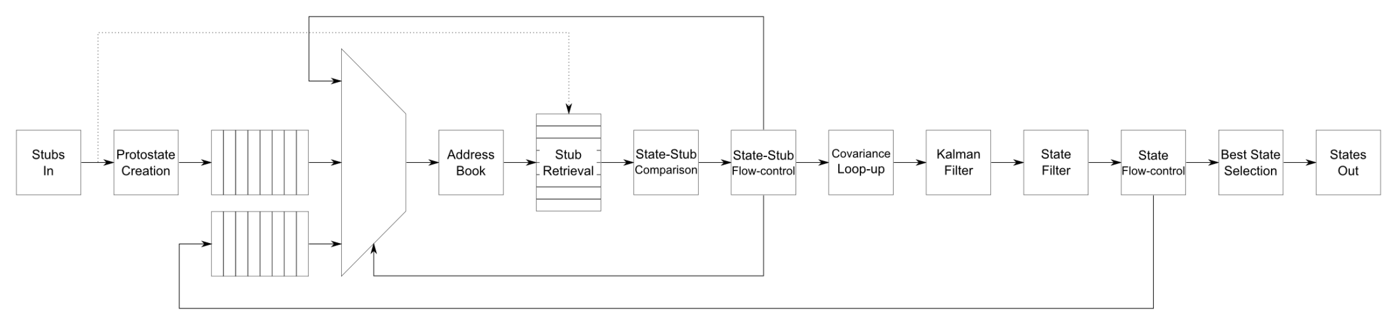
And we have stepped up to the plate!
In
For track fitter we wrote a full Kalman Filter
  Which is iterative
  Results in combinatorics
  Is data-dependent (pseudo-deterministic)
  Requires a division
  We also played with floating-point but dropped it in the final version
Forecast
Update
Out

Slide 67
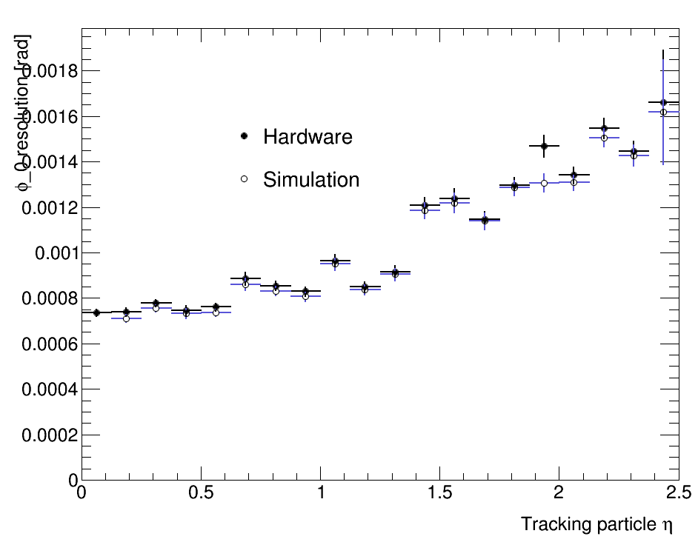


And we have stepped up to the plate!
Fits a 4-point track in 1.5μs
Matches offline floating-point resolution
200 events of TTbar+200PU
OPEN BLUE: floating-point CMSSW
CLOSED BLACK: Hardware capture

Slide 68

Common HW:
Serenity
CPU
36+36 firefly
36+36 firefly
North
Standard configuration. Provision for:
  2 × 72+72 links @ 28Gbps optical
    4 + 4 Tbps
  64 links @ 32Gbps between DCs
    2 Tbps
Optional optical expansion:
  2 × 96+96 links @ 28Gbps optical
    5.375 + 5.375 Tbps
  16 links @ 32Gbps between DCs
    0.5 Tbps
QSFP
64 pairs, direction unspecified
24+24 “spare”
24+24 “spare”
36+36 firefly
36+36 firefly
South

Slide 69
Common HW:
Serenity
CPU
36+36 firefly
36+36 firefly
North
Freedom
  Choose your preferred family, package, generation, (vendor?)
  Choose your balance of optical and electrical connectivity
Reduces financial risk
  Carrier (bulk of potential failure-modes) qualified before FPGAs (bulk of the cost) are fitted!
QSFP
64 pairs, direction unspecified
24+24 “spare”
24+24 “spare”
36+36 firefly
36+36 firefly
South

