Slide 1
AION-10 Work Package
For AION meeting, Birmingham
Sept 2019

Slide 2
AION-10 in Beecroft building, Oxford
14.7m
10.0m
Interferometry
beams
AI-10
7.7m
10 m
5.0m
lens
Core site

Slide 3
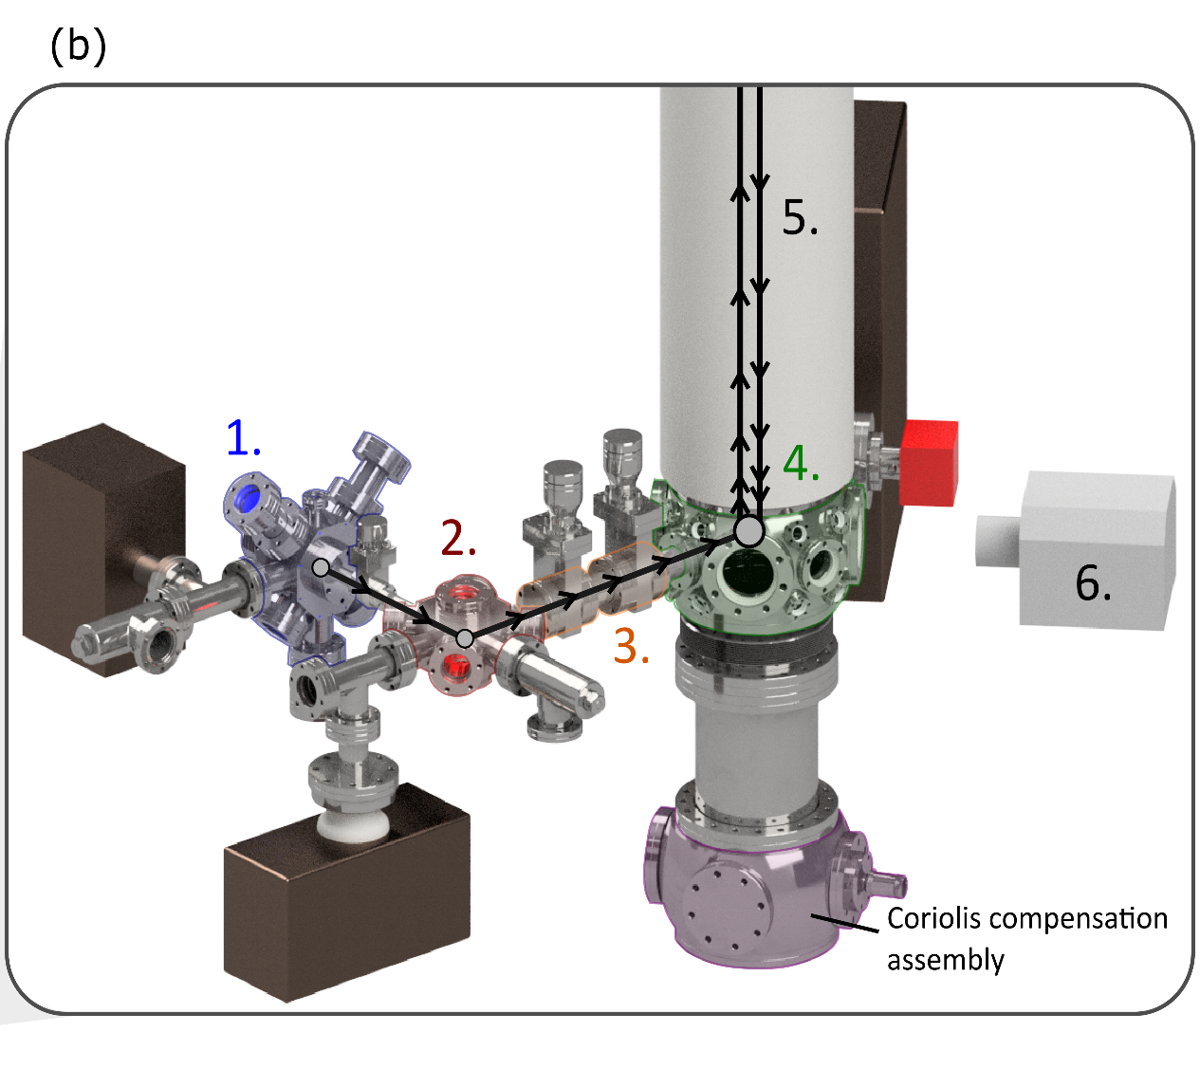
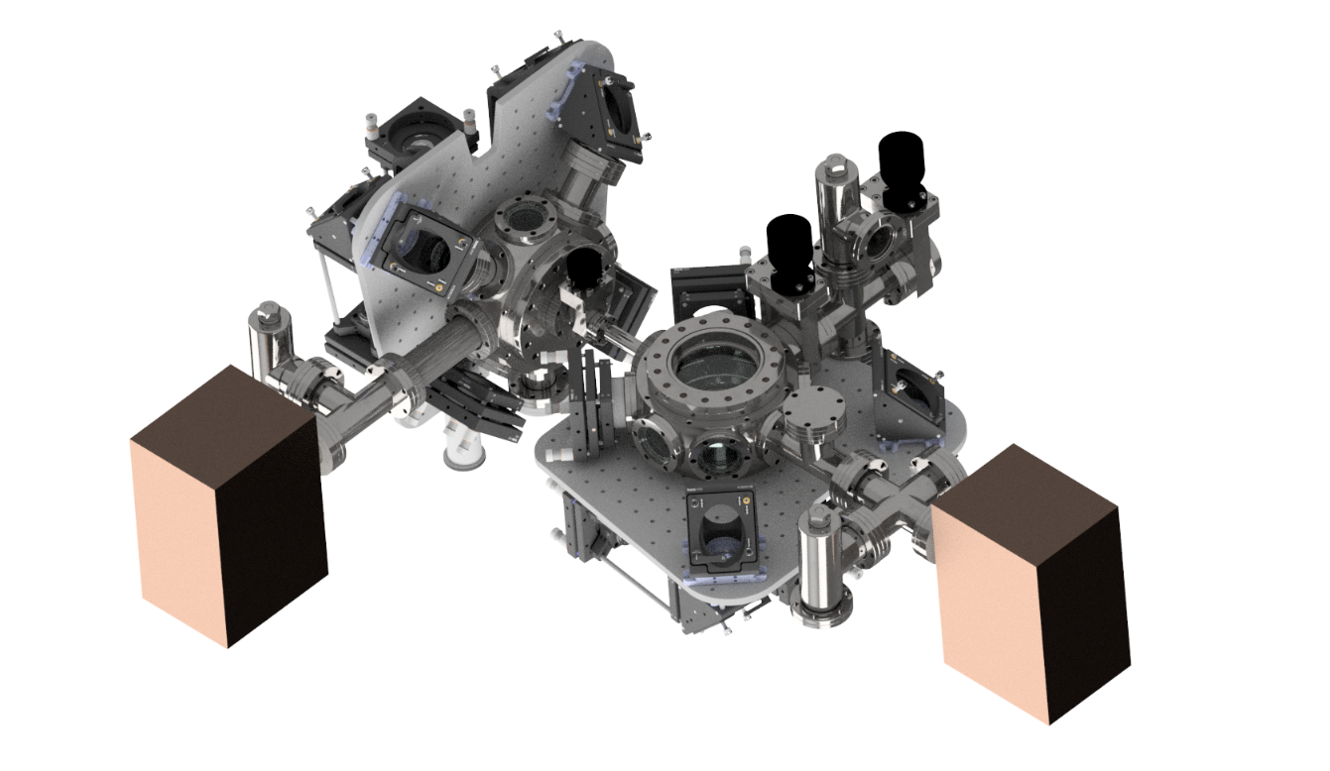
AOIN-10: sub-assemblies
Key stages:
Source of neutral strontium atoms
Two stages of laser cooling
3a. Transport into vertical tube
3b. Further cooling
4. Launching (copy MAGIS)
5. ToF - interferometer sequence
6. Detection – CCD camera

Slide 4
Laser systems
Blue laserhead,
AOM to spec,
shutters
3D MOT repumper
ECDL board
2D MOT delivery
3D MOT
Repumper distribution
AOMS
3D MOT,
distribution & delivery
(source side)
Blue spec
Not needed if wavemeter used
Clock laserhead,
Distribution,
AOM shutters
3D MOT repumper
delivery
3DMOT laserhead,
distribution,
AOM shutters
Transport optics
Frequency stabilisation
High-finesse cavity
3D MOT delivery
Dipole trap laserhead
AOM shutter and power stab
fiber to wavemeter
AI10 source and chamber
Spectroscopy
Launching optics
in Laser Lab
on 10m tower

Slide 5
AOIN-10: Sequencing of Milestones @ site in Oxford
End:
Month 36
Month
15
Month
27
Atoms @1 μK
in vertical tube
AI in
fountain
Maximum LMT
w. AION-10
UHV achieved
First AI signal
Install 2nd side-arm + delta-kick cooling
Dual AI
signal
Install side-arm
1a
2
Dark-matter etc.
Further AI studies
3
4
5
6
7
8
Assemble 10m
apparatus
10m apparatus
to AION-100
In Laser Lab
Stabilise clock laser
Test side-arm in laser lab
0
1b
Preparation
Set up lasers
Laser-cooling light
Laser Lab ready

Slide 6
AOIN-10: Milestones
Milestone 0: Preparation of the site and laser lab. (by the start of the project)
Design and construct support structure including provision of hoist/lifting equipment. Provision of services for the experiment. (A new laser lab adjacent to the AION-10 site is ready and reserved for this project.) All to be carried out by Oxford Physics. Further details - see Appendix.
Milestone 1: Construction of AION-10 apparatus (all except side-arms)
1a) Assembly of 10m vacuum apparatus: UHV achieved with clean in-vacuum optics. Comprehensive CAD model of all components to be used in the planning of AION-100. The apparatus will be constructed to full height at the beginning to avoid having to break vacuum (and minimise the number of gate valves), although initially work will be carried in the lower half.
1b) Lasers set up and tested in the laser labs at IC, Cam and Oxford. A laser system (without clock laser) set up with a control system in the AION Laser Lab in Oxford.
Milestone 2: Installation of a side-arm (after testing in laser lab)
Sidearm: strontium source and vacuum components assembled; laser cooling; mounting side-arm on main apparatus; connections via optical fibre and other cables for control signals
Milestone 3: Transport of atoms into the 10m vertical tube and evaporative cooling
Connect IR laser. Transport of atoms to launch site. Install some of detection optics and CCDs. Evaporative cooling to a few microkelvin.
Month 15 ?

Slide 7
AOIN-10: Milestones
Milestone 5: Launching atoms and interferometry in an atomic fountain.
Align launching laser beams (on lower interferometer) and launch atoms upwards to increasing heights. Obtain interferometry signal with launched atoms with time of flight sufficient for many pulses.
Milestone 6: Installation of the second sidearm and cooling to lower temperatures
A more complex laser cooling and transport system, that has been developed and tested in laser lab, will give colder samples of atoms (delta-kick cooling) which can be launched to full height within the magnetically shielded region (around 4.5m).
Milestone 7: Dual-mode operation of AION-10
Installing the second sidearm, launching and detection optics at the mid-point, AION-10 will enable the observation of signals from both interferometers, initially without launching and then using two atomic fountains.
Milestone 8: Detailed investigation of Large Momentum Transfer Pulses
The operation dual-interferometer will be used for detailed investigation of composite-pulse sequences giving high-fidelity LMT developed in the AION-Technology part of this project, in conjunction with MAGIS.
Month 27?
END:- Month 36

Slide 8
MS.1a) Manufacture and installation of vacuum components + in-vacuum optics

Slide 9
MS.1b) Lasers set up and tested in the laser lab
Deliverable | Job type | Sub-system | Tasks | Partners
Safety inspection | Lasers | Laser safety | Enclosures w. interlocks. | Ox
Lasers for laser cooling (blue + red) set up w. control system in the AION Laser Lab (clock laser - later) | Purchasing: lasers from M Squared Lasers (MSL) | 461nm, MSL | Move existing laser. Alignment by MSL technician | Ox
 |  | 689nm, MSL | Installed by MSL inc. pump | Ox
 |  | 532nm, MSL | New pump laser for 461nm system (keep Verdi for clock) | Ox
 | Diode Lasers Toptica/AOS | 707 nm 679 nm | Install on optical table or in racks? | NPL/Ox
 | Purchasing | Wavemeter | Install with optical fibre switch to monitor all lasers
 | Purchasing | Control electronics ARTIQ | Set up experimental control | Oxford/NPL
 | From NPL/IC | Optical cavity | Developed at NPL, install one in AION-Lab
 | Computer | Interface lasers, wavemeter+ cavity | Set for remote 24-hour running:auto-relock, alarms

Slide 10
MS.2: Construction and installation of a side-arm
Deliverable | Job type | Sub-system | Tasks | Partners
Side-arm(s) construction + Testing of laser cooling and transport | Vacuum | Vacuum system inc. gate valves | Assemble, leak check, bake components | 2@Ox + 1@Cam+ 1@IC = 4 systems
 | Optics | Design + set up mirrors etc. | Install fibres in Lab; connect 4 lasers = blue+ 3*red | At: Ox, NPL, Cam
 | Laser cooling | Sr source+2D MOT | Test blue + red stages of laser cooling in laser lab | Cam/Ox
 |  | Transport system | Load atoms in dipole trap + move horizontally | Cam/Ox
 | Laser cooling | Transport system | Evaporative cooling in optical dipole trap | Cam/Ox
Install side-arm on AION-10 | Mechanical | Complete side-arm | Lift into place on AION-10 | Ox
 | Vacuum | Side-arm gate valves | Connect and evacuate. Open gate valves. | Ox
 | Lasers | Optical fibres | Install all fibres: Lab to tower Connect 4 lasers: blue+ 3 red | Ox

Slide 11
AOIN-10: Sequencing of Milestones @ site in Oxford
Cambridge
Liverpool
Align vertical laser beams
Evaporative cooling
Detectors and optics
Atoms @1 μK
in vertical tube
UHV in 10m apparatus
Install side-arm
Transport
First AI signal
RAL
1a
2
3
4
In-vac optics -test
Interferometry sequence
Insulation and bake out
Pulse generation
Shielding
Birmingham
In-vacuum optics
Stabilise clock laser
Launch optics (in-vac.)
689 nm
Vacuum assembly
IR laser
Laser-cooling
light
Test side-arm in laser lab
0
1b
Preparation - see other sheets
689 nm
461 nm
Repump lasers
Wavemeter
Laser Lab ready
Optical cavity
NPL, Imperial College

Slide 12
AOIN-10: Sequencing of Milestones @ site in Oxford
Detection (2nd)
to AION-100
Transport (2nd)
  Launching 2nd fountain
  Launching one fountain
  LMT
Cont’d
from above
Dark-matter etc.
Further AI studies
5
6
7
8
AI in
fountain
Dual AI
signal
Maximum LMT
w. AION-10
Install 2nd side-arm +
delta-kick cooling
Key:
Milestones -
Oxford and collaboration –
Side-arm(s) –
(multiple contributors)
Other tasks colour coded as indicated by arrows.

Slide 13
AOIN-10: First-generation sequence
Cold-atom source
Blue MOT (1st stage laser cooling)
Red MOT (2nd stage laser cooling)
Load crossed dipole at 1064nm
Optical pumping into desired spin states
First stage of evaporative cooling
Transport into vertical tube
Second stage of evaporative cooling (T = 20 -50 nK)
Decompression cooling (in 1064nm)
Launch
Interferometry sequence
Fluorescent detection
N.B. Stirring for Sr-87
Blue@461 nm
Red@689 nm
IR@1064 nm
Clock@698 nm
Repump@707 nm
Repump@679 nm
time
Second-generation sequence (increased complexity, needs more development time):
add delta-kick cooling in vertical tube using 689nm light to reach 1nK compatible with interleaving by omitting further evaporation after transport (Delta-kick cooling is <50ms). Achieve same as MAGIS
Use SLMs to implement wavefront corrections to reach pK regime, eventually.

Slide 14
Uncertain points (for discussion)
In-vacuum optics – liaise with Stanford (Oxf ?)
CAD – draw ourselves? Liaise with Stanford about stability requirements. Costs for drawings?

Slide 15
WP Technology plan
Task flow; FTE/equipment; synergy with AION 10
Thanks to Richard Hobson for these slides

Slide 16
In this presentation
WP Technology plan
Slide 3: Overall task flow for WP Technology
Slide 4 to 4+N: Breakdown of each task
  Each slide has a task description, a note of how the task feeds into AION 10, and FTE/equipment requirements
  Highlight any open questions for discussion
Slide 4 + N + 1: Summary of total FTE and equipment requirements

Slide 17
WP Technology plan
461 nm system
LMT R&D
Dipole trap laser system
Transport & delta-kick distribution
High power 698 nm
689 nm system
Transport & delta-kick R&D
Repump systems
Laser stabilisation
Atoms at 2 uK
Atoms at 100 nK
Transport & delta-kick
AION 10:
1st AI demo
Experimental control
2D MOT source
Legend
Cooling and squeezing R&D
AION 10 parts from Oxford, RAL, Liverpool
Oxford
3D MOT chamber
Imperial/NPL
Task
Cambridge
Milestone
Squeezing cavity
Coils, electronics
Birmingham
698 nm laser stabilisation
Task lead
Transparency laser

Slide 18
WP Technology plan
461 nm system
Imperial/NPL
TBD
Oxford
Already has 461 nm system
Cambridge
TBD
Birmingham
TBD
 | Imperial/NPL | Oxford | Cambridge | Birmingham
FTE |  | 0
Equipment |  | Existing, may swap V18 for Equinox

Slide 19
WP Technology plan
689 nm system
 | Imperial/NPL | Oxford | Cambridge | Birmingham
FTE |  | 1
Equipment |  | MSL, complete system

Slide 20
WP Technology plan
Repump systems
Imperial/NPL
Design repump laser system + distribution ()
 | Imperial/NPL | Oxford | Cambridge | Birmingham
FTE |  | 2
Equipment |  | Diode lasers, install locking

Slide 21
WP Technology plan
Laser stabilisation
Imperial/NPL
Constructs copies of multi-wavelength cavity, ships to Oxford and Cambridge
Builds wavemeter-based software and hardware for locking repump lasers
Oxford
Already has 461 nm lock
(With IC/NPL) Locks 698 nm and 689 nm laser to multi-wavelength cavity
Makes copy of Imperial/NPL wavemeter-based repump lock
Cambridge
(With IC/NPL) Locks 922 nm, 698 nm and 689 nm to multi-wavelength cavity
Makes copy of Imperial/NPL wavemeter-based repump lock
Birmingham
TBD
 | Imperial/NPL | Oxford | Cambridge | Birmingham
FTE
Equipment

Slide 22
WP Technology plan
Experimental control
 | Imperial/NPL | Oxford | Cambridge | Birmingham
FTE
Equipment

Slide 23
WP Technology plan
2D MOT source
Oxford
Already has a tested design for oven + 2D MOT chamber (£20k)
Build copies to be sent to Cambridge, Imperial and BHam (TBD shipped under vacuum with Sr pre-loaded)
 | Imperial/NPL | Oxford | Cambridge | Birmingham
FTE
Equipment

Slide 24
WP Technology plan
3D MOT chamber
 | Imperial/NPL | Oxford | Cambridge | Birmingham
FTE
Equipment

Slide 25
WP Technology plan
Coils, electronics
MOT/compensation coils plus drivers
Photodiodes (PDH and intensity stabilisation)
Loop filters
(With IC/NPL) Locks 922 nm, 698 nm and 689 nm to multi-wavelength cavity
 | Imperial/NPL | Oxford | Cambridge | Birmingham
FTE
Equipment

Slide 26
WP Technology plan
Atoms at 2 uK
Imperial/NPL, Oxford,
Each location plugs together all their components to realize red MOT at 2 uK
Special case: Oxford
This milestone needs to be realised twice
  Bottom sidearm (month 18?)
  Top sidearm (month 36?)
 | Imperial/NPL | Oxford | Cambridge | Birmingham
FTE | Lots (debugging etc.)
Equipment | None (it’s a milestone)

Slide 27
AION-10: Other tasks
AION-10 (default PPt colours for diagrammatic plan do not indicate ownership of tasks)
PREPARATIONS: before Start
Core holes
Cladding*
Frame
Completed Tower
Wall fixings
Prepared stairwell
Cabling*
Conduits*
SIDE-ARM: Cambridge, NPL/Imperial, Oxford and others
10m apparatus
- Beecroft Lab.
- to be completed
*partial - finished after vacuum system
Sr oven
laser cooling – 2nd stage
Dipole trap
laser cooling – 1st stage
Transport – testing
Detection
Shipping to Oxf.
Install sidearm(s)
Optical tables
Laser Lab ready
Laser safety
Move in blue laser
Test blue fibres
Laser Lab. Oxford
Expandable control system
Expt. control programming
Functional control system
Test ARTIQ modules
Specify new modules
Expt. control system

Slide 28
AION-10: Detectors and Electronics
Electronics: servo-control for multiple systems for frequency and intensity stabilisation. (NPL/Oxford)
Control system: light pulse timing and shaping, laser cooling and transport sequences. *
CCD cameras for detection, e.g. Andor in the UK
Test & Measurement equipment (mostly contributed)
* Email exchange, May 2019 (Chris F, Richard, Ulrich and Oliver)
… there seem to be many views on the a suitable electronic control system for AION-10. Although is isn’t a major cost, it could cause a significant delay to setting up AION-10…
…there is good existing solutions such as ArtiQ (as used by many ion-trapping expts)…
Not included in original budget: synchronisation with MAGIS (month 32) – contribution?

Slide 29
Technical challenges to solve on atom source
(copied from Richard Hobson, AION meeting 22 Feb 2019)
High atom flux into blue MOT (~ 10¹¹ in 1 second)
cf. fastest published loading into blue MOT is < 10¹⁰ per second of ⁸⁸Sr.
Need to overcome light-assisted collision losses. Also density limits from scatter / reabsorption which are significant at N > 10⁸ , for 1cm beams.
Efficient transfer blue MOT → red MOT → dipole trap ⁸⁷Sr is hard!
In Florian Schreck’s group, total efficiency from atomic beam to dipole trap was ~ 30 times less for ⁸⁷Sr than for bosonic ⁸⁴Sr.
Transport
Evaporative cooling of 10⁹ atoms to < 100 nK
May need many parallel dipole traps → combine large N with fast evaporation
Launching atoms and collimating with atom optics: needs pK temperature!
Magnetic force too weak → dipole force for atom optics.
Going beyond AION-10
Need to preserve squeezing → magic wavelength (or transfer squeezing)
Spin squeezing - spin squeezing not yet been realised on an optical clock transition

Slide 30
AION-10: Lasers & optics
Abbreviations: Ti:Sa – Titanium-doped sapphire laser e.g. M Squared Lasers
diode – semiconductor diode lasers, e.g. AO Sense Inc., Toptica
blue cooling (1st stage) – Ti:Sa or amplified diode laser
red cooling (2nd stage) - diode or Ti:Sa or SFM of fibre lasers
clock (narrow bandwidth) – power critical for one-photon interferometry
two repumping lasers – diodes for low power
dipole trapping lasers – high power at a frequency far off resonance
  transport by optical tweezers from sidearm into vertical tube
  optical lattice for launching without heating
  (Launching squeezed states in future upgrades)
Optics: mirrors, polarisers, AOMs, EOMs, shutters, optical fibres etc. (modular system for ease of transport to different locations)
Laser frequency stabilisation – reference cavity provided by National Physical Laboratory (NPL), or a frequency comb (not included in budget)
To be decided and agreed in the Project Plan:
How much PDRA effort and staff time from AION-Technology/other WPs, will be used to kick start AION-10, e.g. build modules for the laser system?

Slide 31
Action points (for discussion)
Sr-source – can we borrow one from MAGIS?
Transport for AION-10 – confirm
Control system for AION – leave open (low cost)
Synchronisation with MAGIS – Cam, costs?
In-vacuum optics – liaise with Stanford (Oxf ?)
CAD – draw ourselves? Liaise with Stanford about stability requirements.
[ Laser systems for AION-10 – discuss later]
Vacuum tubes (4m vertical) - Liverpool or RAL

Slide 32
In-vacuum optics: configuration of launching laser beams in the vertical tubes?
15 cm
150 cm
150 cm

