Slide 1
AION Management Board-October 2019
STFC
Impact Office
XXXXX
XXXX
Advisors
X. yyy
P. Ttttt , L. uuuuu, xxxx
Institutional Board
Principal Investigator
XXXXXXXXXX
IB Chair
H. XXXXXX
Physics Office
XXXXX
Project Manager
XXXXXXXXXX
Birmingham
M.XXXX
Cambridge
G. IIIIII
Management Board
Members
PI
PM
IO
PO
IB chair
Technology
Coordination
Advisors
ATOM
S. YYYYY
Imperial Col.
L.YYYY
Kings Col.
V. XYZKL
PHYSICS
S. YYYYY
Transport
A. CCCCC
Liverpool
G. PPPP
NPL
D. UUUU
AION-10
A. CCCCC
LMT
L. TTTTT
Oxford
F. QQQQ
RAL
T. PPPP
AION-100
L. TTTTT
Squeezing
L. TTTTT
MAGIS-UK
L. TTTTT
MAGIS US
Technology
Coordination
October 2019

Slide 2
AION Management Board-October 2019
STFC
Impact Office
XXXXX
XXXX
Advisors
X. yyy
P. Ttttt , L. uuuuu, xxxx
Institutional Board
Principal Investigator
XXXXXXXXXX
IB Chair
H. XXXXXX
Physics Office
XXXXX
Project Manager
XXXXXXXXXX
Birmingham
M.XXXX
Cambridge
G. IIIIII
IC/NPL**
ATOM
S. YYYYY
KCL**
Imperial Col.
L.YYYY
Kings Col.
V. XYZKL
PHYSICS
S. YYYYY
Cambridge**
Transport
A. CCCCC
Liverpool
G. PPPP
NPL
D. UUUU
AION-10
A. CCCCC
Oxford**
Birmingham**
LMT
L. TTTTT
Oxford
F. QQQQ
RAL
T. PPPP
AION-100
L. TTTTT
RAL**
IC/NPL**
Squeezing
L. TTTTT
MAGIS-UK
L. TTTTT
MAGIS US
** budget holder
Technology
Coordination
Liverpool+??**
October 2019

Slide 3
Mandate in a Nutshell
The organisation of the AION project is shown in Figure 1, including lines of responsibility and links to the UK funding agency and the US project MAGIS. The team is organised in coordination and technology areas representing in total eight Work Packages (WPs) overseen by a management WP. The WP managers (XXX, YYY, ZZZ …..) were chosen based on expertise and in most cases they are already performing the required duties in the project. They report to the UK Project Manager (PM, XXXX) and the UK Principal Investigator (PI, YYYY), who are responsible for delivering the total project.
The PM will conduct weekly meetings (minuted) of the WP leaders to monitor progress and assess deployment of resources. S/he will be part of the AION Management Board, which oversees the progress of the project.
The AION Management Board, chaired by the PI, is responsible for directing the AION project following the policies agreed by the AION Institutional Board. The PI represents the project and the AION collaboration to STFC and externally.
Both PI and PM will report regularly to an STFC Oversight Committee.
Scrutiny of the management is provided by the AION Institute Board IB), which is composed of senior members of the team and is presided by an elected Chair (XXXXX). Each institute has one voting member; the PI and PM are ex officio non-voting members. The UK IB meets monthly to assess progress and governance matters and will organise together with the PI regular collaboration meetings of the whole project.

Slide 4
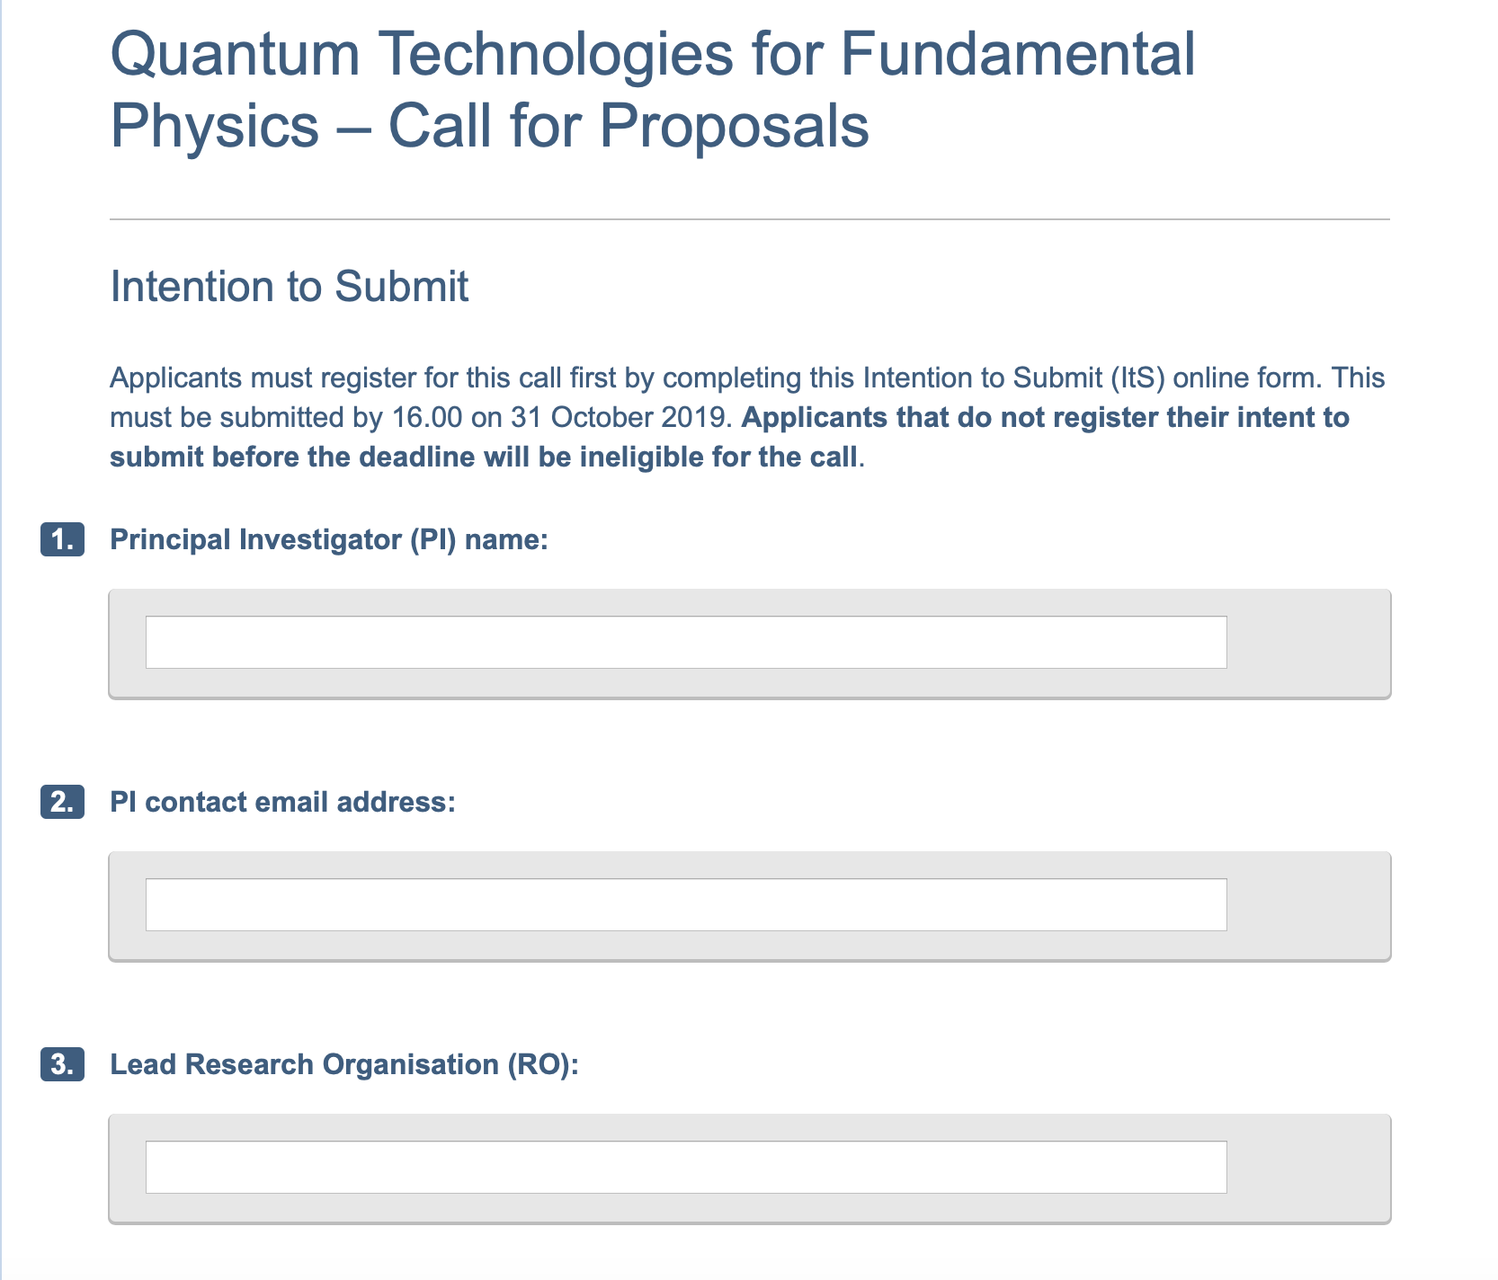
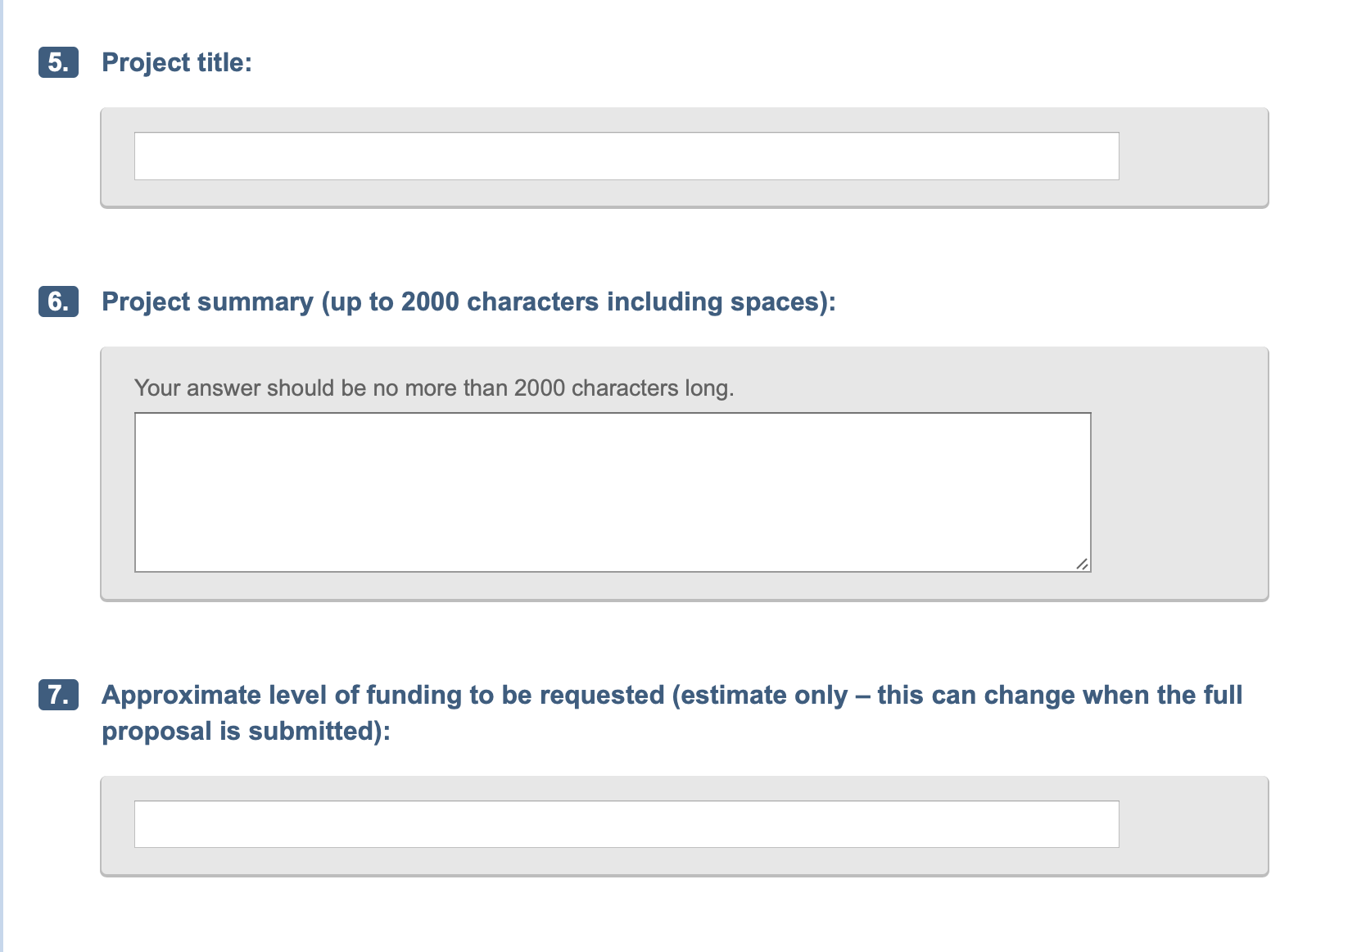
Intention to Submit – deadline Oct 31
Proposal:
PI: Oliver Buchmueller
RO: imperial College (goes with PI)

Slide 5
Timeline towards Dec 3rd
Example IC (might be different for others).
Letter of Support draft text: 19 Nov
Internal deadline: 26 Nov
Call deadline: 3 Dec

