Slide 1
AION Working Meeting
CORE Team
Budget Estimate
Oct 18, 2019
Oliver Buchmueller, Imperial College London

Slide 2
Reminder [without Cambridge]

Slide 3
WP-AI [=WP AION-10 + WP AION-RD]
WP AION-10:
+ add additional costing from RAL for the task items discussed
+ add FTE estimate: at the moment its 2 FTEs
Total Budget Estimate: ~1.9M [capital] + ~0.9M [FTE] = ~2.8M
WP AION-RD
+ need to think of a better name – suggestions are AION-Upgrade, AION-Performance
+ merge task 1 and 2 in one coherent task proposal with squeezing coming in towards the end of the 3 year period. Reduce cost additionally and emphasis potential in-kind contributions
+ task 3 [LMT]: Scope & budget
Total Budget Estimate: ~1.0M [capital, task1/2] + 0.6M [capital, task3] + 0.9 [FTE] = ~2.5M;

Slide 4
Budget in IRB Proposal
Work Package | Capital [£ in M] | FTE [£ in M] | Total [£ in M]
WP AION-10 | 1.9 | 0.9 | 2.8
WP AION-Technology | 1.6 | 0.9 | 2.5
WP AION-100 | 0.1 | 1.9 | 2.0
WP AION-Physics | 0.1 | 1.2 | 1.3
WP MAGIS | 1.8 | 1.2 | 3.0
AION Project Total | 5.5 | 6.1 | 11.6
Table 2: AION Budget: tentative breakdown in individual Work Packages with task and milestones as discussed in the text. The budget numbers are given in Million £ and they cover a 3-year period.
AION-10: 3 FTE
AION-Technology 3 FTE [one for Each Task]
AION-Physics 4 FTE [2 Future, 1 AION-10, 1 ATOM]
AION-100 [backup]
With Cambridge coming in, I propose to start costing:
AION-10: 3 FTE
AION-Technology 4 FTE [one for Each Task – now adding Cambridge]
AION-Physics 3 FTE [1 Future, 1 AION-10, 1 ATOM]
AION-100 [backup]

Slide 5
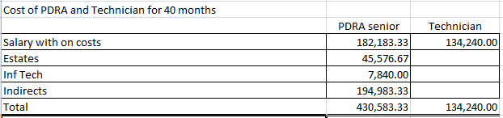
FTE and Co-PI Costing
Institute | University of Cambridge
 | Department of Physics
FEC rates per person-year
Estates | 13,673.00
Inf Tech | 2,352.00 | if applicable
Indirects | 58,495.00
CoIs: please give salary band as would be entered in JeS (as 1 FTE)
Co 1 | 101,974.00
Co 2 | 87,836.00
PDRA cost (salary & oncosts) *for 40 months*
Junior (after PhD) | 41,444.00 | 138146.7
Senior | 54,655.00 | 182183.3
Other
Techncian | 40,272.00 | Pooled labour
DI / DA ? |  | 134240
Studentship
London Weighting ? | N/A
The Leading Research Office will be
Imperial and Louise Hayward will be the contact.
We have approached admin people in all involved institutes to provide FTE templates that can be used to define costing scenarios for personal.
These will be used to make realistic estimates for FTE cost.
Still missing are KCL and Liverpool
Example: Cambridge Senior RA
£129,175 per year at 100 FEC
£129,175 x 0.8 =£103304
Not too far from the 100K used

Slide 6
Equipment & Consumables
Example
IC/NPL

Slide 7
Equipment & Consumables
Missing:
+ More details and finer breakdown from Birmingham [recall 10K and below is consumables and NOT equipment]
+ Refined budget from Oxford [double checking that we really have all we need for AION-10 and ensure its not double counted in other budgets]
+ MAGIS: Not detailed budget available – need this urgently

Slide 8
Budget Scenarios
I am currently working with Louise to make Budget scenarios, which, assuming missing information is available early next week, should be ready by Friday next week. I will circulate when ready.
We will discuss these scenarios in details during our meeting in Birmingham

Slide 9
Birmingham Meeting on Oct 28th
Main focus will be on budget discussion so that we can provide a sensible total cost estimate by Oct 31th to STFC.
We will also discuss management and AION organization for the proposal. Before Oct 31th we have to agree on PI and lead RO. Email from Jon and Oliver will be send to individual institutions contacts later today.

Slide 10
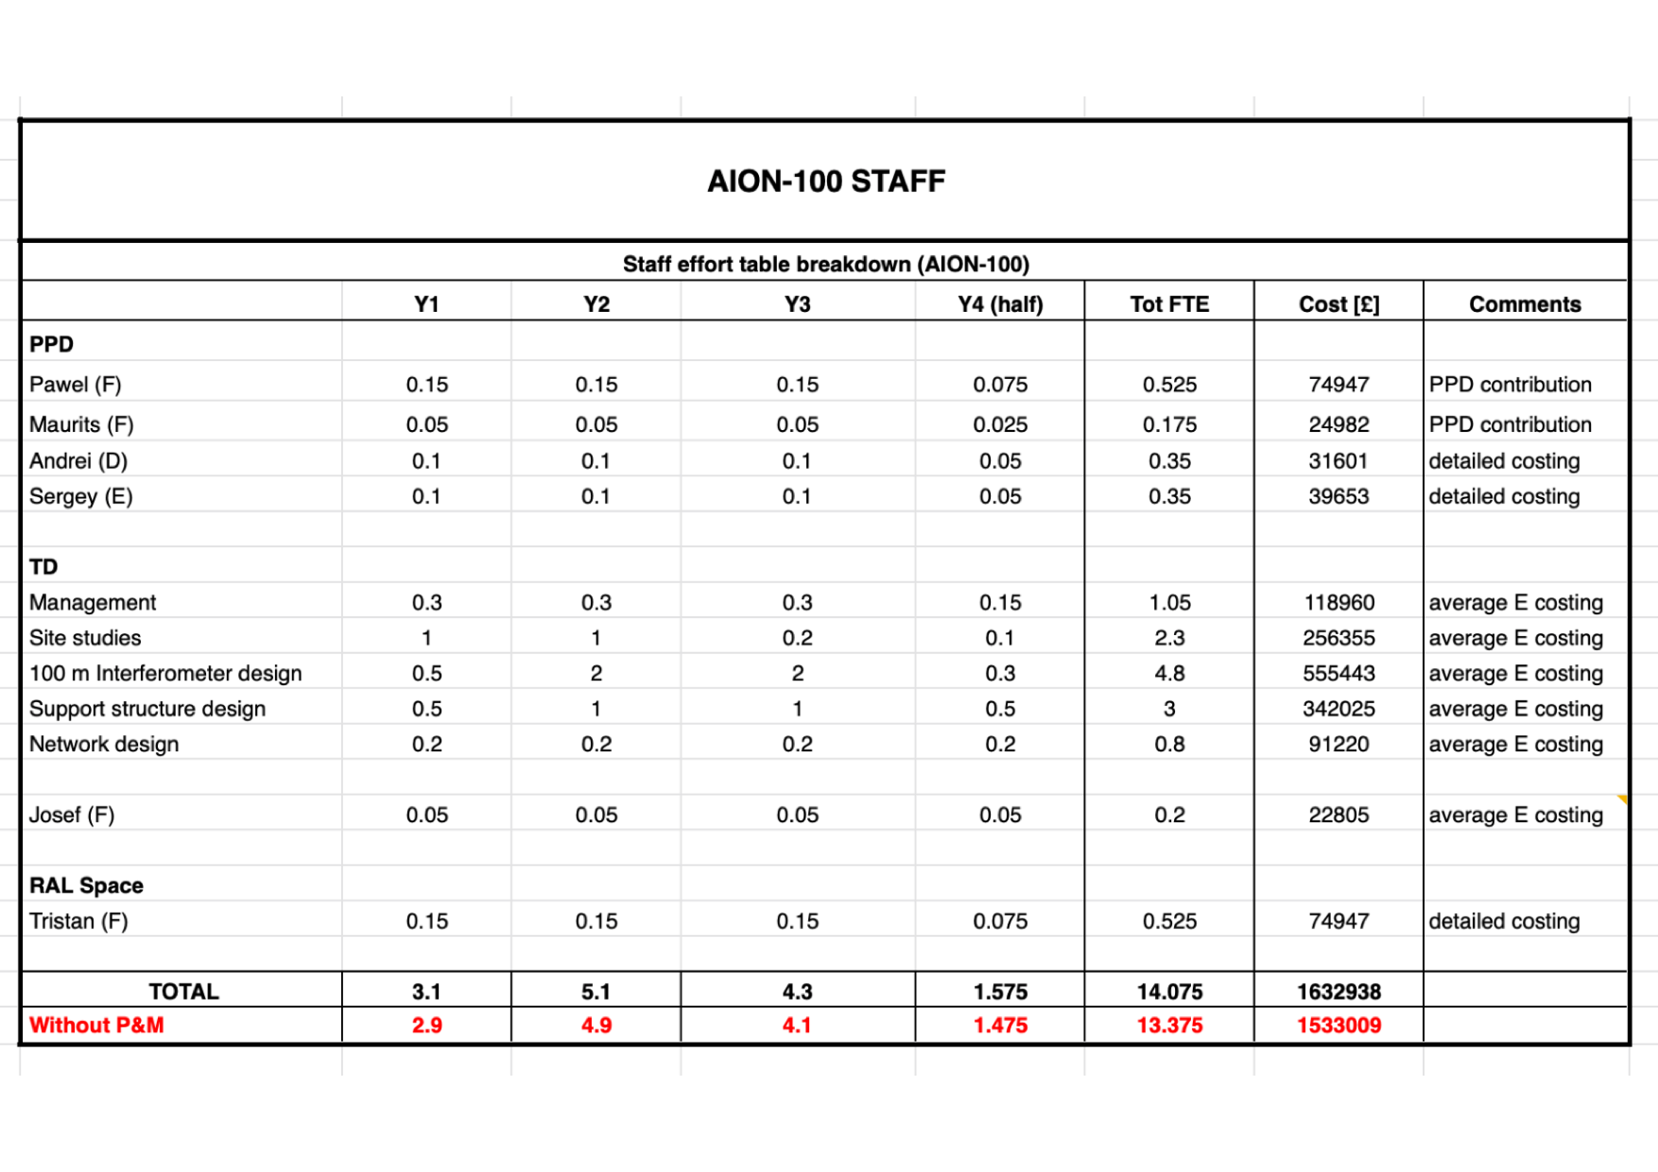
AION 100

Slide 11
WP AION-100
+ estimate of required EFT is on the high side; provide funding envelope/range instead of upper. For now we use the upper range for the total budget estimate
Total Budget Estimate: ~1.9M [FTE mainly]
WP AION-Physics
+ three main physics task are identified each will be have an EFT assigned
Total Budget Estimate: ~0.9M [FTE mainly]

Slide 12
WP MAGIS
+ the current estimate is still based on a scenario before details of the other WPs were defined. It requires now a consolidation as several task items are now also covered, at least in part, by other WPs, especially WP-AION-RD. Total Budget Estimate: ~1.8M [capital] + 1.2 [FTE] = ~3.0M;
Total AION Project budget estimate for year 1 to 3:
AION Project [1-3 year]= ~2.8M [WP AION-10] + ~2.5M[WP AION-RD] + ~1.9M[WP AION-100] + ~0.9M [WP AION-PHYSICS] + ~3.0M[WP MAGIS] = £11.1M

