Slide 1



A high-flux source of laser-cooled strontium atoms
Oxford Physics:
Chris Foot, Elliot Bentine, Sean Ravenhall, Leo Xu, & Peter Zhou

Slide 2
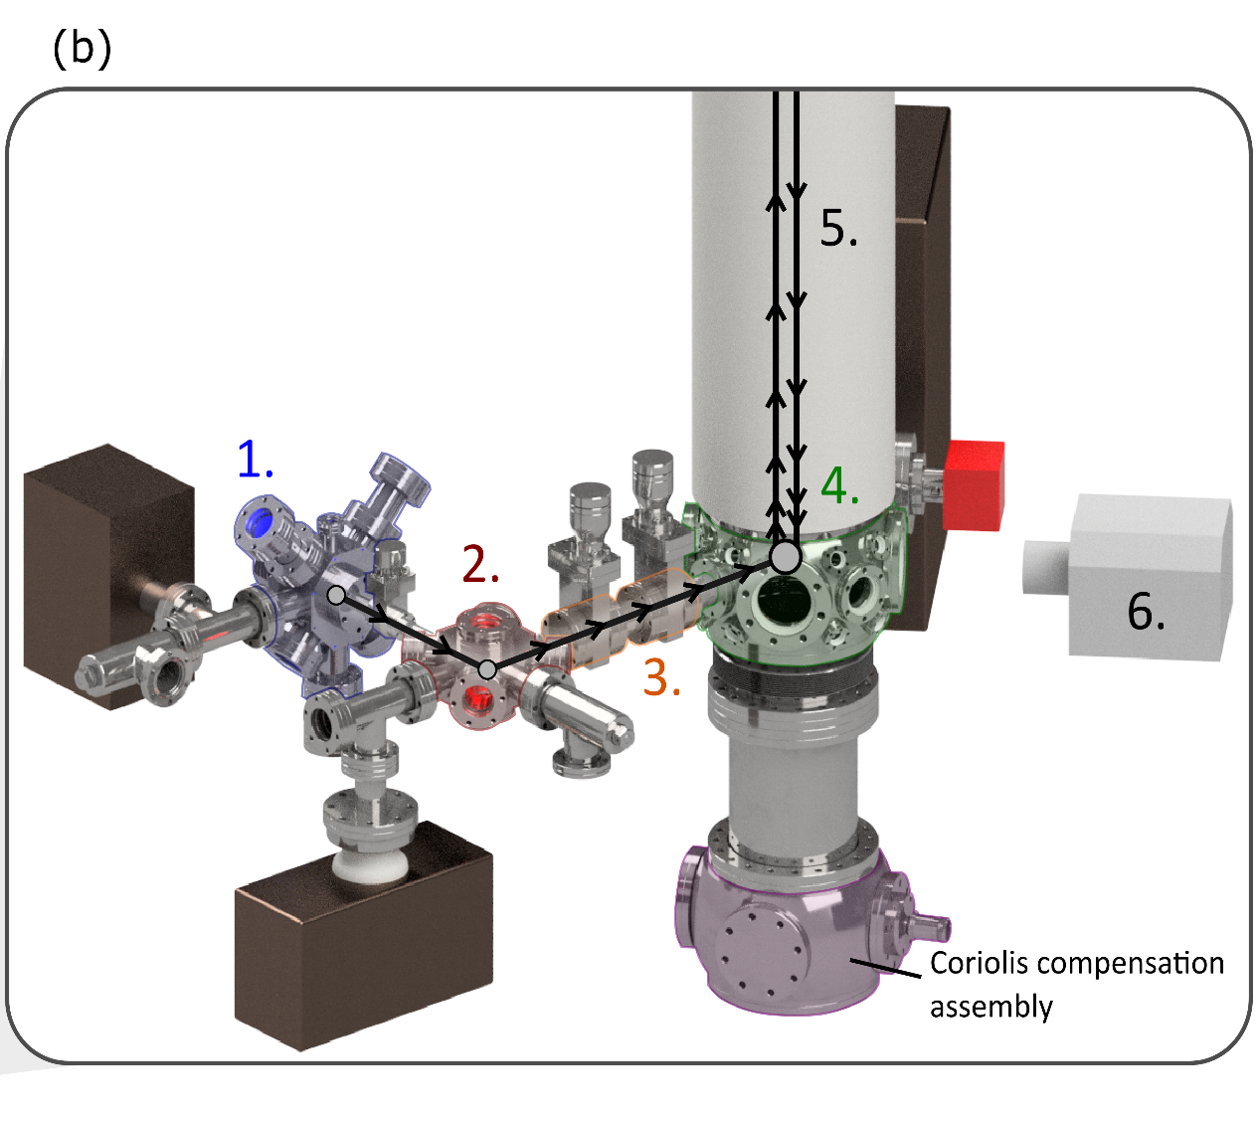
AOIN-10: sub-assemblies
Key stages:
Source of neutral strontium atoms
- Oxf or MAGIS?
2. Two stages of laser cooling
- Oxf/NPL
3. Transport into vertical tube (injection)
- Cam
3a. Further cooling?
- TBD
4. Launching (acceleration)
– copy MAGIS?
5. ToF - interferometer sequence
6. Detection – CCD camera
Oxf/MAGIS (existing expts@Stanford)
CAD in the pre-proposal ( E.Bentine, June 2019)

Slide 3
AION-10: Temperature vs. Number/second (Sr-87?)
Temperature/ K
1000
800 K = oven temperature – strontium source .
1
first-stage laser cooling
10⁻³
770 μK = Doppler cooling limit (461 nm) blue
second-stage laser cooling
0.18 μK = Doppler cooling limit
0.23 μK = Recoil limit
10⁻⁶
1 μK ≈ cooling limit (689 nm) red (a few μK)
Transport
Transport without heating?
evaporative cooling?
Delta-kick (adiabatic) cooling
10⁻⁹
AION-10
- initial
AION-10
upgraded
x100 higher flux ⇒
x10 improvement in sensitivity
10⁻¹²
10³
10⁶
10⁹
10¹²
10¹⁵
Number/second
(Atom flux)

Slide 4
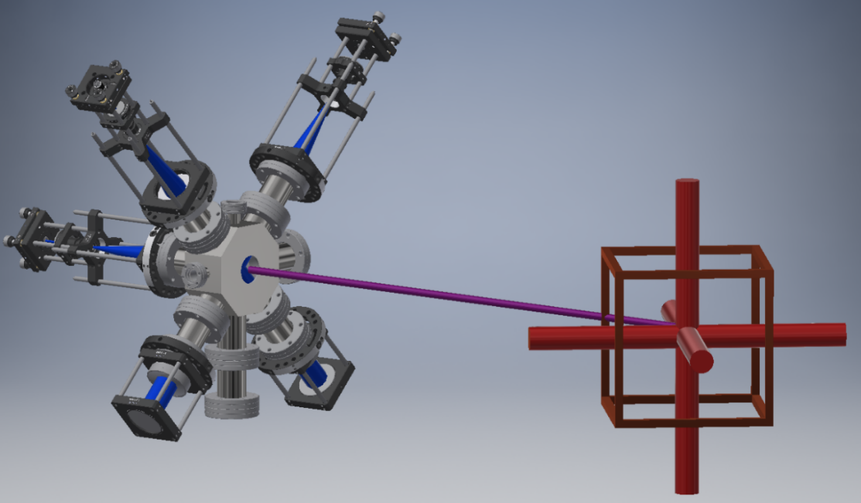
Source laser-cooled strontium atoms (Oxford and NPL)_
Loading a 3D MOT
2D MOT cold-atom source
To replace Zeeman slower on existing set ups

Slide 5
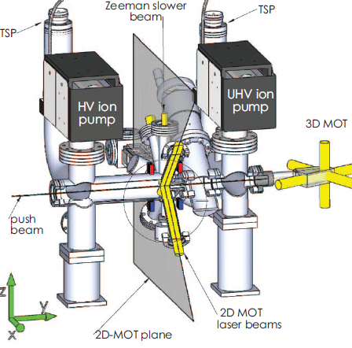
Atom source: sodium (Trento, Italy)
  permanent magnets for Zeeman slower and 2D MOT
  Commercially available
Compact high-flux source of cold sodium atoms
Lamporesi, G. … and Ferrari, G., (2013)
Rev. Sci. Instrum., 84, 063102
Direct comparison between a two-dimensional magneto-optical trap and a Zeeman slower as sources of cold sodium atoms.
Pedrozo-Peñafiel, E. … & Bagnato, V. S. (2016).
Laser Physics Letters, 13, 065501
Notes:
The advantages of strontium stem directly from the atomic structure of `two-
electron' systems such as the alkaline earth metals and elements with similar
electronic structure such as Yb and Hg.1 For two spin-1/2 particles such as elec-
trons there are states which have total spin S= 0 or 1, called singlet and triplets
respectively since they have degeneracy 2S + 1. Transitions between singlets
and triplets are `forbidden' by the selection rules for electric-dipole transitions
however the approximations on which the rule S = 0 is based, i.e. the LS-
coupling scheme for angular momenta, partially breaks down for heavy atoms
[3]. Thus two-electron systems have both strong transitions which give rise to
strong radiation forces and weaker transitions that can be used for laser cooling
to much lower temperatures (because of their narrow linewidth). `Two-electron
atoms' have transitions that are `forbidden' to various degrees and the very nar-
row clock transitions in Sr are used for the time standards. Alkali metals do
not provide these narrow optical transitions and current atomic clocks use mi-
crowave transitions between hyperne levels of ground electronic conguration
of caesium. Optical transitions at frequencies 4105 GHz of can have a much
higher Q-factor than a microwave clocks at a 9 GHz and therefore it is expected
that optical-lattice clocks, or trapped ions, will eventually replace atomic foun-
tain clocks as the primary time standards. This is the focus of research and
development at national standard labs, and more detailed information is given
on the NPL web site and publications. Strontium optical-lattice clocks are suit-
able for transportable clocks since they can be compact and less sensitive to
orientation than atomic fountains.

Slide 6
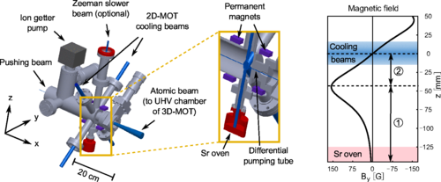
Atom source of strontium @ Shanghai, China with team members from Heidelberg
“atomic flux exceeding 10⁹ atoms/s without indication of saturation”
Two-dimensional magneto-optical trap as a source for cold strontium atoms
I. Nosske, … M. Weidemüller (2017)
Phys. Rev. A 96, 053415

Slide 7

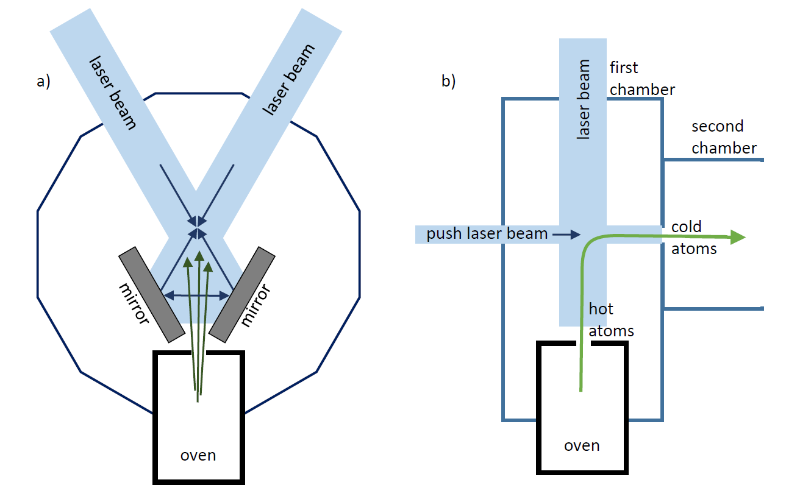
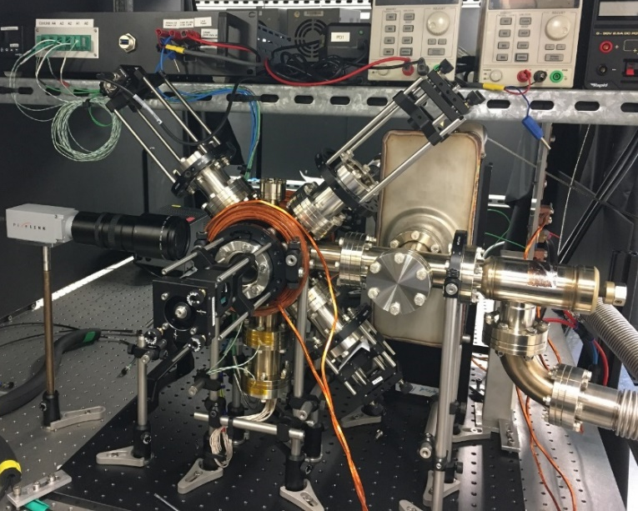
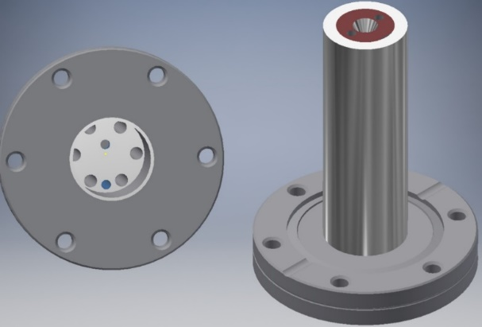
A high-flux source of laser-cooled strontium atoms: Oxford Physics
2D MOT cold-atom source
Principle of 2D MOT source
  Stainless steel oven on CF40 flange

Slide 8
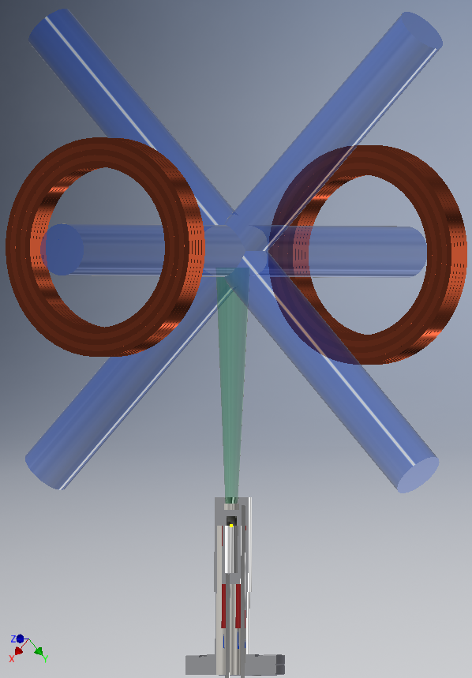
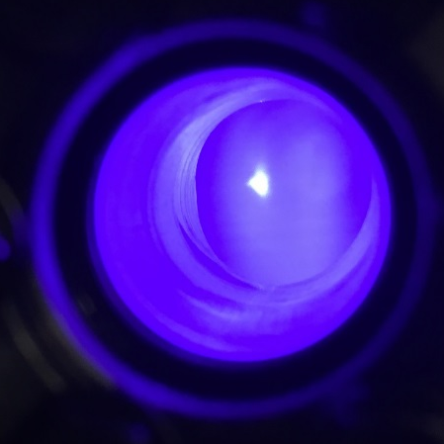
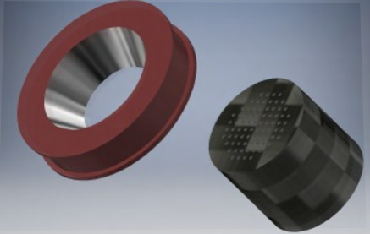

Test by making a 3D magneto-optical trap (MOT): preliminary results at first AION workshop (Apr 2019)
Blue fluorescence from atoms in MOT. Estimated cold-atom flux > 10⁹ s⁻¹ (of ⁸⁸Sr)
  Multichannel nozzle
  Stainless steel oven welded to a standard CF40 flange (tested up to 700 °C )

Slide 9
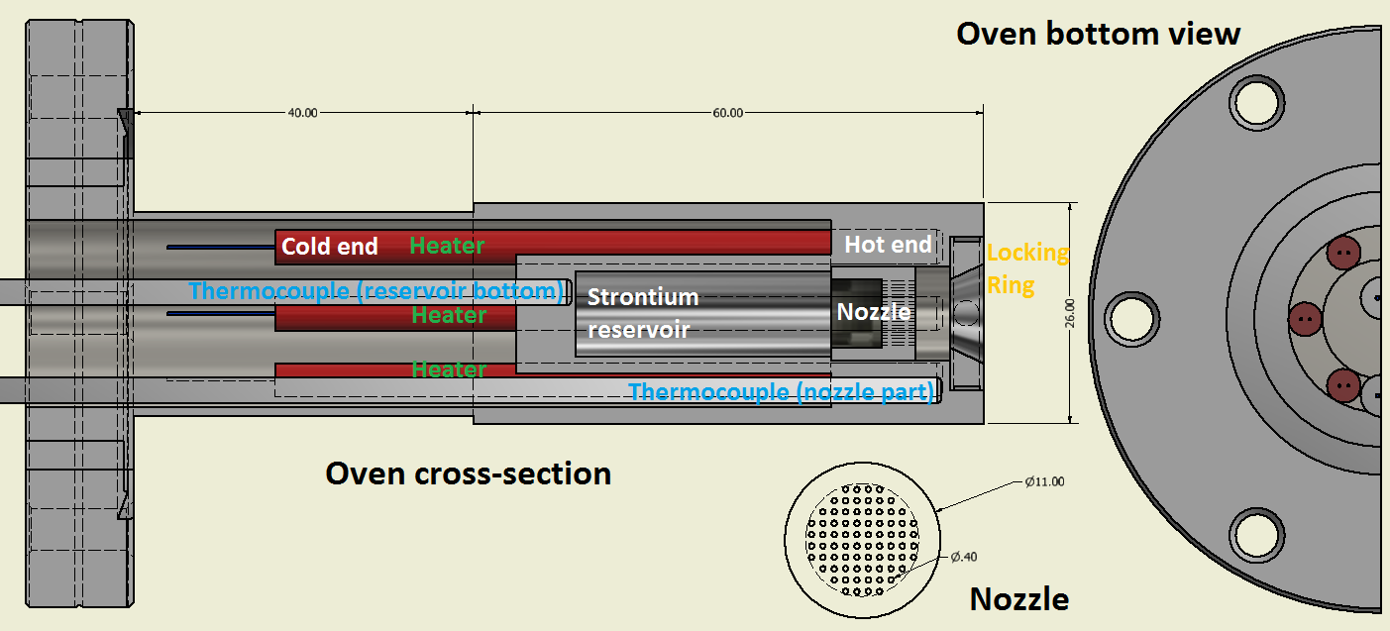
Strontium atom source
  Vacuum region
Strontium reservoir
Heater for nozzle

Slide 10
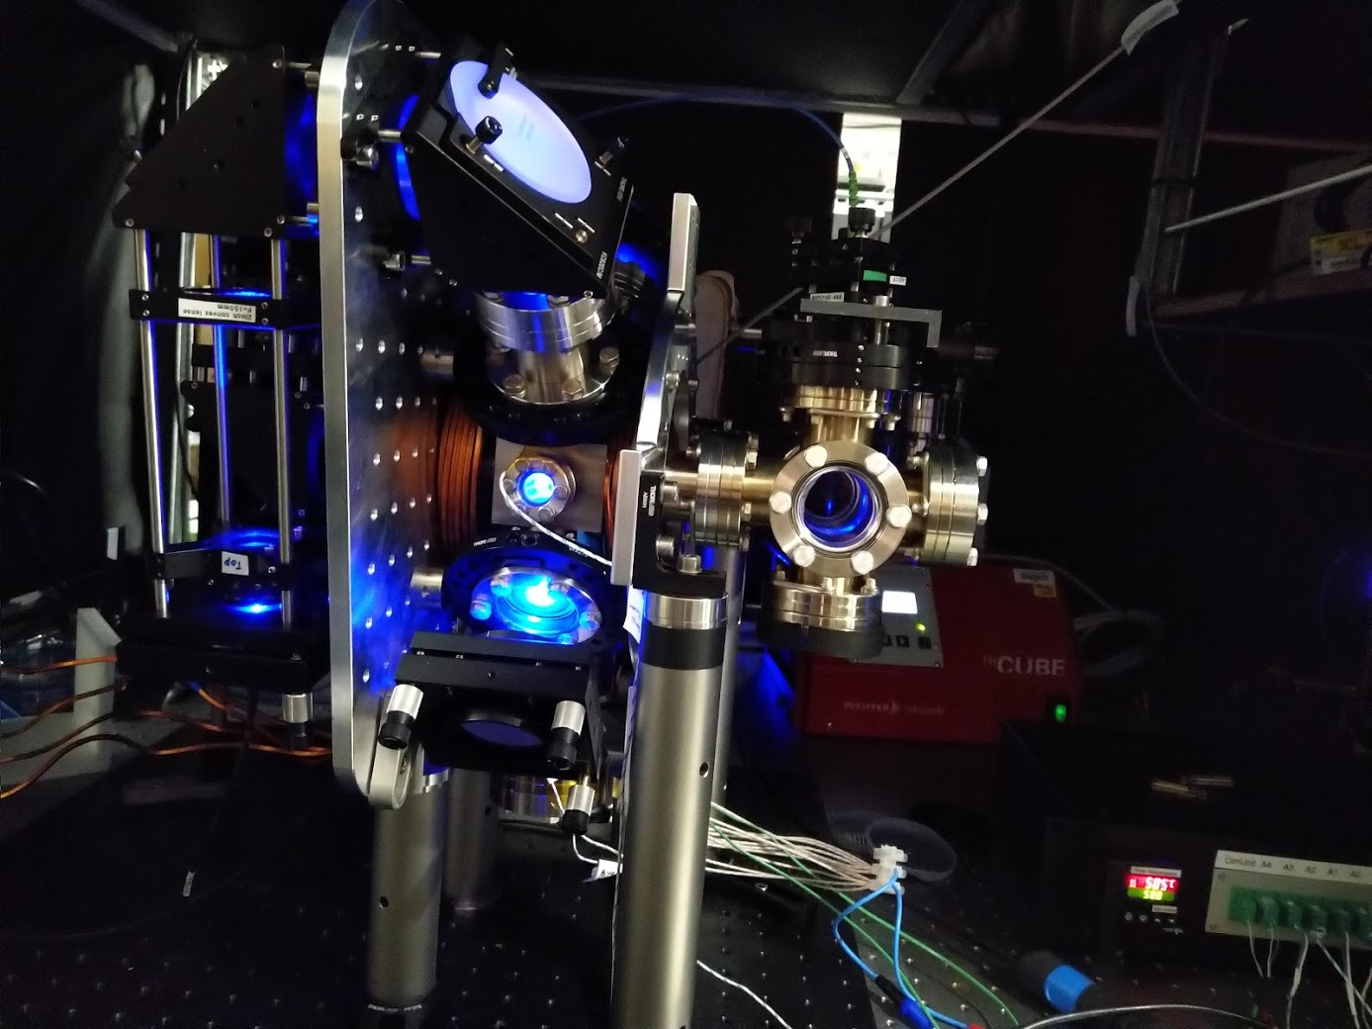
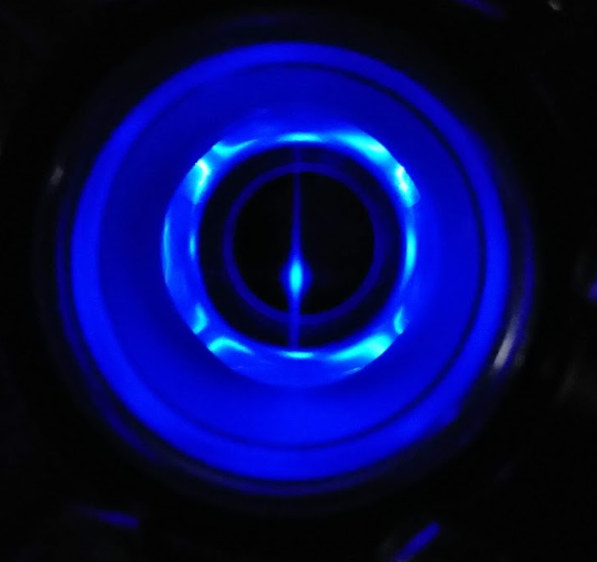
Laser-cooled strontium atoms pushed from a 2D magneto-optical trap (MOT)
Probe laser beam
Probe laser beam
Push laser beam
Oven temperature = 500 °C
Oven
25 Sept 2019

Slide 11
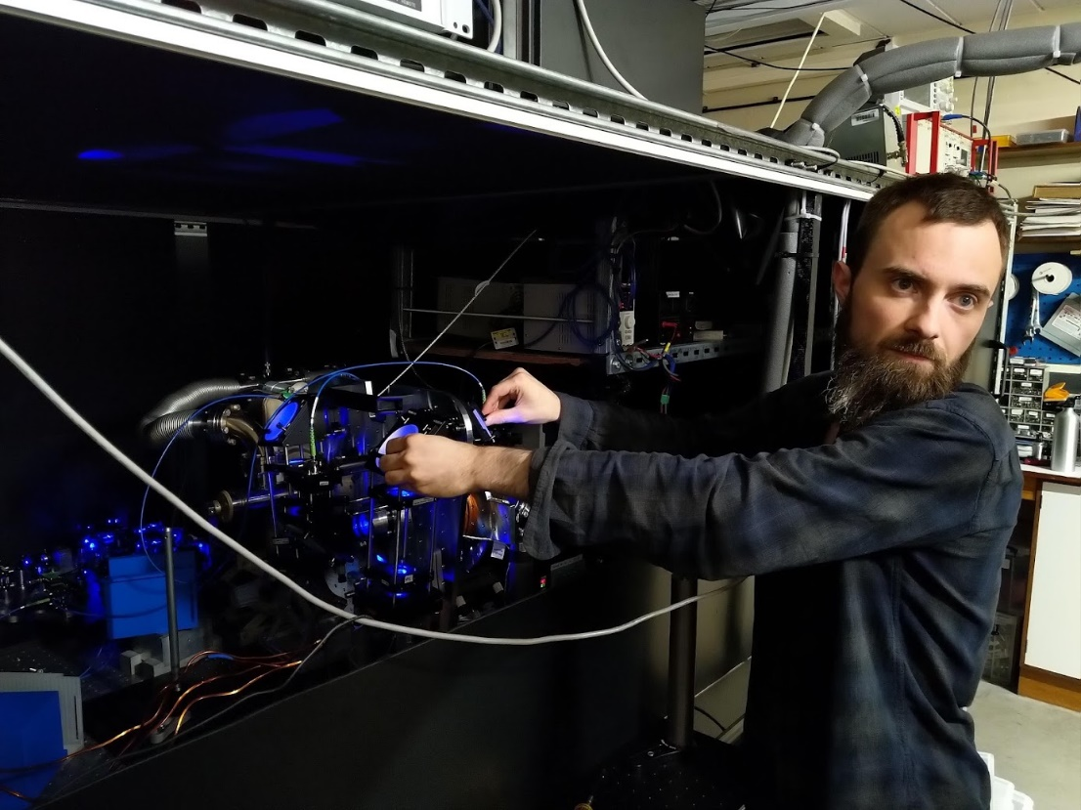
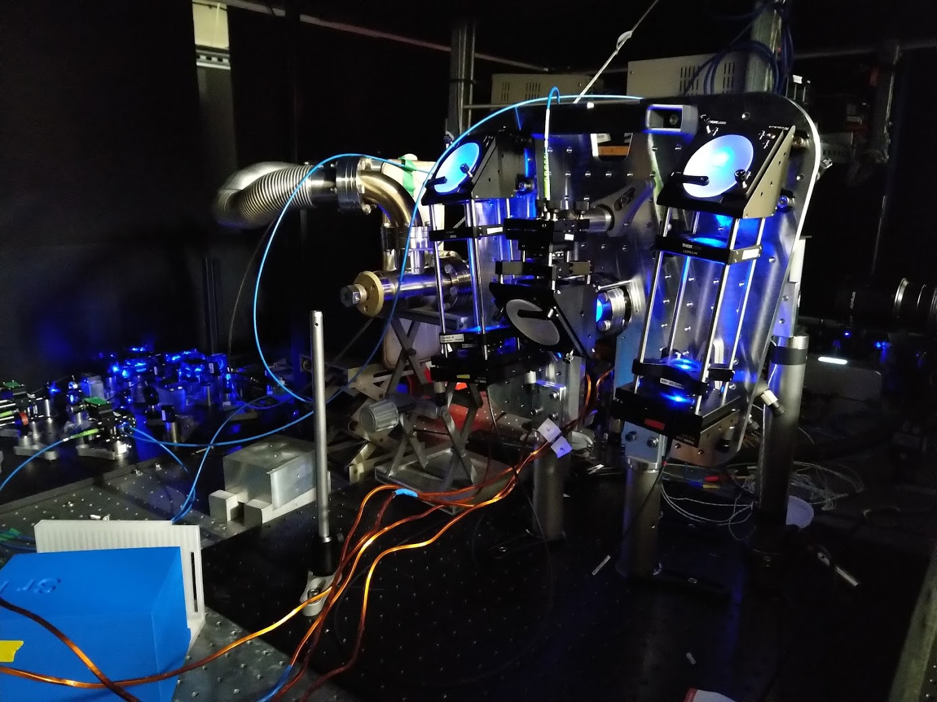
Cold-atom source for strontium:
‘Low cost’ – make it ourselves
Laser system available for AION-10 (need extended warranty)
Estimated cold-atom flux > 10⁹ s⁻¹ (of ⁸⁸Sr)

Slide 12
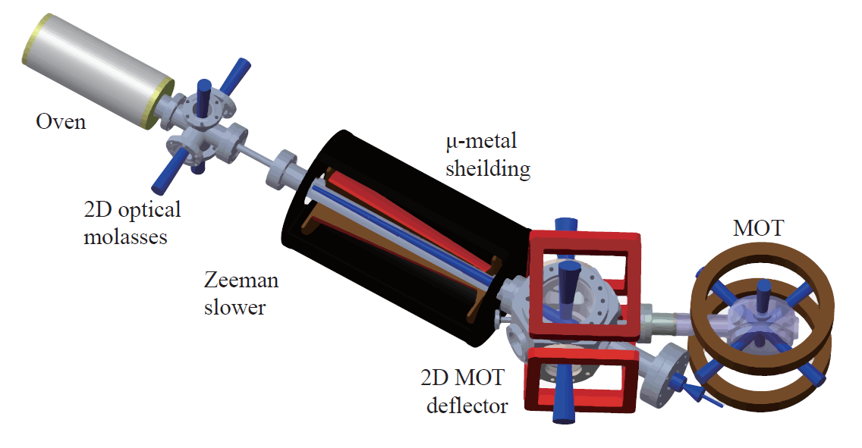
Strontium atom source (Singapore)
  Multiple stages: atomic oven, transverse collimator, Zeeman slower, and a deflector (to avoid line of sight to the oven) before collection in a 3D MOT. Length = 1.2m
  Maximum loading rate measured in the MOT: 6×10⁹ atoms/s
A high flux source of cold strontium atoms. Yang, T. … & Wilkowski, D. (2015). European Phys. J. D, 69, 1
Also @NPL
Zeeman slowers for strontium based on permanent magnets. Hill, I., Ovchinnikov, Y.B., Bridge, E.M., Curtis, E.A. and Gill, P., (2014). J. Phys. B: 47, 075006.
Notes:
Using the 2D MOT, we selectively deect the longitudinally decelerated atomic beam into the science chamber. We show that the 2D MOT eciency is limited by the decay into the 1D2 long-lived state. The maximum loading rate measured in the MOT is 6 109 s-1.
The oven is made of a stainless-steel cylinder heated at a maximal temperature of 550 C. This temperature is stabilized to ensure a constant ux of the outgoing eusive atomic beam.
The beam is generated in a multichannel nozzle made of nine hundred Monel400 micro tubes clamped in a 1 1 cm square area. The length of each tube is 1 cm with inner and outer diameters of 200 um and 300 um respectively. We keep the nozzle at a temperature of roughly 50 C above the oven temperature to avoid clogging the tubes.

Slide 13
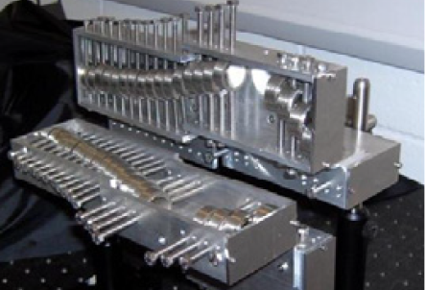
Zeeman slower @ NPL
  Fast atoms cooled by radiative force.
  Scattering rate is velocity-dependent; resonance depends on Doppler shift.
  Zeeman shift induced by a magnetic field (generated by coils or permanent magnets) keeps atoms in resonance with counter-propagating laser.
  High capture velocity (150m/s commonly)
Zeeman slowers for strontium based on permanent magnets.
Hill, I.R., Ovchinnikov, Y.B., Bridge, E.M., Curtis, E.A. and Gill, P., 2014. Journal of Physics B: Atomic, Molecular and Optical Physics, 47(7), p.075006.
Notes:
A Zeeman slower (ZS) can have a high capture velocity (comparable with the most probable velocity), but significantly increase the length of the apparatus. A 2D+ MOT offers a more compact alternative.

Slide 14
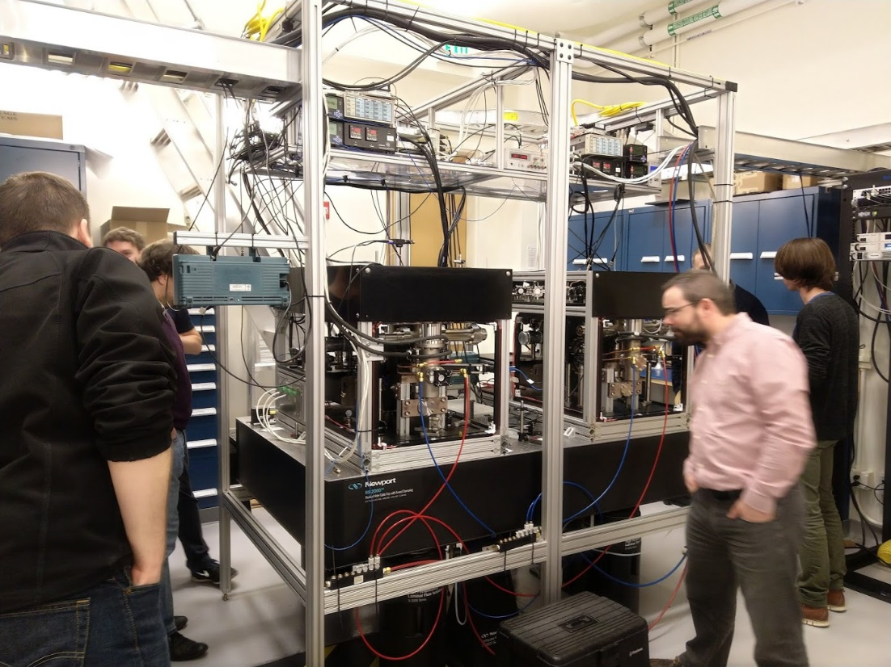
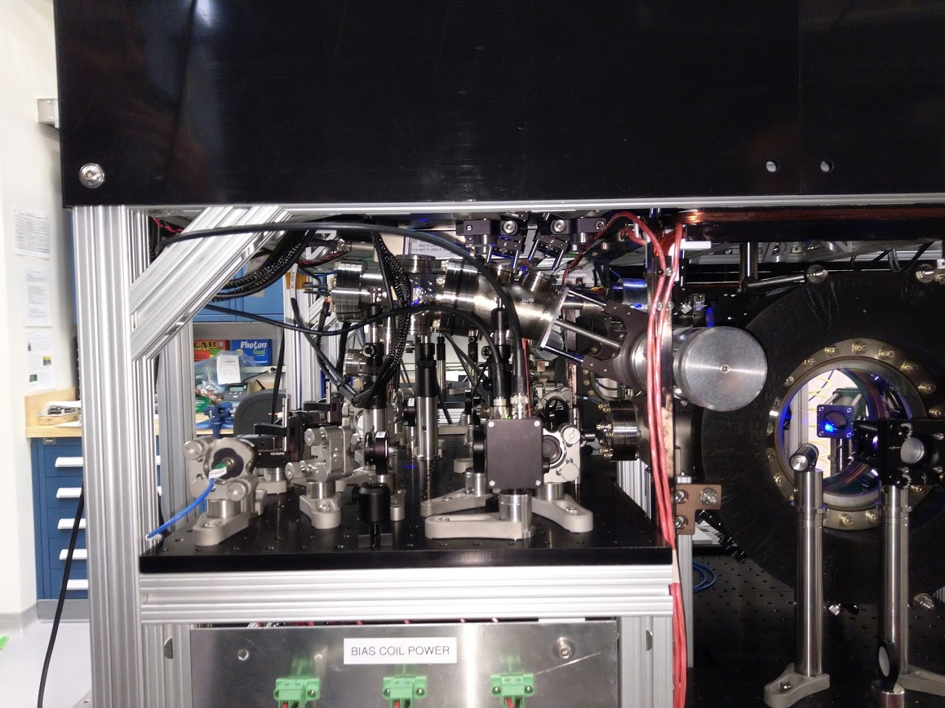
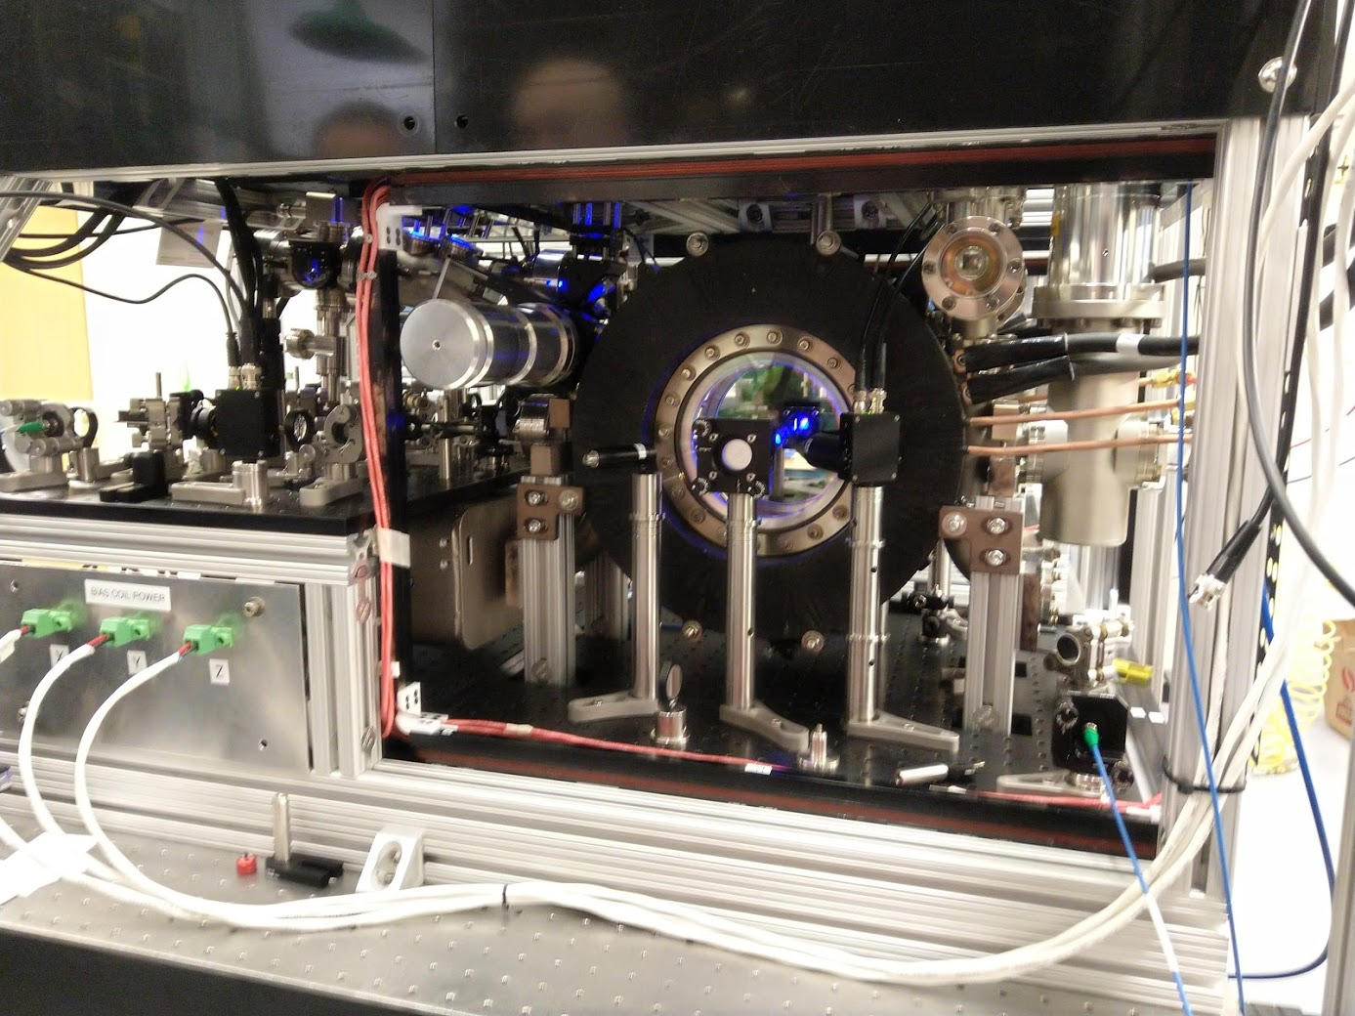
Photos from Stanford lab visit, Jan 2019
Sr source from AOSense Inc.
Sr atoms in blue MOT
(large windows)

Slide 15
Photos from Stanford lab visit, Jan 2019
Sr source from AOSense Inc.
Sr atoms in blue MOT
(large windows)

Slide 16
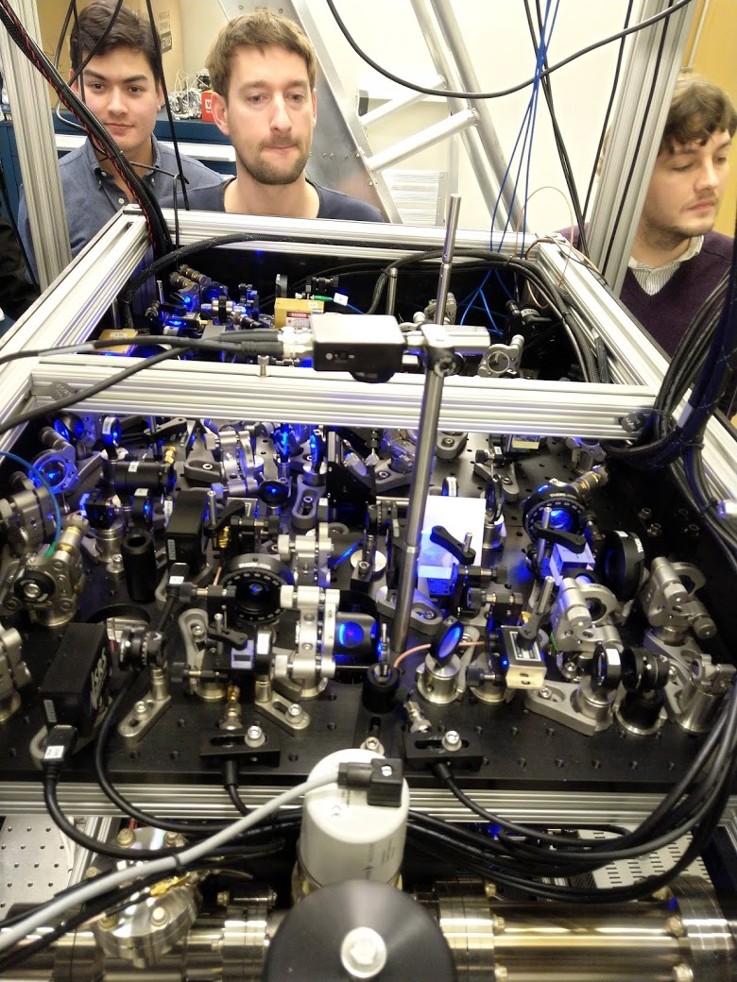
Optics at Stanford
Sr source from AOSense Inc.

Slide 17
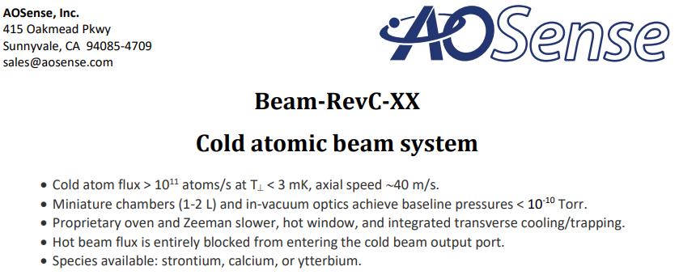
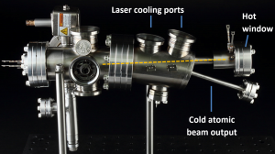
AOSense Inc. (copied from https://aosense.com/)
Cost > $100 000?
Availability?
Quotation requested
25 cm (approx.)
https://aosense.com/wp-content/uploads/2018/02/Datasheet_Cold_atomic-beam_system_20180124.pdf

Slide 18
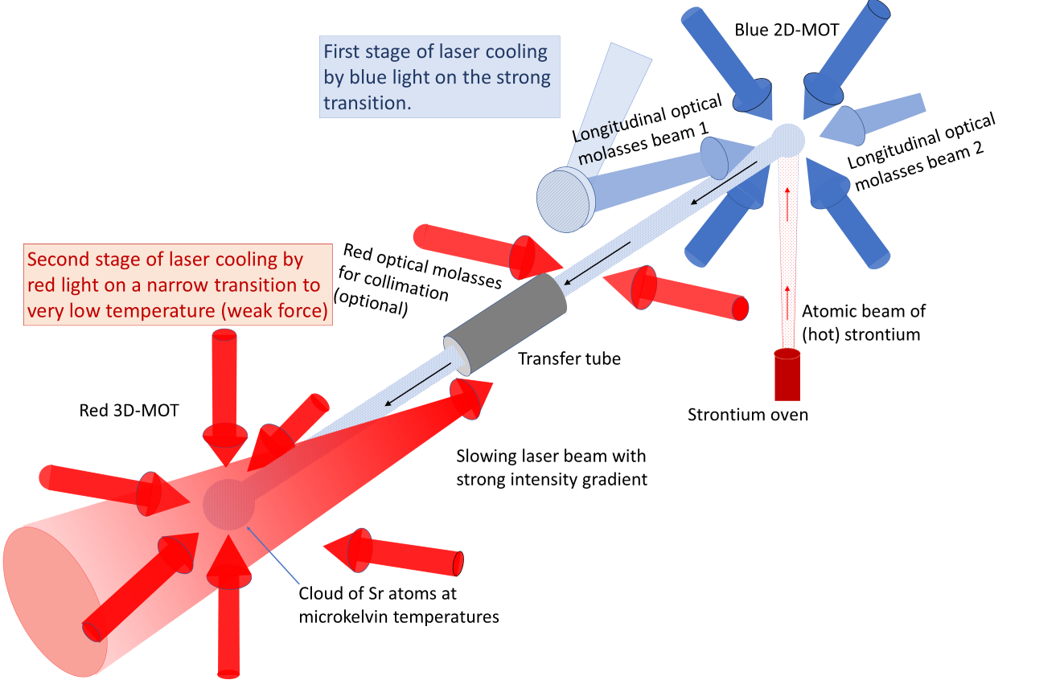
Florian Schreck et al (Amsterdam): direct transfer from blue to red MOT

Slide 19
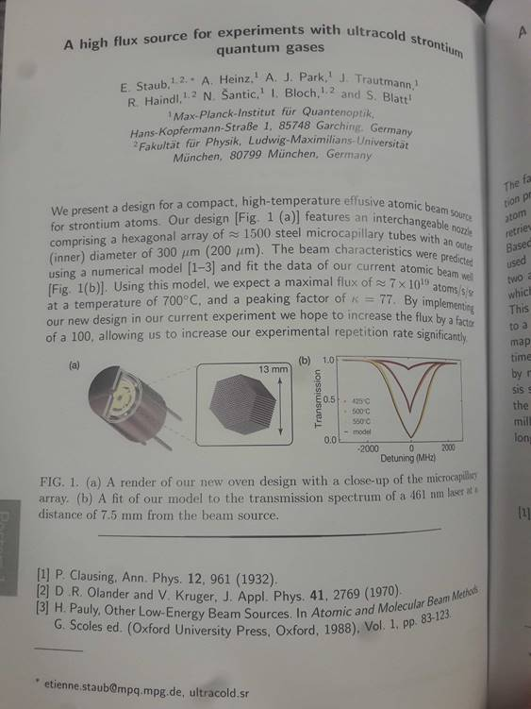
Another strontium oven (Munich)
From a book of abstracts:
1500 microchannels

Slide 20

Strontium atoms source (2D+ MOT)
  A 2D MOT offers a more compact alternative for ZS.
  Low capture velocity (30m/s vs. 150m/s for ZS) ⇒ efficient oven design.
Notes:
A Zeeman slower (ZS) can have a high capture velocity (comparable with the most probable velocity), but significantly increase the length of the apparatus. A 2D+ MOT offers a more compact alternative.
Our proposed design is a compact source of cold strontium atoms using a two-dimensional magneto-optical trap (MOT) with a ‘push’ laser beam (a so-called 2D+ MOT).
A direct comparison between a Zeeman slower and a 2D MOT for sodium was carried out by a group in Brazil[1] by measuring the loading rate and the final number in the final 3D MOT with each case. This work showed that a 2D MOT can provide a flux of atoms comparable with that from a ZS.

Slide 21
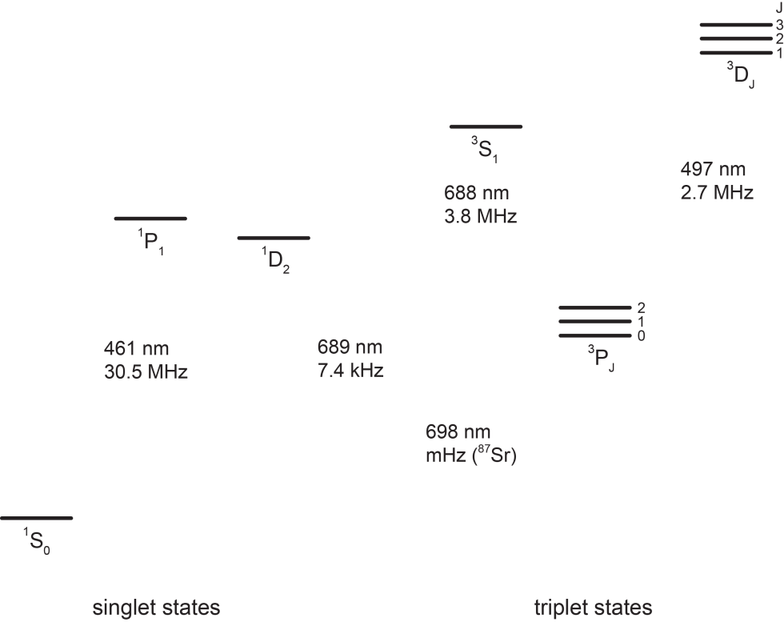
Strontium atomic energy levels – strong and weak transitions
narrow cooling
transition
triplet states
singlet states
Repumping transitions
@ 679 and
707 nm
broad cooling
transition
metastable states
Blue transition @ 461 nm
v_{recoil} = 1.0 cm s⁻¹
T_{Doppler} = 770 μK
Red transition @ 689 nm
v_{recoil} = 0.7 cm s⁻¹
T_{Doppler} ≈ T_{recoil} = 0.2 μK
698 nm
1 mHz
clock
transition
Laser cooling used to prepare atoms, as well as probing transitions.

Slide 22
AION-10: Lasers & optics
Abbreviations: Ti:Sa – Titanium-doped sapphire laser e.g. M Squared Lasers
diode – semiconductor diode lasers, e.g. AO Sense Inc., Toptica
blue cooling (1st stage) – Ti:Sa or amplified diode laser
red cooling (2nd stage) - diode or Ti:Sa or SFM of fibre lasers
clock (narrow bandwidth) – power critical for one-photon interferometry
two repumping lasers – diodes for low power
dipole trapping lasers – high power at a frequency far off resonance
  transport by optical tweezers from sidearm into vertical tube
  optical lattice for launching without heating
  (Launching squeezed states in future upgrades)
Optics: mirrors, polarisers, AOMs, EOMs, shutters, optical fibres etc. (modular system for ease of transport to different locations)
Laser frequency stabilisation – reference cavity provided by National Physical Laboratory (NPL), or a frequency comb (not included in budget)
To be decided and agreed in the Project Plan:
How much PDRA effort and staff time from AION-Technology/other WPs, will be used to kick start AION-10, e.g. build modules for the laser system?

Slide 23
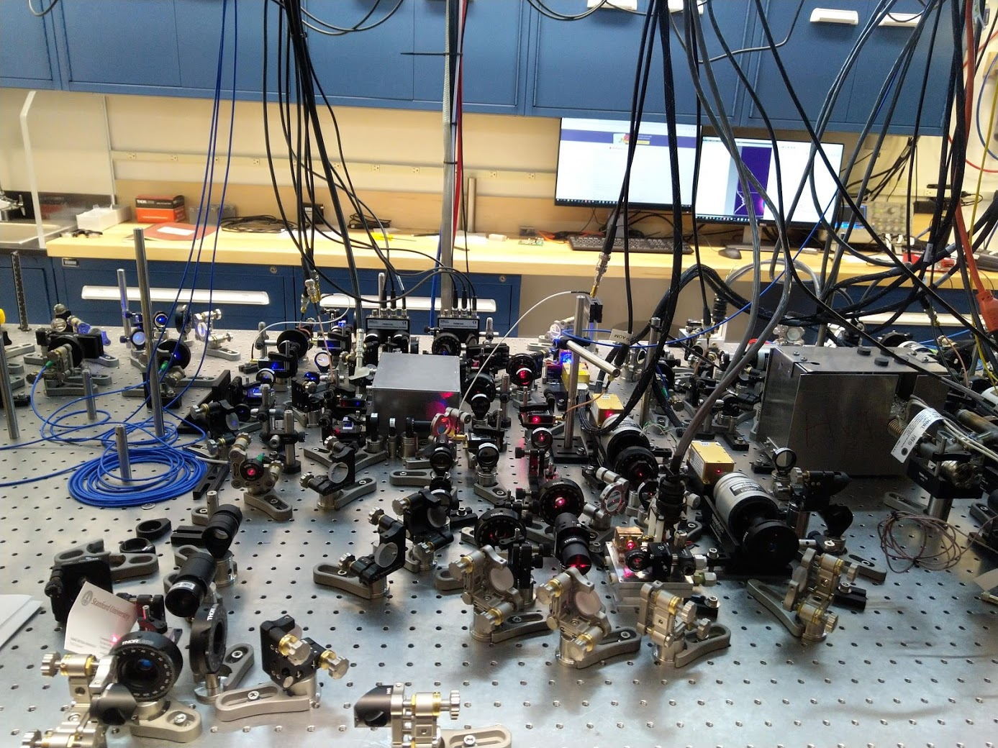
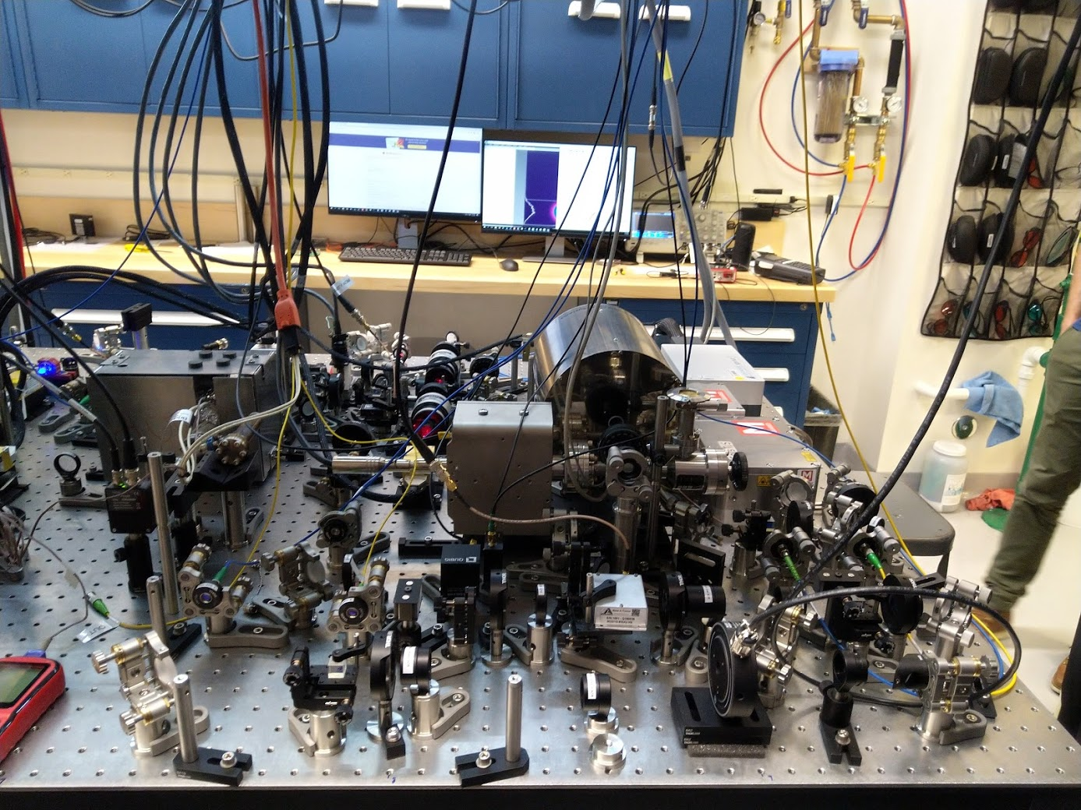
Laser system, Jason Hogan’s lab@Stanford (Jan 2019)

Slide 24
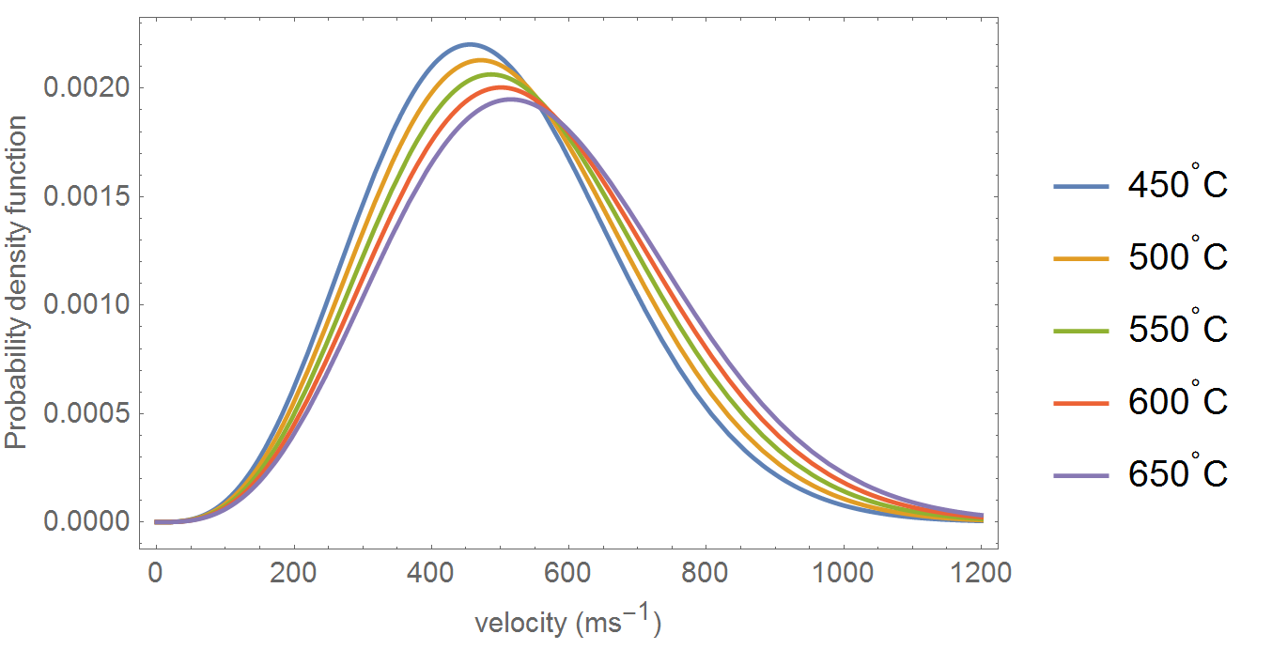
Strontium atom source
  oven at a temperature over 500C to give adequate vapour pressure
Notes:
At 450 C, the mean velocity (RMS) exiting the oven is 526m/s, however, the capture velocity for a 3D MOT is typically 30m/s. Therefore an additional cooling stage is required. A Zeeman slower (ZS) can have a high capture velocity (comparable with the most probable velocity), but significantly increase the length of the apparatus.

Slide 25
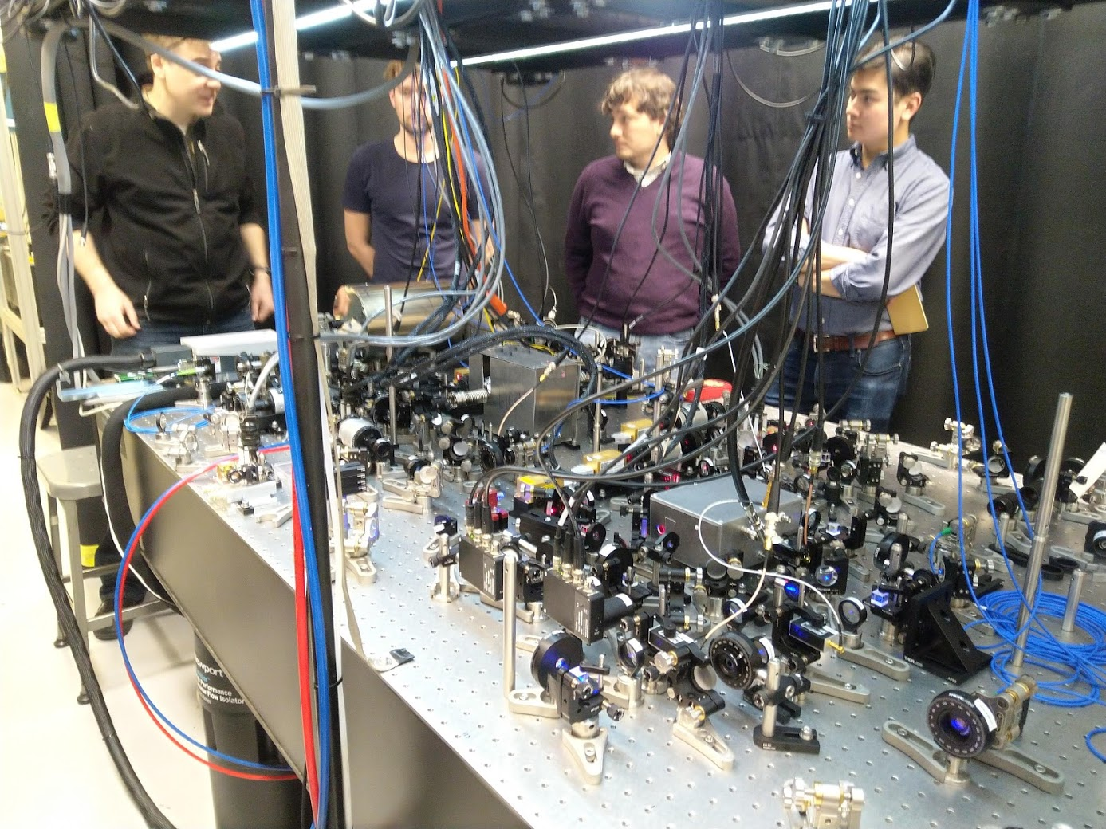
Optics at Stanford

