Slide 1
A UK
Atom Interferometer Observatory and Network
(AION) for the exploration of Ultra-Light Dark Matter and Mid-Frequency Gravitational Waves.
AION Planning Event in Cambridge,
Sep 26, 2019
Oliver Buchmueller, Imperial College London

Slide 2
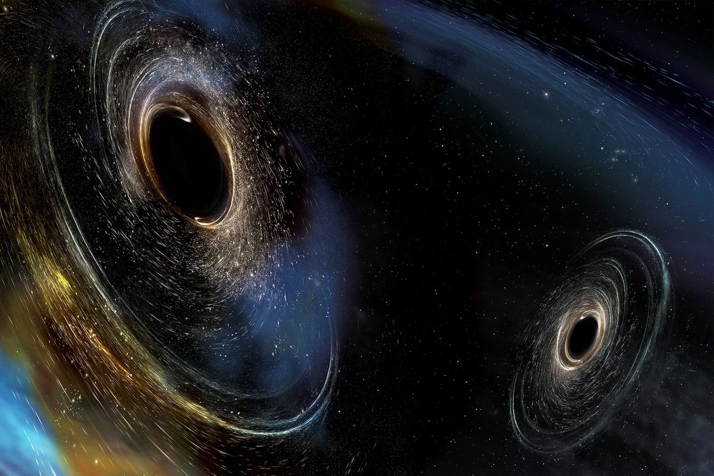
Gravitational Waves
Gravitational waves open a new window to the universe
  sourced by mass, not charge
  universe is transparent to gravity waves
GW provide unique astrophysical information
  compact object binaries
  black holes, strong field GR tests
• Every new band opened has revealed unexpected discoveries

Slide 3

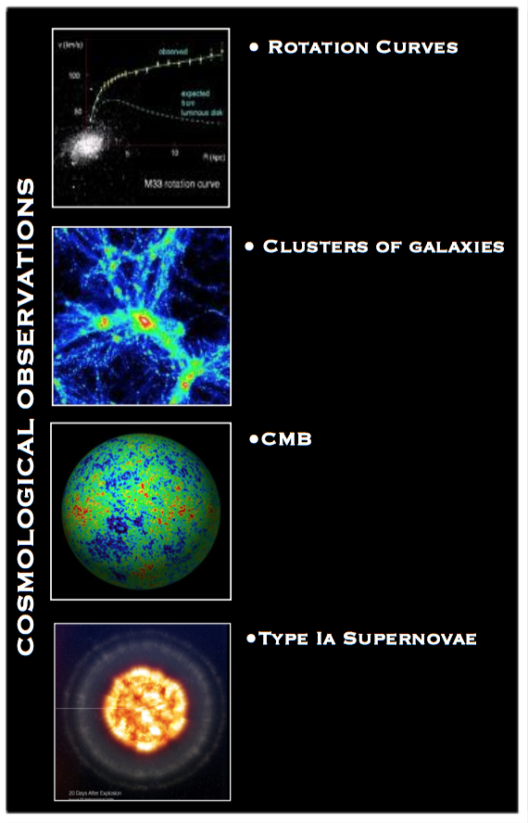
(Very Strong) Evidence for Dark Matter
G. Bertone

Slide 4
(Very Strong) Evidence for Dark Matter
Can we build an experiment
that can tackle both of these
important physics questions
(and more)?
G. Bertone

Slide 5
Outline
What is AION
The Physics Case
In Backup
The Atom Interferometer

Slide 6
What is AION

Slide 7
What is AION (in a nutshell)?
The proposal is to construct and operate a next generation Atomic Interferometric Observatory and Network (AION) in the UK that will enable the exploration of properties of dark matter as well as searches for new fundamental interactions.
It will provide a pathway for detecting gravitational waves from the very early universe in the, as yet mostly unexplored, mid-frequency band, ranging from several milliHertz to a few Hertz.
The proposed project spans several science areas ranging fundamental particle physics over astrophysics to cosmology and, thus, connects these communities.
Following the “Big Ideas” call, the project was selected by PAAP and STFC as a high priority for the community. It was provisionally classified as a medium scale project.
AION is also a Work Package of the QSFP proposal

Slide 8
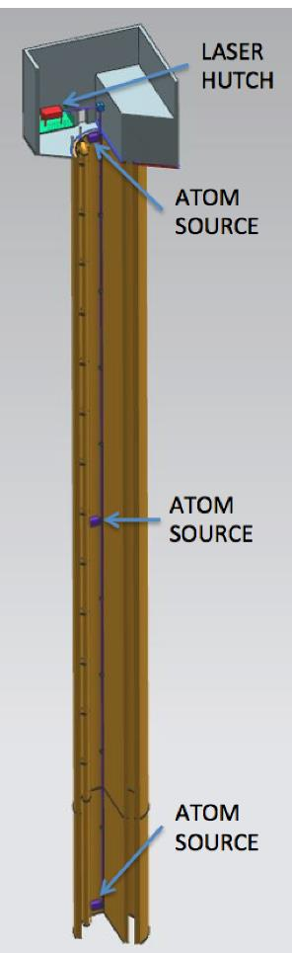
Proposed AION Programme
The AION Project is foreseen as
a 4-stage programme:
The first stage develops existing technology (Laser systems, vacuum, magnetic shielding etc.) and the infrastructure for the 100m detector and produces detailed plan resulting in an accurate assessment of the expected performance in Stage 2.
The second stage builds, commissions and exploits the 100m detector and also prepares design studies for the km-scale.
The third and fourth stage prepare the groundwork for the continuing programme:
  Stage 3: Terrestrial km-scale detector
  Stage 4: space based detector
L ~ 1m to 10m
L
L ~ 100m
L ~ km-scale
L ~ 10⁴ km

Slide 9
AION – A Staged Programme**
AION-10: Stage 1 [year 1 to 3]
1 & 10 m Interferometers & Site Development for 100m Baseline
AION-100: Stage 2 [year 3 to 6]
100m Construction & Commissioning
AION-KM: Stage 3 [ > year 6 ]
Operating AION-100 and planning for 1 km & Beyond
AION-SPACE: Stage 4 [ after AION-KM ]
Space based version
**outlined in Big Ideas proposal

Slide 10
AION – A Staged Programme**
AION-10: Stage 1 [year 1 to 3]
1 & 10 m Interferometers & Site Development for 100m Baseline
AION-100: Stage 2 [year 3 to 6]
100m Construction & Commissioning
AION-KM: Stage 3 [ > year 6 ]
Operating AION-100 and planning for 1 km & Beyond
AION-SPACE: Stage 4 [ after AION-KM ]
Space based version
**outlined in Big Ideas proposal

Slide 11









AION Project: Core Team
Birmingham
Kai Bongs*
M. Holynski*
Y. Singh*
Cambridge
V. Gibson**
U. Schneider*
Imperial College London
O. Buchmueller** [co-coord.]
M. Tarbutt*
B. Sauer*
Kings College London
J. Ellis**
C. McCabe**
Liverpool
T. Bowcock**
J. Coleman** [co-coord.]
National Physical Lab.
W. Bowden***
P. Gill***
R. Hobson***
UK
8 Institutes
22 Core Members
Many Associates
Liverpool
Cambridge
Birmingham
Oxford
E. Bentine*
C. Foot*
J. March-Russell**
I. Shipsey**
Rutherford Appleton Lab.
P. Majewski**
T. Valenzuela**
I. Willmut**
Oxford
RAL
ICL, KCL, NPL
Main UK funding source:
*EPSRC; **STFC, ***NMS

Slide 12
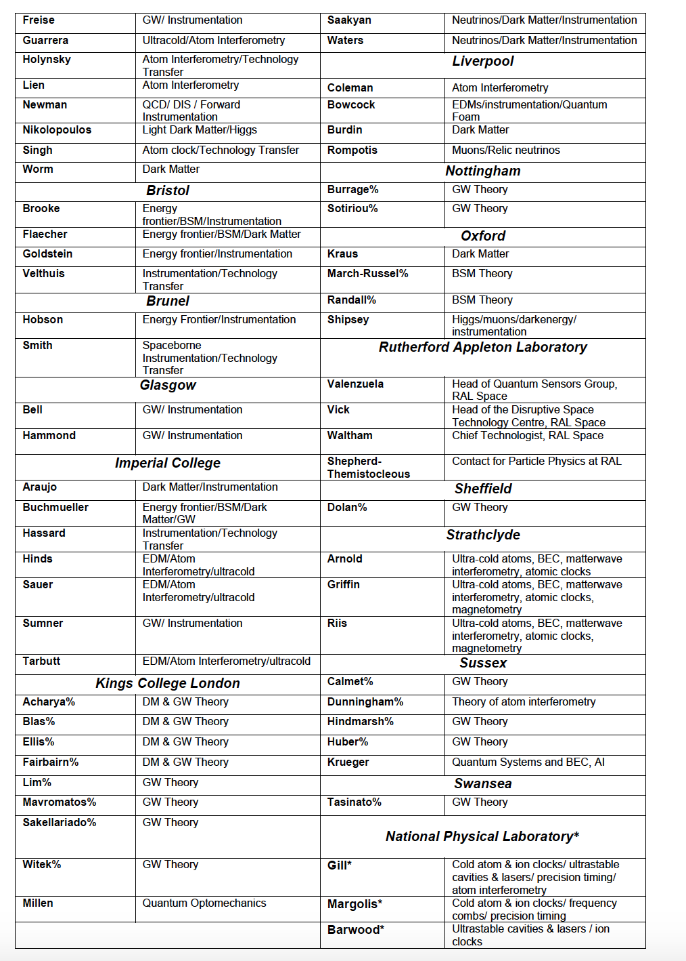
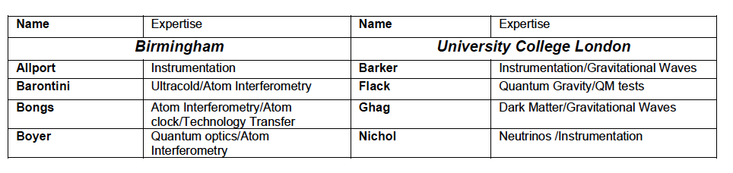
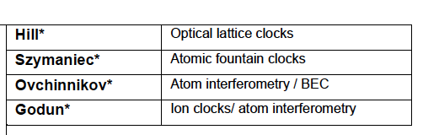
Status “Big Ideas Call”
In preparation of this proposal we have broadly consulted with the relevant UK science communities and have received very positive feedback. The support is across several fields, ranging from fundamental particle physics, over atom interferometry to gravitational wave physics. The support also covers both experimental as well as theory communities in the UK. So far, more than 70 members from 20 UK institutions have provided explicit support for this proposal:
Aberdeen, Birmingham, Bristol, Brunel, Durham, Glasgow, Imperial College, Kings College London, University College London, Liverpool, Nottingham, Open University, Oxford, RAL, Sheffield, Strathclyde, Sussex, Swansea and NPL

Slide 13
Status “Big Ideas Call”
In preparation of this proposal we have broadly consulted with the relevant UK science communities and have received very positive feedback. The support is across several fields, ranging from fundamental particle physics, over atom interferometry to gravitational wave physics. The support also covers both experimental as well as theory communities in the UK. So far, more than 70 members from 20 UK institutions have provided explicit support for this proposal:
Aberdeen, Birmingham, Bristol, Brunel, Durham, Glasgow, Imperial College, Kings College London, University College London, Liverpool, Nottingham, Open University, Oxford, RAL, Sheffield, Strathclyde, Sussex, Swansea and NPL
More recent update: AION Workshop March 2019:
http://www.hep.ph.ic.ac.uk/AION2019/participants.html
again about ~70 participants from
several different areas!
There is clearly a large interest in the
UK community in AION Project!

Slide 14
In preparation of this proposal we have broadly consulted with the relevant UK science communities and have received very positive feedback. The support is across several fields, ranging from fundamental particle physics, over atom interferometry to gravitational wave physics. The support also covers both experimental as well as theory communities in the UK. So far, more than 70 members from 20 UK institutions have provided explicit support for this proposal:
Aberdeen, Birmingham, Bristol, Brunel, Durham, Glasgow, Imperial College, Kings College London, University College London, Liverpool, Nottingham, Open University, Oxford, RAL, Sheffield, Strathclyde, Sussex, Swansea and NPL
If you are interested to follow the AION activity
you can subscribe to the AION Email list:
aion-project@imperial.ac.uk
via:
https://mailman.ic.ac.uk/mailman/listinfo/aion-project

Slide 15
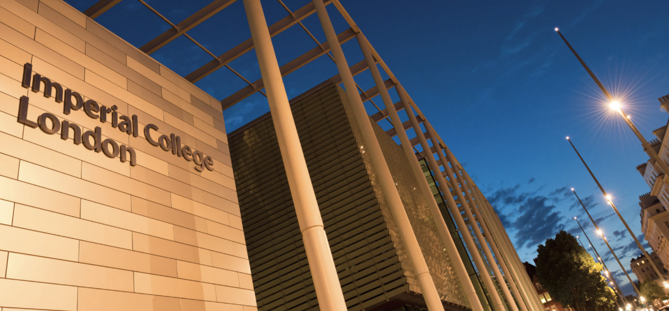
First AION Workshop at Imperial College London
March 25/26 2019
Organised by:
T. Bowcock,
O. Buchmueller [Coord.],
J. Coleman,
J. Ellis [Theory],
I. Shipsey
2-Day Workshop:
Day 1: Instrumentation
Day 2: Physics case
If you like to participate or
require further information
please contact:
fundamental-physics-admin@imperial.ac.uk
with “AION” in title.

Slide 16
The Physics case

Slide 17
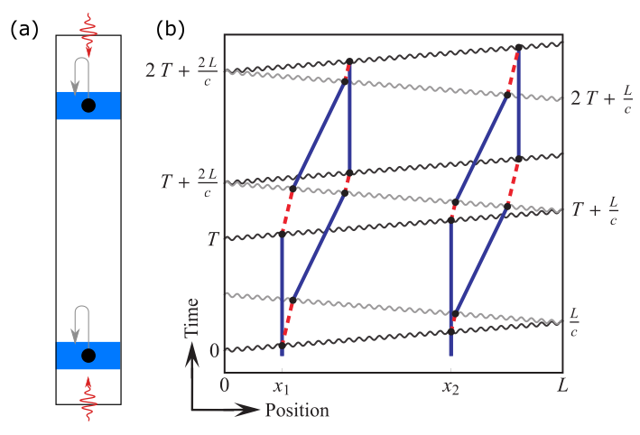
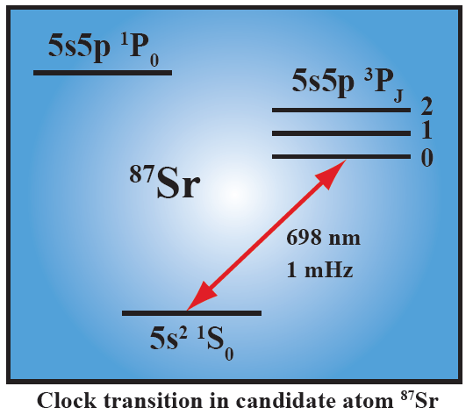
A different kind of atom interferometer
Hybrid “clock accelerometer”
Graham et al., PRL 110, 171102 (2013).
Clock: measure light travel time ➜ remove laser noise with single baseline
Accelerometer: atoms excellent inertial test masses

Slide 18
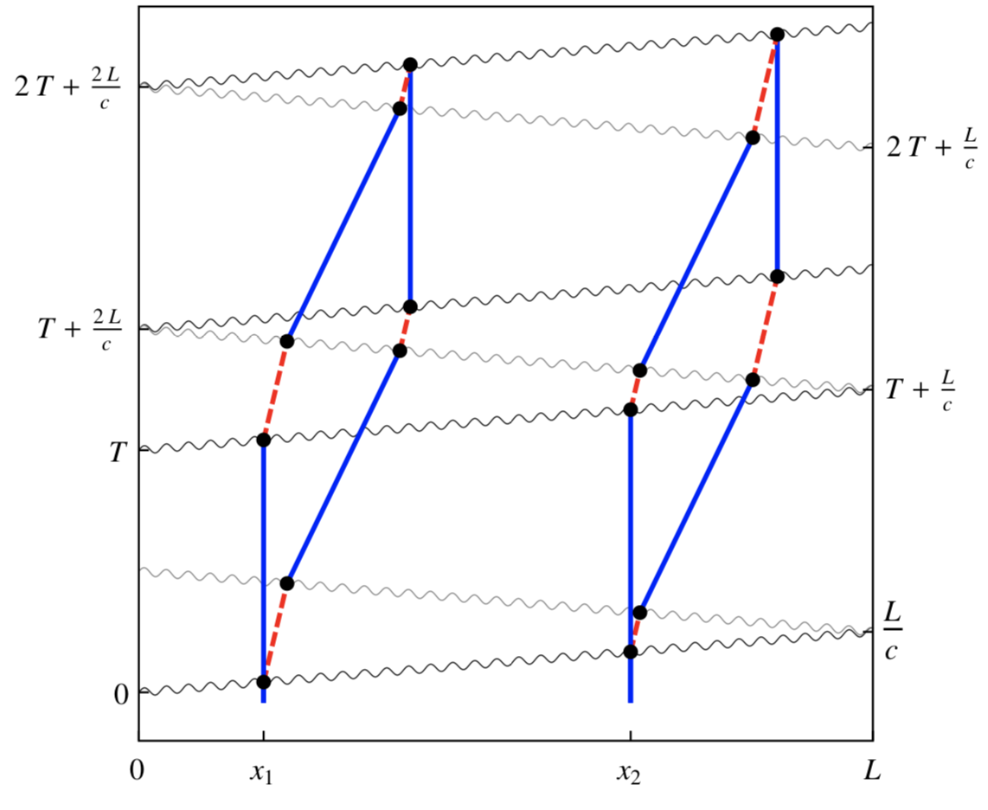
Basic Differential Measurement
Laser 1
Laser 2
Atom
Source
Atom
Source

Slide 19
Basic Differential Measurement
Laser 2: π pulse [high p]
Laser 1: π/2 pulse [split]
Laser 1
Laser 2
Atom
Source
Atom
Source

Slide 20
Basic Differential Measurement
“Mirror”
3π pulse
[low-high/low-high]
[Doppler shift to select]
Laser 2: π pulse [high p]
Laser 1: π/2 pulse [split]
Laser 1
Laser 2
Atom
Source
Atom
Source

Slide 21
Basic Differential Measurement
Laser 1: π/2 pulse [split]
Laser 2: π pulse [low p]
“Mirror”
3π pulse
[low-high/low-high]
[Doppler shift to select]
Laser 2: π pulse [high p]
Laser 1: π/2 pulse [split]
Laser 1
Laser 2
Atom
Source
Atom
Source

Slide 22
Basic Differential Measurement
Laser 1: π/2 pulse [split]
Laser 2: π pulse [low p]
“Mirror”
3π pulse
[low-high/low-high]
[Doppler shift to select]
Laser 2: π pulse [high p]
Laser 1: π/2 pulse [split]
Laser 1
Laser 2
Each AI spends time L/c
in excited state but at different
periods in the sequence
Atom
Source
Atom
Source

Slide 23
GW Physics @ AION
References:
On the Maximal Strength of a First-Order Electroweak Phase Transition and its Gravitational Wave Signal, 1809.08242
Cosmic Archaeology with Gravitational Waves from Cosmic Strings, 1711.03104
Probing the pre-BBN universe with gravitational waves from cosmic strings, 1808.08968
Formation and Evolution of Primordial Black Hole Binaries in the Early Universe, 1812.01930
Primordial Black Holes from Thermal Inflation, 1903.09598

Slide 24
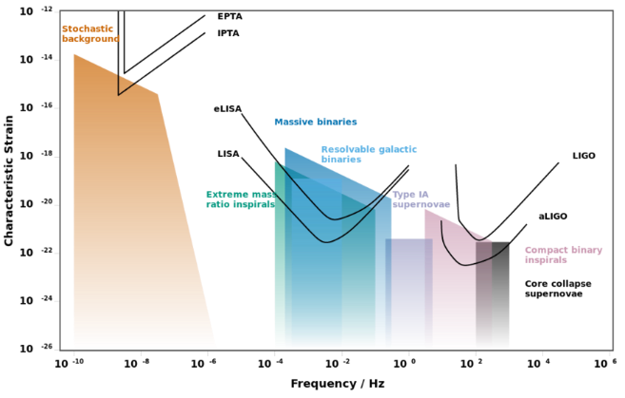
AION: Pathway to the GW Mid-(Frequency) Band
Experimental GW Landscape

Slide 25
AION: Pathway to the GW Mid-(Frequency) Band
Experimental GW Landscape
Mid-Band currently
NOT covered
Mid-band
decihertz to hertz
Mid-band science
Detect sources BEFORE they reach the high frequency band [LIGO, ET]
Optimal for sky localization: predict when and where events will occur (for multi-messenger astronomy)
Search for Ultra-light dark matter in a similar frequency [i.e. mass] range

Slide 26
Gravitational Wave Detection with Atom Interferometry
high-frequency
region
low-frequency
region
mid-frequency
region

Slide 27
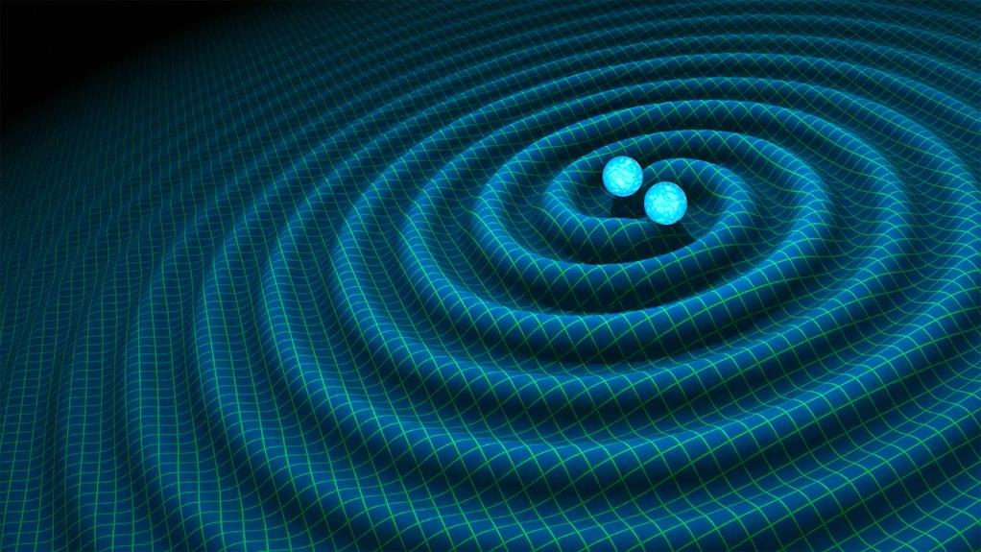
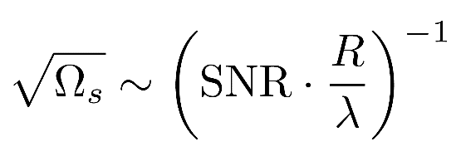
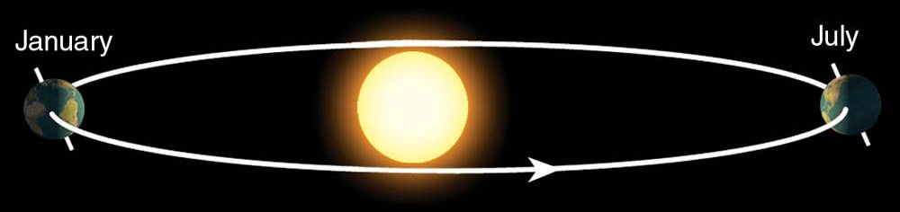
Sky position determination
Sky localization precision:
Images: R. Hurt/Caltech-JPL; 2007 Thomson Higher Education
Mid-band advantages
- Small wavelength λ
- Long source lifetime (~months) maximizes effective R
λ
R
Courtesy of Jason Hogan!
Ultimate sensitivity for terrestrial based detectors is achieved by operating 2 (or more)
Detectors in synchronisation mode

Slide 28
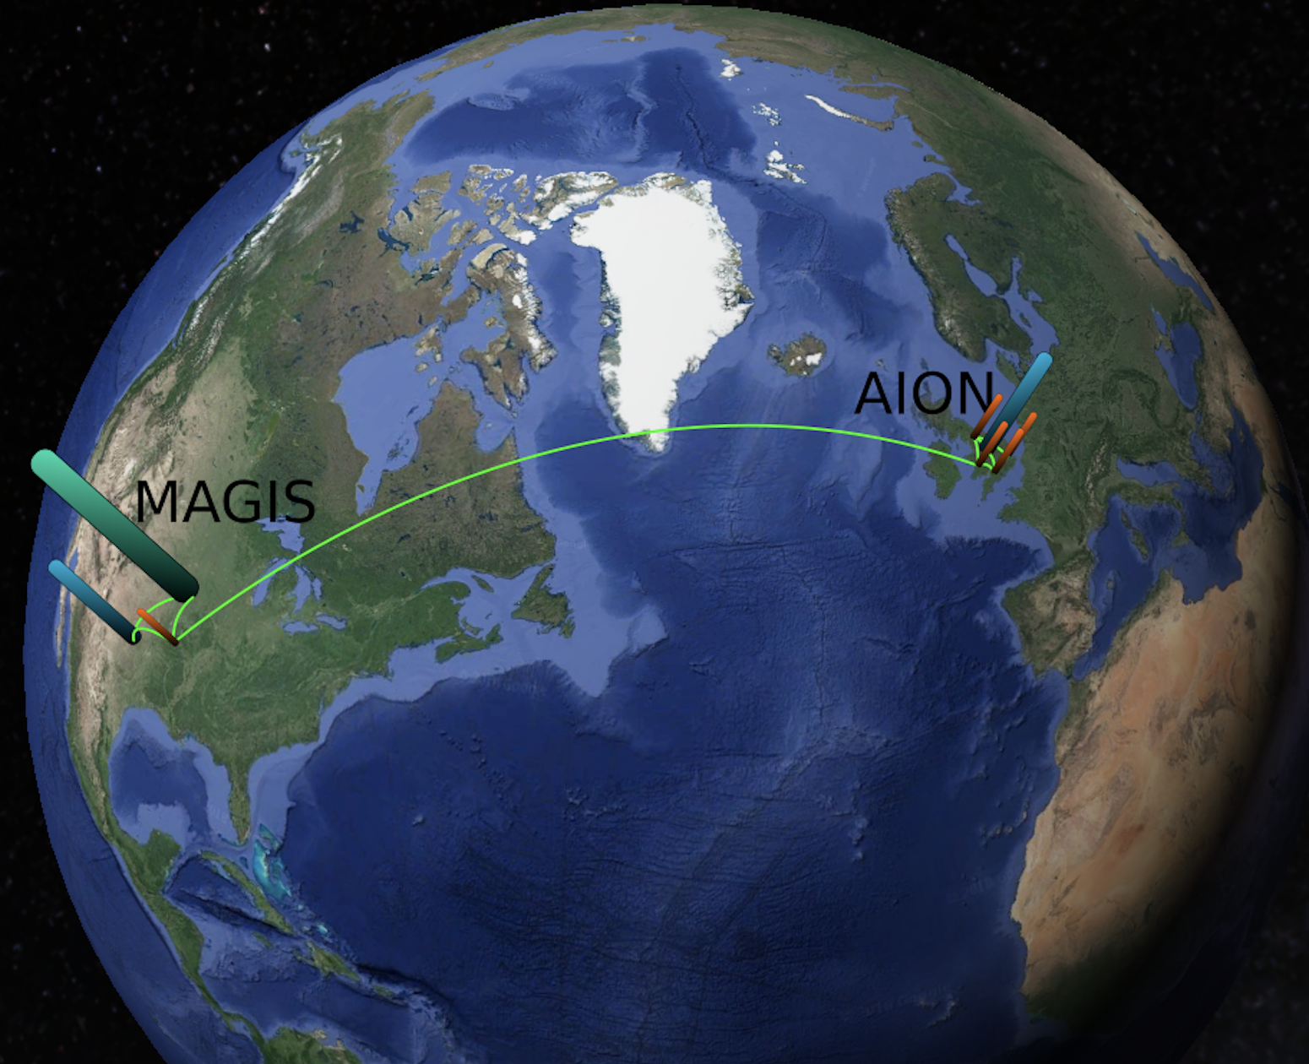
Ultimate Goal: Establish International Network
Illustrative Example:
Network could be further extended
or arranged differently

Slide 29
GW Detection & Fundamental Physics - Example
First-Order Electroweak Phase Transition and its Gravitational Wave Signal
arXiv:1809.08242
John Ellis, Marek Lewicki,
José Miguel No
What is is the GW signal
of electroweak phase
transition in various
theories beyond
the Standard Model.
Plots provided by Marek Lewicki
Translate strain into dimensionless energy density Ω_{GW}h² in GWs against frequency

Slide 30
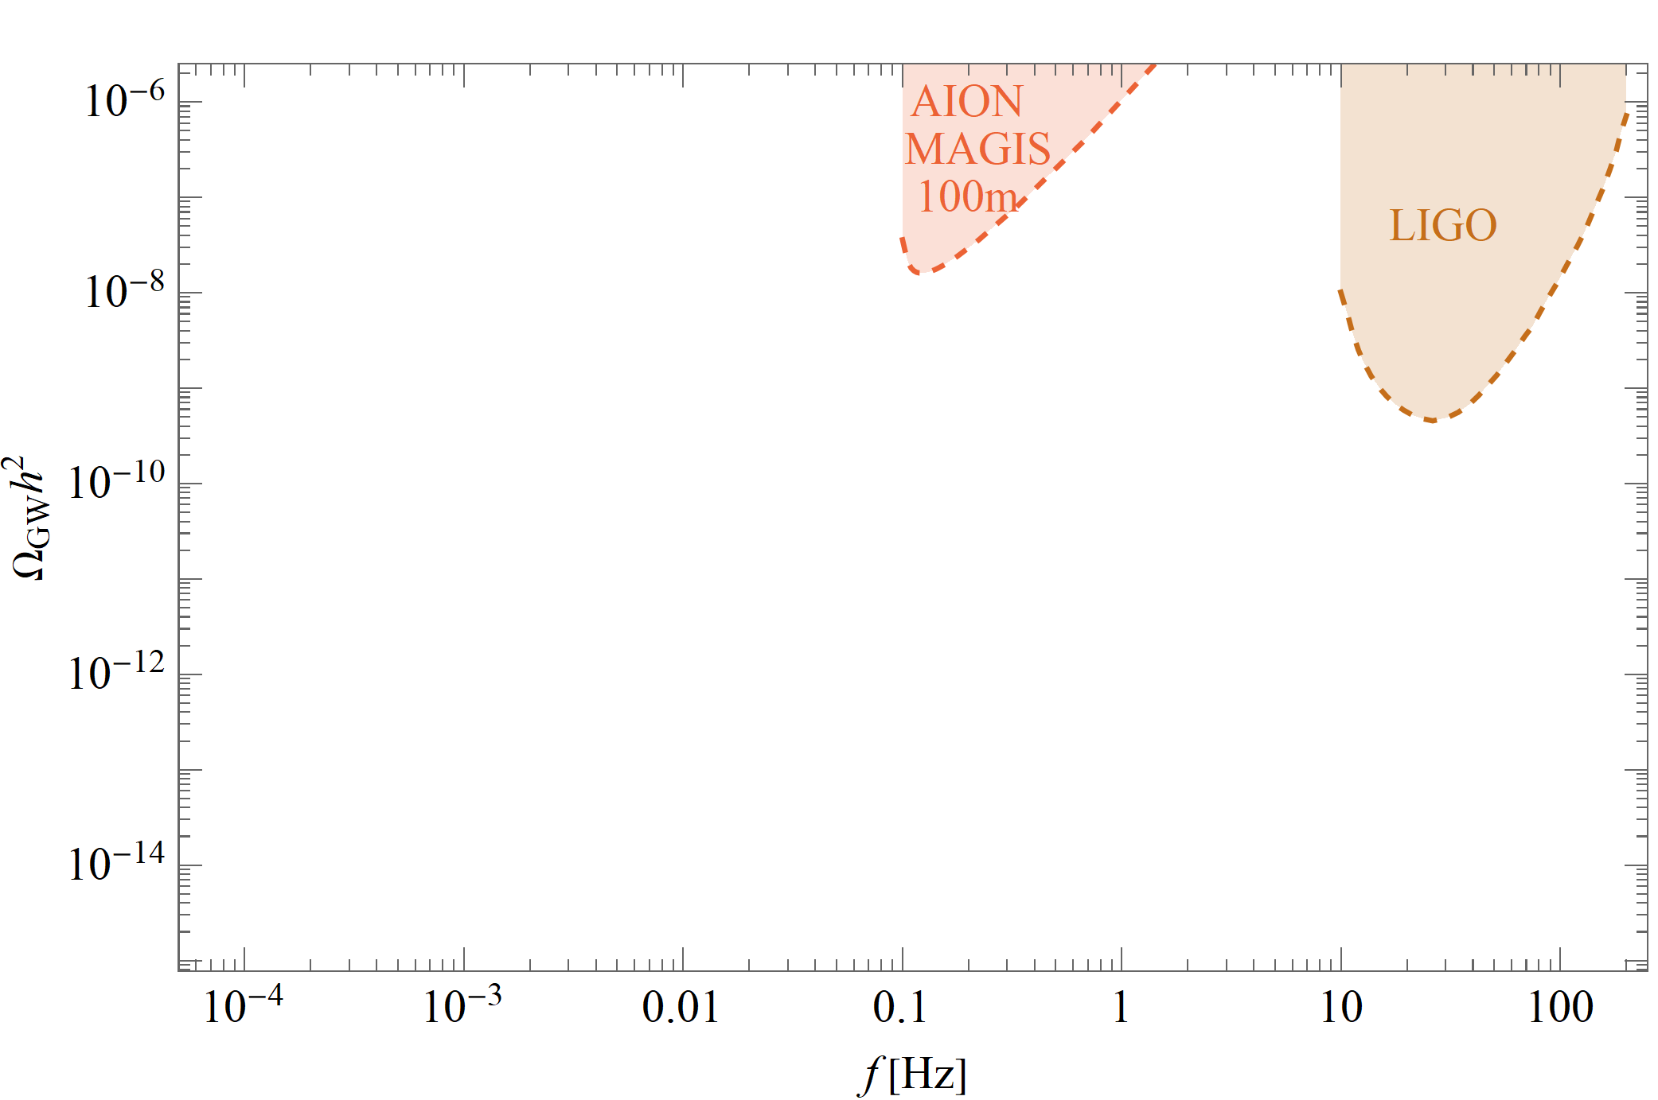
The GW Experimental Landscape: 2030ish

Slide 31
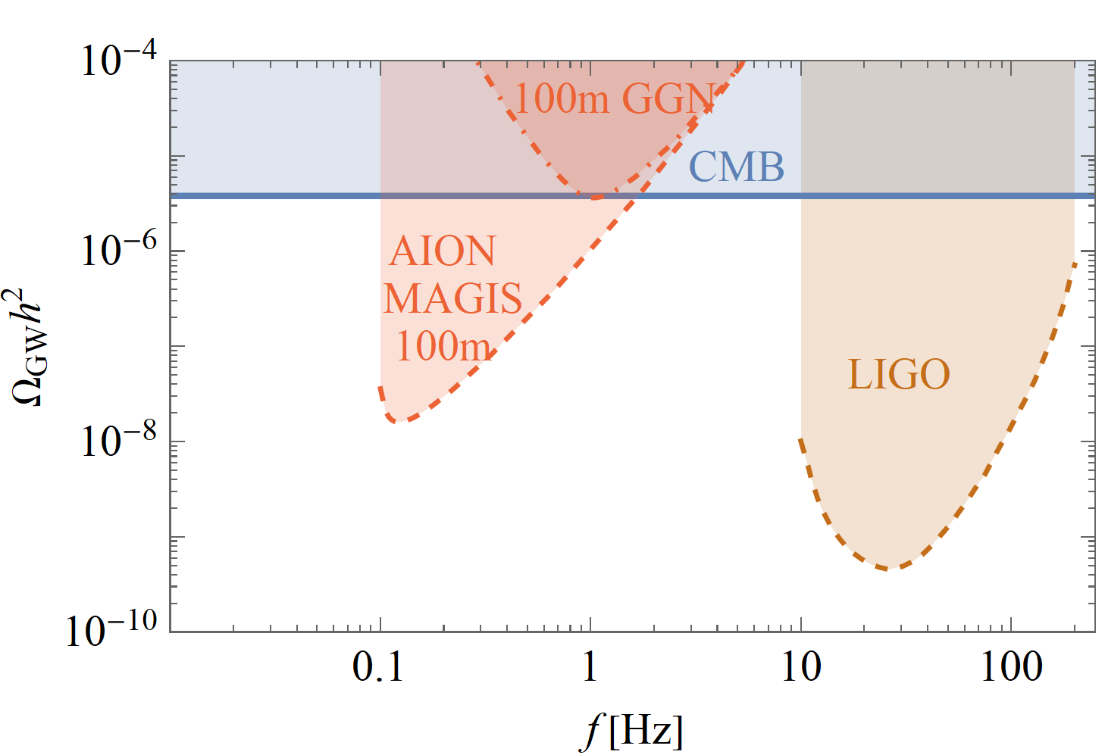
The GW Experimental Landscape: 2030ish

Slide 32
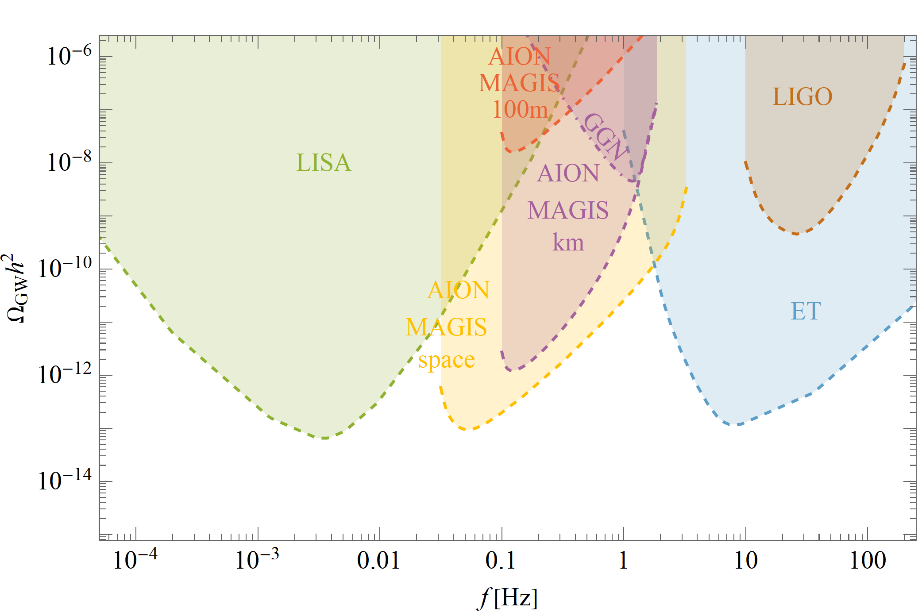
The GW Experimental Landscape: 2030ish
Sensitivity Scenario | L [m] | T_{int} [s] | Φ [1/√Hz] | LMP [#]
AION-100-today | 100 | 1.4 | 10⁻³ | 100
AION-100-ultimate | 100 | 1.4 | 10⁻⁵ | 40000
AION-km | 2000 | 5 | 0.3 x 10⁻⁵ | 40000
AION-space | 4.4x10⁷ | 300 | 10⁻⁵ | <1000
List of basic parameters: Lengths of the detector L, interrogation time of the atom interferometer T_{int} , phase noise φ, and number of momentum transfers LMP. The choice of these parameters predominately defines the sensitivity of the projection scenarios.

Slide 33
GW Physics: A Few Examples
Astrophysical Sources
  The Black Holes (BH) whose mergers were discovered by LIGO and Virgo have masses up to several tens of solar masses. Many galaxies are known to contain super-massive black holes (SMBHs) with masses in the range between 10⁶ and billions of solar masses.
  It is expected that intermediate-mass black holes (IMBHs) with masses in the range 100 to 10⁵ solar masses must also exist [6]. There is some observational evidence for IMBHs, and they are thought to have played key roles in the assembly of SMBHs.
Cosmological Sources
  Many extensions of the Standard Model (SM) predict first-order phase transitions in the early Universe. Examples include extended electroweak sectors, effective field theories with higher-dimensional operators and hidden sector interactions.
    Extended electroweak model with a massive Z' boson
    Cosmic String Model

Slide 34
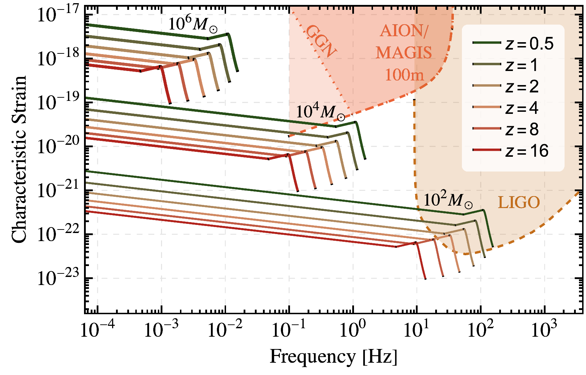
Strain Sensitivity & BH Mergers: 2030ish
The AION frequency range is ideal for observations of mergers involving IMBHs,
to which LISA and the LIGO/Virgo/KAGRA/ET experiments are relatively insensitive.

Slide 35
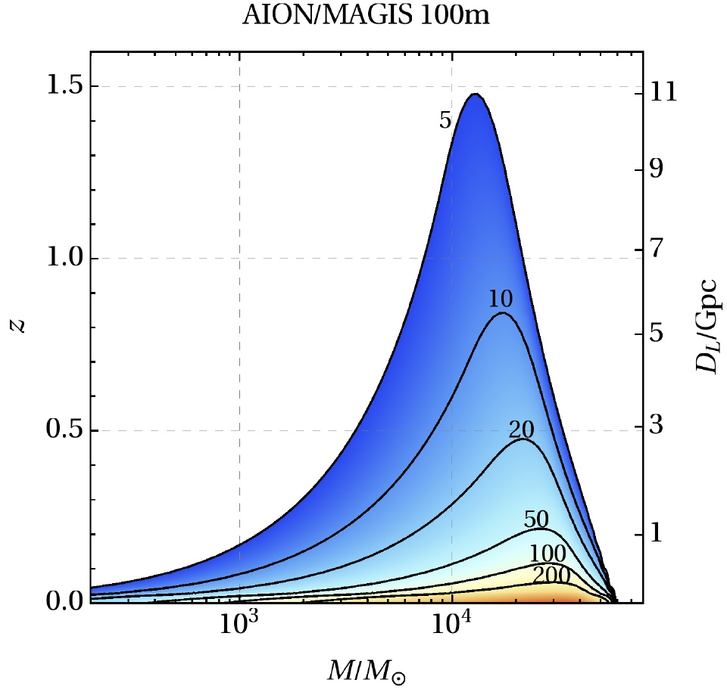
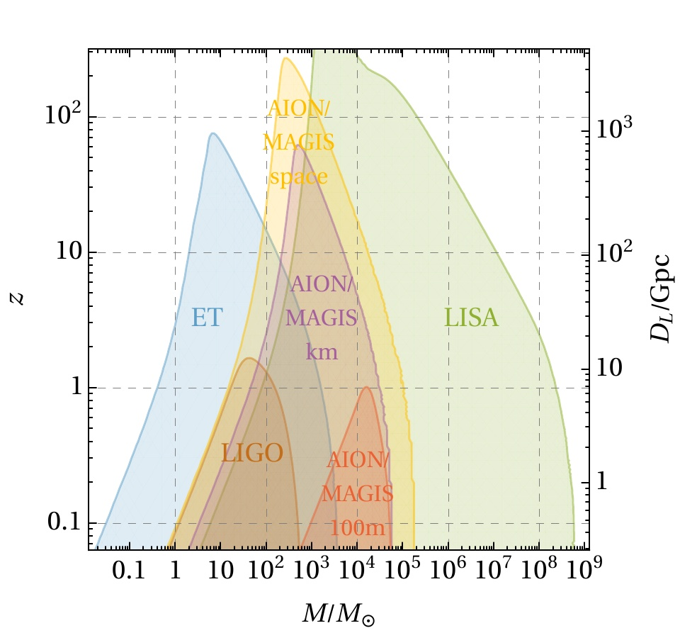
Strain Sensitivity & BH Mergers
Sensitivity of AION-100m for detecting GWs from the mergers of IMBHs at signal-to-noise (SNR) levels ≥ 5, which extends to redshifts of 1.5 for BHs with masses ∼ 10⁴ solar masses.
Comparison of the sensitivities of AION and other experiments with threshold SNR = 8.

Slide 36
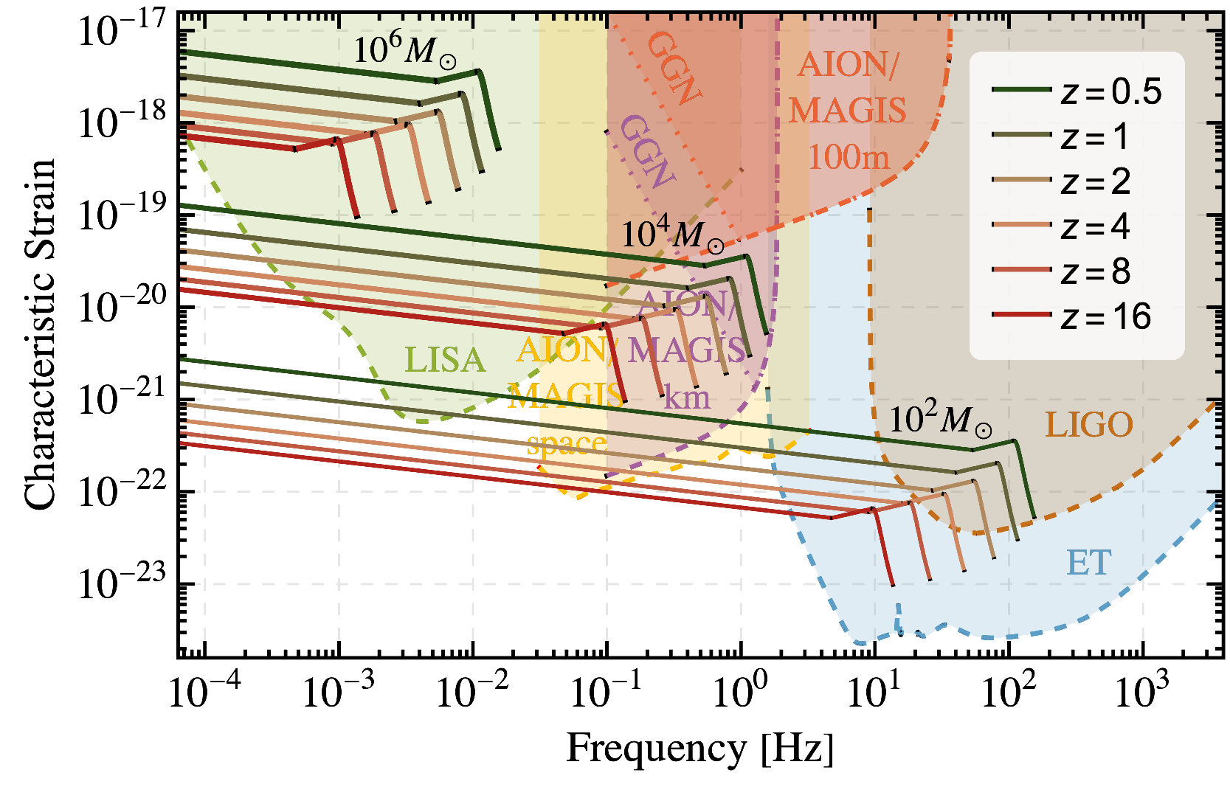
Strain Sensitivity & BH Mergers: Future
The AION frequency range is ideal for observations of mergers involving IMBHs,
to which LISA and the LIGO/Virgo/KAGRA/ET experiments are relatively insensitive.

Slide 37
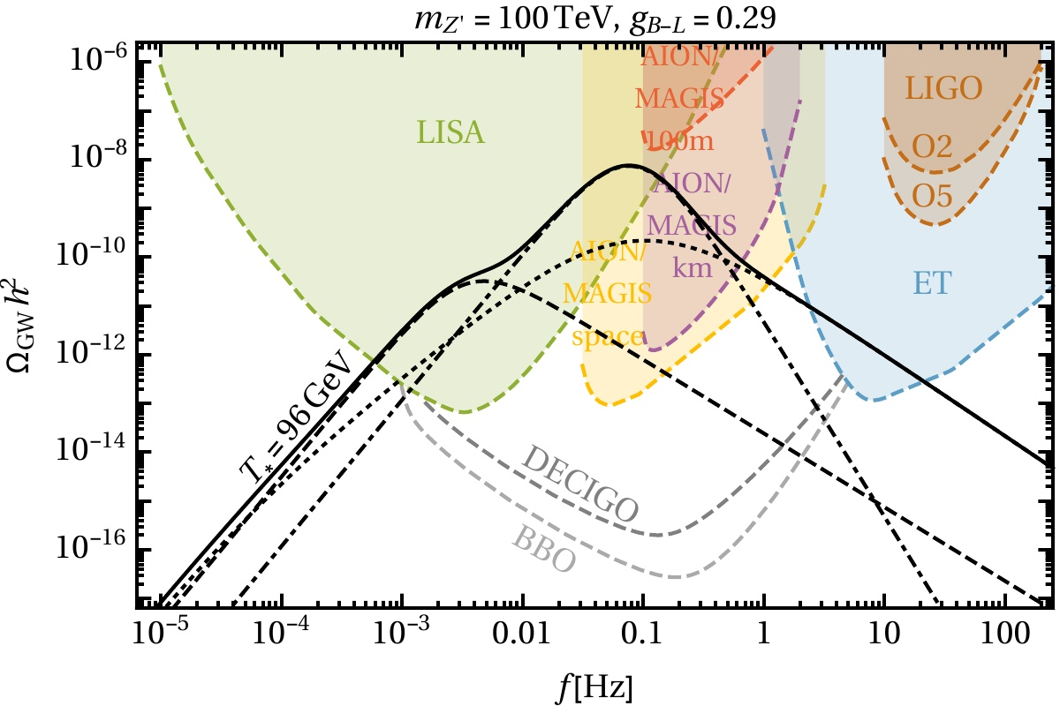
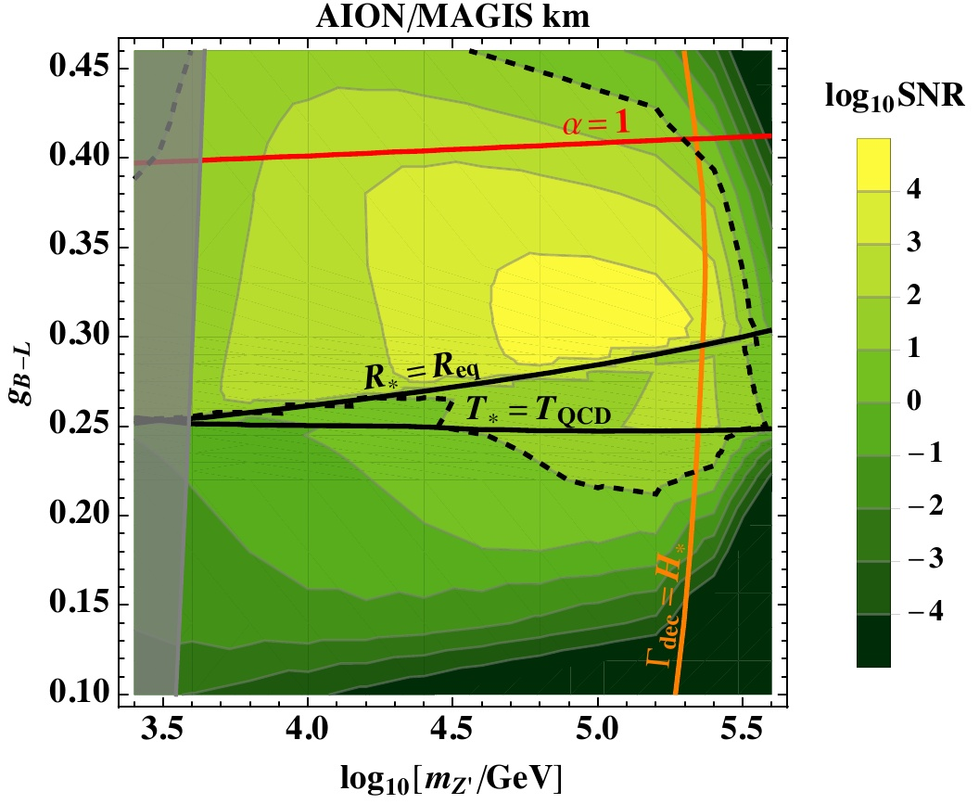
Cosmological GW Sources: Z’ Model
Many extensions of the Standard Model (SM) predict first-order phase transitions in the early Universe.
Example: Extended electroweak model with a massive Z' boson
Example of the GW spectrum in a classical scale-invariant extension of the SM with a massive Z' boson compared with various experimental sensitivities. Right panel: Signal-to-noise ratio (SNR) in the parameter plane of the same model for the AION-1km stage.

Slide 38
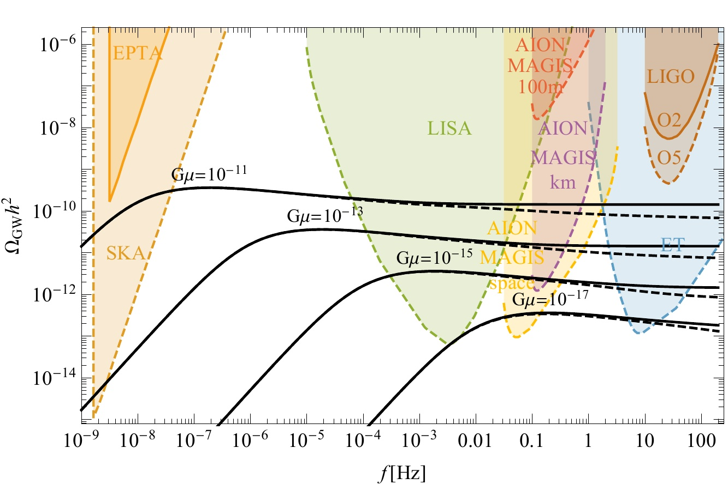
Cosmological GW Sources: Cosmic Strings
Other possible cosmological sources of GW signals are cosmic strings. These typically give a very broad frequency spectrum stretching across the ranges to which the LIGO/ET, AION/MAGIS, LISA and SKA experiments are sensitive.
The impact of including the change in the number of degrees of freedom as predicted in the Standard Model and clearly shows that probing the plateau in a wide range of frequencies can give us a significant amount of information not only on strings themselves but also on the evolution of the universe.
This way we could probe both SM processes such as the QCD phase transition and BSM scenarios predicting new degrees of freedom or even more significant cosmological modifications such as early matter domination, which would all leave distinguishable features in the GW background.

Slide 39
Dark Matter Physics @AION
Based on DM workshop at KCL:
https://indico.cern.ch/event/797031/timetable/
and AION workshop at Imperial:
https://indico.cern.ch/event/802946/
Using Material from. M. Bauer, J. Hogan, J. March-Russel, C. McCabe, and Y. Stadnik

Slide 40
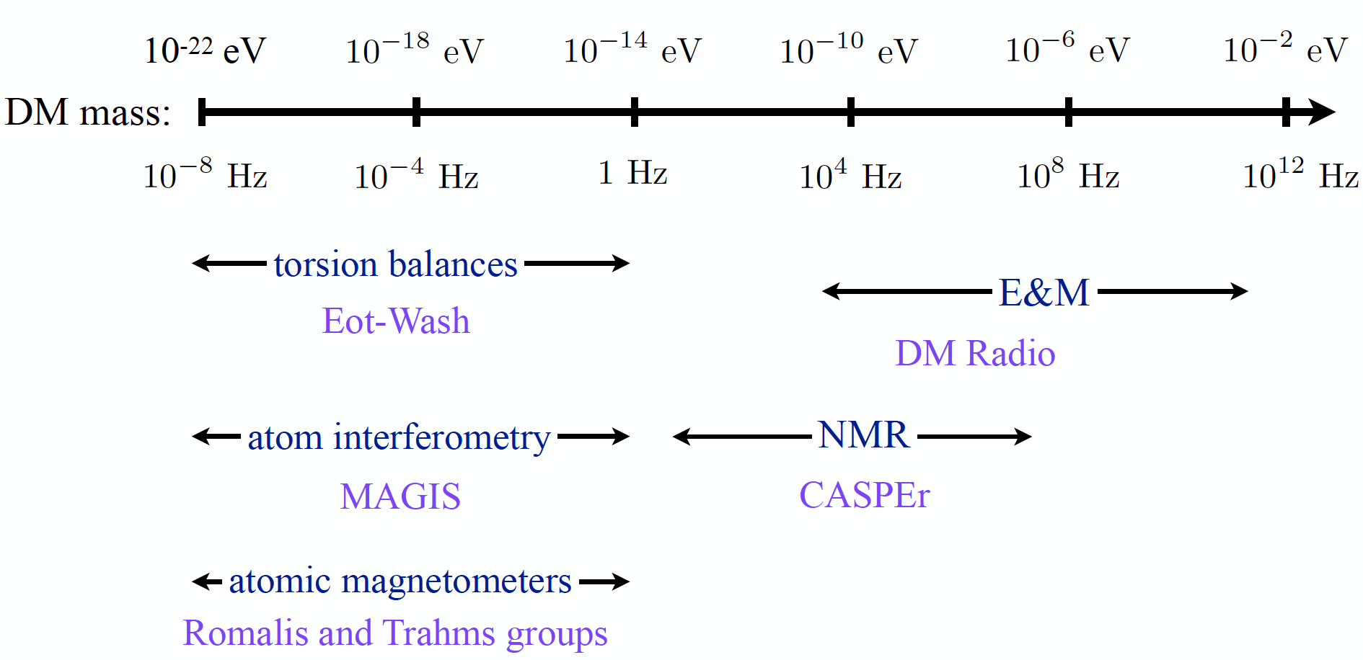
The Landscape of Ultra-Light Dark Matter Detection
Vey light dark matter and gravitational wave detection similar when detecting
coherent effects of entire field, not single particles.
Example: Ultra-Light Dark Matter:
Diagram taken from P. Graham’s
talk at HEP Front 2018

Slide 41
The Landscape of Ultra-Light Dark Matter Detection
Vey light dark matter and gravitational wave detection similar when detecting
coherent effects of entire field, not single particles.
Example: Ultra-Light Dark Matter:
MAGIS/AION
Diagram taken from P. Graham’s
talk at HEP Front 2018

Slide 42
The Landscape of Ultra-Light Dark Matter Detection
Vey light dark matter and gravitational wave detection similar when detecting
coherent effects of entire field, not single particles.
Example: Ultra-Light Dark Matter:
MAGIS/AION
Diagram taken from P. Graham’s
talk at HEP Front 2018

Slide 43


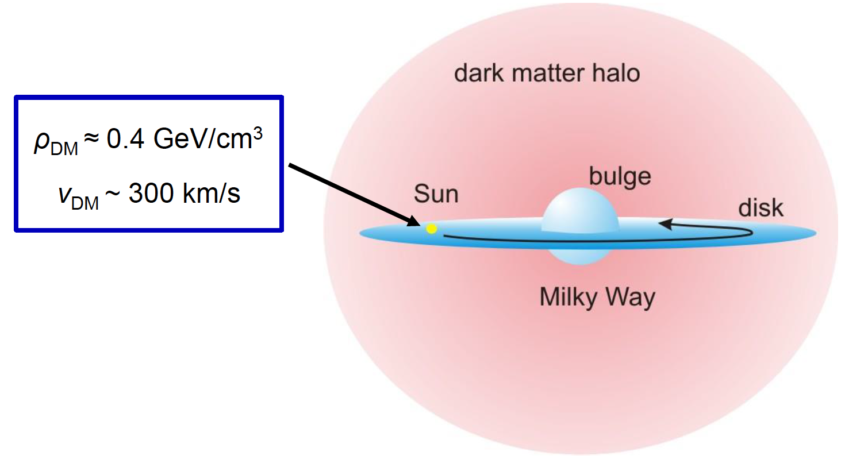
Ultra-Light Spin-0 Dark Matter
Ultra-light spin 0 particles are expected to form a coherently oscillating classical field
as with an energy density of

Slide 44
Ultra-Light Spin-0 Dark Matter
e
Atomic spectroscopy (clocks)
ΔE = hν
δ(ν₁/ν₂) ∝ cos(m_{φ}t)
10⁻²³ eV < m_{φ} < 10⁻¹⁶ eV
g
Notes:
44

Slide 45
Ultra-Light Spin-0 Dark Matter
e
Atomic spectroscopy (clocks)
ΔE = hν
δ(ν₁/ν₂) ∝ cos(m_{φ}t)
10⁻²³ eV < m_{φ} < 10⁻¹⁶ eV
g
Laser interferometry (cavities)
ν
δΦ ∝ δ(νL) ∝ cos(m_{φ}t)
10⁻²⁰ eV < m_{φ} < 10⁻¹⁵ eV
L
Notes:
45

Slide 46
Ultra-Light Spin-0 Dark Matter
e
Atomic spectroscopy (clocks)
ΔE = hν
δ(ν₁/ν₂) ∝ cos(m_{φ}t)
10⁻²³ eV < m_{φ} < 10⁻¹⁶ eV
g
Laser interferometry (cavities)
ν
δΦ ∝ δ(νL) ∝ cos(m_{φ}t)
10⁻²⁰ eV < m_{φ} < 10⁻¹⁵ eV
L
g
Atom interferometry
e
e
F (t) ∝ p_{φ} sin(m_{φ}t)
g
10⁻²³ eV < m_{φ} < 10⁻¹⁶ eV
2T
Notes:
46

Slide 47
Ultra-Light Spin-0 Dark Matter
e
Atomic spectroscopy (clocks)
ΔE = hν
δ(ν₁/ν₂) ∝ cos(m_{φ}t)
10⁻²³ eV < m_{φ} < 10⁻¹⁶ eV
g
Laser interferometry (cavities)
ν
δΦ ∝ δ(νL) ∝ cos(m_{φ}t)
10⁻²⁰ eV < m_{φ} < 10⁻¹⁵ eV
L
g
Atom interferometry
e
e
F (t) ∝ p_{φ} sin(m_{φ}t)
g
10⁻²³ eV < m_{φ} < 10⁻¹⁶ eV
2T
g
δΦ(T,L) = max. for 2π/m_{φ} ~ 2T
e
e
10⁻¹⁷ eV < m_{φ} < 10⁻¹⁵ eV
g
Courtesy of Yevgeny Stadnik!
Notes:
47

Slide 48



Ultralight scalar dark matter
Ultralight dilaton DM acts as a background field (e.g., mass ~10⁻¹⁵ eV)
+ …
Electron
coupling
Photon
coupling
e.g., QCD
DM scalar field
DM mass density
DM coupling causes time-varying atomic energy levels:
DM induced oscillation
Dark matter coupling
Time
Courtesy of Jason Hogan!

Slide 49
Sensitivity for DM with Scalar Couplings to Matter
Coupling
to electron
Coupling
to photon
DM with scalar couplings to matter, which cause time
variation of fundamental constants such as the electron mass
Based on: Arvanitaki et al., PRD 97, 075020 (2018).
Higgs Portal
b coupling

Slide 50
Sensitivity for DM with Scalar Couplings to Matter
Coupling to e
Coupling to photon
Higgs Portal b coupling
AION will be probing new territory in ULD scalar scenarios.
With different configurations of the Atom Interferometer
it will be also possible to search for
Axions (pseudo-scalar) and Vector DM candidates!
[studies are ongoing]
DM with scalar couplings to matter, which cause time
variation of fundamental constants such as the electron mass
Based on: Arvanitaki et al., PRD 97, 075020 (2018).
Sensitivity Scenario | L [m] | T_{int} [s] | Φ [1/√Hz] | LMP [#]
AION-100-today | 100 | 1.4 | 10⁻³ | 100
AION-100-ultimate | 100 | 1.4 | 10⁻⁵ | 40000
AION-km | 2000 | 5 | 0.3 x 10⁻⁵ | 40000
AION-space | 4.4x10⁷ | 300 | 10⁻⁵ | <1000

Slide 51
Other Fundamental Physics
Ultra-high-precision atom interferometry may also be sensitive to other aspects of fundamental physics beyond dark matter and GWs, though studies of such possibilities are still at exploratory stages.
Examples may include:
The possibility of detecting the astrophysical neutrinos
Probes of long-range fifth forces.
Constraining possible variations in fundamental constants.
Probing dark energy.
Probes of basic physical principles such as foundations of quantum mechanics and Lorentz invariance.

Slide 52
AION-10: 10 Meter Side chosen to be Oxford

Slide 53
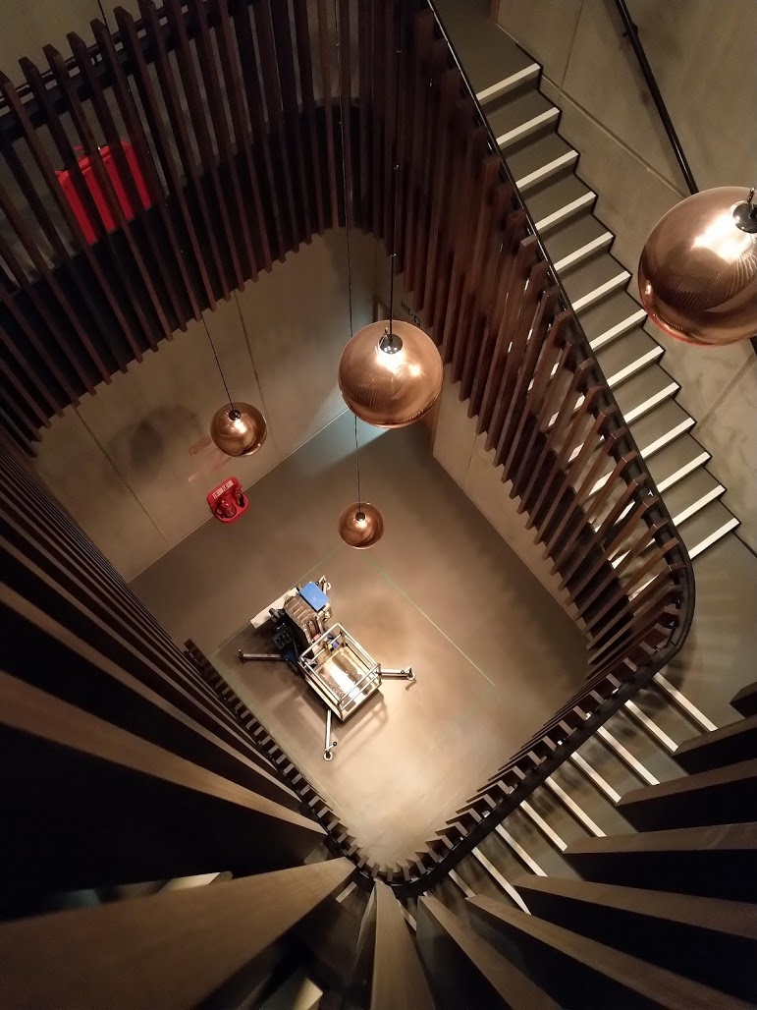
Beecroft building, Oxford Physics
The Beecroft in Oxford is the proposed site, with a backup at RAL (MICE Hall) in case show-stoppers are encountered.

Slide 54

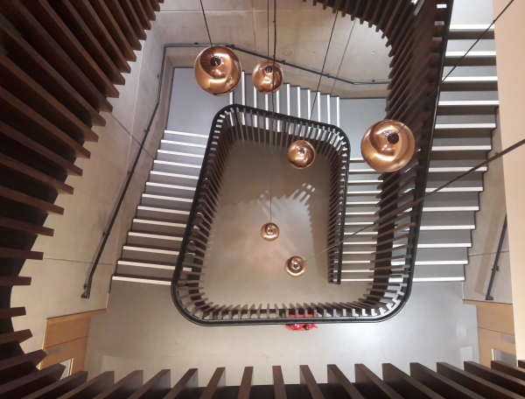
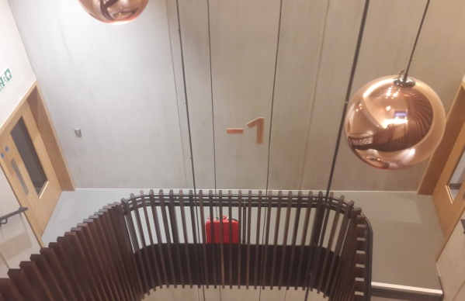
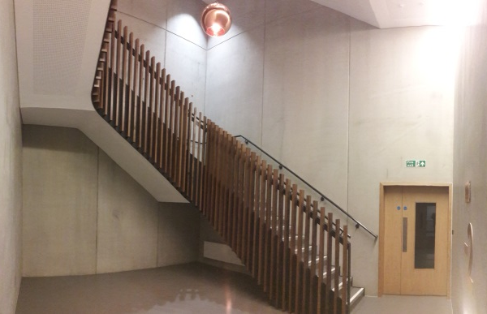
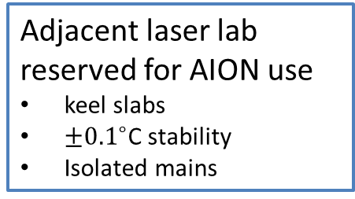
Beecroft building, Oxford Physics
Ultralow vibration
All plant isolated
Thick concrete walls
Adjacent laser lab reserved for AION use
keel slabs
$±{0.1}^{∘}$C stability
Isolated mains
Ground level
AION
12 m
Vertical space
12m basement to ground floor
14.7m floor to ceiling
Aircon infrastructure
Stairwell is not a fire escape route.
Laser lab
Bakeout room and cleanroom nearby
Void
Keel slab

Slide 55
Beecroft building, Oxford Physics
← Side view
↓ Plan view
14.7m
5.4m
10.0m
AI-10
Bake room
7.7m
AI-10
Laser Lab
Keel slab,
Optical table
5.0m
Core site
Core site

Slide 56
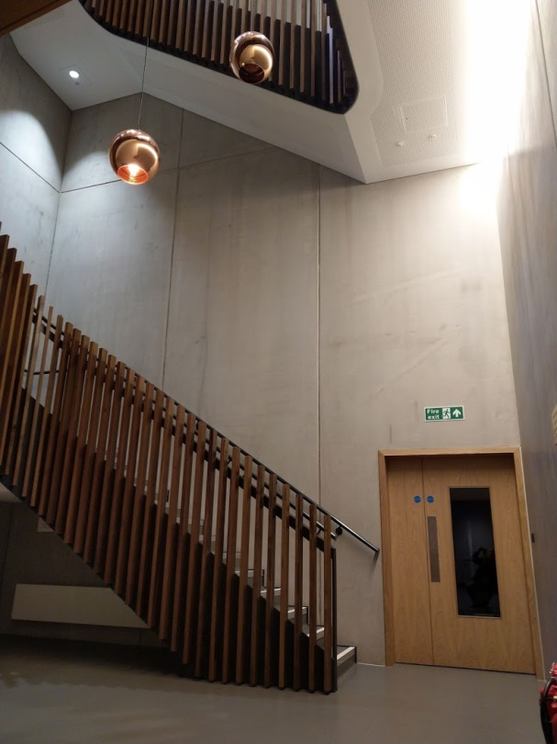
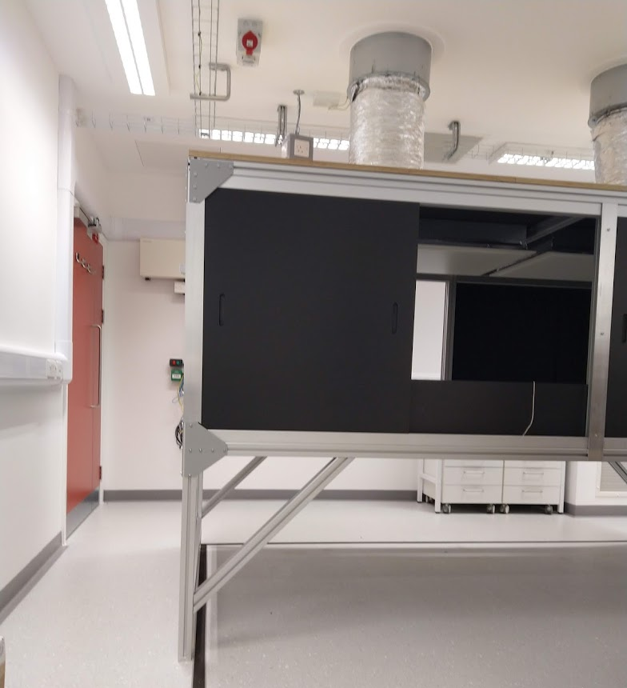
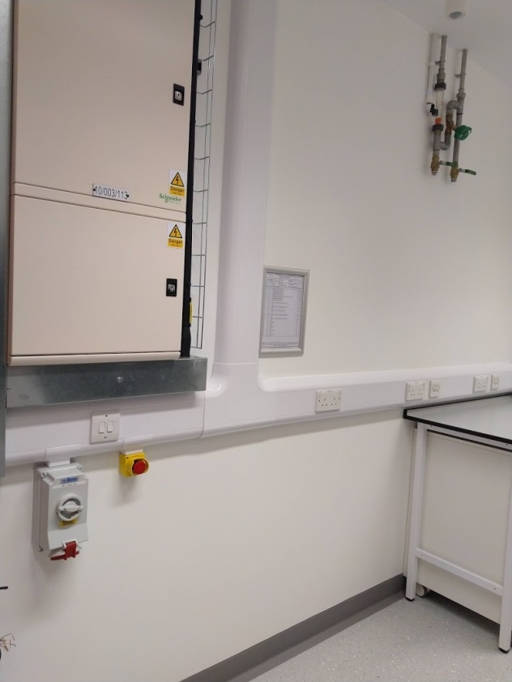
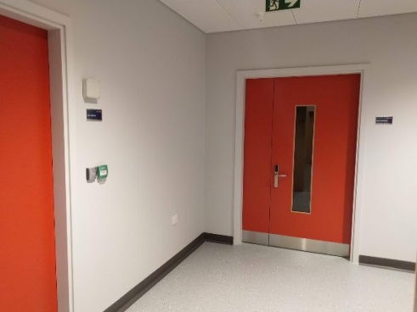
Beecroft building laser lab
Beecroft stairwell: lowest level
Laminar flow
Isolated electrical supply
Cooling water
Keel slab
Core site: feed through fibre and cables
laser lab (interior): optical table enclosure with laminar air flow and temperature-control installed.
Bake-out room next door

Slide 57
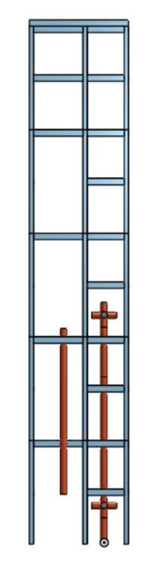
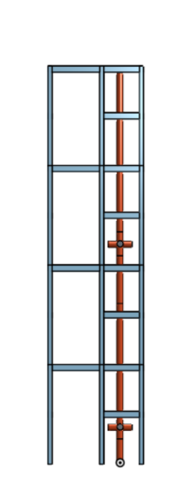
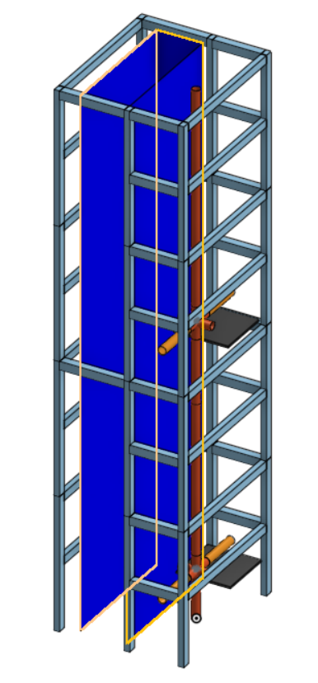
Assembly: extruded aluminium support structure
Remove top layer
after hoisting
Scaffolding erected from ground up.
10 m
vacuum pipe;
3.8 m long,
<100 kg.

Slide 58
Summary
The AION programme is driven by a well-defined and ambitious physics case to explore the Mid-Frequency Band of the GW spectrum.
  In addition, it will enable the exploration of properties of dark matter as well as searches for new fundamental interactions
AION foreseen as a staged programme: AION-10, AION-100, AION-KM and AION-SPACE.
  AION-10 [year 1 to 3] and AION-100 [year 3 to 6] are part of the QSFP WP3
  AION-KM and AION-SPACE are the pathway to the future and achieving ultimate sensitivity
The AION project will closely collaborate with the US initiative, MAGIS-100, which pursues a similar goal of an eventual km-scale atom interferometer on a comparable timescale.
  The option of operating two detectors, one in the UK and one in the US, in tandem enables new exciting physics opportunities not accessible to either detector alone.
  To accomplish the ultimate sensitivity required to study the Mid-Frequency Band of the GW spectrum, the basic parameters of the Atom Interferometer have to be significantly improved. This requires significant effort and ingenuity, and the UK community can play an important role in it!
The formation of an AION collaboration is well underway with the next important milestone to finalize a full funding proposal.

Slide 59
Atom Interferometer Concept

Slide 60
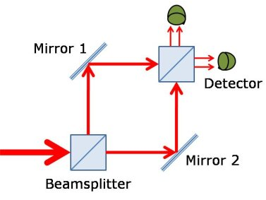
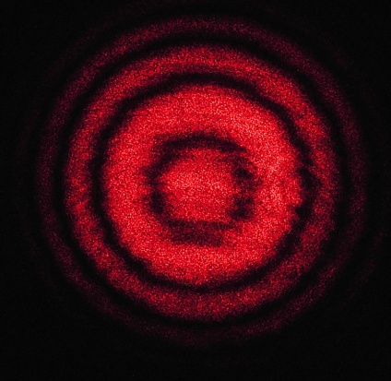
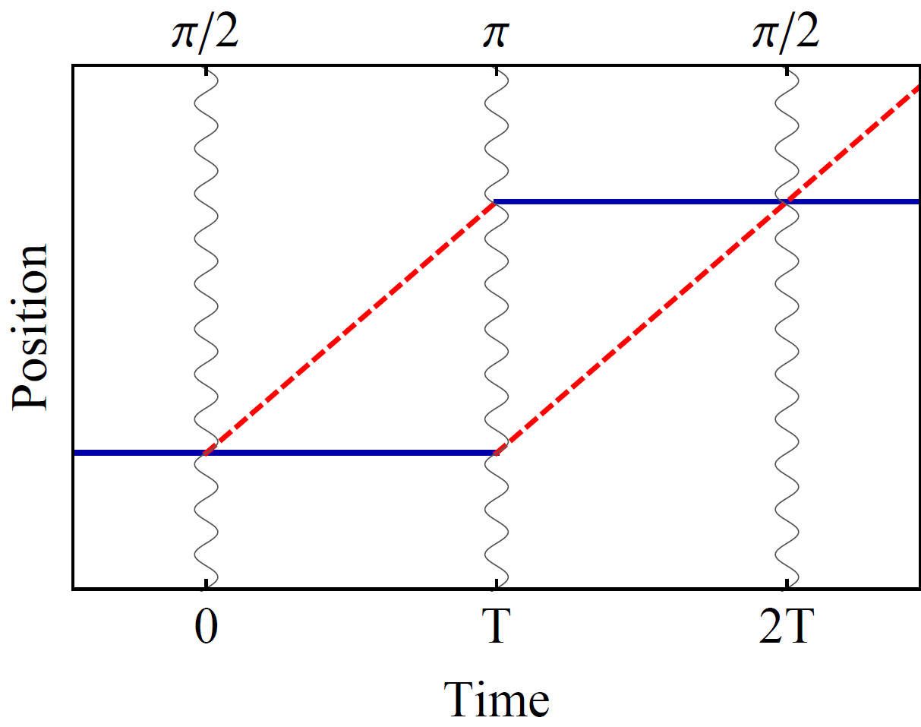
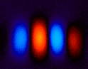
Atom interference
Light interferometer
Light
Light fringes
Atom interferometer
Beamsplitter
Atom fringes
Atom
Beamsplitter
Mirror
http://scienceblogs.com/principles/2013/10/22/quantum-erasure/
http://www.cobolt.se/interferometry.html

Slide 61

Atom optics using light
(1) Light absorption:
Rabi oscillations
ħk
v = ħk/m
(2) Stimulated emission:
ħk
Time

Slide 62
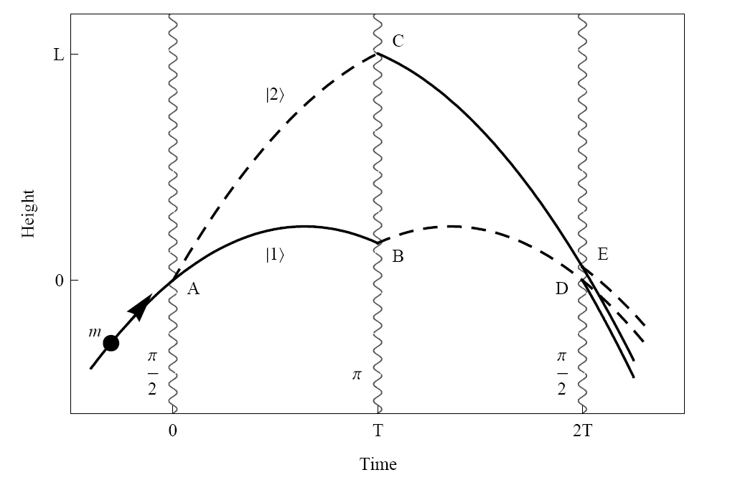
Light Pulse Atom Interferometry
Long duration
Large wavepacket separation
“π/2 pulse”: ½ of ground state go to exited state
“π pulse”: “180 degree flip”: Ground state < - > Exited state

Slide 63
A different kind of atom interferometer
Hybrid “clock accelerometer”
Graham et al., PRL 110, 171102 (2013).
Clock: measure light travel time ➜ remove laser noise with single baseline
Accelerometer: atoms excellent inertial test masses

Slide 64
Basic Differential Measurement
Laser 1
Laser 2
Atom
Source
Atom
Source

Slide 65
Basic Differential Measurement
Laser 2: π pulse [high p]
Laser 1: π/2 pulse [split]
Laser 1
Laser 2
Atom
Source
Atom
Source

Slide 66
Basic Differential Measurement
“Mirror”
3π pulse
[low-high/low-high]
[Doppler shift to select]
Laser 2: π pulse [high p]
Laser 1: π/2 pulse [split]
Laser 1
Laser 2
Atom
Source
Atom
Source

Slide 67
Basic Differential Measurement
Laser 1: π/2 pulse [split]
Laser 2: π pulse [low p]
“Mirror”
3π pulse
[low-high/low-high]
[Doppler shift to select]
Laser 2: π pulse [high p]
Laser 1: π/2 pulse [split]
Laser 1
Laser 2
Atom
Source
Atom
Source

Slide 68
Basic Differential Measurement
Laser 1: π/2 pulse [split]
Laser 2: π pulse [low p]
“Mirror”
3π pulse
[low-high/low-high]
[Doppler shift to select]
Laser 2: π pulse [high p]
Laser 1: π/2 pulse [split]
Laser 1
Laser 2
Each AI spends time L/c
in excited state but at different
periods in the sequence
Atom
Source
Atom
Source

Slide 69

Simple Example: Two Atomic Clocks
Atom clock
Atom clock
Phase evolved by atom after time T
Time

Slide 70
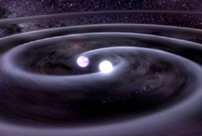


Simple Example: Two Atomic Clocks
GW changes light travel time
Time
Atom clock
Atom clock

Slide 71


Phase Noise from the Laser
The phase of the laser is imprinted onto the atom.
Laser phase noise, mechanical platform noise, etc.
Laser phase is common to both atoms – rejected in a differential measurement.

Slide 72
Clock gradiometer
Excited state phase evolution:
Two ways for phase to vary:
Dark matter
Gravitational wave
Each interferometer measures the change over time T
Laser noise is common-mode suppressed in the gradiometer
Graham et al., PRL 110, 171102 (2013).
Arvanitaki et al., PRD 97, 075020 (2018).

Slide 73
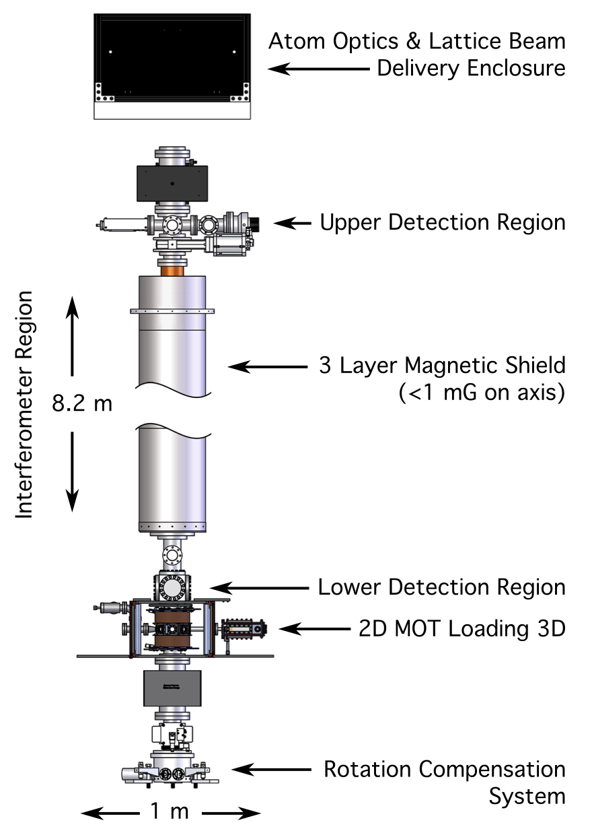
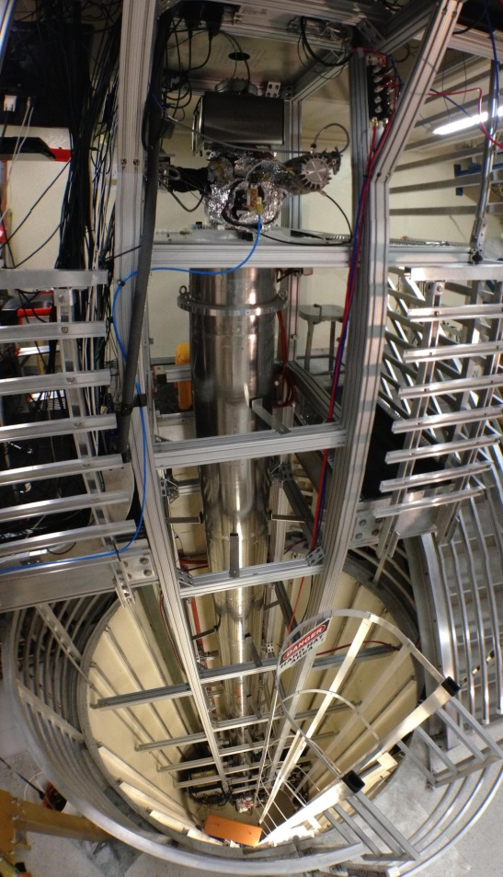
10 meter scale atomic fountain

Slide 74

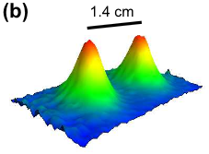
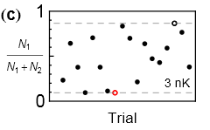
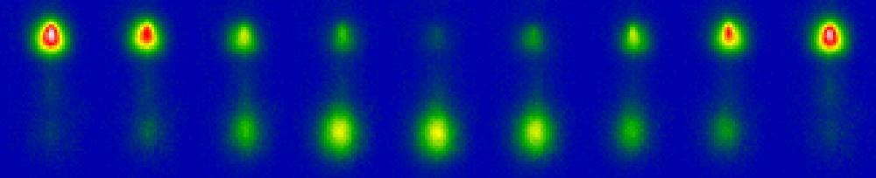

Interference at long interrogation time
Port 1
Port 2
Wavepacket separation at apex (this data 50 nK)
2T = 2.3 seconds
1.4 cm wavepacket separation
Interference (3 nK cloud)
Dickerson, et al., PRL 111, 083001 (2013).

Slide 75

LMT and Resonant Pulse Sequences
Large Momentum Transfer (LMT): Sequential single-photon transitions
remain laser noise immune
LMT beamsplitter (N = 3)
Resonant sequence (Q = 4)
Graham, et al., PRL (2013)
Graham, et al., PRD (2016)

Slide 76


Large space-time area atom interferometry
max wavepacket separation
Long duration (2 seconds), large separation (>0.5 meter) matter wave interferometer
90 photons worth of momentum
World record wavepacket separation due to multiple laser pulses of momentum
54 cm
Kovachy et al., Nature 2015

Slide 77

What are the challenges?
Still several orders of
Magnitude away in sensitivity required to be sensitive to Mid-band GW physics!
Need to push the basic parameters to accomplish this goal! Although there is a clear path forward this won’t be a free lunch and it will require effort and ingenuity!
The UK community could play an important role to accomplish this goal, which, in turn, can accelerate the schedule and minimize the risk of failure
AION/MAGIS-100 with current (2019) technology
AION/MAGIS-100 (5 to 6 year)
AION/MAGIS-km
AION/MAGIS-space
AION/MAGIS-100
current
AION/MAGIS-100
5/6 year
AION/MAGIS-km

