Slide 1
Towards the AION arxiv Paper:
Schematic Illustration Figure for arXiv [and proposal]
Oliver Buchmueller, Imperial College London

Slide 2
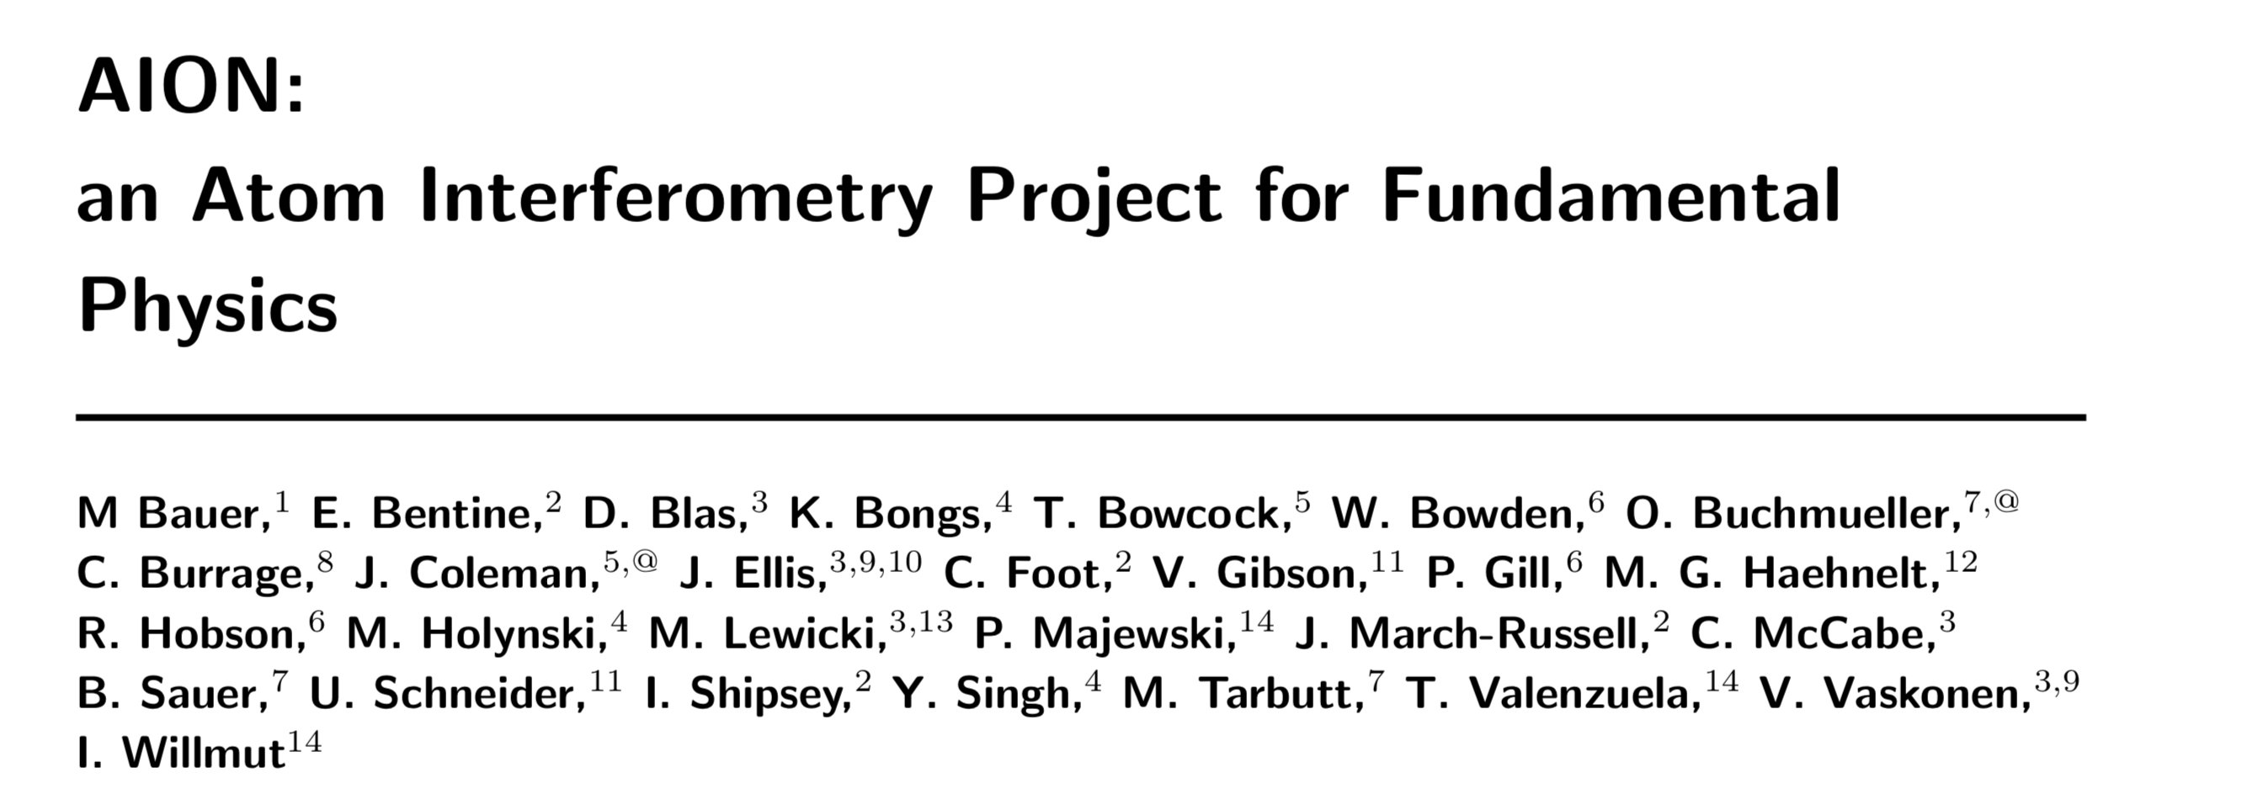
Towards the AION ArXiv Paper
As we likely will only have a dozen or less pages for the actual proposal, we are
Planning to support the proposal with a comprehensive aiXiv paper that will outline the
Full physics case and schematic design principals of AION.
This will allow us to focus
more on the work packages in the actual proposal.

Slide 3
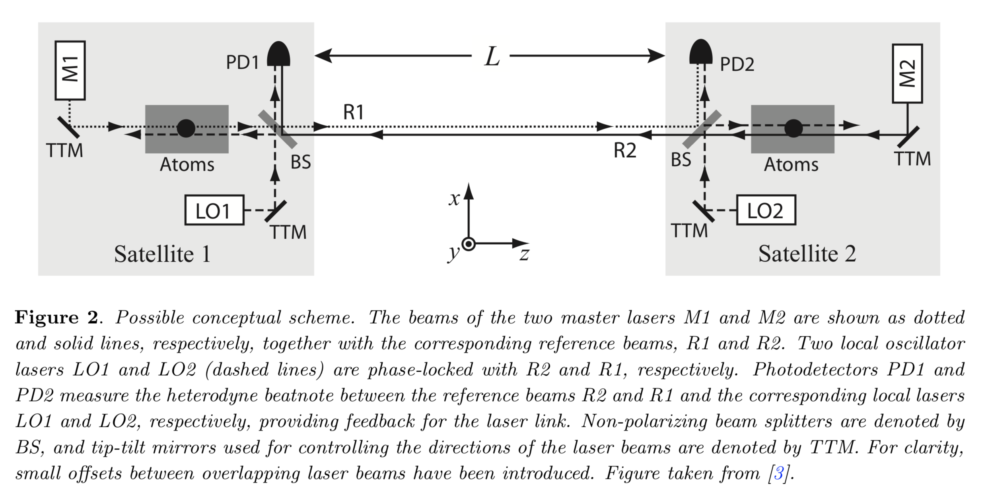
What we have for AEDGE Paper [Space Version]
For the AEDGE paper we have drafted a section for a space version of AION [see attachment on agenda page] and the idea is to adopt this section for the "vertical shaft” AION 10/100/km conceptual work design. For this we would need a similar figure as figure 2 in the attachment [which shows the space designs] but showing the ground based “vertical shaft design”.

Slide 4
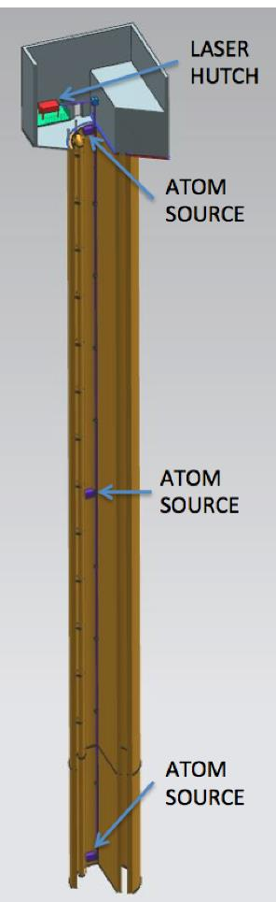
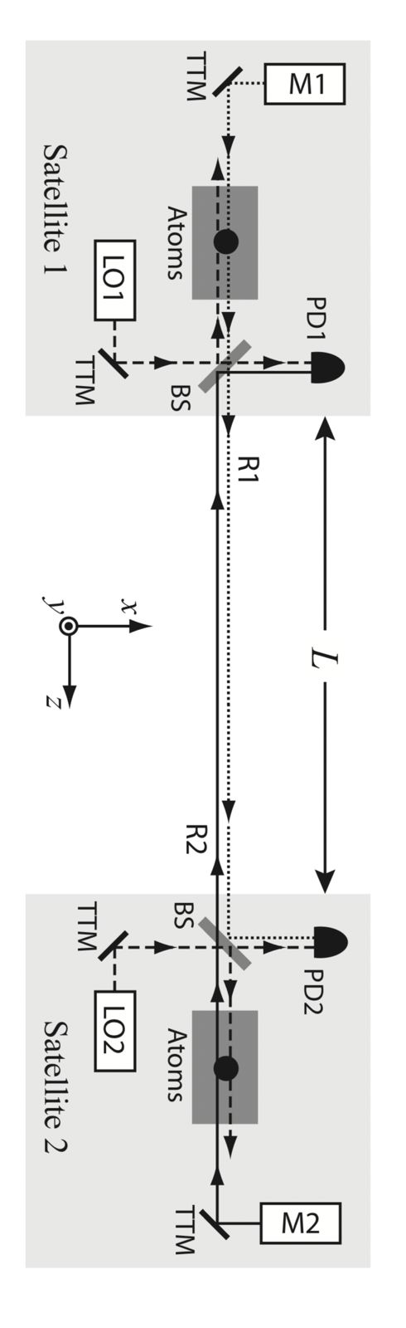
Schematic Design Figure for “Ground-based Shaft”
We could combine this two drawings
To make it a “shaft design” with N Atom
Sources along L and a similar laser
design/source as in the space picture.
Would this make sense?
Would anyone of the Cold Atom Experts
be prepared to take a lead in creating this schematic design figure for arXiv paper [and proposal]?
Please note: We need this rather soon [i.e. in the next 14 days].

