Slide 1
ESA White Paper
Cold ATOMS in SPACE:
AEDGE:
Atomic Experiment for Dark Matter and Gravity
Exploration
John & Oliver

Slide 2
ESA Voyager 2050 call: White Paper
White Paper High-Level Scope
By means of the present Call for White Papers, the Agency is soliciting ideas from the scientific community for the science themes that should be covered during the Voyage 2050 planning cycle.
White Papers are not proposals for specific missions; they should rather argue why a specific scientific theme should have priority in the Voyage 2050 planning cycle. At the same time, and to ensure realism in the resulting Programme, applicants should briefly illustrate possible mission profiles.
https://www.cosmos.esa.int/web/voyage-2050
[Deadline August 8]

Slide 3
Atomic Experiment for Dark Matter and Gravity Exploration
Currently preparing a White Paper for the
ESA Voyager 2050 call:
https://www.cosmos.esa.int/web/voyage-2050
[Deadline August 8]
Focus on physics case!
AEDGE Main Physics Goals:
Search for Ultra-Light Dark Mater
  Complement and expand parameter space for DM searches
  Main focus on scalar DM, but pseudoscalar and vector DM might be possible too.
Measurement of GW signals in mid-frequency band
  Measure GW in the frequency range between the most sensitive ranges of LISA and the LIGO/Virgo, KAGRA and Einstein Telescope experiments.

Slide 4
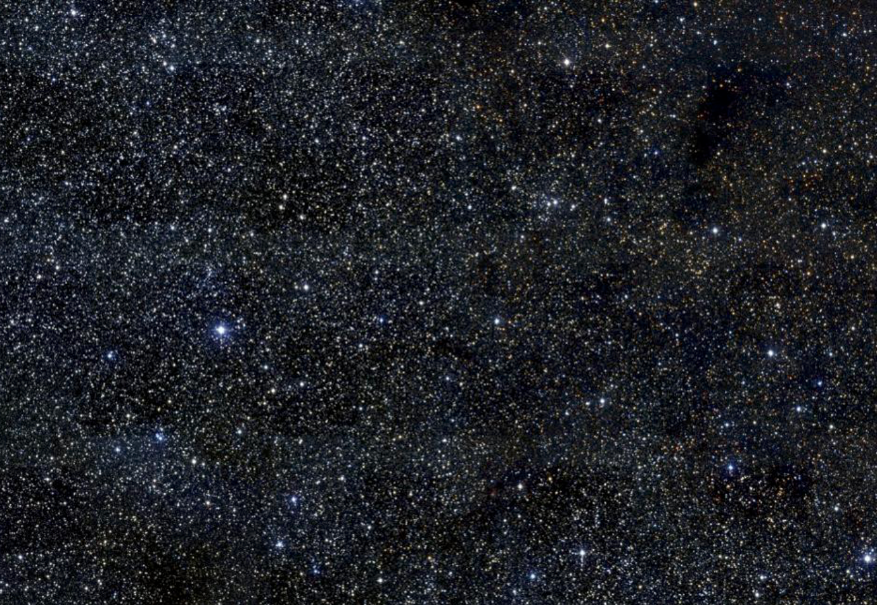
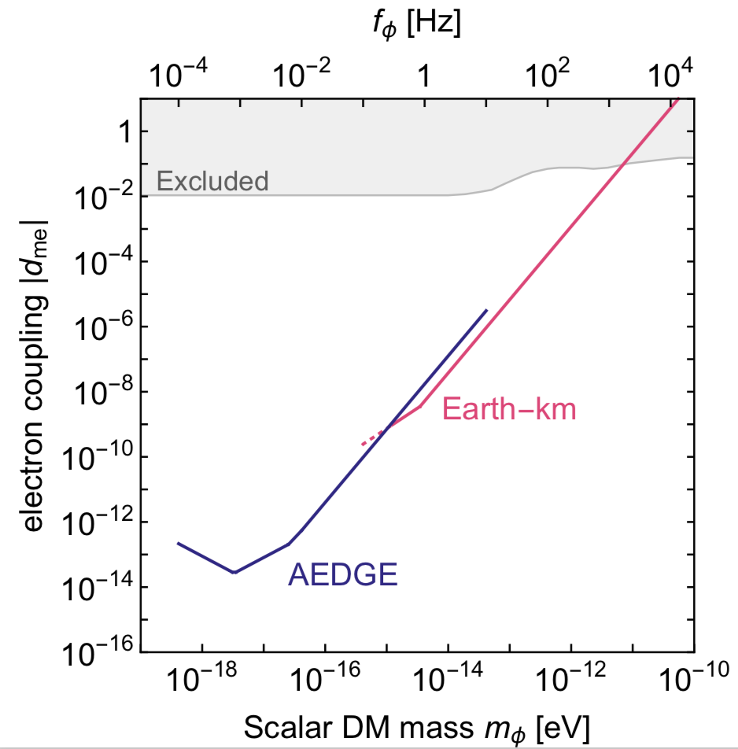
Workshop at CERN
AEDGE:
Atomic Experiment for Dark Matter
and Gravity Exploration
Informal Workshop
CERN, July 22/23 2019
https://indico.cern.ch/event/830432/

Slide 5
Workshop at CERN
AEDGE:
Atomic Experiment for Dark Matter
and Gravity Exploration
The workshop will be on July 22 and 23 at CERN, and a corresponding workshop page has already been created:
https://indico.cern.ch/event/830432/
The link above also contains a tentative workshop scope and proposed goal to help it attract the right audience. You input and scrutiny of it would be much appreciated [it has yet to be announced]!
Informal Workshop
CERN, July 22/23 2019
https://indico.cern.ch/event/830432/

Slide 6
DAY 1: Review Experimental Landscape
The Matter-wave laser Interferometric Gravitation Antenna (MIGA) Experiment:
http://miga-project.org/. MIGA aims at demonstrating precision measurements of gravity with cold atom sensors in a large-scale instrument and at studying associated applications in geosciences and fundamental physics. In particular, it will assess future potential applications of atom interferometry to gravitational wave detection in the mid-frequency band between 0.1 and 10 Hz, intermediate between LISA and LIGO/Virgo/KAGRA/INDIGO/ET.
The MAGIA-Advanced
Project funded by the Italian Ministry for Research and Istituto Nazionale Fisica Nucleare for a large scale atom interferometer based on ultracold Rb and Sr atoms. In additions to lab R&D activity, the team is investigating the possibility of a 100-300 m atom interferometer to be installed in a vertical shaft on Sardinia island. Main goals are GW observation and search for DM.
The Zhaoshan long-baseline Atom Interferometer Gravitation Antenna (ZAIGA) https://arxiv.org/pdf/1903.09288.pdf ZAIGA is an underground laser-linked interferometer facility under construction near Wuhan, China. It has an equilateral triangle configuration with two 1-km-apart atom interferometers in each arm, a 300-meter vertical tunnel equipped with an atom fountain and atomic clocks, and 1-km-arm-length optical clocks linked by locked lasers. It is designed for experimental research on gravitation and related problems including gravitational wave detection and high-precision tests of the equivalence principle.
The Matter-wave Atomic Gradiometer Interferometric Sensor (MAGIS) project https://arxiv.org/pdf/1812.00482.pdf The MAGIS project in the US plans a series of interferometers using cold atoms with progressively increasing baselines of 10m, 100m, and 1km. The first step is funded and under construction at Stanford, the second step is being prepared at Fermilab, and the third step is planned for the Sanford Underground Research Facility.
ELGAR
ELGAR is a European initiative to build a terrestrial infrastructure for cold atoms for gravitational wave detection with potential applications also for dark matter. Configurations similar to MAGIS/AION are included in the proposal, and a White Paper about this infrastructure is being prepared [https://indico.obspm.fr/event/58/contributions/214/attachments/88/98/Slides-bouyer2018_06_21_MIGA_GDR.pdf]
The UK Atom Interferometry Observatory and Network (AION) project
http://www.hep.ph.ic.ac.uk/AION-Project/ The AION project in the UK proposes a series of atom interferometers with baselines of 10m, 100m, and 1km, similar to MAGIS. The first stage would be located in Oxford, with sites for the subsequent steps awaiting study.
The Space Atomic Gravity Explorer (SAGE)
The SAGE mission was proposed to the European Space Agency in 2016 in response to a Call for “New Ideas” (https://www.cosmos.esa.int/web/new-scientific-ideas). It has the scientific objective to investigate Gravitational Waves, Dark Matter, and other fundamental aspects of gravity as well as the connection between gravitational physics and quantum physics combining quantum sensing and quantum communication based on recent impressive advances in quantum technologies for atom interferometers, optical clocks, microwave and optical links.

Slide 7
DAY 2: Focus White Paper
The Physics Case of AEDGE
Other Space Missions relevant to AEDGE
Closed session: Editor Meeting

Slide 8
Relevant for AION
The WP is mainly supposed to focus on the Physics case, which we have been working on for months now in the context of the AION proposal. Thus, it will stay clear of any technology choices or even concrete recommendations; though it’s clear that AION technology will be one important option.
AION should (and will) play a critical part in this WP helping to foster a strong UK community presence in this European effort [much stronger than it was in the 2016 SAGE proposal that was unsuccessful].
We managed to get most of the important Cold Atom people in Europe on board. The next step is now to get also the PP and GW communities more educated and stronger involved. AION people can facilitate this community building exercise, which, in turn, will also help the AION project in the UK.
Therefore, it would be good to have a significant presences of the AION core team at the workshop [Note: for those unable to travel, there will be also Vidyo option -- though this is never as effective as in person attendance]

