Slide 1
Towards AION write-up for confidential IRB review
April 26, 2019
Oliver Buchmueller, Imperial College London
and
Jon Coleman, Liverpool University

Slide 2
Reminder from last meeting about scope and timeline

Slide 3
Summary
1) All WP leaders to communicate to their collaborations the need for an explicit balance in bids between short-term (possibly as short as 20-24 months from start of funding) aims and deliverables, especially *science*, and *ambitious* long-term goals.
2) If possible all WP's that have not already done so should organise workshops/meetings in near future, ideally next 2 months. Joint meetings involving two or more WPs are OK. Funding up to a maximum of ~4-5K available per meeting.
3) Possible 10th WP to join QSFP. We should be open to others, and actively encourage community in UK to grow (see also later important item concerning diversity). Current WP structure not set is stone -- if better science or bids possible with different arrangements (mergers, splits, focussing,...) then this should be discussed asap at future meetings.
4)[ Draft of individual WP documents including estimated costing (including overheads) to be ready by end of April for confidential IRB review. Documents should be dominantly the science case (motivation, background theory, and especially experimental methodology; possibly comparisons with other approaches). Max length ~20 pages, min length ~10 pages. A *realistic* timeline is important. Please don't hide potential weaknesses/issues -- this is not final bid document but step on the way.

Slide 4
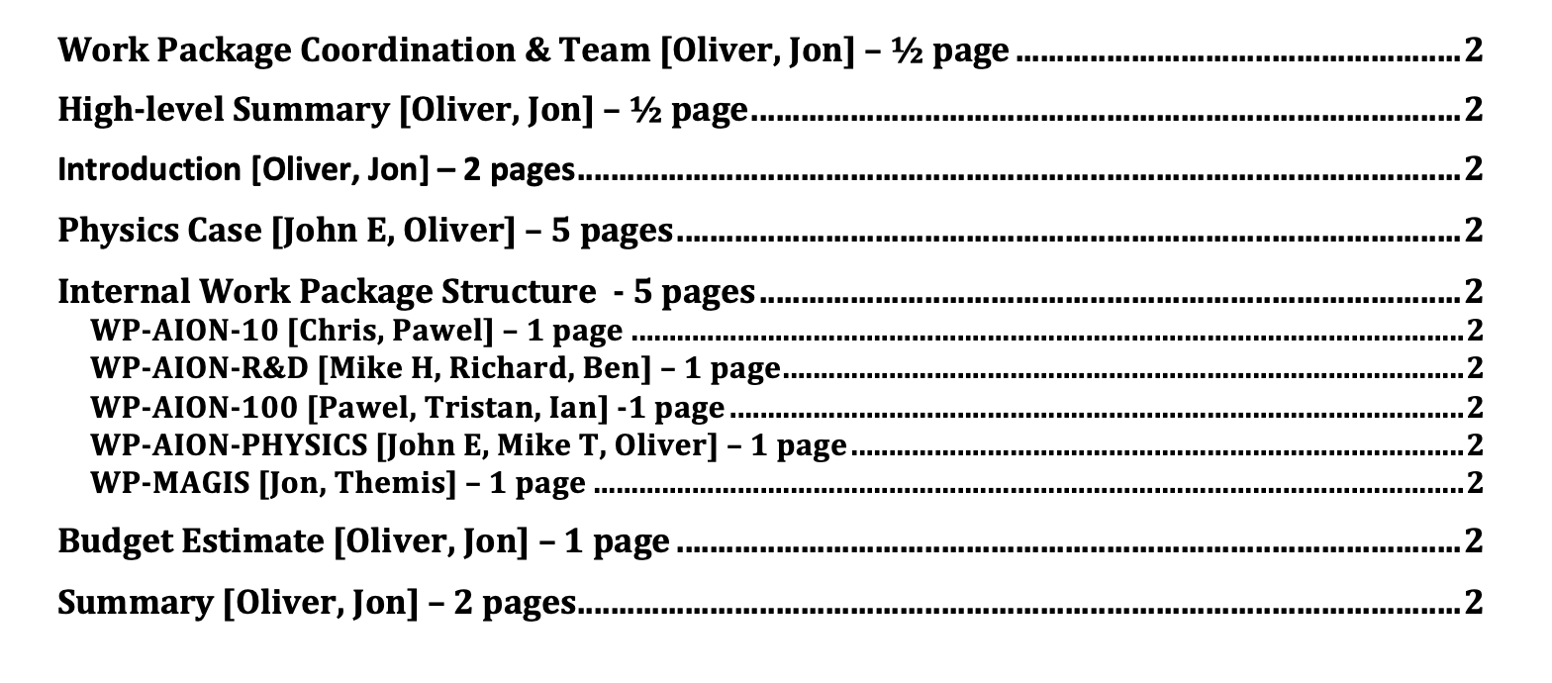
Proposal for Writing
  Total of about 16 pages. For WP 1-page write-up, please self-organise the writing.
Note: The final proposal outline will be likely very similar in lengths and content
and thus this document will form the foundation for it. So, making an effort would certainly be worthwhile.

Slide 5
Proposal: TimeLine for Writing
April 26:
  First Complete draft [three weeks from now]
May 3:
  One week polishing
May 6
  Ready for Review
Is this doable?

Slide 6
Update: QSFP Timeline
Decided in last QSFP steering meeting based on feedback from WP leads was that end of April was too soon for revised proposal material - therefore the deadline for this revised material, including preliminary costings, is now moved back to MAY 17th.
This gives us 10 more days that we initially planned for [not a lot].
Suggest to stick with already agreed timeline and use this 10 days a contingency for polishing, etc.

Slide 7
Cambridge: Interest to join AION core team
Cambridge as expressed a strong interest to join the AION core team. They have already identified some concrete areas to contribute: e.g. MAGIS and AION-10 and AION-RD momentum transfer.
Jon and I are planning to invite the Cambridge group to express their interest with concrete suggestion for contributions in a forthcoming meeting to ensure that we all can review and discuss it.
  Suggest to make this in our next meeting on May 3 (i.e. in one week from now)

Slide 8
Next Meeting:
Next meeting will be on May 3 at the usual timeslot.
  Note: this is going back to the old bi-weekly cycle which we skipped due to the Ester break

