Slide 1
AION-100 costing
Ian, Pawel, Tristan
5 April 2018

Slide 2
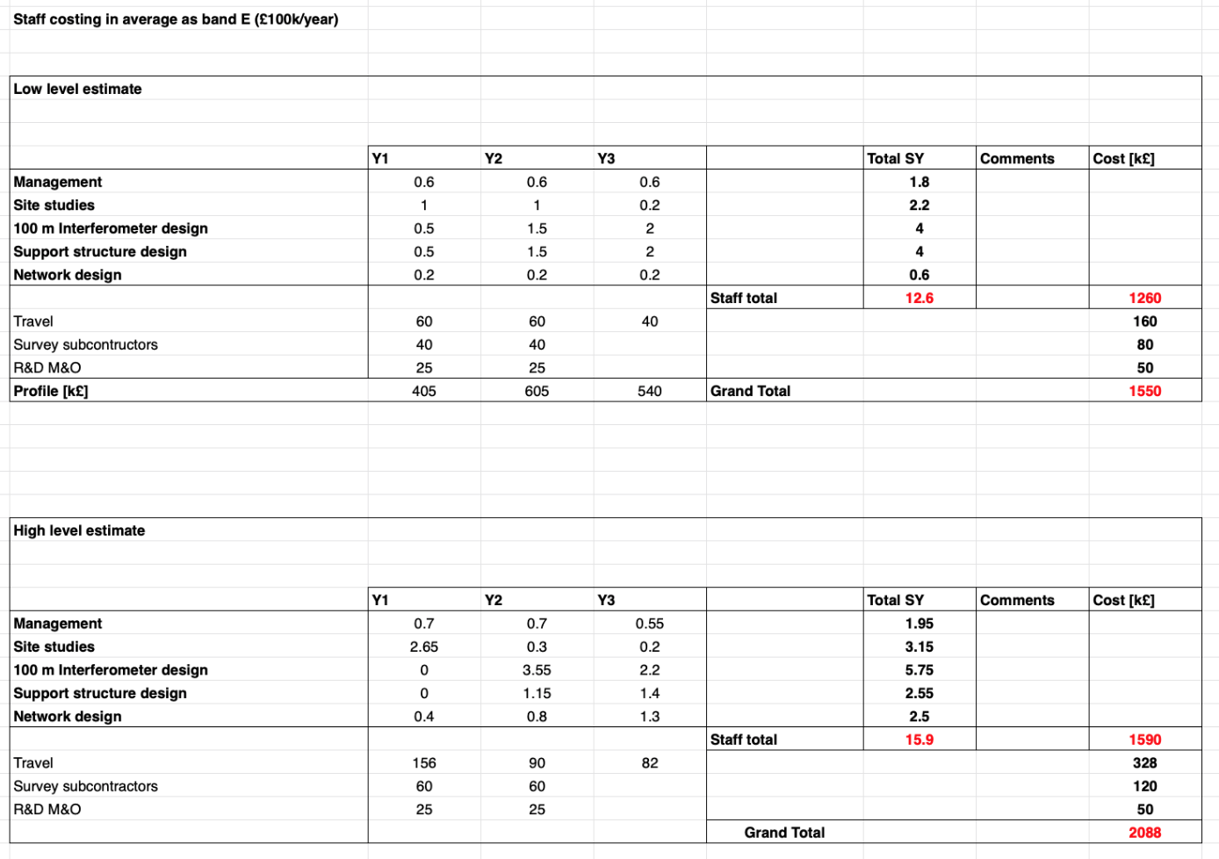
New costing table (initial cost reduced by 25%)
Staff cost reprofiled
Total SY reduced from 15.9 to 12.6
Travel budged halved
Work allowance changed to survey subcontractors and reduced
R&D M&O added for small tests if required i.e. for shielding test (this is for discussion if AION-100 requires any R&D)

