Slide 1
WP AION-Upgrade Task 2
Design goals for 5e-19 /rt(Hz) strain sensitivity in AI-100:
Task 2a: Atom Preparation
  Prepare 10⁹ atoms at < 100 nK within 10 s; transport from sidearm to AI tube
Task 2b: Spin Squeezing
  Realise 20 dB of metrologically useful squeezing on the clock transition
Need to shrink θ
Note added by RH 26/03/19: Actual requirement is 10⁸ atoms/s, so fewer atoms can be used if the cooling sequence can be made shorter.
Jason Hogan hopes to achieve a very short 1 s sequence → he’s aiming for 10⁸ atoms. Either approach is hard, in slightly different ways.
Note added by RH 26/03/19:
The goals above are long-term ambitions to support AI-km performance. In the shorter term, “realistic deliverables” for years 1-3 could be:
2a: Prepare 10⁷ atoms at < 500 nK within 10 s (matching MAGIS-100 goal of 10⁶ atoms/second)
2b: Achieve 20 dB of squeezing on the clock transition, but with no guarantee of metrological usefulness (e.g. not yet controlling anti-squeezing)

Slide 2
Upgrade task 2a: Atom preparation
Notes added by RH 26/02/19: Citations for “state of the art”
  10.1103/PhysRevLett.119.223202 quotes up to 10¹⁰/s flux of slow ⁸⁸Sr at hottest oven setting; I have scaled by natural abundance ratio ⁸⁷Sr/⁸⁸Sr.
  10.1140/epjd/e2015-60288-y and 10.1103/PhysRevA.96.053415 report comparable flux. AOSense claims better (10¹¹/s of ⁸⁸Sr) in a datasheet but no data is presented and no peer reviewed publication is available.
High-flux ⁸⁷Sr source: 10¹¹ slow atoms/second
  State of the art: 10⁹ atoms/second
Big ⁸⁷Sr “blue” MOT: 10¹¹ atoms
  State of the art: 5 x 10⁸ atoms
Narrow-line cooling of 10¹⁰ atoms to 1 uK in dipole trap (+ optical pumping)
  State of the art: 10⁷ atoms
Evaporative cooling of 10⁹ atoms to < 100nK
  State of the art: 2 x 10⁵ atoms
Horizontal transport over 50 cm with heating < 100 nK
  State of the art: few uK heating
  5e8 atoms is estimated from experience and talking to other Sr groups. Blue MOT size is not usually quoted in publications - Sr BEC experiments with high atom number usually load a magnetic trap reservoir so don’t need a big blue MOT. We can’t use a magnetic trap reservoir in AION because there are too many untrapped hyperfine states in 87Sr → lots of atoms would be wasted → cycle time would be too long. (Also collisional losses would likely be prohibitive). Main atom number limitations are (i) inelastic collisions and (ii) density limits from rescatter – see 10.1103/PhysRevA.59.1216
  Narrow-line cooling and evaporative cooling numbers are as reported in Schreck group 10.1103/PhysRevA.87.013611. Similar numbers are achieved in the JILA group – see e.g. 10.1126/science.aam5538. Both sequences are ~ 30 seconds.
  Jason Hogan mentioned he wanted to skip out evaporative cooling altogether, instead exploiting a dark SPOT MOT induced by a transparency beam as partially demonstrated in 10.1103/PhysRevLett.110.263003. This will probably help (I was thinking to try the same thing), but its temperature/density limits are unclear.
  Few uK heating is quoted in the moving tweezers (focus-tuneable lens) in 10.1088/1367-2630/16/9/093028. A moving lattice combined with Bessel beam waveguide sounds more promising – see 10.1088/1367-2630/8/8/159 for 20 cm transport with < 30 nK axial heating (but note that transverse heating is not reported)

Slide 3
Notes added by RH 26/03/19: I have added realistically achievable deliverables within 3 year AI-Upgrade programme. These will hopefully be refined more in coming weeks. The stretch goals listed in the main bullets are guided by strain sensitivity goals of AI-100, not by achievability in 3 year timescale.
I would hope we could do better than the “realistic deliverables” even within 3 year timescale, in some cases hopefully by an order of magnitude, but I wouldn’t be comfortable guaranteeing it. The stretch goals will need longer - they need beyond state of the art in both atom density and trap volume. Plausible methods are available – Jason has some ideas and so do we – but each step is risky and the stretch goals are definitely at the limit of what seems possible. I think we can promise larger improvements in the earlier stages of cooling (i.e. high flux source; blue MOT) simply because we will do these stages first.
High-flux ⁸⁷Sr source: 10¹¹ slow atoms/second
  State of the art: 10⁹ atoms/second – Realistic 3 year deliverable: 5 x 10⁹ atoms/second
Big ⁸⁷Sr “blue” MOT: 10¹¹ atoms
  State of the art: 5 x 10⁸ atoms – Realistic 3 year deliverable: 5 x 10⁹ atoms
Narrow-line cooling of 10¹⁰ atoms to 1 uK in dipole trap (+ optical pumping)
  State of the art: 10⁷ atoms – Realistic 3 year deliverable: 3 x 10⁷ atoms to 1.5 uK
Evaporative cooling of 10⁹ atoms to < 100nK
  State of the art: 2 x 10⁵ atoms – Realistic 3 year deliverable: 1 x 10⁷ atoms to < 500 nK
Horizontal transport over 50 cm with heating < 100 nK
  State of the art: few uK heating – Realistic 3 year deliverable: Nothing!
  (We should make a best effort to demonstrate transport, but progress on other stages is more important in years 1-3)

Slide 4
Upgrade task 2b: Spin squeezing
Realistic 3 year deliverable: Cavity weak measurement at a signal to noise compatible with 20 dB squeezing of 10⁹ atoms (note: this is beyond state of the art). I don’t think we can guarantee metrological usefulness in years 1-3; we should wait until years 4-6 before promising to characterise dephasing & heating to the required level. Ultimately to get metrological usefulness in years 4-6 may involve upgrading the cavity or detection scheme based on lessons learned in years 1-3
Apply 20 dB spin squeezing on “clock” transition – State of the art: 0 dB (i.e. not yet done!)
  Option 1: Cavity – either weak measurement or one axis twisting (“cavity feedback”)
  Option 2: Interactions – e.g. through Rydberg dressing
Squeezing must be metrologically useful
  Low dephasing and decoherence
Squeezing must not induce too much heating (< 100 nK)
  Cavity: Challenging due to dipole forces from cavity spatial mode; Rydberg: untested
Squeezing must be compatible with 10⁹ atoms
  Cavity: large cavity mode volume; Rydberg: must avoid inelastic collisions
Squeezing must be compatible with transport, lattice launch and delta-kick lens
  Preserve squeezing in magnetic sublevels, then transfer to clock states in AI tube?
Detection noise < 10⁻⁶ to measure squeezed population distribution
Citations for state of the art squeezing:
Vuletic (MIT) cavity feedback squeezing between ground states of Yb: arXiv:1901.10499
Kasevich (Stanford) 20 dB cavity feedback and weak measurement squeezing between ground states of Rb: 10.1038/nature16176
Jones (Durham, UK) Proposal for Rydberg dressed squeezing (possible alternative to cavities): 10.1103/PhysRevLett.112.103601

Slide 5
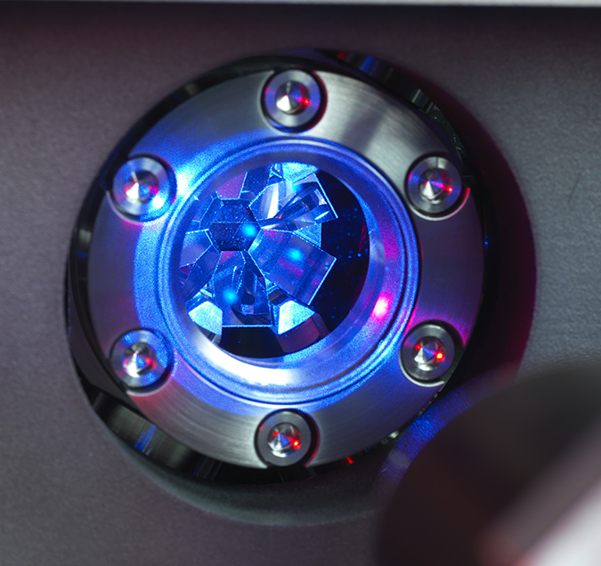
Upgrade task 2: Budget estimate
⁸⁷Sr
Labour: £600k
£600k = 2 PDRA staff at £100k/yr each
+ in kind contributions (e.g. students)
Capital: £1.0M
See table below
I recognise that there are finite resources but 2 PDRA is probably not enough to deliver this task unless there is a lot of synergy with other WPs
Laser systems for cooling | £605,000
Laser stabilisation ("clock" laser + stability transfer) | £580,000
Experimental control and electronics | £125,000
Vacuum system, camera and squeezing cavity | £140,000
Test and measurement | £100,000
Estimated in-kind contributions from hosts | -£550,000
Total capital budget | £1,000,000
But this is only 10⁷ atoms…

