Slide 1
AION Working Meeting
Feb 22, 2019
Oliver Buchmueller, Imperial College London
and
Jon Coleman, Liverpool University

Slide 2
Minutes from last Meeting
Next Meeting
Friday Feb 22, at TIME to be decided via doodle poll
Sensitivity & Challenges
Mike T presented a first look on sensitivity estimates of basic parameters and corresponding challenges. We discussed briefly implications on how aggressive/conservative we should be in the proposal and how to evolve this in the future.
Action Item: Get in touch with the R&D program for the MAGIS collaboration to further discuss the subject and see where the UK could contribute to reach the ultimate design goals.
10m Site Options
We had updates on the site proposals providing further details. RAL remained with only one site option (building R72), while Oxford presented three possible options; 2 in Beecroft and 1 in Van de Graaf tower; where, the staircase in Beecroft is the preferred option.
Action Item: We agreed to schedule a site visit to RAL (and if needed again to Oxford). Date proposal will be circulated soon.
Work Package Scope and Breakdown
Postponed to next meeting
Action Item: Mike H volunteered to compile further information and present a more concrete WP breakdown for the technology priorities in the next meeting

Slide 3
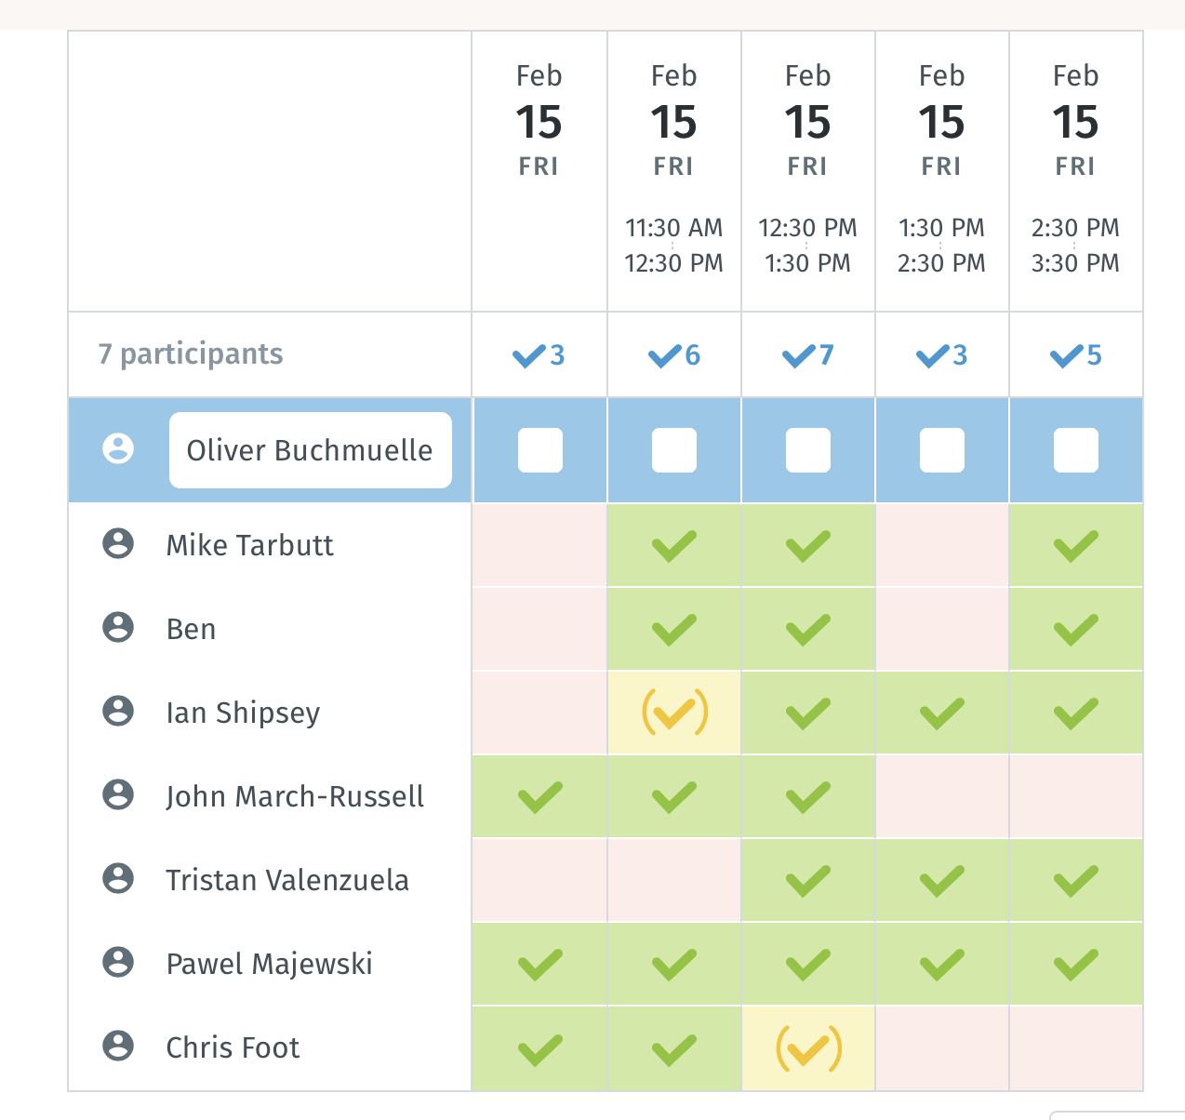
New Meeting starting Time is 12:30 pm (UK)

Slide 4
Site Visit to RAL planned for January 27th at 1pm
We agreed to visit RAL in order to inspect the proposal for a 10m site at RAL
The visit is scheduled for Feb 27th at 1pm.
  Please free to join us
As we have already visited Beecroft in Oxford during the last QSFP workshop, we are NOT planning another visit
  Do we have consensus on this?

Slide 5
Work Package Discussion
a) We agreed that the smaller WPs ( WP-Physics, WP-AION100, WP-MAGIS ) are already sufficiently defined to serve as baseline WPs for the big discussion during the AION works at the end of March. However, the big WP, WP-AI, should be broken down into smaller pieces to better reflect the actual work and milestones.
b) We agreed that we should enter the workshop with a well-defined “1st order” proposal of WPs in order to facilitate the discussion and to converge on a final WP outline for the proposal. This requires a decision on the 10m site before the workshop as well as further refinements of WP-AI.
For b) we still have 4 weeks and today we start the discussion on how to breakdown WP-AI in smaller pieces. I do NOT expect that we converge on a final outline today but rather continue the process over the coming weeks.
Do we have consensus on this?

Slide 6
Workshops

Slide 7
1-day Workshop on DM@QS
The informal 1-day Workshop on the phenomenology of Dark Matter searches with Quantum Sensors, which will take place at Kings College London on March 6. The event will start at 10am and last until about 3pm.
The workshop is organised in the context of the ongoing "Quantum Sensors for Fundamental Physics” activity that was launched in Oct 16-17, 2018 in Oxford.
http://www.physics.ox.ac.uk/confs/quantum2018/index.asp
The idea is to brainstorm the options for Dark Sector searches with Quantum Sensors in categories like:
- light DM (< GeV scale) which is hard to see in DD or at the LHC because of negligible nuclear recoil or missing energy, respectively.
- ultralight (fuzzy) DM (~10^-22 eV) that behaves more like a classical wave and ends up modifying fundamental constants through oscillations.
We hope that this event will facilitate the process of establishing a sound phenomenology input for the ongoing work in the different Work Packages of QSFT (e.g. atom interferometry and spectroscopy), which in turn could help to strengthen and refine the physics case for forthcoming funding proposals. In this context we would also like to discuss the tools (e.g. Whitepaper, etc) to best inject this information in the process.

Slide 8
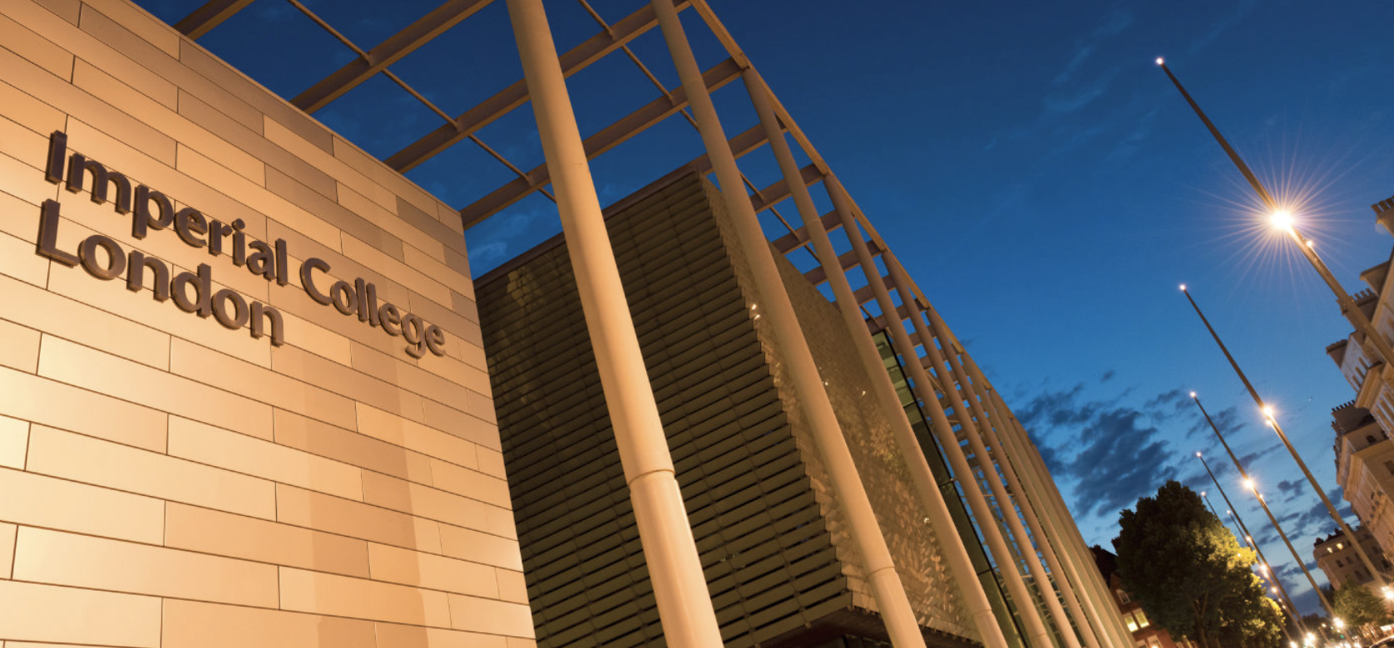

First AION Workshop at Imperial College London
March 25/26 2019
Organised by:
T. Bowcock,
O. Buchmueller [Coord.],
J. Coleman,
J. Ellis [Theory],
I. Shipsey
2-Day Workshop:
Day 1: Instrumentation
Day 2: Physics case
If you like to participate or
require further information
please contact:
fundamental-physics-admin@imperial.ac.uk
with “AION” in title.
Please register at:
http://www.hep.ph.ic.ac.uk/AION2019/

Slide 9
First AION Workshop at Imperial College London
March 25/26 2019
We have about 4 weeks left to finalize the planning for
the workshop!
For the 2nd day, Physics case, John and Oliver have
already started the planning for scope, speakers, etc.
We need to do the same for the 1st day covering
Instrumentation, Organisation (e.g. WPs, collaboration, etc)
Organised by:
T. Bowcock,
O. Buchmueller [Coord.],
J. Coleman,
J. Ellis [Theory],
I. Shipsey
2-Day Workshop:
Day 1: Instrumentation
Day 2: Physics case
If you like to participate or
require further information
please contact:
fundamental-physics-admin@imperial.ac.uk
with “AION” in title.
Please register at:
http://www.hep.ph.ic.ac.uk/AION2019/

