Slide 1
AION Working Meeting
March 8, 2019
Oliver Buchmueller, Imperial College London
and
Jon Coleman, Liverpool University

Slide 2
Workshops

Slide 3
1-day Workshop on DM@QS
The informal 1-day Workshop on the phenomenology of Dark Matter searches with Quantum Sensors, which will take place at Kings College London on March 6. The event will start at 10am and last until about 3pm.
The workshop is organised in the context of the ongoing "Quantum Sensors for Fundamental Physics” activity that was launched in Oct 16-17, 2018 in Oxford.
http://www.physics.ox.ac.uk/confs/quantum2018/index.asp
The idea is to brainstorm the options for Dark Sector searches with Quantum Sensors in categories like:
- light DM (< GeV scale) which is hard to see in DD or at the LHC because of negligible nuclear recoil or missing energy, respectively.
- ultralight (fuzzy) DM (~10^-22 eV) that behaves more like a classical wave and ends up modifying fundamental constants through oscillations.
We hope that this event will facilitate the process of establishing a sound phenomenology input for the ongoing work in the different Work Packages of QSFT (e.g. atom interferometry and spectroscopy), which in turn could help to strengthen and refine the physics case for forthcoming funding proposals. In this context we would also like to discuss the tools (e.g. Whitepaper, etc) to best inject this information in the process.

Slide 4
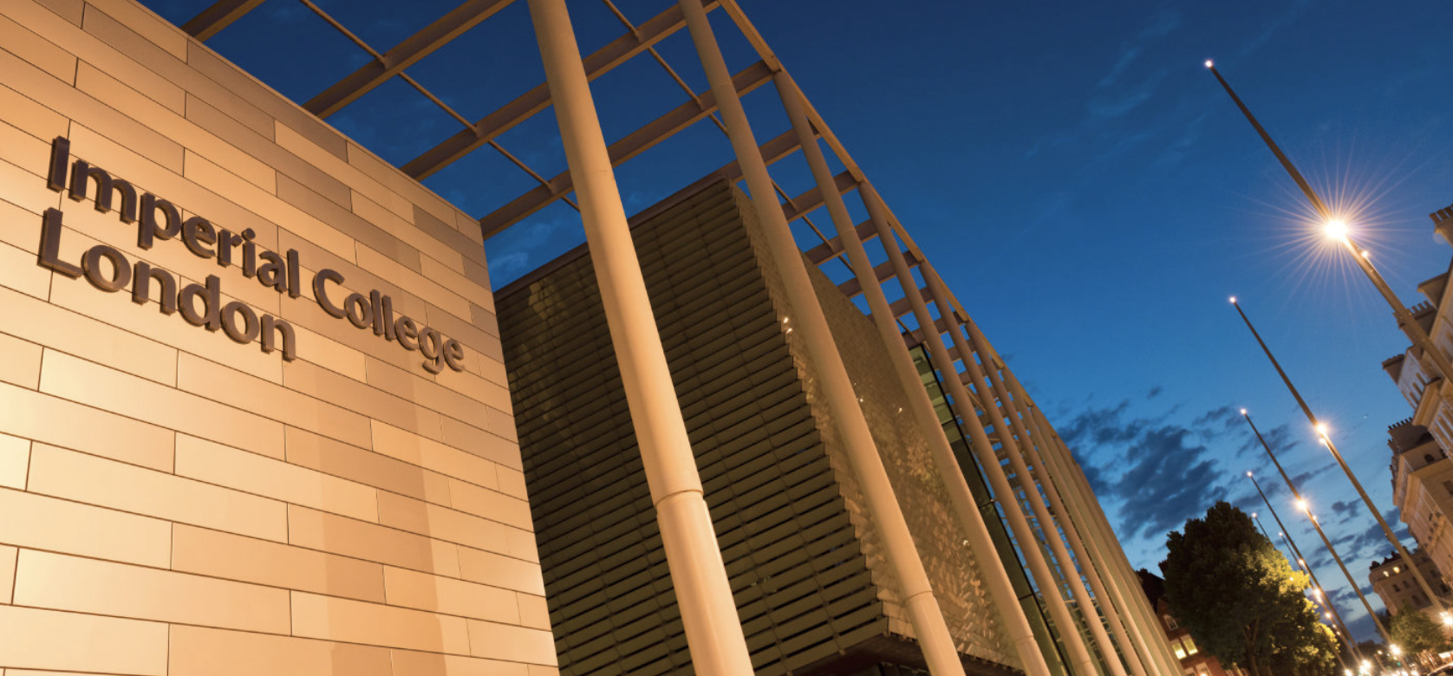

First AION Workshop at Imperial College London
March 25/26 2019
Organised by:
T. Bowcock,
O. Buchmueller [Coord.],
J. Coleman,
J. Ellis [Theory],
I. Shipsey
2-Day Workshop:
Day 1: Instrumentation
Day 2: Physics case
If you like to participate or
require further information
please contact:
fundamental-physics-admin@imperial.ac.uk
with “AION” in title.
Please register at:
http://www.hep.ph.ic.ac.uk/AION2019/

Slide 5
First AION Workshop at Imperial College London
March 25/26 2019
We have about 2 weeks left to finalize the planning for
the workshop!
For the 2nd day, Physics case, John Ellis and Oliver have
already started the planning for scope, speakers, etc.
We need to do the same for the 1st day covering
Instrumentation, Organisation (e.g. WPs, collaboration, etc)
Organised by:
T. Bowcock,
O. Buchmueller [Coord.],
J. Coleman,
J. Ellis [Theory],
I. Shipsey
2-Day Workshop:
Day 1: Instrumentation
Day 2: Physics case
If you like to participate or
require further information
please contact:
fundamental-physics-admin@imperial.ac.uk
with “AION” in title.
Please register at:
http://www.hep.ph.ic.ac.uk/AION2019/

