Slide 1
Closing Remarks
Developing the Physics Case
AION Workshop @ Imperial
March 25/26, 2019
John Ellis (King’s College London)

Slide 2
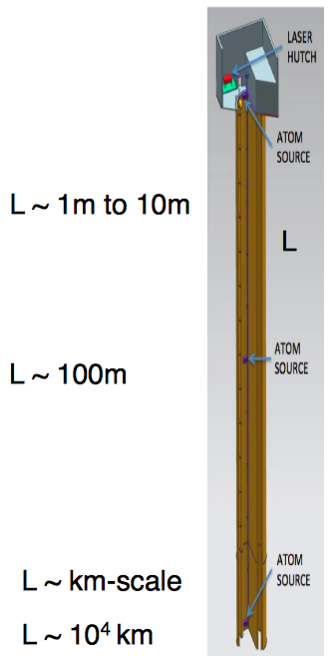
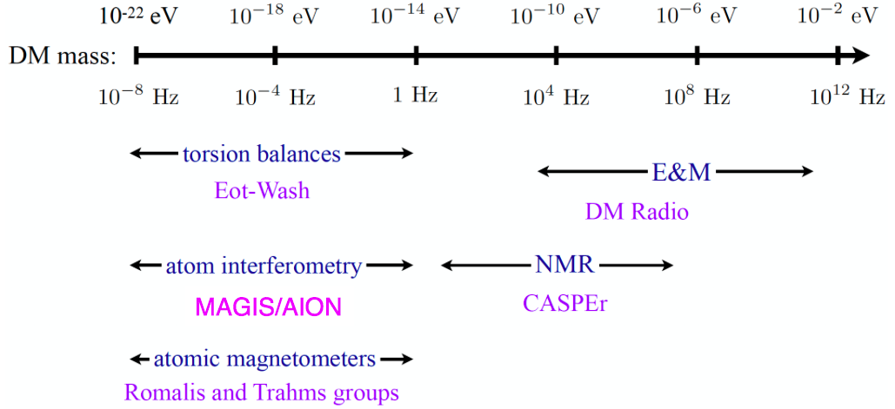
Searches for Light Dark Matter
Dark matter could be coherent waves of light bosons
  Many detection techniques, e.g. atom interferometers
also interesting for gravitational waves

Slide 3
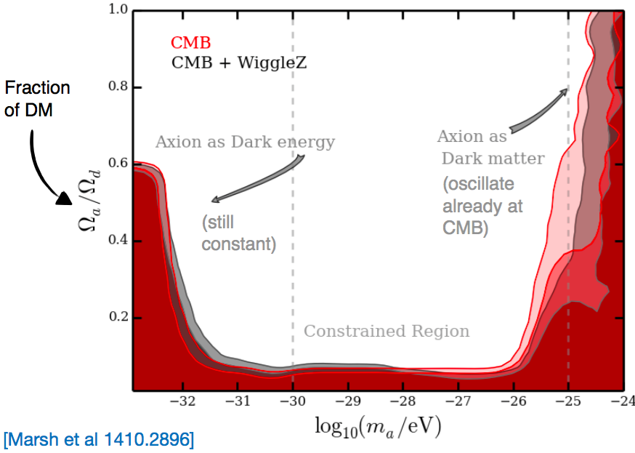
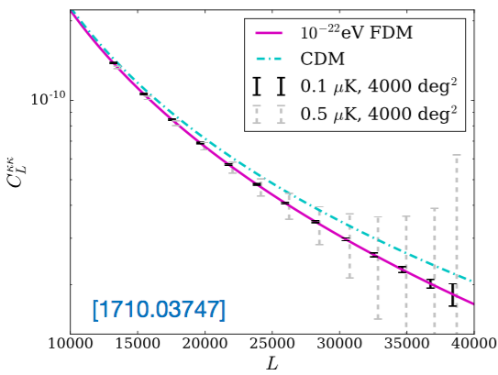
Constraints on Light Bosonic DM
& Preferred (?) Mass
Martin Bauer
Could be all DM if mass > 10⁻²⁴ eV
Small-scale structure likes
mass ~ 10⁻²² eV

Slide 4
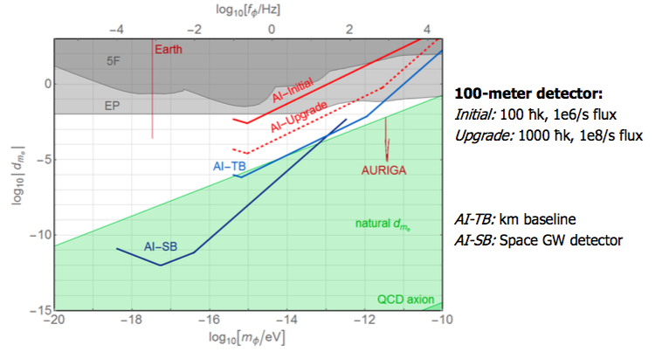
Searches for Light Scalar DM
Martin Bauer

Slide 5
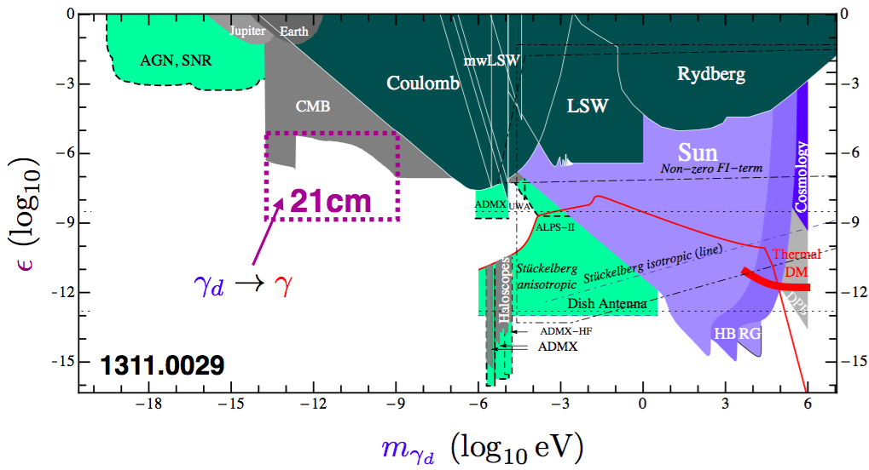
Searches for a Dark Photon
Martin Bauer

Slide 6
Possible DM Theory Tasks
Understanding the synergies between dark matter searches in this mass range and other astrophysical and cosmological observations.
Exploring the synergies between AION and other laboratory probes of ultra-light bosonic dark matter.
Showing how to identify unambiguously dark matter as the origin of a signal in AION, rather than a signal from, e.g., time-varying physical parameters or GWs, and extract the dark matter properties from the signal.

Slide 7
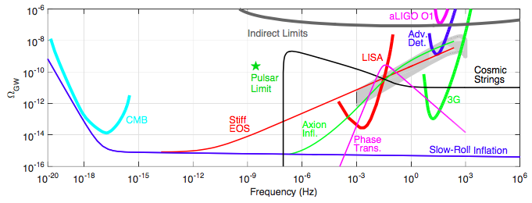

Gravitational Wave Spectrum
Gap between ground-based optical interferometers @ LISA
Electroweak phase transition? Cosmic strings?

Slide 8
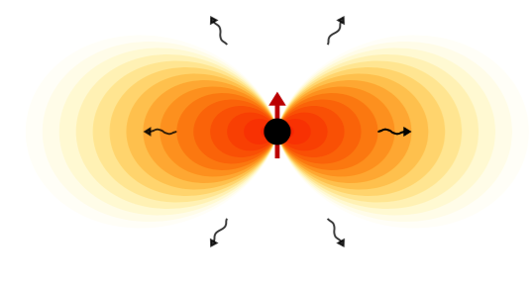

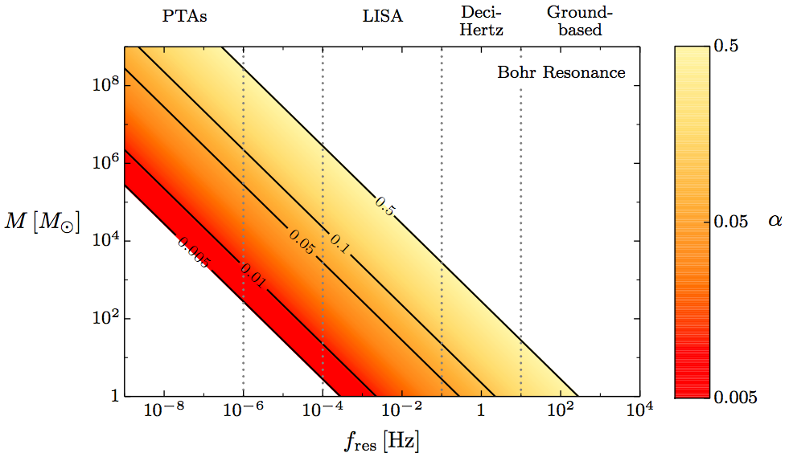
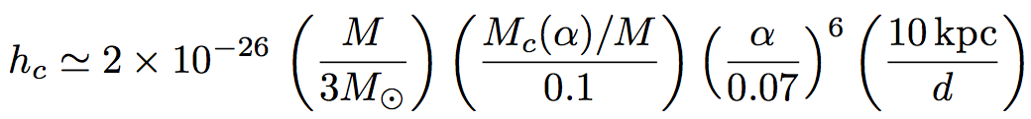
Gravitational Radiation from
Scalar Cloud around Black Hole
Horng Sheng Chia
Observe radiation
from Sagittarius A*?

Slide 9
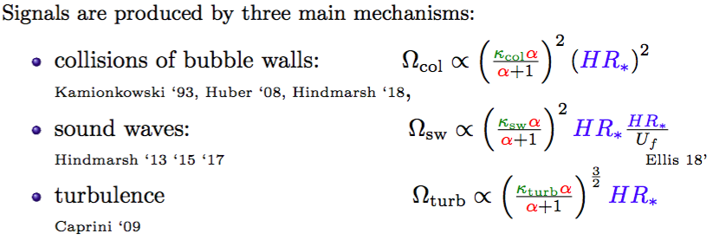
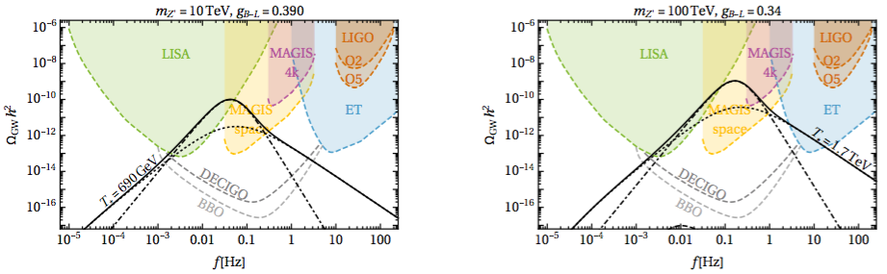
Gravitational Waves from
Phase Transition
Marek Lewicki

Slide 10
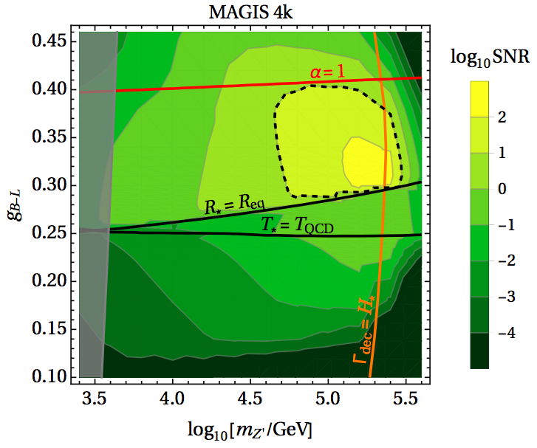
Gravitational Waves from
Phase Transition
Marek Lewicki

Slide 11
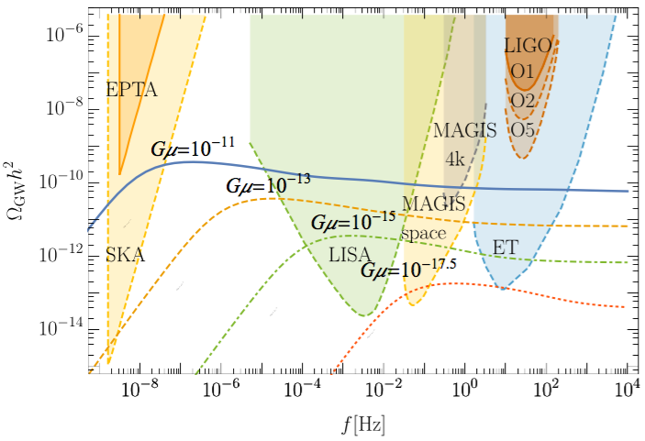
Gravitational Waves from Cosmic Strings
Marek Lewicki

Slide 12
Possible GW Theory Tasks
Calculating mid-frequency GW signatures of cosmological phase transitions, e.g., at the electroweak scale, and relating them to collider signatures of possible extensions of the Standard Model.
Sensitivity to cosmic strings.
Understanding synergies of multiband GW astronomy combining GW searches in this frequency range with LISA, LIGO/Virgo/KAGRA & other astrophysical observations, e.g., for predicting timing, directions & distances of future merger events.
Novel tests of the strong-gravity regime via, e.g., accurate timing of the GW phase evolution, that are not accessible with ground-based interferometers and LISA alone.
- Modelling astrophysical sources whose GWs peak in mid- frequency range, e.g., intermediate-mass BHs (seeds for supermassive BHs observed today), providing insight into their evolution and their host galaxies.

Slide 13
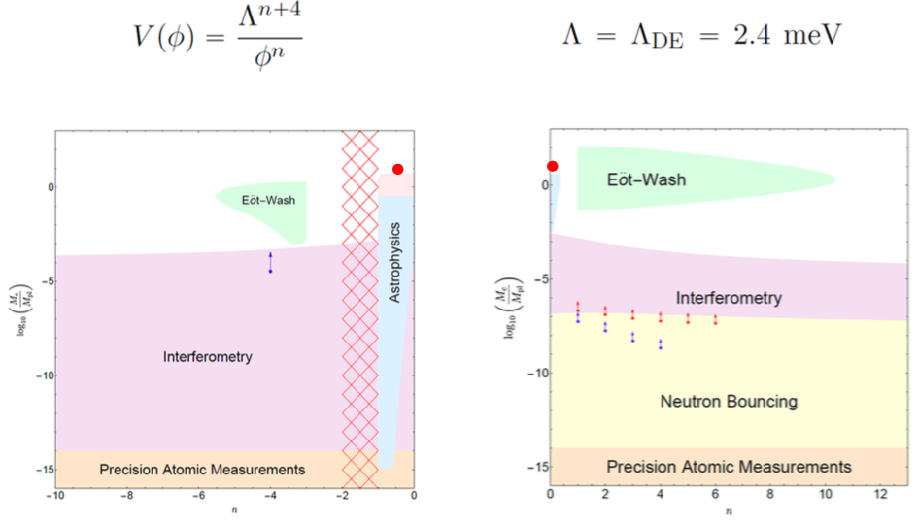
Interferometry & Chameleons?
Clare Burrage
Astrophysical hint

Slide 14
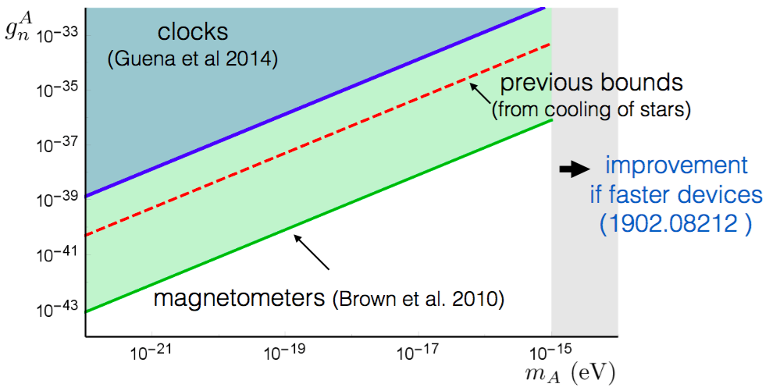
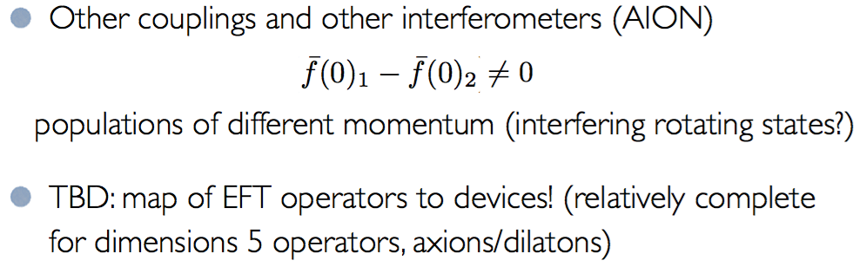
Quantum Clocks & Co-Magnetometers
Diego Blas
Axial-vector boson
Towards systematic comparisons:
to-do list

Slide 15
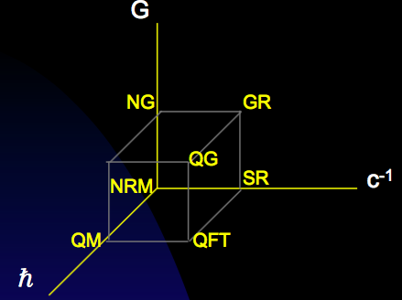
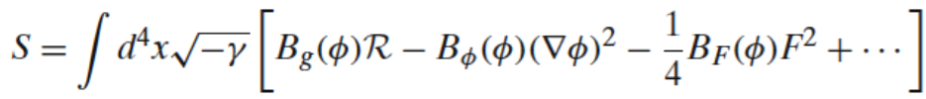
Varying Fundamental “Constants”?
Ed Copeland
Grand cube or hypercube?
How many dimensions?
Variable geometry?
Effective action in string
theory depends on moduli/dilaton fields
Varying “constants” related to varying moduli/dilaton

Slide 16
Beyond Dark Matter & GWs
- Probing fundamental “constants”, chameleons, dark energy
Detecting the astrophysical neutrinos that traverse the Earth with high flux though very small cross-section and tiny momentum
Precise interferometry may also be relevant for understanding long-range fifth forces
Fundamental (≠ environmental) decoherence

Slide 17
Gravitational Decoherence?
Charles Wang
Quantum nonlocality, expressed in the Bell inequality, which has been verified to high accuracy
Microscopic quantum decoherence could provide a dynamical mechanism of quantum-to-classical transition.
Origin in quantum gravity?
[JE, Hagelin, Nanopoulos & Srednicki (1984),
JE + Mavromatos + Nanopoulos (1992), Penrose (1996)].
Constrained by kaon physics, neutrons, …
Could the unprecedented macroscopic quantum superpositions achieved by AION provide a test of gravitational decoherence?

Slide 18
Future Planning
AION-Physics also includes atomic physics, data analysis
Particle theory/phenomenology still in fledgling state
  Continue brainstorming new ideas
  Refine/correct/add to topics proposed in previous slides
After call for proposals, will have 3 months
  When the time comes, there will be little time
Prepare to write White Paper?
Two conveners each for DM, GW, other topics:
  Martin B/Chris McC(?) Marek L/? Clare B/Diego B

