Slide 1

Proposal for
AION Project
Work Package Structure
Discussion
AION Workshop, march 25, 2019
Oliver Buchmueller, Imperial College London
and
Jon Coleman, Liverpool University

Slide 2
WP-AI [=WP AION-10 + WP AION-RD]
WP AION-10:
+ add additional costing from RAL for the task items discussed
+ add FTE estimate: at the moment its 2 FTEs
Total Budget Estimate: ~1.9M [capital] + ~0.9M [FTE] = ~2.8M
WP AION-RD
+ need to think of a better name – suggestions are AION-Upgrade, AION-Performance
+ merge task 1 and 2 in one coherent task proposal with squeezing coming in towards the end of the 3 year period. Reduce cost additionally and emphasis potential in-kind contributions
+ task 3 [LMT]: Scope & budget
Total Budget Estimate: ~1.0M [capital, task1/2] + 0.6M [capital, task3] + 0.9 [FTE] = ~2.5M;

Slide 3
WP AION-100
+ estimate of required EFT is on the high side; provide funding envelope/range instead of upper. For now we use the upper range for the total budget estimate
Total Budget Estimate: ~1.9M [FTE mainly]
WP AION-Physics
+ three main physics task are identified each will be have an EFT assigned
Total Budget Estimate: ~0.9M [FTE mainly]

Slide 4
WP MAGIS
+ the current estimate is still based on a scenario before details of the other WPs were defined. It requires now a consolidation as several task items are now also covered, at least in part, by other WPs, especially WP-AION-RD. Total Budget Estimate: ~1.8M [capital] + 1.2 [FTE] = ~3.0M;
Total AION Project budget estimate for year 1 to 3:
AION Project [1-3 year]= ~2.8M [WP AION-10] + ~2.5M[WP AION-RD] + ~1.9M[WP AION-100] + ~0.9M [WP AION-PHYSICS] + ~3.0M[WP MAGIS] = £11.1M

Slide 5
Summary
With an refined estimated of about £11M we are well compatible with our initial estimate in the outline proposal of £9.7M.
However, this new estimate is now based on a substantially improved and scrutinised task list, which will be further refined as we proceed towards the final proposal.

Slide 6
Backup

Slide 7
AION – A Staged Programme**
AION-10: Stage 1 [year 1 to 3]
1 & 10 m Interferometers & Site Development for 100m Baseline
AION-100: Stage 2 [year 3 to 6]
100m Construction & Commissioning
AION-KM: Stage 3 [ > year 6 ]
Operating AION-100 and planning for 1 km & Beyond
AION-SPACE: Stage 4 [ after AION-KM ]
Space based version
**outlined in Big Ideas proposal

Slide 8
AION – A Staged Programme**
AION-10: Stage 1 [year 1 to 3]
1 & 10 m Interferometers & Site Development for 100m Baseline
AION-100: Stage 2 [year 3 to 6]
100m Construction & Commissioning
AION-KM: Stage 3 [ > year 6 ]
Operating AION-100 and planning for 1 km & Beyond
AION-SPACE: Stage 4 [ after AION-KM ]
Space based version
**outlined in Big Ideas proposal

Slide 9
AION Project Work Packages
What is presented here is an evolution of the content described in the QSFP outline case of the AION project:
http://www.hep.ph.ic.ac.uk/AION2019/documents/AION-WP-QSFT-final.pdf
It is outcome of our regular bi-weekly AION working group meetings that were introduced following the QSFP meeting in January 2019 in Oxford.

Slide 10
AION10 [Stage 1]: Work Packages in a Nutshell
WP-AI
Form UK collaboration to design and construct AION1 and AION10 and establish a first UK AION Network by building AION-1 in selected places.
Prototype AION-10 to demonstrate the technology and to establish UK expertise and leadership in the field.
Commission AION-10, compare with AION-1 Network and perform synchronised measurement campaigns with MAGIS.
Connect to UK QTH to develop techniques and technology required to reach performance for realising science goals, in collaboration with developments in the MAGIS consortium.
WP-Physics
Establish physics programme for AION-1/10 Network.
Physics exploitation of AION-1/10 Network
Contribute to work establishing the physics case for AION-100 and beyond.
Support phenomenology for AION physics case.
WP-AION100
Work towards AION-100 including design work for AION-100 in a tower or a shaft and establish the physics case.
WP-MAGIS
Collaborate with MAGIS-100 to contribute to experiment & exploitation
Build the foundation of a strong and lasting collaboration with US.

Slide 11
AION10 [Stage 1]: Work Packages in a Nutshell
WP-AI
Form UK collaboration to design and construct AI1 and AI10 and establish a first UK AI Network by building AI1 in Liverpool and other selected places.
Prototype AI10 to demonstrate the technology and to establish UK expertise and leadership in the field.
Commission AI10 with short baseline and compare with AI1 Network.
WP-Physics
Establish physics programme for AI1/A10 Network.
Physics exploitation of AI1/10 Network
Contribute to work establishing the physics case for AI100 and beyond.
Support phenomenology both for AI in general and AION physics case.
WP-AION100
Work towards AI100 including design work for AI100 in a tower or a shaft and establish the physics case.
WP-MAGIS
Collaborate with MAGIS to contribute to experiment & exploitation
Build the foundation of a strong and lasting collaboration with US.
Pathway to technology and expertise and will form
a first network of AI’s in the UK.
This will give us physics & phenomenology
This will give us the path into the future (next bid)
This will give us MAGIS and US Collaboration

Slide 12
AION10 [Stage 1]: Main WP Connections
WP-Physics
WP-AI
WP-MAGIS
WP-AION-
100

Slide 13
AION10 [Stage 1]: Main WP Connections
WP-Physics
WP-AION-10
WP-MAGIS
WP-AION-RD
WP-AION-
100

Slide 14
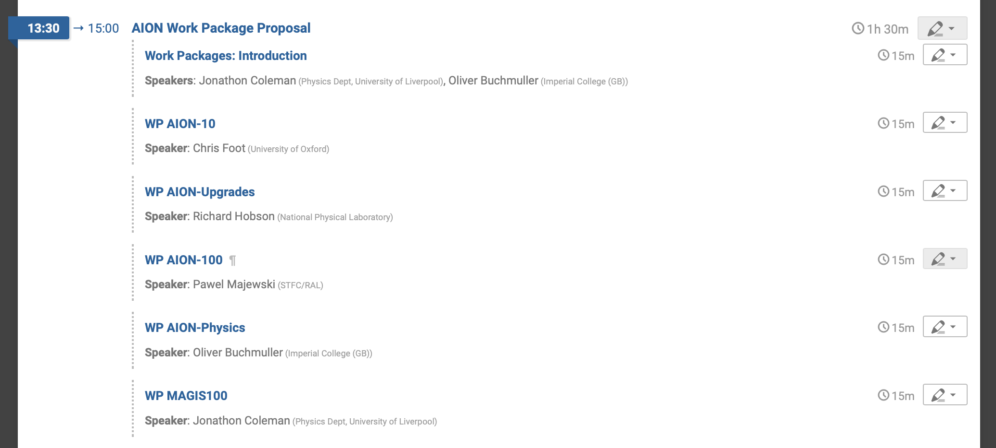
Presentation of WPs

