Slide 1
WP AION-Upgrades
How do we reach the sensitivity required to enable the science goals?
Tasks to define work areas:
  Task 1: Large momentum transfer
  Task 2a: Atom preparation
  Task 2b: Spin Squeezing
Aim to demonstrate significant advancements prior to AI-100/1000

Slide 2
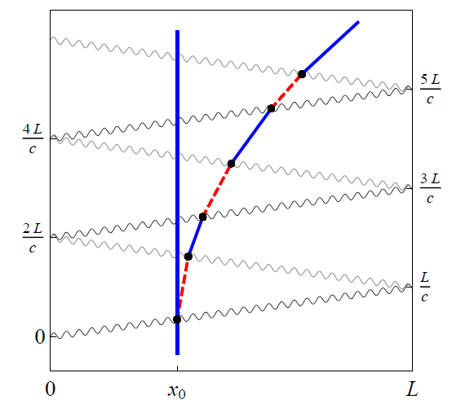
WP AION-Upgrade Task 1: LMT
To address propagation delay → single photon LMT on clock transition
Meeting MAGIS/AION goals → need 10-100x LMT increase over SOTA
Graham, et al., PRL (2013)

Slide 3
WP AION-Upgrade Task 1: LMT
To address propagation delay → single photon LMT on clock transition
Meeting MAGIS/AION goals → need 10-100x LMT increase over SOTA
Work in Task 1
Enable LMT and minimise errors:
  Single photon gradiometry on narrow line to suppress spont. emission
  Beam quality (wavefront, shaping, filtering)
  Robust and high fidelity schemes, composite
  Launching and collimation/cooling schemes
Demonstrate in laboratory and translate to AI-10
Estimated budget for Task 1
36 months of RF time, £100k/year: £300k
Capital: £550k
- Will require in-kind capital and staff (est >£2M)
Worked capital example:
Laser systems for cooling and interferometry | £260,000
Experimental control and electronics | £70,000
Optical equipment | £50,000
Vacuum system and camera | £110,000
Test and measurement | £60,000
Total | £550,000

Slide 4
WP AION-Upgrade Task 2
Design goals for 5e-19 /rt(Hz) strain sensitivity in AI-100:
Task 2a: Atom Preparation
  Prepare 10⁹ atoms at < 100 nK within 10 s; transport from sidearm to AI tube
Task 2b: Spin Squeezing
  Realise 20 dB of metrologically useful squeezing on the clock transition
Need to shrink θ

Slide 5
Upgrade task 2a: Atom preparation
High-flux ⁸⁷Sr source: 10¹¹ slow atoms/second
  State of the art: 10⁹ atoms/second
Big ⁸⁷Sr “blue” MOT: 10¹¹ atoms
  State of the art: 5 x 10⁸ atoms
Narrow-line cooling of 10¹⁰ atoms to 1 uK in dipole trap (+ optical pumping)
  State of the art: 10⁷ atoms
Evaporative cooling of 10⁹ atoms to < 100nK
  State of the art: 2 x 10⁵ atoms
Horizontal transport over 50 cm with heating < 100 nK
  State of the art: few uK heating

Slide 6
Upgrade task 2b: Spin squeezing
Apply 20 dB spin squeezing on “clock” transition
  Option 1: Cavity – either weak measurement or one axis twisting (“cavity feedback”)
  Option 2: Interactions – e.g. through Rydberg dressing
Squeezing must be metrologically useful
  Low dephasing and decoherence
Squeezing must not induce too much heating (< 100 nK)
  Cavity: Challenging due to dipole forces from cavity spatial mode; Rydberg: untested
Squeezing must be compatible with 10⁹ atoms
  Cavity: large cavity mode volume; Rydberg: must avoid inelastic collisions
Squeezing must be compatible with transport, lattice launch and delta-kick lens
  Preserve squeezing in magnetic sublevels, then transfer to clock states in AI tube?
Detection noise < 10⁻⁶ to measure squeezed population distribution

Slide 7
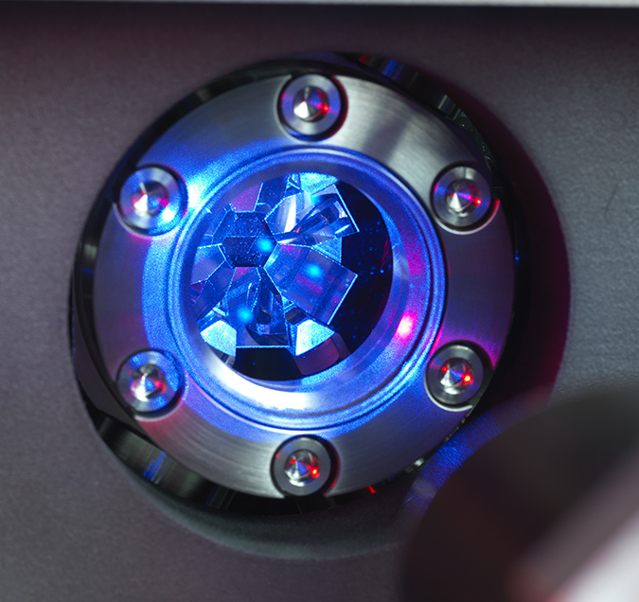
Upgrade task 2: Budget estimate
⁸⁷Sr
Labour: £600k
£600k = 2 PDRA staff at £100k/yr each
+ in kind contributions (e.g. students)
Capital: £1.0M
See table below
Laser systems for cooling | £605,000
Laser stabilisation ("clock" laser + stability transfer) | £580,000
Experimental control and electronics | £125,000
Vacuum system, camera and squeezing cavity | £140,000
Test and measurement | £100,000
Estimated in-kind contributions from hosts | -£550,000
Total capital budget | £1,000,000
But this is only 10⁷ atoms…

