Slide 1
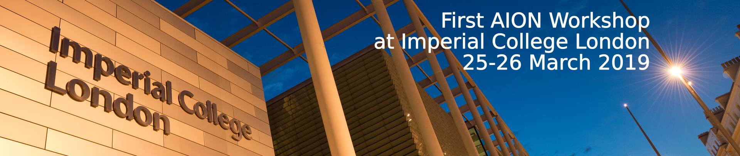
Proposal for
AION Project
Work Package Structure
AION Workshop, march 25, 2019
Oliver Buchmueller, Imperial College London
and
Jon Coleman, Liverpool University

Slide 2
AION – A Staged Programme**
AION-10: Stage 1 [year 1 to 3]
1 & 10 m Interferometers & Site Development for 100m Baseline
AION-100: Stage 2 [year 3 to 6]
100m Construction & Commissioning
AION-KM: Stage 3 [ > year 6 ]
Operating AION-100 and planning for 1 km & Beyond
AION-SPACE: Stage 4 [ after AION-KM ]
Space based version
**outlined in Big Ideas proposal

Slide 3
AION – A Staged Programme**
AION-10: Stage 1 [year 1 to 3]
1 & 10 m Interferometers & Site Development for 100m Baseline
AION-100: Stage 2 [year 3 to 6]
100m Construction & Commissioning
AION-KM: Stage 3 [ > year 6 ]
Operating AION-100 and planning for 1 km & Beyond
AION-SPACE: Stage 4 [ after AION-KM ]
Space based version
**outlined in Big Ideas proposal

Slide 4
AION Project Work Packages
What is presented here is an evolution of the content described in the QSFP outline case of the AION project:
http://www.hep.ph.ic.ac.uk/AION2019/documents/AION-WP-QSFT-final.pdf
It is outcome of our regular bi-weekly AION working group meetings that were introduced following the QSFP meeting in January 2019 in Oxford.

Slide 5
AION10 [Stage 1]: Work Packages in a Nutshell
WP-AI
Form UK collaboration to design and construct AION1 and AION10 and establish a first UK AION Network by building AION-1 in selected places.
Prototype AION-10 to demonstrate the technology and to establish UK expertise and leadership in the field.
Commission AION-10, compare with AION-1 Network and perform synchronised measurement campaigns with MAGIS.
Connect to UK QTH to develop techniques and technology required to reach performance for realising science goals, in collaboration with developments in the MAGIS consortium.
WP-Physics
Establish physics programme for AION-1/10 Network.
Physics exploitation of AION-1/10 Network
Contribute to work establishing the physics case for AION-100 and beyond.
Support phenomenology for AION physics case.
WP-AION100
Work towards AION-100 including design work for AION-100 in a tower or a shaft and establish the physics case.
WP-MAGIS
Collaborate with MAGIS-100 to contribute to experiment & exploitation
Build the foundation of a strong and lasting collaboration with US.

Slide 6
AION10 [Stage 1]: Work Packages in a Nutshell
WP-AI
Form UK collaboration to design and construct AI1 and AI10 and establish a first UK AI Network by building AI1 in Liverpool and other selected places.
Prototype AI10 to demonstrate the technology and to establish UK expertise and leadership in the field.
Commission AI10 with short baseline and compare with AI1 Network.
WP-Physics
Establish physics programme for AI1/A10 Network.
Physics exploitation of AI1/10 Network
Contribute to work establishing the physics case for AI100 and beyond.
Support phenomenology both for AI in general and AION physics case.
WP-AION100
Work towards AI100 including design work for AI100 in a tower or a shaft and establish the physics case.
WP-MAGIS
Collaborate with MAGIS to contribute to experiment & exploitation
Build the foundation of a strong and lasting collaboration with US.
Pathway to technology and expertise and will form
a first network of AI’s in the UK.
This will give us physics & phenomenology
This will give us the path into the future (next bid)
This will give us MAGIS and US Collaboration

Slide 7
AION10 [Stage 1]: Main WP Connections
WP-Physics
WP-AI
WP-MAGIS
WP-AION-
100

Slide 8
AION10 [Stage 1]: Main WP Connections
WP-Physics
WP-AION-10
WP-MAGIS
WP-AION-RD
WP-AION-
100

Slide 9
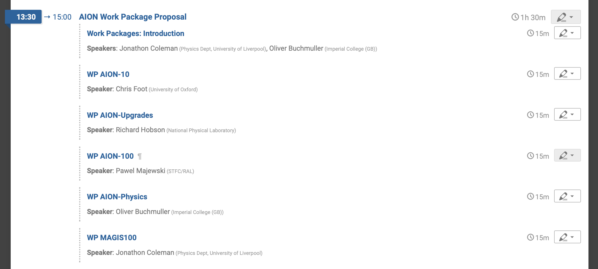
Presentation of WPs

