Slide 1
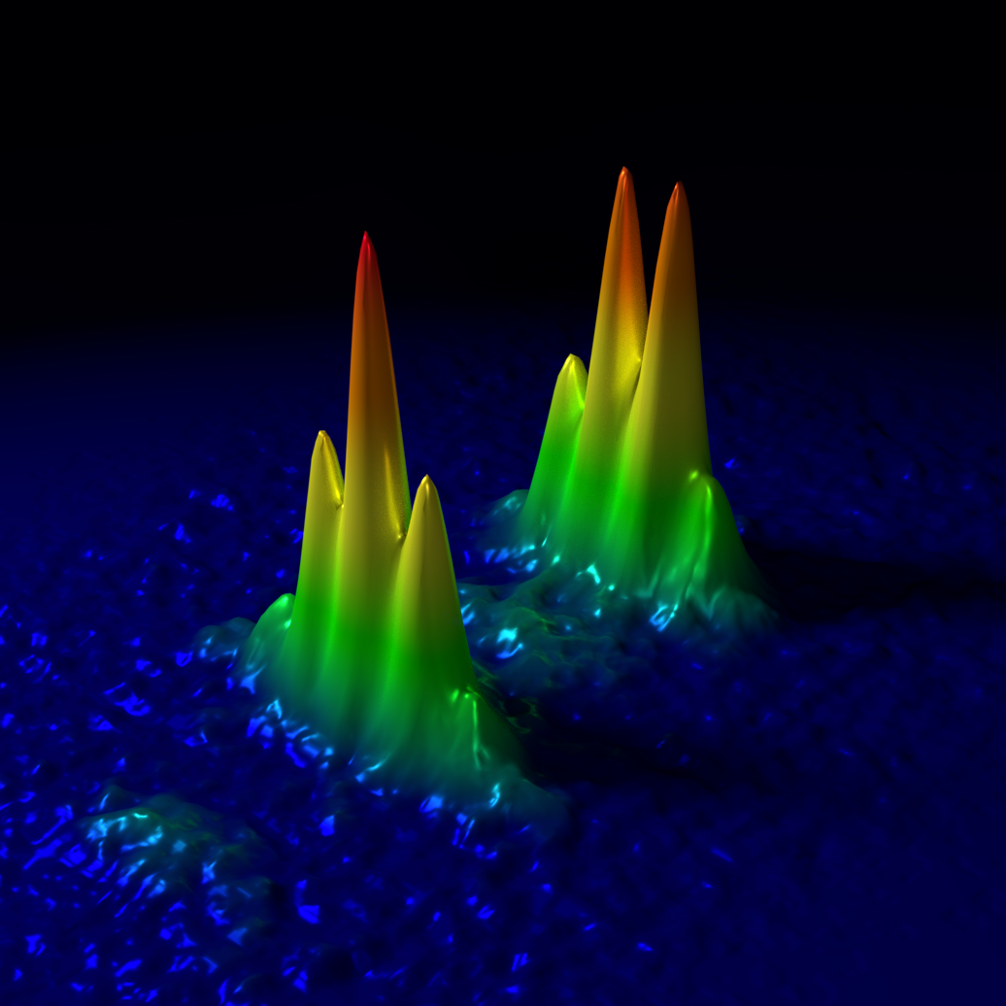
The MAGIS-100 Project in the US
First AION Workshop
Imperial College London
Jason Hogan
Stanford University
March 25, 2019
Notes:
25 min +5 min questions

Slide 2






MAGIS Collaboration
Part of the proposed Fermilab Quantum Initiative:
http://www.fnal.gov/pub/science/particle-detectors-computing/quantum.html#magis
Notes:
Collaboration between atomic physicists and particle physicists
scientists and engineers

Slide 3
Physics motivation
Dark matter and new forces
Time-dependent signals caused by ultra-light dark matter candidates (dilaton, ALP, relaxion …)
Dark matter that affects fundamental constants: electron mass, fine structure constant
Time-dependent EP violations from B-L coupled dark matter
New forces
Advancing quantum science
Atom de Broglie wavepackets in superposition separated by up to 10 meters
Durations of many seconds, up to 9 seconds (full height launch)
Quantum entanglement to reduce sensor noise below the standard quantum limit
Gravitational wave detector development
Probe for studying cosmology
Explores range of frequencies not covered by other detectors
LIGO sources before they reach LIGO band
Optimal for sky localization: predict when and where events will occur (for multi-messenger astronomy)

Slide 4
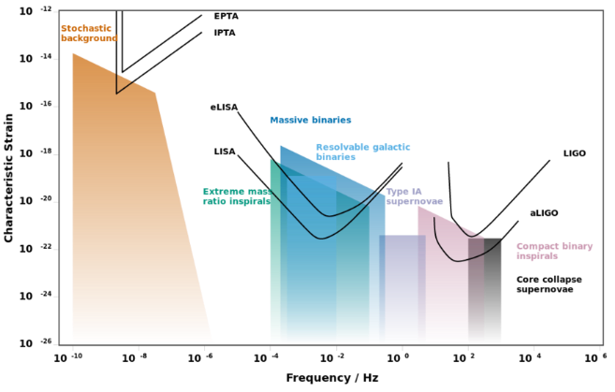
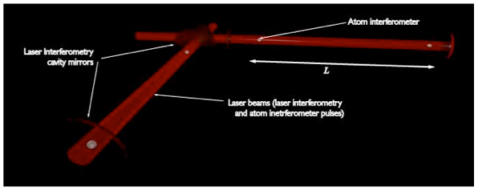
Atomic sensors for gravitational wave detection
Atomic clocks and atom interferometry offer the potential for gravitational wave detection in an unexplored frequency range (“mid-band”)
Potential for single baseline detector (use atoms as phase reference/local clock)
Mid-band
0.03 Hz to 3 Hz
Satellite proposal using optical lattice clocks + drag free inertial reference (Kolkowitz et al., PRD 2016)
MAGIS: Atom interferometry with clock atoms serving as both inertial reference + phase reference (Hogan, Kasevich)
Mid-band science
LIGO sources before they reach LIGO band
Optimal for sky localization: predict when and where inspiral events will occur (for multi-messenger astronomy)
Probe for studying cosmology
Search for dark matter (dilaton, ALP, …)
MIGA: Terrestrial detector using atom interferometer + optical cavity (Bouyer, France)
Notes:
Basic concept: atoms are good clocks (phase ref.) and good inertial references. Use clock to measure light-flight time between two inertial references traveling on their geodesics.
The mid-band is not covered by other GW detectors, would be complementary. Mid-band is very promising for sky localization and parameter estimation.
There are several large baseline proposals for GW detectors using clocks and atom interferometers (on ground and in space), each with a different approach and technical pros/cons, but based on similar basic concepts. It makes sense to study many ideas.

Slide 5
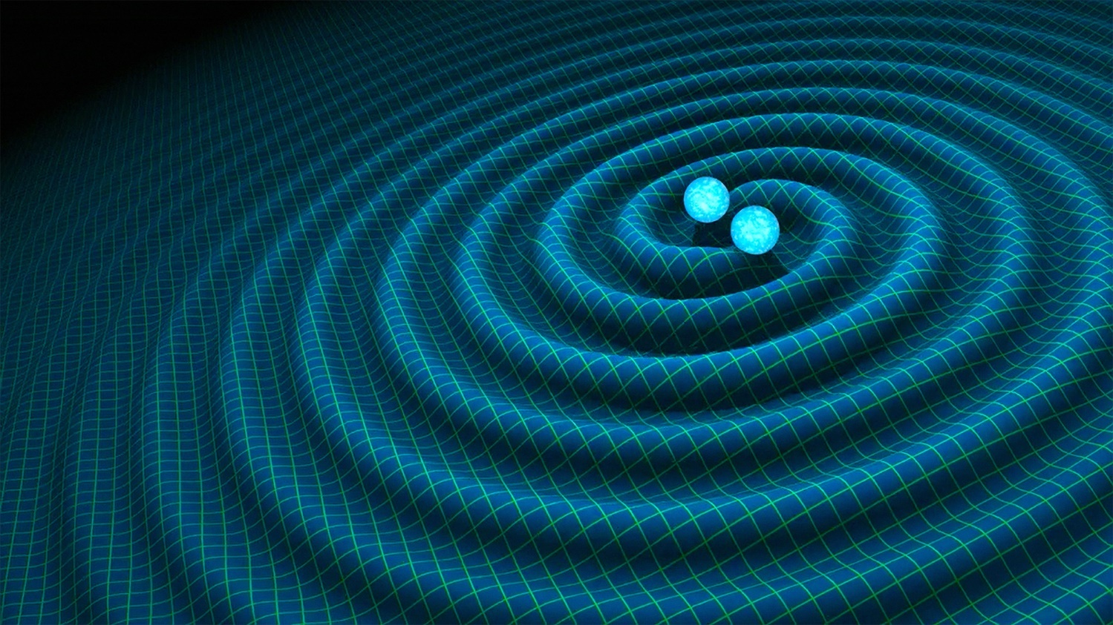
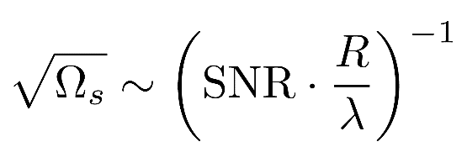
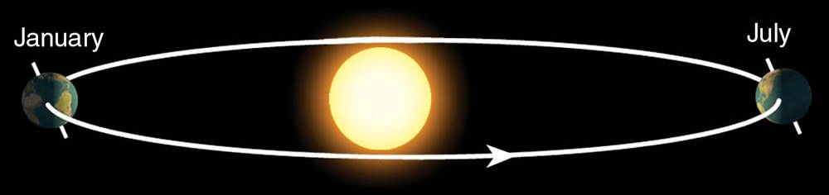
Sky position determination
Sky localization precision:
Mid-band advantages
- Small wavelength λ
- Long source lifetime (~months) maximizes effective R
λ
R
Images: R. Hurt/Caltech-JPL; 2007 Thomson Higher Education

Slide 6
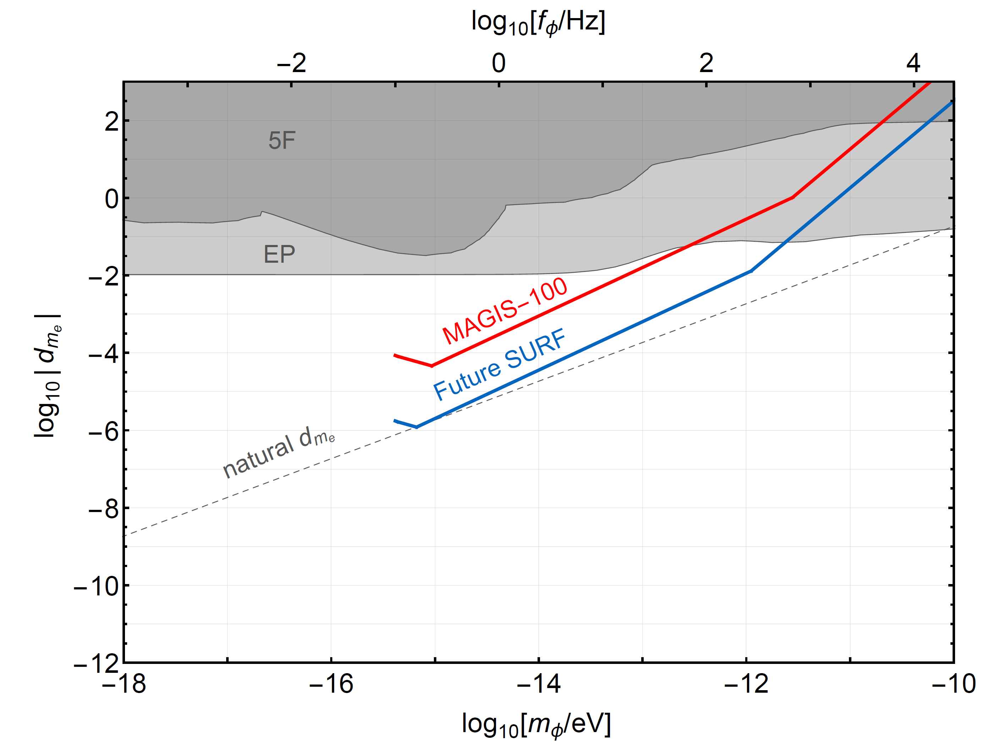
Projected sensitivity to dark matter
Sensitivity to ultralight scalar dark matter
Sensitivity to B-L coupled new force
~ 1 year data taking
Assuming shot-noise limited phase resolution
Graham et al. PRD 93, 075029 (2016).
Arvanitaki et al., PRD 97, 075020 (2018).

Slide 7
Quantum science
Realizing macroscopic quantum mechanical superposition states
Distance: Wave packets are expected to be separated by distances of up to 10 meters (current state-of-art 0.5 meters)
Time: Support record breaking matter wave interferometer durations, up to 9 seconds (current state-of-art 2 seconds)
Entanglement: 20 dB spin squeezed Sr atom sources takes advantage of quantum correlations to reduce sensor noise below the standard quantum limit (shot noise)

Slide 8
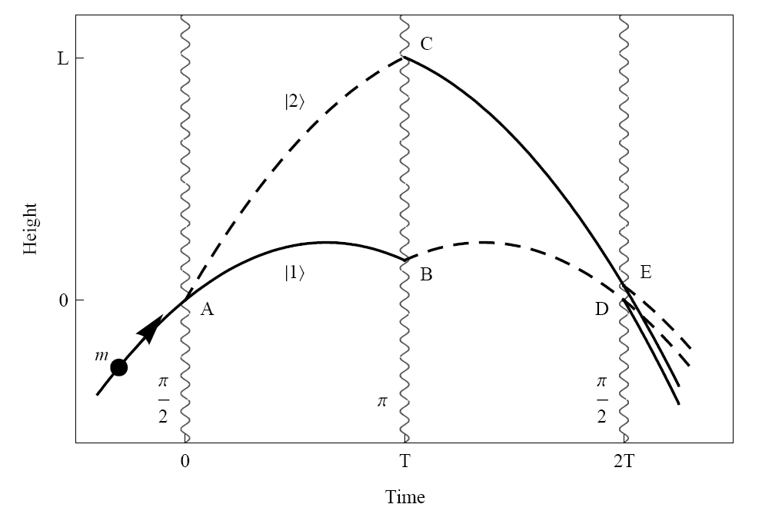
Light Pulse Atom Interferometry
Long duration
Large wavepacket separation

Slide 9
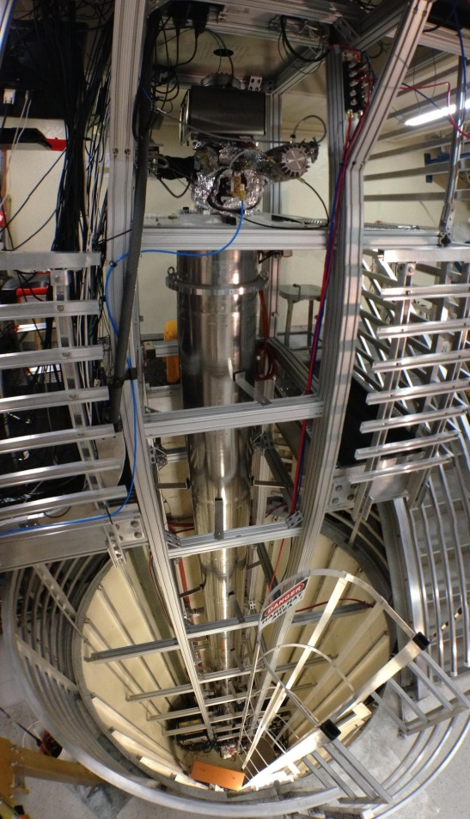
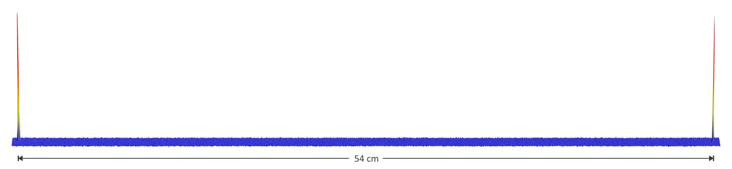
Current generation: Stanford 10-meter fountain
Milestones
Record matter wave interferometer duration (>2 s)
Record wavepacket separation (>0.5 meter)
Record effective temperature (< 50 pK)
First observation of phase shift due to space-time curvature across a single particle’s wavefunction
Large momentum transfer 90 ћk
Record accelerometer scale factor
Dual species (⁸⁵Rb / ⁸⁷Rb) gradiometer
First demonstration of phase shear readout and point source interferometry techniques
Record wavepacket separation due to multiple laser pulses
54 cm
10-meter tall Rb atomic fountain

Slide 10
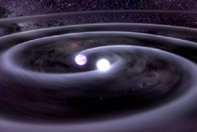
Gradiometer detector concept
Gradiometer
Compare two (or more) atom ensembles separated by a large baseline
Science signal is differential phase between interferometers
Differential measurement suppresses many sources of common noise and systematic errors
Atoms
Baseline
Laser
GW source (e.g., black hole binary inspiral)
Atoms
Science signal strength is proportional to baseline length (DM, GWs).

Slide 11
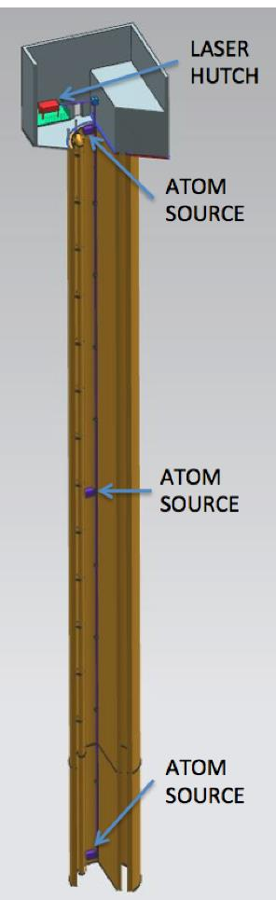
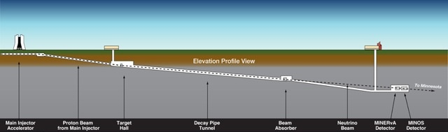




MAGIS-100: GW detector prototype at Fermilab
Matter wave Atomic Gradiometer Interferometric Sensor
100-meter baseline atom interferometry in existing shaft at Fermilab
Intermediate step to full-scale (km) detector for gravitational waves
Clock atom sources (Sr) at three positions to realize a gradiometer
Probes for ultralight scalar dark matter beyond current limits (Hz range)
Extreme quantum superposition states: >meter wavepacket separation, up to 9 seconds duration
100 meters
Notes:
MAGIS = Matter wave Atomic Gradiometer Interferometric Sensor

Slide 12

Gordon and Betty Moore Foundation grant
New funding received from GBMF
$9.8M, 5 years, start date Jan 2019
MAGIS-100 at Fermilab
100 meter vacuum tube (Fermilab design contribution)
Three atomic sources (Stanford design contribution)
Atom interferometry laser system (Northwestern design contribution)
Atom interferometry sensor development at Stanford
Hogan
Kasevich
Hogan

Slide 13
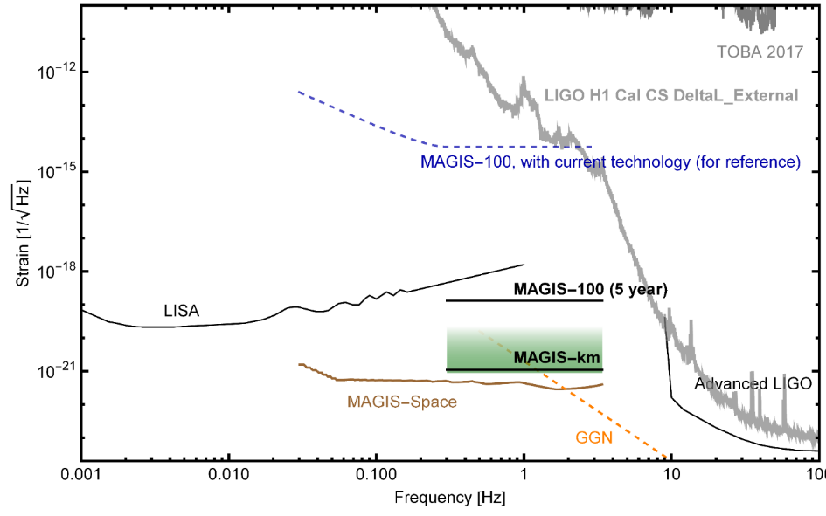
GW Sensitivity development plan (part of GBMF grant)
Phase noise improvements:
10x from higher flux
10x from squeezing
Atom source scaling: ~
MAGIS-km additional factor of 3x improvement in phase noise from flux + quantum entanglement (spin squeezing)

Slide 14
MAGIS-100 timeline: Design phase
Target Completion
Dec 2019
Northwestern
Summer 2019
Fall 2019
Dec 2019
Summer 2020
Fall 2020
Dec 2020
Northwestern
Fall 2020
Summer 2021
Dec 2021
Years 4 and 5 for science data taking and analysis

Slide 15
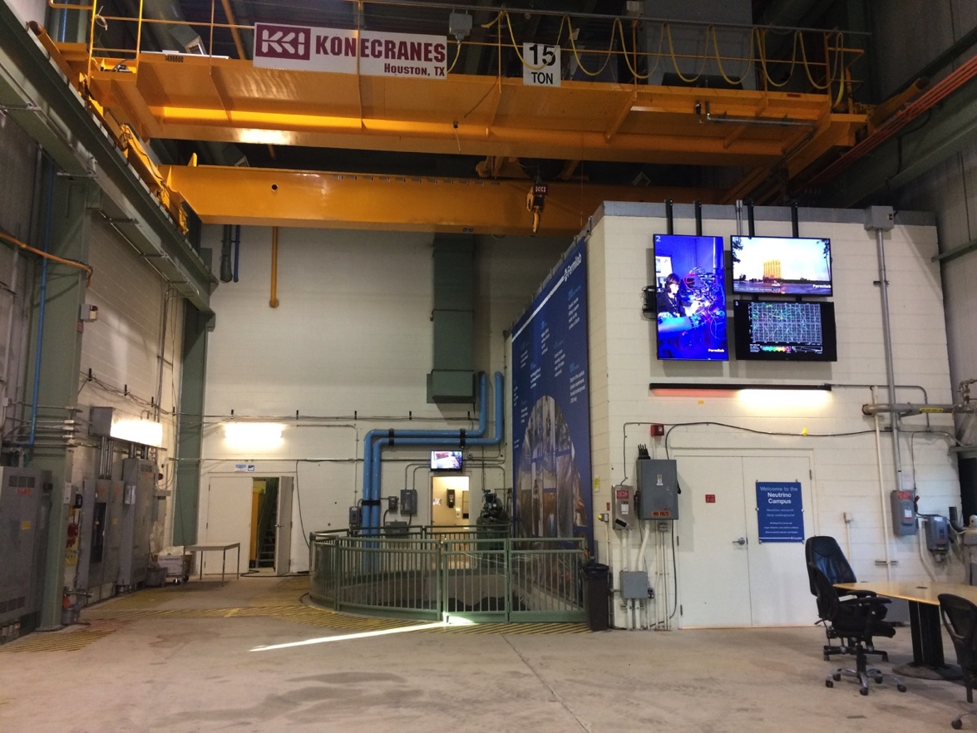
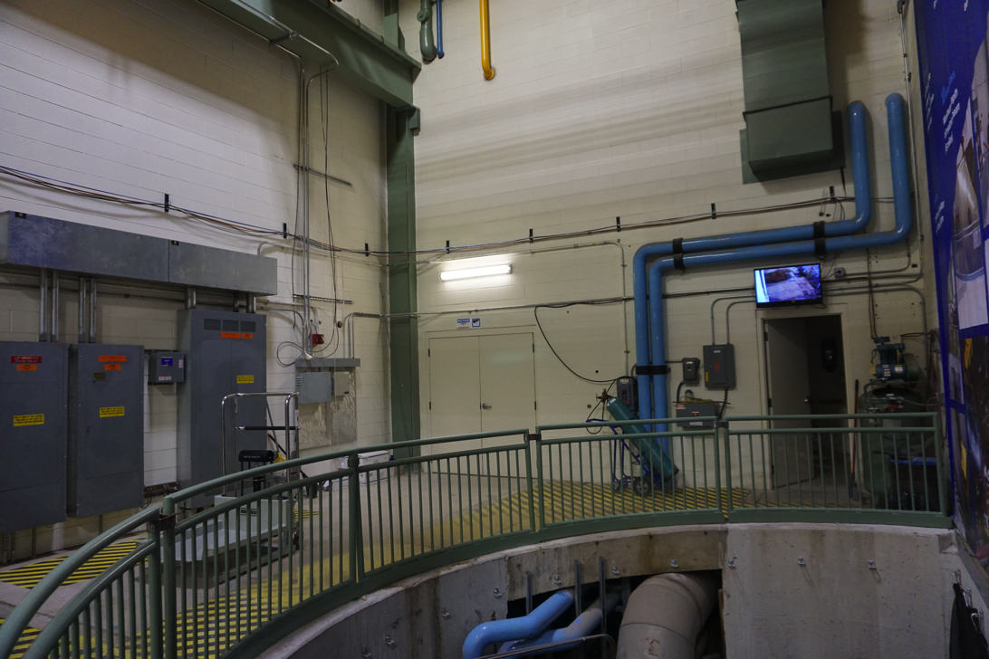
MAGIS-100 Location: MINOS building
Ground level of MINOS building
From: L. Valerio (Fermilab), MAGIS Project Engineer

Slide 16
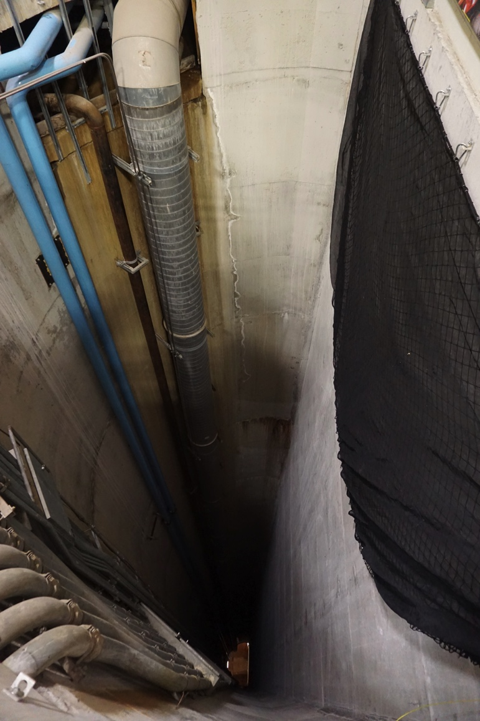
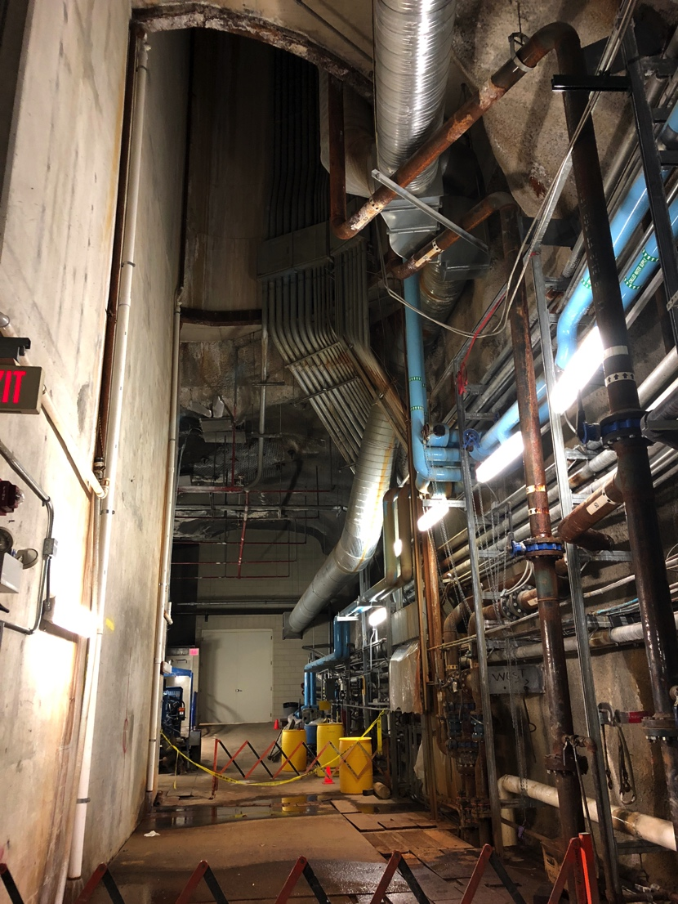
MAGIS-100 Location: Shaft in MINOS building
Top and bottom of ~100m shaft.
From: L. Valerio (Fermilab), MAGIS Project Engineer

Slide 17
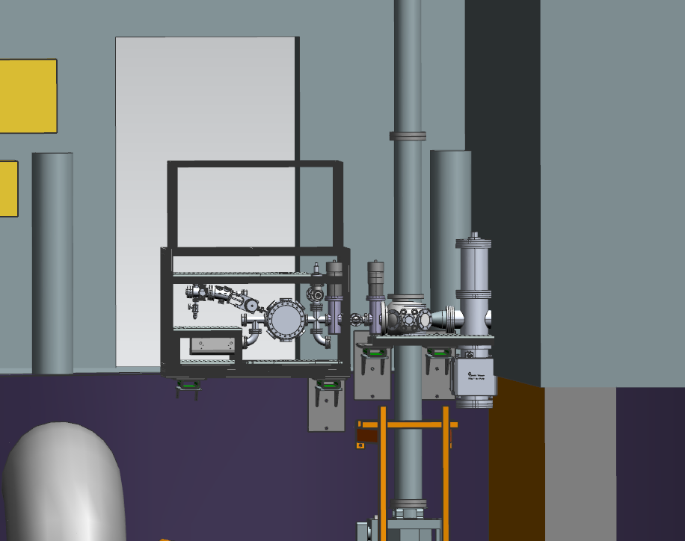
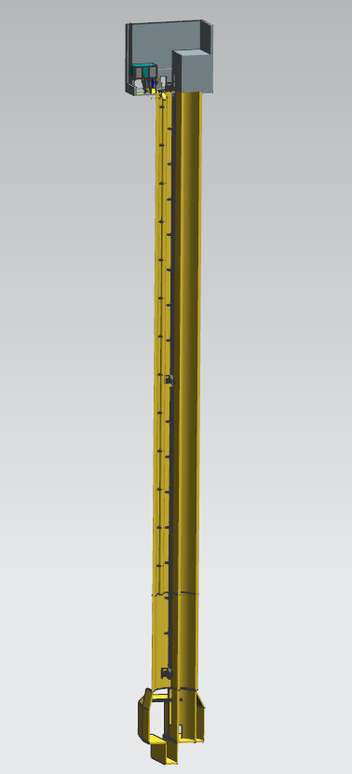
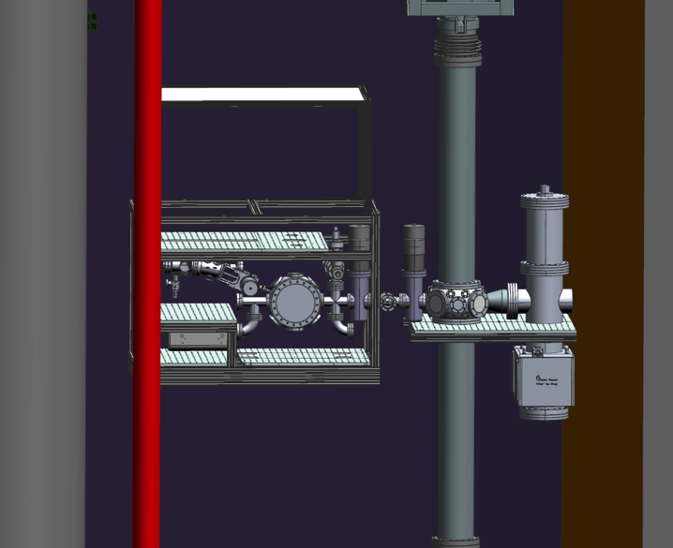
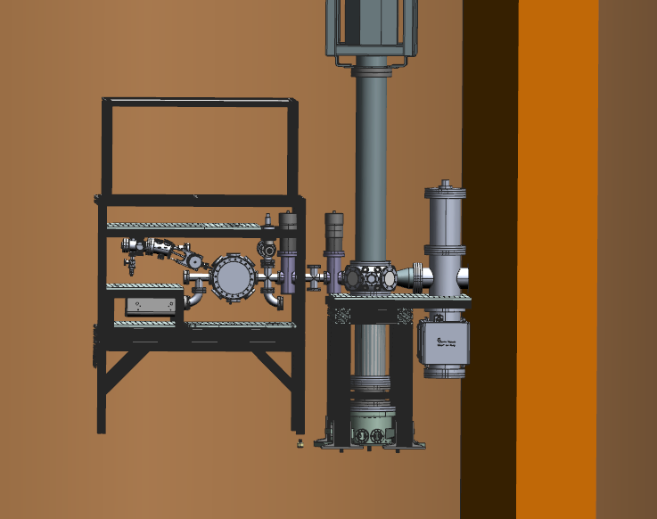
Preliminary designs – 3D model
LASER
PLATFORM
Top, middle, and bottom atom source details
ATOM
SOURCE
ATOM
SOURCE
ATOM
SOURCE
Atom sources mounted to 2m sections with in-vacuum optics for atom launch.
From: L. Valerio (Fermilab), MAGIS Project Engineer

Slide 18
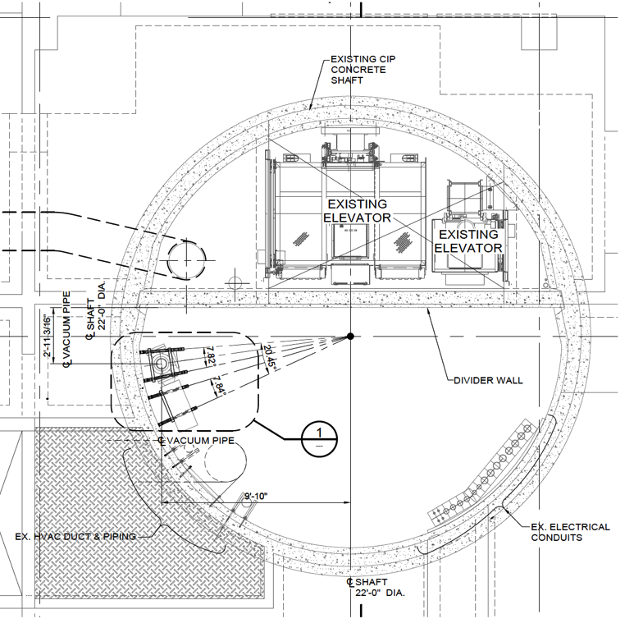
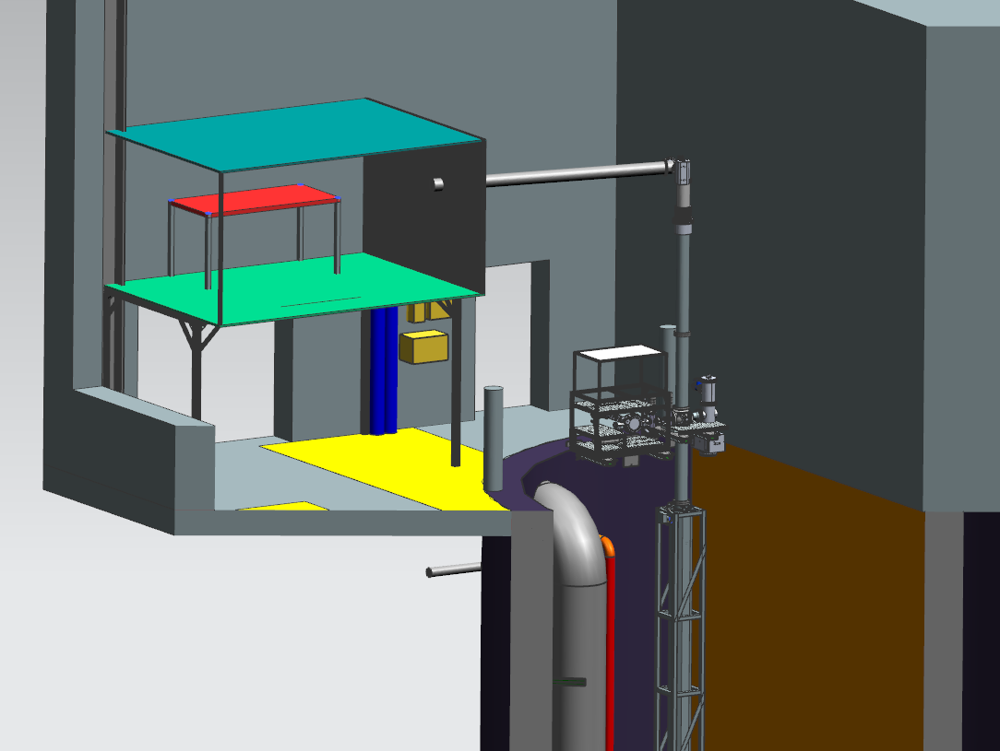
Preliminary designs – 3D model
Civil engineering drawing of shaft and proposed location of mounting brackets.
Cutaway view of laser platform and top of shaft.
From: L. Valerio (Fermilab), MAGIS Project Engineer

Slide 19
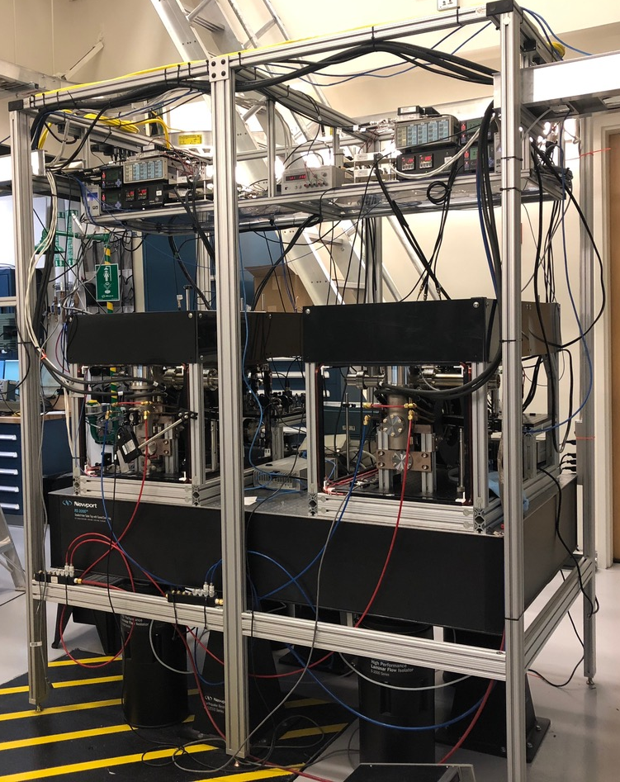
Stanford Sr 10-meter prototype
Two assembled Sr atom sources
Sr gradiometer CAD
(atom source detail)
Trapped Sr atom cloud
(Blue MOT)

Slide 20
10-meter Sr prototype design
Vacuum system CAD
Magnetic shield design and simulations
Bias magnetic field simulation
Example multi-layer design
Layer thickness 0.02 inch
Conservative
100 μm gaps
staggered layer design
2D FEM shielding results
2D transverse octagonal shield simulation, with coils for transverse bias field
Assembly to occur in summer/fall 2019
Ripple ~ 21%
Gradient ~ 40 mG/m

Slide 21
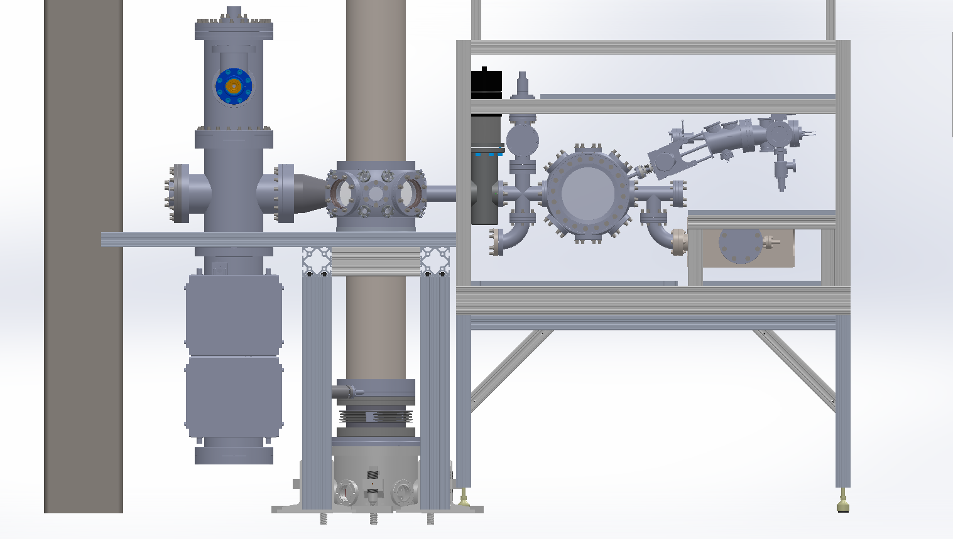
10-m prototype: Atom source connection
Connection node
Atom source
CAD model of lower atom source in Sr 10-m prototype.

Slide 22
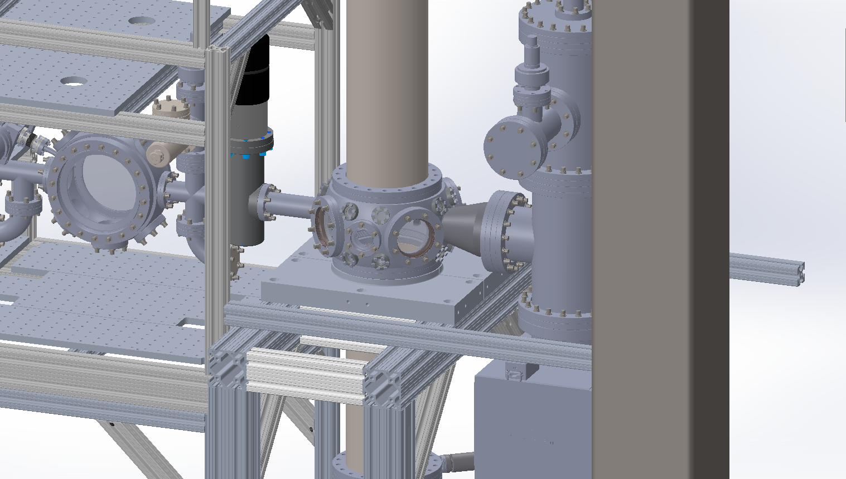
Atom source connection node
Functions
Atom detection: imaging from two directions
Lattice shuttle, lattice launch
Vacuum pumping
10-m prototype CAD

Slide 23
MAGIS-100 atom sources sub-systems
3x Sr atom sources targeting 1e6 atoms/s, nK temperature
Design based on existing Sr atom sources
System level component list (sub-systems)
Commercial Sr beam (oven, Zeeman slower, 2D MOT) Fall 2019
3D cooling vacuum chamber, pumps Spring 2020
Magnetic coils (quadrupole for MOT, bias coil set) Spring 2020
Laser frequency locks: 461 nm, 689 nm (narrow), 679 nm, 707 nm Summer 2020
Laser frequency control (AOMs, fiber EOMs) Summer 2020
RF electronics for laser frequency control Summer 2020
Power electronics (magnetic coils, DC power rails) Summer 2020
Timing control electronics Summer 2020
Laser delivery optics frame Fall 2020
1064 nm dipole trap (matter wave lensing, evaporation, shuttle) Fall 2020
Detection/diagnostics imaging system Fall 2020
Remote monitoring and tweak-up system Winter 2020
Environmental isolation and control (temperature, water infiltration, laser safety) Winter 2020

Slide 24
Atom optics
Two detection modes:
Single photon transitions on clock transition
  Long-baseline gradiometer configuration
  Gravitational wave detection
  Scalar dark matter search
Two-photon Bragg transitions
  Compare two co-located isotopes
  Time-varying Equivalence Principle violating new forces
  B-L vector coupled dark matter search

Slide 25


Clock gradiometer using single photon transitions
Excited state phase evolution:
Two ways for phase to vary:
Dark matter
Gravitational wave
Each interferometer measures the change over time T
Laser noise is common-mode suppressed in the gradiometer
Graham et al., PRL 110, 171102 (2013).
Arvanitaki et al., PRD 97, 075020 (2018).

Slide 26
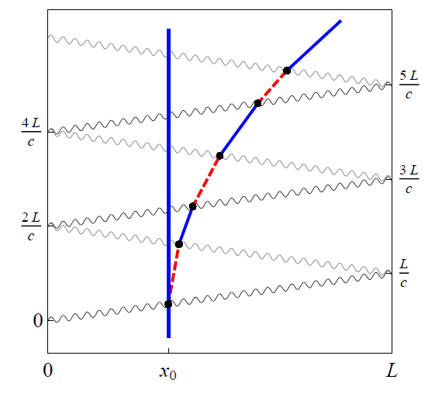
LMT and Resonant Pulse Sequences
Sequential single-photon transitions remain laser noise immune
LMT beamsplitter (N = 3)
Resonant sequence (Q = 4)
Graham, et al., PRL (2013)
Graham, et al., PRD (2016)

Slide 27
Extreme LMT with clock atoms
Alkali atoms (e.g. rubidium)
Clock atoms (e.g. strontium)
Two photon Raman/Bragg transitions for atom optics
Requires large detuning, high power to suppress spontaneous emission
Current state of the art: ~100 pulses
Single photon transition for atom optics
Spontaneous emission naturally highly suppressed (150 s lifetime clock state, other levels far detuned)
Possibility to support > 10⁶ pulses

Slide 28
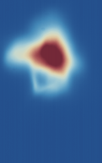
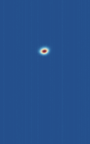
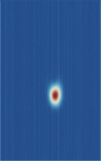
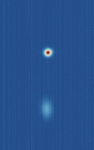
Clock atom interferometry demonstration
Goal: 698 nm clock transition in ⁸⁷Sr
Use 689 nm transition in ⁸⁸Sr for initial demonstration of LMT clock AI
689 nm transition features:
1-photon AI possible
22 μs lifetime
High Rabi frequency possible
5P ¹P₁
5P ³P_{j}
461 nm
30.5 MHz
689 nm
7.4 kHz
698 nm
1 mHz (⁸⁷Sr)
5S² ¹S₀
Push Beam
Imaging
Experimental sequence and detection protocol
Excited state
Left AI Beam
Right AI Beam
Ground state
(pushed)
Fluorescence Beams
Blue MOT
Red MOT
Pushed
red MOT
AI Ports

Slide 29
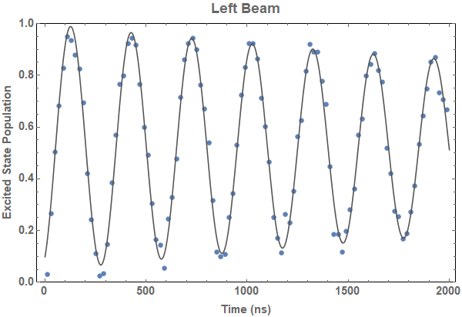
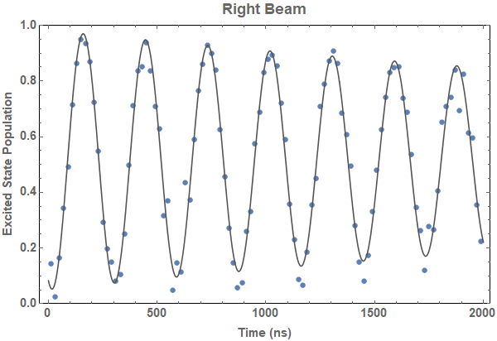
Rabi oscillations
Rabi oscillations on the 689 nm transition
Q = 87.7
Q = 82.5
High Q, high Rabi frequency (MHz), 150 ns π-time, good contrast
Residual decay explained by finite beam sizes
Trade-off between Rabi frequency and Q
Measured inhomogeneous loss could support 1000 ћk atom optics (>95% efficiency)

Slide 30
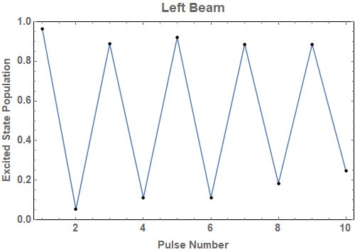
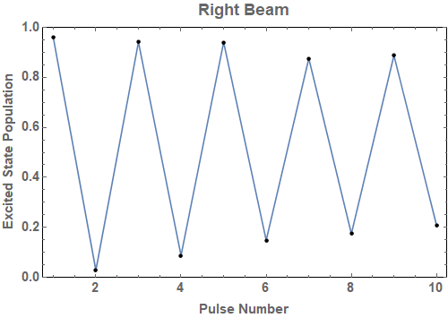
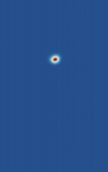
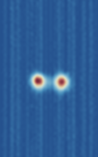
LMT beam splitter demonstration
Sequential π-pulses show similar efficiency
Beam splitter (π/2)
+ 20 alternating π pulses
41ħk Beam Splitter
(after TOF)

Slide 31
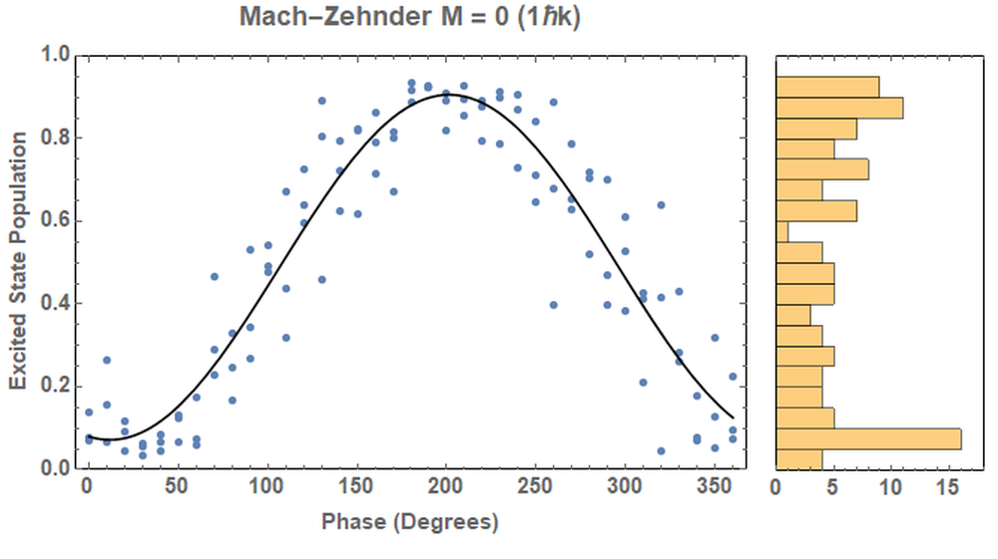

Mach-Zehnder Interferometer (Preliminary!)
M = 0 (1ħk)
Contrast = 0.9
Visibility = 0.83
Right Beam
Left AI Beam
Right AI Beam
Left Beam
π/2
π
π/2
This sequence first demonstrated (on 698 nm transition) in:
L. Hu, N. Poli, L. Salvi, and G. M. Tino, PRL 119, 263601 (2017).

Slide 32
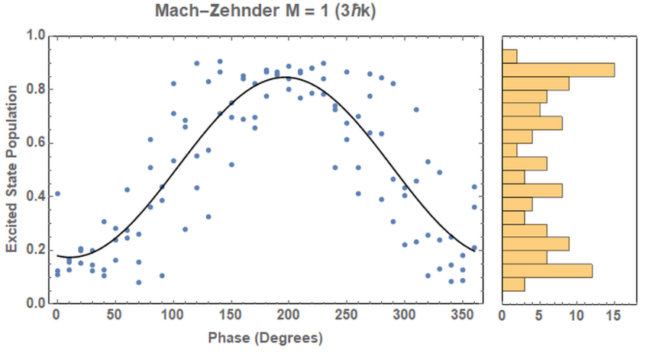
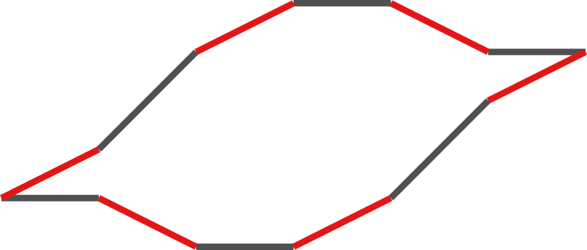
Mach-Zehnder & LMT (Preliminary!)
M = 1 (3ħk)
Contrast = 0.83
Visibility = 0.67
Left AI Beam
Right AI Beam
Right Beam
Left Beam
π/2
π
π
π
π
π
π/2

Slide 33
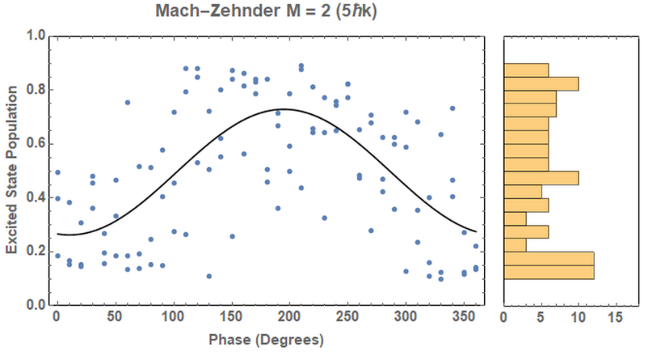
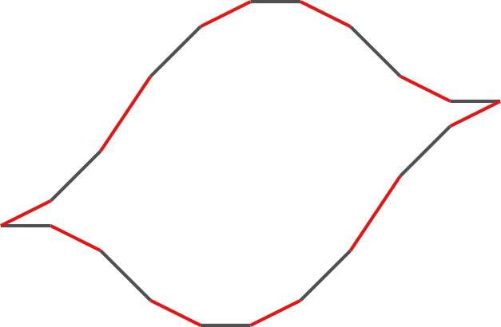
Mach-Zehnder & LMT (Preliminary!)
M = 2 (5ħk)
Contrast = 0.79
Visibility = 0.47
Left AI Beam
Right AI Beam
Right Beam
Left Beam
π/2
π
π
π
π
π
π
π
π
π
π/2

Slide 34
Mach-Zehnder & LMT (Preliminary!)
M | N π | ħk | Visibility | Contrast
0 | 1 | 1 | 0.83 | 0.90
1 | 5 | 3 | 0.67 | 0.83
2 | 9 | 5 | 0.47 | 0.79
Consistent high contrast; reduction of visibility as expected due to phase noise.
Next steps: Extend to higher LMT and implement gradiometer sequences.

Slide 35



Collaborators
Sr Atom Interferometry
Jan Rudolph
TJ Wilkason
Hunter Swan
Yijun Jiang
Ben Garber
Connor Holland
Rb Atom Interferometry
Mark Kasevich
Tim Kovachy
Chris Overstreet
Peter Asenbaum
Remy Notermans
Theory
Peter Graham
Roger Romani
Savas Dimopoulos
Surjeet Rajendran
Asimina Arvanitaki
Ken Van Tilburg
MAGIS-100:
Joseph Lykken (Fermilab)
Robert Plunkett (Fermilab)
Swapan Chattopadhyay (Fermilab/NIU)
Jeremiah Mitchell (Fermilab)
Roni Harnik (Fermilab)
Phil Adamson (Fermilab)
Steve Geer (Fermilab)
Jonathon Coleman (Liverpool)
Tim Kovachy (Northwestern)
GBMF7945
DE-SC0019174
N00014-17-1-2247

Slide 36
Backup

Slide 37
Technical noise suppression
Practical limitation of extreme LMT is fidelity of the atomic transitions
Technical noise (e.g., laser intensity, frequency) reduces transfer efficiency
Well-known techniques can be used to avoid this, at the cost of pulse area
Composite pulse sequences
LMT
π/2
π/2 π₉₀
π/2 π₉₀ π/2
Adiabatic rapid passage (ARP)
Intensity
Detuning
Time
Time
Detuning
ARP figures from: Kovachy et al., PRA 86, 011606 (2012).

Slide 38
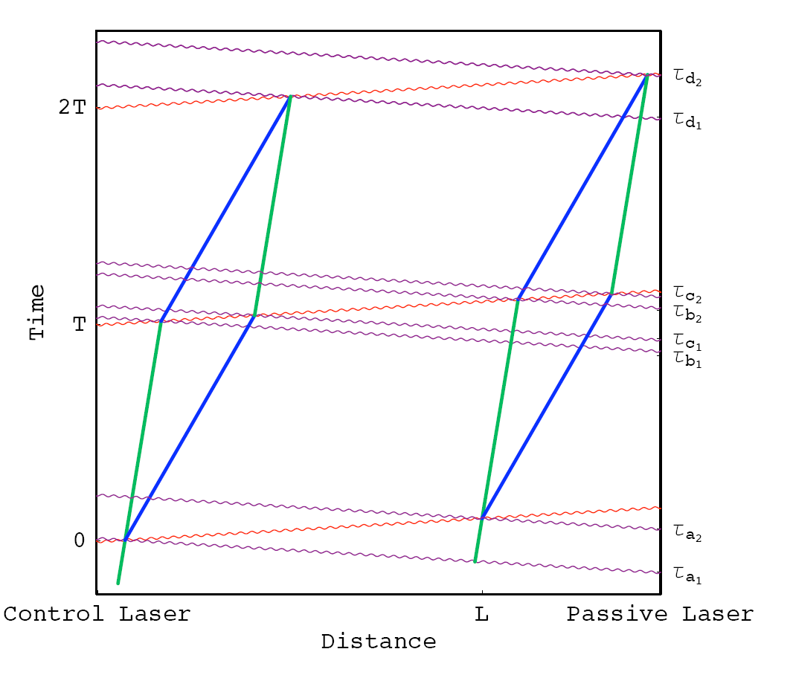
Two-photon laser frequency noise in a gradiometer
Consider a laser frequency error dw that varies at the GW frequency
Phase error:
GW Signal:

Slide 39
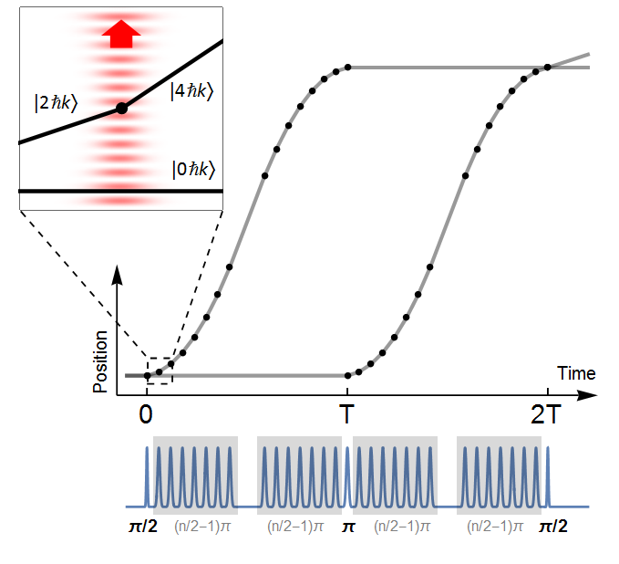
Large space-time area atom interferometry
max wavepacket separation
Long duration (2 seconds), large separation (>0.5 meter) matter wave interferometer
90 photons worth of momentum
World record wavepacket separation due to multiple laser pulses of momentum
54 cm
Kovachy et al., Nature 2015

Slide 40

Ultralight scalar dark matter
Ultralight dilaton DM acts as a background field (e.g., mass ~10⁻¹⁵ eV)
+ …
Electron
coupling
Photon
coupling
e.g., QCD
DM scalar field
DM mass density
DM coupling causes time-varying atomic energy levels:
DM induced oscillation
Dark matter coupling
Time

Slide 41
GW Sensitivity for a Satellite Detector
Satellite detector concept
Two spacecraft, MEO orbit
Atom source in each
Heterodyne laser link
Resonant/LMT sequences
L = 4 × 10⁷ meters
Dots indicate remaining lifetimes of 10 years, 1 year and 0.1 years

Slide 42
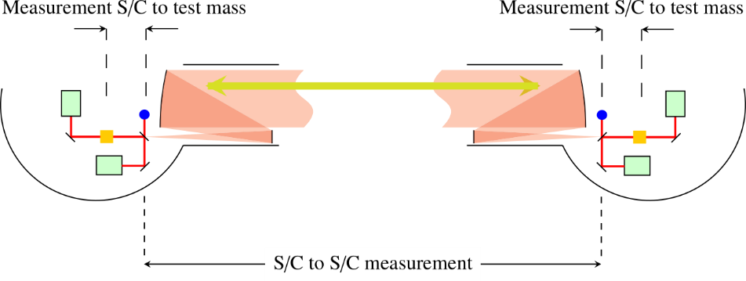
Compare to LISA
LISA:
Second baseline needed for phase reference:
Atom interferometer:
Atom test mass
- Records laser noise
- Acts as phase reference
Atoms
(Figures adapted from LISA yellow book.)

