Slide 1


Atom Interferometry in the UK
Jon Coleman

Slide 2

Outline – Atom Interferometry in the UK
UK efforts
  Experimental Efforts
    Birmingham
    RAL Space
    M Squared
    Imperial
    Liverpool
    NPL
  Sr
    Clocks - NPL
    Source - Oxford
  MAGIS-UK
  AION

Slide 3

University of Birmingham

Slide 4




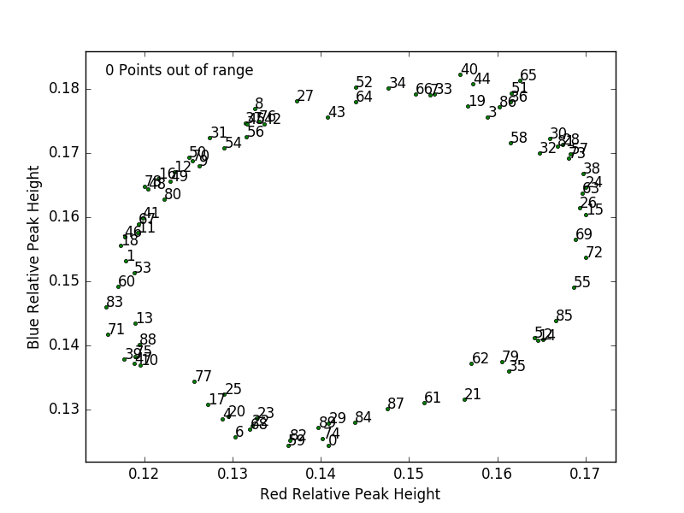
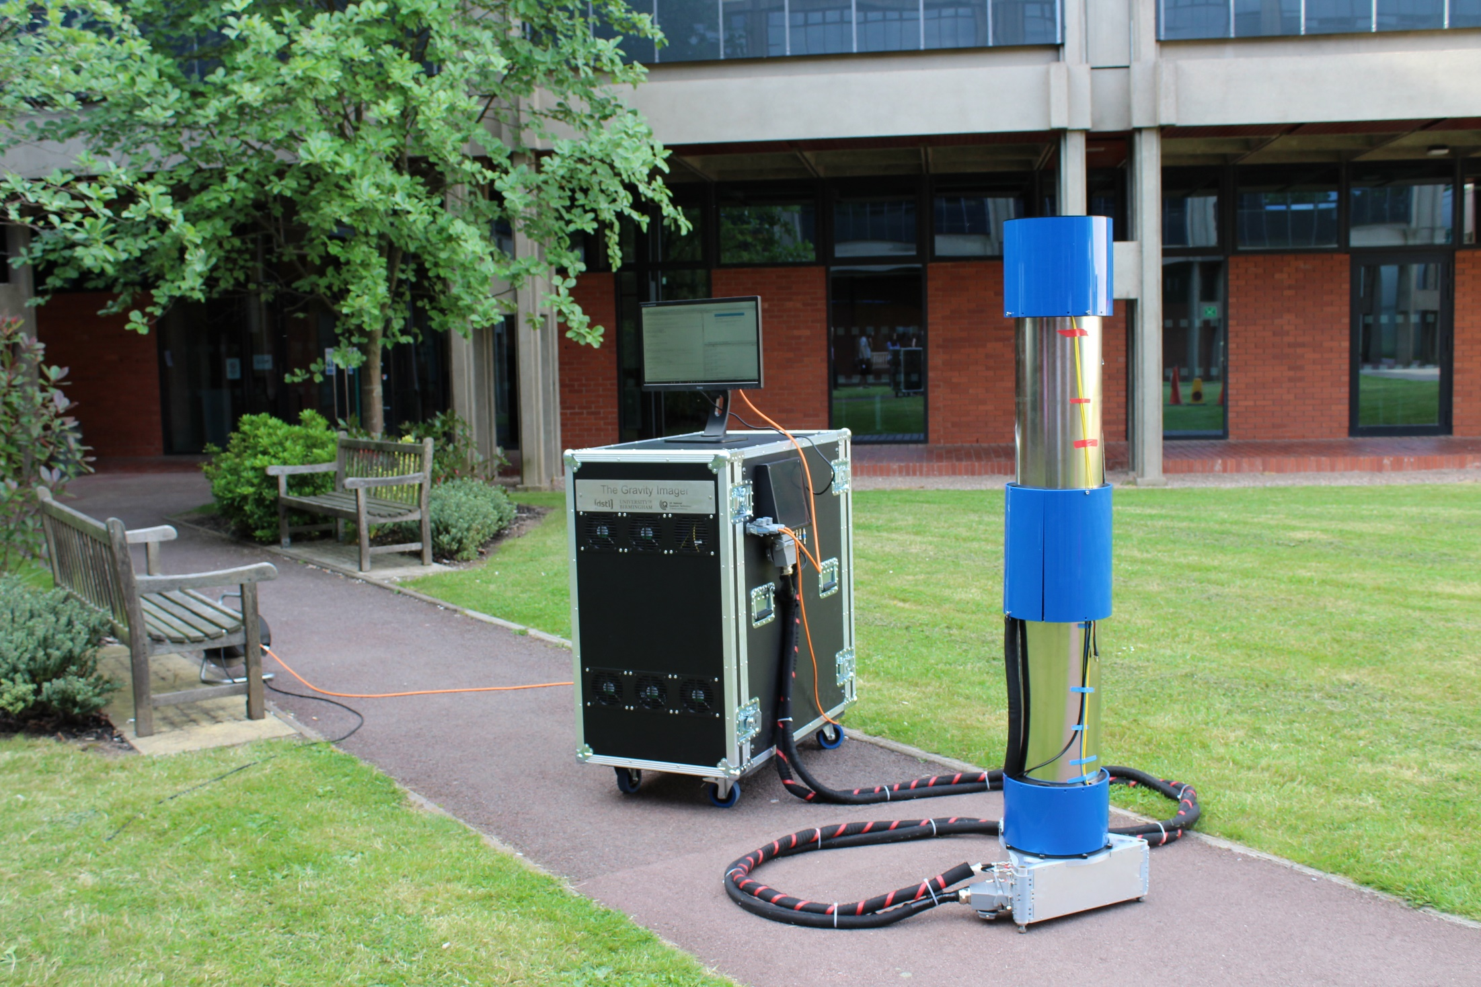
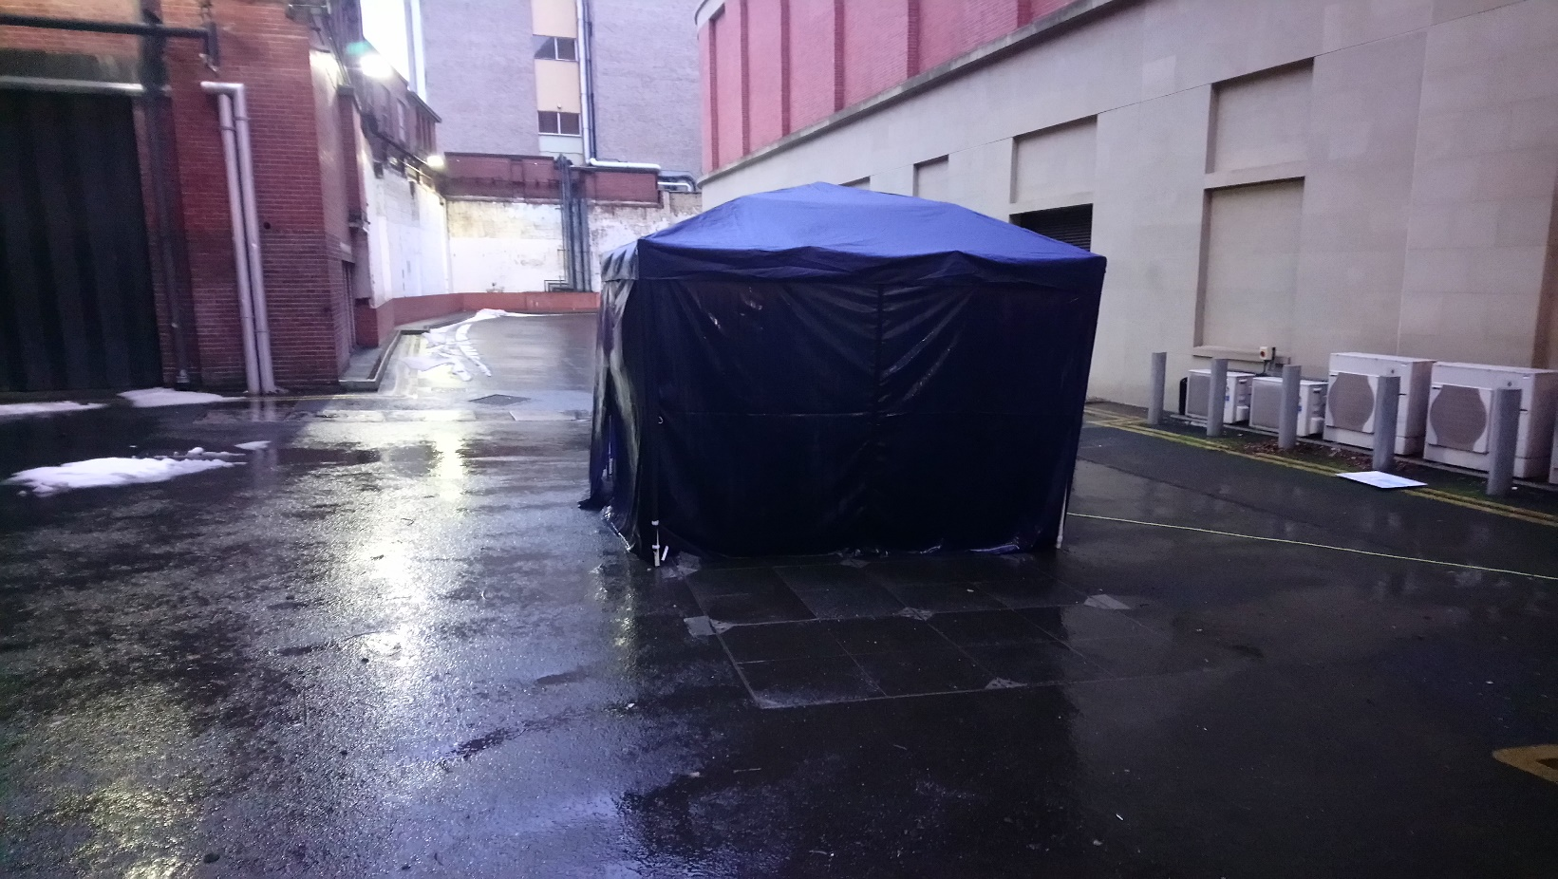
UoB Atom Interferometry
Developing gravity gradiometers for field applications¹
Demonstrate application feasibility and improve sensor readiness
Outdoor application demonstrations
Challenging environmental conditions (0 °C, wind)
Detection of 100s kg
masses in laboratory
UoB Gravity Gradiometer in “Beast from the East” storm, March 2018
Currently ~ 1000 E/Hz^{½} in field, optimising to achieve ~200 E/Hz^{½} in next year
Building MKII system in launch configuration, aiming to detect tunnels in <60 s per point
1. for example: A. Hinton et al, Phil. Trans. R. Soc. A, 375, 20160238 2017
m.holynski@bham.ac.uk

Slide 5
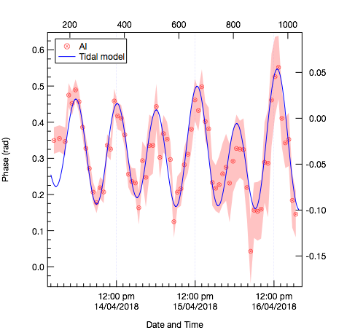
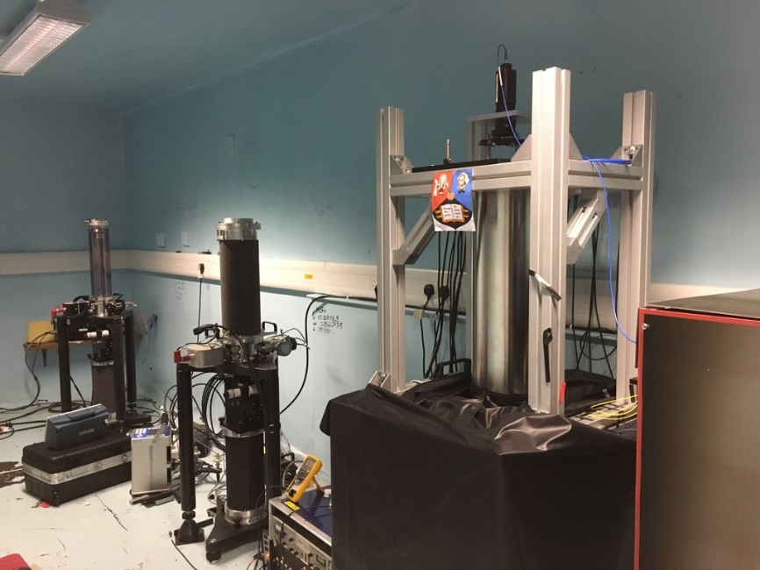
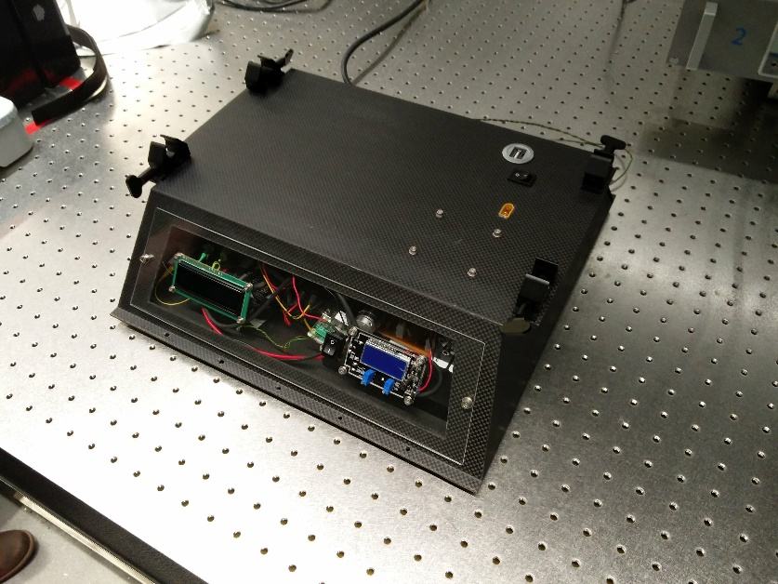
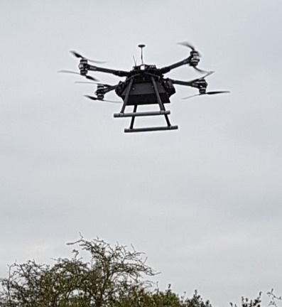
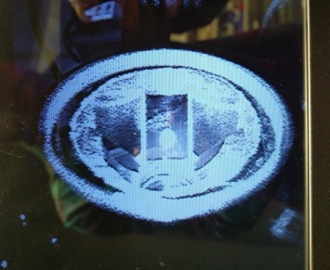
UoB Atom Interferometry
Transportable gravimeters and compact gradiometry for UAVs
Investigating applications in satellite laser ranging, geophysics, metrology
Current performance 5 ng in 30 min, now focusing on long term stability and accuracy
Compact and flexible OSSB laser system for reduced systematics¹
UoB Gravimeter with FG5s at NERC SLR facility measuring tides (2017)
Compact cold atoms systems
Building low size, weight, power gravity gradiometer
12 kg, 50 litres, initial target ~2000 E/Hz^{½}
UAV GG prototype and MOT creation in flight
1. L. Zhu et al, Opt. Express 26, 6542-6553, 2018
m.holynski@bham.ac.uk

Slide 6
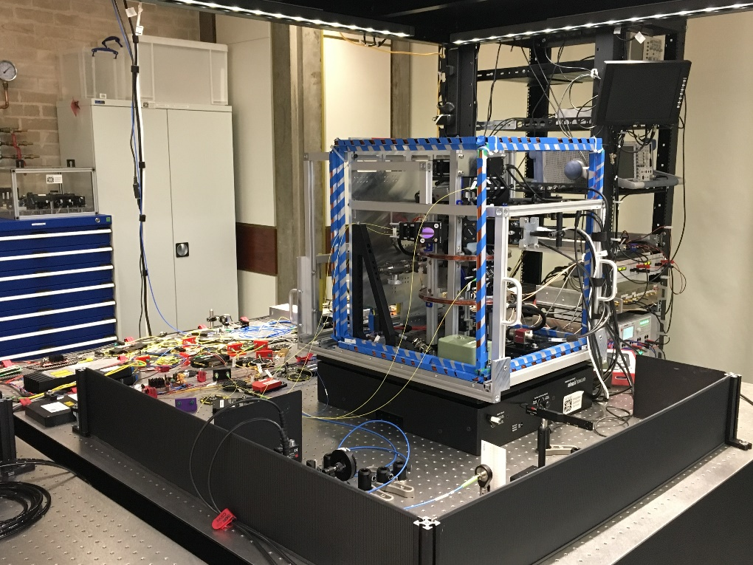
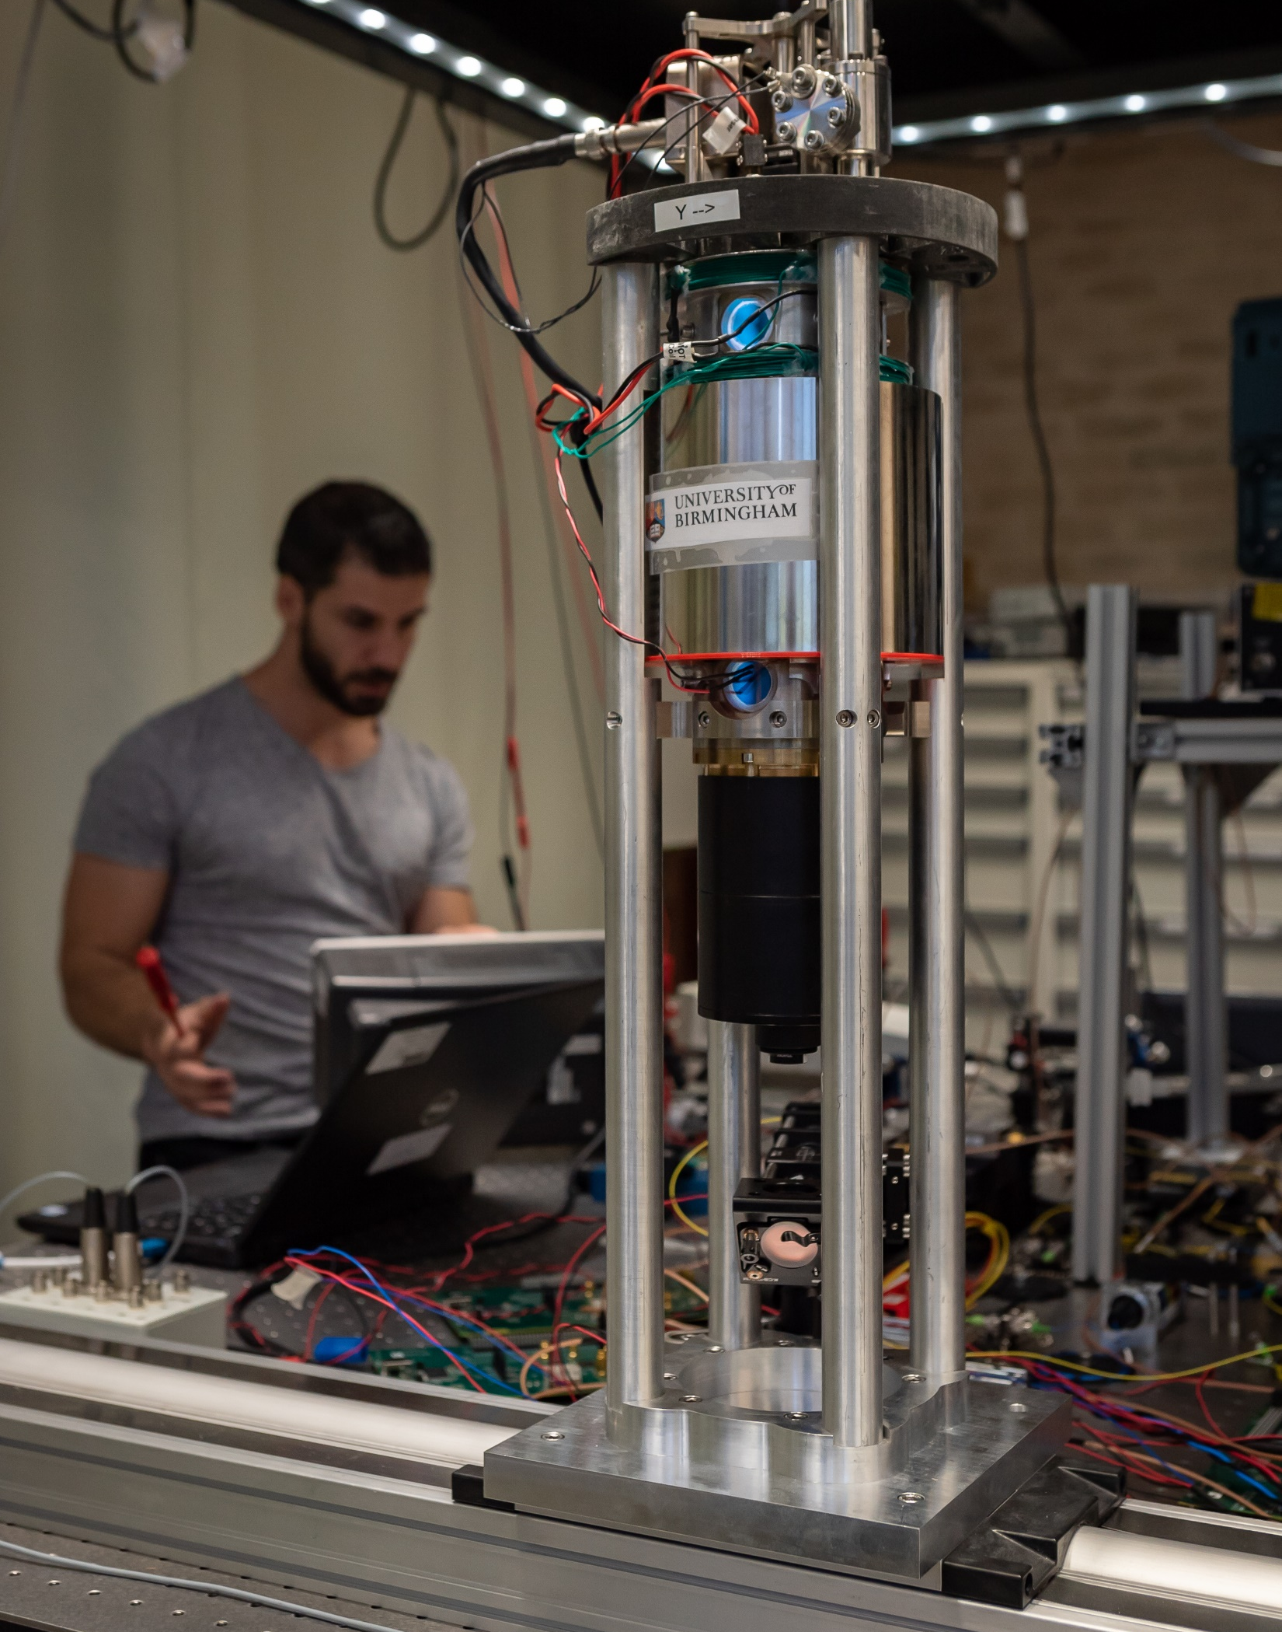
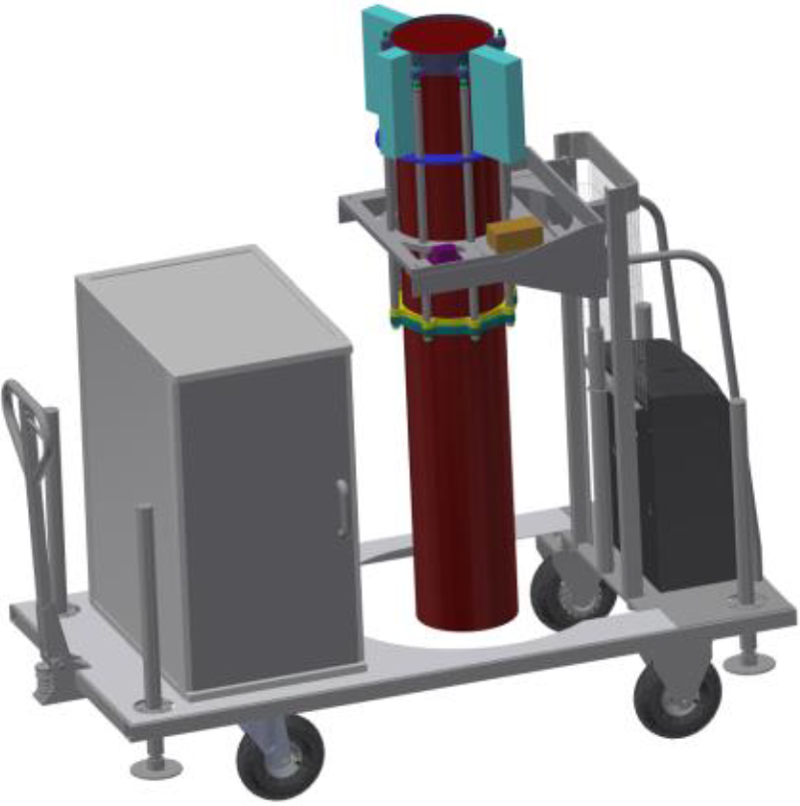
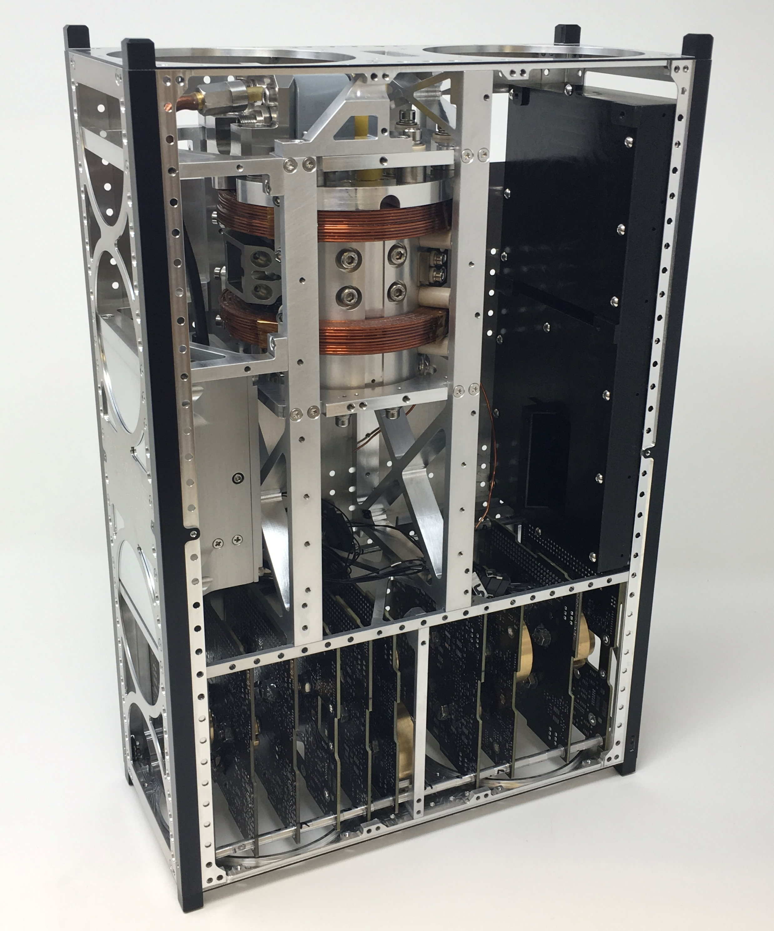


UoB Atom Interferometry
Collaboration with multiple industry partners
  Testbed systems for atom interferometry: techniques and new hardware
  16 Innovate UK projects in atom interferometry, e.g.:
RTF: Rapid test of new hardware or techniques
GP: testing of atom interferometers on moving platforms
REVEAL: Industrial prototype gravity gradiometer with
CASPA: 6U CubeSat payload for atomic sensing in space with
and partners
and partners
m.holynski@bham.ac.uk

Slide 7

Quantum Sensors at RAL Space
Dr. Tristan Valenzuela
UKRI/STFC – RAL Space

Slide 8

RAL Space Objectives
Identify current technology needs
Space Electronics for Cold Atoms, Lasers, Vacuum, …
Liaise with agencies
UKSA, ESA
Build partnership relations with academia and industry
Uni of Birmingham, Uni of Strathclyde, UK QT Hubs
e2v, SSTL
“Space-ify” subsystems
Integrate space ready quantum sensors

Slide 9
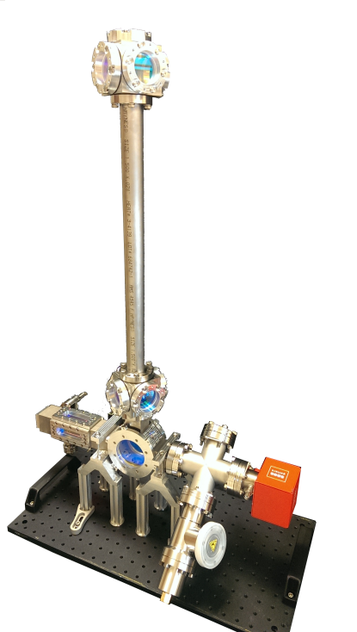
Gravity Gradiometer
Status:
Vacuum chamber assembled
Optics assembled
3D MOT being optimised and characterised
μ-shield being procured
Next Steps:
Atomic fountain implementation and optimization
Rabi oscillations and Ramsey Spectroscopy
Gravity measurement (Atom Interferometry in atomic fountain, single cloud)
Atom Cloud “Juggling”
Gravity Gradient measurement (Atom Interferometry in atomic fountain, two clouds)
2 layers
m-metal shield
(not yet present)
70cm
tall fountain
2D MOT
3D MOT
Notes:
We are currently finishing the setup of our Gravity Gradiometer. We have a 2D-3D MOT working and are optimising and characterising the 3D MOT. We expect to get the atoms to temperatures below $5μK$. After what, we will be launching the cold atom cloud in a 70cm tall atomic fountain to perform interferometry in one cloud for gravity measurements or two clouds simultaneously for gravity gradient measurements.

Slide 10

M Squared

Slide 11
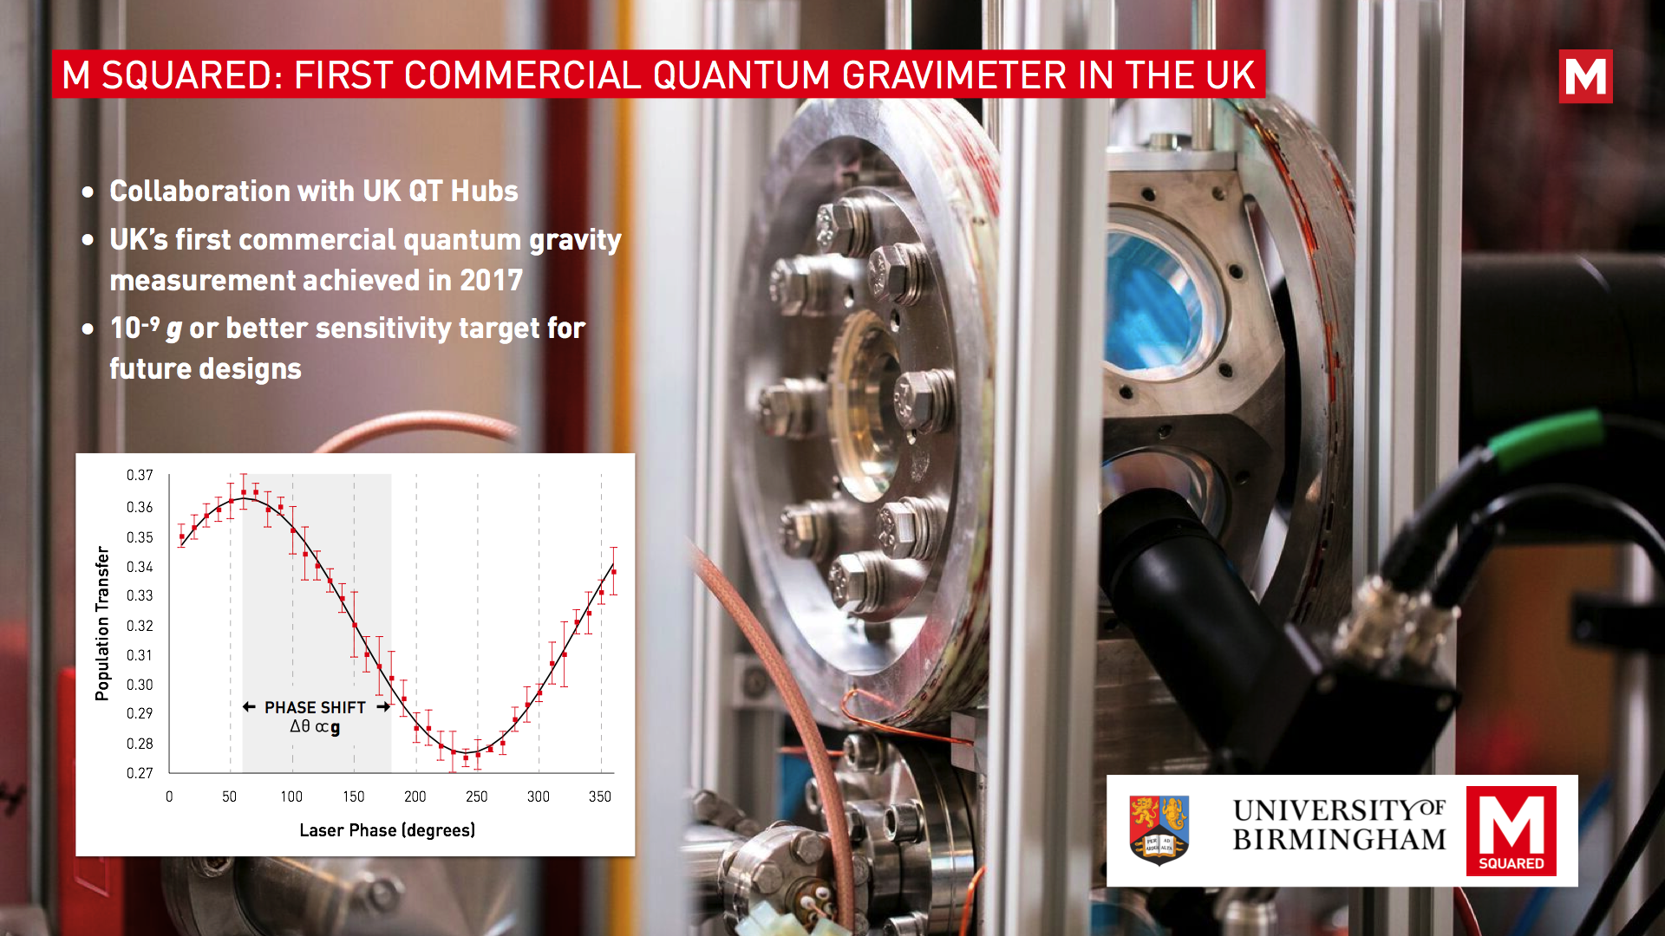

Slide 12
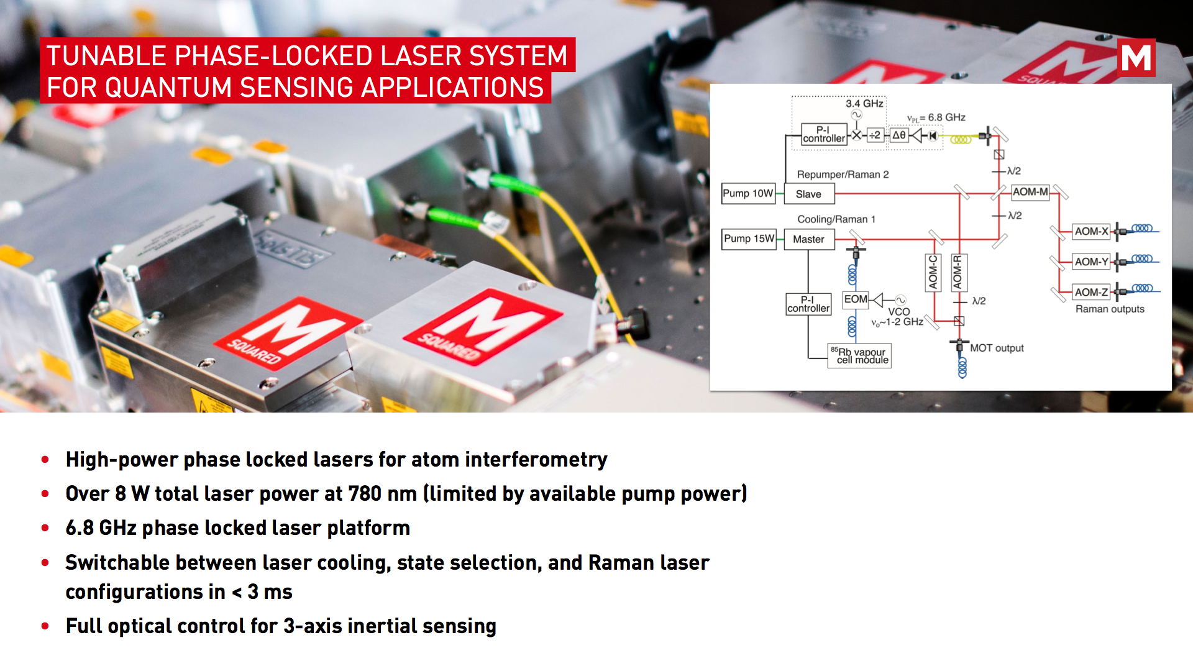

Slide 13
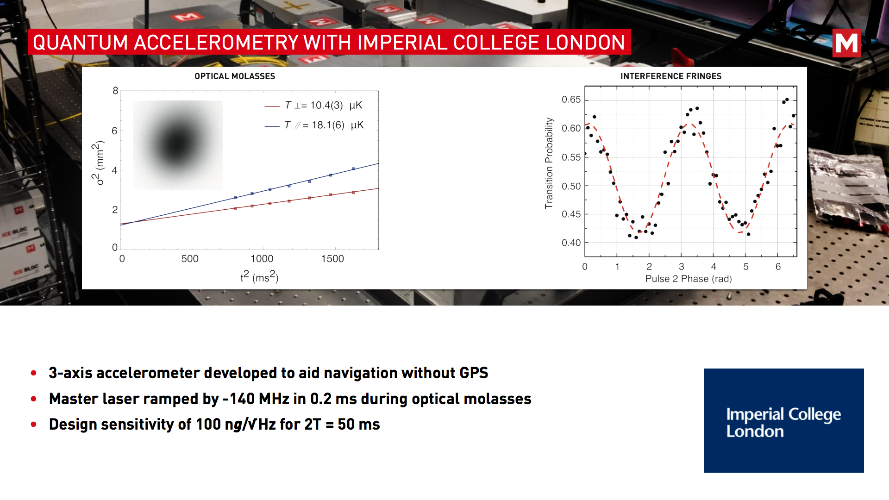

Slide 14

Imperial College London

Slide 15

Waiting on Slides

Slide 18
University of Liverpool
Particle Physics

Slide 19
Looking for a new way to do fundamental Physics…
Part of our strategy for the future

Slide 20
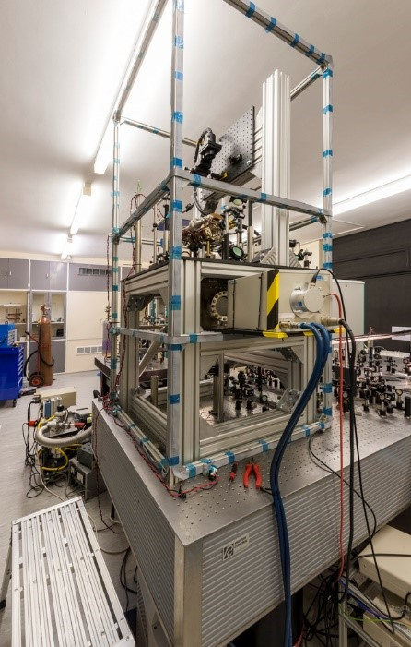
Liverpool
Add work with Perl
Work in Collaboration with late Martin Perl (Nobel Laureate, visiting professor @ U. Of Liverpool)

Slide 21
Initial results

Slide 23

NPL

Slide 24
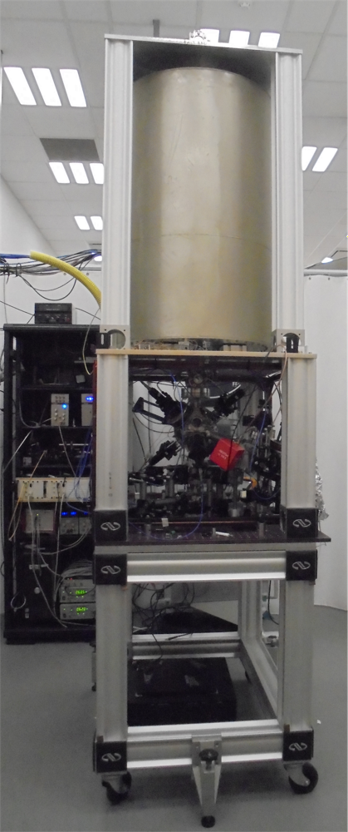
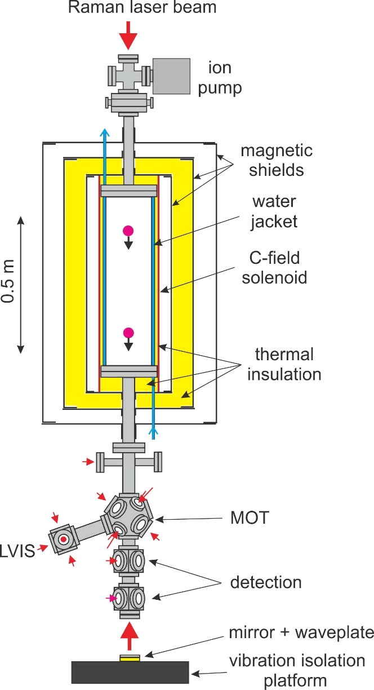

NPL Rb Fountain
Conversion of Rb frequency standard
‘fountain clock’ into an interferometer.
Joint project with Liverpool and NPL

Slide 25
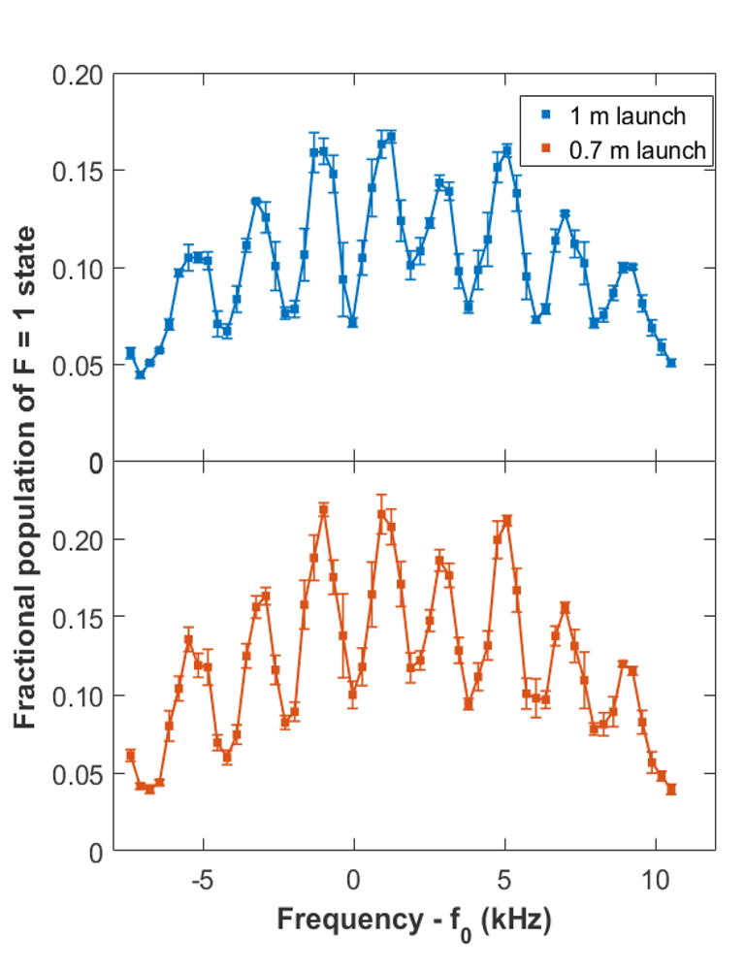
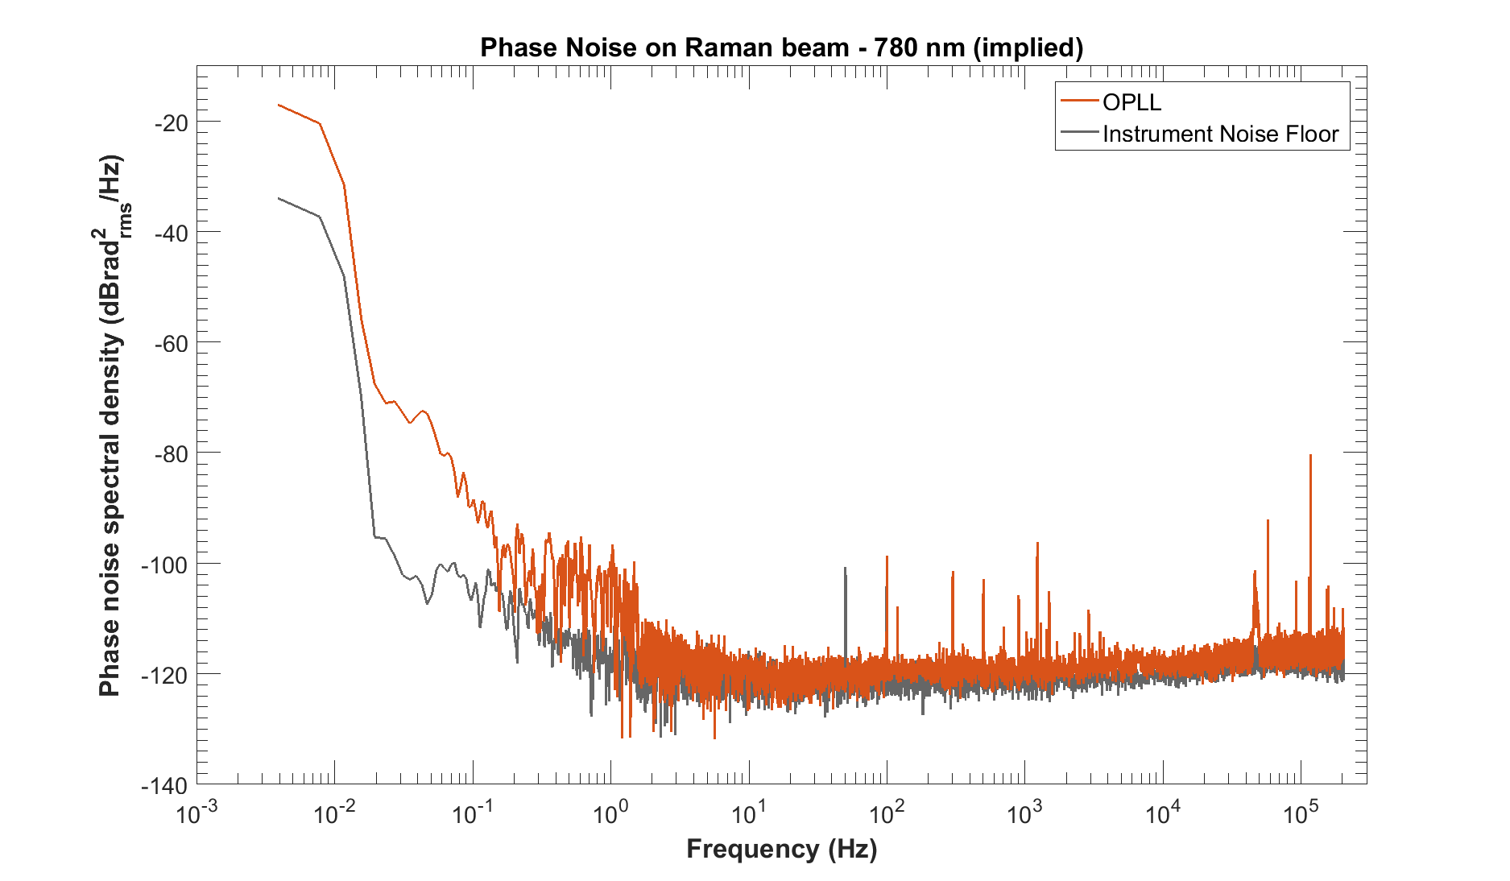
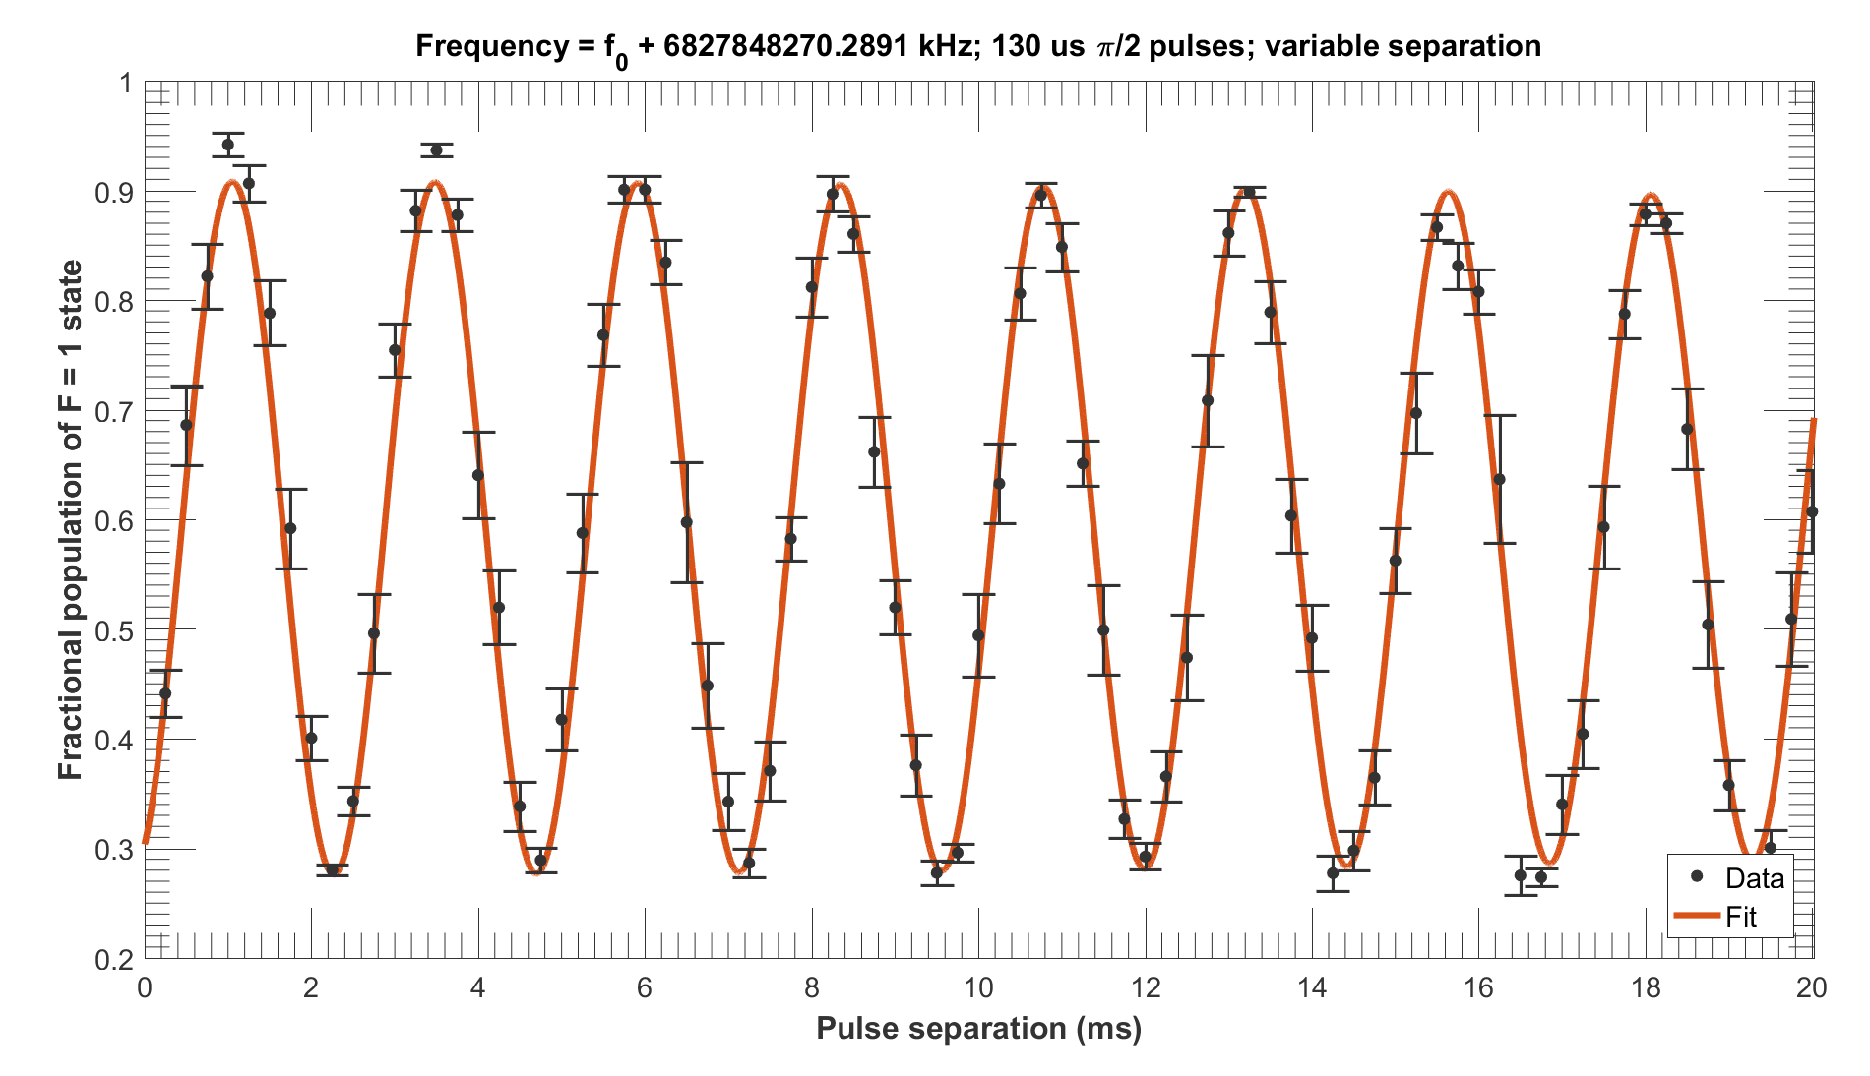
Rb Fountain
Ramsey Fringes on two clouds taken simultaneously
Low phase noise
Long coherence times

Slide 26
Strontium
NPL
  have an extremely good system working
  with the fermionic isotope
Oxford
  developing a new type of cold-atom source for Sr
  simple to construct and operate
other work at Birmingham and Durham
  also using cold Sr
  different objectives

Slide 27
NPL

Slide 30
University of Oxford

Slide 31
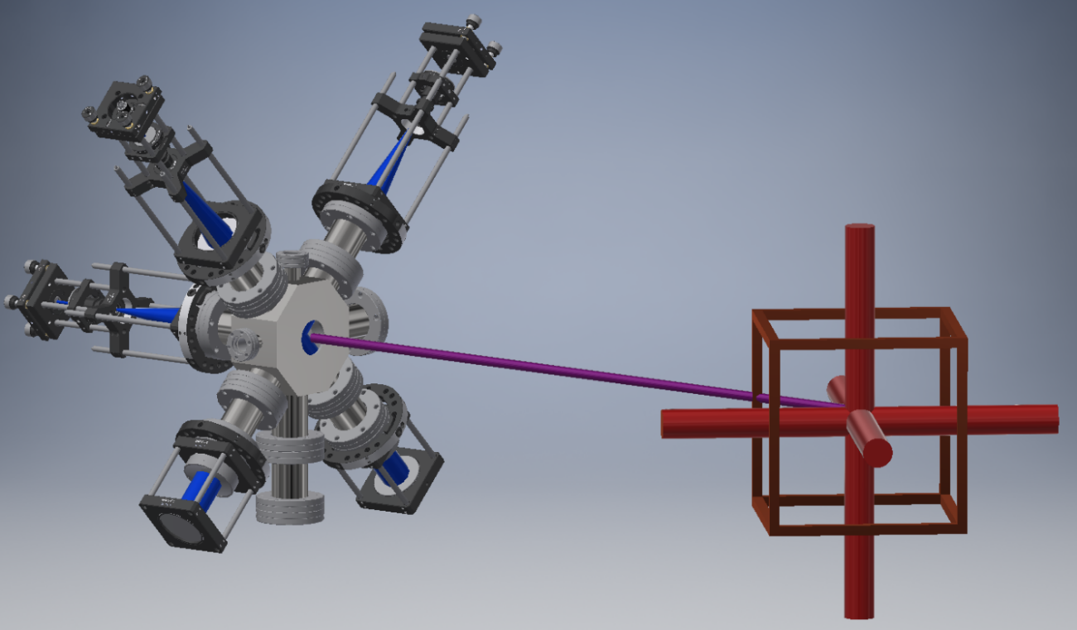
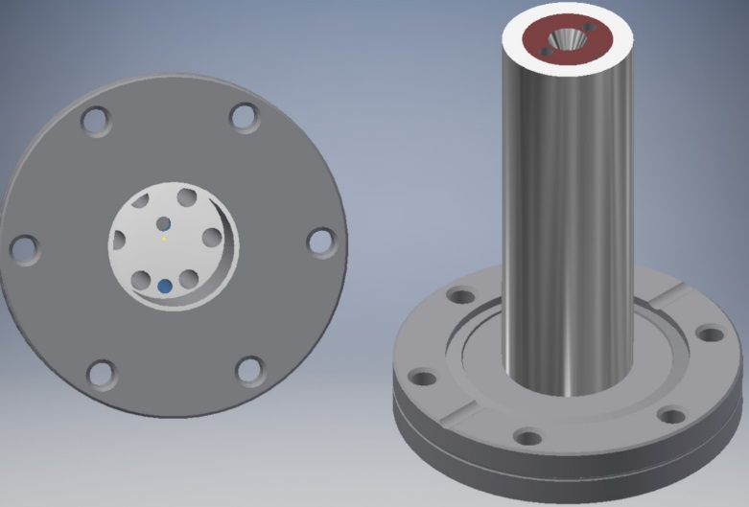



A compact high-flux source of laser-cooled strontium atoms
Oxford Physics:
Chris Foot, Dongyang Xu (aka Leo), Elliot Bentine &Peter Zhou
2D MOT cold-atom source
Loading a 3D MOT
  Stainless steel oven welded to CF40 flange
Use M Squared Laser systems

Slide 32
MAGIS-UK

Slide 33
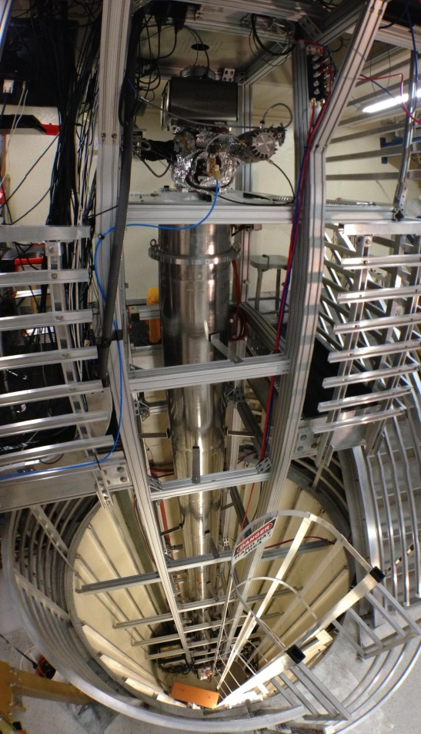
UK Plans for MAGIS
Option for building a 10m test-stand
  AION-10 as a test-stand for MAGIS and AION
Fast and flexible turnaround
  Produce multiple physics results whilst MAGIS/AION is in preparation
Provide UK hardware & Physics contribution to MAGIS-100
8.7 m at Stanford supporting the present 10 m-scale experiment

Slide 34
UK Contributions
  AION-10 as a test-stand for atomic concepts to be used in MAGIS-100
    As well as a prototype for AION-100
  UK contributions in Hardware and Manpower
  Interferometry Lasers (MSquared as a potential vendor)
  Camera’s. e.g. EMCCD as low noise high-contrast device
    Working with Fermilab to improve technology
  Contributions in hardware for Control and readout
    Requirements are to integrate with existing sequencing and schemes that have been developed
    Link with Fermilab infrastructure
    Ideally linked to do time synchronization
  Work with Stanford for AION atom source – and prototyping ruggedization
  Work on integration, commissioning and running,
    A substantial fraction of time is foreseen to be spent at Fermilab to contribute towards the construction, commissioning, as well as operations and data-taking.

Slide 35
AION - Proposal
Networking atom interferometers for
  Fundamental physics
Build another detector networked with MAGIS
  LIGO/Virgo style collaboration
Non-common background mode rejection
Provide unequivocal proof of any observation
AION and UK involvement in MAGIS presented to the Gordon and Betty Moore Foundation – 22/3/91

Slide 36
Summary
Science Driven
  Linking UK expertise with world leading US program for fundamental physics
Involvement in International Experiment
  Atomic, Particle physicists, astronomers, cosmologists etc, working in collaboration
  next generation design
  Probe for new physics
Bringing together fundamental science and existing UK technology companies
Huge Scientific and Innovation Imperative

Slide 37

Questions or Comments?

Slide 38
MAGIS-100 Present Status
New experiment at Fermilab
  potential to for larger scale at SURF
Using Atom Interferometry to:
  Explore the dark sector
  Test quantum mechanics at Large Distance Scales
  Prototype for a mid-band gravity wave detector
MAGIS-100 endorsed by Fermilab management
  Stage 1 approval via PAC
Strong interest and encouragement from funding agencies
Looking to start construction in FY19

