Slide 1
THE AION Project
A UK
Atom Interferometer Observatory and Network for the exploration of Ultra-Light Dark Matter and Mid-Frequency Gravitational Waves.
AION Workshop, march 25, 2019
Oliver Buchmueller, Imperial College London

Slide 2
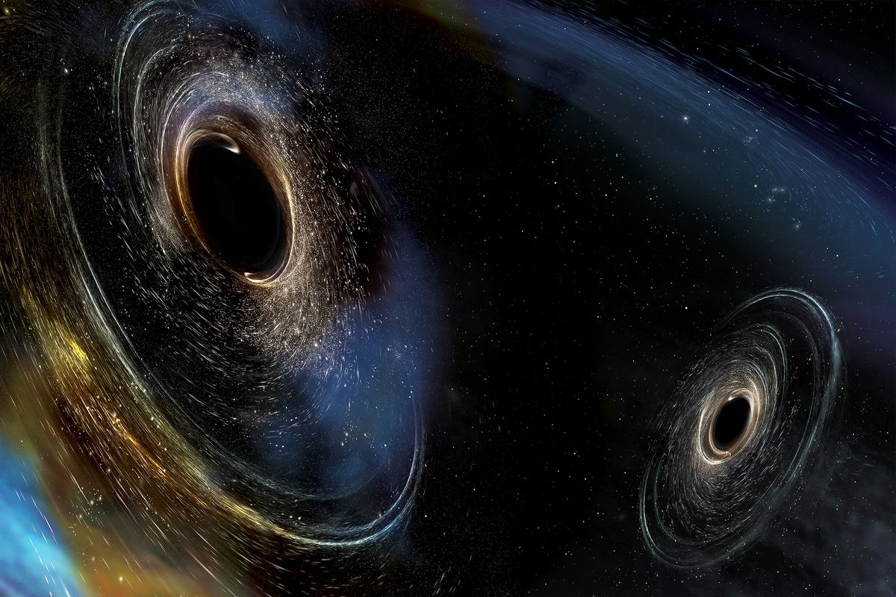
Gravitational Waves
Gravitational waves open a new window to the universe
  sourced by mass, not charge
  universe is transparent to gravity waves
GW provide unique astrophysical information
  compact object binaries
  black holes, strong field GR tests
• Every new band opened has revealed unexpected discoveries

Slide 3

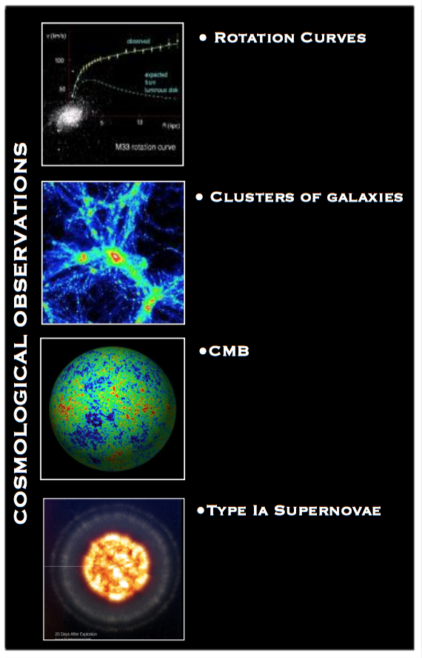
(Very Strong) Evidence for Dark Matter
G. Bertone

Slide 4
(Very Strong) Evidence for Dark Matter
Can we build an experiment
that can tackle both of these
important physics questions
(and more)?
G. Bertone

Slide 5
Outline
What is AION
Collaboration of AION with the US effort MAGIS
The Physics Case

Slide 6
What is AION

Slide 7
What is AION (in a nutshell)?
The proposal is to construct and operate a next generation Atomic Interferometric Observatory and Network (AION) in the UK that will enable the exploration of properties of dark matter as well as searches for new fundamental interactions.
It will provide a pathway for detecting gravitational waves from the very early universe in the, as yet mostly unexplored, mid-frequency band, ranging from several milliHertz to a few Hertz.
The proposed project spans several science areas ranging fundamental particle physics over astrophysics to cosmology and, thus, connects these communities.
Following the “Big Ideas” call, the project was selected by PAAP and STFC as a high priority for the community. It was provisionally classified as a medium scale project.
AION is also a Work Package of the QSFP proposal

Slide 8
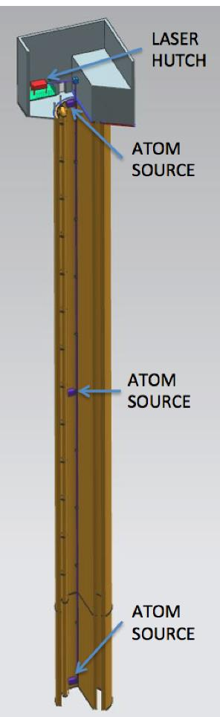
Proposed AION Programme
The AION Project is foreseen as
a 4-stage programme:
The first stage develops existing technology (Laser systems, vacuum, magnetic shielding etc.) and the infrastructure for the 100m detector and produces detailed plan resulting in an accurate assessment of the expected performance in Stage 2.
The second stage builds, commissions and exploits the 100m detector and also prepares design studies for the km-scale.
The third and fourth stage prepare the groundwork for the continuing programme:
  Stage 3: Terrestrial km-scale detector
  Stage 4: space based detector
L ~ 1m to 10m
L
L ~ 100m
L ~ km-scale
L ~ 10⁴ km

Slide 9
AION – A Staged Programme**
AION-10: Stage 1 [year 1 to 3]
1 & 10 m Interferometers & Site Development for 100m Baseline
AION-100: Stage 2 [year 3 to 6]
100m Construction & Commissioning
AION-KM: Stage 3 [ > year 6 ]
Operating AION-100 and planning for 1 km & Beyond
AION-SPACE: Stage 4 [ after AION-KM ]
Space based version
**outlined in Big Ideas proposal

Slide 10
AION – A Staged Programme**
AION-10: Stage 1 [year 1 to 3]
1 & 10 m Interferometers & Site Development for 100m Baseline
AION-100: Stage 2 [year 3 to 6]
100m Construction & Commissioning
AION-KM: Stage 3 [ > year 6 ]
Operating AION-100 and planning for 1 km & Beyond
AION-SPACE: Stage 4 [ after AION-KM ]
Space based version
**outlined in Big Ideas proposal

Slide 11
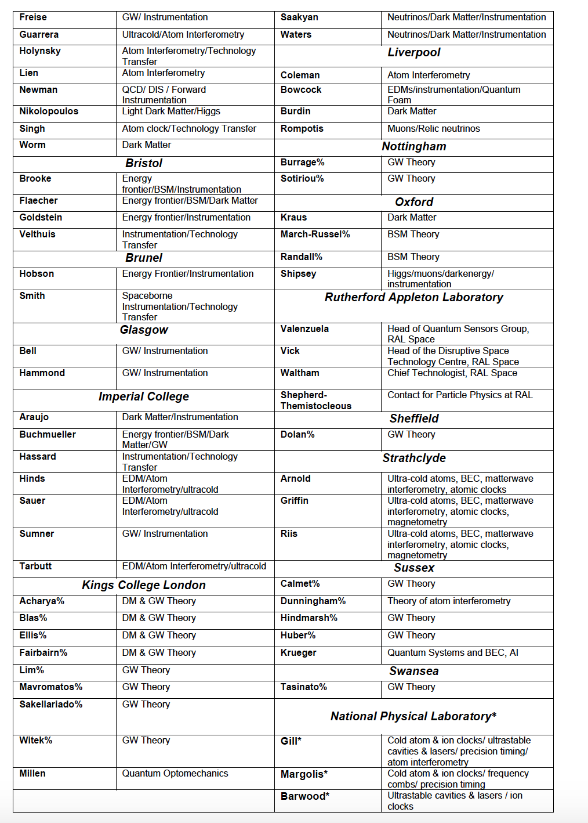
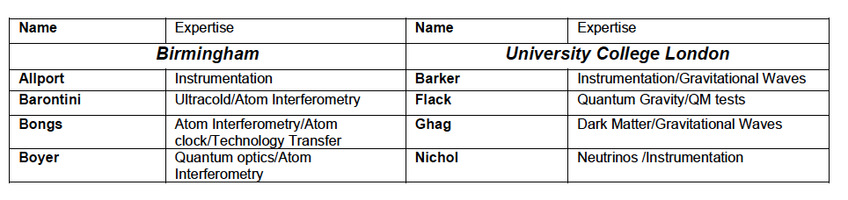
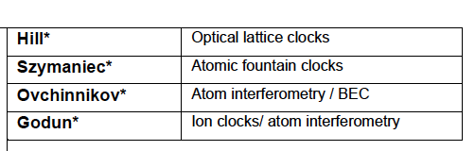
Status “Big Ideas Call”
Will be updated in March 2019
In preparation of this proposal we have broadly consulted with the relevant UK science communities and have received very positive feedback. The support is across several fields, ranging from fundamental particle physics, over atom interferometry to gravitational wave physics. The support also covers both experimental as well as theory communities in the UK. So far, more than 70 members from 20 UK institutions have provided explicit support for this proposal:
Aberdeen, Birmingham, Bristol, Brunel, Durham, Glasgow, Imperial College, Kings College London, University College London, Liverpool, Nottingham, Open University, Oxford, RAL, Sheffield, Strathclyde, Sussex, Swansea and NPL

Slide 12
In preparation of this proposal we have broadly consulted with the relevant UK science communities and have received very positive feedback. The support is across several fields, ranging from fundamental particle physics, over atom interferometry to gravitational wave physics. The support also covers both experimental as well as theory communities in the UK. So far, more than 70 members from 20 UK institutions have provided explicit support for this proposal:
Aberdeen, Birmingham, Bristol, Brunel, Durham, Glasgow, Imperial College, Kings College London, University College London, Liverpool, Nottingham, Open University, Oxford, RAL, Sheffield, Strathclyde, Sussex, Swansea and NPL
If you are interested to follow the AION activity
you can subscribe to the AION Email list:
aion-project@imperial.ac.uk
via:
https://mailman.ic.ac.uk/mailman/listinfo/aion-project

Slide 13
Collaboration with US (via MAGIS)

Slide 14
International Collaboration
From the outset this project would greatly benefit from close collaboration on an international level with the US initiative, MAGIS-100, which pursues a similar goal of an eventual km-scale atom interferometer on a comparable timescale.
The option of operating two AI detectors, one in the UK and one in the US, in tandem enables new exciting physics opportunities not accessible to either AI detector alone.
A collaboration with AION by the MAGIS experiment has already been endorsed by the community at Fermilab, presenting the UK with an immediate window of scientific opportunity.
This US-UK collaboration will serve as the testbed for full-scale terrestrial (kilometre-scale) and satellite-based (thousands of kilometres scale) detectors and build the framework for global scientific leadership in this area.

Slide 15
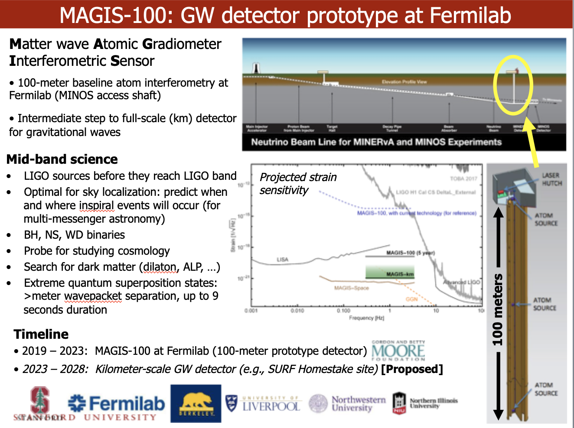
MAGIS100
Courtesy of Jason Hogan!

Slide 16
MAGIS100
Timeline:
2019-2023: MAGIS-100 at Fermilab (100m)
2023-2028: km-scale detector [site still be chosen]
Funding:
The project was partly founded in January 2019 by the MOORE
foundation with $10Mio (£7.7Mio) over 5 years.
The project is now applying for additional DOE funding
More about MAGIS-100 in the talk of Jason Hogan
Courtesy of Jason Hogan!

Slide 17
Visit to stanford on 10/11 January 2019

Slide 18
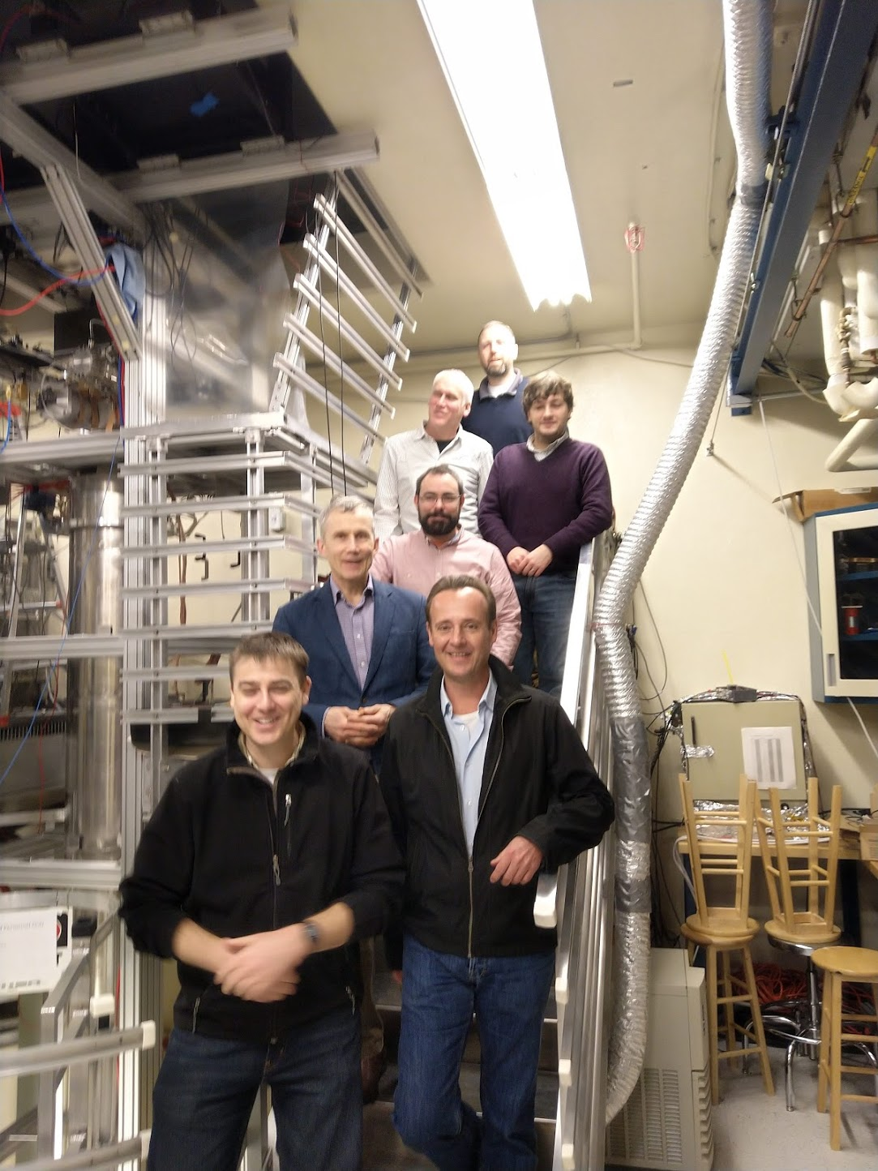
Stanford Visit 10/11 January 2019
We had a very fruitful visit to Stanford!
Main goals of the visit:
Establish information exchange and
review the Stanford work.
Strengthen the US-UK collaboration
Identify synergies and common goals between AION and MAGIS.
Outcome:
Stanford/MAGIS is very open to closer collaboration with the UK/AION and they very much welcome another activity working towards the mid-band with AIs.
There are several challenges where the UK expertise can help to achieve the design goals of the programme [see next slide].
We agreed to include the synchronised operation of 10m prototype versions (later 100m) in the programme of MAGIS and AION.
Ben
Sauer
(Imperial)
Jon
Micheal
Holynski
(Birmingham)
Chris
Foot
(Oxford)
Tristan
Valenzuela
(RAL)
Oliver
Jason
Hogan
(Stanford)

Slide 19
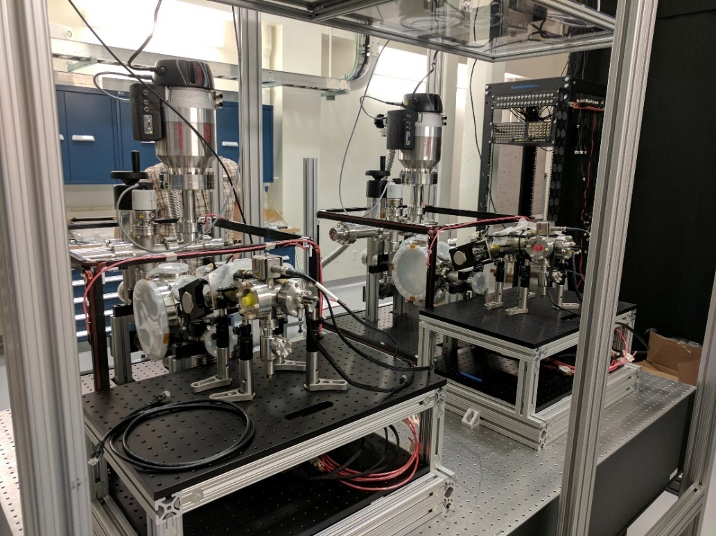
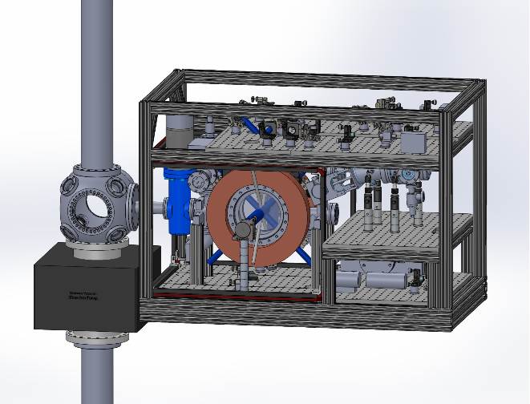
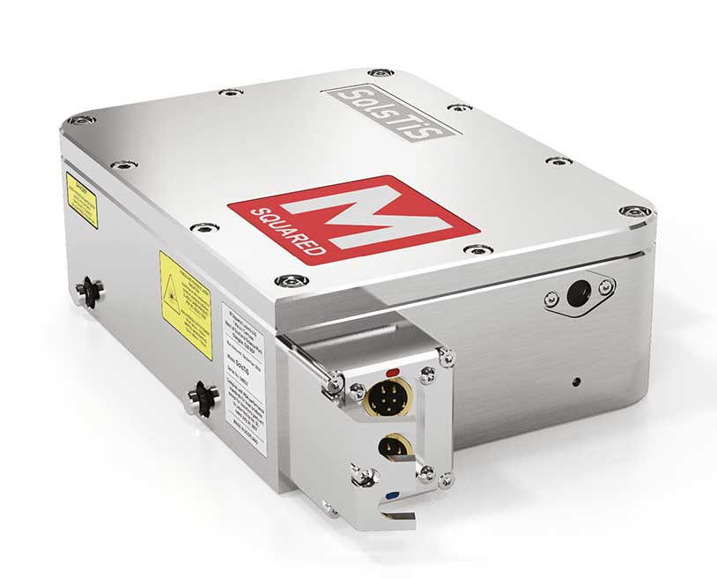
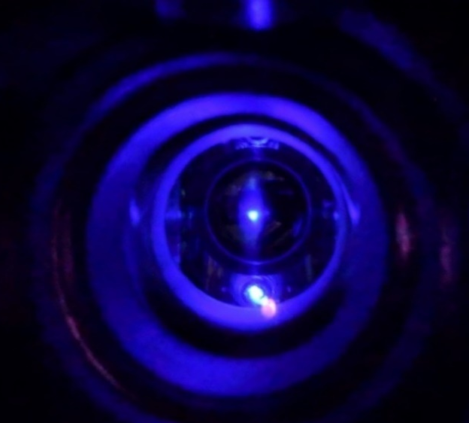
Stanford MAGIS prototype
Sr gradiometer CAD
(atom source detail)
Two assembled Sr atom sources
Trapped Sr atom cloud
(Blue MOT)
Atom optics laser
(M Squared SolsTiS)
Courtesy of Jason Hogan!

Slide 20
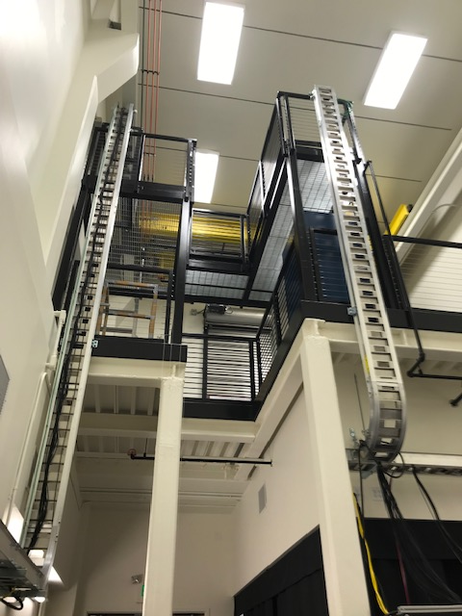
Stanford MAGIS prototype
Sr gradiometer CAD
(atom source detail)
Two assembled Sr atom sources
Stanford Lab to host 8 m
prototype of the Sr fountain.
It is supposed to be assembled
over summer 2019.
Trapped Sr atom cloud
(Blue MOT)
Atom optics laser
(M Squared SolsTiS)

Slide 21
Stanford MAGIS prototype
Sr gradiometer CAD
(atom source detail)
Two assembled Sr atom sources
Stanford Lab to host 8 m
prototype of the Sr fountain.
It is supposed to be assembled
over summer 2019.
Trapped Sr atom cloud
(Blue MOT)
More about MAGIS-100 in the talk of Jason Hogan
Atom optics laser
(M Squared SolsTiS)

Slide 22
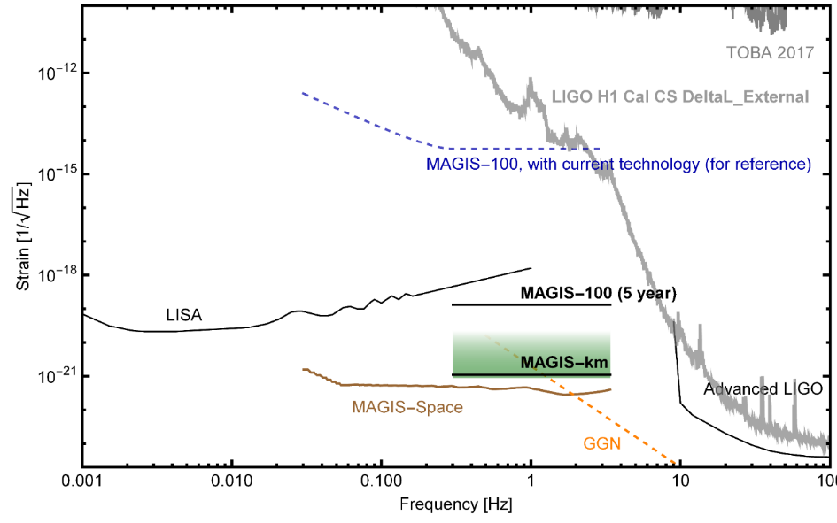
What are the challenges?
Still several orders of
Magnitude away in sensitivity required to be sensitive to Mid-band GW physics!
Need to push the basic parameters to accomplish this goal! Although there is a clear path forward this won’t be a free lunch and it will require effort and ingenuity!
The UK community could play an important role to accomplish this goal, which, in turn, can accelerate the schedule and minimize the risk of failure
AION/MAGIS-100 with current (2019) technology
AION/MAGIS-100 (5 to 6 year)
AION/MAGIS-km
AION/MAGIS-space
AION/MAGIS-100
current
AION/MAGIS-100
5/6 year
AION/MAGIS-km

Slide 23
AION Project Work Packages

Slide 24
AION10 [Stage 1]: Work Packages in a Nutshell
WP-AI
Form UK collaboration to design and construct AION1 and AION10 and establish a first UK AION Network by building AION-1 in selected places.
Prototype AION-10 to demonstrate the technology and to establish UK expertise and leadership in the field.
Commission AION-10, compare with AION-1 Network and perform synchronised measurement campaigns with MAGIS.
Connect to UK QTH to develop techniques and technology required to reach performance for realising science goals, in collaboration with developments in the MAGIS consortium.
WP-Physics
Establish physics programme for AION-1/10 Network.
Physics exploitation of AION-1/10 Network
Contribute to work establishing the physics case for AION-100 and beyond.
Support phenomenology for AION physics case.
WP-AION100
Work towards AION-100 including design work for AION-100 in a tower or a shaft and establish the physics case.
WP-MAGIS
Collaborate with MAGIS-100 to contribute to experiment & exploitation
Build the foundation of a strong and lasting collaboration with US.

Slide 25
AION10 [Stage 1]: Work Packages in a Nutshell
WP-AI
Form UK collaboration to design and construct AI1 and AI10 and establish a first UK AI Network by building AI1 in Liverpool and other selected places.
Prototype AI10 to demonstrate the technology and to establish UK expertise and leadership in the field.
Commission AI10 with short baseline and compare with AI1 Network.
WP-Physics
Establish physics programme for AI1/A10 Network.
Physics exploitation of AI1/10 Network
Contribute to work establishing the physics case for AI100 and beyond.
Support phenomenology both for AI in general and AION physics case.
WP-AION100
Work towards AI100 including design work for AI100 in a tower or a shaft and establish the physics case.
WP-MAGIS
Collaborate with MAGIS to contribute to experiment & exploitation
Build the foundation of a strong and lasting collaboration with US.
Pathway to technology and expertise and will form
a first network of AI’s in the UK.
This will give us physics & phenomenology
This will give us the path into the future (next bid)
This will give us MAGIS and US Collaboration

Slide 26
AION10 [Stage 1]: Main WP Connections
WP-Physics
WP-AI
WP-MAGIS
WP-AION100

Slide 27
AION10 [Stage 1]: Main WP Connections
WP-Physics
More information and discussion about WPs
in the dedicated WP session this afternoon!
WP-AI
WP-MAGIS
WP-AION100

Slide 28
The Physics case

Slide 29
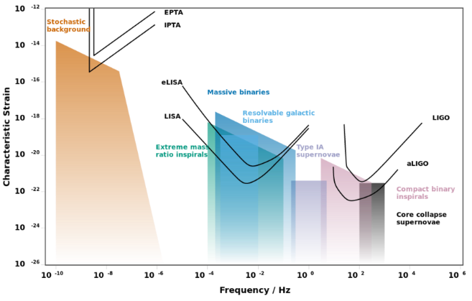
AION: Pathway to the GW Mid-(Frequency) Band
Experimental GW Landscape

Slide 30
AION: Pathway to the GW Mid-(Frequency) Band
Experimental GW Landscape
Mid-Band currently
NOT covered
Mid-band
decihertz to hertz
Mid-band science
Detect sources BEFORE they reach the high frequency band [LIGO, ET]
Optimal for sky localization: predict when and where events will occur (for multi-messenger astronomy)
Search for Ultra-light dark matter in a similar frequency [i.e. mass] range

Slide 31
Gravitational Wave Detection with Atom Interferometry
high-frequency
region
low-frequency
region
mid-frequency
region

Slide 32
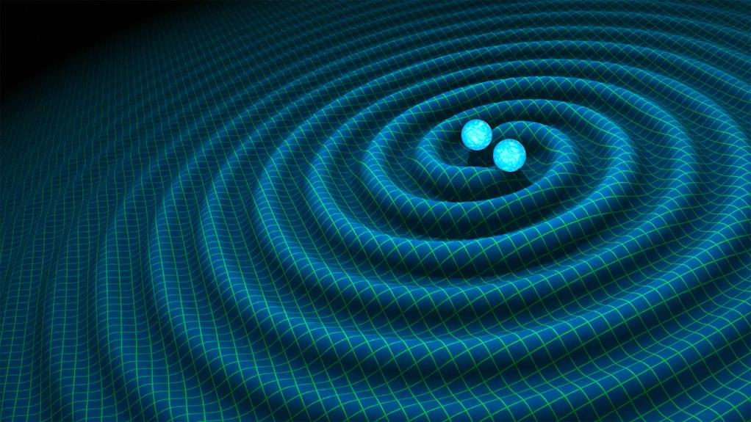
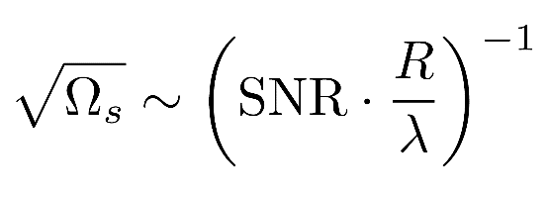
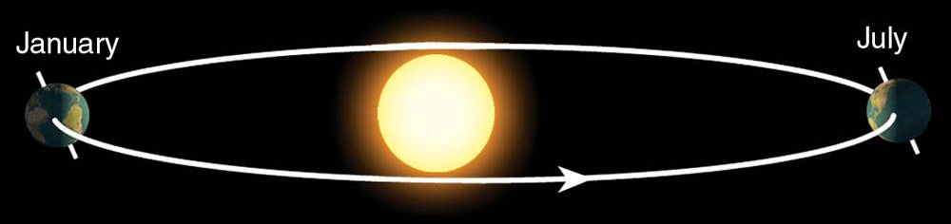
Sky position determination
Sky localization precision:
Images: R. Hurt/Caltech-JPL; 2007 Thomson Higher Education
Mid-band advantages
- Small wavelength λ
- Long source lifetime (~months) maximizes effective R
λ
R
Courtesy of Jason Hogan!
Ultimate sensitivity for terrestrial based detectors is achieved by operating 2 (or more)
Detectors in synchronisation mode

Slide 33
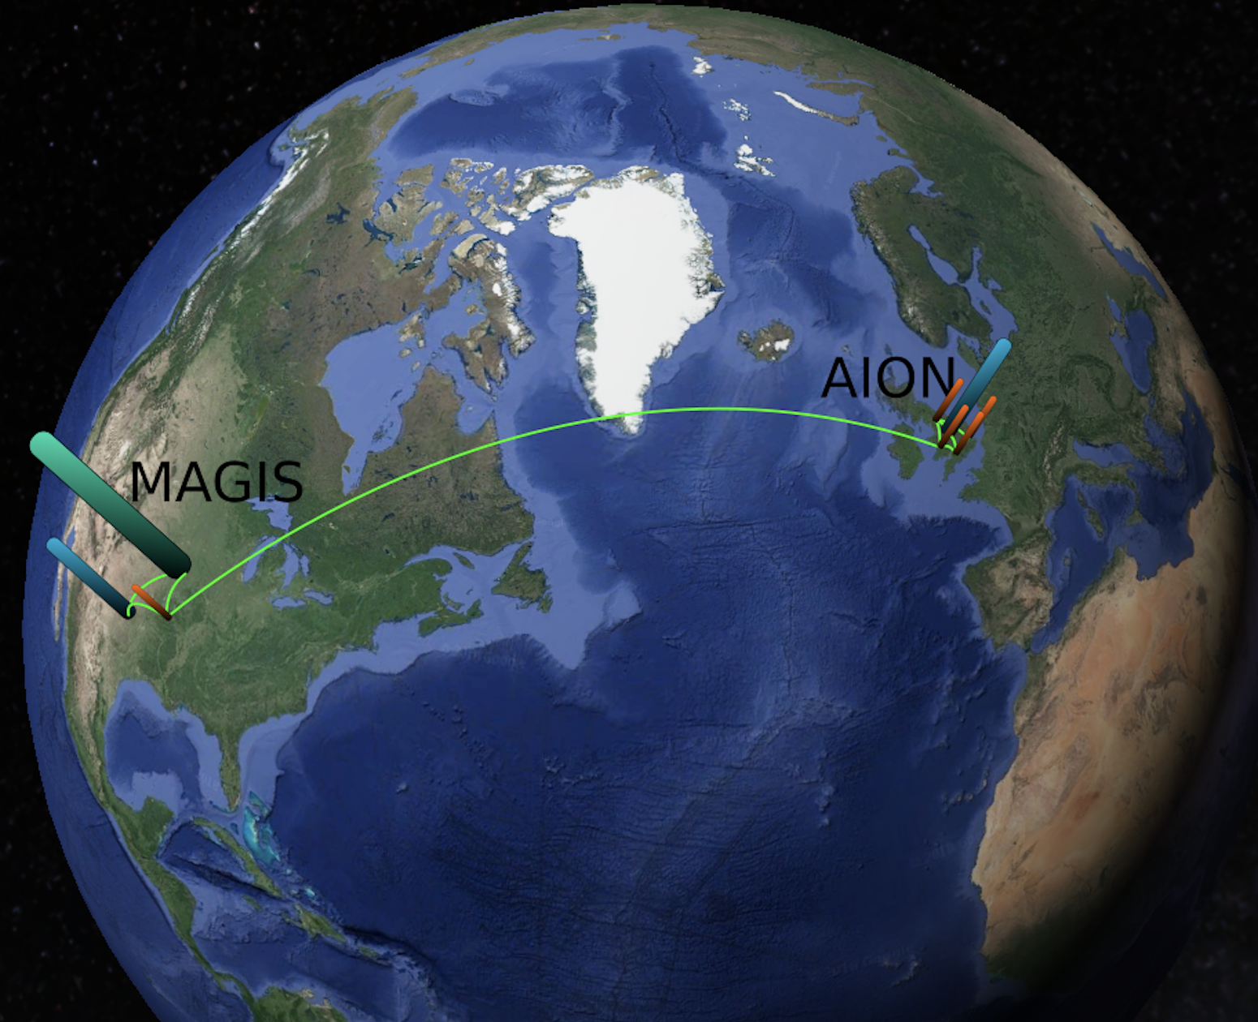
Ultimate Goal: Establish International Network
Illustrative Example:
Network could be further extended
or arranged differently

Slide 34
GW Detection & Fundamental Physics - Example
First-Order Electroweak Phase Transition and its Gravitational Wave Signal
arXiv:1809.08242
John Ellis, Marek Lewicki,
José Miguel No
What is is the GW signal
of electroweak phase
transition in various
theories beyond
the Standard Model.
Plots provided by Marek Lewicki
Translate strain into dimensionless energy density Ω_{GW}h² in GWs against frequency

Slide 35
GW Detection & Fundamental Physics - Example
MAGIS
AION
4K
MAGIS
AION
Space
arXiv:1809.08242
Plots provided by Marek Lewicki

Slide 36
GW Detection & Fundamental Physics - Example
MAGIS
AION
4K
MAGIS
AION
Space
arXiv:1809.08242
Plots provided by Marek Lewicki

Slide 37
GW Detection & Fundamental Physics - Example
MAGIS
AION
4K
MAGIS
AION
Space
We would more studies like this
to further workout the physics case!
arXiv:1809.08242
Plots provided by Marek Lewicki

Slide 38
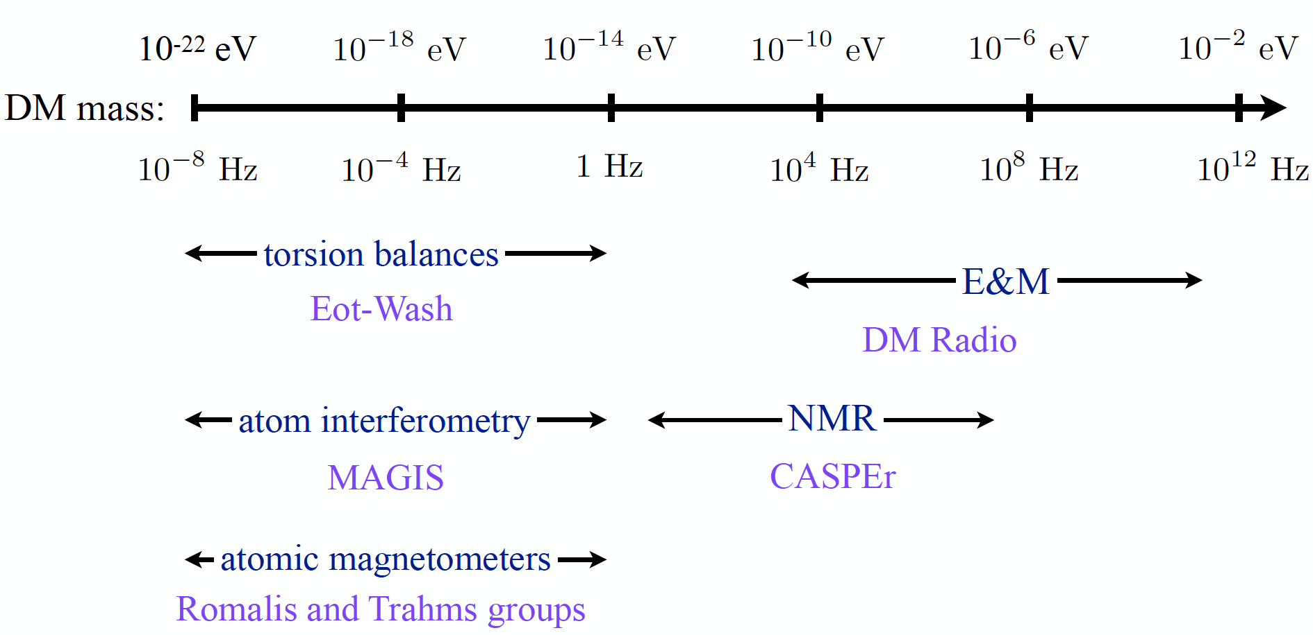
The Landscape of Ultra-Light Dark Matter Detection
Vey light dark matter and gravitational wave detection similar when detecting
coherent effects of entire field, not single particles.
Example: Ultra-Light Dark Matter:
Diagram taken from P. Graham’s
talk at HEP Front 2018

Slide 39
The Landscape of Ultra-Light Dark Matter Detection
Vey light dark matter and gravitational wave detection similar when detecting
coherent effects of entire field, not single particles.
Example: Ultra-Light Dark Matter:
MAGIS/AION
Diagram taken from P. Graham’s
talk at HEP Front 2018

Slide 40
The Landscape of Ultra-Light Dark Matter Detection
Vey light dark matter and gravitational wave detection similar when detecting
coherent effects of entire field, not single particles.
Example: Ultra-Light Dark Matter:
MAGIS/AION
Diagram taken from P. Graham’s
talk at HEP Front 2018

Slide 41


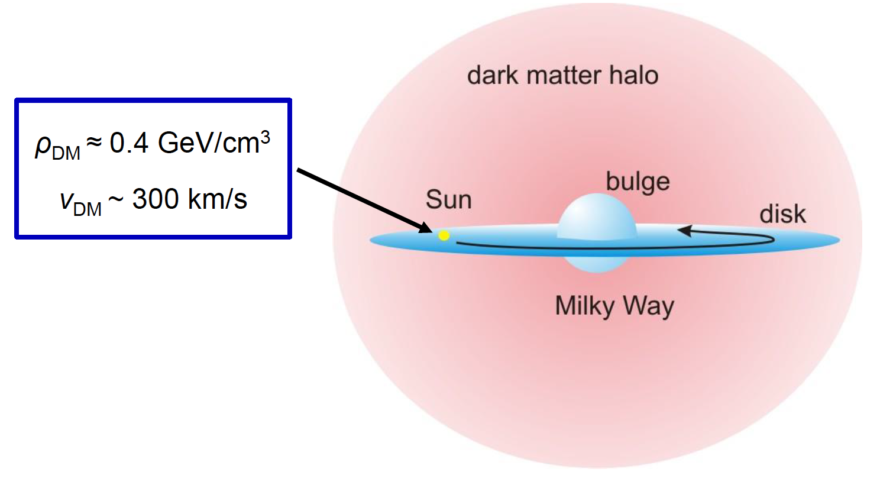
Ultra-Light Spin-0 Dark Matter
Ultra-light spin 0 particles are expected to form a coherently oscillating classical field
as with an energy density of

Slide 42



Ultralight scalar dark matter
Ultralight dilaton DM acts as a background field (e.g., mass ~10⁻¹⁵ eV)
+ …
Electron
coupling
Photon
coupling
e.g., QCD
DM scalar field
DM mass density
DM coupling causes time-varying atomic energy levels:
DM induced oscillation
Dark matter coupling
Time
Courtesy of Jason Hogan!

Slide 43
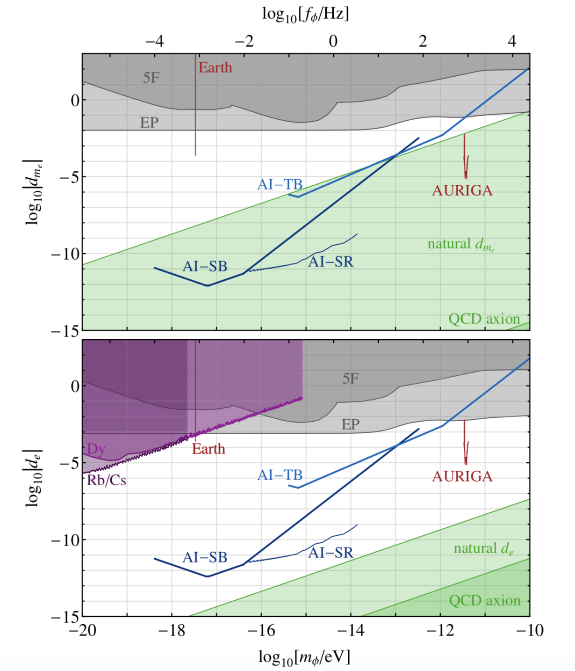
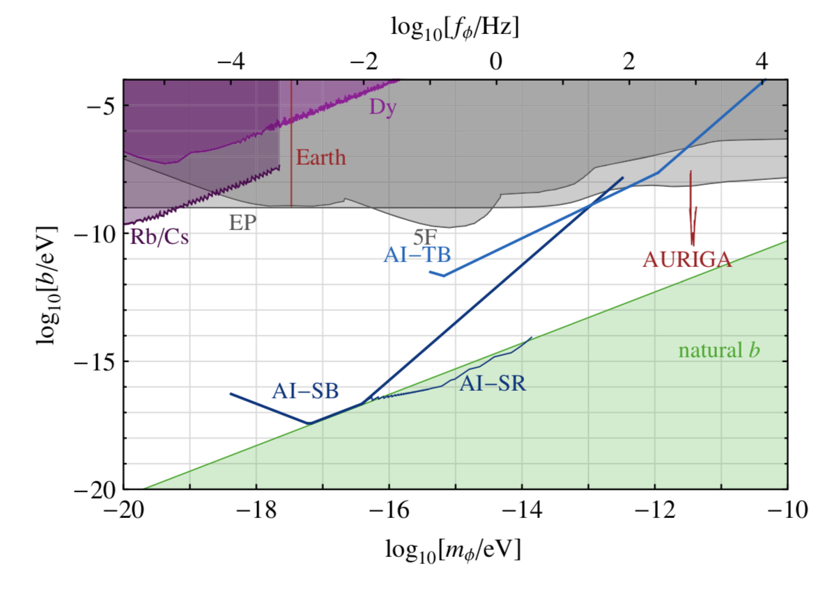
Sensitivity for DM with Scalar Couplings to Matter
Coupling to e
Higgs Portal b coupling
DM with scalar couplings to matter, which cause time
variation of fundamental constants such as the electron mass
Arvanitaki et al., PRD 97, 075020 (2018).
Coupling to ϒ

Slide 44
Sensitivity for DM with Scalar Couplings to Matter
AI-100m
Coupling to e
Higgs Portal b coupling
DM with scalar couplings to matter, which cause time
variation of fundamental constants such as the electron mass
Arvanitaki et al., PRD 97, 075020 (2018).
Coupling to ϒ

Slide 45
Summary
The AION programme is driven by a well-defined and ambitious physics case to explore the Mid-Frequency Band of the GW spectrum.
  In addition, it will enable the exploration of properties of dark matter as well as searches for new fundamental interactions
AION foreseen as a staged programme: AION-10, AION-100, AION-KM and AION-SPACE.
  AION-10 [year 1 to 3] and AION-100 [year 3 to 6] are part of the QSFP WP3
  AION-KM and AION-SPACE are the pathway to the future and achieving ultimate sensitivity
The AION project will closely collaborate with the US initiative, MAGIS-100, which pursues a similar goal of an eventual km-scale atom interferometer on a comparable timescale.
  The option of operating two detectors, one in the UK and one in the US, in tandem enables new exciting physics opportunities not accessible to either detector alone.
  To accomplish the ultimate sensitivity required to study the Mid-Frequency Band of the GW spectrum, the basic parameters of the Atom Interferometer have to be significantly improved. This requires significant effort and ingenuity, and the UK community can play an important role in it!

