Slide 1

Quantum Sensors
Fundamental Physics
Consortium
Q
S
WP1
WP2
WP3
WP4
WP5
WP6
WP7
WP8
WP9
F
P
T. Bowcock

Slide 2
Q
S
WP1
WP2
WP3
WP4
WP5
WP6
WP7
WP8
WP9
F
P
Ian will talk (tomorrow)
about
status
next steps
Milestones
Governance
Review Board
….

Slide 3
Q
S
Glasgow, Strathclyde
WP1
WP2
WP3
WP4
WP5
WP6
WP7
WP8
WP9
Aberdeen
F
P
St Andrews
Edinburgh, Heriot Watt
Newcastle
Lancaster
Newcastle
Durham
Belfast
Leeds
Liverpool
Sheffield
Manchester
Birmingham
Nottingham
UK
Warwick
Cambridge
Swansea
Oxford
31 institutes
Multiple companies
Scientists….
Cardiff
I
ICTS, King’s, UCL, NPL,RH
RAL
Brighton, Sussex
Plymouth
Southampton

Slide 4































Q
S
F
P
c

Slide 5
Q
S
Glasgow, Strathclyde
WP1
WP2
WP3
WP4
WP5
WP6
WP7
WP8
WP9
Aberdeen
F
P
St Andrews
Edinburgh, Heriot Watt
Newcastle
Lancaster
Newcastle
WP1
Durham
Belfast
Leeds
Liverpool
Sheffield
Manchester
Birmingham
Nottingham
Quantum Sensors for Hidden Sector Physics
Warwick
Cambridge
Swansea
Oxford
Cardiff
I
ICTS, King’s, UCL, NPL,RH
RAL
Brighton, Sussex
Plymouth
Southampton

Slide 6
Q
S
Glasgow, Strathclyde
WP1
WP2
WP3
WP4
WP5
WP6
WP7
WP8
WP9
Aberdeen
F
P
St Andrews
Edinburgh, Heriot Watt
Newcastle
Lancaster
Newcastle
WP2
Durham
Belfast
Leeds
Liverpool
Sheffield
Manchester
Birmingham
Nottingham
Macroscopic quantum superpositions for physics beyond the standard model
Warwick
Cambridge
Swansea
Oxford
Cardiff
I
ICTS, King’s, UCL, NPL,RH
RAL
Brighton, Sussex
Plymouth
Southampton

Slide 7
Q
S
Glasgow, Strathclyde
WP1
WP2
WP3
WP4
WP5
WP6
WP7
WP8
WP9
Aberdeen
F
P
St Andrews
Edinburgh, Heriot Watt
Newcastle
Lancaster
Newcastle
WP3
Durham
Belfast
Leeds
Liverpool
Sheffield
Manchester
Birmingham
Nottingham
AION
Warwick
Cambridge
Swansea
Oxford
Cardiff
I
ICTS, King’s, UCL, NPL,RH
RAL
Brighton, Sussex
Plymouth
Southampton

Slide 8
Q
S
Glasgow, Strathclyde
WP1
WP2
WP3
WP4
WP5
WP6
WP7
WP8
WP9
Aberdeen
F
P
St Andrews
Edinburgh, Heriot Watt
c
Newcastle
Lancaster
Newcastle
WP4
Durham
Belfast
Leeds
Liverpool
Sheffield
Manchester
Birmingham
Nottingham
Quantum Sensors for Neutrino Mass
Warwick
Cambridge
Swansea
Oxford
Cardiff
I
ICTS, King’s, UCL, NPL,RH
RAL
Brighton, Sussex
Plymouth
Southampton

Slide 9
Q
S
Glasgow, Strathclyde
WP1
WP2
WP3
WP4
WP5
WP6
WP7
WP8
WP9
Aberdeen
F
P
St Andrews
Edinburgh, Heriot Watt
Newcastle
Lancaster
Newcastle
WP5
Durham
Belfast
Leeds
Liverpool
Sheffield
Manchester
Birmingham
Nottingham
Quantum Simulators of
Fundamental Physics
Warwick
Cambridge
Swansea
Oxford
Cardiff
I
ICTS, King’s, UCL, NPL,RH
RAL
Brighton, Sussex
Plymouth
Southampton

Slide 10
Q
S
Glasgow, Strathclyde
WP1
WP2
WP3
WP4
WP5
WP6
WP7
WP8
WP9
Aberdeen
F
P
St Andrews
Edinburgh, Heriot Watt
c
Newcastle
Lancaster
Newcastle
WP6
Durham
Belfast
Leeds
Liverpool
Sheffield
Manchester
Birmingham
Nottingham
Networked Sensors
Warwick
Cambridge
Swansea
Oxford
Cardiff
I
ICTS, King’s, UCL, NPL,RH
RAL
Brighton, Sussex
Plymouth
Southampton

Slide 11
Q
S
Glasgow, Strathclyde
WP1
WP2
WP3
WP4
WP5
WP6
WP7
WP8
WP9
Aberdeen
F
P
St Andrews
Edinburgh, Heriot Watt
Newcastle
Lancaster
Newcastle
WP7
Durham
Belfast
Leeds
Liverpool
Sheffield
Manchester
Birmingham
Nottingham
Searches for a Fifth Force and Dark Matter Using Precision Atomic Spectroscopy
Warwick
Cambridge
Swansea
Oxford
Cardiff
I
ICTS, King’s, UCL, NPL,RH
RAL
Brighton, Sussex
Plymouth
Southampton

Slide 12
Q
S
Glasgow, Strathclyde
WP1
WP2
WP3
WP4
WP5
WP6
WP7
WP8
WP9
Aberdeen
F
P
St Andrews
Edinburgh, Heriot Watt
Newcastle
Lancaster
Newcastle
WP8
Durham
Belfast
Leeds
Liverpool
Sheffield
Manchester
Birmingham
Nottingham
Fundamental Physics with exotic atoms
Warwick
Cambridge
Swansea
Oxford
Cardiff
I
ICTS, King’s, UCL, NPL,RH
RAL
Brighton, Sussex
Plymouth
Southampton

Slide 13
Q
S
Glasgow, Strathclyde
WP1
WP2
WP3
WP4
WP5
WP6
WP7
WP8
WP9
Aberdeen
F
P
St Andrews
Edinburgh, Heriot Watt
c
Newcastle
Lancaster
Newcastle
WP9
Durham
Belfast
Leeds
Liverpool
Sheffield
Manchester
Birmingham
Nottingham
Lorentz Invariance Space Test
Warwick
Cambridge
Swansea
Oxford
Cardiff
I
ICTS, King’s, UCL, NPL,RH
RAL
Brighton, Sussex
Plymouth
Southampton

Slide 14
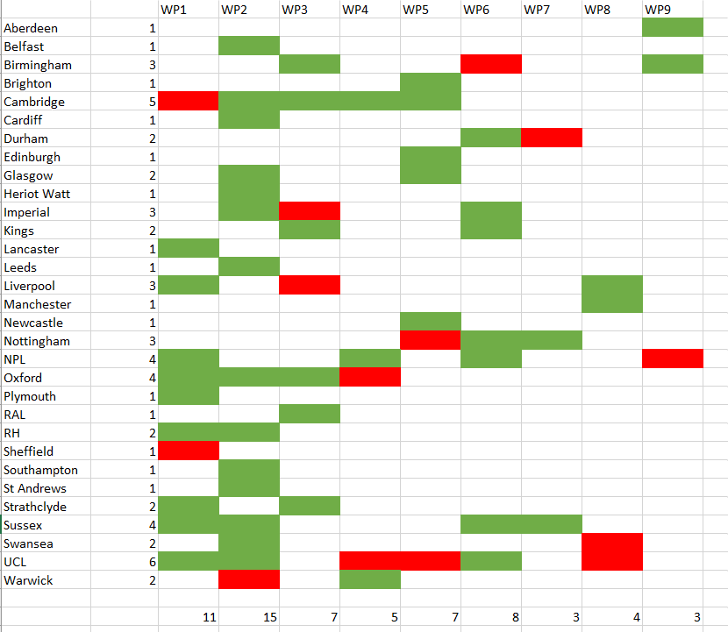
Q
S
F
P

Slide 15
Workpage Summary
Q
S
WP1
WP2
WP3
WP4
WP5
WP6
WP7
WP8
WP9
F
P
Hidden Sector Facility
Macroscopic Superposition
AION
Neutrino Mass
Simulators
Networked Sensors
5th Force & Dark Matter
Exotic Atoms
Lorentz Invariance

Slide 16
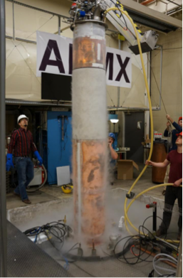
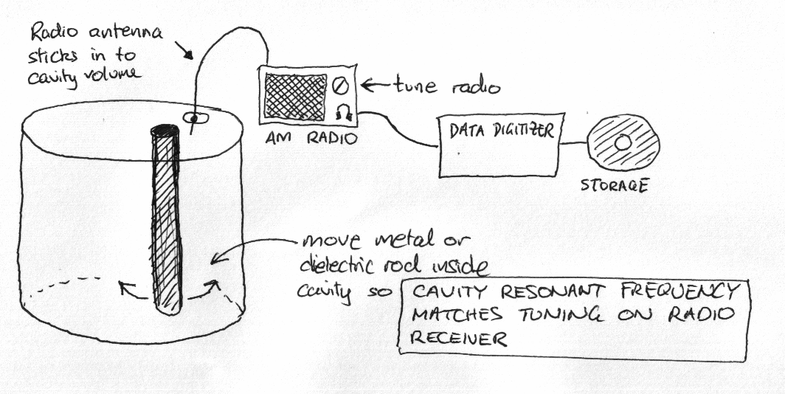

Q
S
WP1
WP2
WP3
WP4
WP5
WP6
WP7
WP8
WP9
Quantum Sensors for Hidden Sector Physics
F
P
Decided not to focus on building a specific instrument during the first phase of the project
Yr 1-2: Build the team and institutional interfaces. Develop an optimised science case
Yr 2-3: Component technology development - superconducting electronics, etc.
Yr 3: Complete end-to-end signal-chain demonstrations through pathfinder – early science
Conceptual design study of national facility. Submit a comprehensive proposal.
Axions
UK Idea Improve hidden sector searches with feedback resonators arXiv:1805.11523.

Slide 17
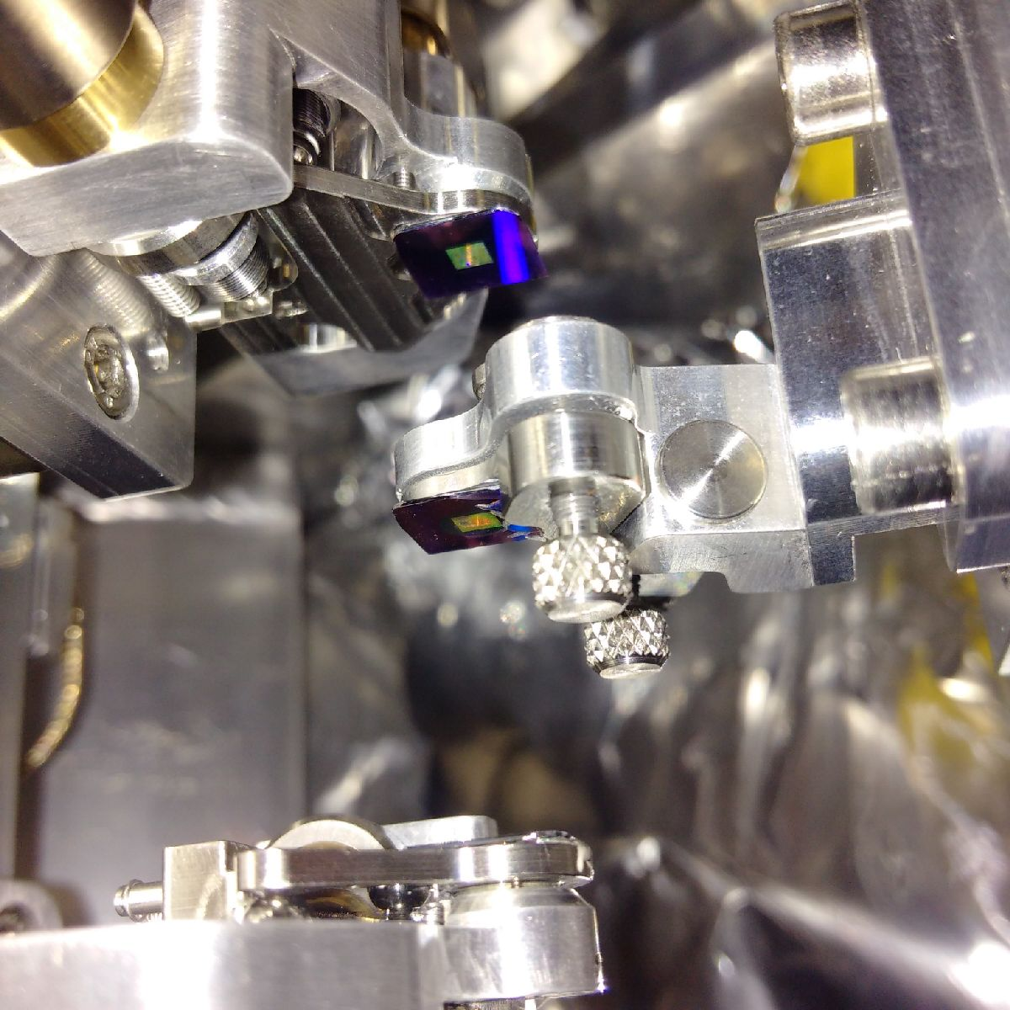
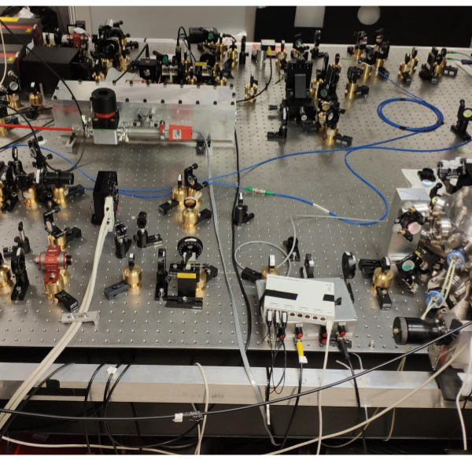
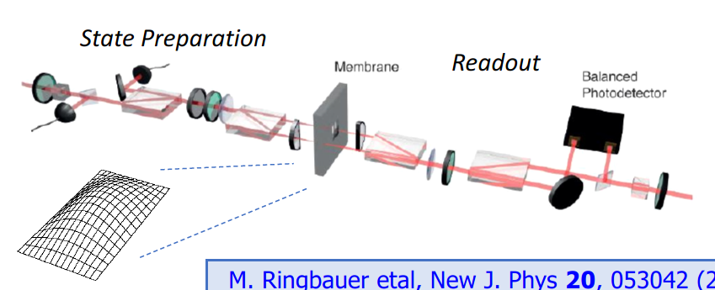
Q
S
WP1
WP2
WP3
WP4
WP5
WP6
WP7
WP8
WP9
Macroscopic Superposition
F
P
Subpackage 1: Silica spheres
Subpackage 2: Diamonds NV⁻ centres
Subpackage 3: Clamped oscillators
Subpackage 4: Theory
sp1
sp2
Simulate the proposed experiments
Dark matter and neutrino detection
Short-range force tests
Relativistic effects
Non-equilibrium mesoscopic quantum mechanics
Gravitational wave detection
sp3
Strengths:
Results come with/without spontaneous collapse
Leverages investment in three QT Hubs
Many years of work by us to propose this work
Community already working together

Slide 18
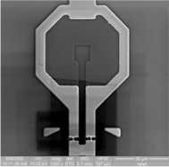
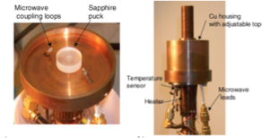
Q
S
WP1
WP2
WP3
WP4
WP5
WP6
WP7
WP8
WP9
Neutrino Mass
F
P
Guaranteed observation
Deliverable: trapping 10²⁰ D/T atoms
Cyclotron Radiation Emission Spectroscopy
Beyond Bolometers (det. dev.)
Sensitivity to 9mev
Nanowire bolometers

Slide 19
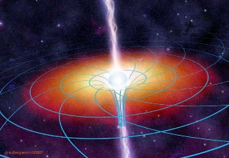
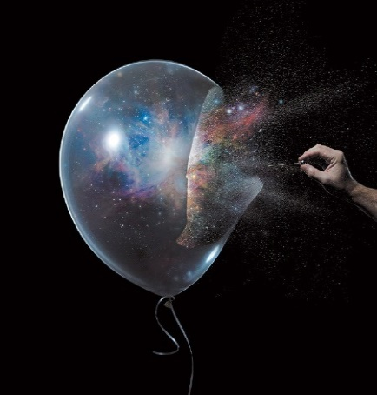

Q
S
WP1
WP2
WP3
WP4
WP5
WP6
WP7
WP8
WP9
Simulators
F
P
Deeping our understanding of dynamics
of the early universe and black holes
Bose-Einstein Condensates, superfluid Helium and optical systems.
2-component Bose-Einstein cond.
in 2D box trap: under development (Cambridge)
Superfluid Helium 4 bathtub
vortex flow (Nottingham, UK). Proof of principle under construction.
Black holes Space-time Vacuum
Our approach: to study these processes
in theory & experiment in
analogue quantum simulators

Slide 20
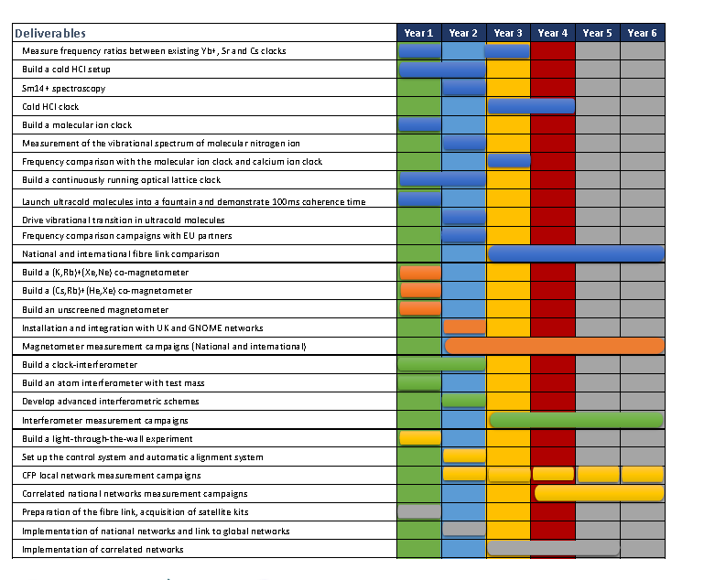
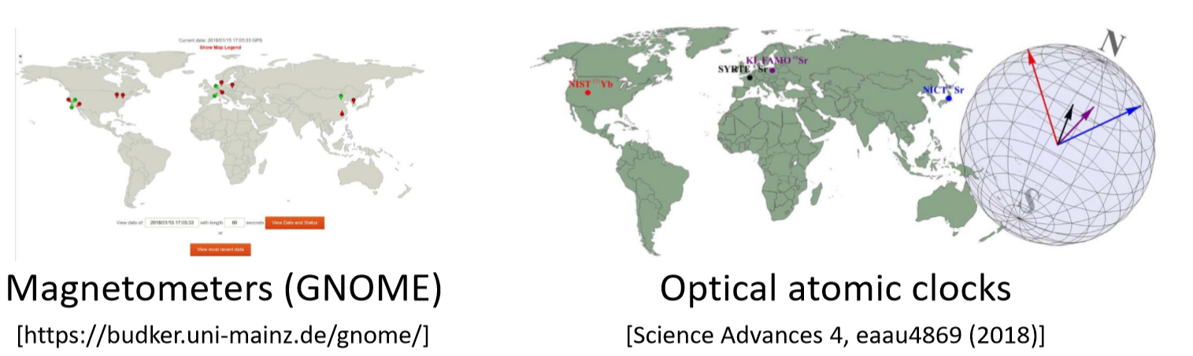
Q
S
WP1
WP2
WP3
WP4
WP5
WP6
WP7
WP8
WP9
Networked Sensors
F
P
“Each node/element will deliver disruptive results in the search for variations in fundamental constants, Lorentz symmetry breaking, new forces, tests of the equivalence principle”
“assemble a new tool” to enable completely new capabilities

Slide 21

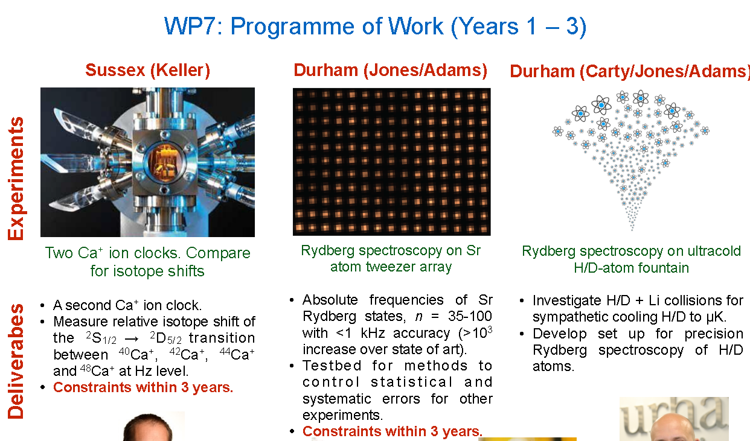
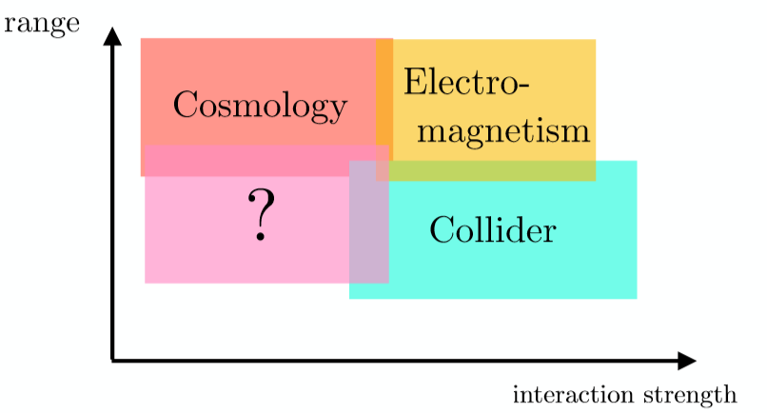
Q
S
WP1
WP2
WP3
WP4
WP5
WP6
WP7
WP8
WP9
5th force + …
F
P

Slide 22
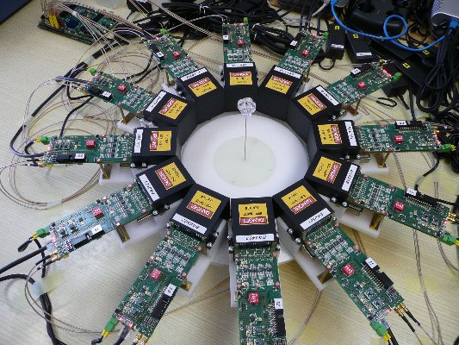
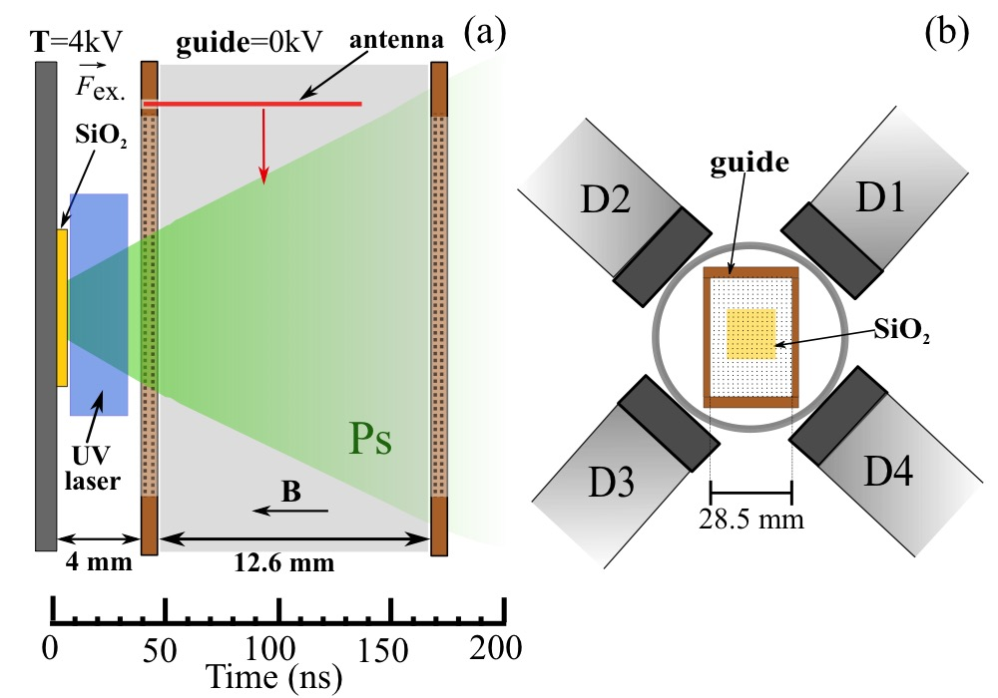
Q
S
WP1
WP2
WP3
WP4
WP5
WP6
WP7
WP8
WP9
Exotic Atoms
F
P
Antihydrogen
trapping efficiency will go up by an order of magnitude,
never been a better time to support this field
Positronium…
Production of slower focused beams [via Rydberg Stark deceleration/manipulation methods]
Construction of new detector(s)
Integration of Rydberg He spectroscopy into Ps experiments for high precision field characterization
Spectroscopic measurements of energy intervals and Rydberg constant
Demonstration of Rydberg Ps interference effects
“up or down” measurement of Ps gravity
New detector system for positronium

Slide 23
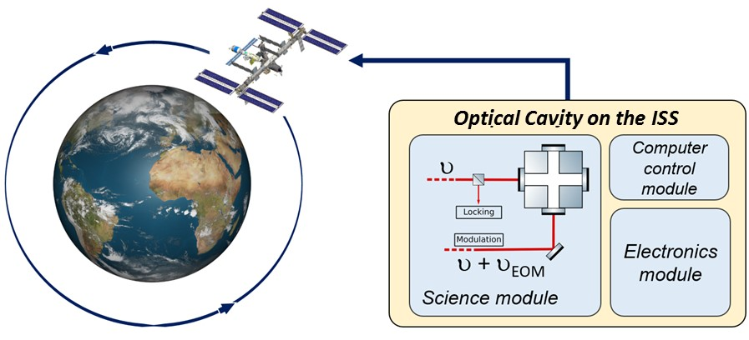
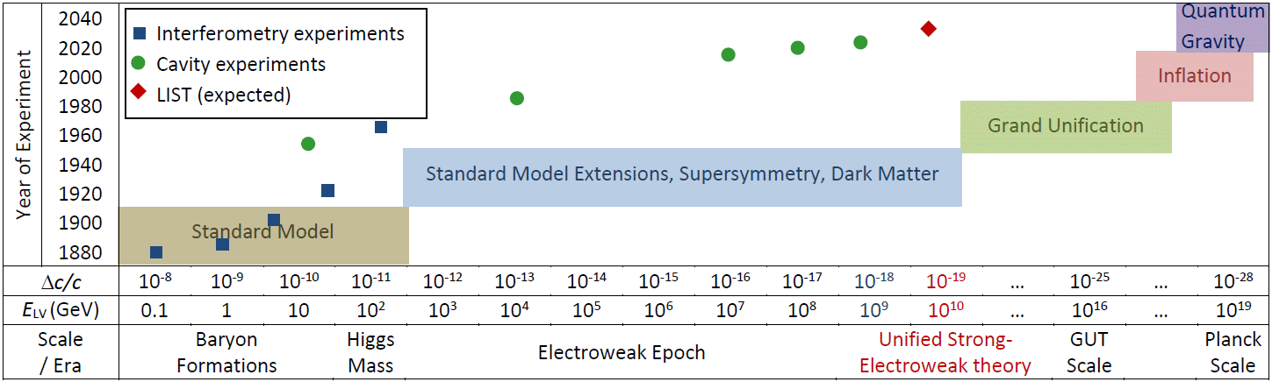
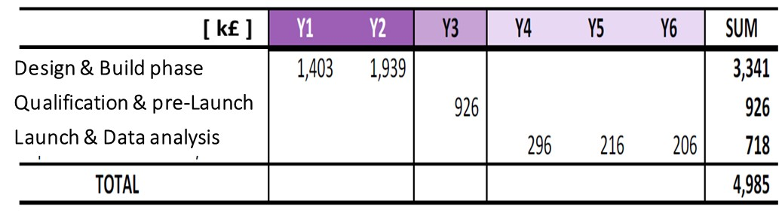
Q
S
WP1
WP2
WP3
WP4
WP5
WP6
WP7
WP8
WP9
Lorentz invariance in Space
F
P
A Michelson-Morley-type of experiment in microgravity
LIST: 1st of kind
Earth-bound experiments limited
LIST aim is to improve precision by an order of magnitude

Slide 24
Q
S
WP1
WP2
WP3
WP4
WP5
WP6
WP7
WP8
WP9
Wide range of thoughts and deliverables
F
P
AION (next 2 days!)
Physics Goals
Detector development
Deliverables
Theory
Plan
Competitiveness
Staff internal WP work allocation
Benefit to UK and UK Industry

Slide 25
Quantum Sensors
Fundamental Physics
Consortium
Q
S
WP1
WP2
WP3
WP4
WP5
WP6
WP7
WP8
WP9
F
P
T. Bowcock

