Slide 1
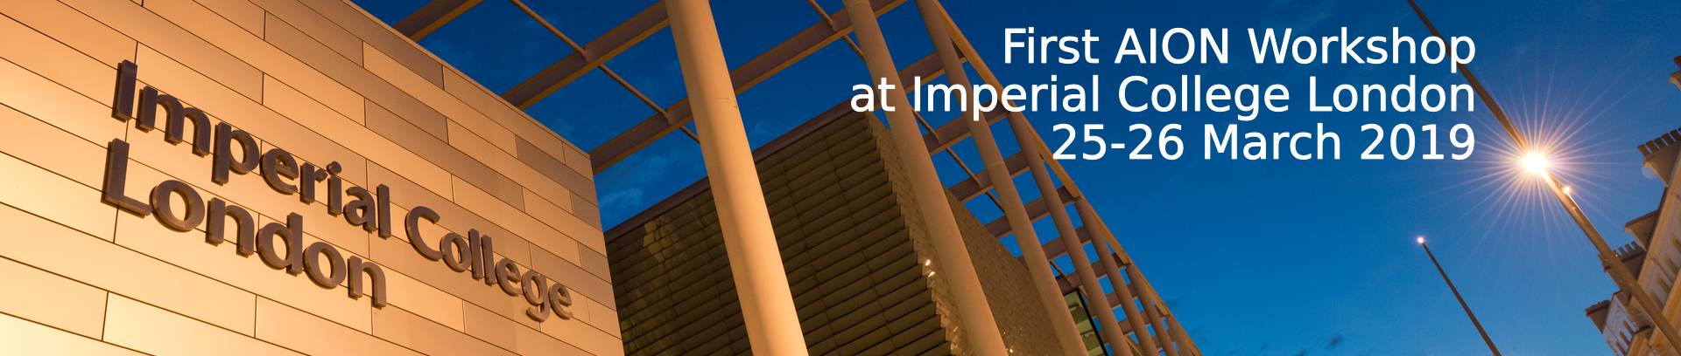
First AION Workshop
Introduction
AION Workshop, march 25, 2019
T. Bowcock,
O. Buchmueller [Coord.],
J. Coleman,
J. Ellis [Theory],
I. Shipsey

Slide 2
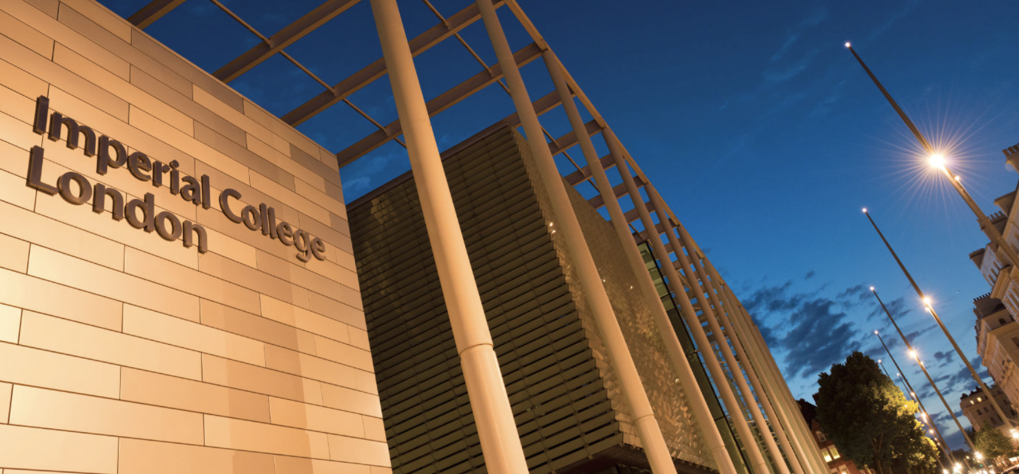

First AION Workshop at Imperial College London
March 25/26 2019
Organised by:
T. Bowcock,
O. Buchmueller [Coord.],
J. Coleman,
J. Ellis [Theory],
I. Shipsey
2-Day Workshop:
Day 1: Instrumentation
Day 2: Physics case
If you like to participate or
require further information
please contact:
fundamental-physics-admin@imperial.ac.uk
with “AION” in title.

Slide 3
Scope of the Workshop
The workshop will be a critical milestone for the assembly of a complete proposal to construct and operate a next generation Atomic Interferometric Observatory and Network (AION) in the UK.
It will enable the exploration of properties of dark matter as well as searches for new fundamental interactions.
In addition, the proposal is supposed to provide a pathway for detecting gravitational waves from the very early universe in the, as yet mostly unexplored, mid-frequency band, ranging from several milliHertz to a few Hertz.
The first day of the 2-day workshop will focus on the technology aspects of the project, while the second day will be devoted to discussions of the physics case and how to further develop and strengthen it.
The project spans several communities: fundamental particle and astroparticle physics, atom interferometry, gravitational wave physics, and cosmology.

Slide 4
2 Days with Different Themes
Day 1:
Instrumentation &
The AION Project
Day 2:
The Physics Case of AION

Slide 5
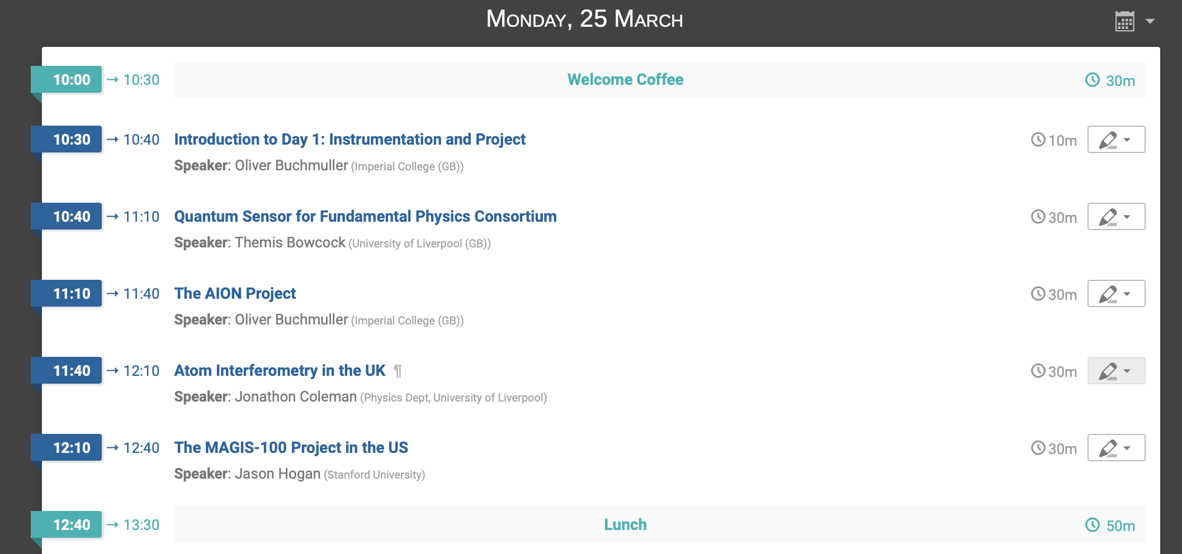
Agenda Today Morning

Slide 6
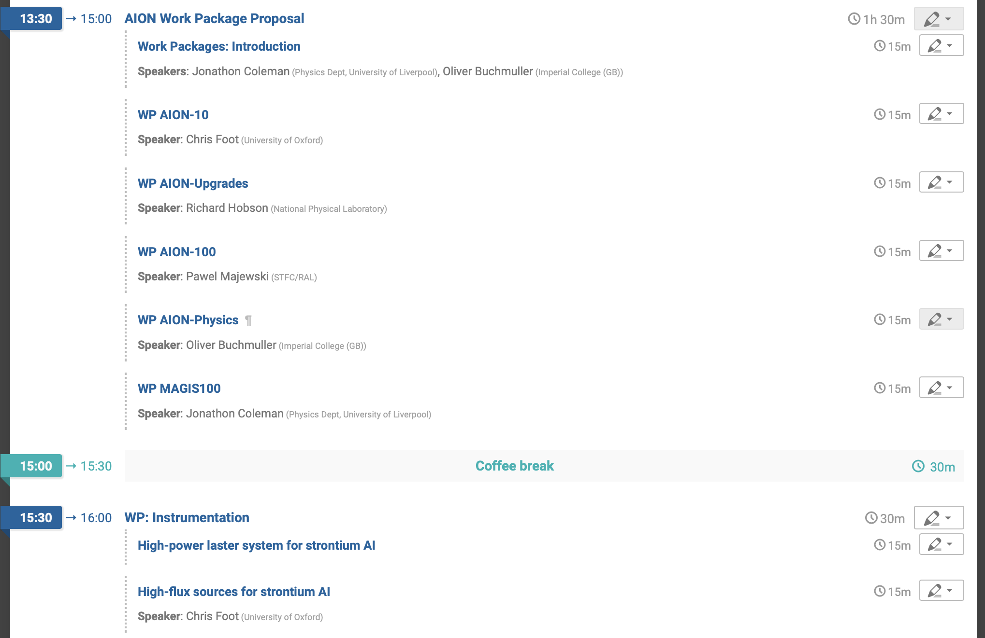
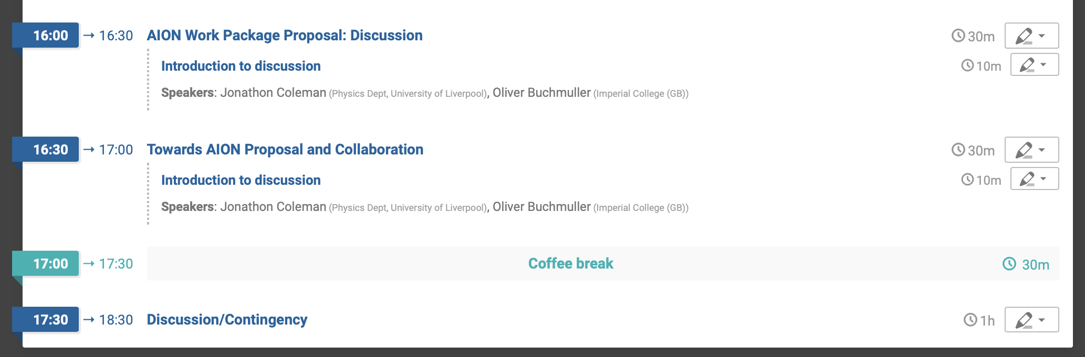
Agenda Monday Afternoon

