Slide 1
Introduction to Discussion of Prospective AION Physics Case
Dark Matter, Gravitational Waves, Other Topics
AION Workshop @ Imperial
March 25/26, 2019
John Ellis (King’s College London)

Slide 2
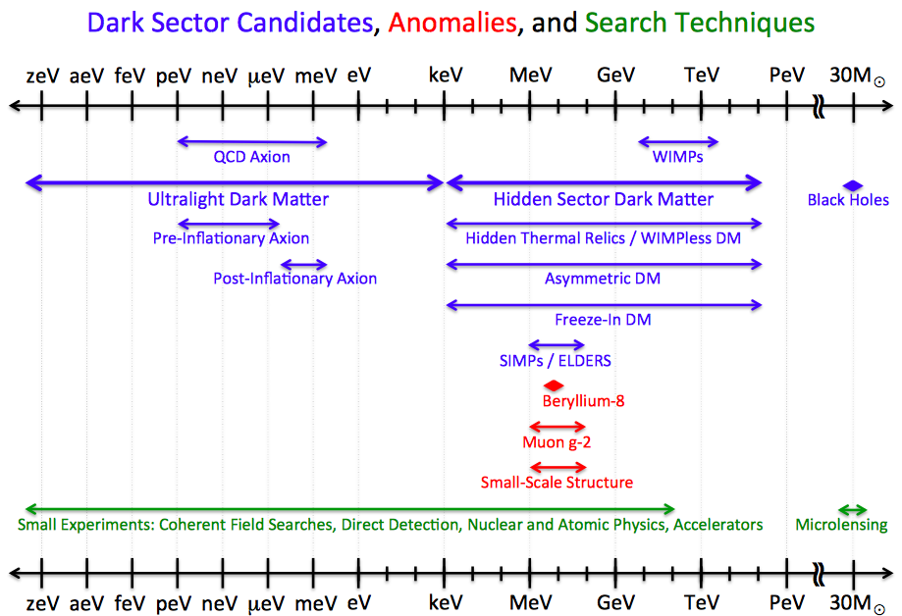
Wide Range of Candidate Dark Matter Particles

Slide 3
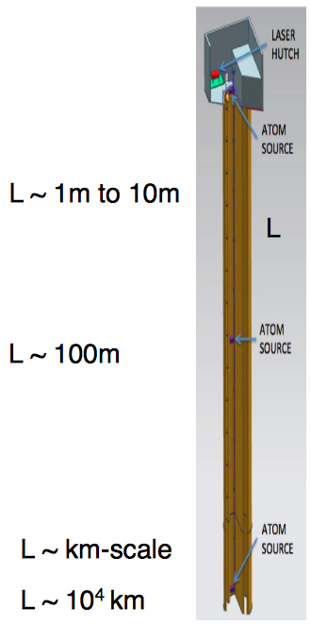
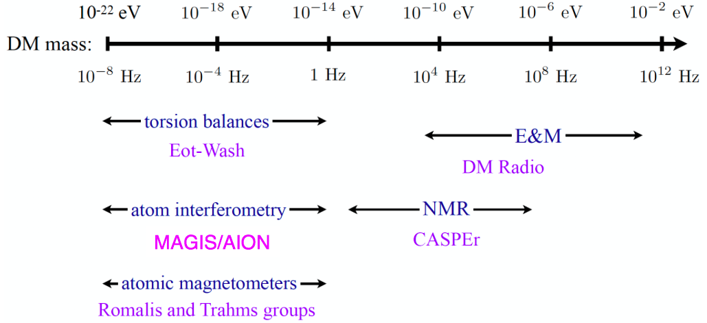
Searches for Light Dark Matter
Dark matter could be coherent waves of light bosons
  Many detection techniques, e.g. atom interferometers
also interesting for gravitational waves

Slide 4
Dark Matter
Martin Bauer
Ultra-light bosons with masses in the range 10⁻²² to 1 eV are motivated in many extensions of the Standard Model, e.g., axion-like particles, ultra-light scalar fields such as moduli, dilatons or radions and ultra-light hidden vector bosons.
Could have correct dark matter density and are consistent with theory of structure formation, which demands that dark matter should be ‘cold’.
AION will be sensitive to the frequency band between 10 and 0.01 Hz, i.e., bosons in the range 10⁻¹⁶ to10⁻¹³ eV.
Complementing torsion-balance, atomic co-magnetometer and atomic spectroscopy experiments.

Slide 5
Possible DM Theory Tasks
Understanding the synergies between dark matter searches in this mass range and other astrophysical and cosmological observations.
Exploring the synergies between AION and other laboratory probes of ultra-light bosonic dark matter.
Showing how to identify unambiguously dark matter as the origin of a signal in AION, rather than a signal from, e.g., time-varying physical parameters or GWs, and extract the dark matter properties from the signal.
Horng Sheng

Slide 6
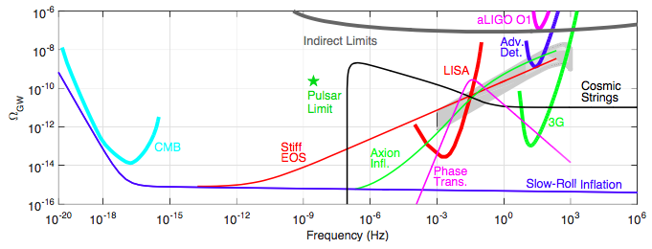
Gravitational Wave Spectrum
Gap between ground-based optical interferometers @ LISA
Electroweak phase transition? Cosmic strings?

Slide 7
Gravitational Waves
Marek Lewicki
Near term: LIGO, Virgo and KAGRA @ frequencies ~ 10 Hz to KHz range.
Longer term: LISA @ frequencies below ~ 0.01 Hz, 3ird-generation ground instruments such as Einstein Telescope @ ~ 1Hz to few kHz, on a similar timeline.
The mid-frequency band between 10 and 0.01 Hz interesting: GWs from phase transitions in early universe; track astrophysical sources evolving from LISA range towards LIGO/Virgo/KAGRA range; new intermediate-mass BH sources.
AION would complement MAGIS, just as Virgo complements LIGO.

Slide 8
Possible GW Theory Tasks
Calculating mid-frequency GW signatures of cosmological phase transitions, e.g., at the electroweak scale, and relating them to collider signatures of possible extensions of the Standard Model.
Sensitivity to cosmic strings.
Understanding synergies of multiband GW astronomy combining GW searches in this frequency range with LISA, LIGO/Virgo/KAGRA & other astrophysical observations, e.g., for predicting timing, directions & distances of future merger events.
Novel tests of the strong-gravity regime via, e.g., accurate timing of the GW phase evolution, that are not accessible with ground-based interferometers and LISA alone.
- Modelling astrophysical sources whose GWs peak in mid- frequency range, e.g., intermediate-mass BHs (seeds for supermassive BHs observed today), providing insight into their evolution and their host galaxies.

Slide 9
Beyond Dark Matter & GWs
Ultra precision interferometry may also be sensitive to other phenomena beyond dark matter and GWs, and we also propose exploratory studies of such possibilities.
Possible exploratory theoretical tasks
Probing fundamental “constants”, dark energy
Detecting the astrophysical neutrinos that traverse the Earth with high flux though very small cross-section and tiny momentum
- Precise interferometry may also be relevant for understanding long-range fifth forces – role of AION
Clare Burrage
Ed Copeland
Diego Blas

