Slide 1
Workshop on the phenomenology of dark matter searches with quantum sensors
AION
Brainstorm options for Dark Sector searches with Quantum Sensors in categories like:
- light DM (< GeV scale, hard to see in DD or at the LHC because of negligible nuclear recoil or missing energy, respectively.
- ultralight (fuzzy) DM (~10^-22 eV) that behaves more like a classical wave and modifies fundamental constants through oscillations.
Objectives:
- Phenomenological input for Quantum Sensors for Future Physics, to strengthen and refine the physics case for forthcoming funding proposals.
- White paper?

Slide 2
What is AION (in a nutshell)?
The proposal is to construct and operate a next generation Atomic Interferometric Observatory and Network (AION) in the UK that will enable the exploration of properties of dark matter as well as searches for new fundamental interactions.
It will provide a pathway for detecting gravitational waves from the very early universe in the, as yet mostly unexplored, mid-frequency band, ranging from several milliHertz to a few Hertz.
The proposed project spans several science areas ranging fundamental particle physics over astrophysics to cosmology and, thus, connects these communities.
Following the “Big Ideas” call, the project was selected by PAAP and STFC as a high priority for the community. It was provisionally classified as a medium scale project.
AION is also a Work Package of the QSFP proposal

Slide 3
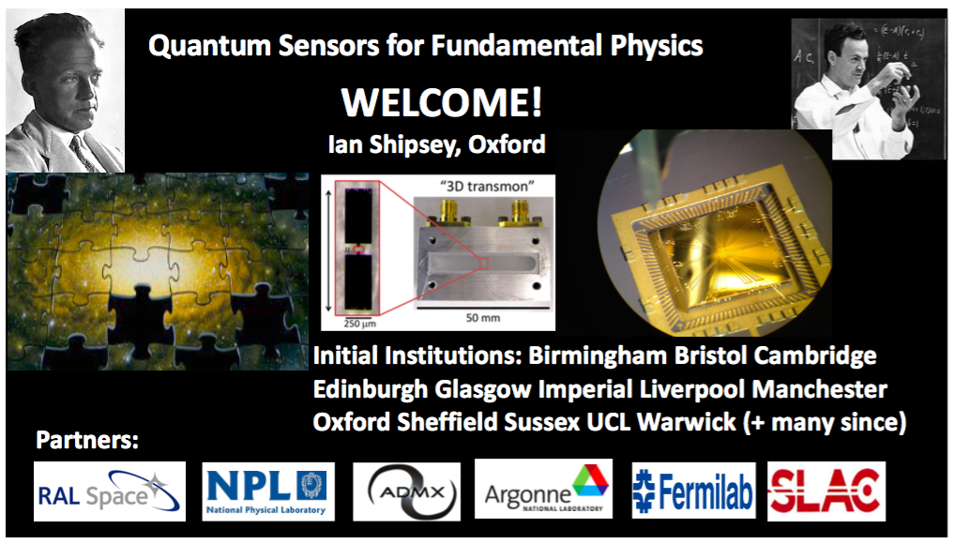

Slide 4
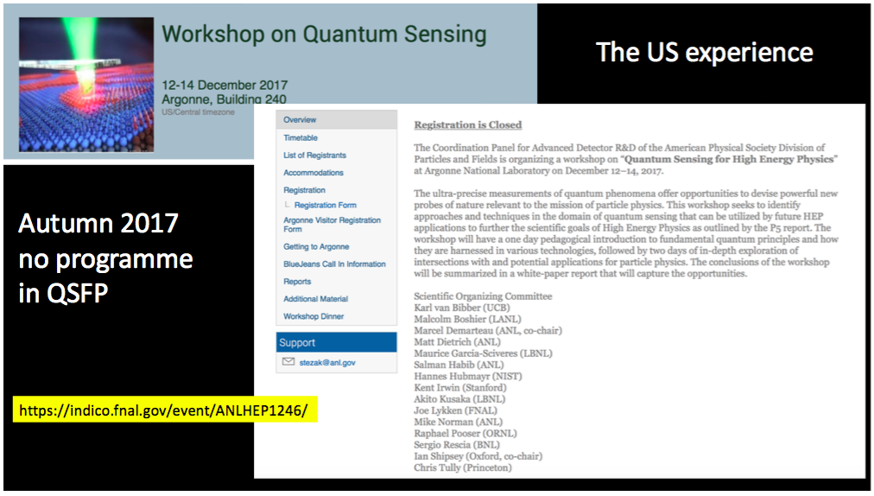

Slide 5
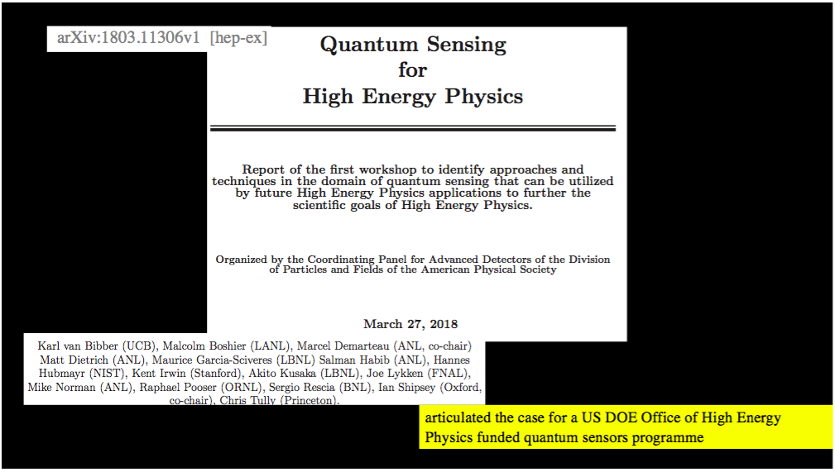

Slide 6
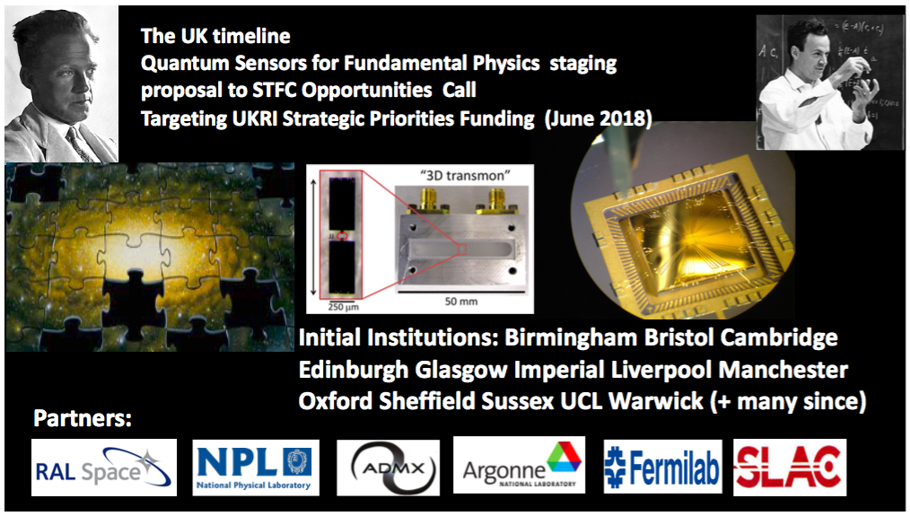

Slide 7
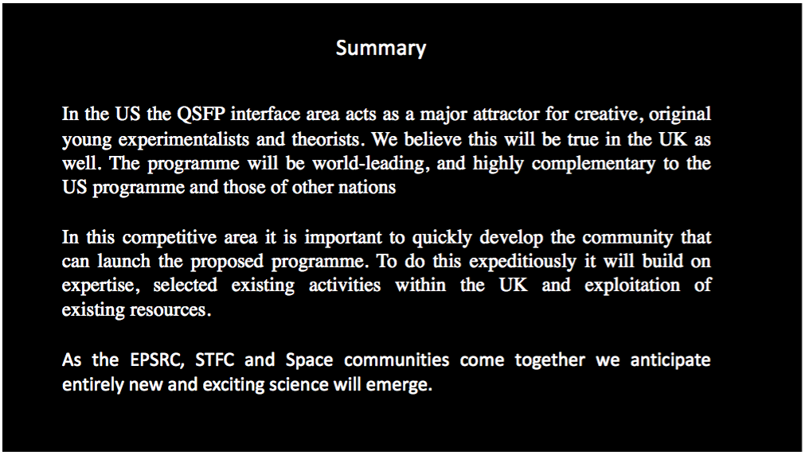

Slide 8
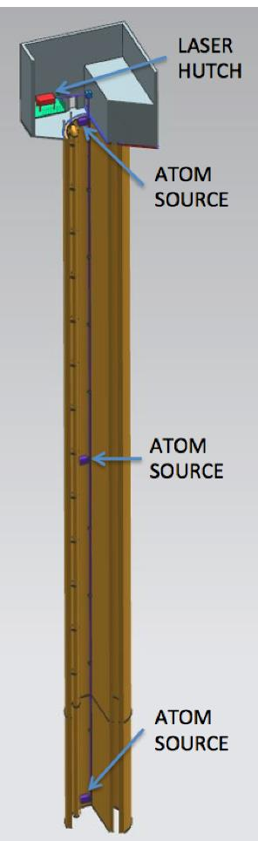
Proposed AION Programme
The AION Project is foreseen as
a 4-stage programme:
The first stage develops existing technology (Laser systems, vacuum, magnetic shielding etc.) and the infrastructure for the 100m detector and produces detailed plan resulting in an accurate assessment of the expected performance in Stage 2.
The second stage builds, commissions and exploits the 100m detector and also prepares design studies for the km-scale.
The third and fourth stage prepare the groundwork for the continuing programme:
  Stage 3: Terrestrial km-scale detector
  Stage 4: space based detector
L ~ 1m to 10m
L
L ~ 100m
L ~ km-scale
L ~ 10⁴ km

Slide 9
AION – A Staged Programme**
AION-10: Stage 1 [year 1 to 3]
1 & 10 m Interferometers & Site Development for 100m Baseline
AION-100: Stage 2 [year 3 to 6]
100m Construction & Commissioning
AION-KM: Stage 3 [ > year 6 ]
Operating AION-100 and planning for 1 km & Beyond
AION-SPACE: Stage 4 [ after AION-KM ]
Space based version
**outlined in Big Ideas proposal

Slide 10
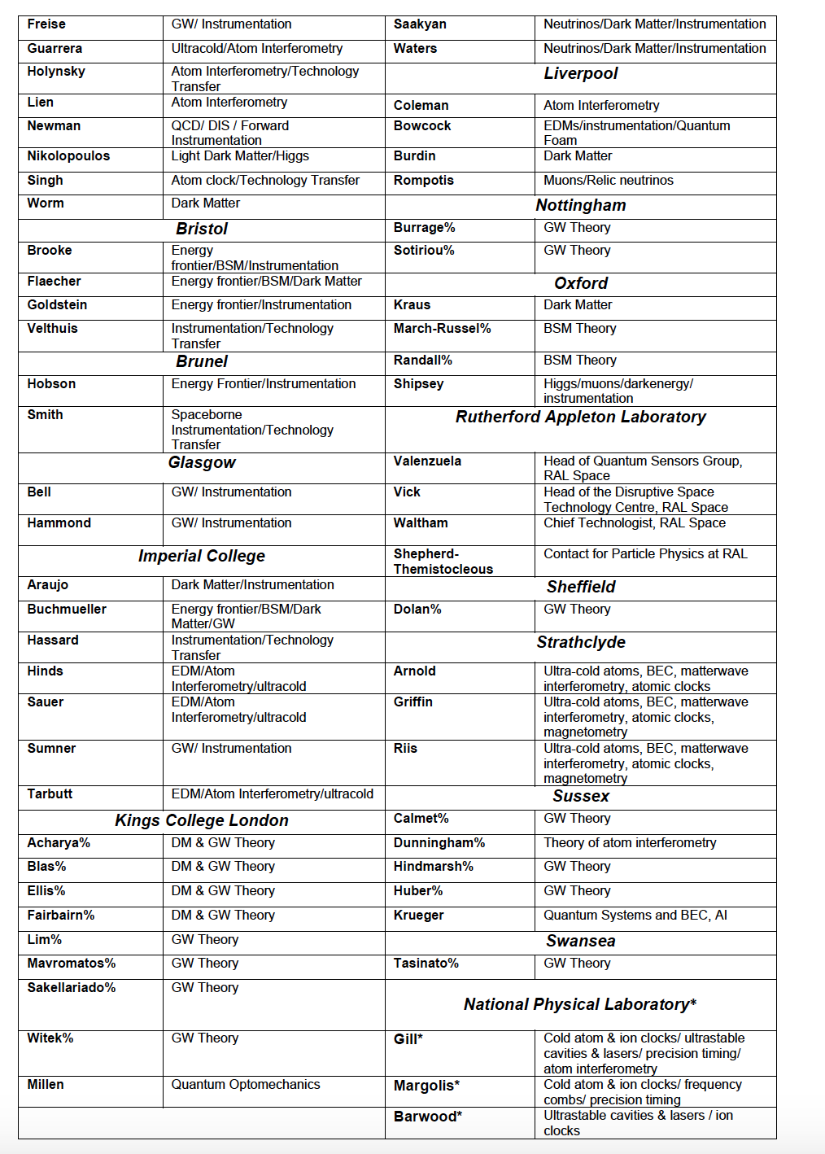
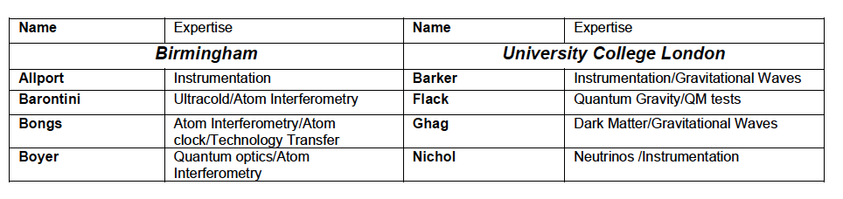
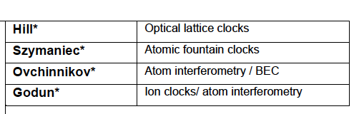
In preparation of this proposal we have broadly consulted with the relevant UK science communities and have received very positive feedback. The support is across several fields, ranging from fundamental particle physics, over atom interferometry to gravitational wave physics. The support also covers both experimental as well as theory communities in the UK. So far, more than 70 members from 20 UK institutions have provided explicit support for this proposal:
Aberdeen, Birmingham, Bristol, Brunel, Durham, Glasgow, Imperial College, Kings College London, University College London, Liverpool, Nottingham, Open University, Oxford, RAL, Sheffield, Strathclyde, Sussex, Swansea and NPL
If you are interested to follow the AION activity
you can subscribe to the AION Email list:
aion-project@imperial.ac.uk
via:
https://mailman.ic.ac.uk/mailman/listinfo/aion-project

