Slide 1
AION-10 location at RAL
Pawel and Tristan
25 January 2019

Slide 2
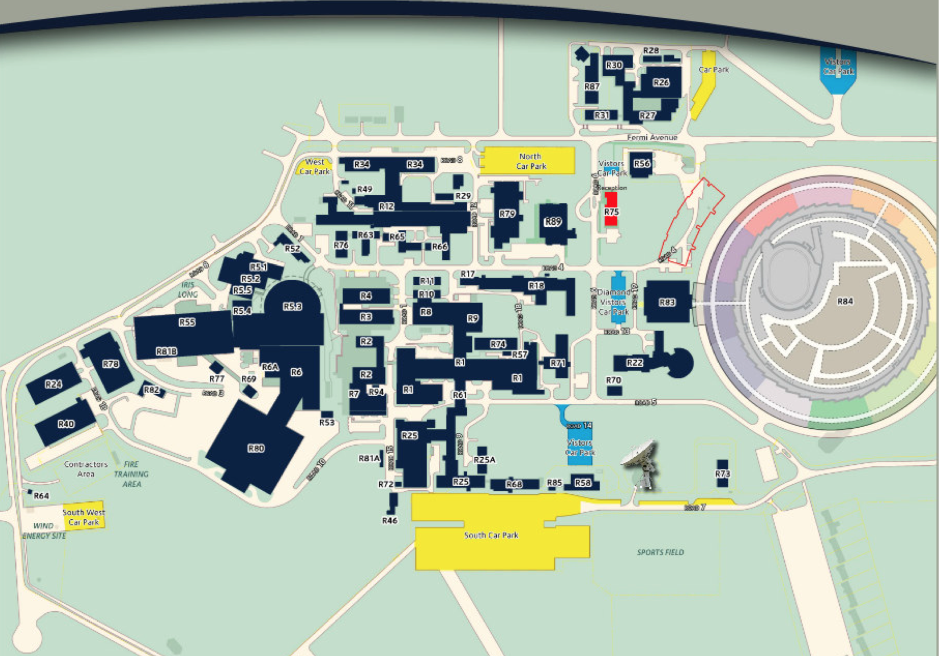
Map of RAL
Main entrance
AION-10
proposed
location
at RAL in R72
Future construction site

Slide 3
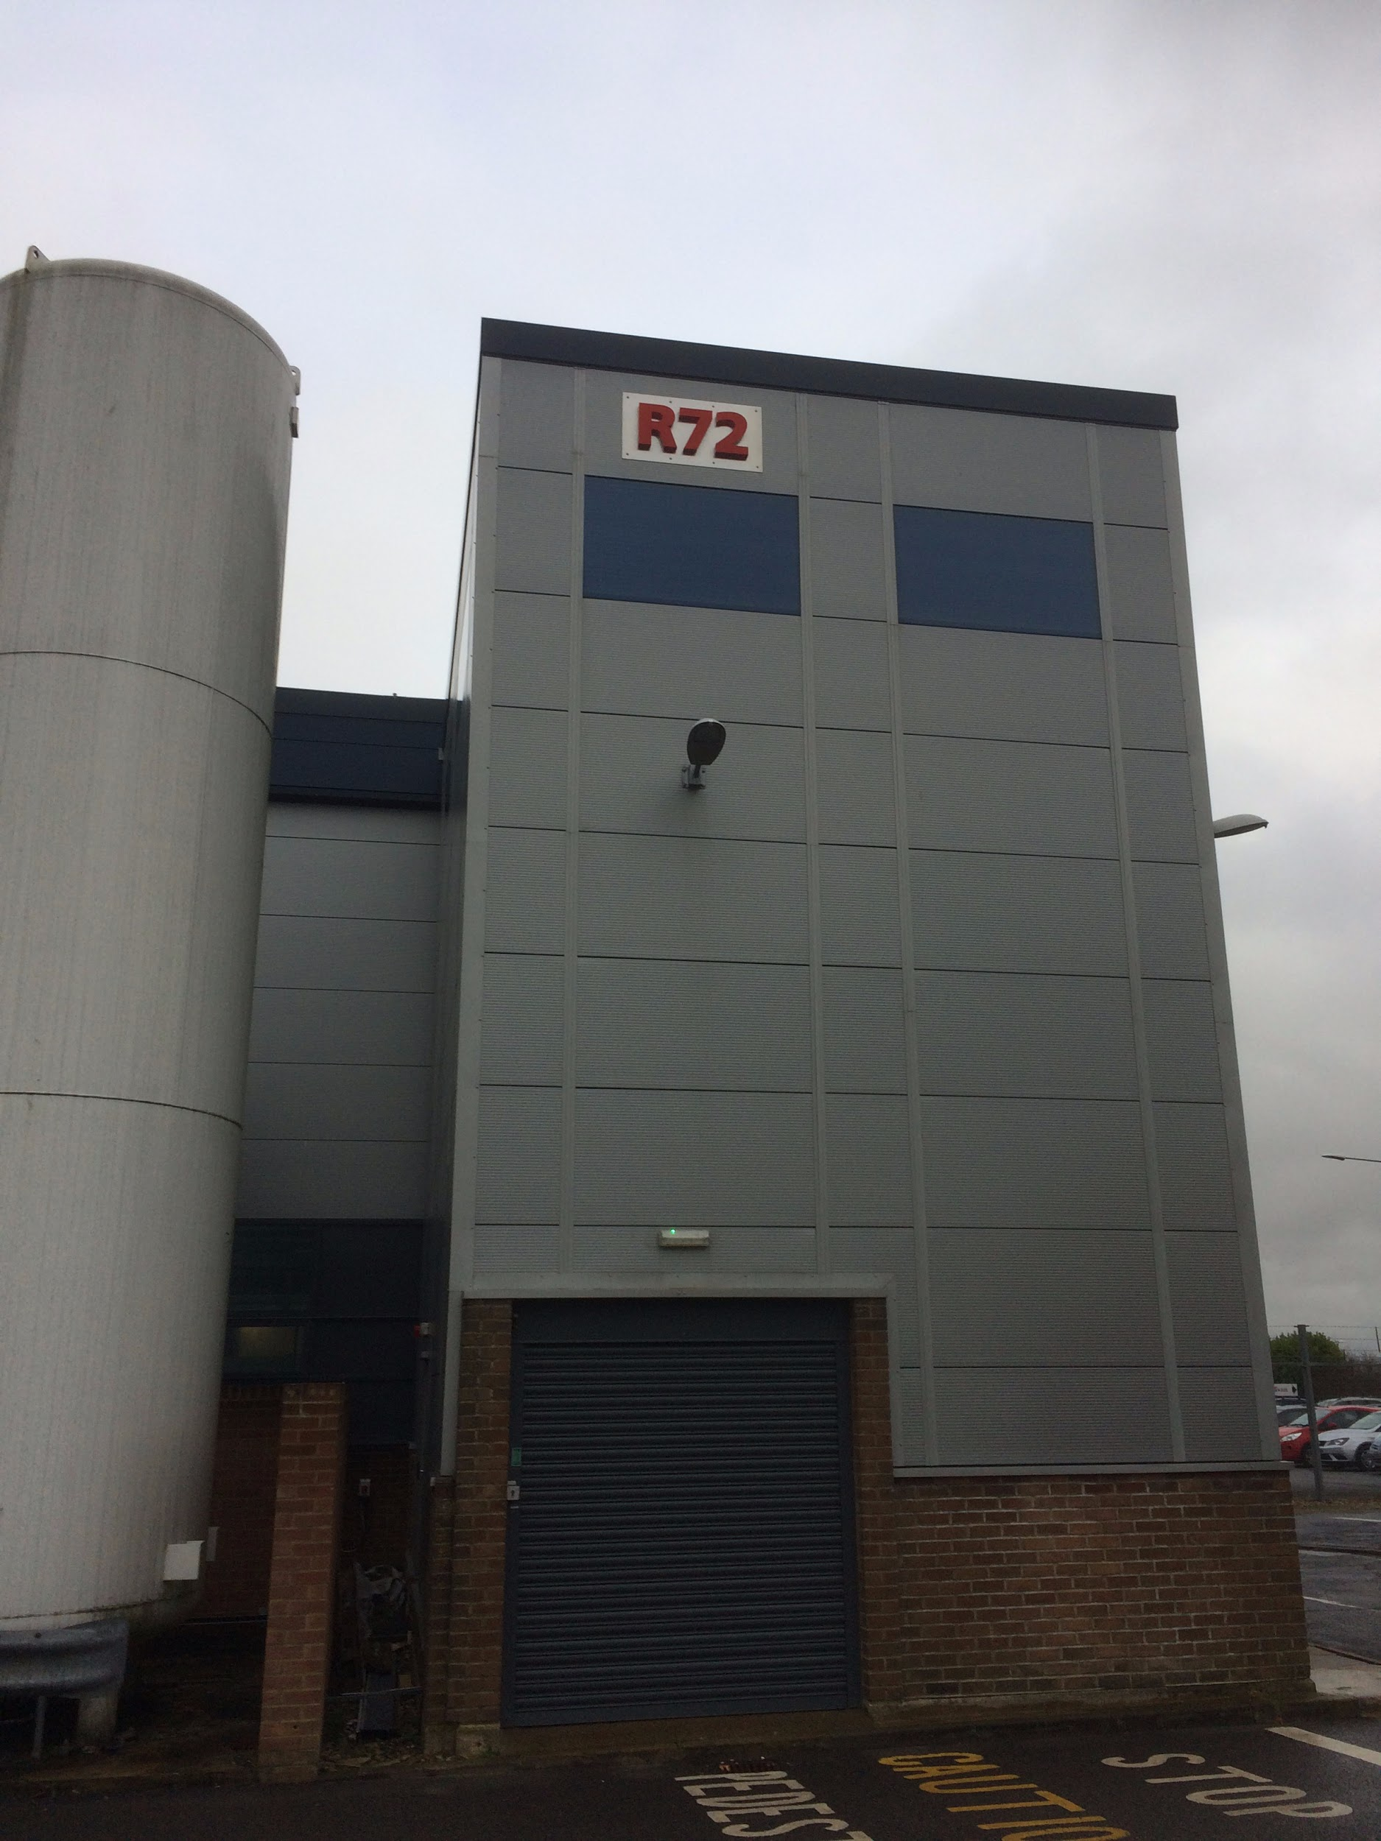
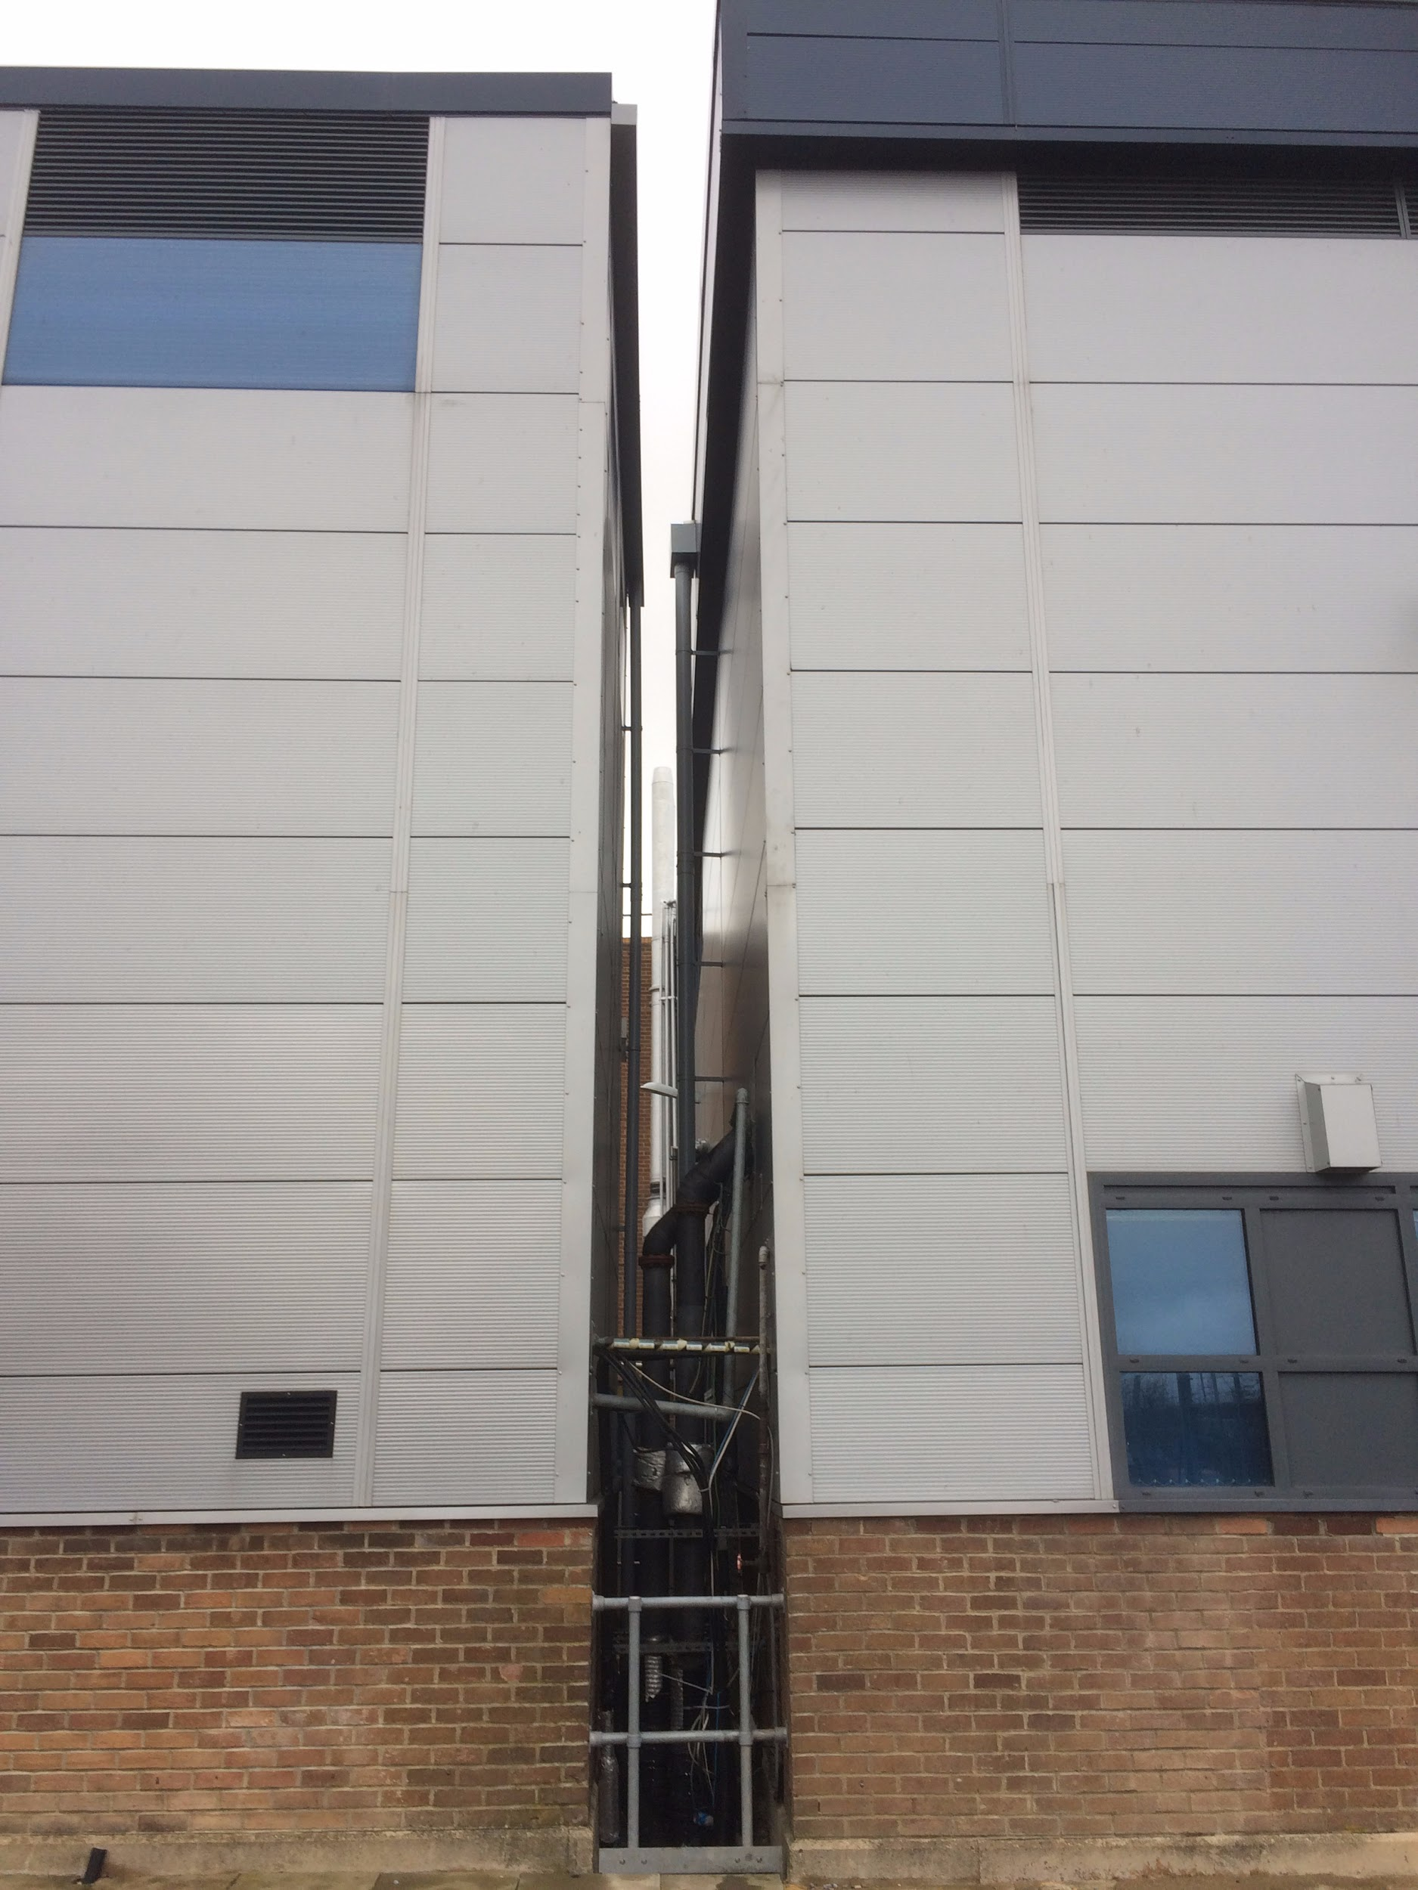
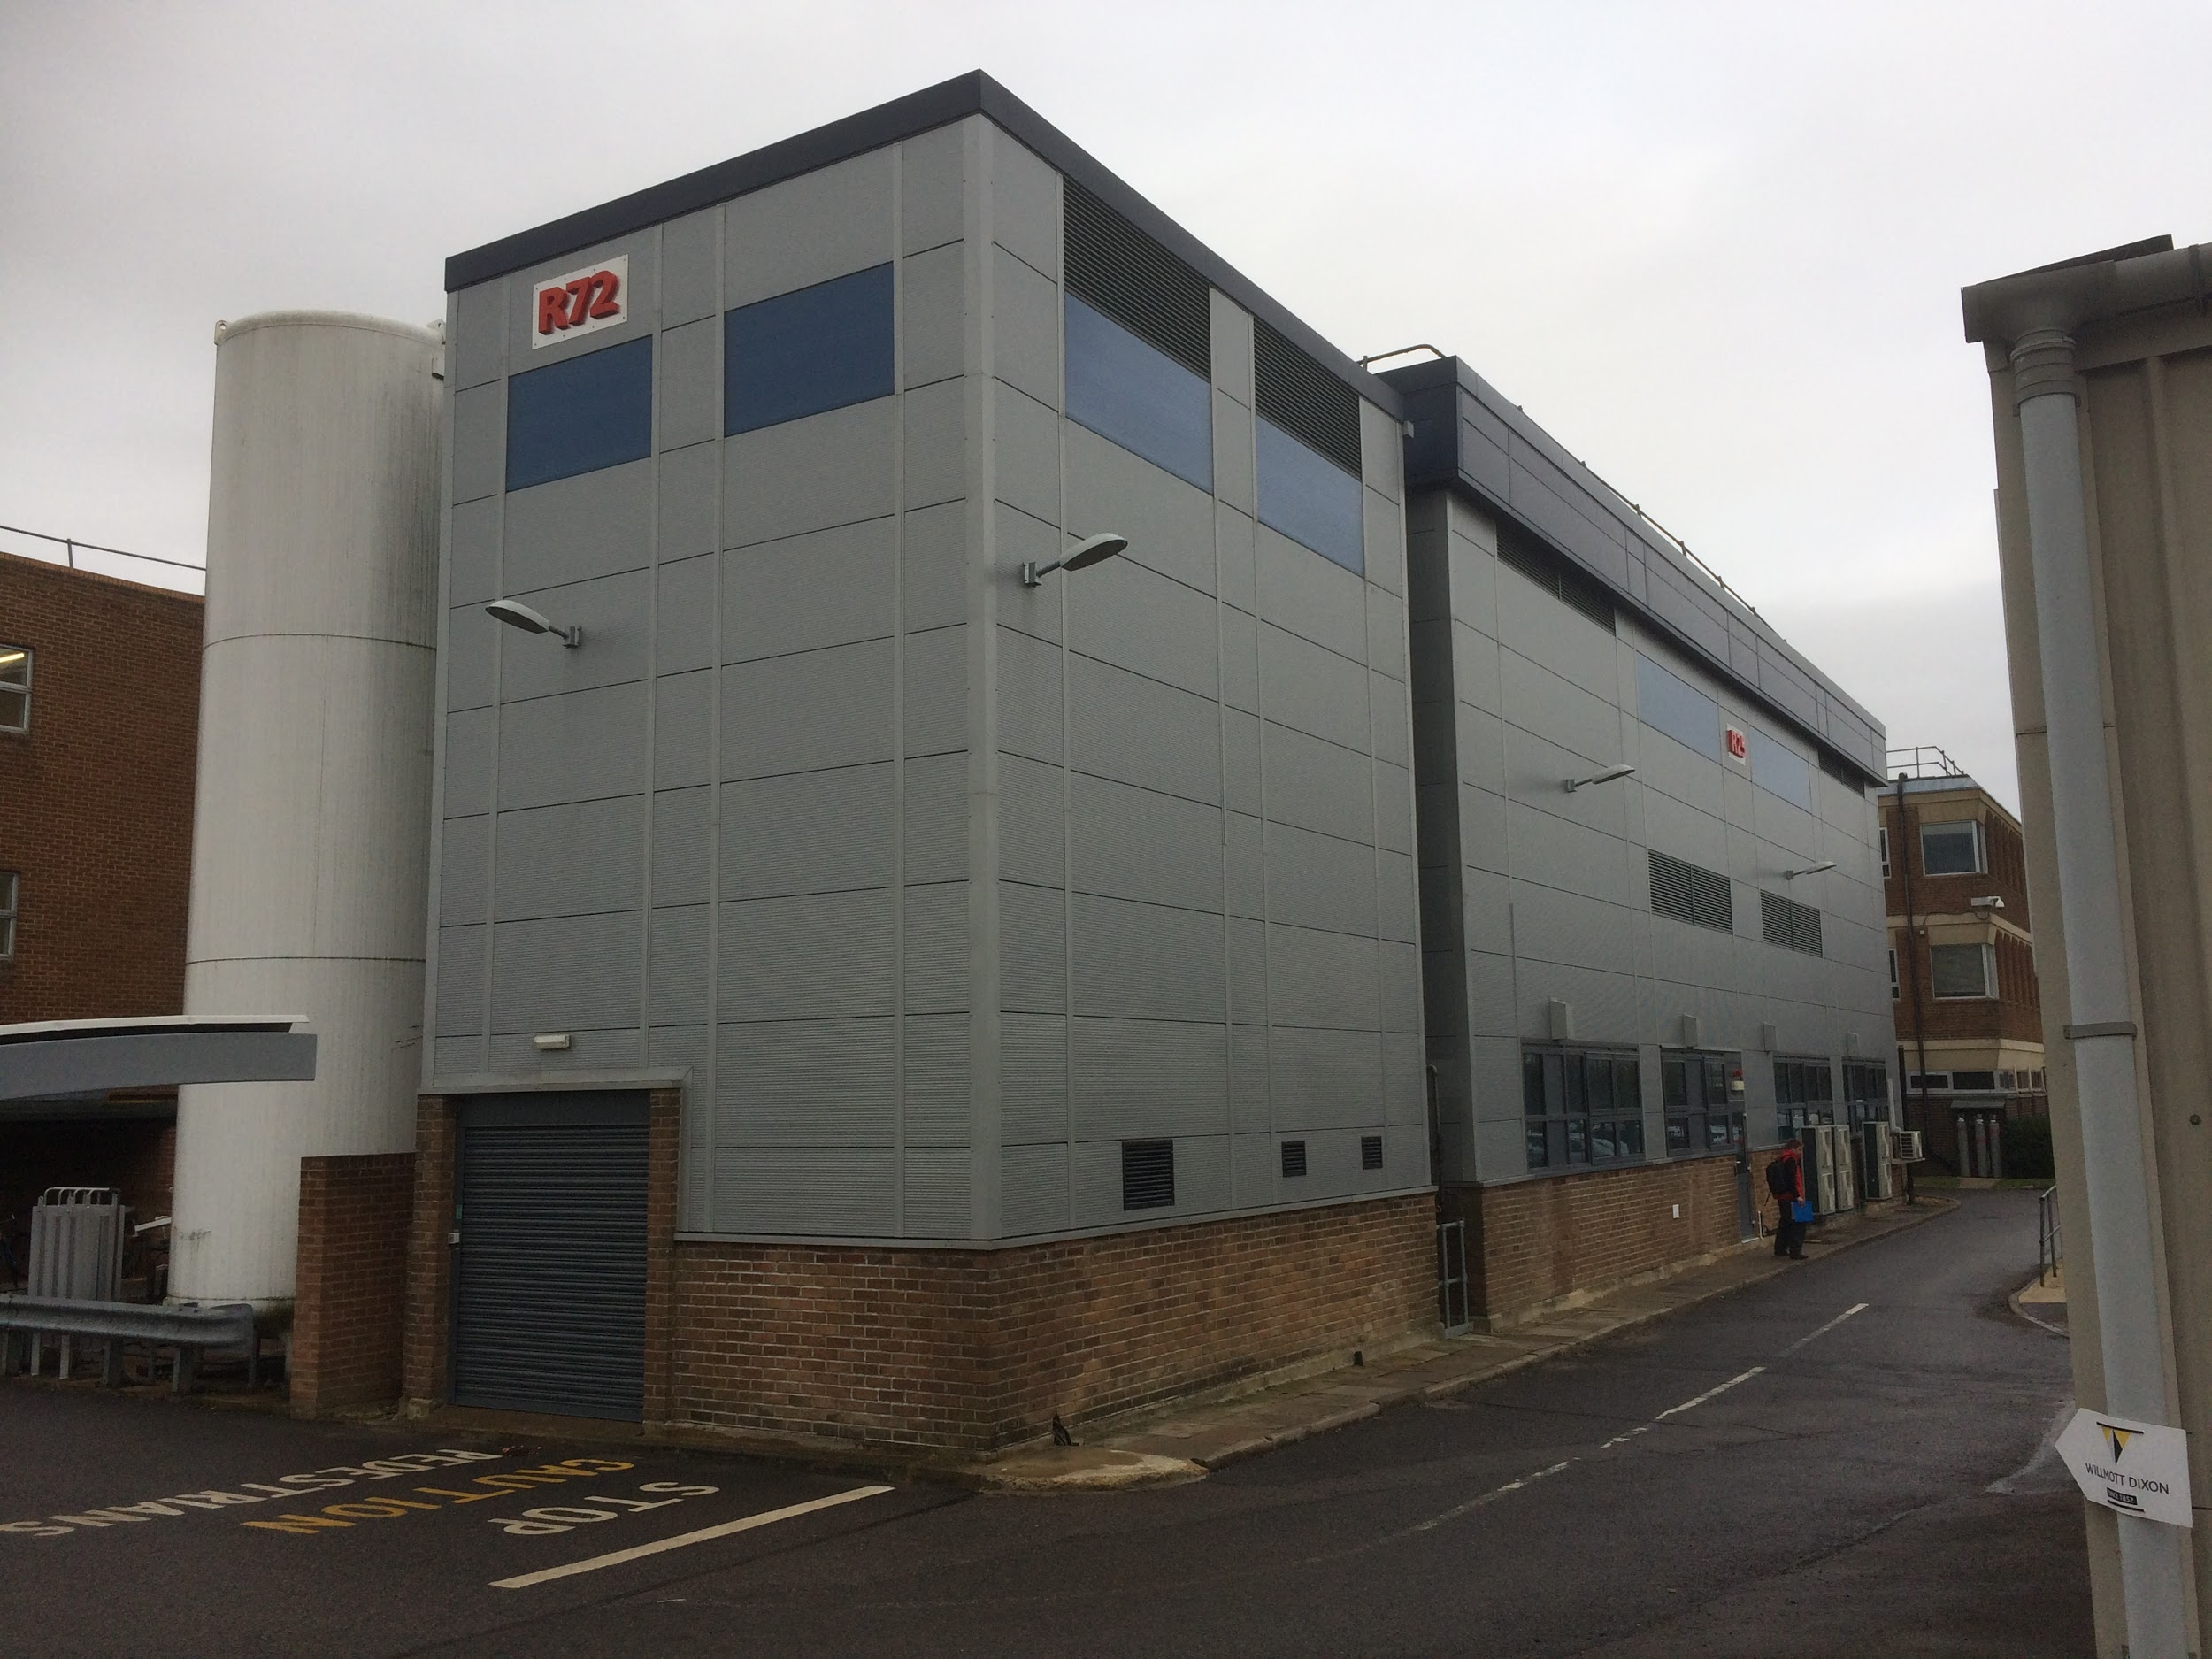
AION-10 at RAL
R72 R25 R46
R72 - stand-alone building housing compressors used for activities in the adjacent building R25
Advantages: single user, easy access, overhead crane, ladder and internal metal structure giving access to different heights, can become available for adaptation work as soon as it is accepted by the project

Slide 4
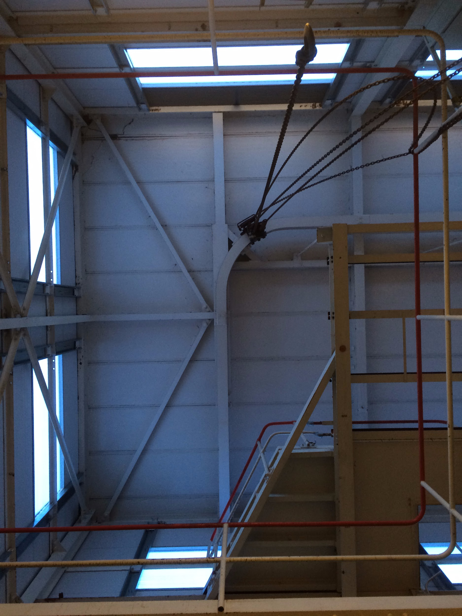
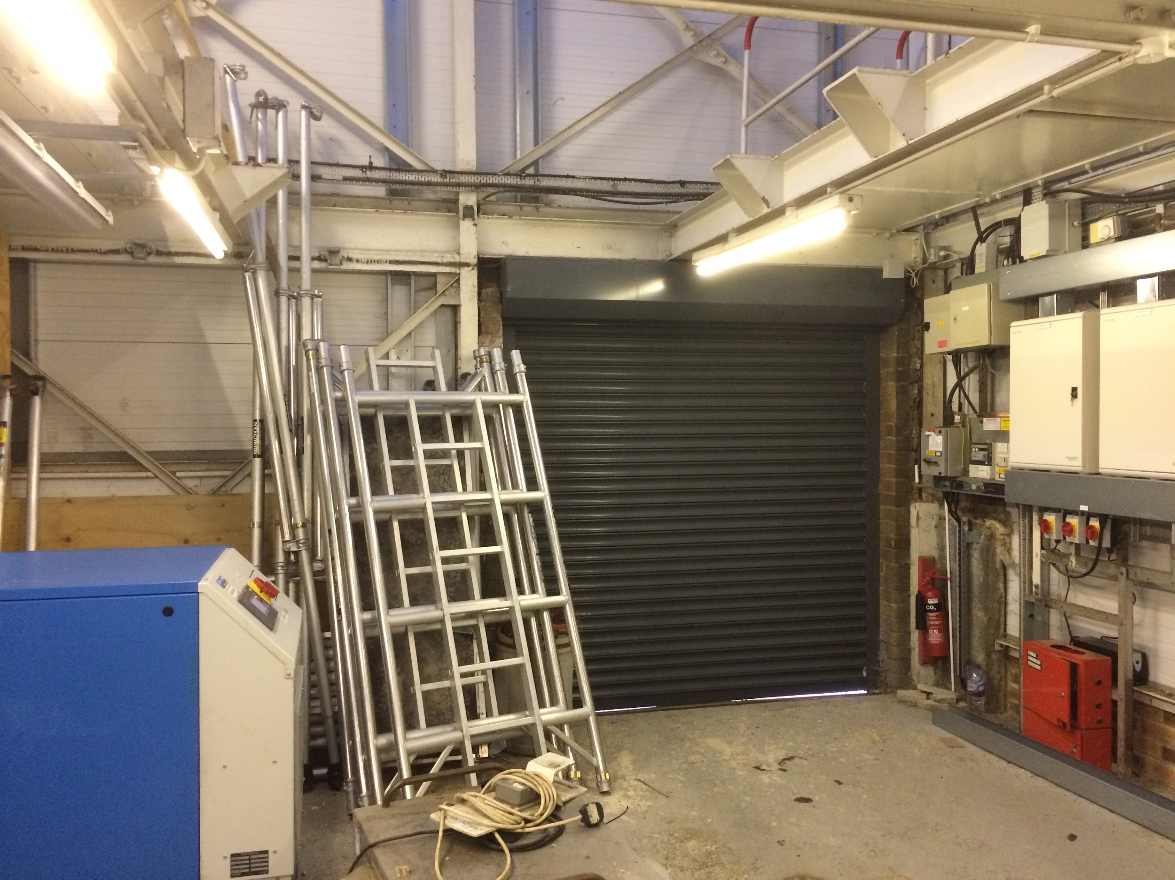
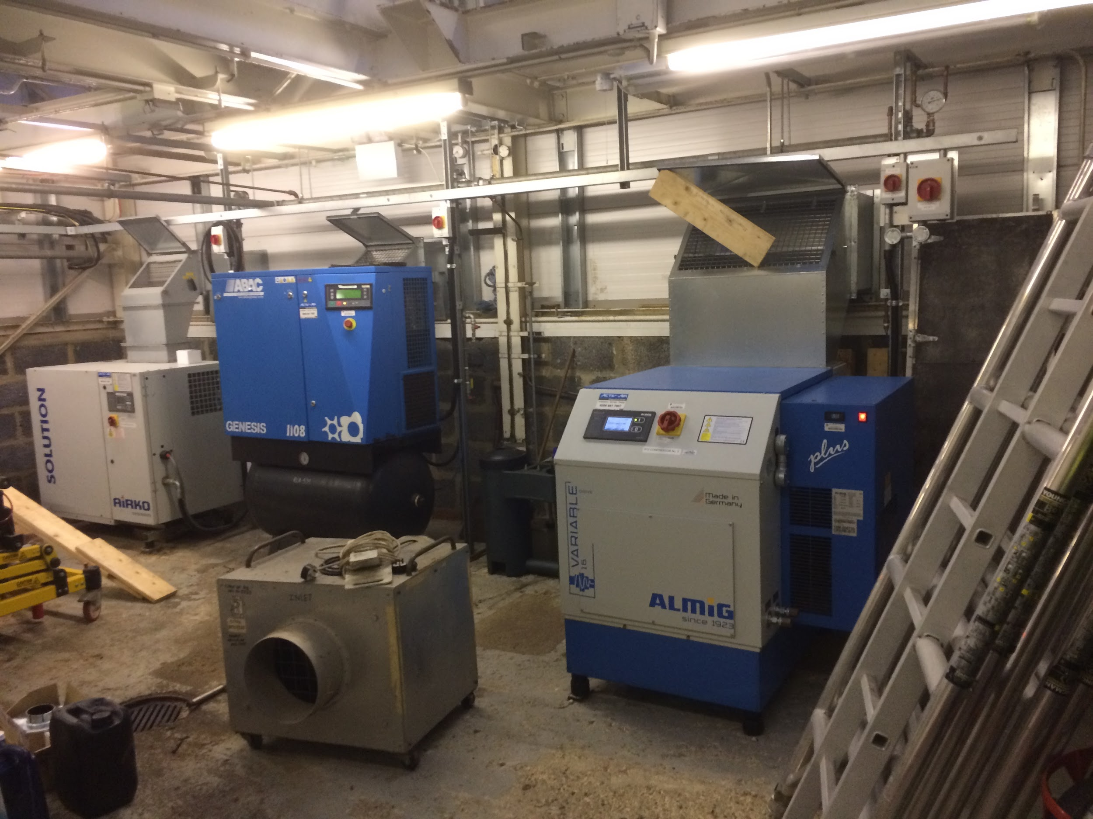
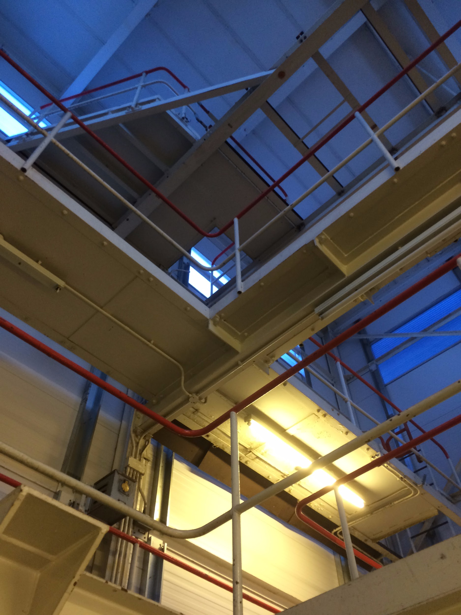
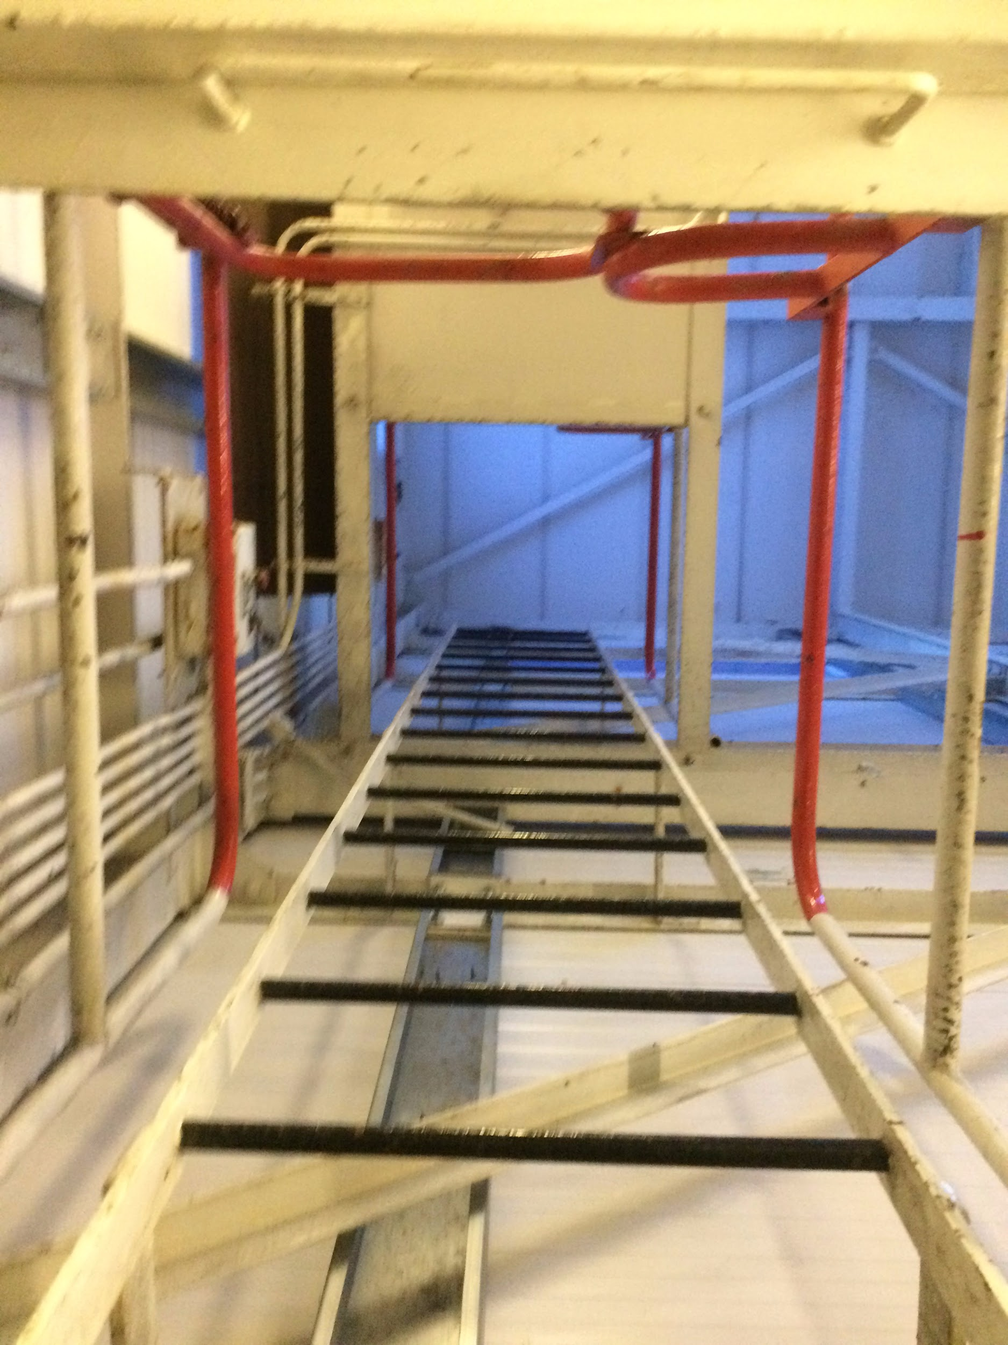
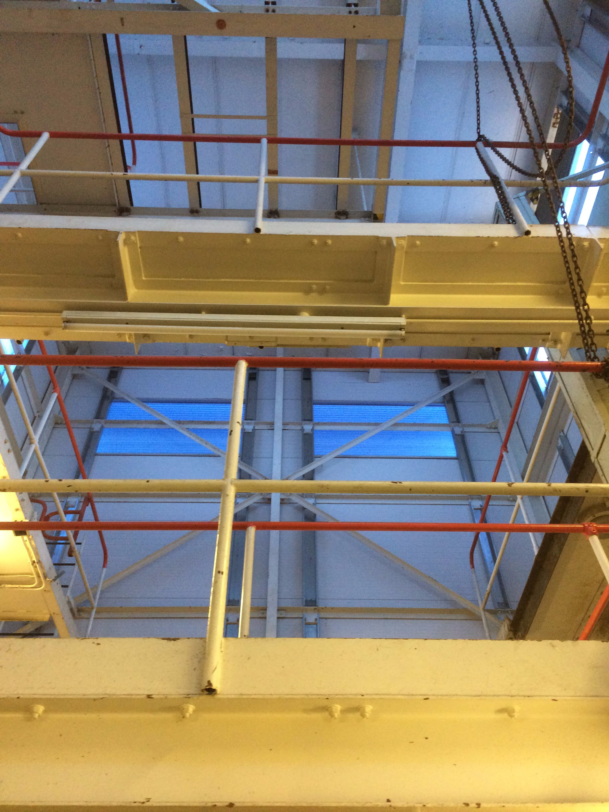
AION-10 at RAL
R72 building
Footprint: 7 m x 5 m
Height : 9 m
It requires:
Asbestos survey
Relocation of the compressors
Adaptation to the project requirements i.e. thermal insulation
Refurbishment

Slide 5
Requirements for the AION-10 m site
Feasibility studies
  List of requirements for the site to achieve science goal by AION-10
    Height for interferometer and total footprint of the experiment
    External electromagnetic interference level (activities around R-72 i.e. big car park, ISIS, mobile phone relay station - to be relocated in the near future)
    External vibration interference level (activities around R-72 i.e. future construction site, big car park)
    …. Probably more to add here
Possible in kind contribution from the host institution to adaptation of the site to AION-10 requirements
  Decision of the director of the host institution on the evaluation of the adaptation cost
    High likelihood that in kind contribution from RAL will be accepted by the director of the lab
AION-10 site decision should be based on fulfilling (1) and (2)

