Slide 1
Sketches for AION
Chris Foot, 21 Jan 2019

Slide 2
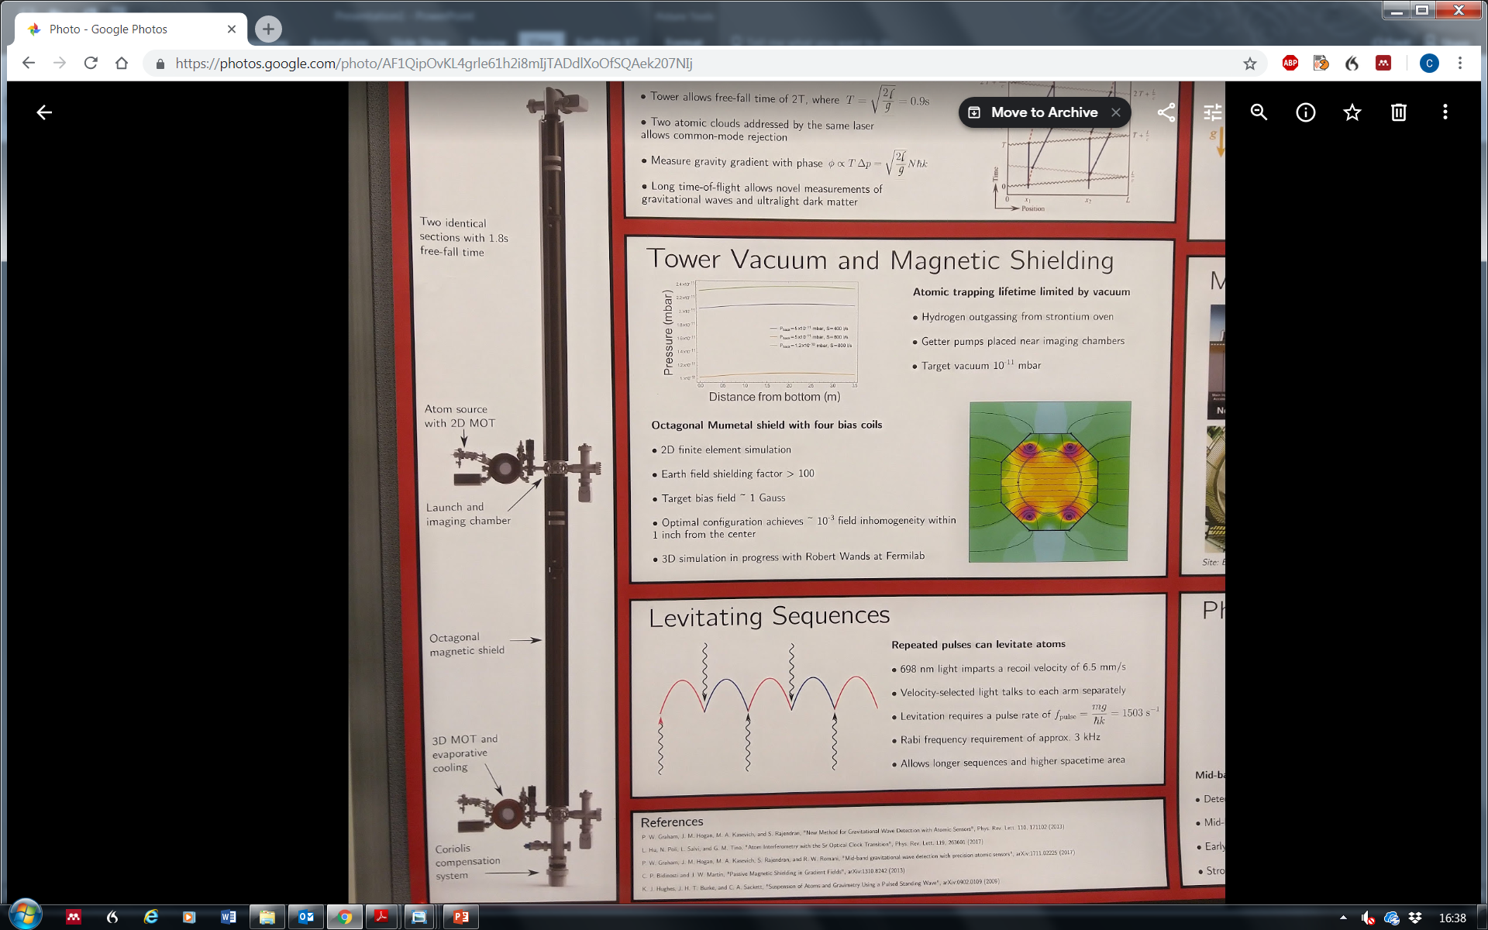
Stairwell in Beecroft (ultralow vibration building): side view
Ground Level
Ground Level
14 m
2 m
Services B1
11.4 m
stairs
Heights (approx.)
5 floors slabs: 5x0.6 = 3m
2 labs: 2x2.5 = 5m
3 interstitial spaces: 3x2.0 = 6m
Void to ground = 14m
[ 6 stair flights: 11.4/6 = 1.9m each]
Labs B1
2.5 m
2.1m
Optical table
14 m
2 m
Services B2
10 m
stairs
2.5 m
Labs B2
Floor of stairwell
ultralow vibration floor
2 m
Keel slabs
Void
Scale: 1:100 in PowerPoint

Slide 3
Stairwell in Beecroft (ultralow vibration building): side view
Ground Level
Heights (approx.)
5 floors slabs: 5x0.6 = 3m
2 labs: 2x2.5 = 5m
3 interstitial spaces: 3x2.0 = 6m
Void to ground = 14m
[ 6 stair flights: 11.4/6 = 1.9m each]
2 m
Services B1
11.4 m
stairs
Labs B1
2.5 m
2.1m
Optical table
14 m
2 m
Services B2
10 m
stairs
2.5 m
Labs B2
2.1m
Optical table
2 m
Keel slabs
Scale: 1:100 in PowerPoint

Slide 4
Stairwell in Beecroft (ultralow vibration building): side view
Ground Level
Heights (approx.)
5 floors slabs: 5x0.6 = 3m
2 labs: 2x2.5 = 5m
3 interstitial spaces: 3x2.0 = 6m
Void to ground = 14m
[ 6 stair flights: 11.4/6 = 1.9m each]
2 m
Services B1
11.4 m
stairs
Optical table
14 m
10 m
stairs
2.1m
Optical table
Scale: 1:100 in PowerPoint

Slide 5
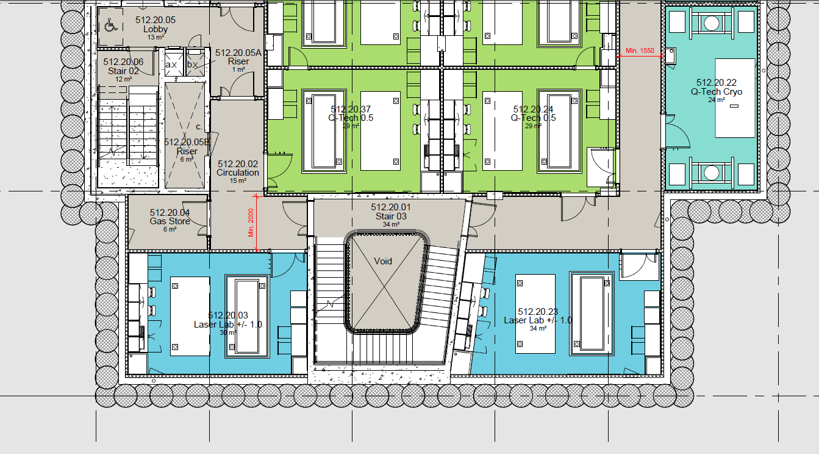
Beecroft: upper basement labs. Plan view of AION apparatus
Key:
Beam pipe +
magnetic shield
Enclosure
(reasonable value?)
Vacuum tube from
laser lab. – spatial filtering of the laser beam by propagation over 5 m.
0.3m
2 m
2 m
5.4 m
5.4 m
Scale: 1:100 in PowerPoint

Slide 6
Beecroft: upper basement labs. Plan view of AION apparatus
Key:
Beam pipe +
magnetic shield
Enclosure
(reasonable value?)
Vacuum tube from
laser lab. – spatial filtering of the laser beam by propagation over 5 m.
0.3m
2 m
2 m
5.4 m
5.4 m
Scale: 1:100 in PowerPoint

Slide 7
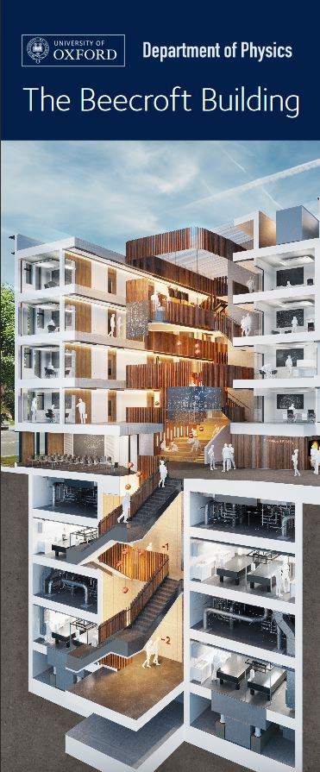
Ground Level
11.4 m
14 m
Keel slab
Ultralow vibration
All plant isolated
Thick concrete walls
Void
Keel slab
filled with polystyrene?

Slide 8
Determine scale of the Stanford poster:
Free-fall time = 0.9 s
Fountain height = 4 m
4 m
10 m
4 m

Slide 9
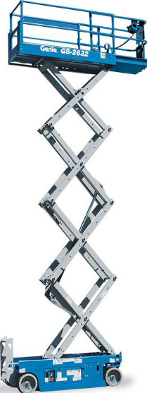
Stairwell in Beecroft (ultralow vibration building)
Ground Level
Ground Level
Heights (estimated)
5 floors slabs: 5x0.6= 3m
2 labs: 2x2.5= 5m
3 spaces: 3x2.0= 6m
Void to ground = 14m
6 stair flights: 11.4/6=1.9m each
2 m
11.4 m
14 m
Services B1
Labs B1
2.5 m
2.1m
7.4 m
Optical table
14 m
2 m
Services B2
2.5 m
Labs B2
Floor of stairwell
2 m
Keel slabs
Void

Slide 10
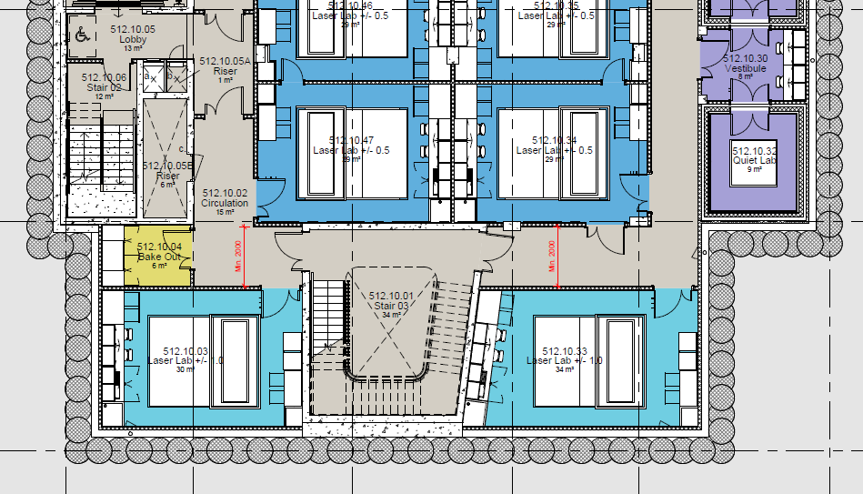
Beecroft:
lower
basement
labs.
7.765 m
5.4 m
5.4 m

