Slide 1
AION Working Meeting
January 25, 2019
Oliver Buchmueller, Imperial College London
and
Jon Coleman, Liverpool University

Slide 2
Main Discussion Items
10 m(ish) Site proposals
Work Package Breakdown
Regular Meeting

Slide 3
10m(ish) Site Proposals
We have two concrete proposals for a site top host the 10m(ish) prototype version, which (so far) is the main deliverable of the 3 year funding cycle
  Oxford (Beecroft)
  RAL (R72)

Slide 4
Work Package Breakdown (and Deliverables)
So far, we only have a high-level WP structure (see next slides) and we will have to refine it in the coming few months. The WPs will form the skeleton for the proposal and thus are the first items we have to define (carefully).
Along with the WPs we will have define the main deliverables of the project for the first three (2+1) years of funding. This request MUST have the follow-up funding for additional three years in mind. Therefore, we need to plan for a 3+3=6 year period.
Several discussion have taken place already on scope & structure [see e.g. Email thread] and this now needs to be carefully crafted in WPs.
We will also have to start to think about WP leaders [IMO we should aim for co-leadership].

Slide 5
AION10 [Stage 1]: Work Packages in a Nutshell
WP-AI
Form UK collaboration to design and construct AION1 and AION10 and establish a first UK AION Network by building AION-1 in selected places.
Prototype AION-10 to demonstrate the technology and to establish UK expertise and leadership in the field.
Commission AION-10, compare with AION-1 Network and perform synchronised measurement campaigns with MAGIS.
Connect to UK QTH to develop techniques and technology required to reach performance for realising science goals, in collaboration with developments in the MAGIS consortium.
WP-Physics
Establish physics programme for AION-1/10 Network.
Physics exploitation of AION-1/10 Network
Contribute to work establishing the physics case for AION-100 and beyond.
Support phenomenology for AION physics case.
WP-AION100
Work towards AION-100 including design work for AION-100 in a tower or a shaft and establish the physics case.
WP-MAGIS
Collaborate with MAGIS-100 to contribute to experiment & exploitation
Build the foundation of a strong and lasting collaboration with US.

Slide 6
AION10 [Stage 1]: Work Packages in a Nutshell
WP-AI
Form UK collaboration to design and construct AI1 and AI10 and establish a first UK AI Network by building AI1 in Liverpool and other selected places.
Prototype AI10 to demonstrate the technology and to establish UK expertise and leadership in the field.
Commission AI10 with short baseline and compare with AI1 Network.
WP-Physics
Establish physics programme for AI1/A10 Network.
Physics exploitation of AI1/10 Network
Contribute to work establishing the physics case for AI100 and beyond.
Support phenomenology both for AI in general and AION physics case.
WP-AION100
Work towards AI100 including design work for AI100 in a tower or a shaft and establish the physics case.
WP-MAGIS
Collaborate with MAGIS to contribute to experiment & exploitation
Build the foundation of a strong and lasting collaboration with US.
Pathway to technology and expertise and will form
a first network of AI’s in the UK.
This will give us physics & phenomenology
This will give us the path into the future (next bid)
This will give us MAGIS and US Collaboration

Slide 7
AION10 [Stage 1]: Main WP Connections
WP-Physics
WP-AI
WP-MAGIS
WP-AION100

Slide 8
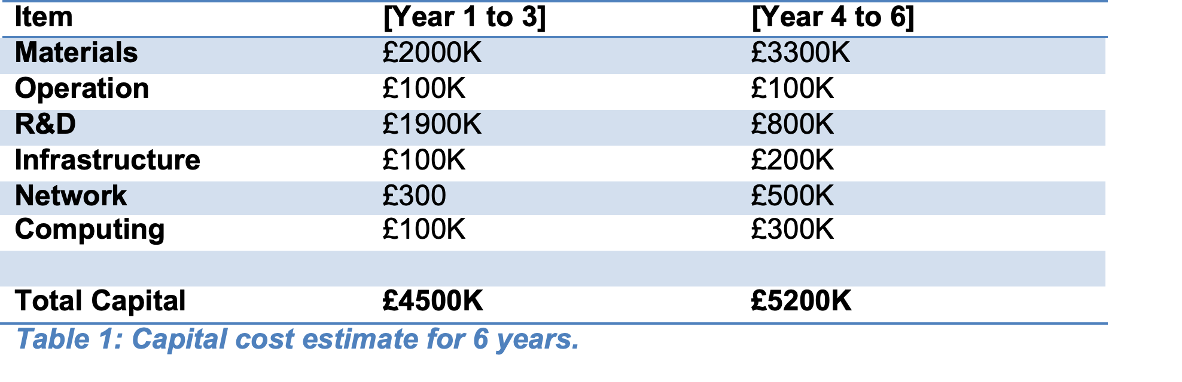
Budget Estimate (so far)
A first estimate for all the work packages suggests that about 8 postdocs and 4 technicians/engineers will be required for the period of the project. This leads to an estimated cost envelope of about £7.2M for RAs and technicians/engineers over the six-year funding period. This will be complemented buy approx. £600K (£100K a year) for travel.
A first preliminary budget estimate, capital plus staff, would amount to £9.7M + £7.8M = £17.5M. This total funding envelope is roughly equally distributed over the six-year period, corresponding to about £2.9M per year. With this simple assumption, a 2 year + 1 year + 3 year budgeting allocation would be: £5.8M (year 1 and 2), £2.9M (year 3), £8.8M (year 4,5, and 6). However, we would like to point out that a 2-year period for a first funding milestone is not ideal for an experimental programme, whereas a 3-year period would allow for greater scientific impact and achievements.

Slide 9
Regular Meeting
As discussed already, we have to start regular Working Meetings in order to prepare for the brutal timeline for the proposal:
Suggestion:
bi-weekly meetings
  will circulate doodle to find best slot]
Use indico to manage agenda and vidyo, etc
  this requires that people subscribe to indico. It’s a light process and simple. Will circulate instructions before the next meeting.

Slide 10
BACKUP
Slides from Oxford Meeting January 17th

Slide 11
A UK
Atom Interferometer Observatory and Network
QSFP WP3 Report, January 17, 2019
Oliver Buchmueller, Imperial College London
and
Jon Coleman, Liverpool University

Slide 12
What is AION

Slide 13
What is AION (in a nutshell)?
The proposal is to construct and operate a next generation Atomic Interferometric Observatory and Network (AION) in the UK that will enable the exploration of properties of dark matter as well as searches for new fundamental interactions.
It will provide a pathway for detecting gravitational waves from the very early universe in the, as yet mostly unexplored, mid-frequency band, ranging from several milliHertz to a few Hertz.
The proposed project spans several science areas ranging fundamental particle physics over astrophysics to cosmology and, thus, connects these communities.
Following the “Big Ideas” call, the project was selected by PAAP and STFC as a high priority for the community. It was provisionally classified as a medium scale project.
AION is also a Work Package of the QSFP proposal

Slide 14
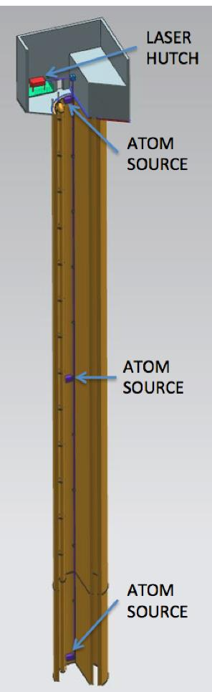
Proposed AION Programme
The AION Project is foreseen as
a 4-stage programme:
The first stage develops existing technology (Laser systems, vacuum, magnetic shielding etc.) and the infrastructure for the 100m detector and produces detailed plan resulting in an accurate assessment of the expected performance in Stage 2.
The second stage builds, commissions and exploits the 100m detector and also prepares design studies for the km-scale.
The third and fourth stage prepare the groundwork for the continuing programme:
  Stage 3: Terrestrial km-scale detector
  Stage 4: space based detector
L ~ 1m to 10m
L
L ~ 100m
L ~ km-scale
L ~ 10⁴ km

Slide 15
AION – A Staged Programme**
AION-10: Stage 1 [year 1 to 3]
1 & 10 m Interferometers & Site Development for 100m Baseline
AION-100: Stage 2 [year 3 to 6]
100m Construction & Commissioning
AION-KM: Stage 3 [ > year 6 ]
Operating AION-100 and planning for 1 km & Beyond
AION-SPACE: Stage 4 [ after AION-KM ]
Space based version
**outlined in Big Ideas proposal

Slide 16
AION – A Staged Programme**
AION-10: Stage 1 [year 1 to 3]
1 & 10 m Interferometers & Site Development for 100m Baseline
AION-100: Stage 2 [year 3 to 6]
100m Construction & Commissioning
AION-KM: Stage 3 [ > year 6 ]
Operating AION-100 and planning for 1 km & Beyond
AION-SPACE: Stage 4 [ after AION-KM ]
Space based version
**outlined in Big Ideas proposal

Slide 17
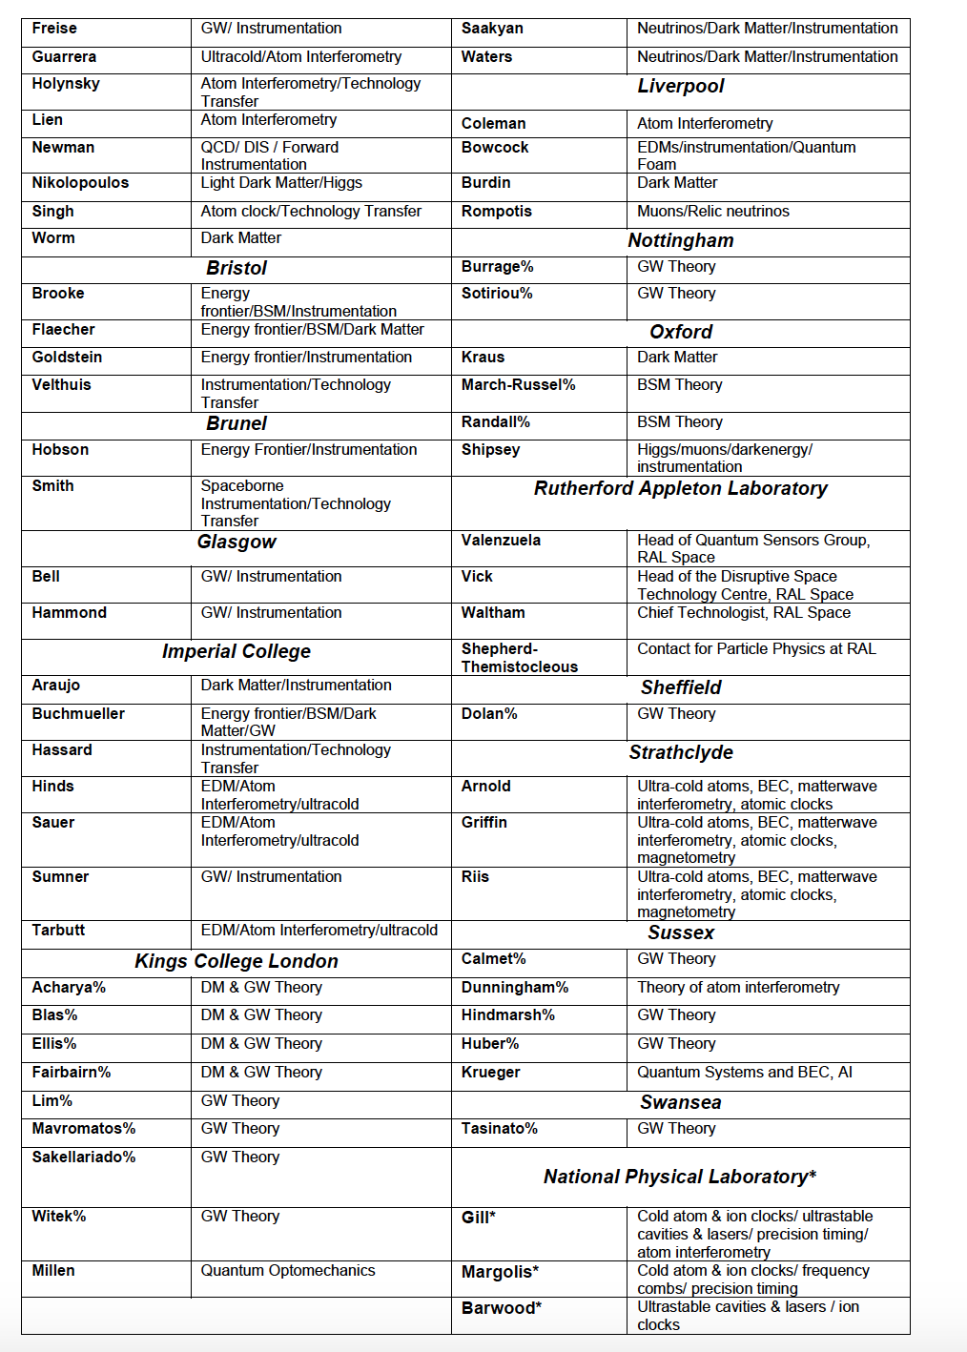
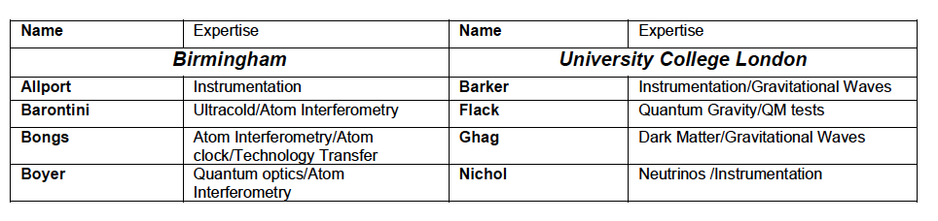
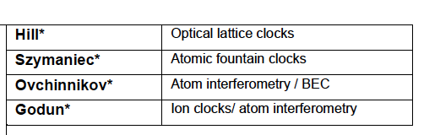
Status “Big Ideas Call”
Will be updated in March 2019
In preparation of this proposal we have broadly consulted with the relevant UK science communities and have received very positive feedback. The support is across several fields, ranging from fundamental particle physics, over atom interferometry to gravitational wave physics. The support also covers both experimental as well as theory communities in the UK. So far, more than 70 members from 20 UK institutions have provided explicit support for this proposal:
Aberdeen, Birmingham, Bristol, Brunel, Durham, Glasgow, Imperial College, Kings College London, University College London, Liverpool, Nottingham, Open University, Oxford, RAL, Sheffield, Strathclyde, Sussex, Swansea and NPL

Slide 18
In preparation of this proposal we have broadly consulted with the relevant UK science communities and have received very positive feedback. The support is across several fields, ranging from fundamental particle physics, over atom interferometry to gravitational wave physics. The support also covers both experimental as well as theory communities in the UK. So far, more than 70 members from 20 UK institutions have provided explicit support for this proposal:
Aberdeen, Birmingham, Bristol, Brunel, Durham, Glasgow, Imperial College, Kings College London, University College London, Liverpool, Nottingham, Open University, Oxford, RAL, Sheffield, Strathclyde, Sussex, Swansea and NPL
If you are interested to follow the AION activity
you can subscribe to the AION Email list:
aion-project@imperial.ac.uk
via:
https://mailman.ic.ac.uk/mailman/listinfo/aion-project

Slide 19
The Physics case

Slide 20
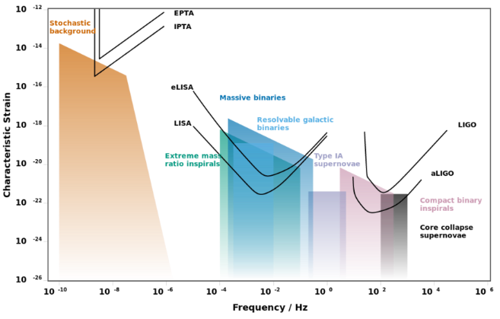
AION: Pathway to the GW Mid-(Frequency) Band
Experimental GW Landscape

Slide 21
AION: Pathway to the GW Mid-(Frequency) Band
Experimental GW Landscape
Mid-Band currently
NOT covered
Mid-band
decihertz to hertz
Mid-band science
Detect sources BEFORE they reach the high frequency band [LIGO, ET]
Optimal for sky localization: predict when and where events will occur (for multi-messenger astronomy)
Search for Ultra-light dark matter in a similar frequency [i.e. mass] range

Slide 22
Gravitational Wave Detection with Atom Interferometry
high-frequency
region
low-frequency
region
mid-frequency
region

Slide 23
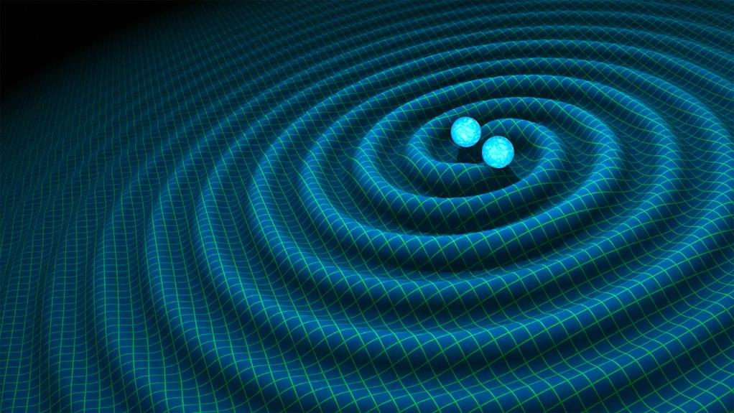
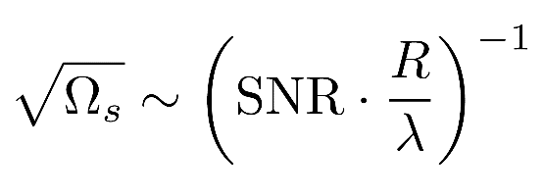
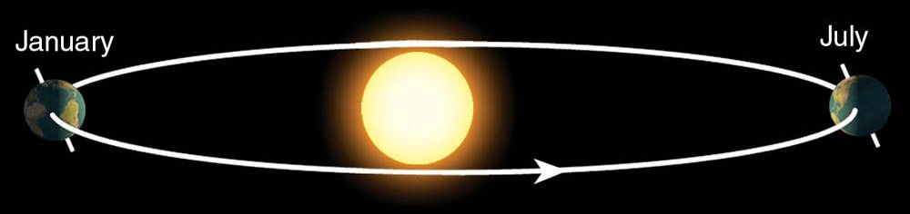
Sky position determination
Sky localization precision:
Images: R. Hurt/Caltech-JPL; 2007 Thomson Higher Education
Mid-band advantages
- Small wavelength λ
- Long source lifetime (~months) maximizes effective R
λ
R
Courtesy of Jason Hogan!
Ultimate sensitivity for terrestrial based detectors is achieved by operating 2 (or more)
Detectors in synchronisation mode

Slide 24
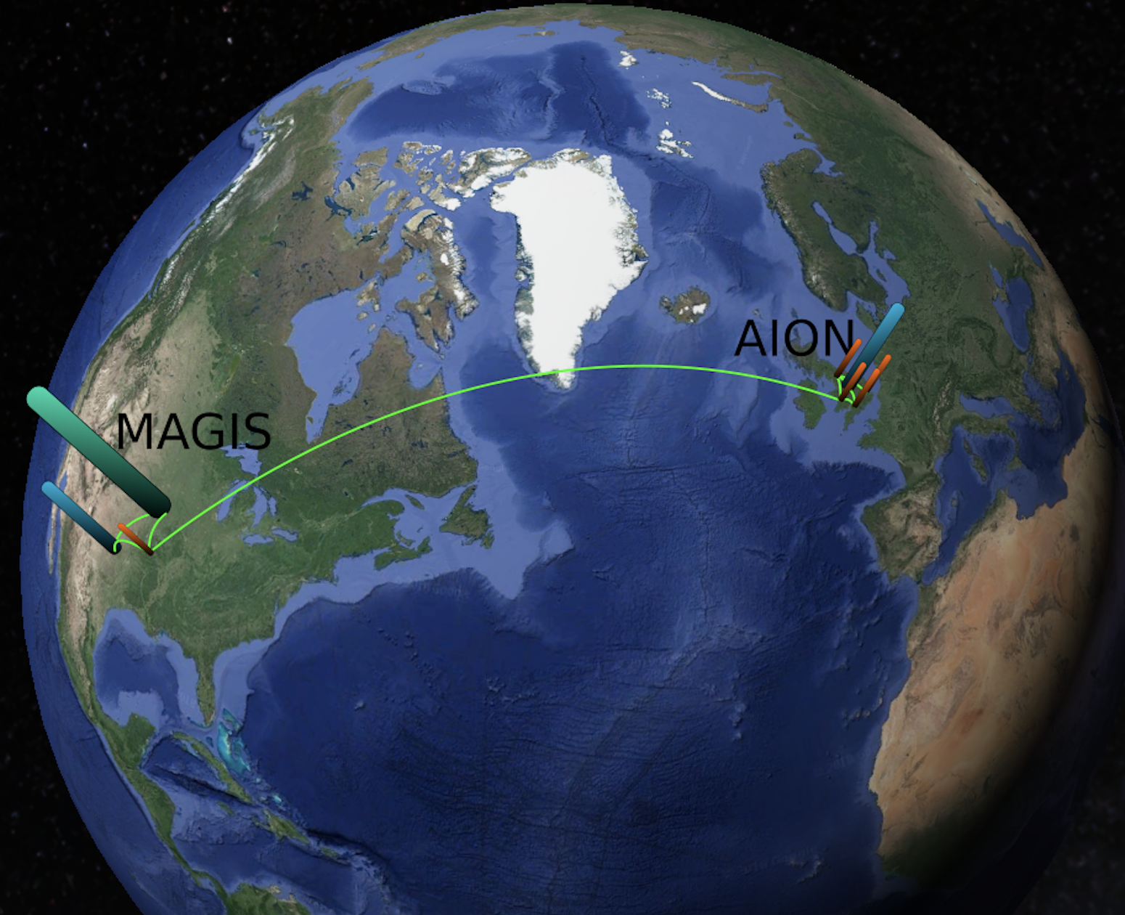
Ultimate Goal: Establish International Network
Illustrative Example:
Network could be further extended
or arranged differently

Slide 25
GW Detection & Fundamental Physics - Example
First-Order Electroweak Phase Transition and its Gravitational Wave Signal
arXiv:1809.08242
John Ellis, Marek Lewicki,
José Miguel No
What is is the GW signal
of electroweak phase
transition in various
theories beyond
the Standard Model.
Plots provided by Marek Lewicki
Translate strain into dimensionless energy density Ω_{GW}h² in GWs against frequency

Slide 26
GW Detection & Fundamental Physics - Example
MAGIS
AION
4K
MAGIS
AION
Space
arXiv:1809.08242
Plots provided by Marek Lewicki

Slide 27
GW Detection & Fundamental Physics - Example
MAGIS
AION
4K
MAGIS
AION
Space
arXiv:1809.08242
Plots provided by Marek Lewicki

Slide 28
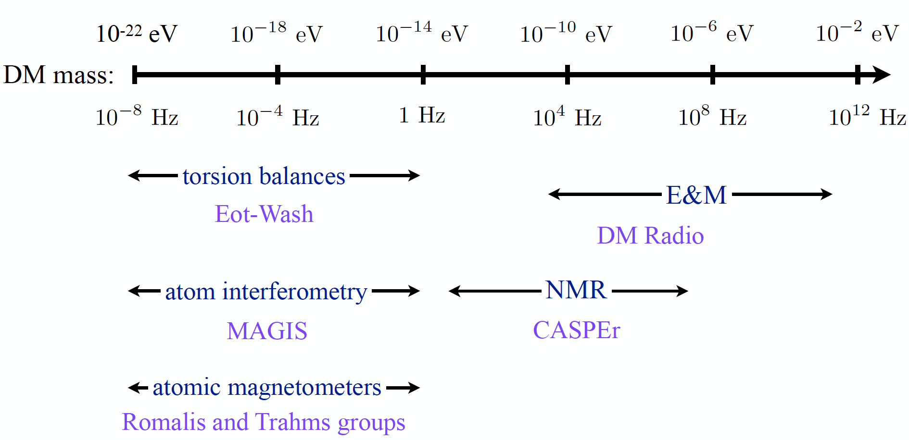
The Landscape of Ultra-Light Dark Matter Detection
Vey light dark matter and gravitational wave detection similar when detecting
coherent effects of entire field, not single particles.
Example: Ultra-Light Dark Matter:
Diagram taken from P. Graham’s
talk at HEP Front 2018

Slide 29
The Landscape of Ultra-Light Dark Matter Detection
Vey light dark matter and gravitational wave detection similar when detecting
coherent effects of entire field, not single particles.
Example: Ultra-Light Dark Matter:
MAGIS/AION
Diagram taken from P. Graham’s
talk at HEP Front 2018

Slide 30
The Landscape of Ultra-Light Dark Matter Detection
Vey light dark matter and gravitational wave detection similar when detecting
coherent effects of entire field, not single particles.
Example: Ultra-Light Dark Matter:
MAGIS/AION
Diagram taken from P. Graham’s
talk at HEP Front 2018

Slide 31
The Landscape of Ultra-Light Dark Matter Detection
Vey light dark matter and gravitational wave detection similar when detecting
coherent effects of entire field, not single particles.
Example: Ultra-Light Dark Matter:
Together with John Ellis (KCL) and Martin Bauer(IPPP, Durham) we plan a
1-day gathering in London on Feb 1
to discuss the theory and phenomenology
of Dark Matter/Sector Physics with Quantum Sensors.
Two main categories of Dark Matter that could be probed within the QSFP programme:
Light DM (< GeV scale) which is hard to see in DD or at the LHC because
of negligible nuclear recoil or missing energy, respectively. This could be probed through
electron scattering or super-sensitive nuclear scattering experiments.
The 3.5 keV sterile neutrino would be a prime candidate for that.
Ultralight DM (~10⁻¹⁴ tto 10⁻²² eV) that behaves more like a classical wave
and ends up modifying fundamental constants through oscillations.
Something like an ultralight axion.
MAGIS/AION
Diagram taken from P. Graham’s
talk at HEP Front 2018

Slide 32
Collaboration with US (via MAGIS)

Slide 33
International Collaboration
From the outset this project would greatly benefit from close collaboration on an international level with the US initiative, MAGIS-100, which pursues a similar goal of an eventual km-scale atom interferometer on a comparable timescale.
The option of operating two AI detectors, one in the UK and one in the US, in tandem enables new exciting physics opportunities not accessible to either AI detector alone.
A collaboration with AION by the MAGIS experiment has already been endorsed by the community at Fermilab, presenting the UK with an immediate window of scientific opportunity.
This US-UK collaboration will serve as the testbed for full-scale terrestrial (kilometre-scale) and satellite-based (thousands of kilometres scale) detectors and build the framework for global scientific leadership in this area.

Slide 34
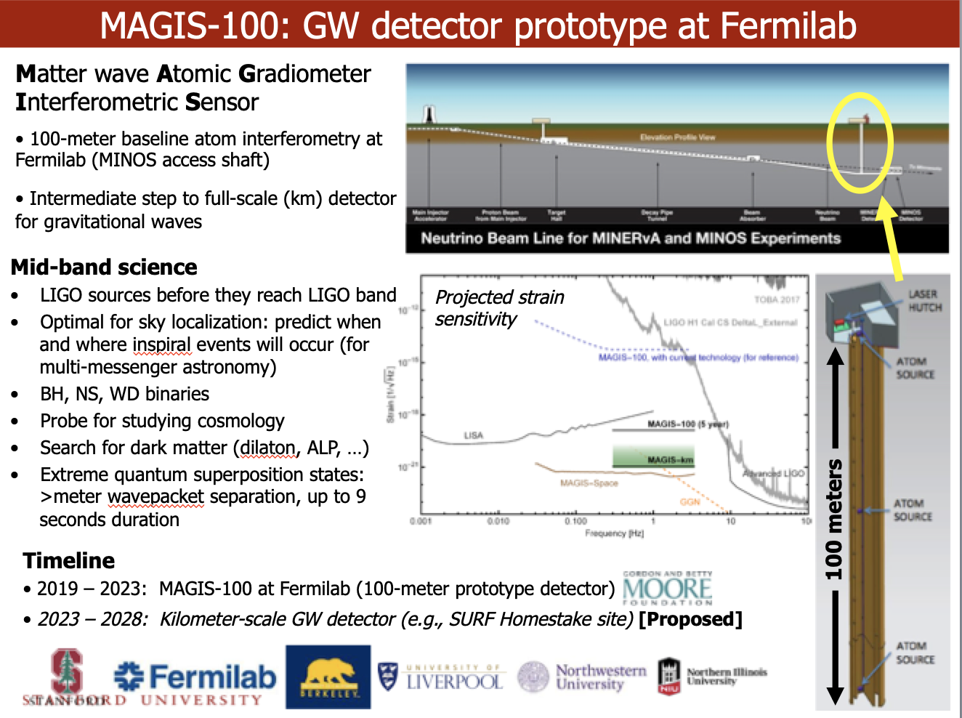
MAGIS100
Courtesy of Jason Hogan!

Slide 35
MAGIS100
Timeline:
2019-2023: MAGIS-100 at Fermilab (100m)
2023-2028: km-scale detector [site still be chosen]
Funding:
The project was partly founded in January 2019 by the MOORE
foundation with $10Mio (£7.7Mio) over 5 years.
The project is now applying for additional DOE funding
Courtesy of Jason Hogan!

Slide 36
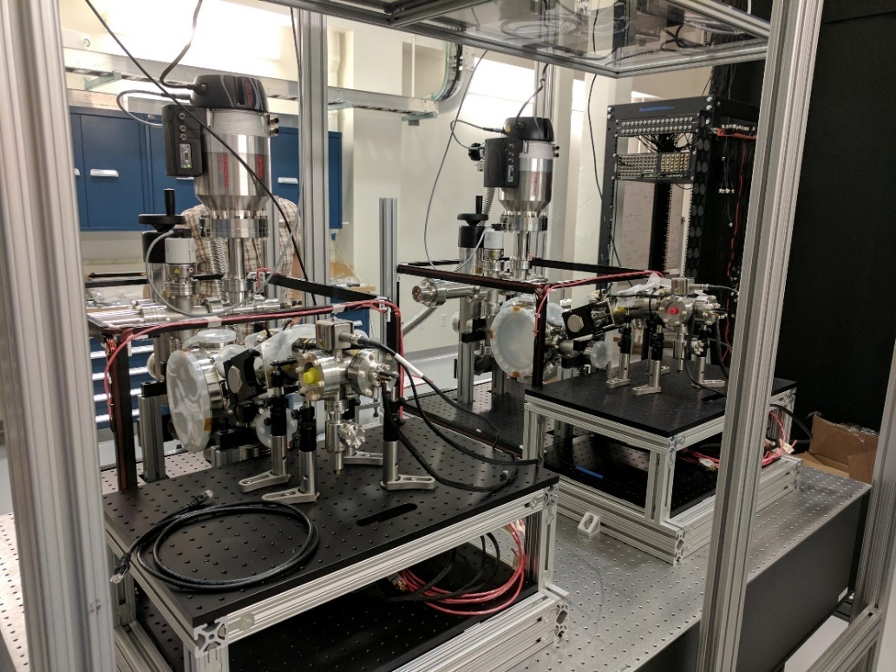
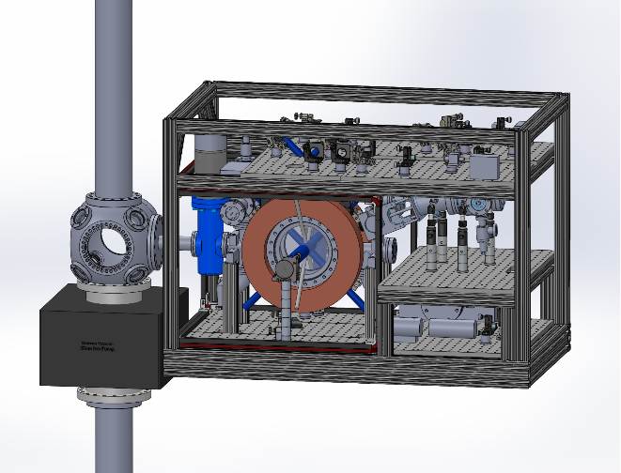
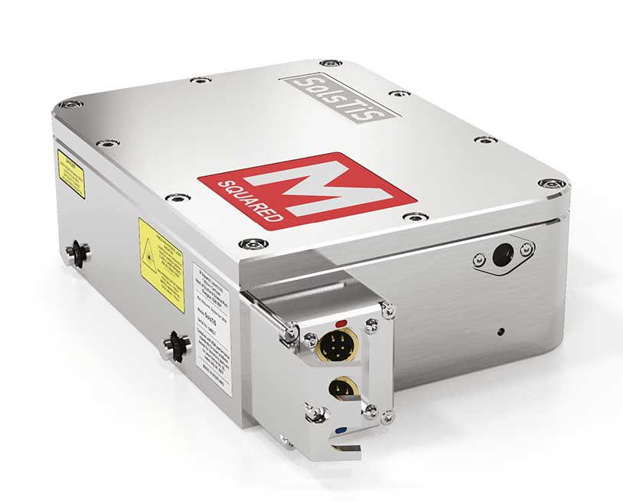
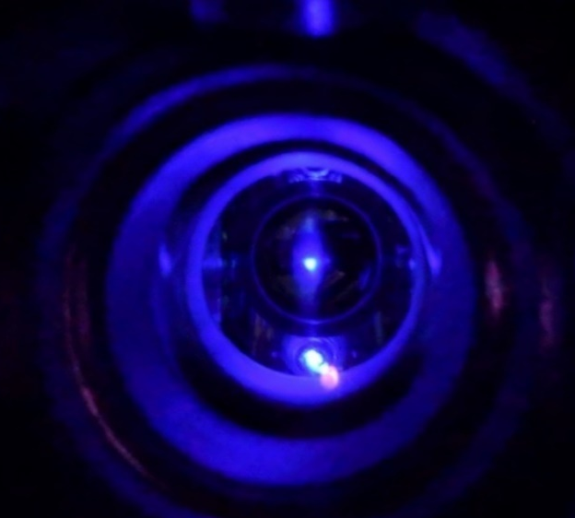
Stanford MAGIS prototype
Sr gradiometer CAD
(atom source detail)
Two assembled Sr atom sources
Trapped Sr atom cloud
(Blue MOT)
Atom optics laser
(M Squared SolsTiS)
Courtesy of Jason Hogan!

Slide 37
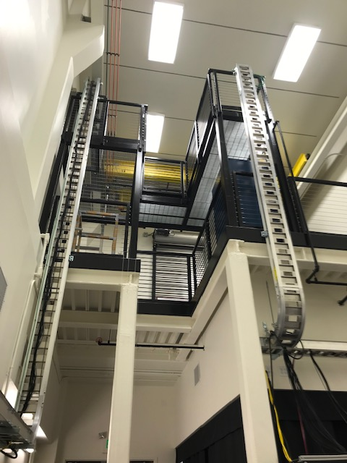
Stanford MAGIS prototype
Sr gradiometer CAD
(atom source detail)
Two assembled Sr atom sources
Stanford Lab to host 8 m
prototype of the Sr fountain.
It is supposed to be assembled
over summer 2019.
Trapped Sr atom cloud
(Blue MOT)
Atom optics laser
(M Squared SolsTiS)

Slide 38
Visit to stanford on 10/11 January 2019

Slide 39
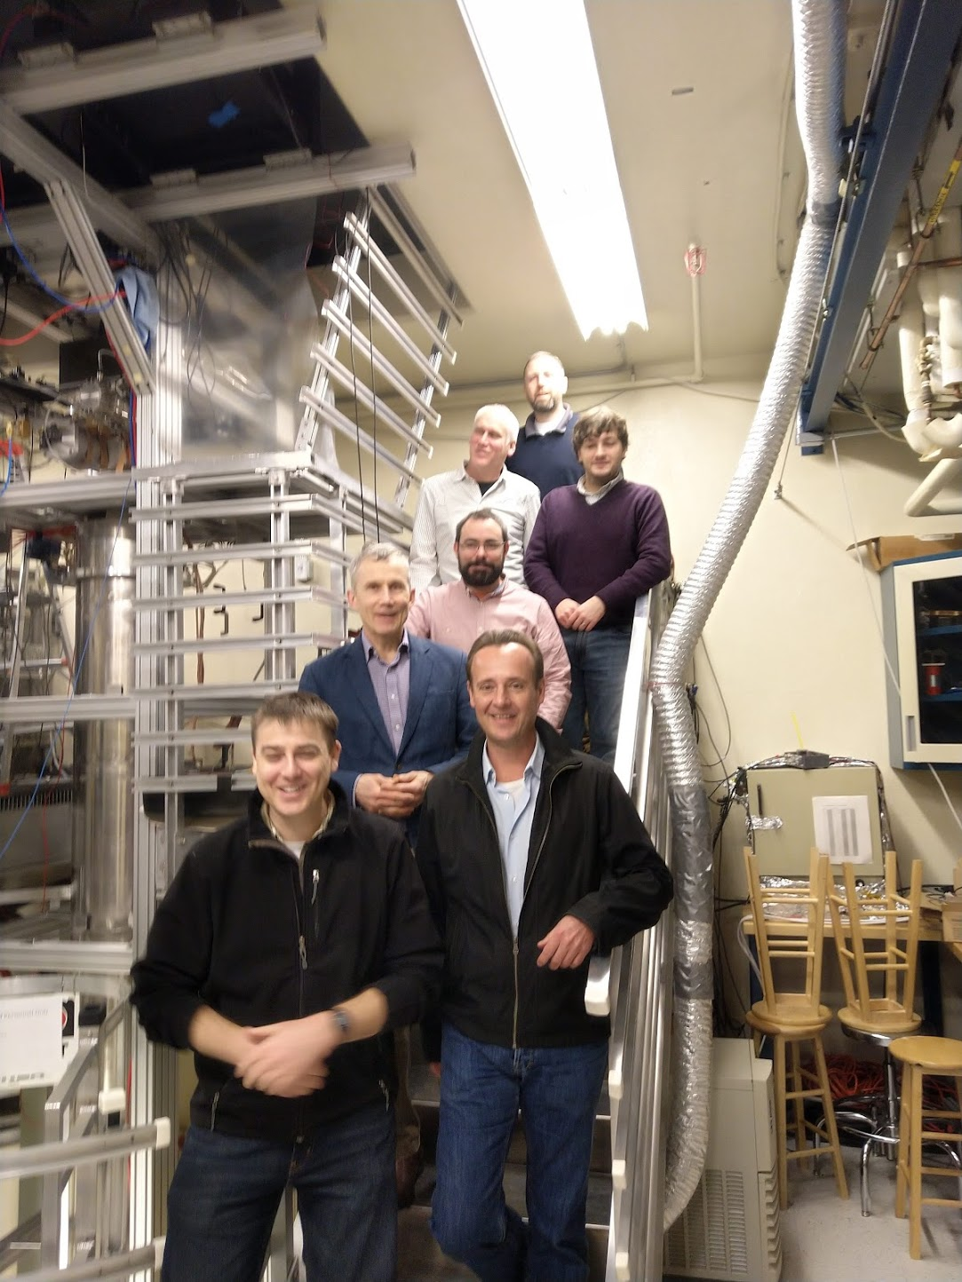
Stanford Visit 10/11 January 2019
We had a very fruitful visit to Stanford!
Main goals of the visit:
Establish information exchange and
review the Stanford work.
Strengthen the US-UK collaboration
Identify synergies and common goals between AION and MAGIS.
Outcome:
Stanford/MAGIS is very open to closer collaboration with the UK/AION and they very much welcome another activity working towards the mid-band with AIs.
There are several challenges where the UK expertise can help to achieve the design goals of the programme [see next slide].
We agreed to include the synchronised operation of 10m prototype versions (later 100m) in the programme of MAGIS and AION.
Ben
Sauer
(Imperial)
Jon
Micheal
Holynski
(Birmingham)
Chris
Foot
(Oxford)
Tristan
Valenzuela
(RAL)
Oliver
Jason
Hogan
(Stanford)

Slide 40
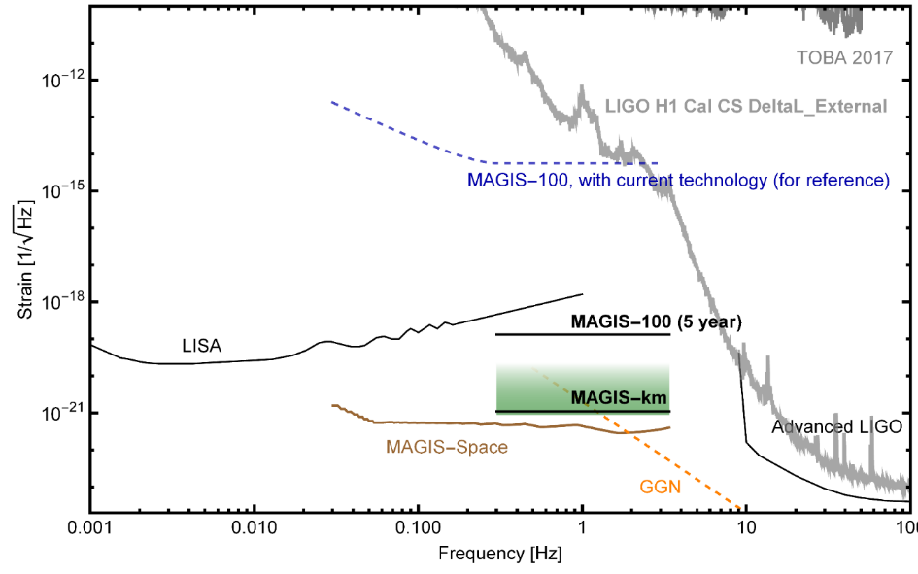
What are the challenges?
Still several orders of
Magnitude away in sensitivity required to be sensitive to Mid-band GW physics!
Need to push the basic parameters to accomplish this goal! Although there is a clear path forward this won’t be a free lunch and it will require effort and ingenuity!
The UK community could play an important role to accomplish this goal, which, in turn, can accelerate the schedule and minimize the risk of failure
AION/MAGIS-100 with current (2019) technology
AION/MAGIS-100 (5 to 6 year)
AION/MAGIS-km
AION/MAGIS-space
AION/MAGIS-100
current
AION/MAGIS-100
5/6 year
AION/MAGIS-km

Slide 41
AION10 [Stage 1]: Work Packages in a Nutshell
WP-AI
Form UK collaboration to design and construct AION1 and AION10 and establish a first UK AION Network by building AION-1 in selected places.
Prototype AION-10 to demonstrate the technology and to establish UK expertise and leadership in the field.
Commission AION-10, compare with AION-1 Network and perform synchronised measurement campaigns with MAGIS.
Connect to UK QTH to develop techniques and technology required to reach performance for realising science goals, in collaboration with developments in the MAGIS consortium.
WP-Physics
Establish physics programme for AION-1/10 Network.
Physics exploitation of AION-1/10 Network
Contribute to work establishing the physics case for AION-100 and beyond.
Support phenomenology for AION physics case.
WP-AION100
Work towards AION-100 including design work for AION-100 in a tower or a shaft and establish the physics case.
WP-MAGIS
Collaborate with MAGIS-100 to contribute to experiment & exploitation
Build the foundation of a strong and lasting collaboration with US.

Slide 42
AION10 [Stage 1]: Work Packages in a Nutshell
WP-AI
Form UK collaboration to design and construct AI1 and AI10 and establish a first UK AI Network by building AI1 in Liverpool and other selected places.
Prototype AI10 to demonstrate the technology and to establish UK expertise and leadership in the field.
Commission AI10 with short baseline and compare with AI1 Network.
WP-Physics
Establish physics programme for AI1/A10 Network.
Physics exploitation of AI1/10 Network
Contribute to work establishing the physics case for AI100 and beyond.
Support phenomenology both for AI in general and AION physics case.
WP-AION100
Work towards AI100 including design work for AI100 in a tower or a shaft and establish the physics case.
WP-MAGIS
Collaborate with MAGIS to contribute to experiment & exploitation
Build the foundation of a strong and lasting collaboration with US.
Pathway to technology and expertise and will form
a first network of AI’s in the UK.
This will give us physics & phenomenology
This will give us the path into the future (next bid)
This will give us MAGIS and US Collaboration

Slide 43
AION10 [Stage 1]: Main WP Connections
WP-Physics
WP-AI
WP-MAGIS
WP-AION100

Slide 44
Budget Estimate (so far)
A first estimate for all the work packages suggests that about 8 postdocs and 4 technicians/engineers will be required for the period of the project. This leads to an estimated cost envelope of about £7.2M for RAs and technicians/engineers over the six-year funding period. This will be complemented buy approx. £600K (£100K a year) for travel.
A first preliminary budget estimate, capital plus staff, would amount to £9.7M + £7.8M = £17.5M. This total funding envelope is roughly equally distributed over the six-year period, corresponding to about £2.9M per year. With this simple assumption, a 2 year + 1 year + 3 year budgeting allocation would be: £5.8M (year 1 and 2), £2.9M (year 3), £8.8M (year 4,5, and 6). However, we would like to point out that a 2-year period for a first funding milestone is not ideal for an experimental programme, whereas a 3-year period would allow for greater scientific impact and achievements.

Slide 45
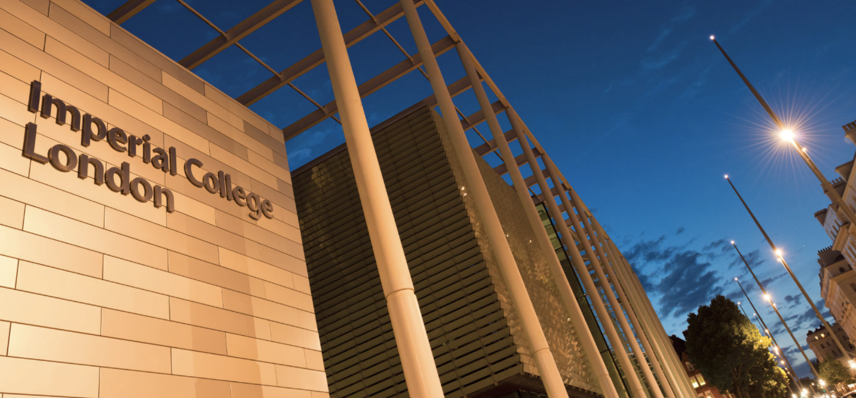

First AION Workshop at Imperial College London
March 25/26 2019
Organised by:
T. Bowcock,
O. Buchmueller [Coord.],
J. Coleman,
J. Ellis [Theory],
I. Shipsey
2-Day Workshop:
Day 1: Instrumentation
Day 2: Physics case
If you like to participate or
require further information
please contact:
fundamental-physics-admin@imperial.ac.uk
with “AION” in title.
Please register at:
http://www.hep.ph.ic.ac.uk/AION2019/

Slide 46
Summary
The AION programme is driven by a well-defined and ambitious physics case to explore the Mid-Frequency Band of the GW spectrum.
  In addition, it will enable the exploration of properties of dark matter as well as searches for new fundamental interactions
AION foreseen as a staged programme: AION-10, AION-100, AION-KM and AION-SPACE.
  AION-10 [year 1 to 3] and AION-100 [year 3 to 6] are part of the QSFP WP3
  AION-KM and AION-SPACE are the pathway to the future and achieving ultimate sensitivity
The AION project will closely collaborate with the US initiative, MAGIS-100, which pursues a similar goal of an eventual km-scale atom interferometer on a comparable timescale.
  The option of operating two detectors, one in the UK and one in the US, in tandem enables new exciting physics opportunities not accessible to either detector alone.
  To accomplish the ultimate sensitivity required to study the Mid-Frequency Band of the GW spectrum, the basic parameters of the Atom Interferometer have to be significantly improved. This requires significant effort and ingenuity, and the UK community can play an important role in it!
The formation of an AION collaboration is well underway with the next important milestone being the AION workshop in March 25/26

Slide 47
Backup

Slide 48
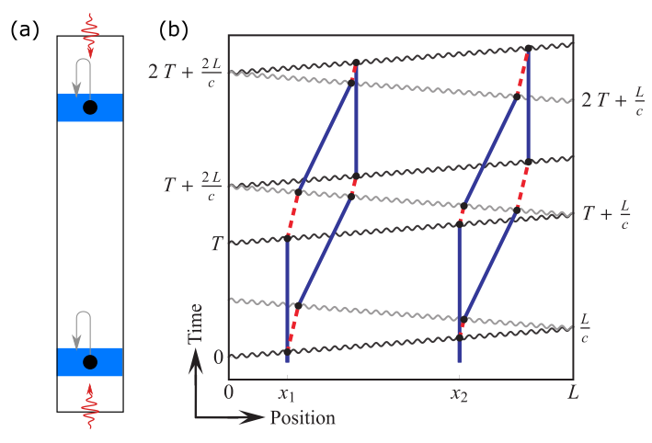
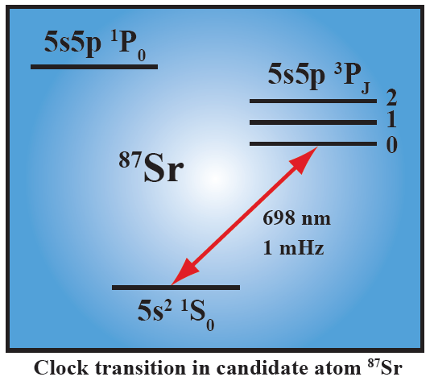
A different kind of atom interferometer
Hybrid “clock accelerometer”
Graham et al., PRL 110, 171102 (2013).
Clock: measure light travel time ➜ remove laser noise with single baseline
Accelerometer: atoms excellent inertial test masses

Slide 49




Simple Example: Two Atomic Clocks
Atom clock
Atom clock
Phase evolved by atom after time T
Time
Courtesy of Jason Hogan!

Slide 50
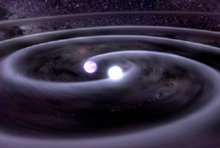


Simple Example: Two Atomic Clocks
GW changes light travel time
Time
Atom clock
Atom clock
Courtesy of Jason Hogan!

Slide 51


Phase Noise from the Laser
The phase of the laser is imprinted onto the atom.
Laser phase noise, mechanical platform noise, etc.
Laser phase is common to both atoms – rejected in a differential measurement.
Courtesy of Jason Hogan!

Slide 52
Clock gradiometer
Excited state phase evolution:
Two ways for phase to vary:
Dark matter
Gravitational wave
Each interferometer measures the change over time T
Laser noise is common-mode suppressed in the gradiometer
Graham et al., PRL 110, 171102 (2013).
Arvanitaki et al., PRD 97, 075020 (2018).
Courtesy of Jason Hogan!

Slide 53

Ultralight scalar dark matter
Ultralight dilaton DM acts as a background field (e.g., mass ~10⁻¹⁵ eV)
+ …
Electron
coupling
Photon
coupling
e.g., QCD
DM scalar field
DM mass density
DM coupling causes time-varying atomic energy levels:
DM induced oscillation
Dark matter coupling
Time
Courtesy of Jason Hogan!

Slide 54
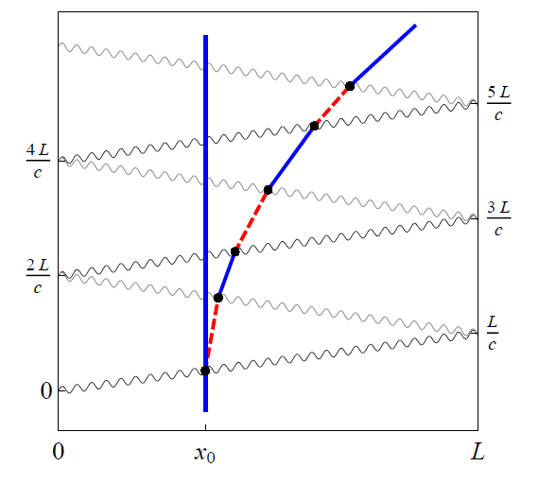
LMT and Resonant Pulse Sequences
Sequential single-photon transitions remain laser noise immune
LMT beamsplitter (N = 3)
Resonant sequence (Q = 4)
Graham, et al., PRL (2013)
Graham, et al., PRD (2016)
Courtesy of Jason Hogan!

