Slide 1
Introduction and goals

Slide 2
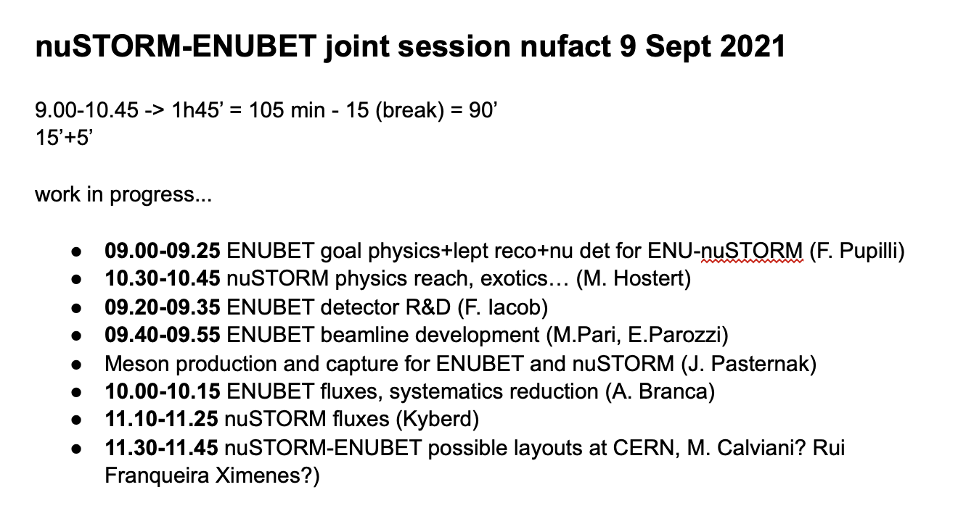
ENUBET/nuSTORM joint session at nuFACT ‘21
Initial proposal
… for dicussion
Further discussion in/after Andrea’s presentation

Slide 3
Meeting schedule established
Next meetings:
  28Jun21
  09Aug21
  20Sep21
Progress in nuSIM development
  See PK
This meeting:
  Review nuSIM progress
  Continue discussion of target synergies w\ ENUBET and demo
  Begin discussion of SPS, muon, and neutrino timing issues
  Begin discussion of neutrino detection

Slide 4
