Slide 1



Pion-production target considerations
Nikos

Slide 2
Selection of the right parameters for nuSTORM’s pion target
Detector, Physics
Neutrino Energy Requirement
Muon Beam for neutrinos
Energy/Emittance
Pion beam
Energy/Emittance
Target system
Horn Singlets, Doublets, Triplets
Solenoid
Pion Required Energy
Selection of Proton Driver
EnergyK, Power

Slide 3
Target considerations for nuSTORM
Horn(s) as focusing element of Aluminum-60xx variants
  Current pulses like LBNF, T2(H)K, 300-400 kA
  Reliable, proven longevity
  π+ or π- can be selected
Target of graphite
  De facto material for LBNF, T2(H)K, used also at NuMI and CNGS
  Adequate pion yields, less neutron radiation than higher Z materials
  Be ready to operate with ~ 1 MW proton drivers
  Use best grades of graphite, e.g. toyo tanso ig-43 for T2(H)K
  Cooling design especially for MW proton drivers
  Results from NuMI @ 1 MW and T2K @ 1.3 MW will prove their lifetimes and reliability

Slide 4
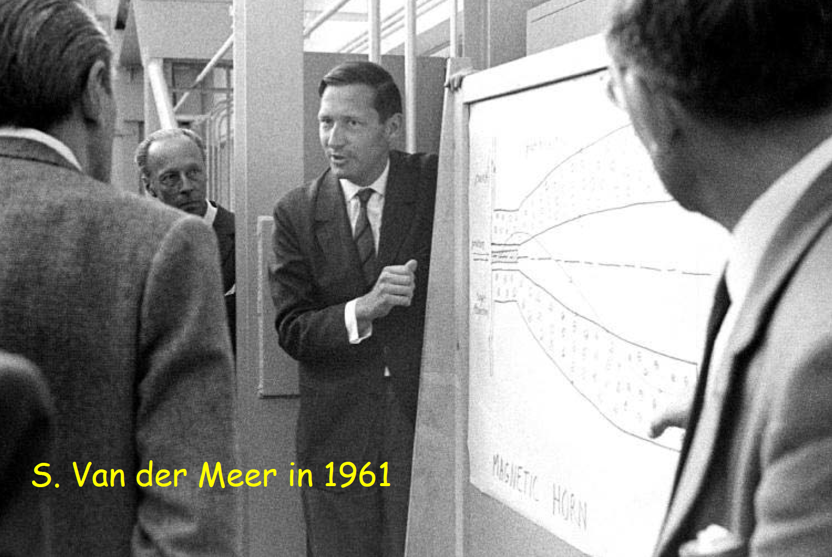
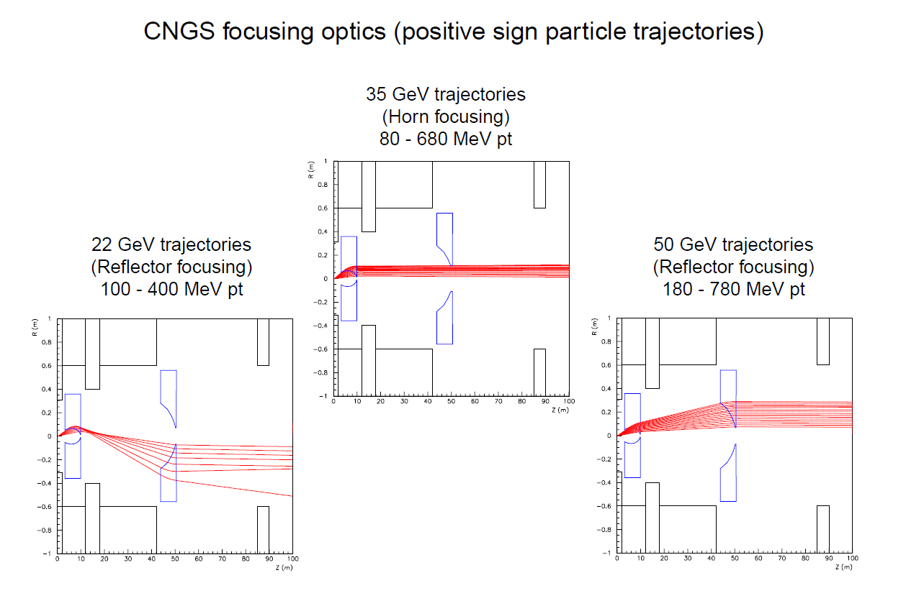
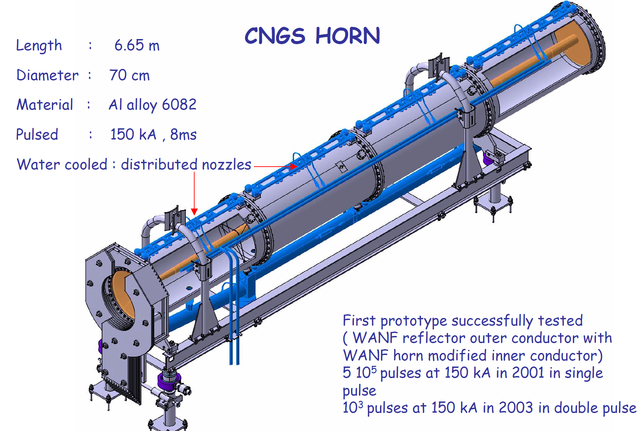
Horns for pion focusing
Tailored to conventional neutrino beams from pions
Focus a particular range of momentum, underfocus and overfocus, higher and lower momentum respectively
Create wide or narrow energy bands for beams depending on the shape of inner conductor, number of horns, neutrino beam design
Proven design at T2K, NuMI, T2K, NuMI, CNGS, SBN experiments
Great experience on constructing and operating at CERN, JPARC, Fermilab

Slide 5
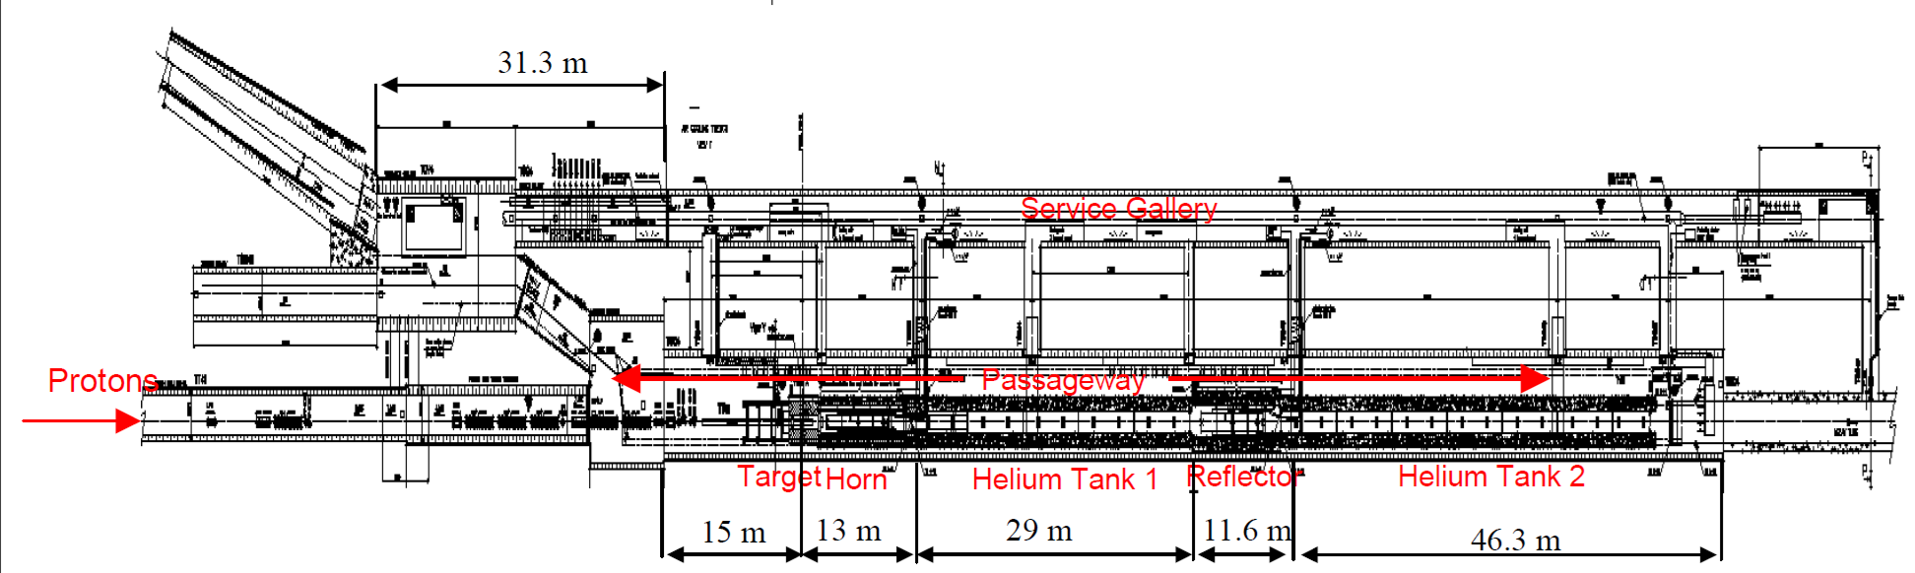
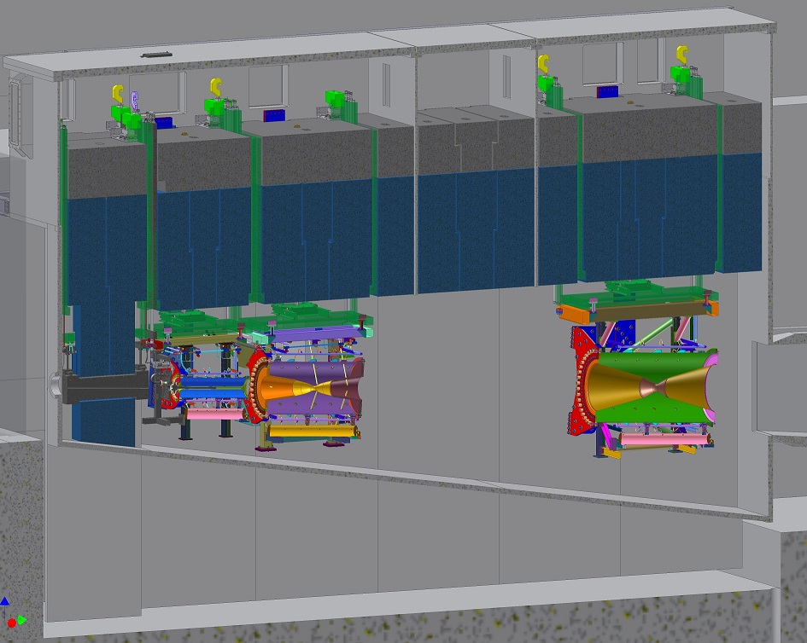

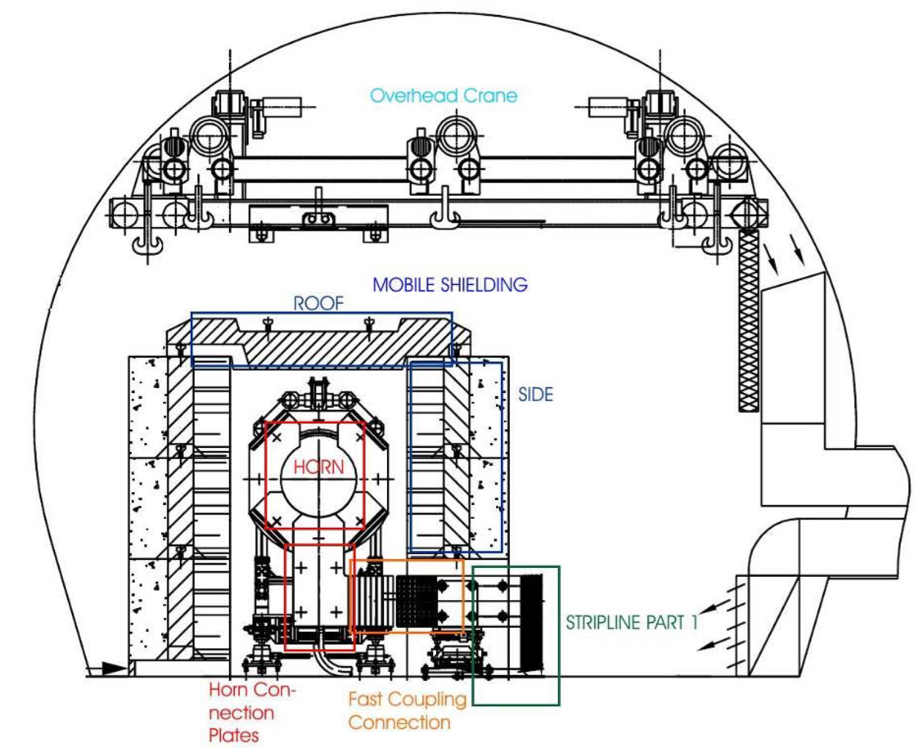
Examples of target stations with horns
CNGS/CERN (~510 kW)
Horn and Reflector on the floor, exchange
though the tunnel with cranes and trolleys/rails
T2K/JPARC (1.3 kW)
3 horns suspended in He environment, exchange with cranes through the roof
Horizontal plane
Large flange, sealed with
Al plates, t= 120mm
Beam window
Ti-alloy
Horn-3
Horn-1
Horn-2
10.6m
Baffle
Graphite
Collimator
Operational parameters
Shielding/lifetime of parts
Maintenance, remote handling, galleries
Radioprotection/ALARA method
  Radiation as low as reasonably achievable
Safety following Laboratory/Country regulation
DV
collimator
15.0m

Slide 6
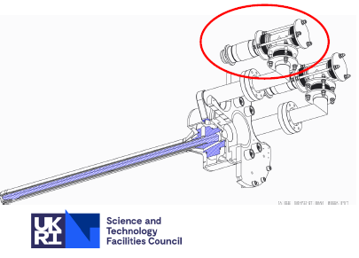
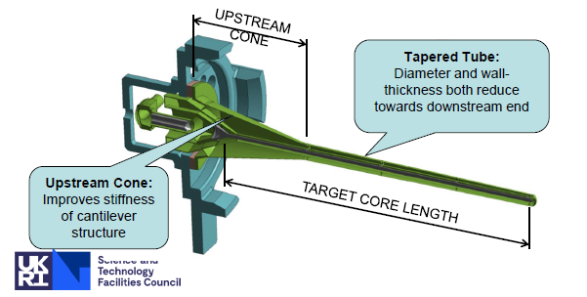
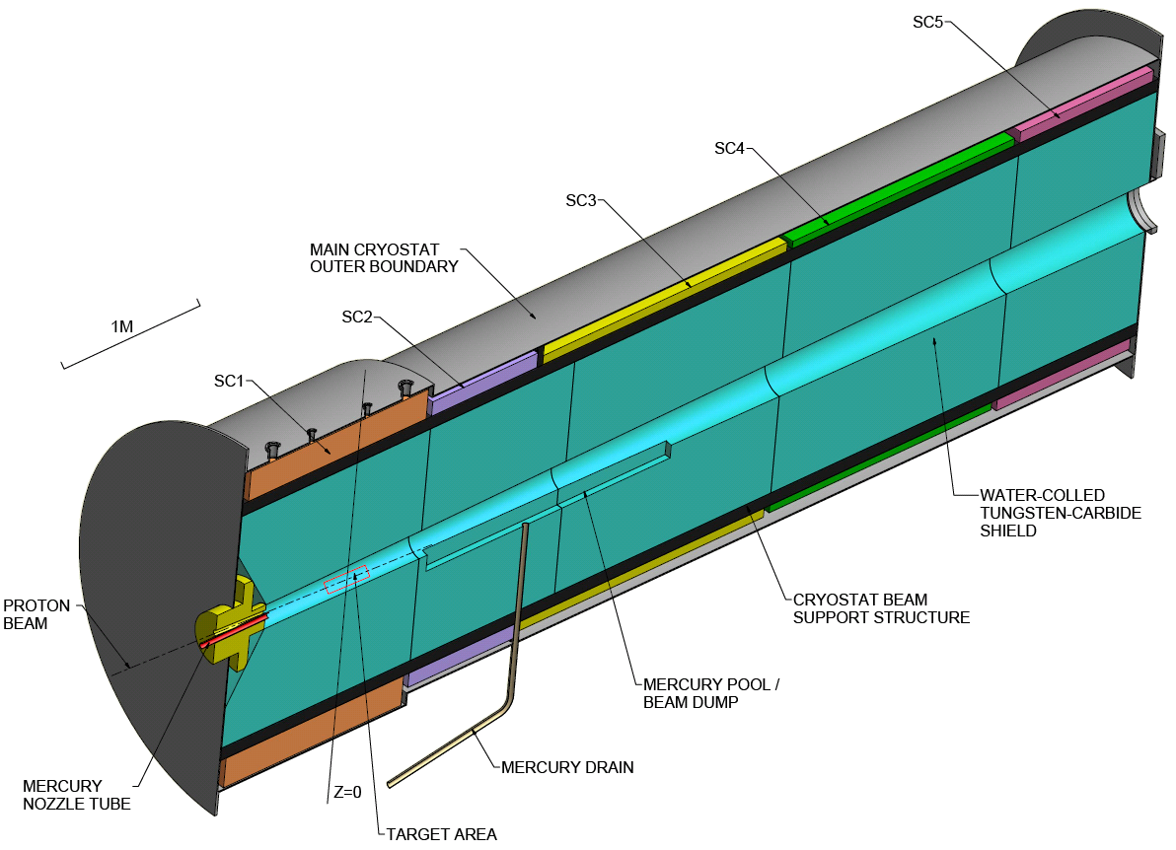
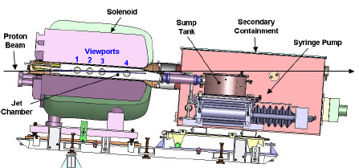
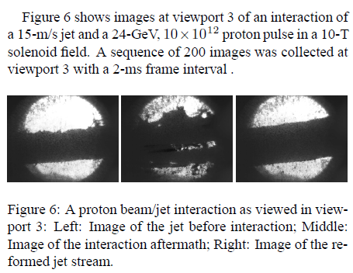
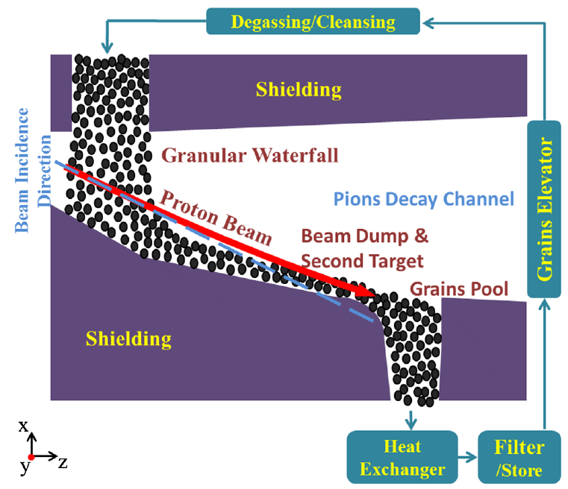
Target systems
T2(H)K @ 1.3 MW
@ ~ 1 MW
A solid or several segmented rods of graphite
with right cooling
LBNF @ 1.2 MW
MOMENT’s 14 T superconducting capture solenoid + waterfall target/tungsten carbide
Muon Collider / Neutrino Factory / MOMENT
Hg- jet @ multi-MW
@ multi-MW
Fluidized recirculated material
Liquids, granules
Jets. waterfalls

Slide 7
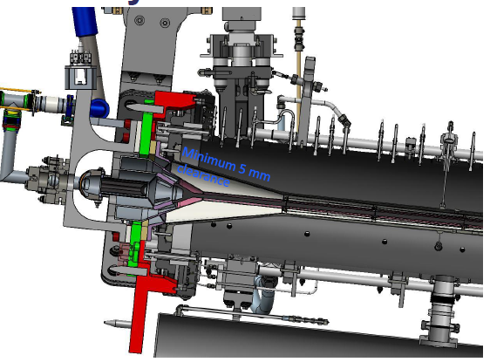
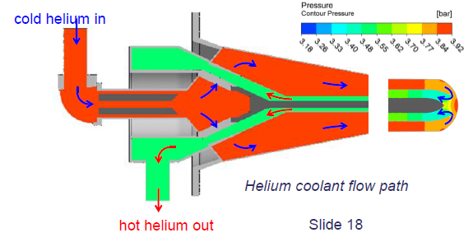
E.g., Proposed Graphite target for LBNF @ 1.2 MW, based on T2K experience
Single cantilevered design
Upstream conical support design
Key to survival ability is cooling
Graphite needs to be run hot to “anneal out” any damage” effect (~ 600 ºC)
Lifetime difficult to predict, data from T2K and NuMI + RaDIATE
Length between 1.5 and 1.8
Upstream conical shape for the target and inner conductor
C. Densham @ Snomass2020

Slide 8
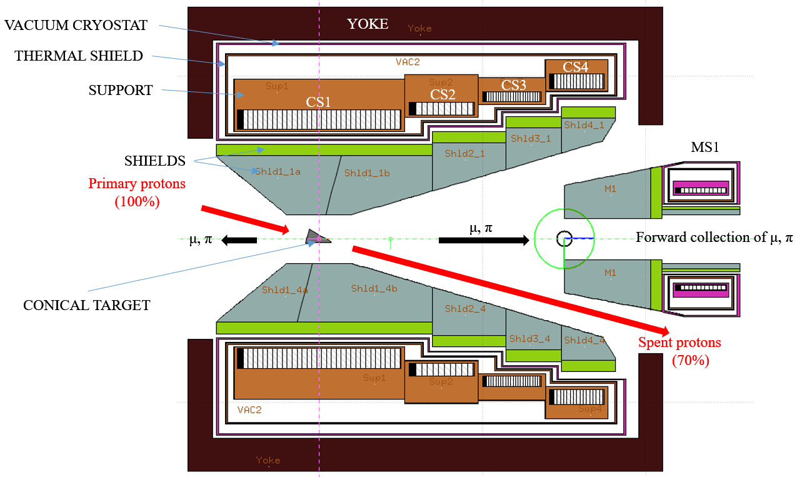
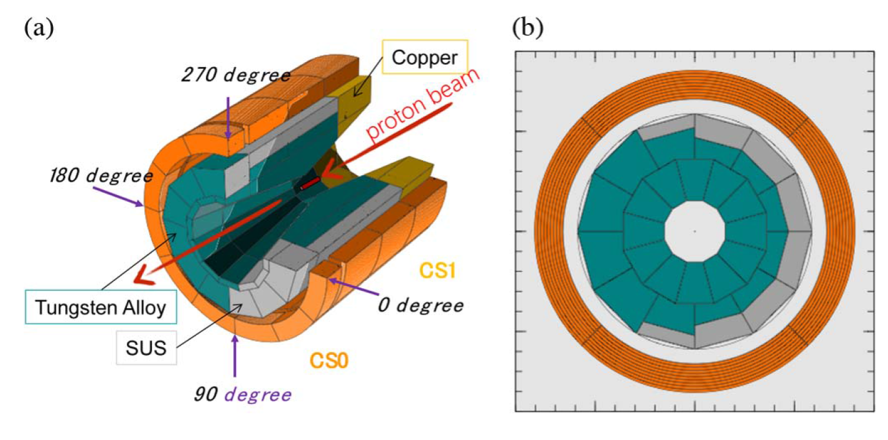
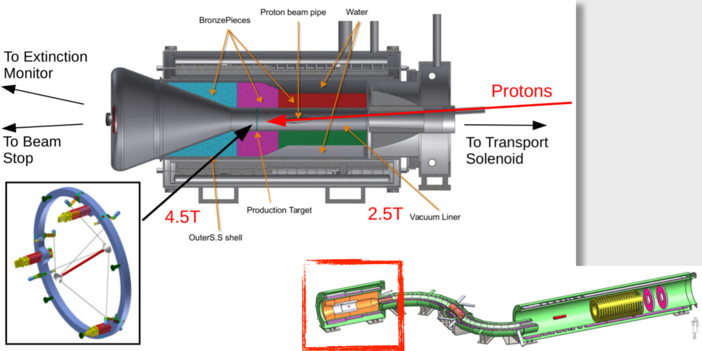
Superconducting solenoids at the target station
Tailored for
  μSR, LFV violation physics with kW targets (EMuS, Mu2e, COMET…)
  Maximum power 100 kW -> Mu2e-II for 3 years
  Neutrino Factories and Muon Colliders with multi-MW targets
Best choice for high-Z fluidized and recirculated targets as liquid/granular jets or waterfalls
Double sign collection for pions, needed for muon colliders
Extensive shielding for coils, complicated design, expensive
Maximum lifetimes based on Monte-Carlos and specific dose limits for their superconducting wires
  Their longevity is not proven in practice like horns
EMuS/CSNS
COMET/JPARC
Mu2e/FERMILAB

Slide 9
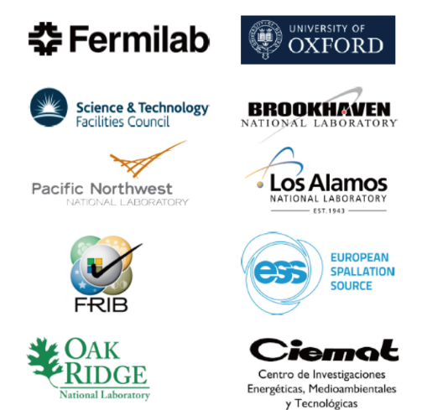



RaDIATE international collaboration
Radiation Damage In Accelerator Target Environments
Predicting and improving lifetimes and reliability of targets, beam windows, focusing devices and other equipment
nuSTORM can benefit and apply the results of this research
Activities so far
a) High-Energy Proton Irradiation Campaign (BLIP, BNL )
Multiple material irradiation, Graphite, Titanium, Beryllium – Post-Irradiation Examination (PIE )
b) In-Beam Thermal Shock Testing (HiRadMat, CERN)
Beryllium beam impact experiment
multiple material (including BLIP irradiated specimens)
c) Autopsy and PIE
NuMI Beryllium Primary Beam Window / micro-mechanical and helium bubble studies
NuMI-MINOS target graphite fins
d) Low-Energy Ion Irradiation
Beryllium at Surrey/Oxford/KIT
Recent results
RaDIATE BLIP irradiation PIE status and preliminary results on Beryllium and Titanium
Beryllium micro-mechanical and helium bubble studies
Graphite characterization at Bristol
In-beam thermal shock testing (HiRadMat @CERN)
NT-02 graphite fin swelling analysis
Patrick Hurh @ NBI2019
C. Densham @ Snomass2020

Slide 10
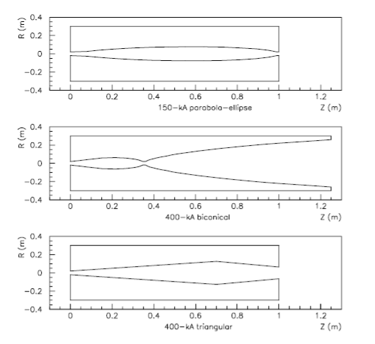
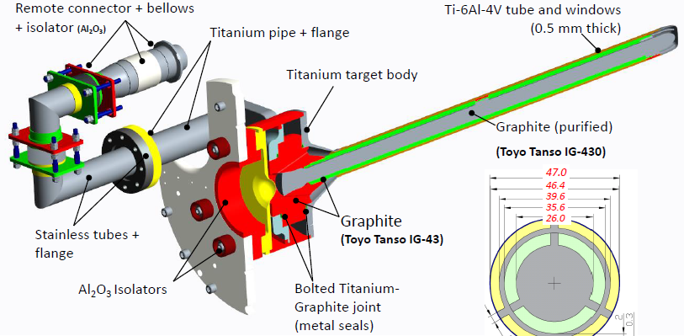
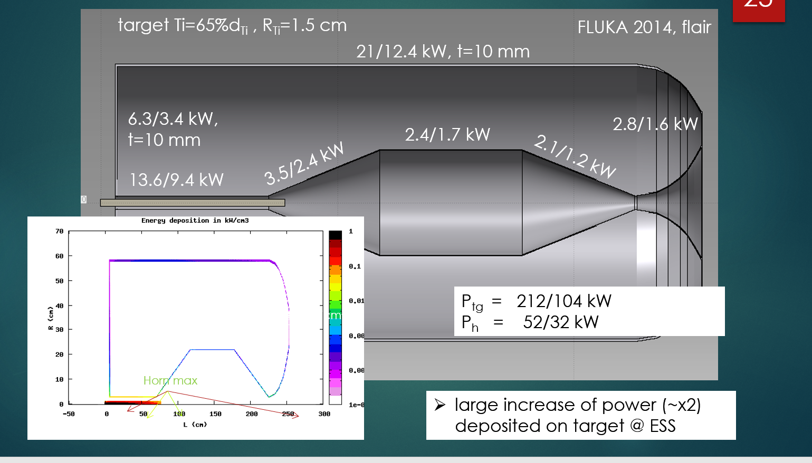
Concluding
For nuSTORM probably the right system for pion capture system might be:
A horn with a proper shape of inner conductor to fulfill the pion capture requirements
Best grades of graphite and special cooling for the target to be ready for a MW primary proton beam power
Inner conductors may vary e.g.,
E.g., like T2(H)K state of the art target design
Length = 90 cm
+

Slide 11
Thank you

Slide 12
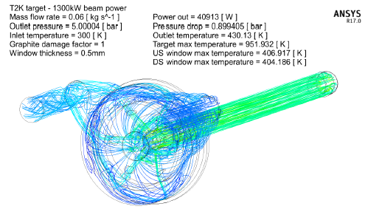
T2(H)K @ 1.3 MW
upgrade the design of 750 KW -> 1.3 MW (2023)
Only increase the pressure from 1 -> 5 bar, for higher He mass flow,
Re-optimization of the Ti windows, upstream and downstream
The LBNF target will be based on the experience of T2K @ 1.3 MW
Length = 90 cm
Graphite runs hot to “anneal out” radiation damage
Eric Harvey-Fishenden @ NBI2019
C. Densham @ Snomass2021

Slide 13
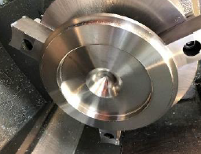
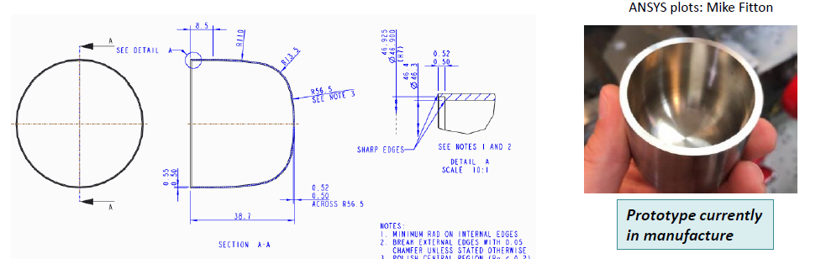
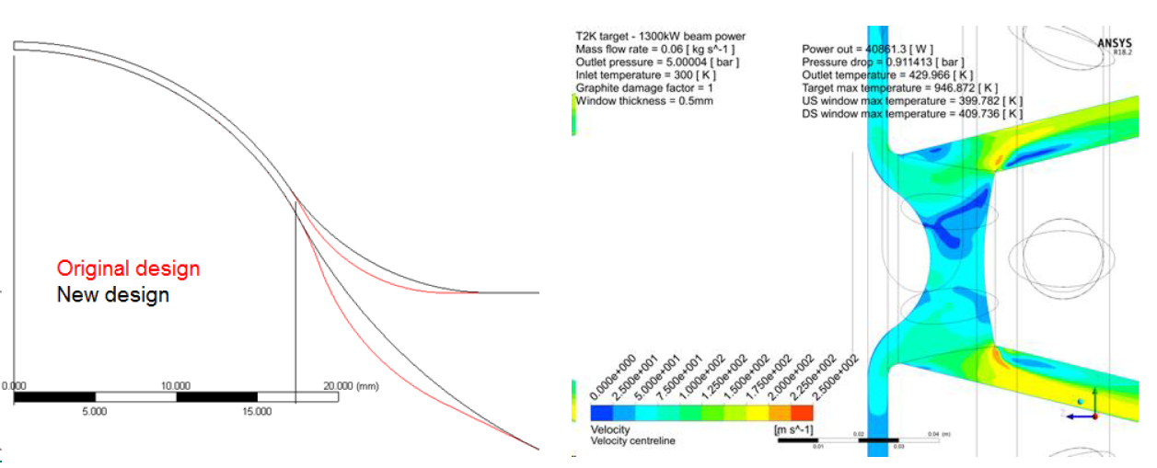
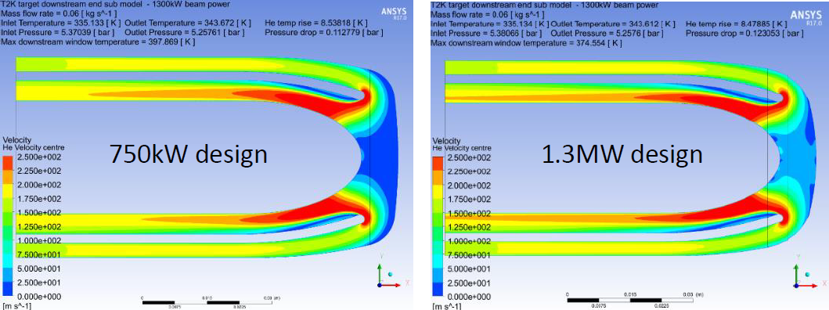
T2(H)K @ 1.3 MW target windows upgrade
Reshaping of the windows in order to decrease pressure stresses by a factor of 3
and maintain good cooling, windows’ thickness = 0.5 mm, Ti-6Al-4V
Downstream window:
curvature increased
Upstream window:
plate thickness increased
Dave Pushka @ NBI2019

Slide 14
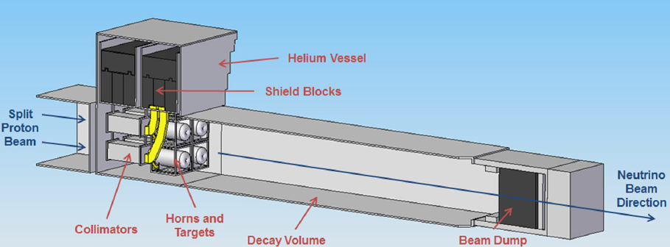
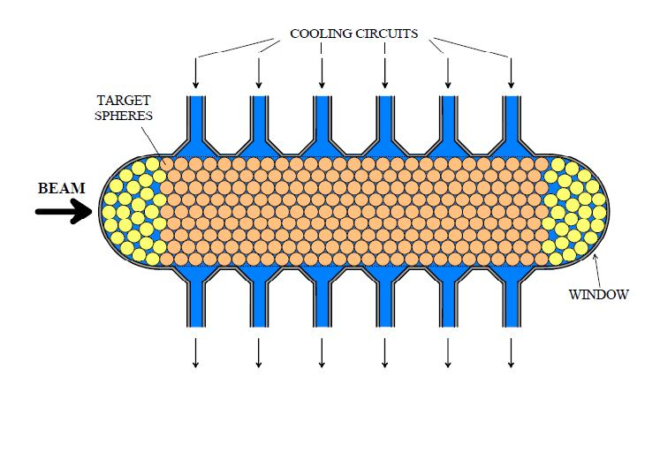
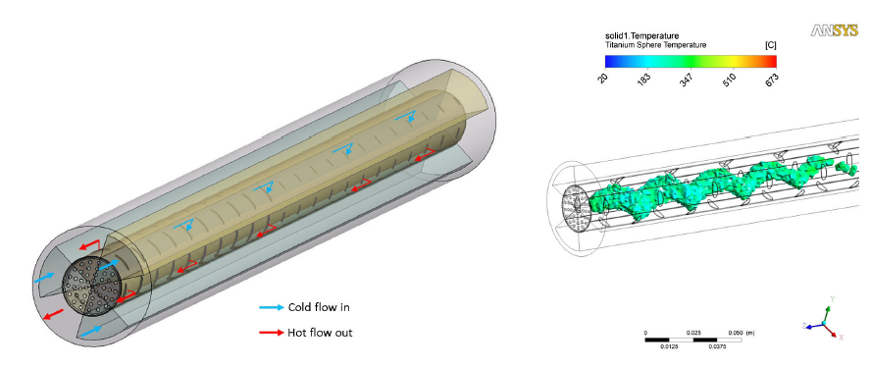
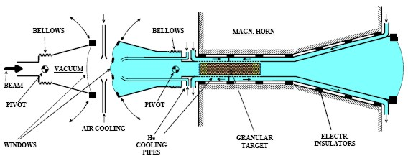
Packed-Bed Target for ESSnuSB, @ 5 MW
Packed bed concept targetry explores transverse cooling, and uniform heating of the spheres to reduce stresses
firstly proposed at CERN (2001) by P. Sievers
ESSnuSB target station splits the 5 MW to 4 x 1.25 MW, using 4 horns and targets
Coolant water
or gas He
Beam power = 1 MW
Titanium sphere = 3 mm
Coolant = He @ 10 bar
Packed bed length / radius = 780 / 12 mm
Max. sphere temperature = 673 ⁰C
Stress on spheres < 50 MPa
Older study 2010-12,
perhaps obsolete in the rising of T2(H)K and LBNF targets

