Slide 1
Introduction and goals

Slide 2
Update since our last meeting on 24Feb21
Introduction and goals

Slide 3
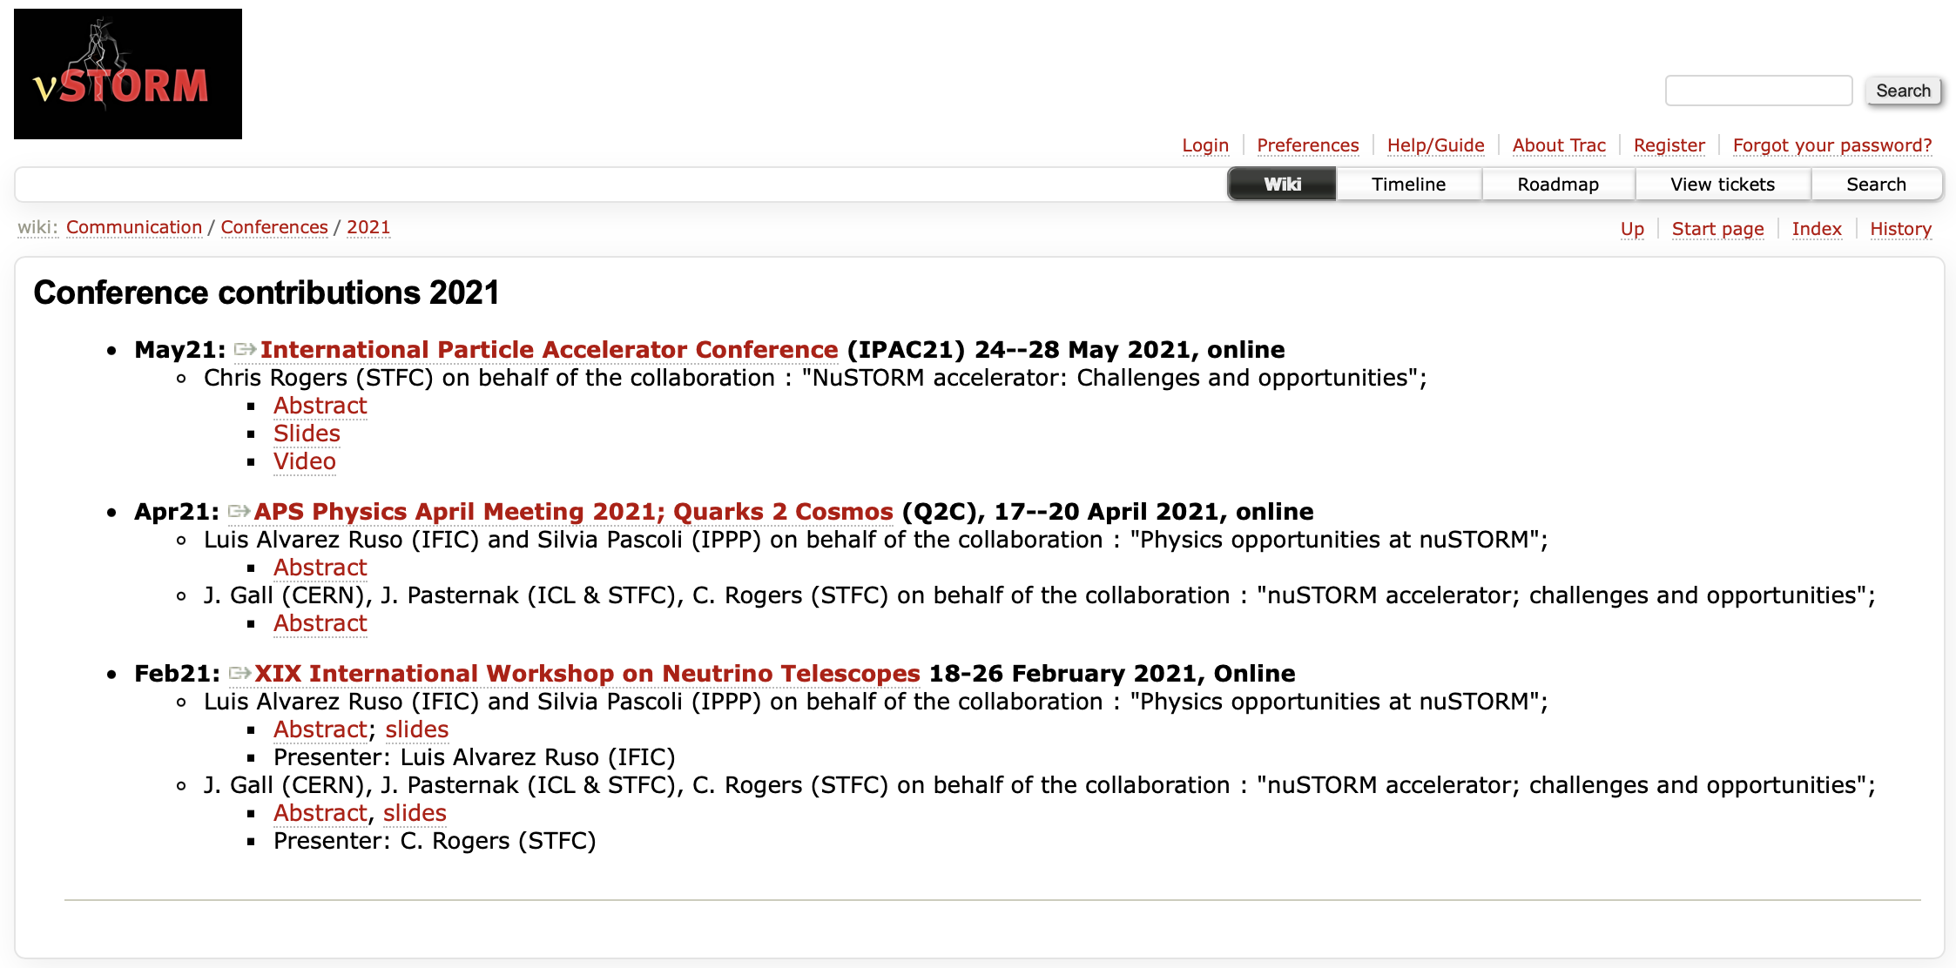

Slide 4
From last time

Slide 5
Strengthening collaborative working …
Made a start:
  Collaborative development of s/w activity (see PK)
  Initiated Steering Group:
    Luis Alvarez-Ruso, Alan Bross, Chris Densham, Marcos Dracos, Tord Ekelof, Anna Holin, Paul Kyberd, Ken Long, Andrea Longhin, Jaroslaw Pasternak, Chris Rogers, Jingyu Tang, Francesco Terranova, Emmanuel Tsesmelis
    nustorm-steer@cern.ch
    Looking for first meeting
Exploiting synergies, working closely with:
  ENUBET, muon collider collaboration
  Seek to find synergies and overlaps with nuSTORM@ESS

Slide 6
Meeting schedule established
Next meetings:
  17May21
  28Jun21
  09Aug21
  20Sep21
Have outlined next steps in nuSIM development
  See PK
Next meeting; need to:
  Review nuSIM progress
  Make a step on discussion of target synergies w\ ENUBET and demo

Slide 7
