Slide 1
Pion Transport from target to nuSTORM ring
Tiago Alves
Imperial College London
March 2021

Slide 2
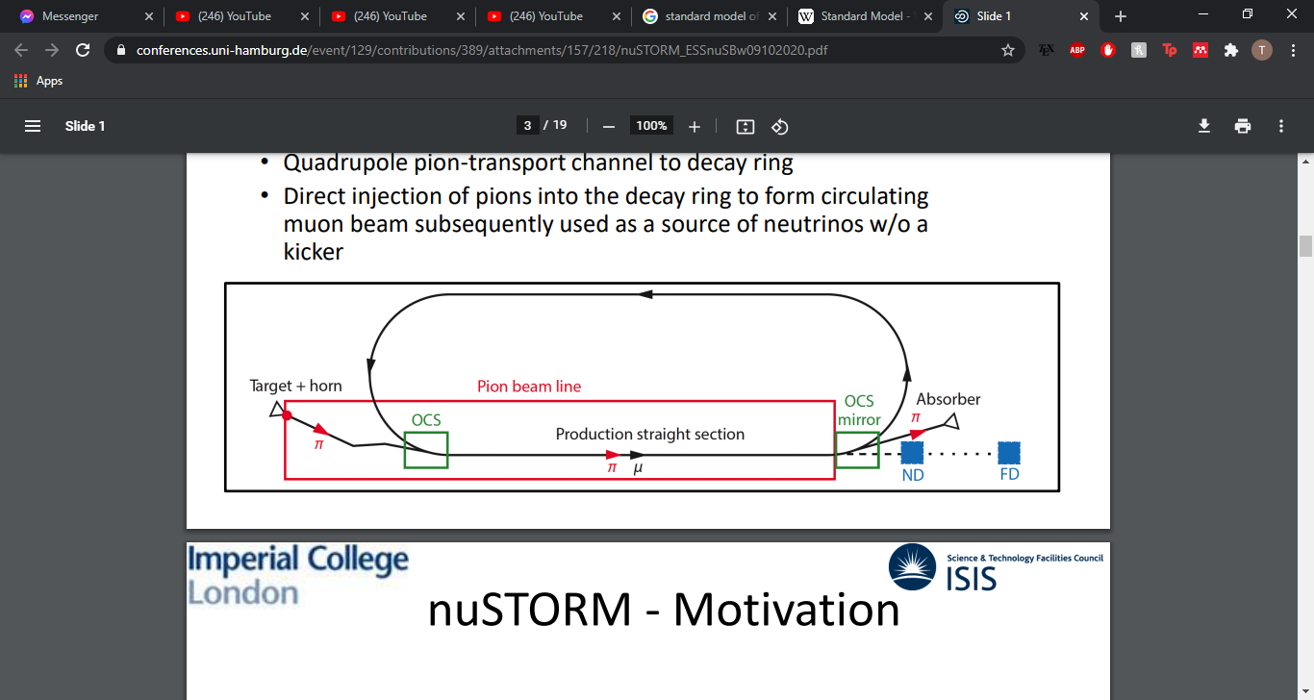

NuSTORM
A new way of producing neutrino beams from stored muons
Typical neutrino beams are produced from decaying pions
Reduction of systematic errors in long base-line oscillation experiments
$π^{+}→μ^{+}+ν_{μ}$
$μ^{+}→e^{+}+{\overline{ν}}_{μ}+ν_{e}$

Slide 3
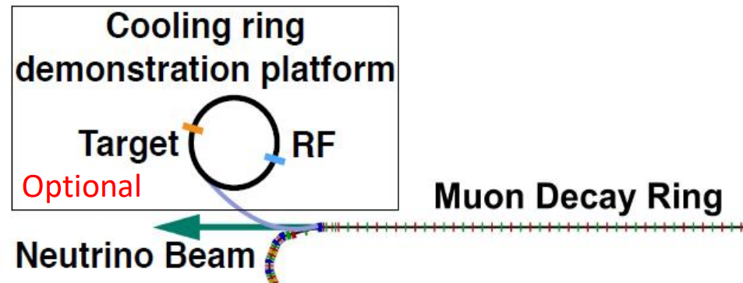


$μ^{+}μ^{−}$ Collider R&D, Measuring $ν_{e}$ Cross Section
nuSTORM provides the ability to research and develop a 6D cooling ring, to aid with the next generation of $μ^{+}μ^{−}$ colliders
The Cross section of the electron neutrino will help reduce the error of the CP violating Phase

Slide 4
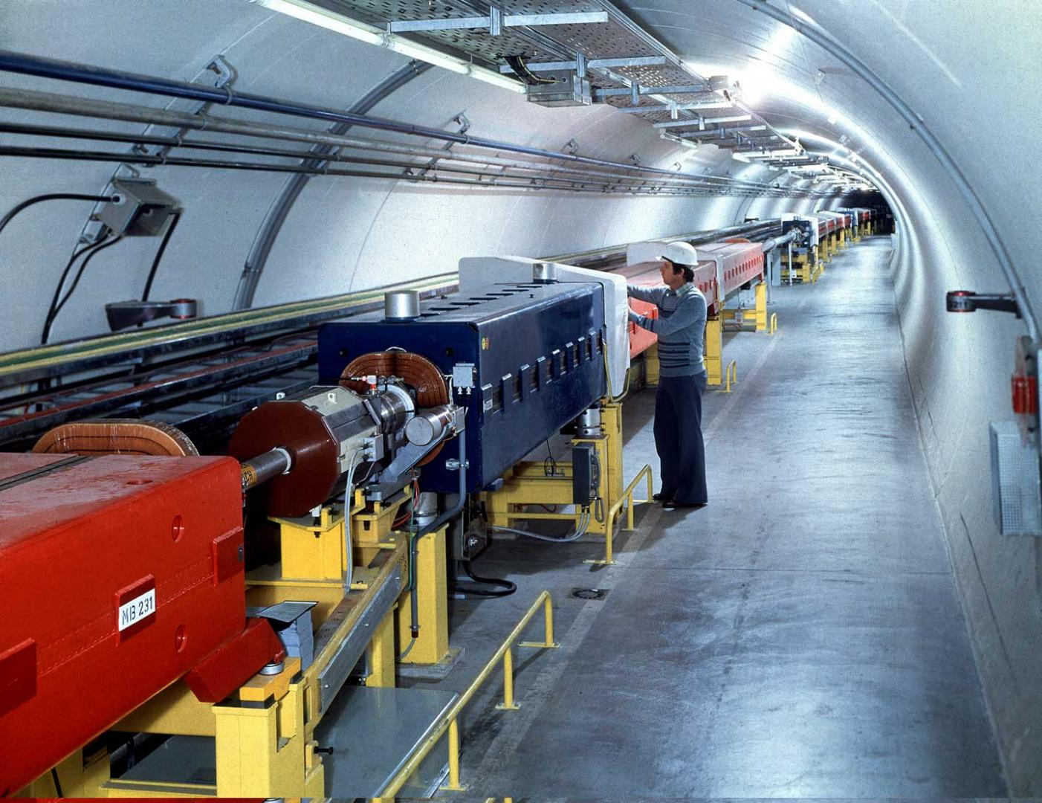


Super Proton Synchrotron $→$ Target
A 100 GeV proton is sent to a target made of Inconel, a nickel-chromium super alloy
The simulations were performed with a cylindrical target of dimensions $0.63×46cm$
The parameters of the proton beam is $σ_{x}$ ${=σ}_{y}=0.267$ cm

Slide 5
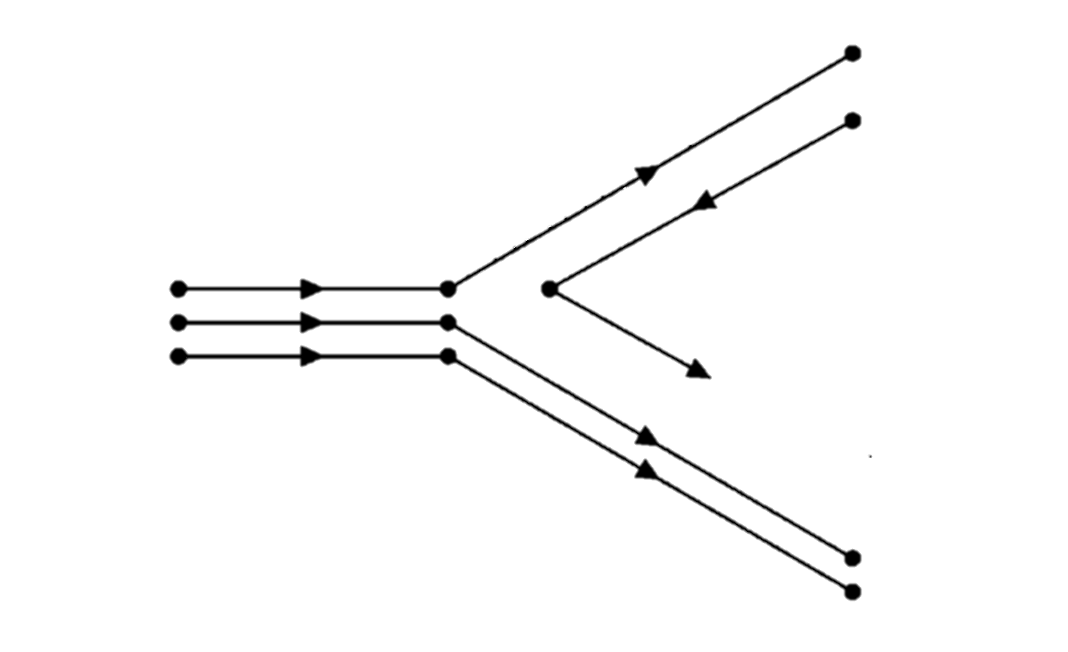




Target
The target is located inside the horn and is readily redirected through towards the transfer beam
The proton interacts to form pions and which continue through the horn
$$p→n+π^{+}$$
$$π^{+}$$
$$p$$
$$n$$

Slide 6

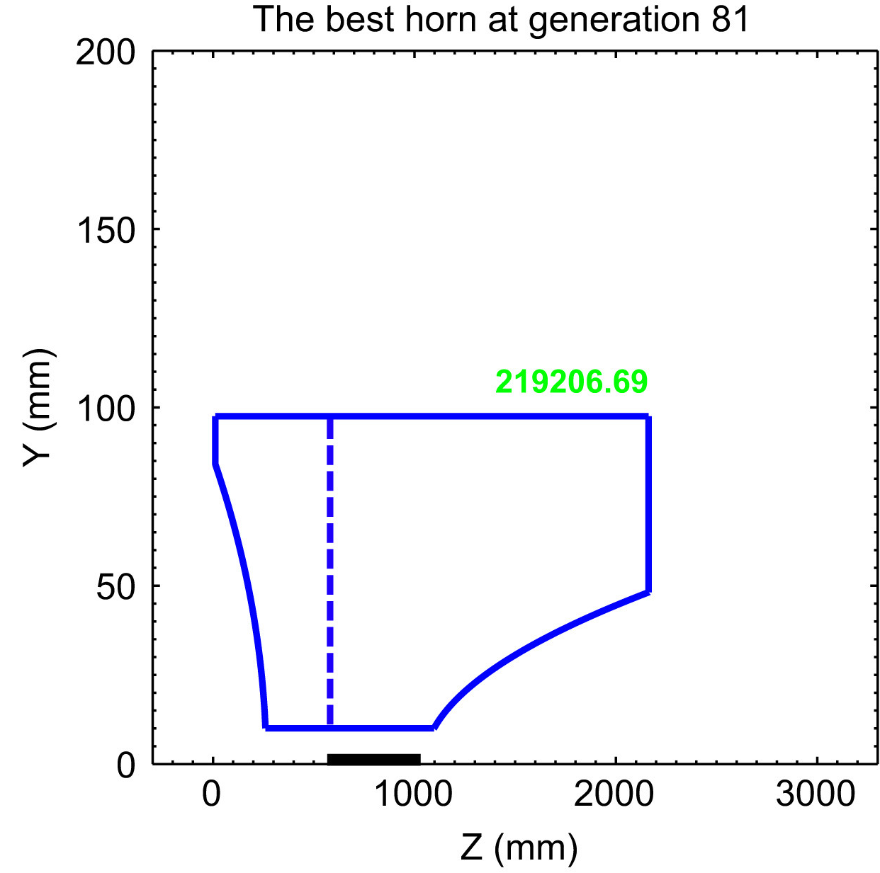
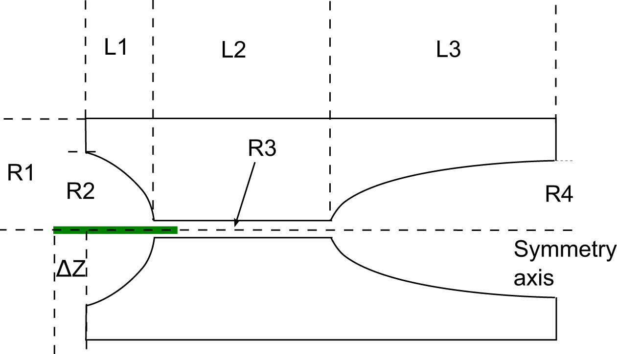

The Pion Horn
The magnetic horn distinguishes between the particles, allowing the $π^{+}$ to go through
The polarity can be reversed to accept $π^{−}$
We only start tracking the pion after the dotted line
The horn model incorporates the B field geometry, but we still don’t have a material for the conductors

Slide 7
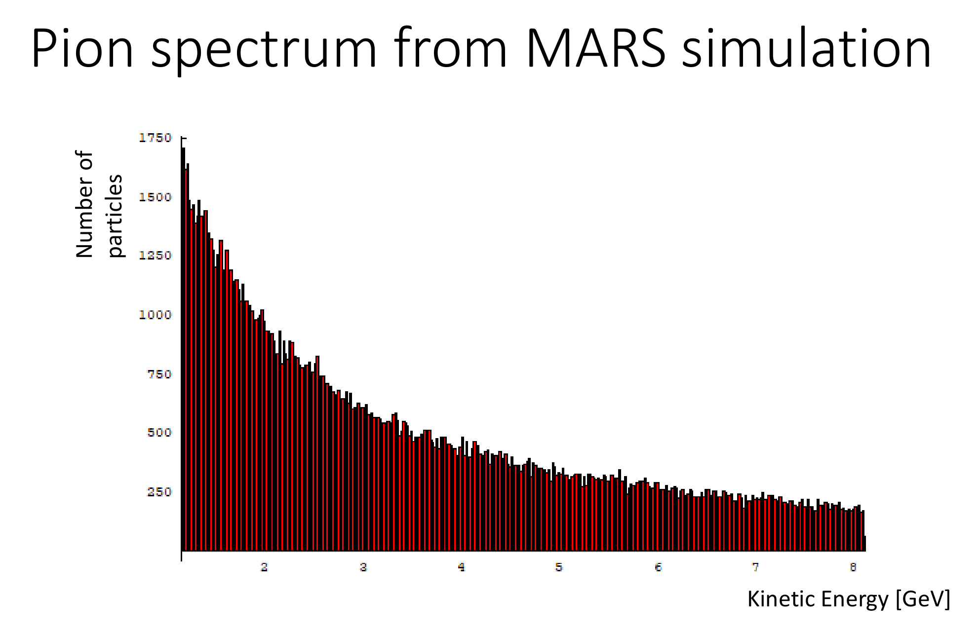
Horn MARS code Simulation
Using the MARS code, courtesy of S.Striganov, the simulation we see the spectrum of pion energies produced
These are then tracked and sent through to the pion transfer line
We tracked pions with 5GeV, 2.64 GeV and 7.2 GeV

Slide 8
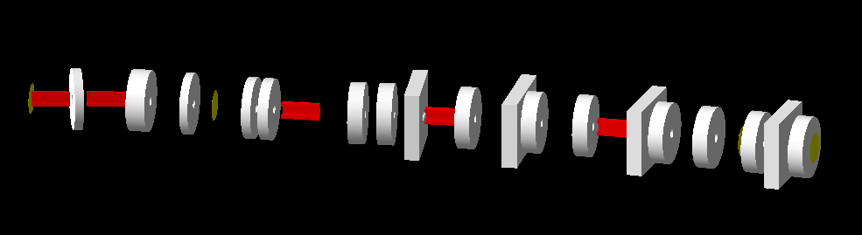
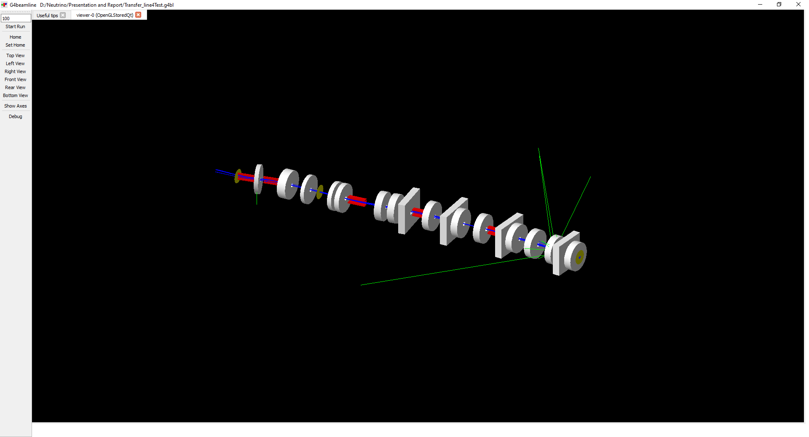
Designing the pion transport line
Used the horn data to model the beam line, tracking the pions at 5 different virtual detectors
Used the design associated to the transfer line and OCS whilst tweaking some of the quadrupole strengths
The decay process happens and the pions decay into muons and neutrinos

Slide 9
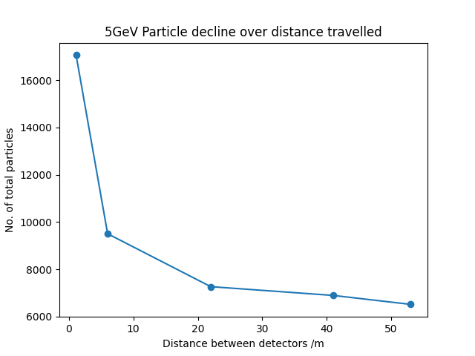
Particle decrease over time
Through our beamline we were able to keep about 38% of pions travelling through the beam line
We are still trying to improve the optics to increase the transmission

Slide 10
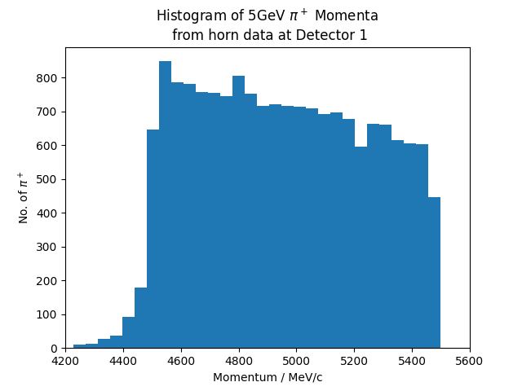
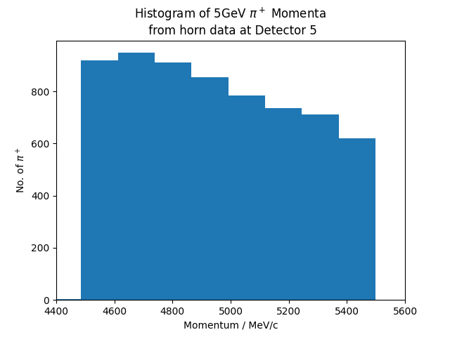
Horn Distribution 5GeV

Slide 11
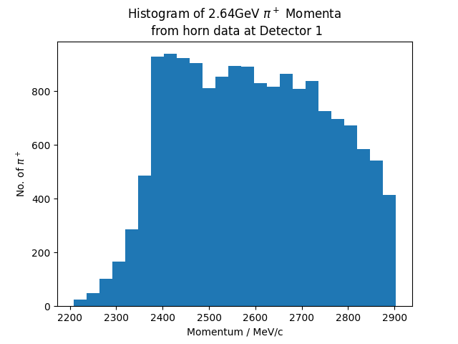
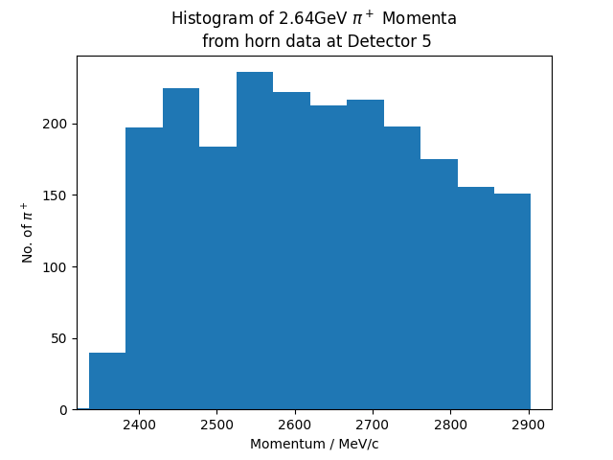
Horn Distribution 2.64GeV

Slide 12
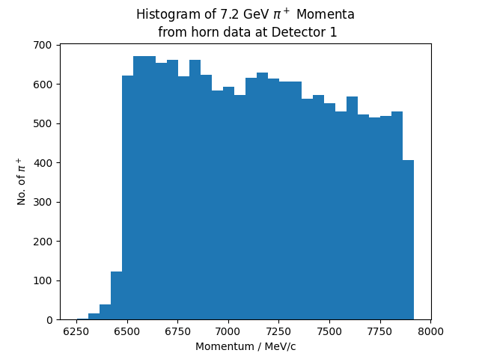
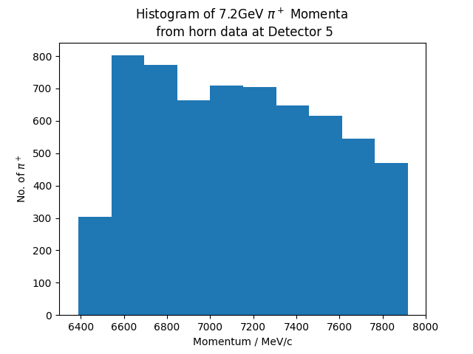
Horn Distribution 7.2GeV

Slide 13
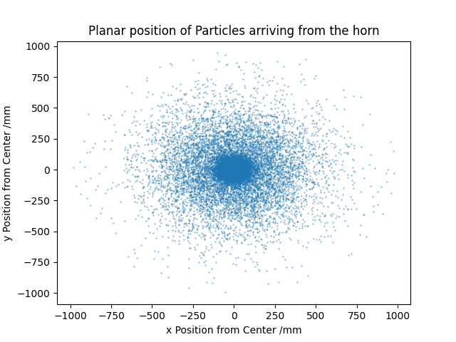
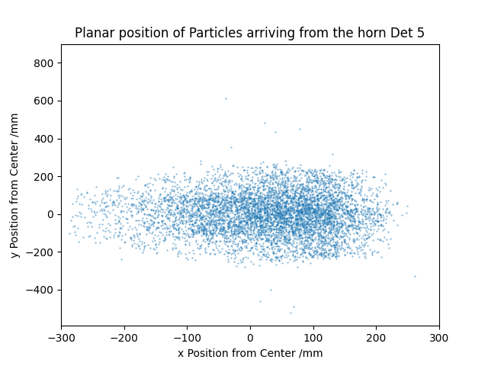
x,y distribution from Horn

Slide 14
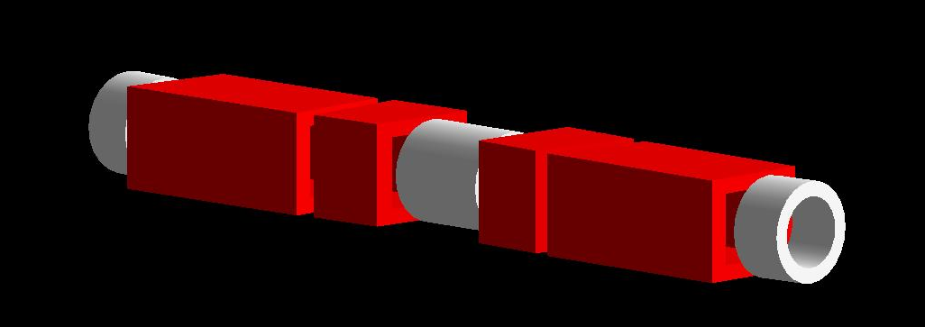
Orbit Combination Section
Originally the idea was to use 3 combined function magnets but G4BeamLine does not have the ability to model them
For now we are using 3 quadrupoles and 4 sector bends to model the same optics
We have still been unable to code with the OCS due to limitations with the G4BL software not allowing high strength sector bends

Slide 15
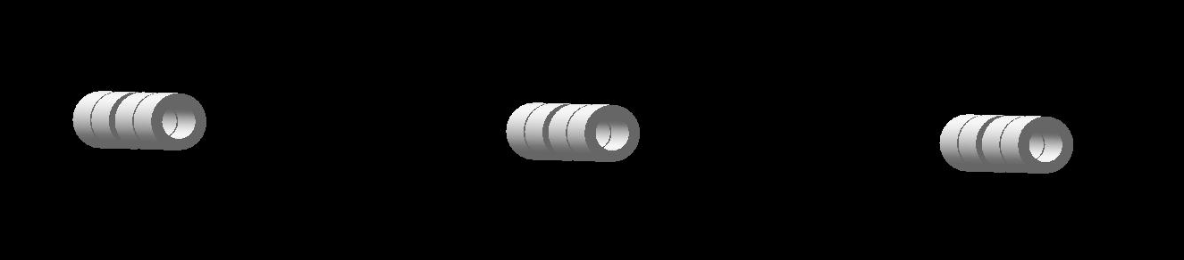

Orbit Combination Section $→$ Decay Straight
We are currently trying to resolve the issues we are facing
In case we have an opportunity we may look at implementing field maps instead to model the OCS
We have also had issues simulating the FFA cells due to limitations from G4BeamLine

Slide 16
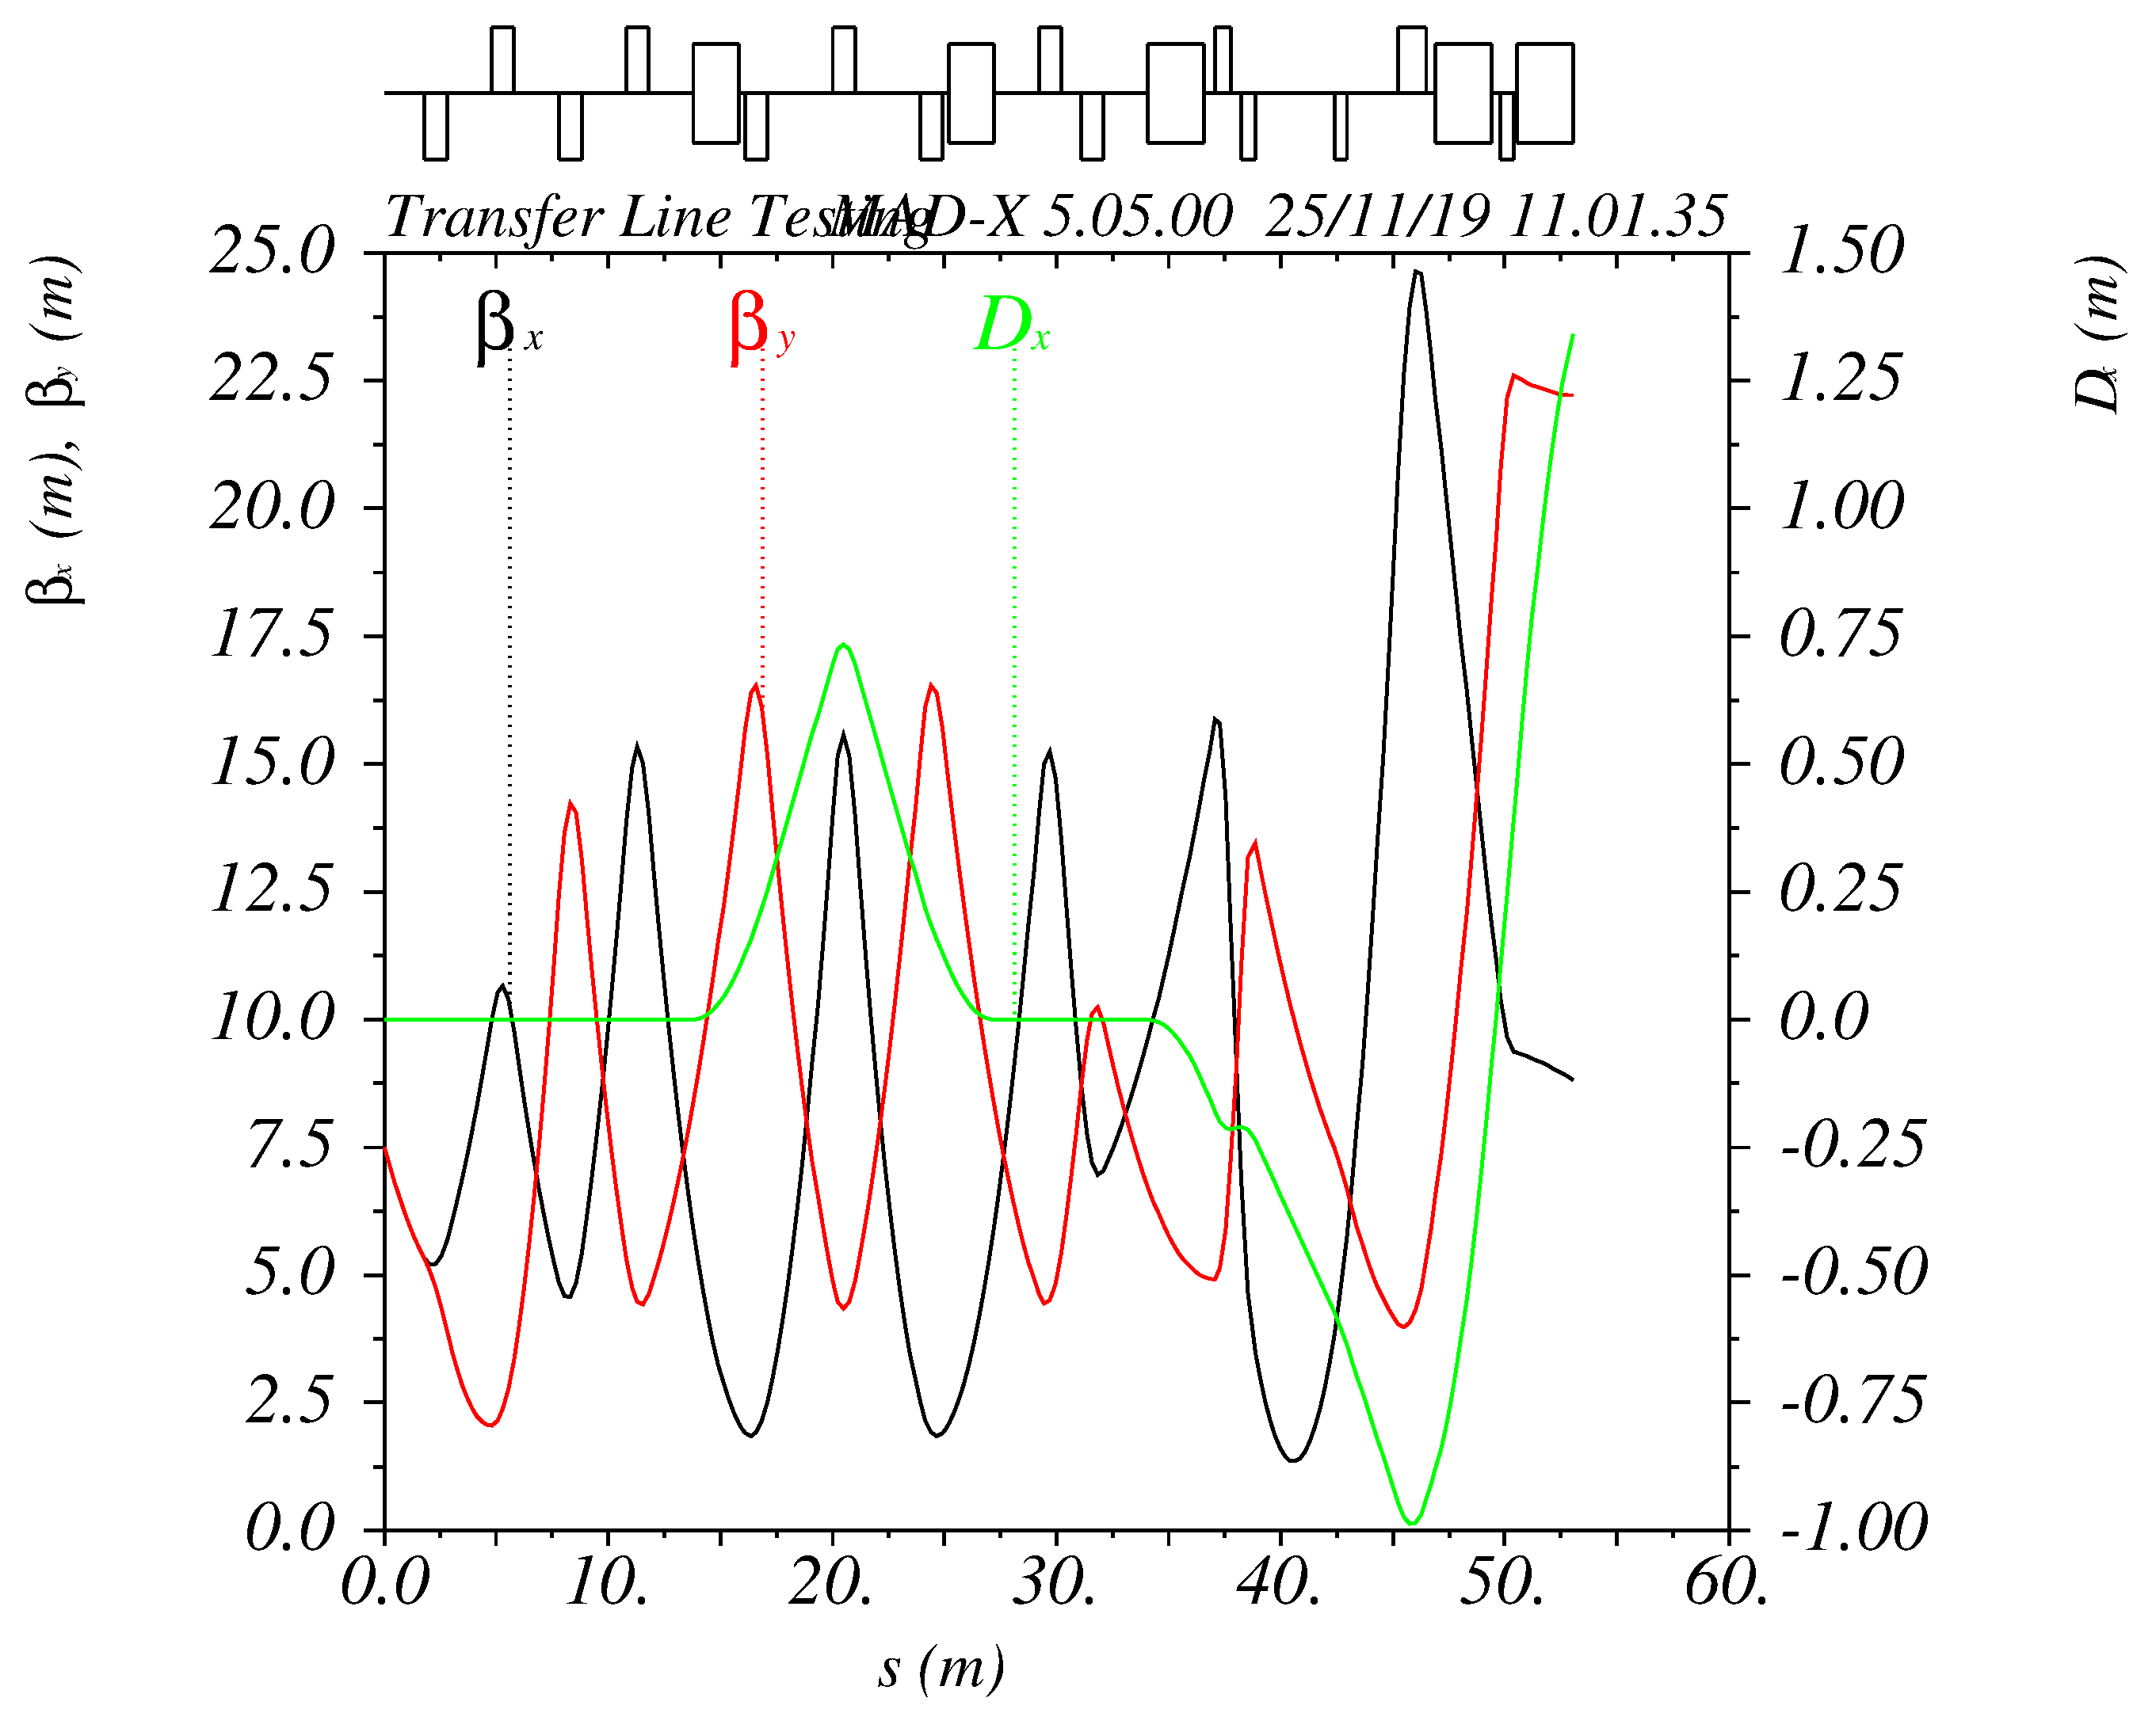
Twiss Function
The Twiss functions helps model how the optics should work
The need for generating dispersion followed by beam contraction is to eliminate the higher energy particles like protons
The Twiss function can be used to find the optimal radius of the quadrupoles
Design by C. Hunt

Slide 17
Conclusions/Future Plans
We will look at fixing the OCS magnets to produce a better phase space plots
Fix issues for the injection septum
We are working towards providing the normalisation of the neutrino flux per single proton striking the target

Slide 18
Thank You!
Questions?

