Slide 1
nuSTORM contribution to talk to PBC

Slide 2
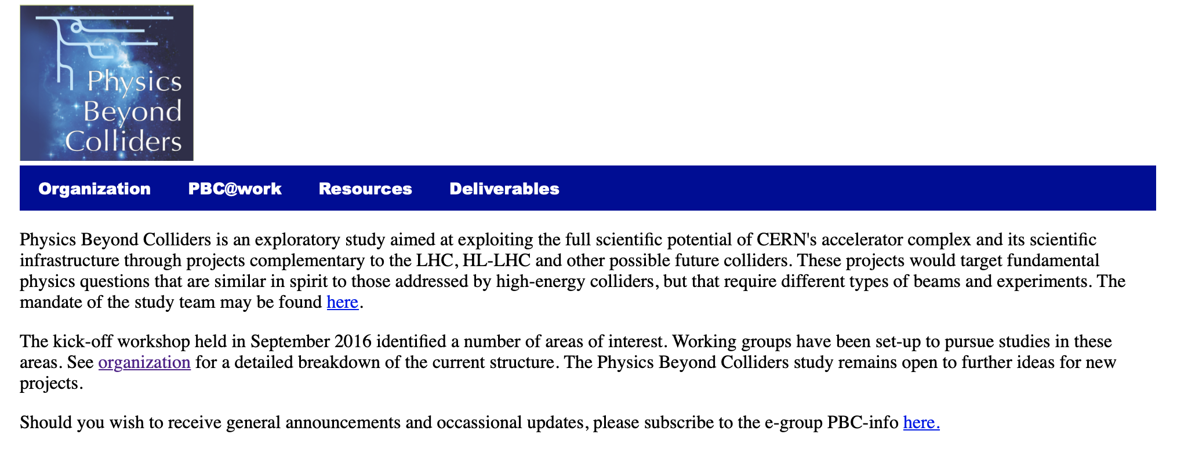
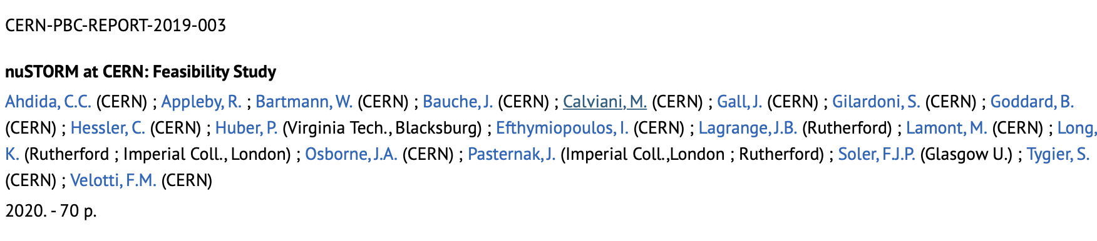
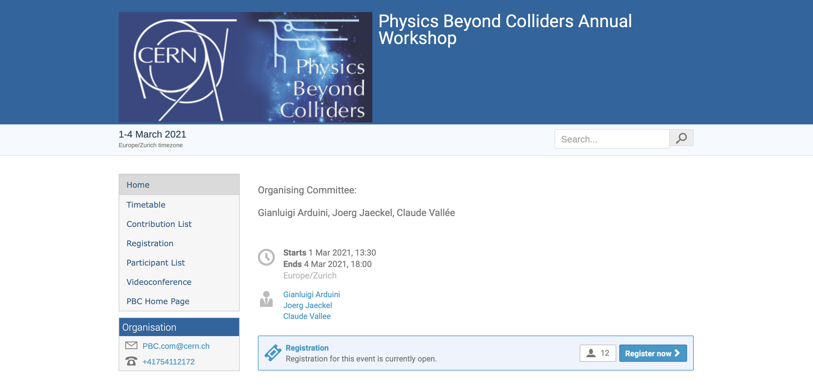
https://pbc.web.cern.ch
https://indico.cern.ch/event/1002356/
Pitch for nuSTORM/ENUBET:
nuSTORM:
Cross sections
BSM with nuSTORM
Demonstrator/accelerator
science test facility for mc

Slide 3
nuSTORM contribution to …
What was done in previous PBC study …
  Feasibility study outcome
  What we concluded re the way forward
For next PBC study:
  Physics
  Detector
  Accelerator/facility
    Co-habitation with ENUBET
  Accelerator science frontier wrt muon coillider

Slide 4
Discussion …

