Slide 1
IPPP w/s summary

Slide 2
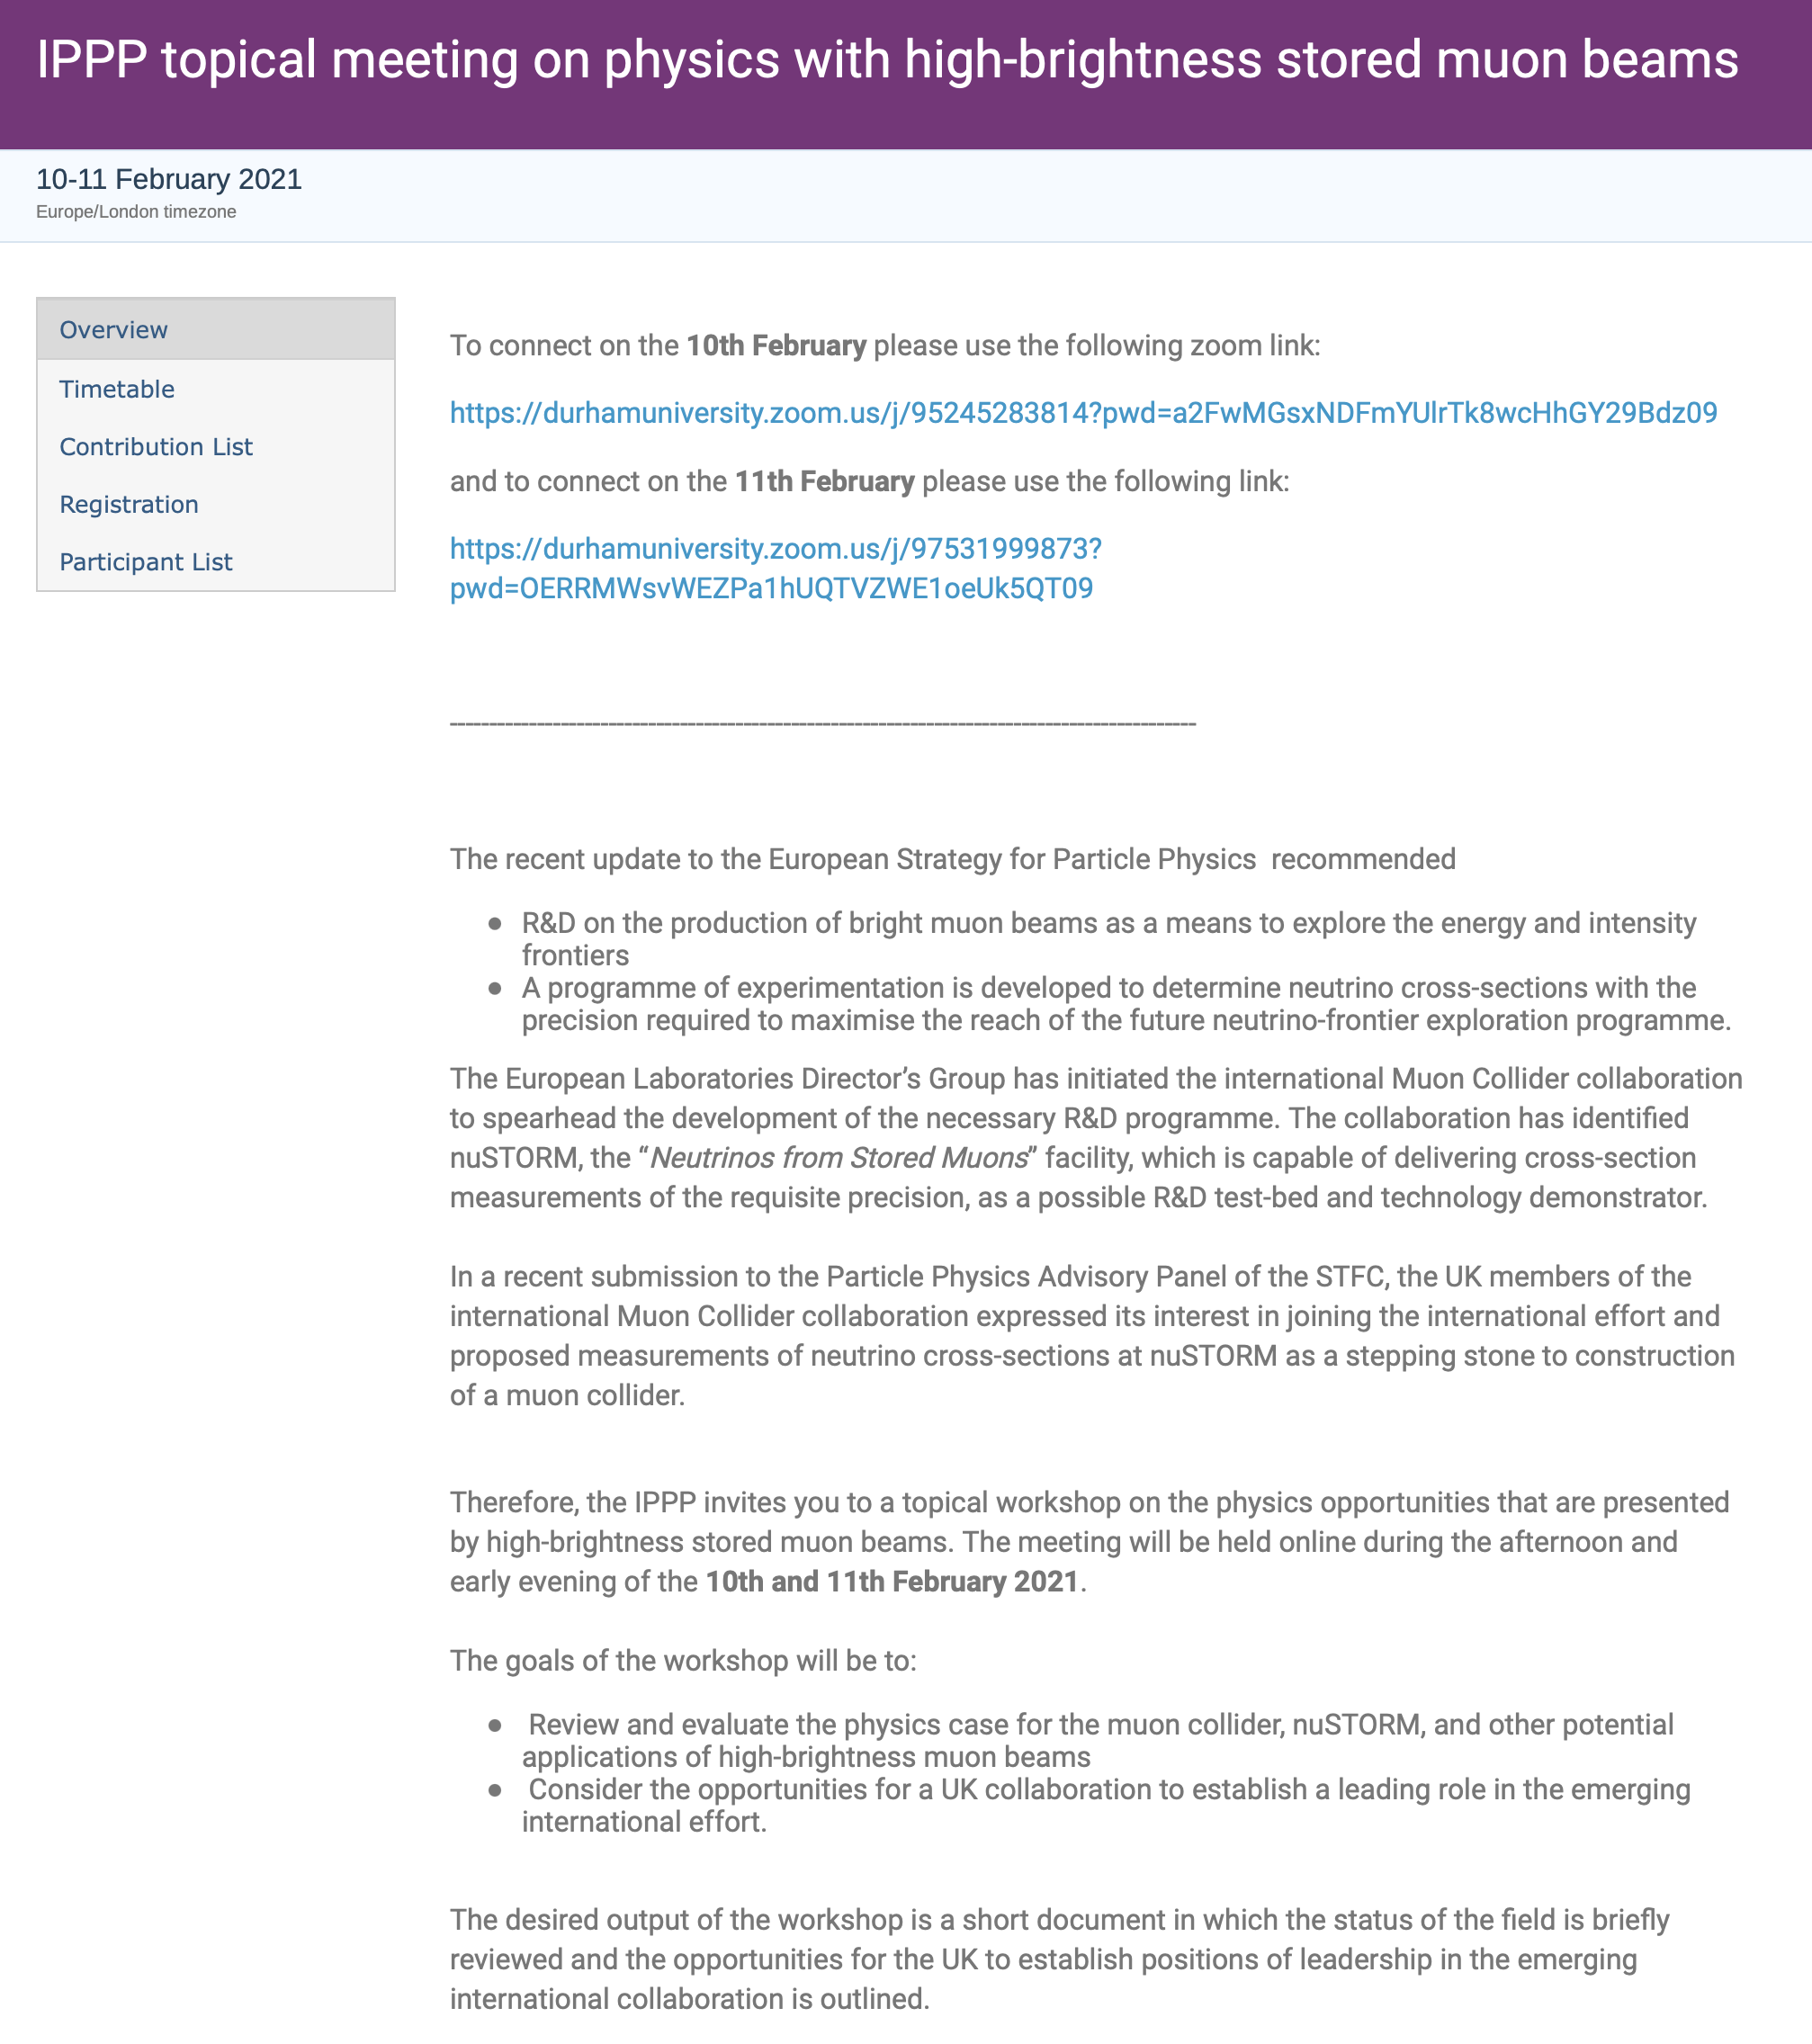
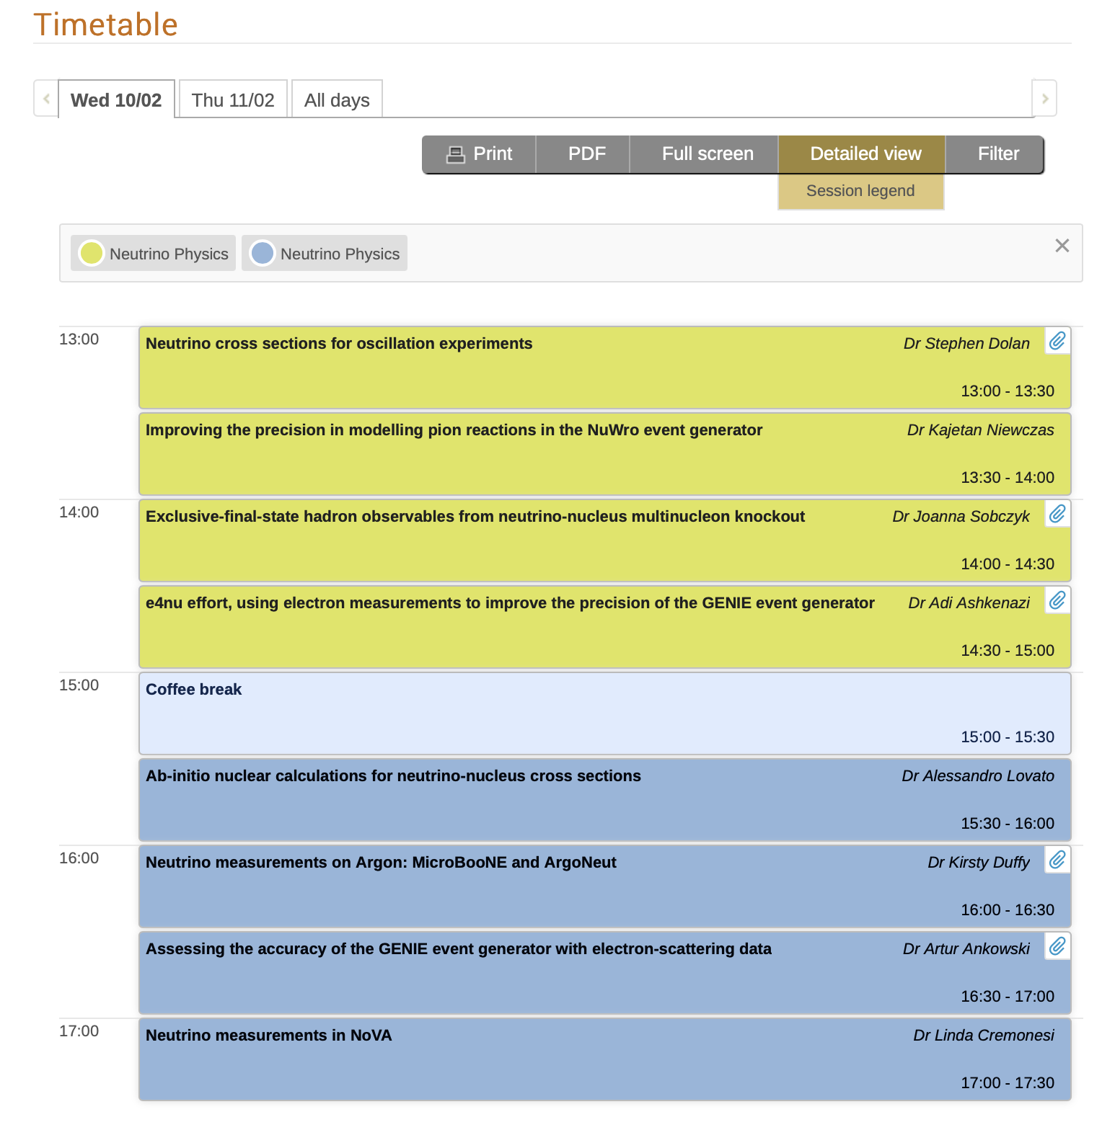
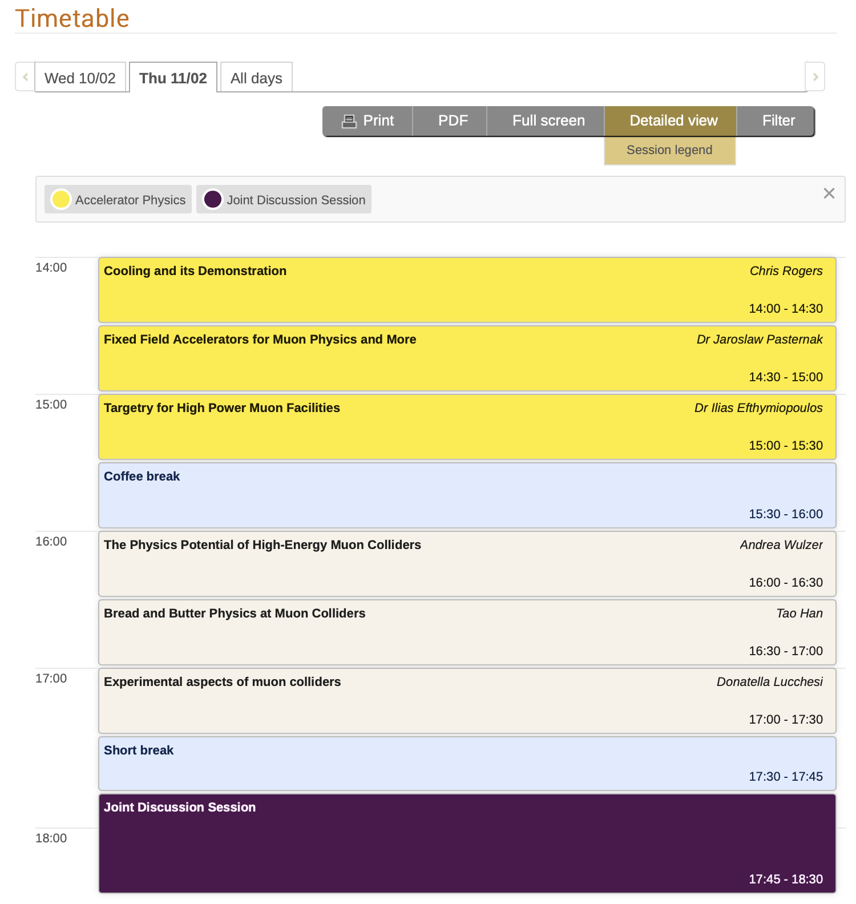
An excellent meeting …

Slide 3
Good start!
Reviewed needs of neutrino programme
& opportunities at the energy frontier
→ Need to quantify benefits …
An important step!
Enthusiasm and interest in community
(e.g. ~60 participants at this workshop)
→ Our ambition …

Slide 4
Agreed during discussion …
Organisers draft 2-pager to:
— Summarises opportunities
— Provide “mandate” for longer workshop
for which ”proceedings” would form
a “white-paper vision” for development of
programme

Slide 5
Draft summary document
Meeting goals, agenda, attendance
Physics highlights:
  Neutrino cross section/BSM
  Energy frontier
  Accelerator science
Opportunity:
  Development of physics programme in each of the themes (2.a, 2.b, and 2.c)
  Outline of programme in framework of iMC
  Articulation of case and programme in “white paper”
Specification for summer 2021 IPPP w/s:
  Extended and updated review as in Feb21 IPPP w/s
  Agree content and authors of white paper
  Agree timeline for its preparation

