Slide 1
Introduction

Slide 2
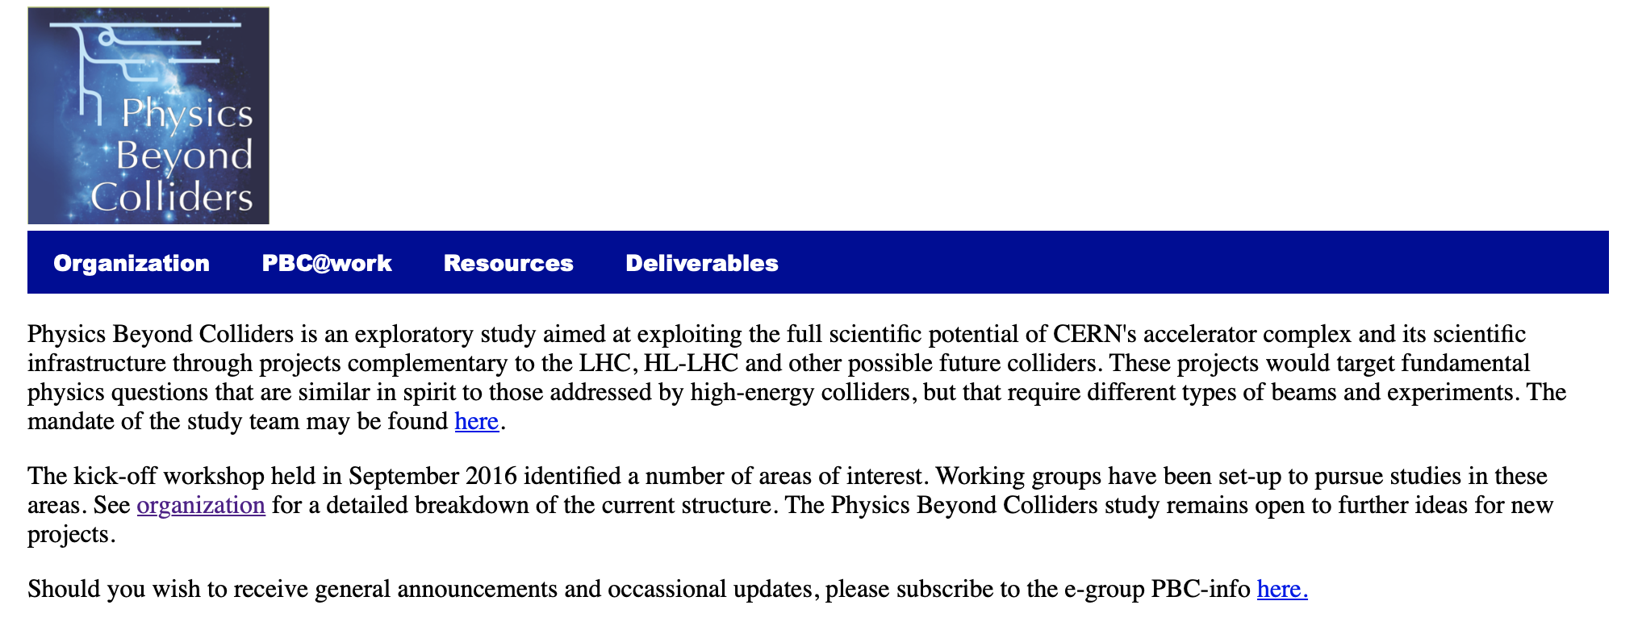
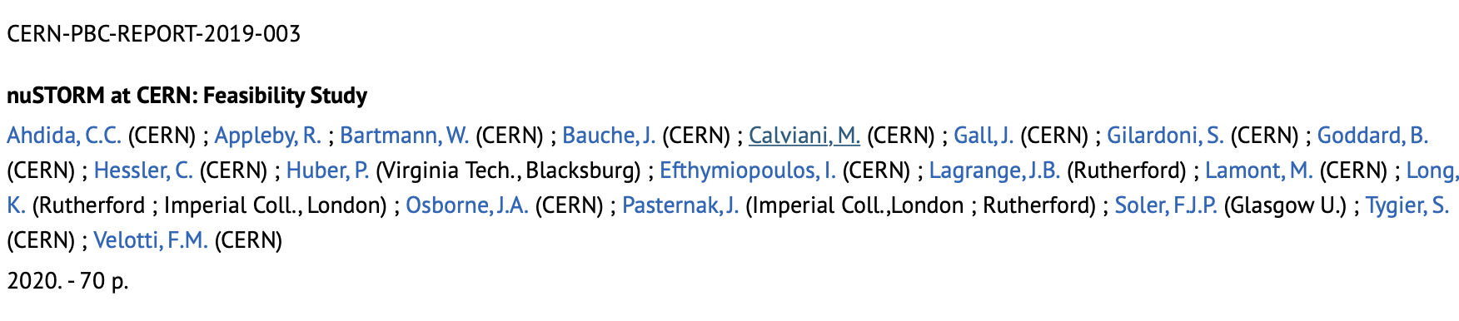
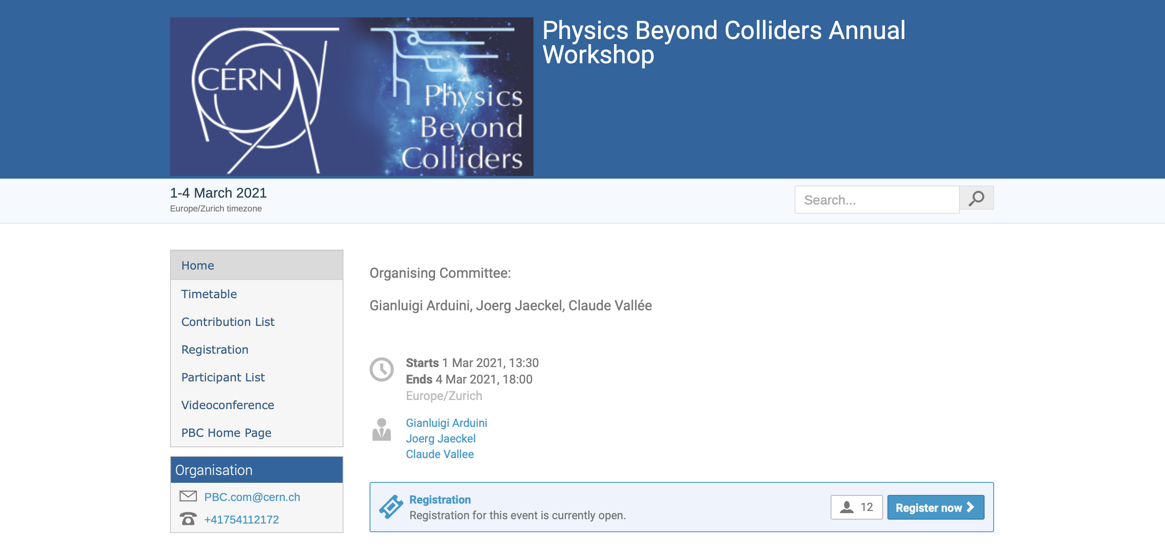
https://pbc.web.cern.ch
https://indico.cern.ch/event/1002356/
Pitch for nuSTORM/ENUBET:
nuSTORM:
Cross sections
BSM with nuSTORM
Demonstrator/accelerator
science test facility for mc

Slide 3
For your diaries …
Combined MICE, Muon Collider and nuSTORM* meeting:
25/26 March 2021; ZOOM
Agenda under development
* Neutrino physics and detector joint with ENUBET

