Slide 1
K. Long, Imperial College London and STFC
Welcome, introduction and aims

Slide 2
Welcome

Slide 3
Since we last met on 18Aug20 …

Slide 4
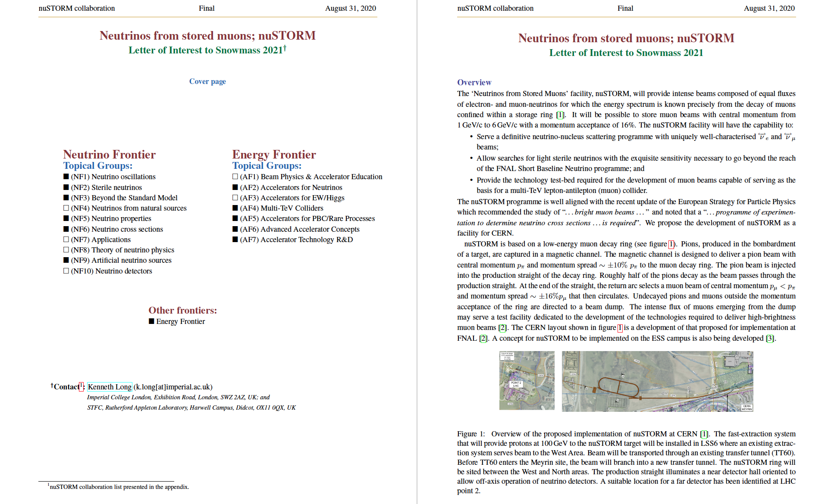

Slide 5
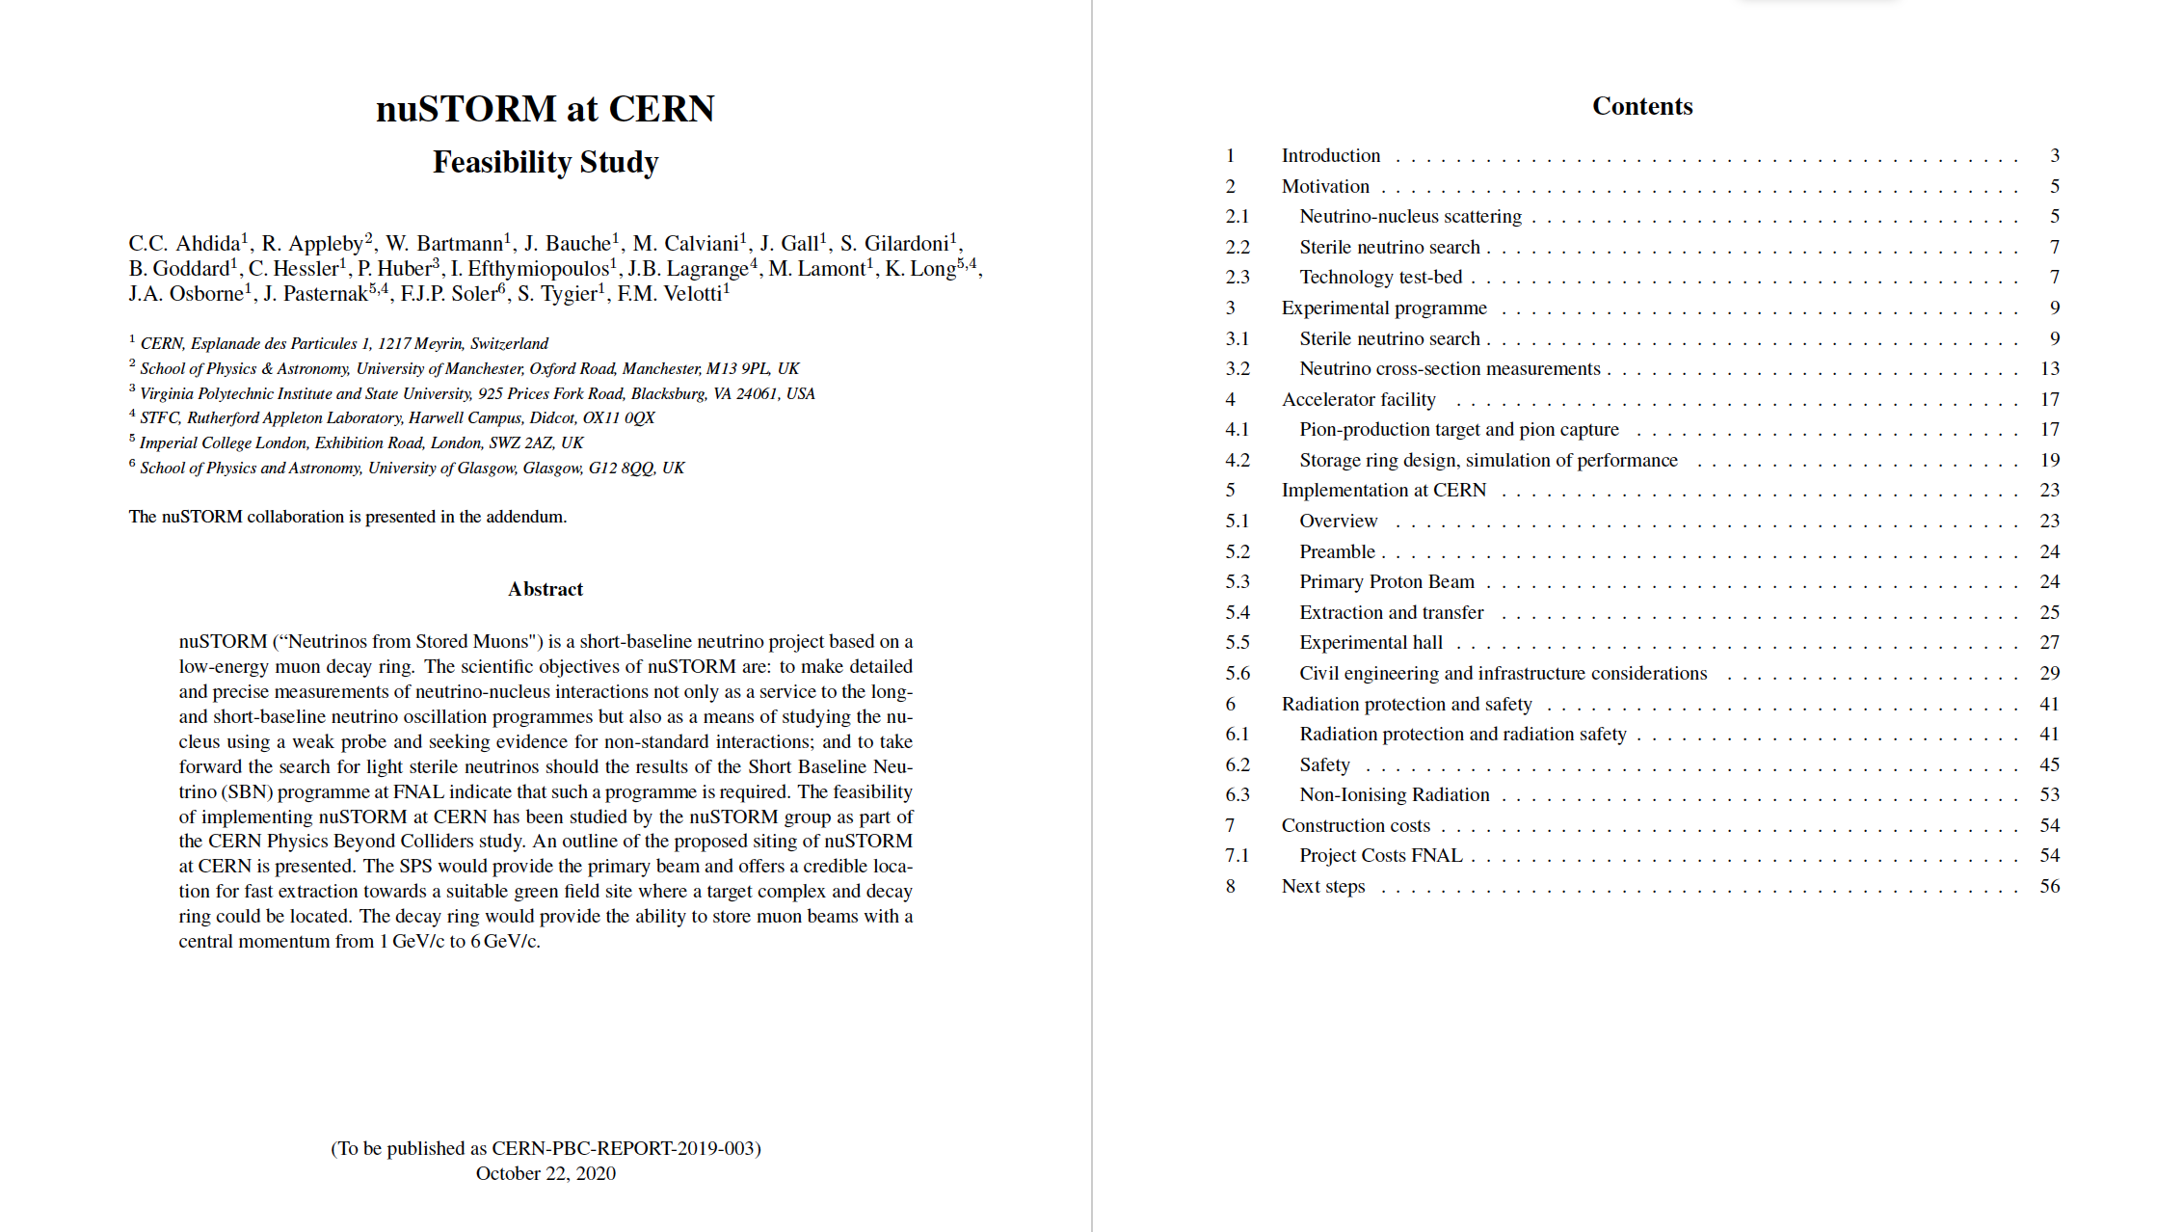
Collaboration list in appendix:
Updated from that in Snowmass submission

Slide 6
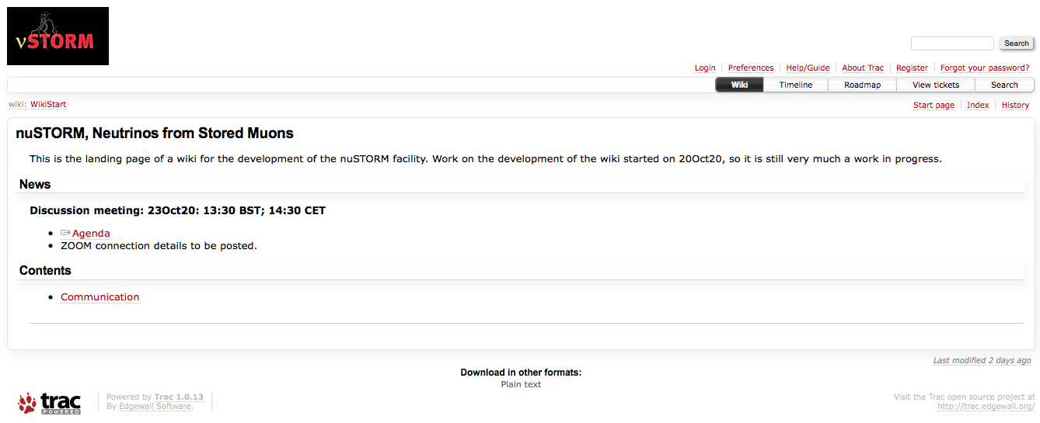
https://www.nustorm.org/trac/

Slide 7
This meeting to discuss how to move forward
Threads (pillars):
  Physics (Silvia Pascoli):
    Cross section
    BSM:
      Sterile, but more broadly
  Detectors (Neil McCauley, Steve Boyd, Jonathan Link):
    Cross section and BSM
      Common requirement: exclusive final state detection
  Accelerator (Jaroslaw Pasternak, Chris Rogers, Jonathan Gall):
    nuSTORM from SPS to beam dump
    Muon collider test bed and technology demonstrator

Slide 8
This meeting to discuss how to move forward
Issues to address:
  How to organise ourselves
  How to engage with international Muon Collider collab
  How to engage with Snowmass
  (For UK) requirement to engage with PPAP roadmap
And:
  How to initiate search for resources

Slide 9
