Slide 1


Beyond the Standard Model; Steriles and Other Effects
Jonathan Link
nuSTORM Meeting
August 18, 2020

Slide 2
Beyond Standard Model Physics at nuSTORM
A comprehensive look at possible Beyond Standard Model (BSM) physics searches at nuSTORM would be an excellent contribution to this meeting, but I am not the one to provide it.
Neutrino BSM topics of which I have a passing awareness include:
Given nuSTORM’s diverse beam offerings, I feel confident that it will offer many good ways to search for these and other BSM effects.
As far as I know, no experiment has been funded with the primary goal of searching for one or multiple of these effects (with one obvious exception)
Sterile neutrinos are the exception that proves the rule, and on this topic I do feel qualifies to speak.
For future meetings we should really try to get a proper theorist to talk about other BSM scenarios at nuSTORM.
Lorentz and CPT Violation | Nonstandard Interactions (NSI)
Generalized Operators (SPVAT) | Light Z’
Sterile Neutrinos

Slide 3
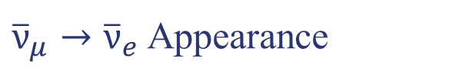
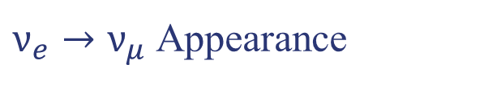

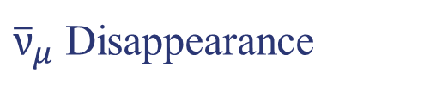
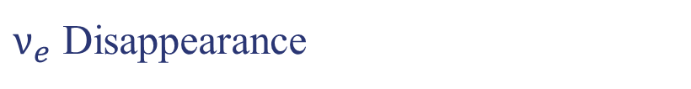
The Many Sterile Channels of nuStorm
For each neutrino type there are both appearance and disappearance channels.
There is also the total neutral current disappearance channel.
This gives a total of 5 channels for sterile neutrino hunters (7 if you count appearance modes for both neutrinos and antineutrinos)
Ranked by experimental accessibility
Not much has changed since our Geneva meeting last fall, but there are some new results.
1.. Frist
2.. Second
3.. Third
4.. Fourth
5.. Fifth
$ν_{e}→ν_{μ}$ Appearance
Golden Mode
${\overline{ν}}_{μ}$ Disappearance
Looking for a tiny spectral distortion in ${\overline{ν}}_{μ} CC$
$ν_{e}$ Disappearance
${\overline{ν}}_{μ}→{\overline{ν}}_{e}$ Appearance
Not a discovery channel
Total NC Disappearance

Slide 4
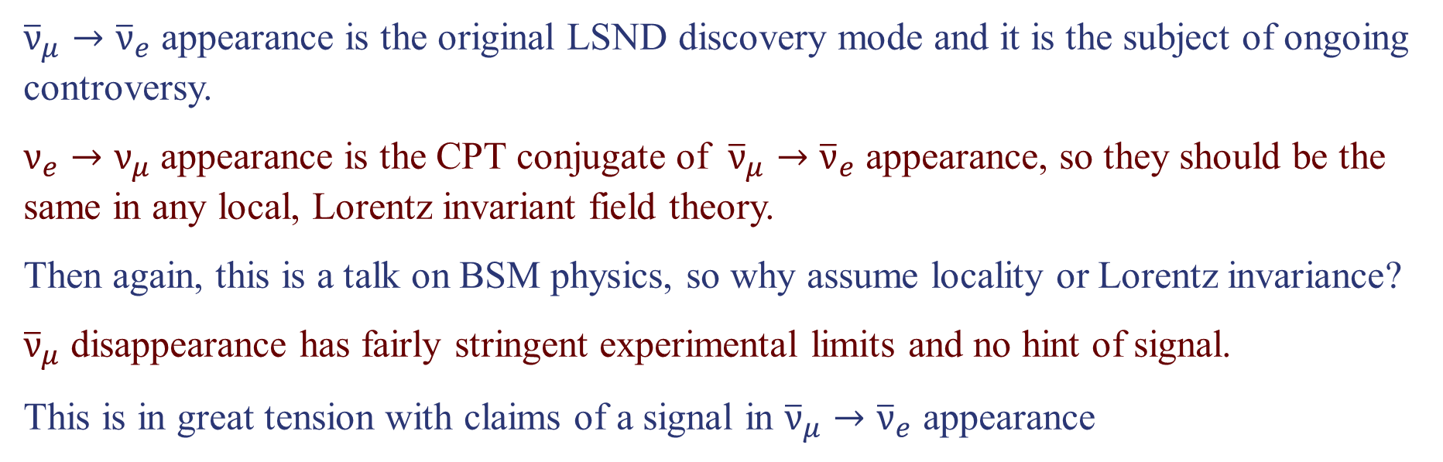
What’s Still Interesting with Sterile Neutrinos
${\overline{ν}}_{μ}→{\overline{ν}}_{e}$ appearance is the original LSND discovery mode and it is the subject of ongoing controversy.
$ν_{e}→ν_{μ}$ appearance is the CPT conjugate of ${\overline{ν}}_{μ}→{\overline{ν}}_{e}$ appearance, so they should be the same in any local, Lorentz invariant field theory.
Then again, this is a talk on BSM physics, so why assume locality or Lorentz invariance?
${\overline{ν}}_{μ}$ disappearance has fairly stringent experimental limits and no hint of signal.
This is in great tension with claims of a signal in ${\overline{ν}}_{μ}→{\overline{ν}}_{e}$ appearance

Slide 5
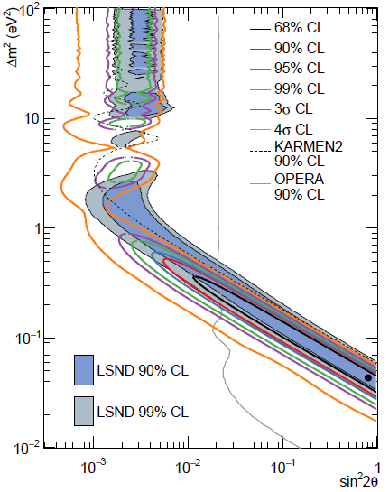
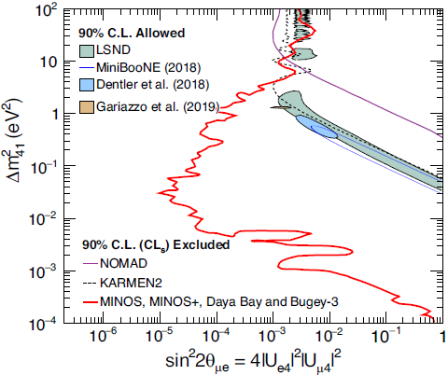
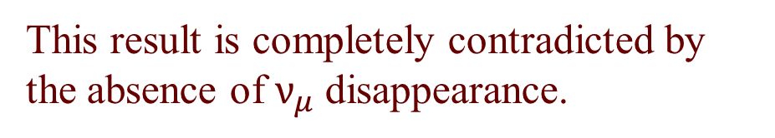
Updated MiniBooNE Results on $ν_{μ}→ν_{e}$
In their Neutrino 2020 update, MiniBooNE claims a closed contour at 4σ.
This result is completely contradicted by the absence of $ν_{μ}$ disappearance.
arXiv:2006.16883
PRL 125, 071801 (2020)

Slide 6
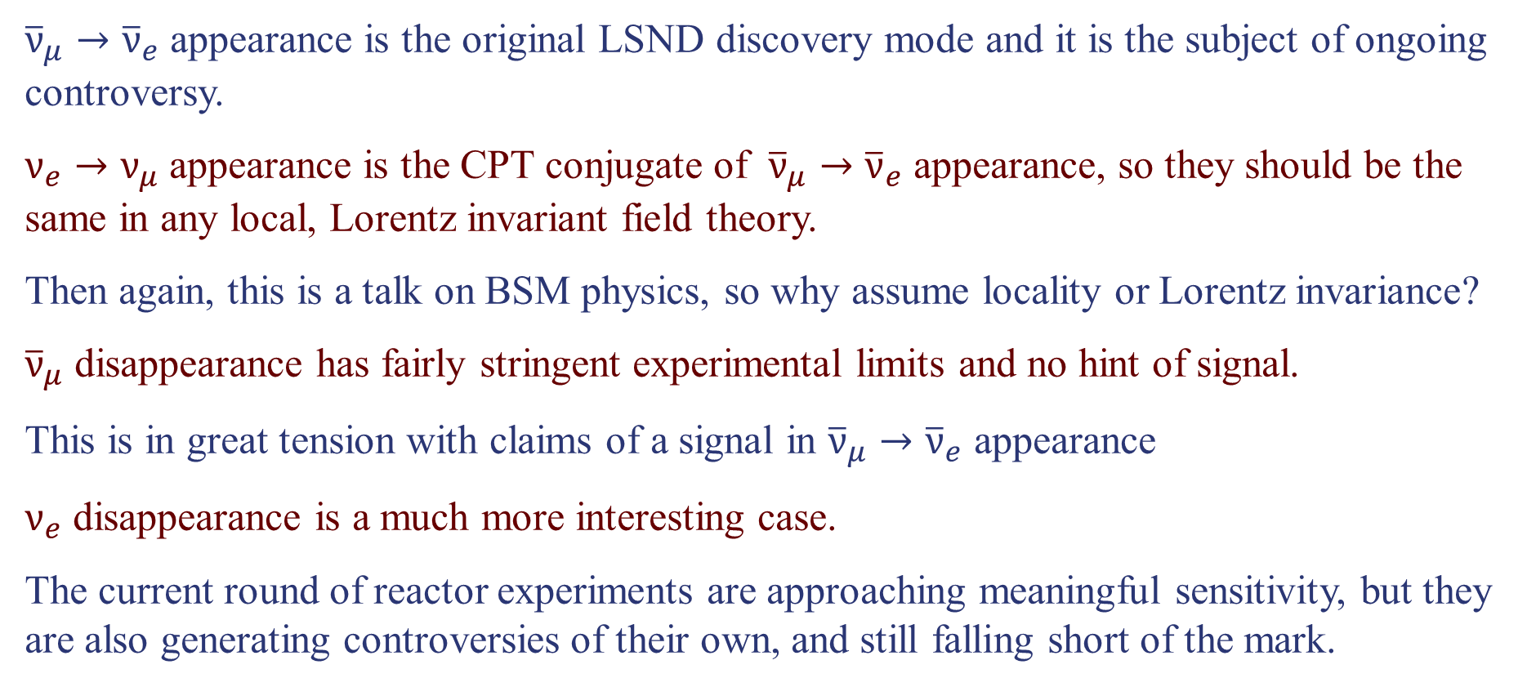
What’s Still Interesting with Sterile Neutrinos
${\overline{ν}}_{μ}→{\overline{ν}}_{e}$ appearance is the original LSND discovery mode and it is the subject of ongoing controversy.
$ν_{e}→ν_{μ}$ appearance is the CPT conjugate of ${\overline{ν}}_{μ}→{\overline{ν}}_{e}$ appearance, so they should be the same in any local, Lorentz invariant field theory.
Then again, this is a talk on BSM physics, so why assume locality or Lorentz invariance?
${\overline{ν}}_{μ}$ disappearance has fairly stringent experimental limits and no hint of signal.
This is in great tension with claims of a signal in ${\overline{ν}}_{μ}→{\overline{ν}}_{e}$ appearance
$ν_{e}$ disappearance is a much more interesting case.
The current round of reactor experiments are approaching meaningful sensitivity, but they are also generating controversies of their own, and still falling short of the mark.

Slide 7
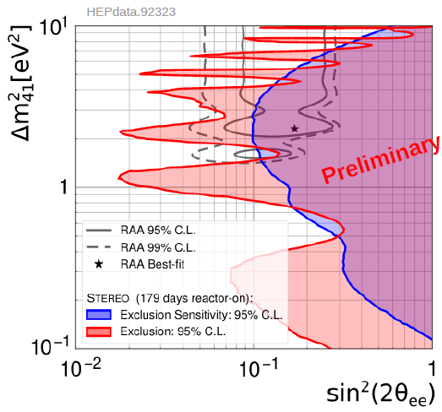
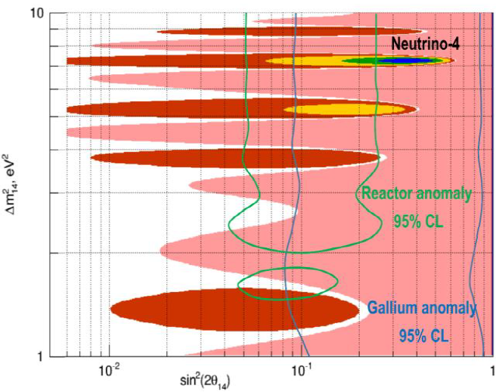
Many Reactor Experiments Looking for ${\overline{ν}}_{e}$ Disappearance
Frankly, reactors should be a better than nuSTORM at this.
Active experiments include: DANSS, Neutrino-4, NEOS, STEREO, Prospect and SoLid
They should be better, but if history is any guide they might not be.
3.5σ

Slide 8
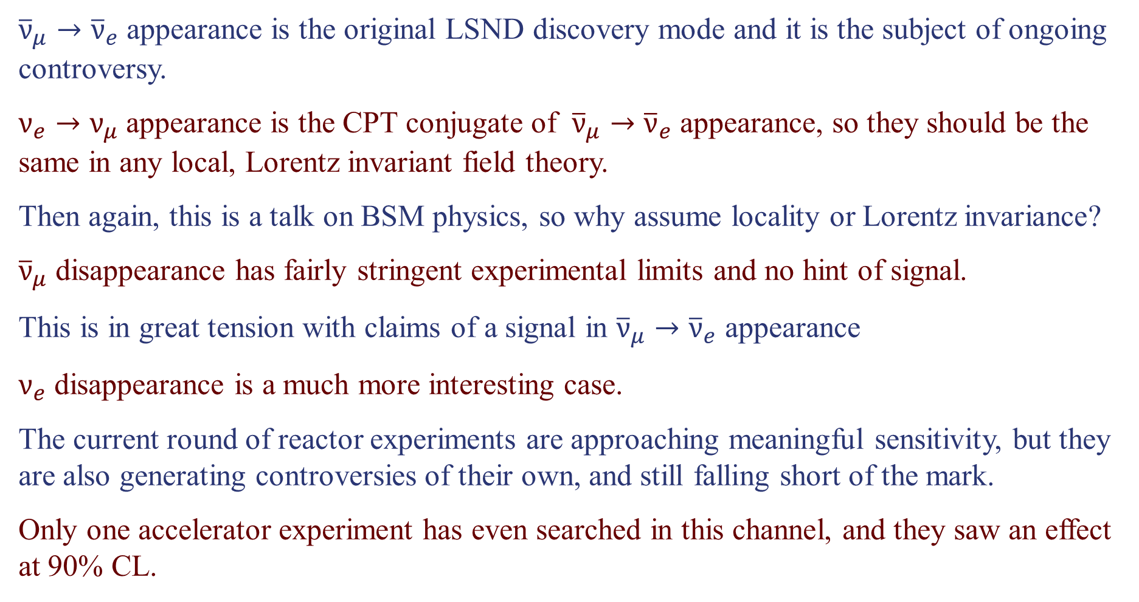
What’s Still Interesting with Sterile Neutrinos
${\overline{ν}}_{μ}→{\overline{ν}}_{e}$ appearance is the original LSND discovery mode and it is the subject of ongoing controversy.
$ν_{e}→ν_{μ}$ appearance is the CPT conjugate of ${\overline{ν}}_{μ}→{\overline{ν}}_{e}$ appearance, so they should be the same in any local, Lorentz invariant field theory.
Then again, this is a talk on BSM physics, so why assume locality or Lorentz invariance?
${\overline{ν}}_{μ}$ disappearance has fairly stringent experimental limits and no hint of signal.
This is in great tension with claims of a signal in ${\overline{ν}}_{μ}→{\overline{ν}}_{e}$ appearance
$ν_{e}$ disappearance is a much more interesting case.
The current round of reactor experiments are approaching meaningful sensitivity, but they are also generating controversies of their own, and still falling short of the mark.
Only one accelerator experiment has even searched in this channel, and they saw an effect at 90% CL.

Slide 9
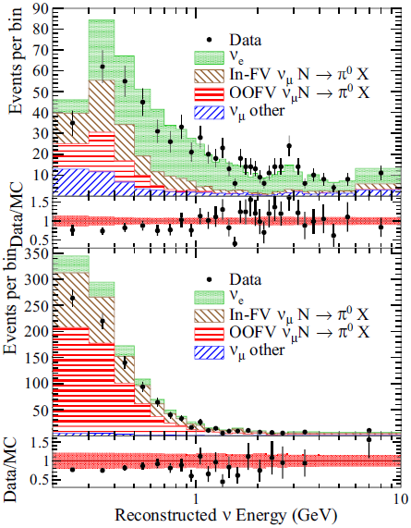
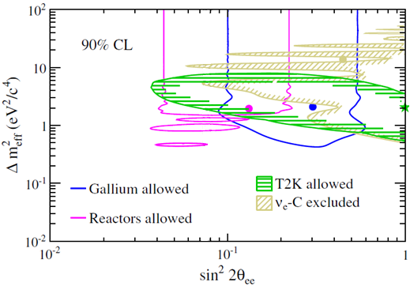

T2K Near Detector: $ν_{e}$ Disappearance
Although the T2K beam is predominantly a $ν_{μ}$ beam, the small $ν_{e}$ component can be used in the near detector for a $ν_{e}$ disappearance search.
ν_{e} Selection
Phys.Rev. D91, 051102(R) (2015)
Control

Slide 10
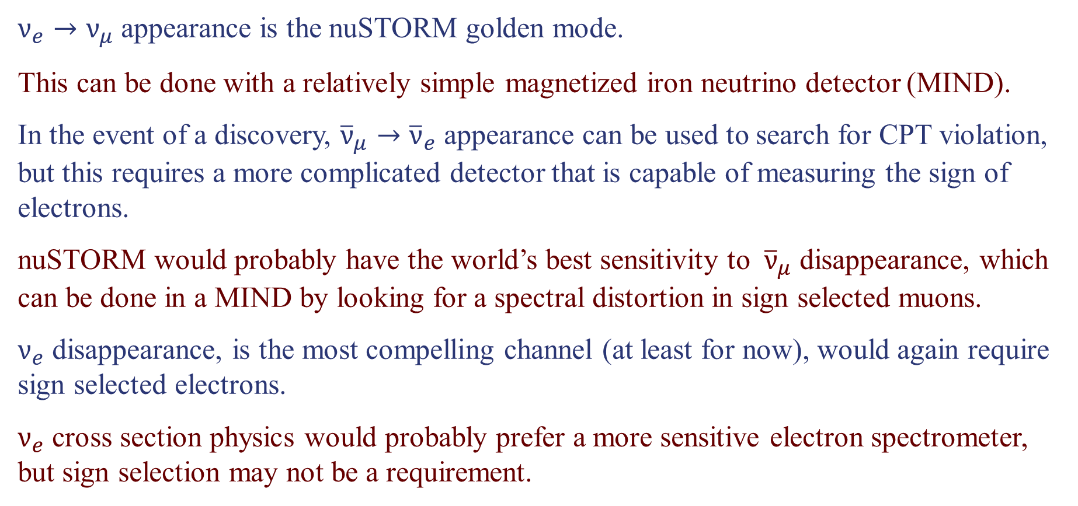
How Can nuSTORM Compete?
$ν_{e}→ν_{μ}$ appearance is the nuSTORM golden mode.
This can be done with a relatively simple magnetized iron neutrino detector (MIND).
In the event of a discovery, ${\overline{ν}}_{μ}→{\overline{ν}}_{e}$ appearance can be used to search for CPT violation, but this requires a more complicated detector that is capable of measuring the sign of electrons.
nuSTORM would probably have the world’s best sensitivity to ${\overline{ν}}_{μ}$ disappearance, which can be done in a MIND by looking for a spectral distortion in sign selected muons.
$ν_{e}$ disappearance, is the most compelling channel (at least for now), would again require sign selected electrons.
$ν_{e}$ cross section physics would probably prefer a more sensitive electron spectrometer, but sign selection may not be a requirement.

Slide 12



Relating Appearance and Disappearance Probabilities
With a single sterile neutrino we get a 4×4 PMNS mixing matrix and 3 independent Δm²s.
ν₄
U_{e4}²
U_{μ4}²
U_{τ4}²
U_{s4}²
The appearance probability:
Sterile
Δm₄₃²
P_{μe} =
sin²2θ
sin²(1.27Δm₄₁²L/E)
4U_{e4}² U_{μ4}²
The $ν_{e}$ disappearance probability:
ν₃
P_{ee} = P_{es} + P_{eμ} + P_{eτ}
P_{ee} ≈ P_{es}
= 4U_{e4}² U_{s4}² sin²(1.27Δm₄₁²L/E)
Atmospheric
The $ν_{μ}$ disappearance probability:
Δm₃₂²
ν₂
ν₁
Solar
P_{μμ} ≈ 4U_{μ4}² U_{s4}² sin²(1.27Δm₄₁²L/E)
Δm₂₁²
Notes:
Because P(mu, e) depends on both U(e,4) and U(mu,4), you can have nu_e disappearance without nu_e appearance, but you can’t have nu_e appearance without nu_mu disappearance.

Slide 13
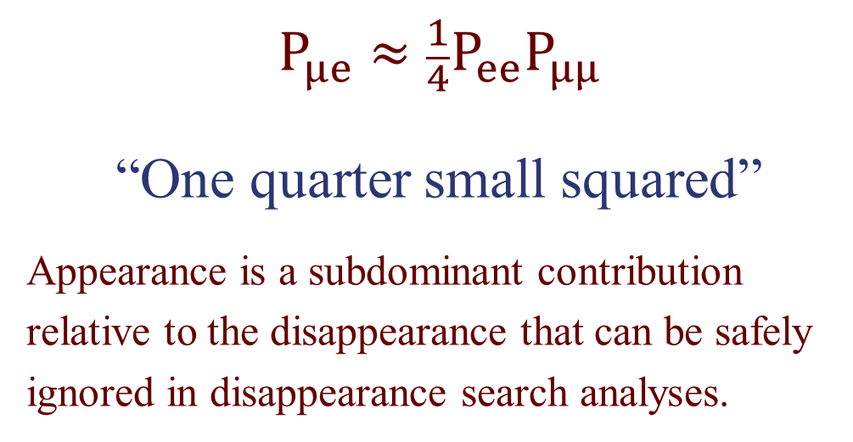
Relating Appearance and Disappearance Probabilities
With a single sterile neutrino we get a 4×4 PMNS mixing matrix and 3 independent Δm²s.
ν₄
U_{e4}²
U_{μ4}²
U_{τ4}²
U_{s4}²
$$P_{μe}≈\frac{1}{4}P_{ee}P_{μμ}$$
“One quarter small squared”
Appearance is a subdominant contribution relative to the disappearance that can be safely ignored in disappearance search analyses.
Sterile
Δm₄₃²
ν₃
Atmospheric
Δm₃₂²
ν₂
ν₁
Solar
Δm₂₁²
Notes:
Because P(mu, e) depends on both U(e,4) and U(mu,4), you can have nu_e disappearance without nu_e appearance, but you can’t have nu_e appearance without nu_mu disappearance.

Slide 14
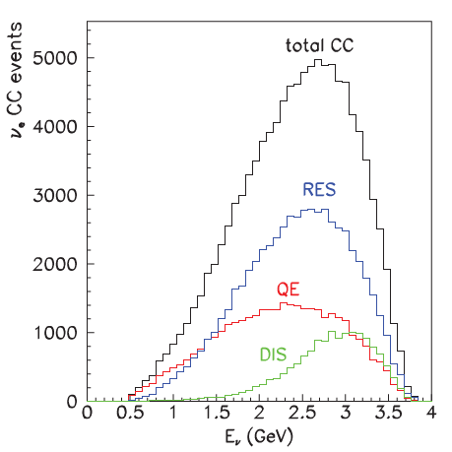
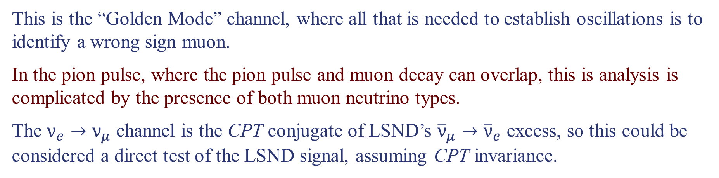

$ν_{e}→ν_{μ}$ Appearance
This is the “Golden Mode” channel, where all that is needed to establish oscillations is to identify a wrong sign muon.
In the pion pulse, where the pion pulse and muon decay can overlap, this is analysis is complicated by the presence of both muon neutrino types.
The $ν_{e}→ν_{μ}$ channel is the CPT conjugate of LSND’s ${\overline{ν}}_{μ}→{\overline{ν}}_{e}$ excess, so this could be considered a direct test of the LSND signal, assuming CPT invariance.
The discovery mode search can be done with a simple magnetized iron detector (like MINOS).
Precision measurement of oscillation parameters requires a full reconstruction of the neutrino’s energy.
This may require a magnetized detector with sensitive to complex event patterns because only about a third of the CC events are quasi-elastic. (Magnetized LAr?)
Only $\frac{1}{3}$ QE

Slide 15
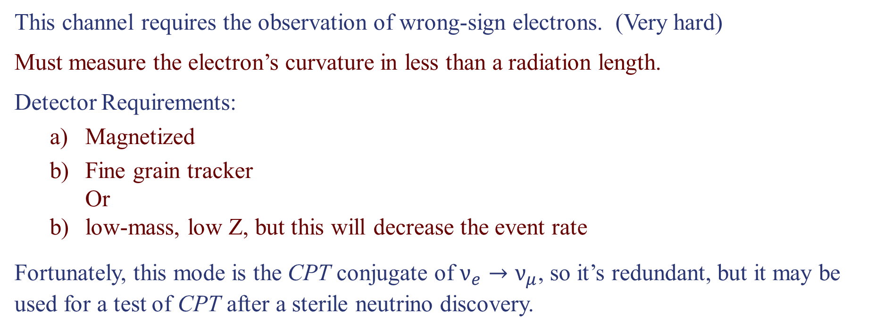
${\overline{ν}}_{μ}→{\overline{ν}}_{e}$ Appearance
This channel requires the observation of wrong-sign electrons. (Very hard)
Must measure the electron’s curvature in less than a radiation length.
Detector Requirements:
  Magnetized
  Fine grain tracker
  Or
  low-mass, low Z, but this will decrease the event rate
Fortunately, this mode is the CPT conjugate of $ν_{e}→ν_{μ}$, so it’s redundant, but it may be used for a test of CPT after a sterile neutrino discovery.

Slide 16
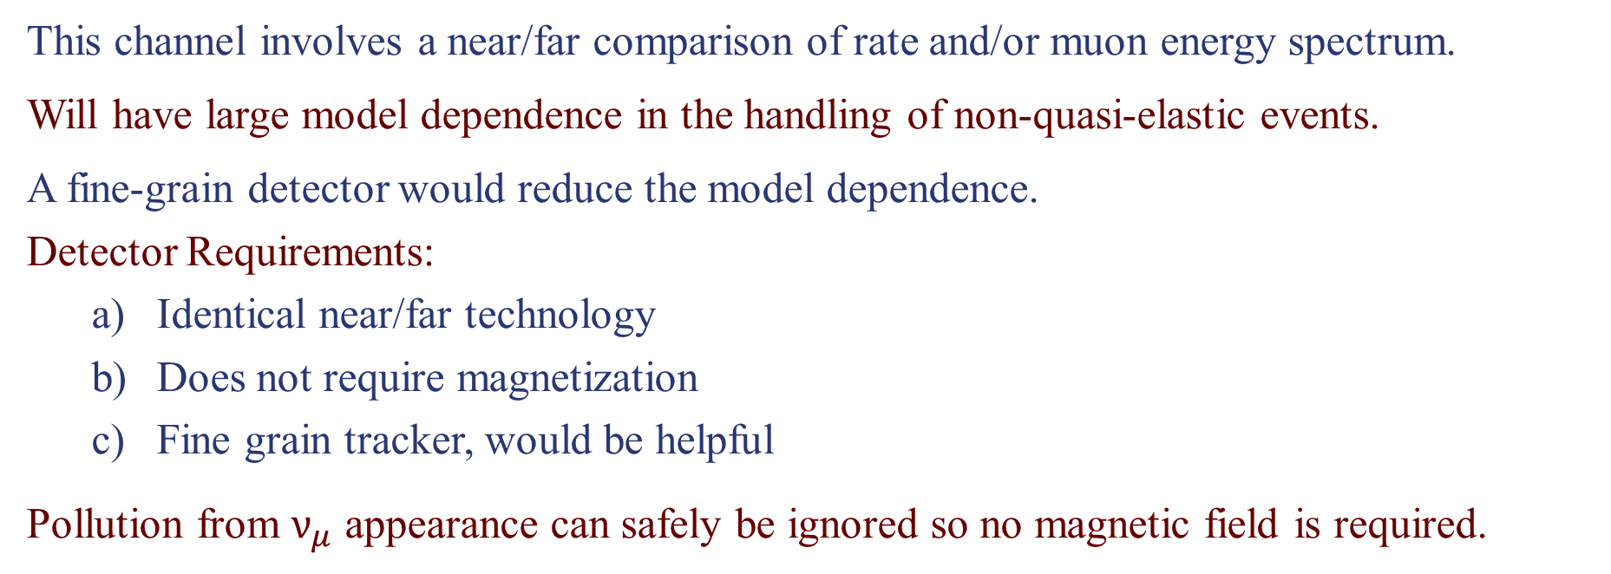
${\overline{ν}}_{μ}$ Disappearance
This channel involves a near/far comparison of rate and/or muon energy spectrum.
Will have large model dependence in the handling of non-quasi-elastic events.
A fine-grain detector would reduce the model dependence.
Detector Requirements:
  Identical near/far technology
  Does not require magnetization
  Fine grain tracker, would be helpful
Pollution from $ν_{μ}$ appearance can safely be ignored so no magnetic field is required.

Slide 17
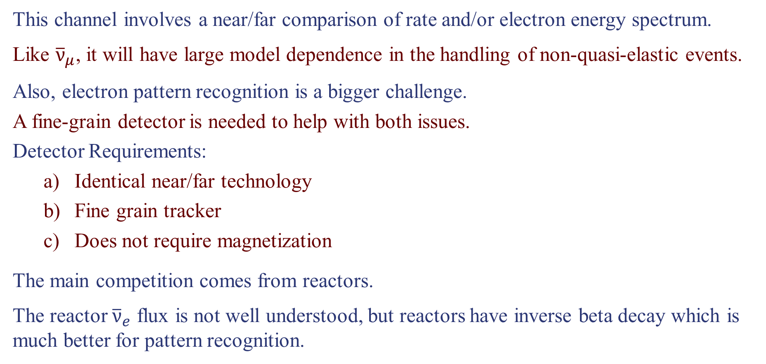
$ν_{e}$ Disappearance
This channel involves a near/far comparison of rate and/or electron energy spectrum.
Like ${\overline{ν}}_{μ}$, it will have large model dependence in the handling of non-quasi-elastic events.
Also, electron pattern recognition is a bigger challenge.
A fine-grain detector is needed to help with both issues.
Detector Requirements:
  Identical near/far technology
  Fine grain tracker
  Does not require magnetization
The main competition comes from reactors.
The reactor ${\overline{ν}}_{e}$ flux is not well understood, but reactors have inverse beta decay which is much better for pattern recognition.

Slide 18
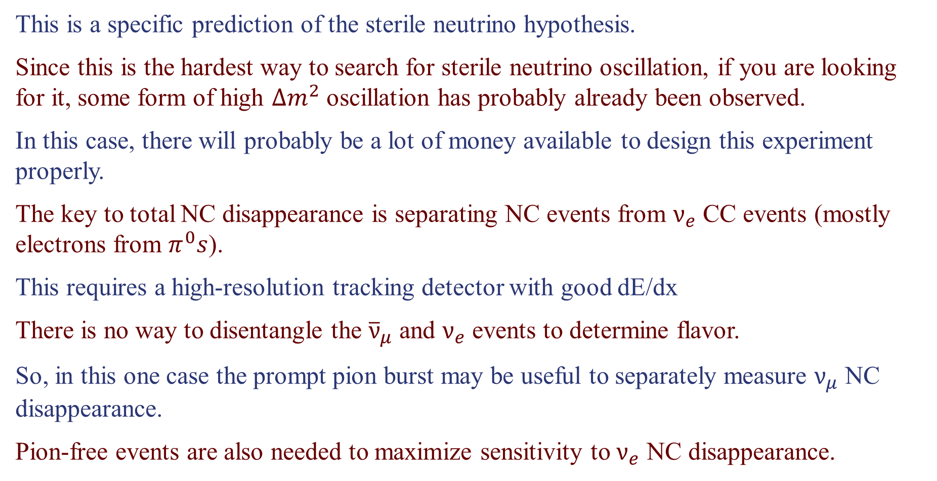
Total Neutral Current Disappearance
This is a specific prediction of the sterile neutrino hypothesis.
Since this is the hardest way to search for sterile neutrino oscillation, if you are looking for it, some form of high $∆m^{2}$ oscillation has probably already been observed.
In this case, there will probably be a lot of money available to design this experiment properly.
The key to total NC disappearance is separating NC events from $ν_{e}$ CC events (mostly electrons from $π^{0}s$).
This requires a high-resolution tracking detector with good dE/dx
There is no way to disentangle the ${\overline{ν}}_{μ}$ and $ν_{e}$ events to determine flavor.
So, in this one case the prompt pion burst may be useful to separately measure $ν_{μ}$ NC disappearance.
Pion-free events are also needed to maximize sensitivity to $ν_{e}$ NC disappearance.

Slide 19
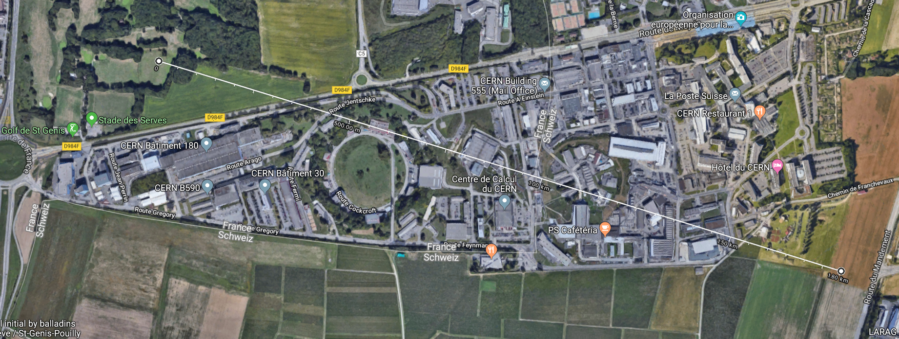
Where Should We be Looking to Site a Far Detector?

