Slide 1


Considerations for Detectors for Sterile Neutrino Detectors at nuStrom
Jonathan Link
nuSTORM - the next steps
October 21, 2019

Slide 2
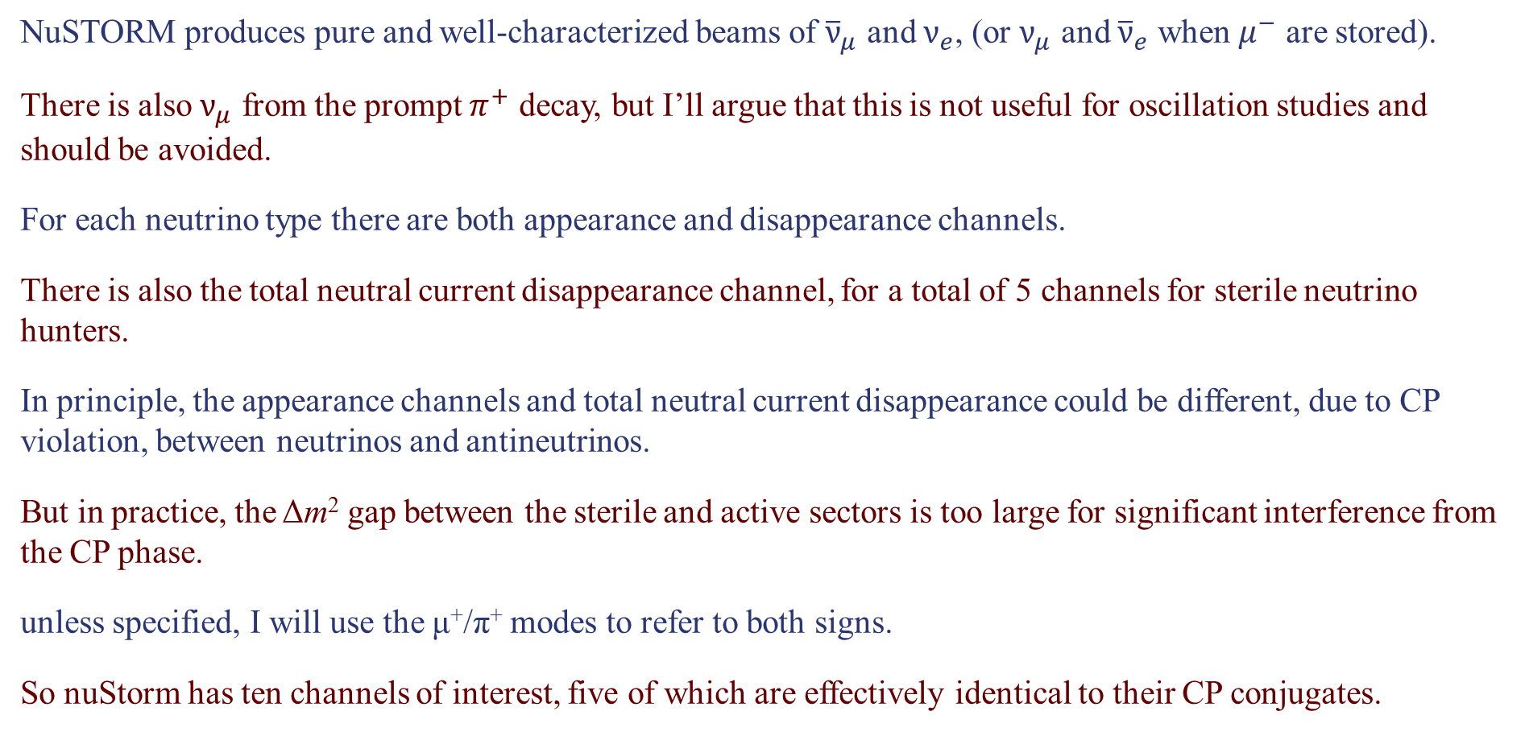
The Many Sterile Channels of nuStorm
NuSTORM produces pure and well-characterized beams of ${\overline{ν}}_{μ}$ and $ν_{e}$, (or $ν_{μ}$ and ${\overline{ν}}_{e}$ when $μ^{−}$ are stored).
There is also $ν_{μ}$ from the prompt $π^{+}$ decay, but I’ll argue that this is not useful for oscillation studies and should be avoided.
For each neutrino type there are both appearance and disappearance channels.
There is also the total neutral current disappearance channel, for a total of 5 channels for sterile neutrino hunters.
In principle, the appearance channels and total neutral current disappearance could be different, due to CP violation, between neutrinos and antineutrinos.
But in practice, the Δm² gap between the sterile and active sectors is too large for significant interference from the CP phase.
unless specified, I will use the μ⁺/π⁺ modes to refer to both signs.
So nuStorm has ten channels of interest, five of which are effectively identical to their CP conjugates.

Slide 3
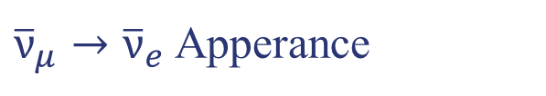
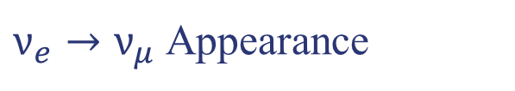

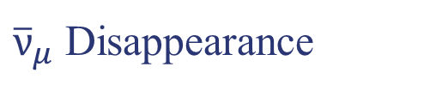
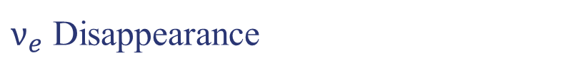
The Many Sterile Channels of nuStorm
Weighted
ranking by experimental accessibility:
R
1.. Frist
2.. Second
3.. Third
4.. Fourth
5.. Fifth
1.
5.
10.
15.
20.
$ν_{e}→ν_{μ}$ Appearance
Golden Mode
${\overline{ν}}_{μ}$ Disappearance
Looking for a tiny spectral distortion in ${\overline{ν}}_{μ} CC$
$ν_{e}$ Disappearance
${\overline{ν}}_{μ}→{\overline{ν}}_{e}$ Apperance
Not a discovery channel
Total NC Disappearance

Slide 4
The Many Sterile Channels of nuStorm
Weighted
ranking by scientific importance:
R
1.
2.
2.
4.
10.
1.. Frist
2.. Second
3.. Third
4.. Fourth
5.. Fifth
$ν_{e}→ν_{μ}$ Appearance
Where the anomaly is least constrained
${\overline{ν}}_{μ}$ Disappearance
Needed to resolve lingering confusion from MiniBooNE and LSND
$ν_{e}$ Disappearance
${\overline{ν}}_{μ}→{\overline{ν}}_{e}$ Apperance
Only important after a discovery
Total NC Disappearance

Slide 5



Relating Appearance and Disappearance Probabilities
With a single sterile neutrino we get a 4×4 PMNS mixing matrix and 3 independent Δm²s.
ν₄
U_{e4}²
U_{μ4}²
U_{τ4}²
U_{s4}²
The appearance probability:
Sterile
Δm₄₃²
P_{μe} =
sin²2θ
sin²(1.27Δm₄₁²L/E)
4U_{e4}² U_{μ4}²
The $ν_{e}$ disappearance probability:
ν₃
P_{ee} = P_{es} + P_{eμ} + P_{eτ}
P_{ee} ≈ P_{es}
= 4U_{e4}² U_{s4}² sin²(1.27Δm₄₁²L/E)
Atmospheric
The $ν_{μ}$ disappearance probability:
Δm₃₂²
ν₂
ν₁
Solar
P_{μμ} ≈ 4U_{μ4}² U_{s4}² sin²(1.27Δm₄₁²L/E)
Δm₂₁²
Notes:
Because P(mu, e) depends on both U(e,4) and U(mu,4), you can have nu_e disappearance without nu_e appearance, but you can’t have nu_e appearance without nu_mu disappearance.

Slide 6
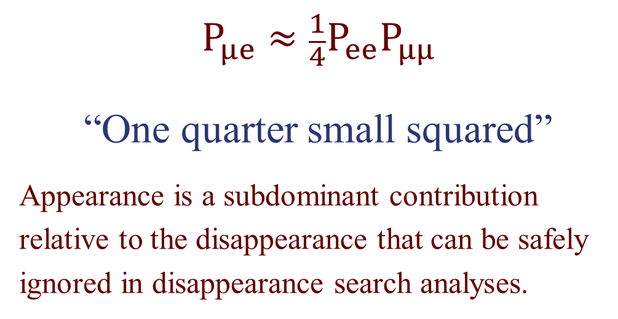
Relating Appearance and Disappearance Probabilities
With a single sterile neutrino we get a 4×4 PMNS mixing matrix and 3 independent Δm²s.
ν₄
U_{e4}²
U_{μ4}²
U_{τ4}²
U_{s4}²
$$P_{μe}≈\frac{1}{4}P_{ee}P_{μμ}$$
“One quarter small squared”
Appearance is a subdominant contribution relative to the disappearance that can be safely ignored in disappearance search analyses.
Sterile
Δm₄₃²
ν₃
Atmospheric
Δm₃₂²
ν₂
ν₁
Solar
Δm₂₁²
Notes:
Because P(mu, e) depends on both U(e,4) and U(mu,4), you can have nu_e disappearance without nu_e appearance, but you can’t have nu_e appearance without nu_mu disappearance.

Slide 7
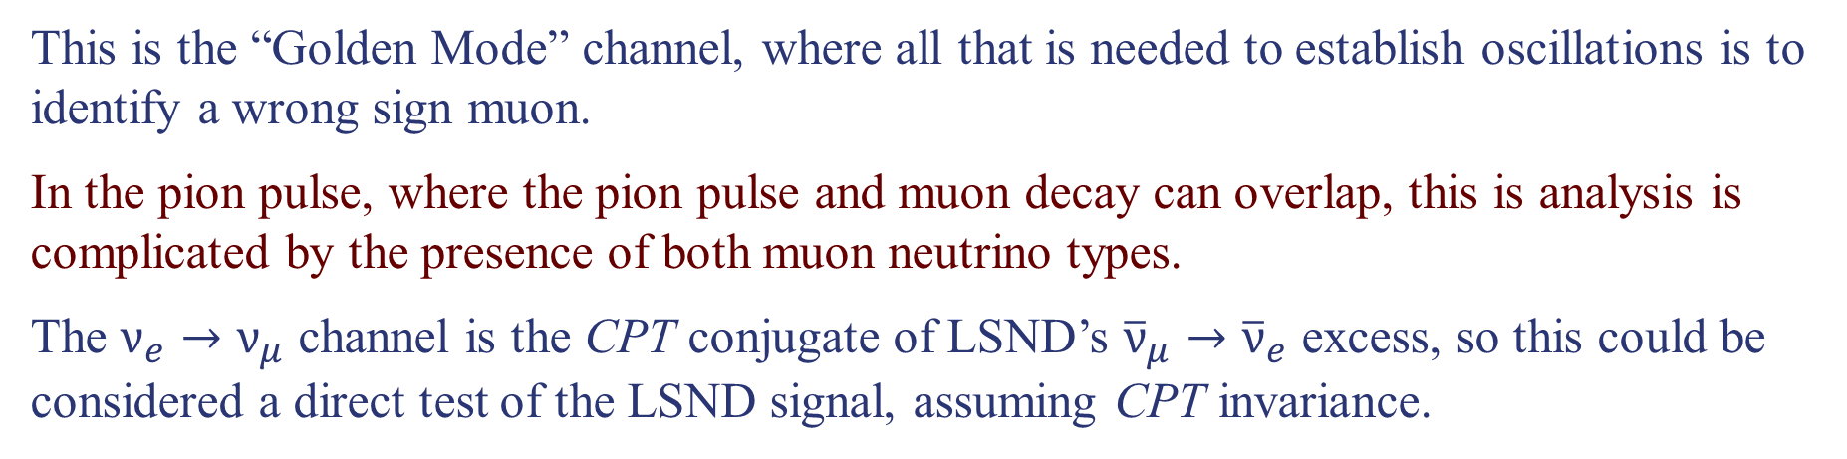
$ν_{e}→ν_{μ}$ Appearance
This is the “Golden Mode” channel, where all that is needed to establish oscillations is to identify a wrong sign muon.
In the pion pulse, where the pion pulse and muon decay can overlap, this is analysis is complicated by the presence of both muon neutrino types.
The $ν_{e}→ν_{μ}$ channel is the CPT conjugate of LSND’s ${\overline{ν}}_{μ}→{\overline{ν}}_{e}$ excess, so this could be considered a direct test of the LSND signal, assuming CPT invariance.
The discovery mode search can be done with a simple magnetized iron detector (like MINOS).

Slide 8
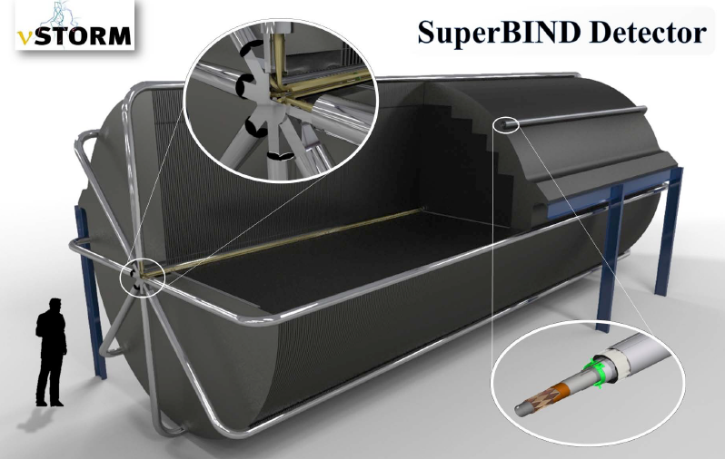
The Super B Iron Neutrino Detector

Slide 9
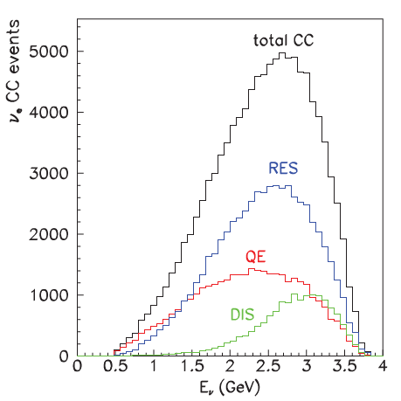

$ν_{e}→ν_{μ}$ Appearance
This is the “Golden Mode” channel, where all that is needed to establish oscillations is to identify a wrong sign muon.
In the pion pulse, where the pion pulse and muon decay can overlap, this is analysis is complicated by the presence of both muon neutrino types.
The $ν_{e}→ν_{μ}$ channel is the CPT conjugate of LSND’s ${\overline{ν}}_{μ}→{\overline{ν}}_{e}$ excess, so this could be considered a direct test of the LSND signal, assuming CPT invariance.
The discovery mode search can be done with a simple magnetized iron detector (like MINOS).
Precision measurement of oscillation parameters requires a full reconstruction of the neutrino’s energy.
This may require a magnetized detector with sensitive to complex event patterns because only about a third of the CC events are quasi-elastic. (Magnetized LAr?)
Only $\frac{1}{3}$ QE

Slide 10
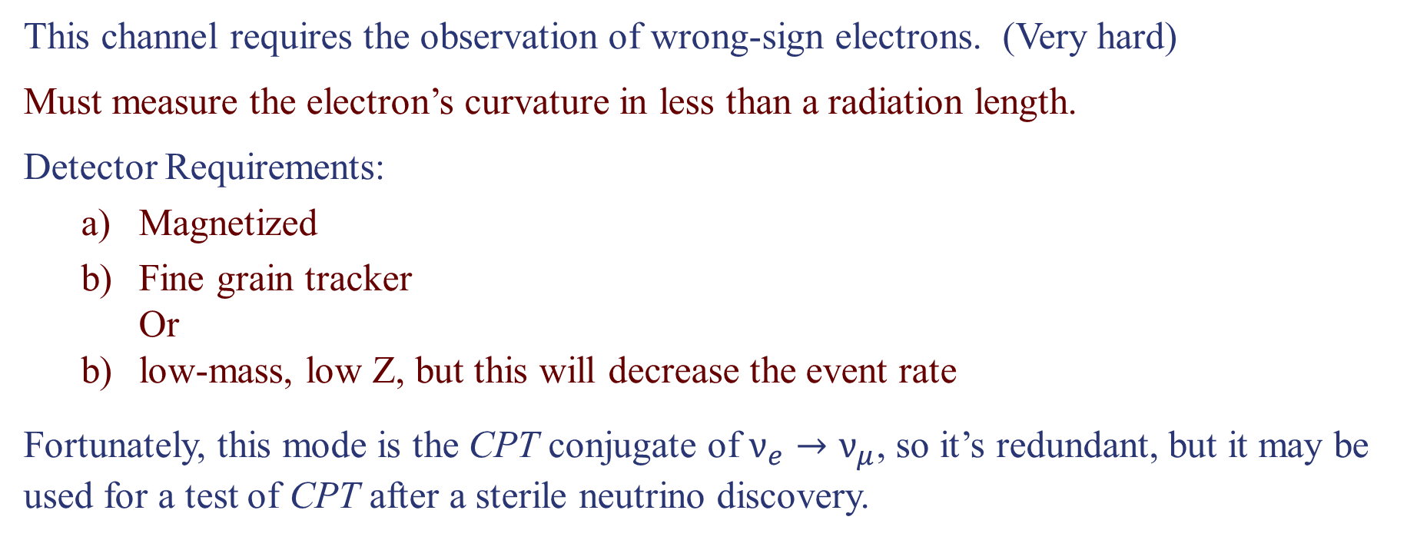
${\overline{ν}}_{μ}→{\overline{ν}}_{e}$ Appearance
This channel requires the observation of wrong-sign electrons. (Very hard)
Must measure the electron’s curvature in less than a radiation length.
Detector Requirements:
  Magnetized
  Fine grain tracker
  Or
  low-mass, low Z, but this will decrease the event rate
Fortunately, this mode is the CPT conjugate of $ν_{e}→ν_{μ}$, so it’s redundant, but it may be used for a test of CPT after a sterile neutrino discovery.

Slide 11
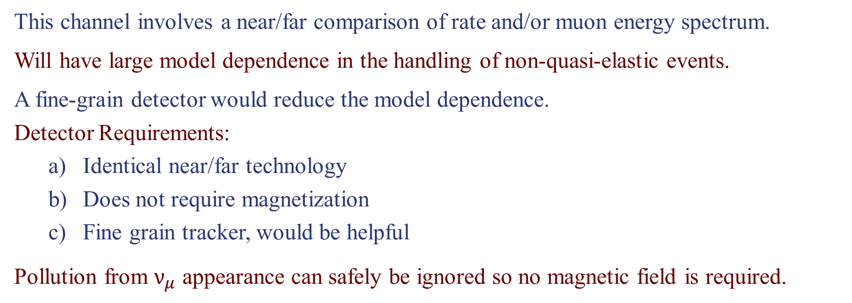
${\overline{ν}}_{μ}$ Disappearance
This channel involves a near/far comparison of rate and/or muon energy spectrum.
Will have large model dependence in the handling of non-quasi-elastic events.
A fine-grain detector would reduce the model dependence.
Detector Requirements:
  Identical near/far technology
  Does not require magnetization
  Fine grain tracker, would be helpful
Pollution from $ν_{μ}$ appearance can safely be ignored so no magnetic field is required.

Slide 12
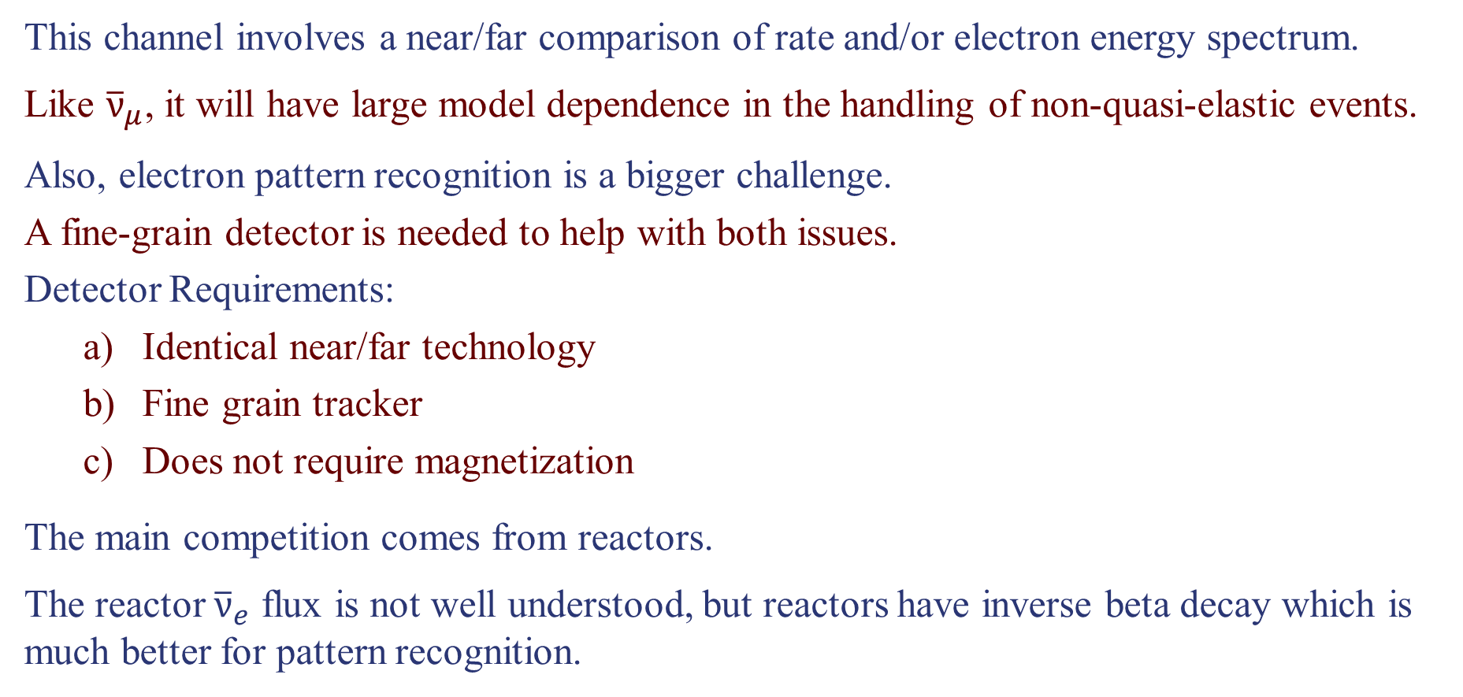
$ν_{e}$ Disappearance
This channel involves a near/far comparison of rate and/or electron energy spectrum.
Like ${\overline{ν}}_{μ}$, it will have large model dependence in the handling of non-quasi-elastic events.
Also, electron pattern recognition is a bigger challenge.
A fine-grain detector is needed to help with both issues.
Detector Requirements:
  Identical near/far technology
  Fine grain tracker
  Does not require magnetization
The main competition comes from reactors.
The reactor ${\overline{ν}}_{e}$ flux is not well understood, but reactors have inverse beta decay which is much better for pattern recognition.

Slide 13
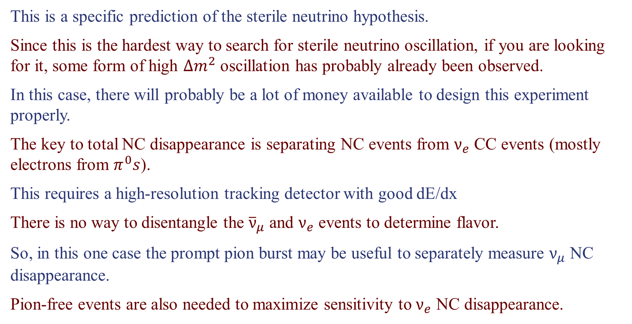
Total Neutral Current Disappearance
This is a specific prediction of the sterile neutrino hypothesis.
Since this is the hardest way to search for sterile neutrino oscillation, if you are looking for it, some form of high $∆m^{2}$ oscillation has probably already been observed.
In this case, there will probably be a lot of money available to design this experiment properly.
The key to total NC disappearance is separating NC events from $ν_{e}$ CC events (mostly electrons from $π^{0}s$).
This requires a high-resolution tracking detector with good dE/dx
There is no way to disentangle the ${\overline{ν}}_{μ}$ and $ν_{e}$ events to determine flavor.
So, in this one case the prompt pion burst may be useful to separately measure $ν_{μ}$ NC disappearance.
Pion-free events are also needed to maximize sensitivity to $ν_{e}$ NC disappearance.

Slide 14
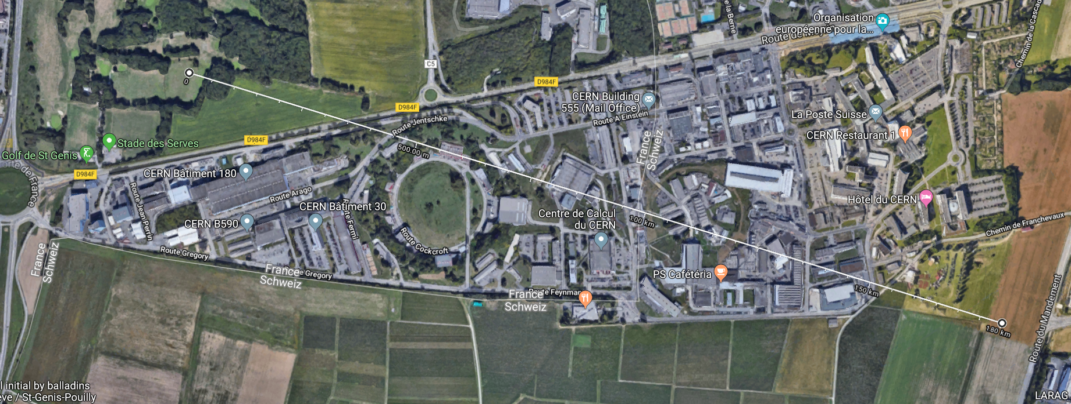
Where Should We be Looking to Site a Far Detector?

Slide 15
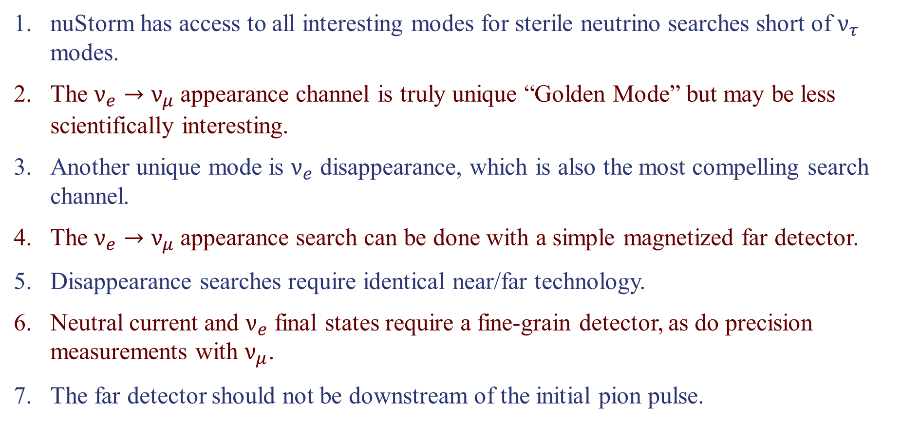
Conclusions
nuStorm has access to all interesting modes for sterile neutrino searches short of $ν_{τ}$ modes.
The $ν_{e}→ν_{μ}$ appearance channel is truly unique “Golden Mode” but may be less scientifically interesting.
Another unique mode is $ν_{e}$ disappearance, which is also the most compelling search channel.
The $ν_{e}→ν_{μ}$ appearance search can be done with a simple magnetized far detector.
Disappearance searches require identical near/far technology.
Neutral current and $ν_{e}$ final states require a fine-grain detector, as do precision measurements with $ν_{μ}$.
The far detector should not be downstream of the initial pion pulse.

