Slide 1
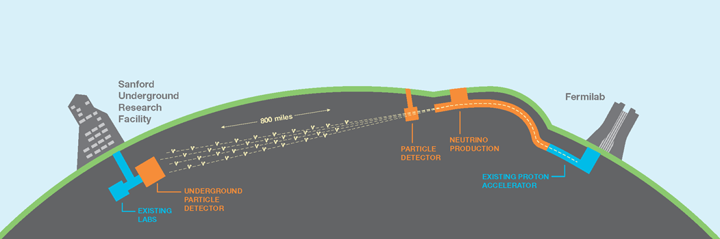
The DUNE Near Detector
Albert De Roeck
CERN
NuStorm Meeting : CERN 21/10/2019

Slide 2

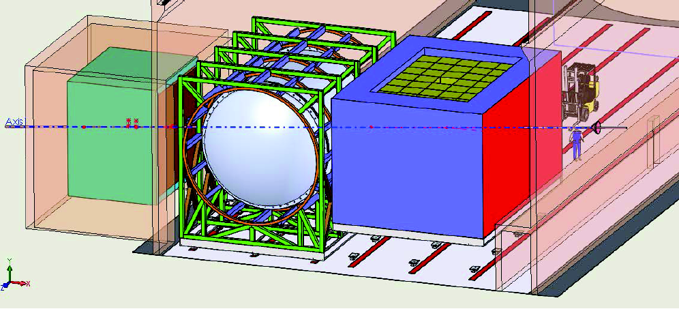
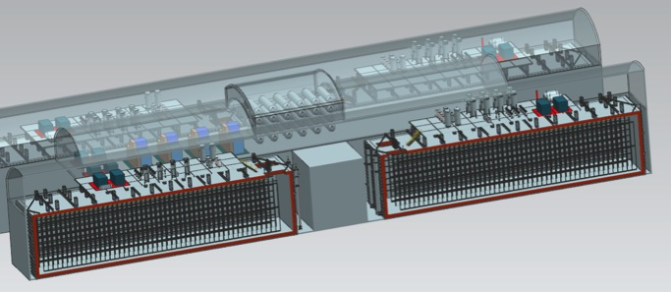
General Setup
Input used from A Bross,
D. Sgalaberna, K. Macfarland
LBNF/DUNE will consist of
  An intense 1.2 MW upgradeable 𝜈-beam fired from Fermilab
  A massive 68 kt (40kt instrumented) deep underground LAr detector in South Dakota and a large Near Detector at Fermilab
  A large international collaboration
1300 km
South Dakota
Chicago
ν_{μ} & ν_{e}
ν_{μ}
FD
ND

Slide 3
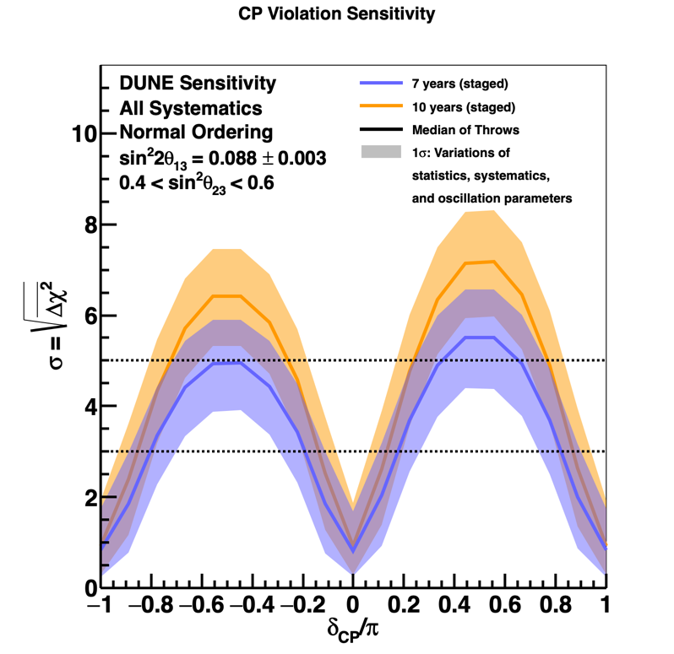
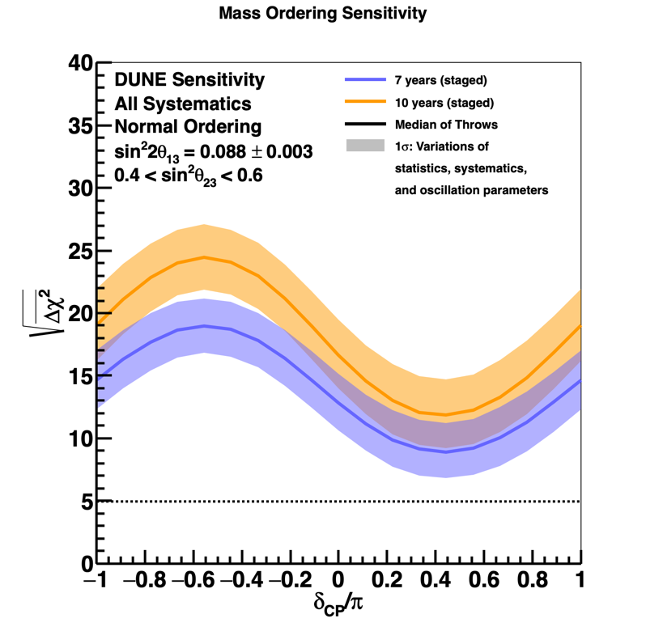
CP Violation and Mass Ordering
CPv sensitivity
Mass ordering sensitivity
Updated Sensitivity with realistic systematics and reconstruction
  Move quickly to potential CP violation discovery
  Rapid, definitive mass ordering determination (>5𝜎)
New Physics TDR
results

Slide 4
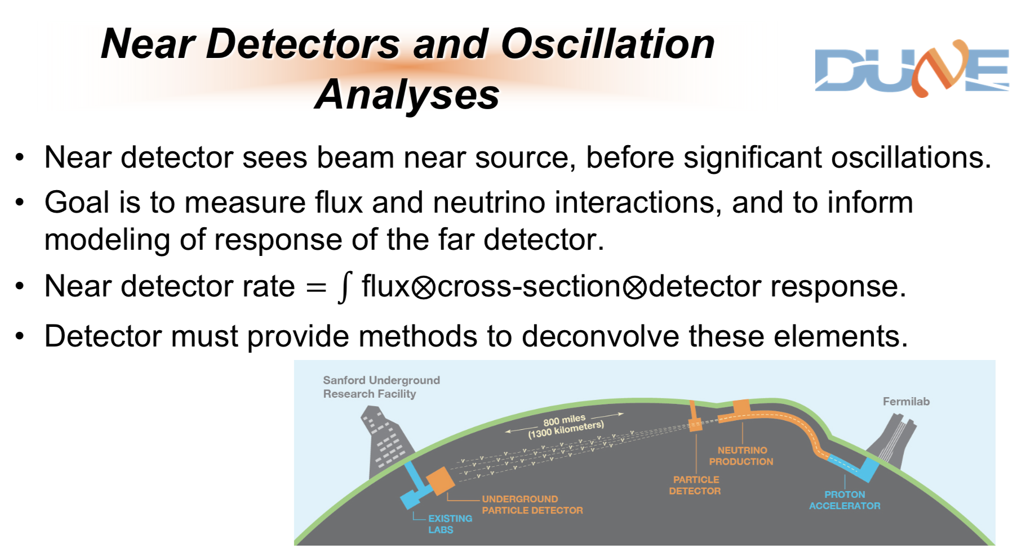

Slide 5
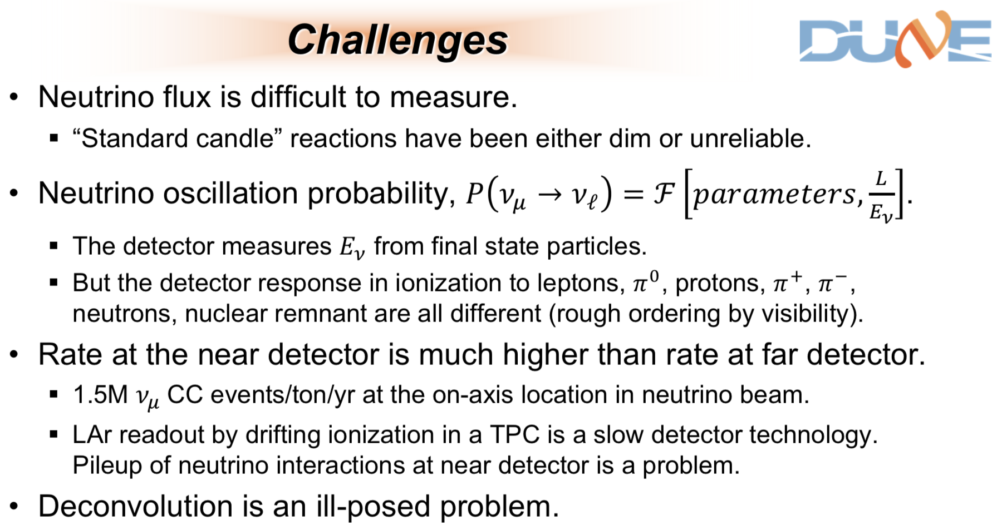

Slide 6
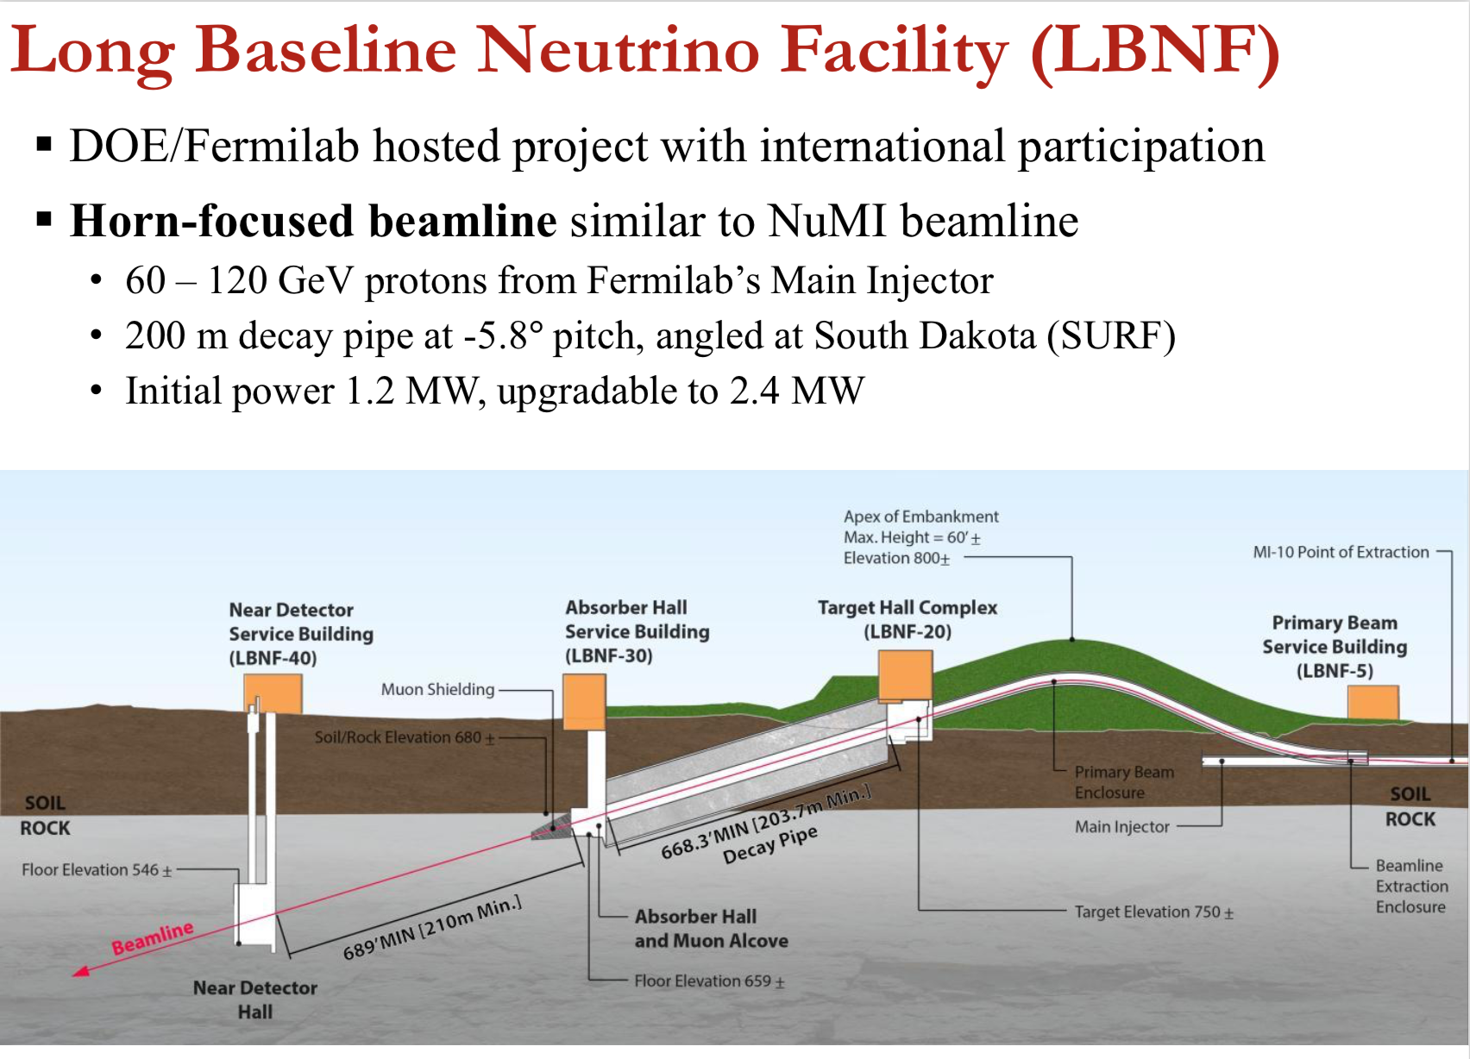

Slide 7
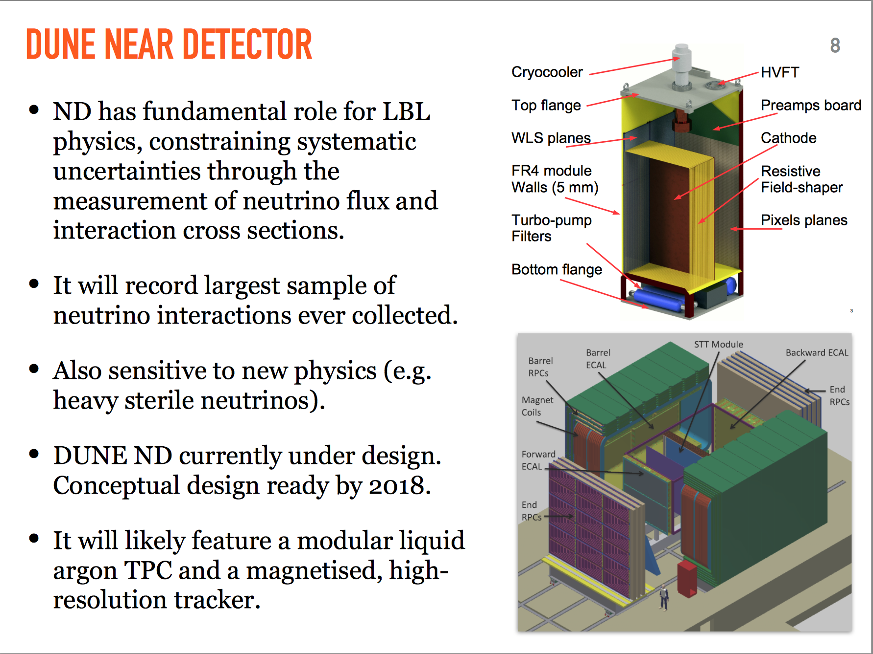
Year 2017!!!
DUNE Near Detector
The ND has a fundamental role for LBL physics, constraining the systematic uncertainties via measurements of the neutrino flux and interaction cross sections
It will record the largest sample of neutrino argon interactions ever collected allowing for precision measurements (EWK, QCD)
Sensitive to new physics (eg Heavy Neutral Leptons/Sterile neutrinos, light dark matter…)
DUNE ND is currently under design. Conceptual design planned to be for 2018
It will likely include a modular liquid
argon TPC and a magnetised high resolution tracker, ECAL and muon system (hybrid system)

Slide 8
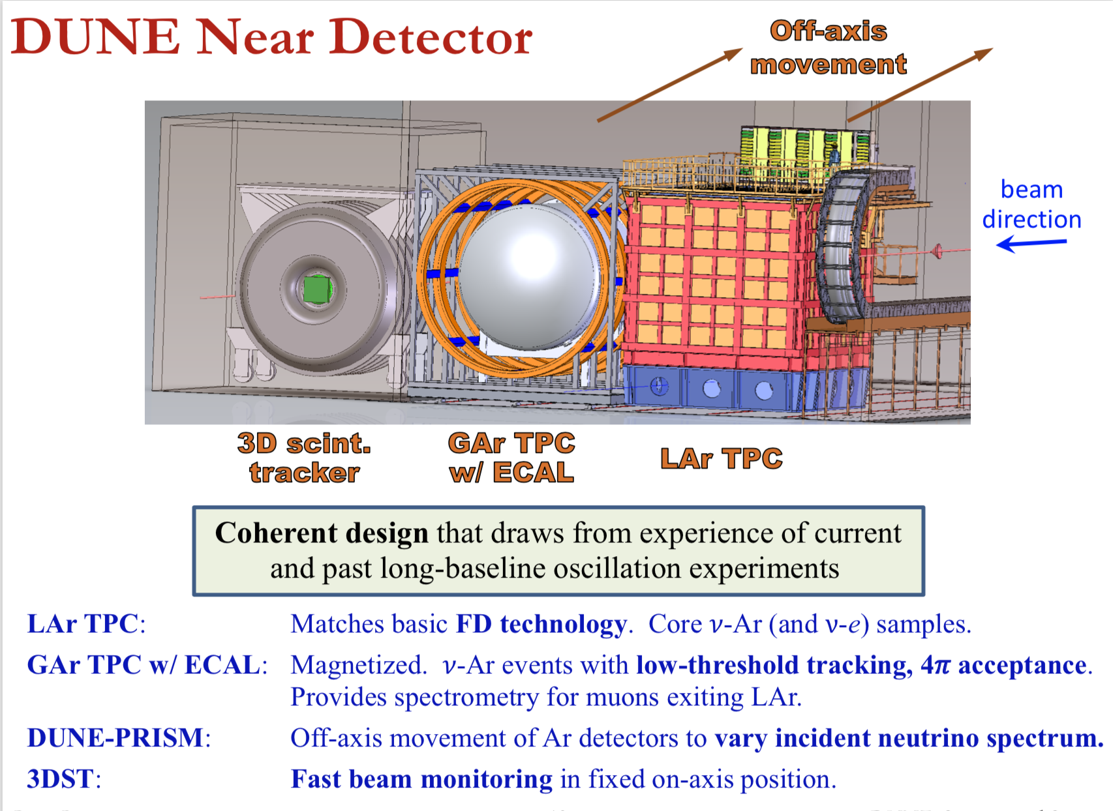
Year 2017!!!
(+Neutrons, other targets)

Slide 9
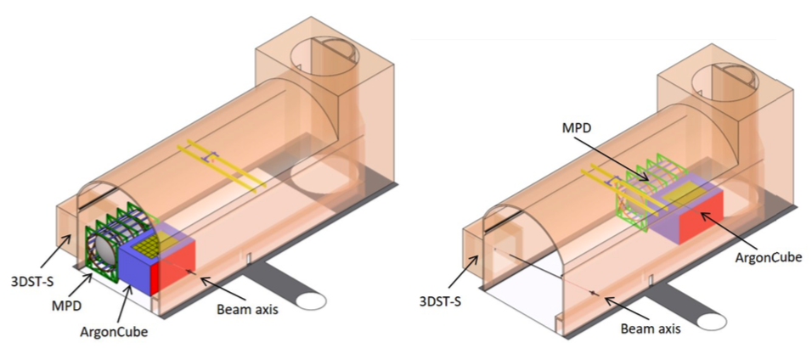
Near Detector Complex
Four main components, working together:
  Liquid argon detector (ArgonCube)
  Downstream tracker with gaseous argon target
  (MPD)
  LAr and GAr systems can move to off-axis fluxes
  (DUNE PRISM)
  On-axis flux monitor with neutron detection capability (3DST-S)
High statistics constrains
  Cross section & Flux

Slide 10
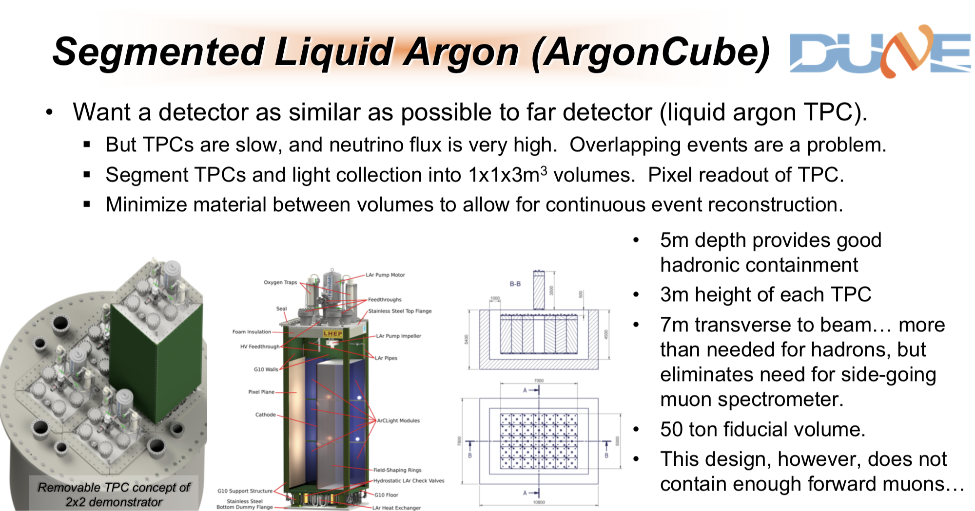


Slide 11
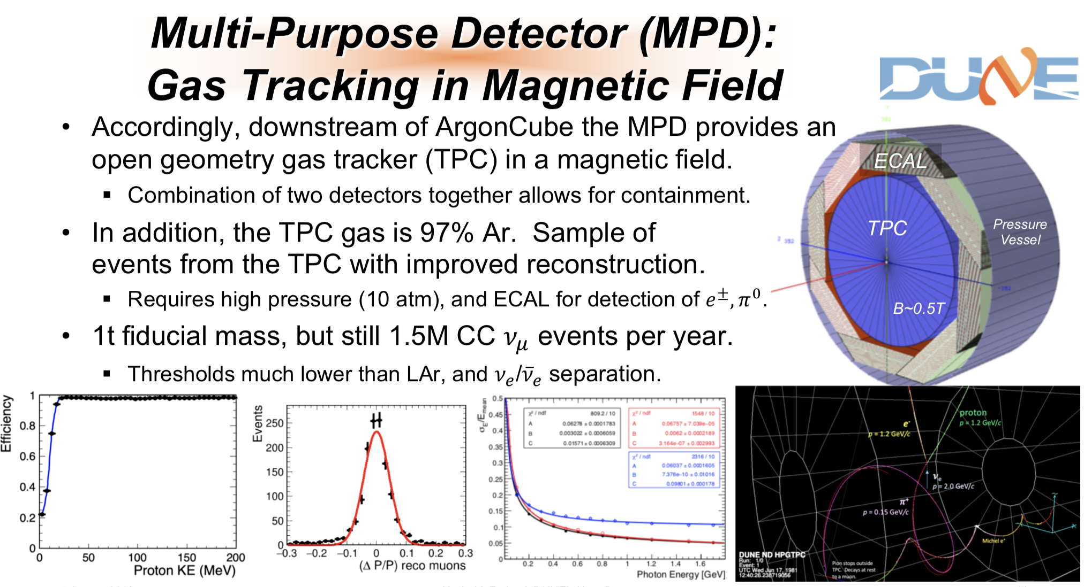

Slide 12
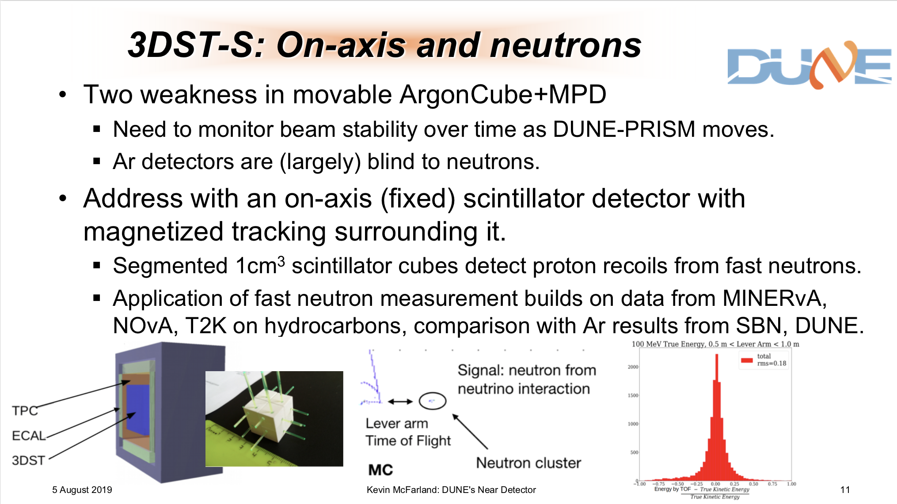

Slide 13
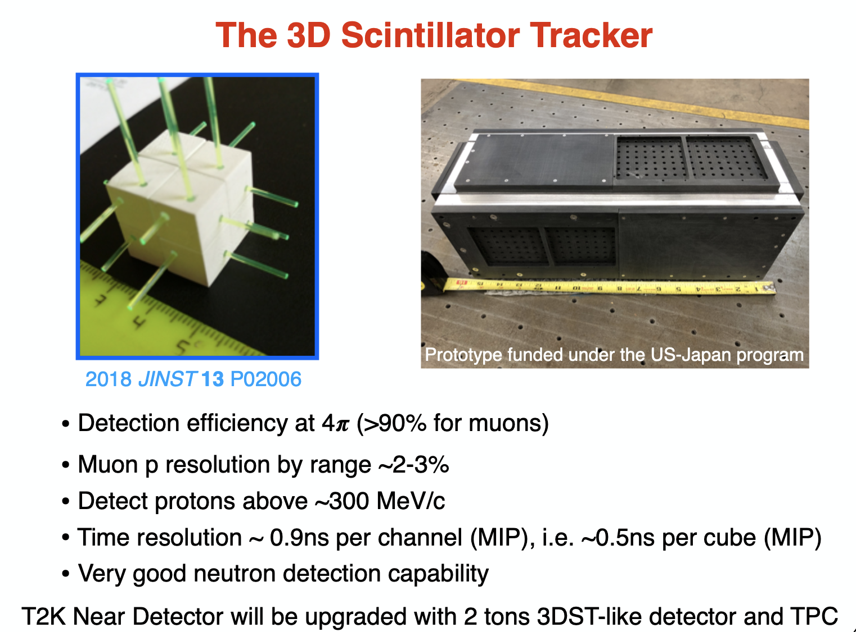

Slide 14
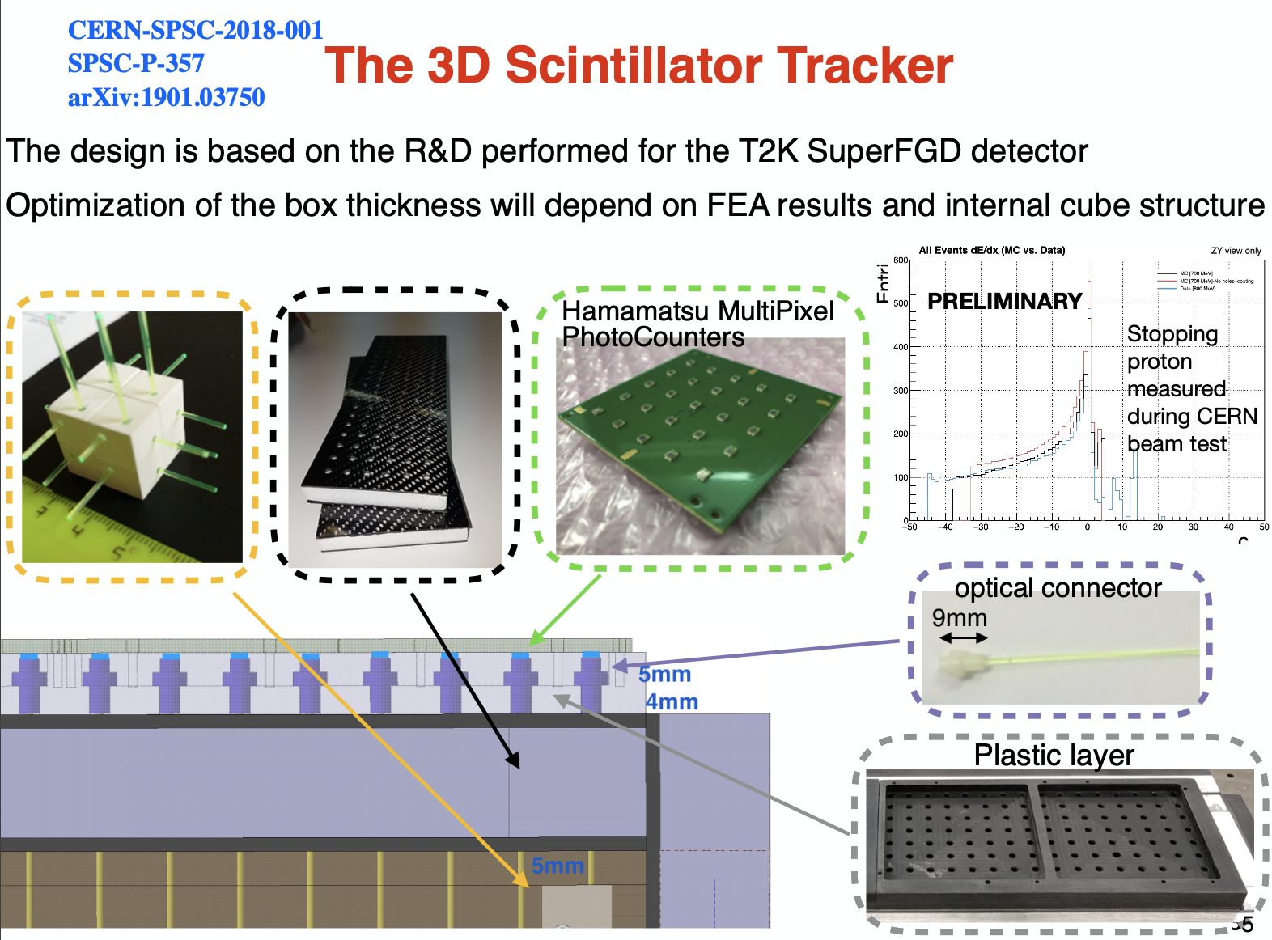

Slide 15
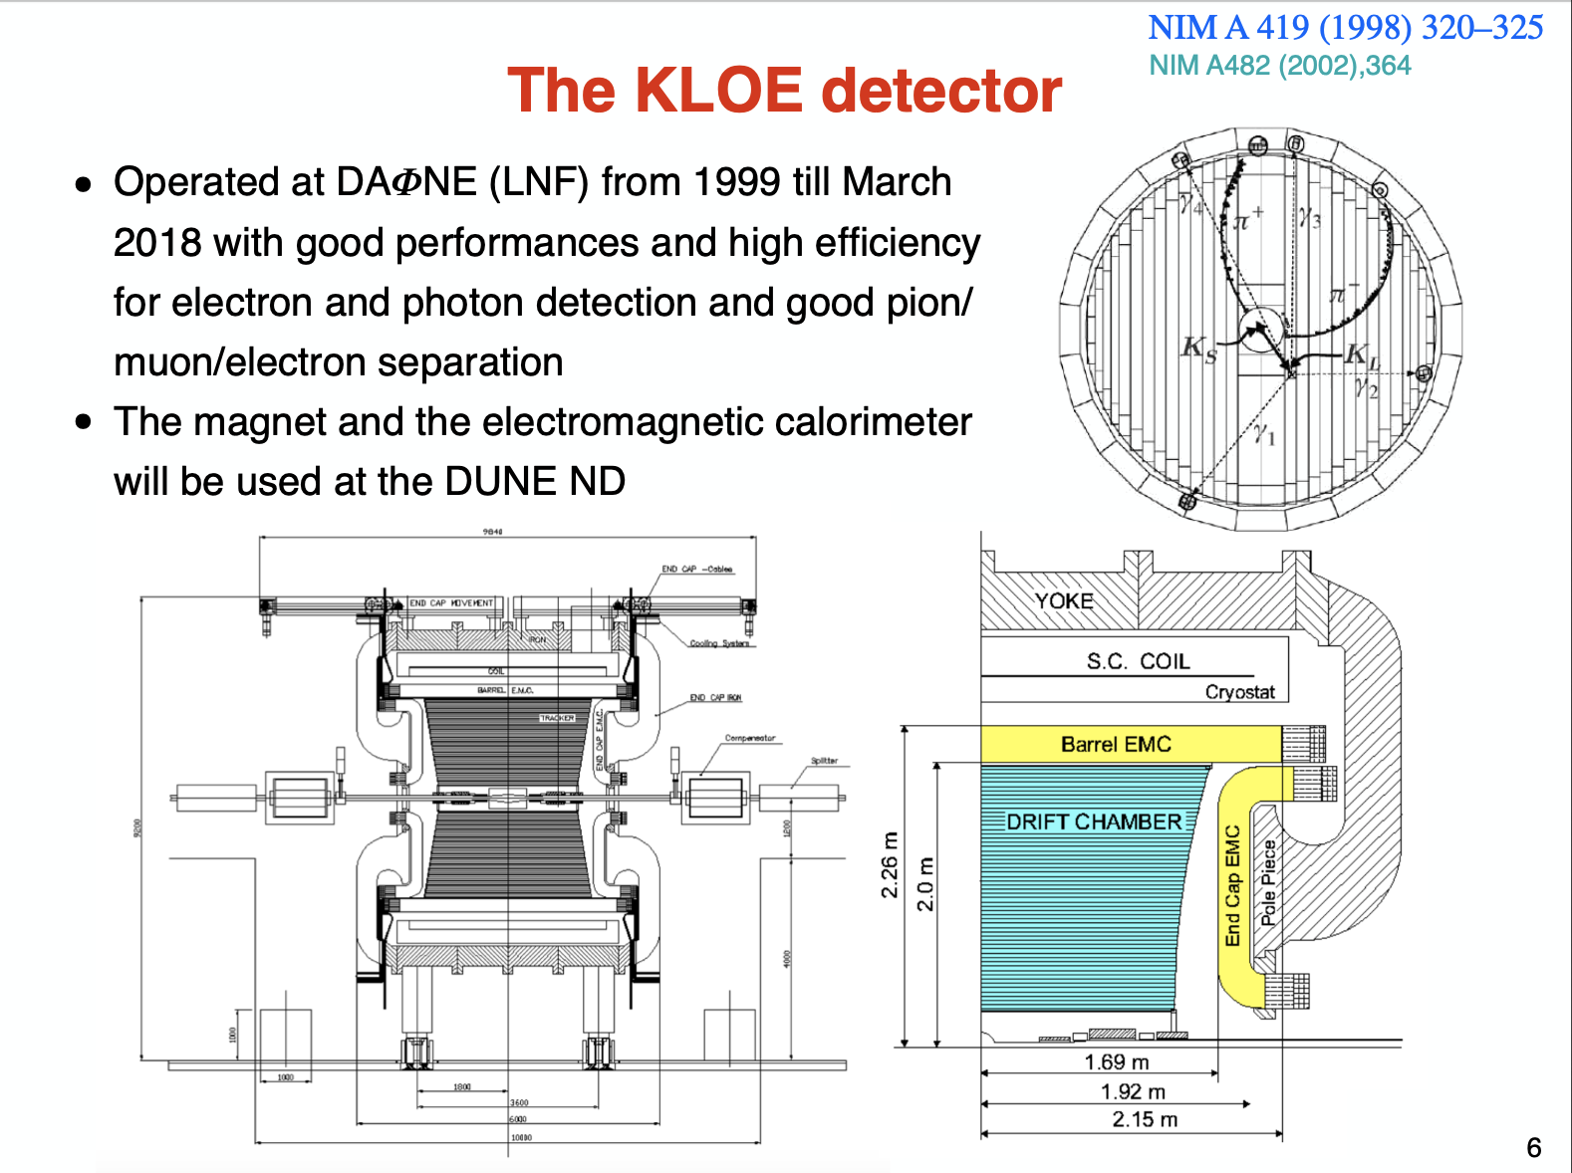

Slide 16
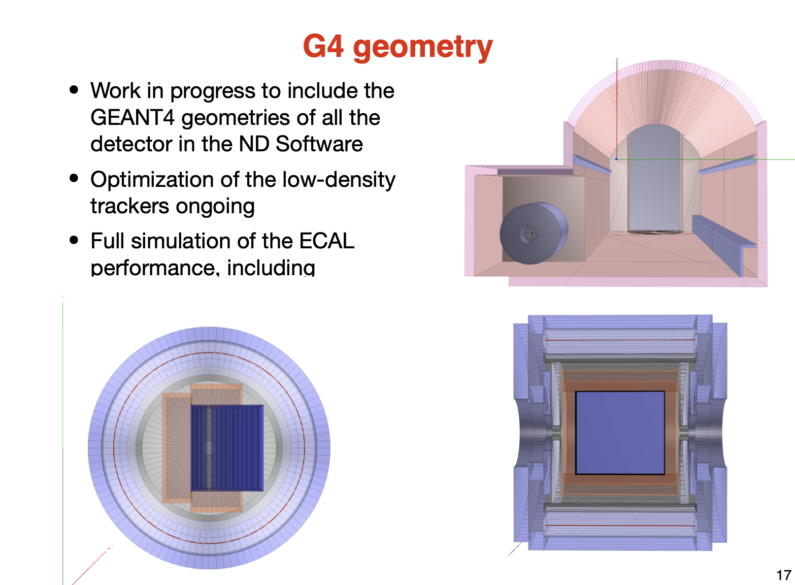

Slide 17
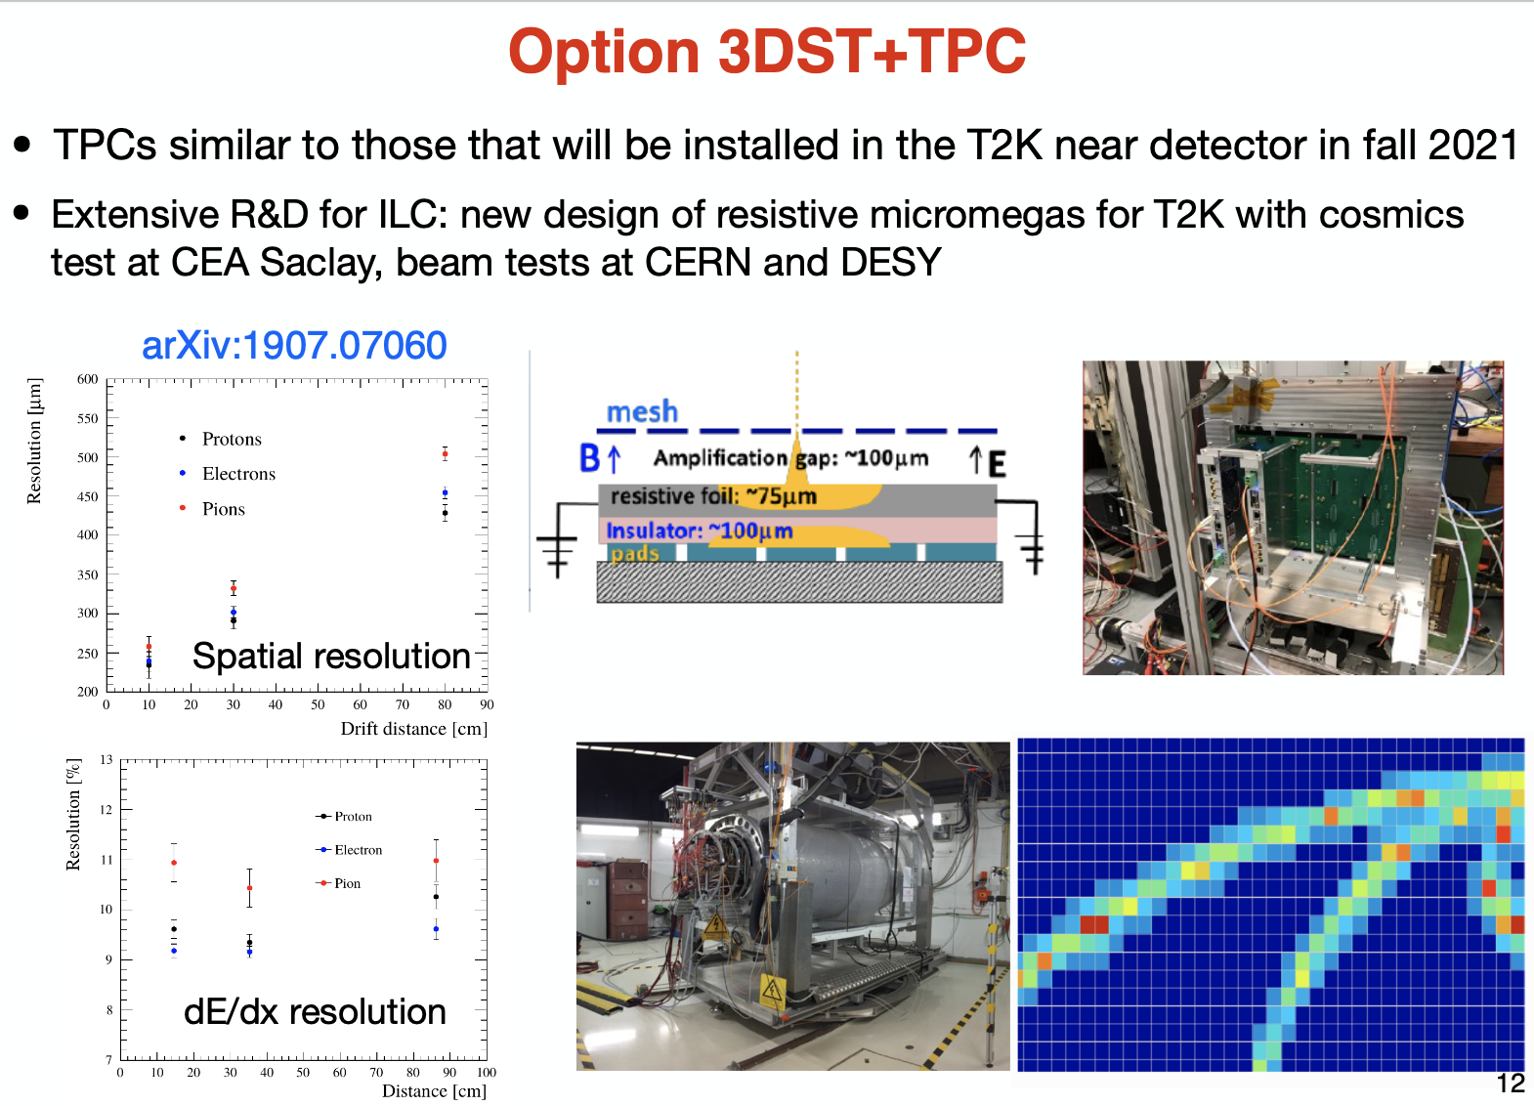

Slide 18
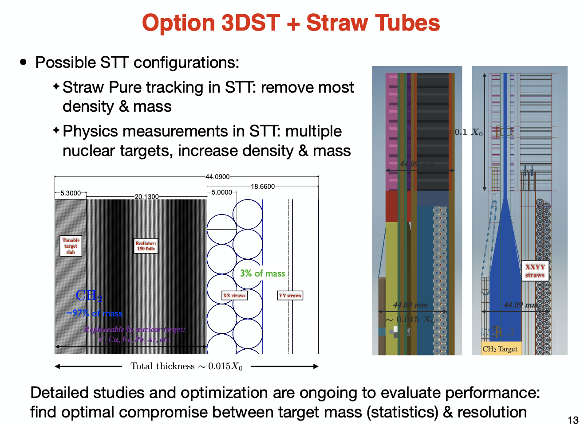

Slide 19
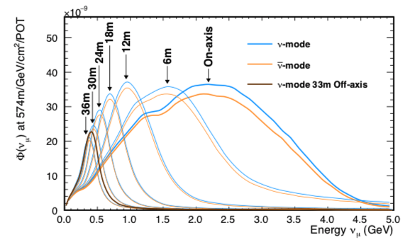
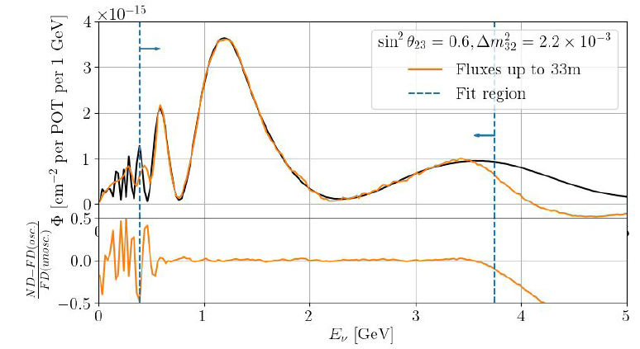
DUNE-PRISM
Vary the incident neutrino spectrum by moving off-axis
Break cross section model degeneracies
Linearly combine off-axis samples to craft “arbitrary” neutrino spectra
- narrow Gaussian spectra
- FD-like oscillated spectra
Unprecedented reduction
in cross section modeling uncertainties

Slide 20
Near Detector at DUNE
Overriding principle so far: try to do everything. Interactions on Ar, C and H, magnetic spectrometry and calorimetry, neutron detection and PRISM, plus working with theorists on modeling. ~80M nuCC events/year in Lar
DUNE is going to attack the problem of flux determination with low correlations with cross-section effects through:
  nu+e scattering
  low-nu scattering
  transverse momentum imbalance + neutrons with CCQE interactions
  Use data from EMPHATIC/NA61/(ENUBET ?)
Exact quantitative benefits from that still under discussion: Reduce flux uncertainty to ~ 2%?
Probably the main advantages of NuStorm would be
  flux normalization <1%
  precise nue/numu xsec ratios and nue xsec
Studies on optimizing and getting hard numbers still on going

Slide 21
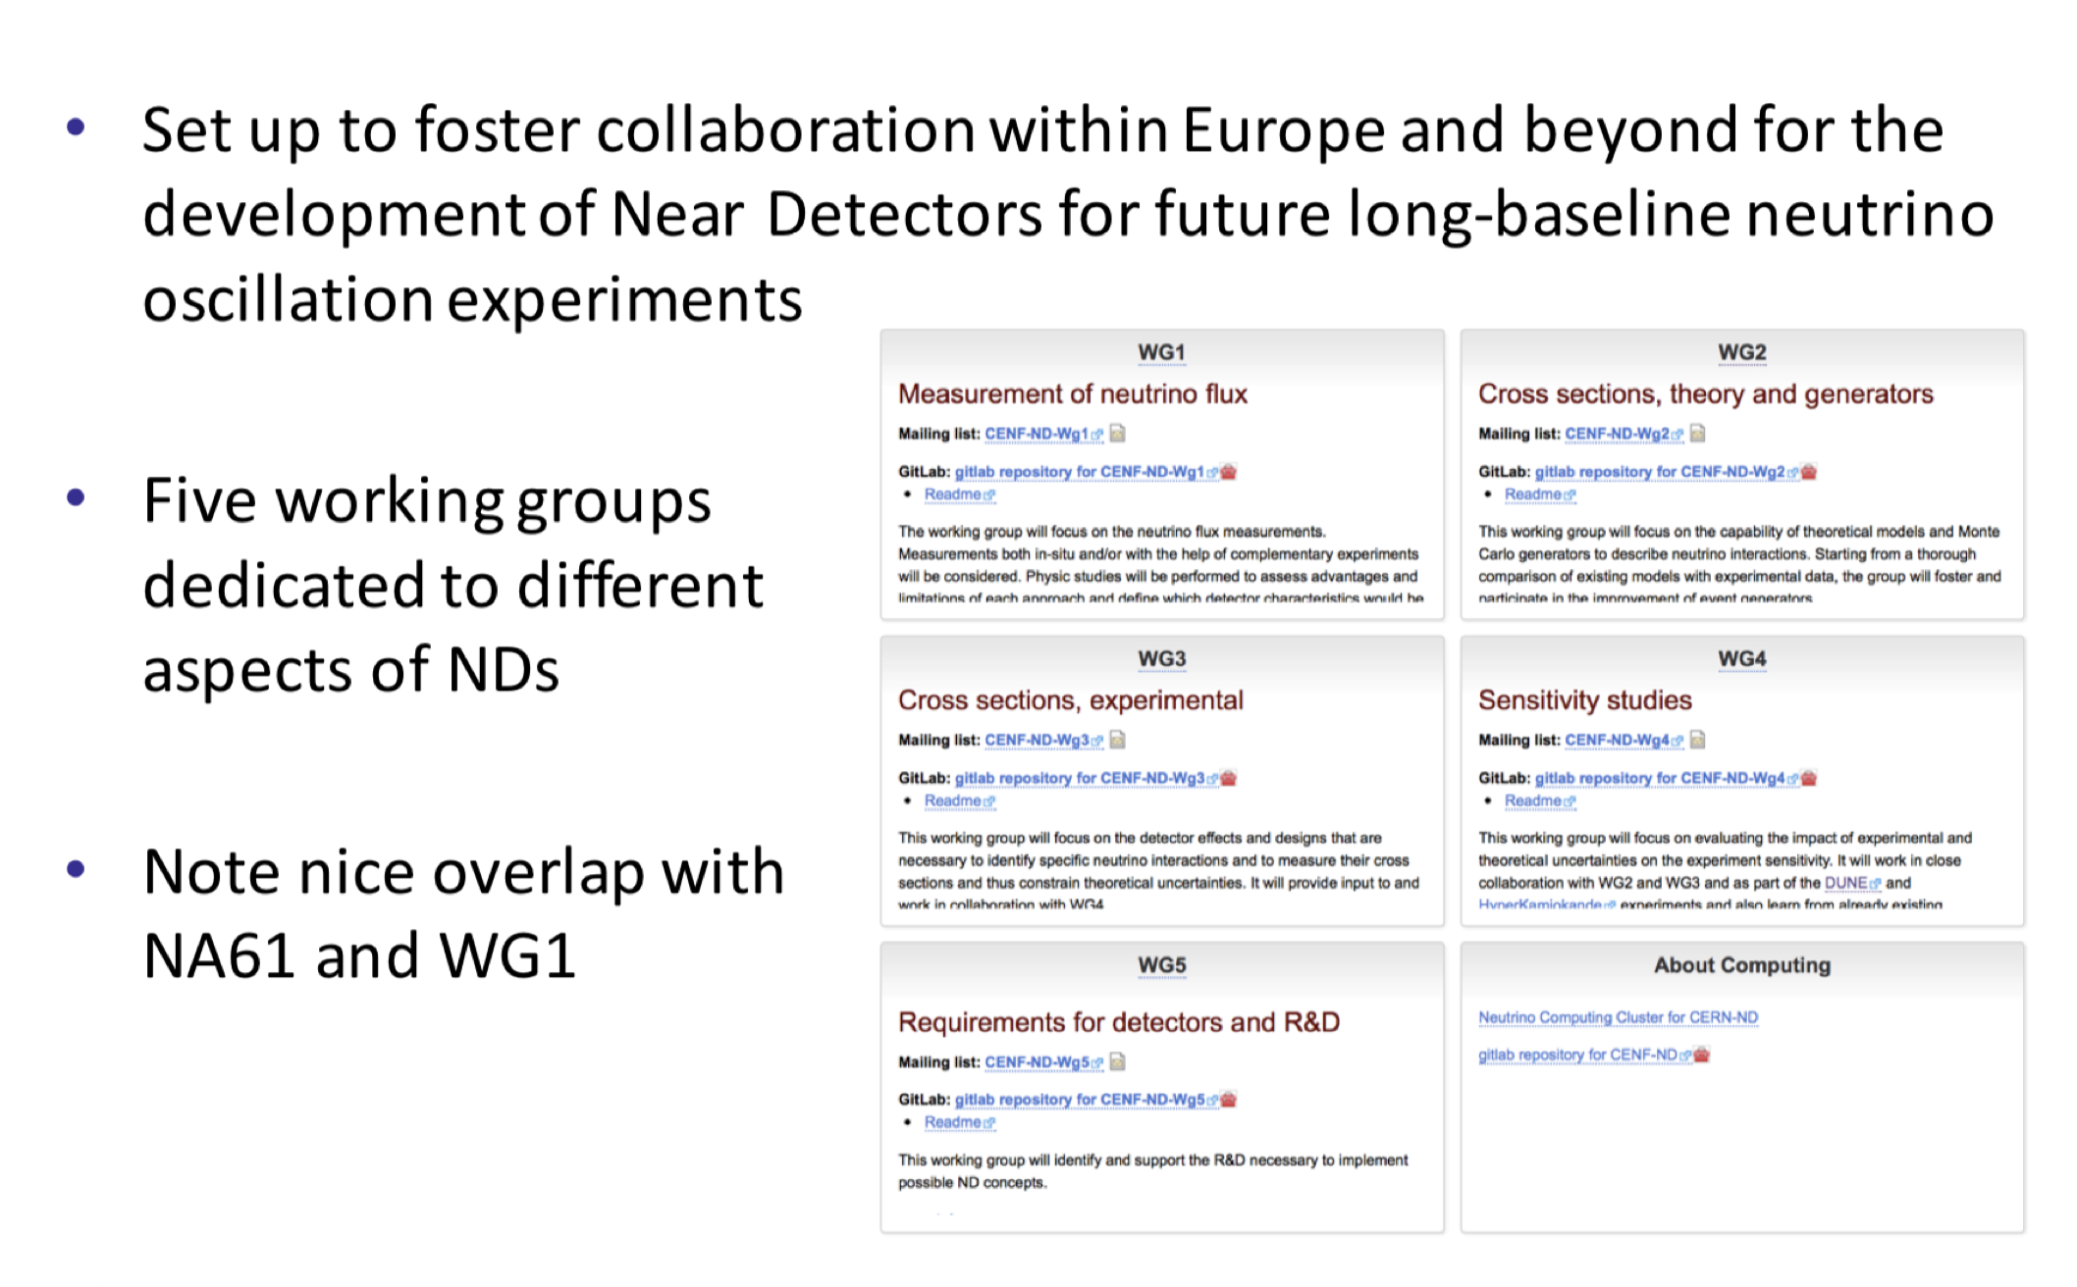
CENF-ND Near Detector Forum
Generic study of near detector topics to engage (European) community
Organizers
•Paola Sala
•Stefania Bordoni
•Alfons Weber
•Marco Zito
https://twiki.cern.ch/twiki/bin/view/CENF/NearDetector

Slide 22
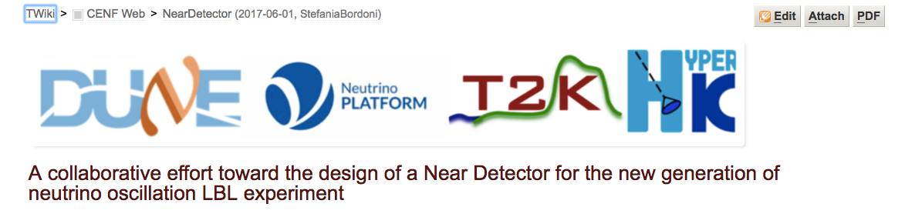
Hub to provide support to the ongoing efforts of the LBN collaborations, strengthen the European support, attract new institutes, endorse participation from Japanese and American Institutes.
Work organised in 5 WGs (flux, cross-section, R&D.. ) in close collaboration with existing frameworks and groups
Activity started in July 2017, more than 100 participants registered
Video meetings, Workshop at CERN, visiting and projects for student are organized.
ESG contribution submitted for December 2018

Slide 23
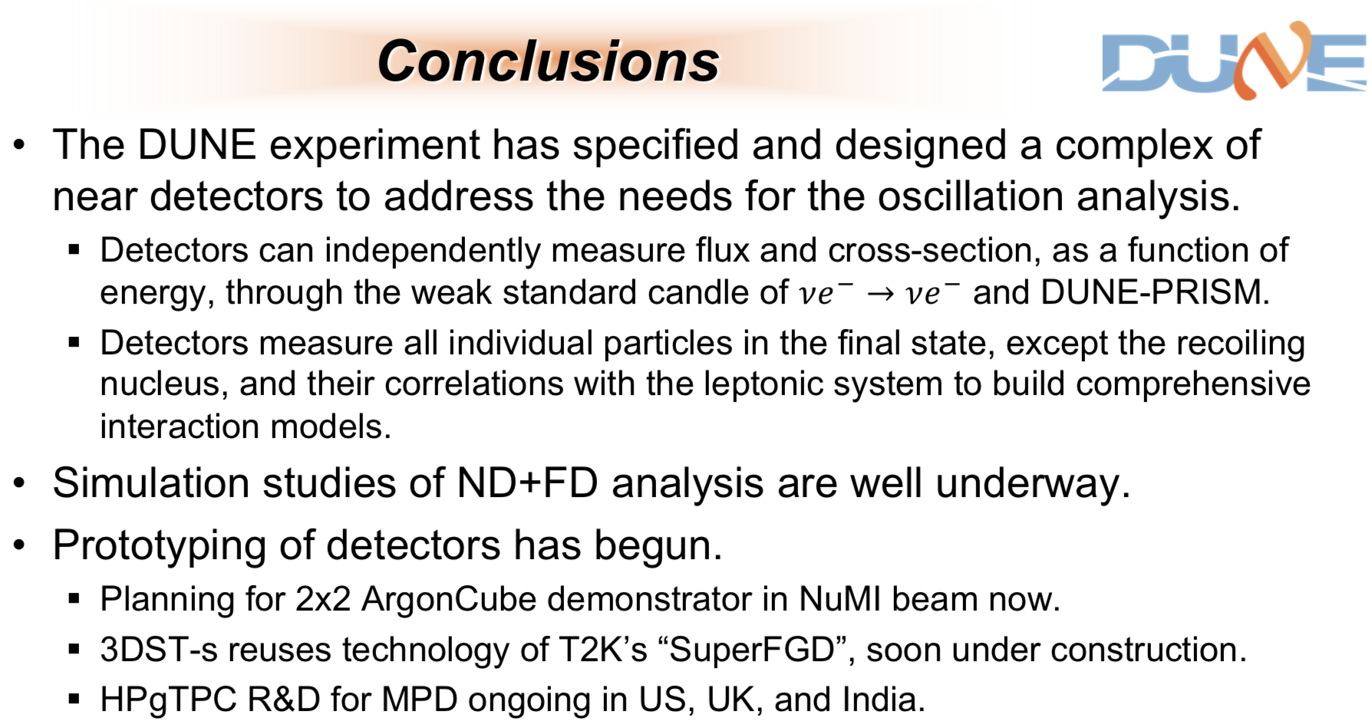
Timelines:
CDR by end of 2019
TDR by end of 2020

Slide 24
Backup

Slide 25
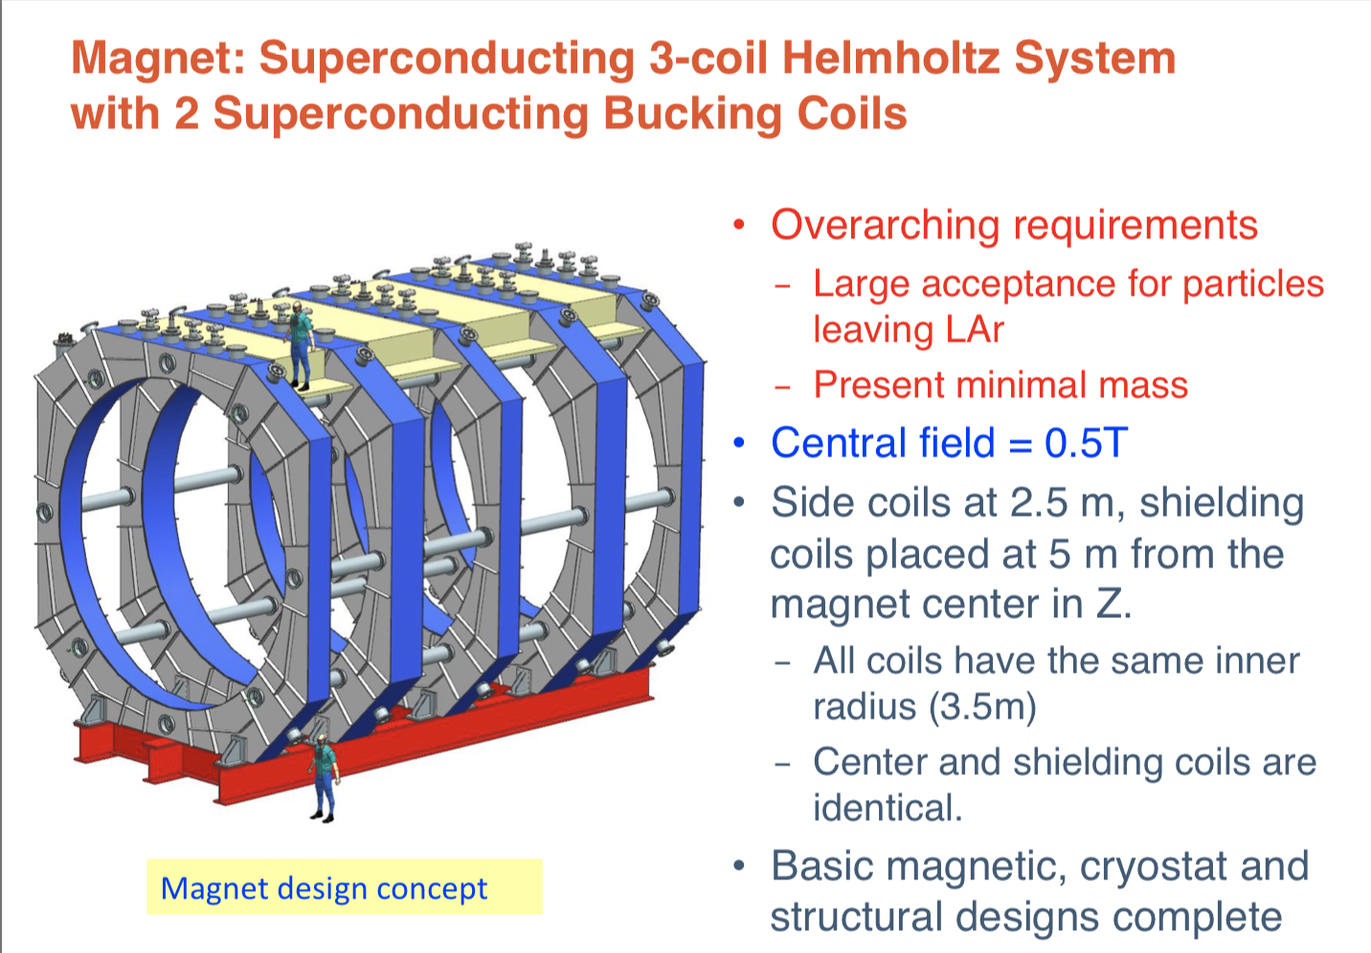

Slide 26
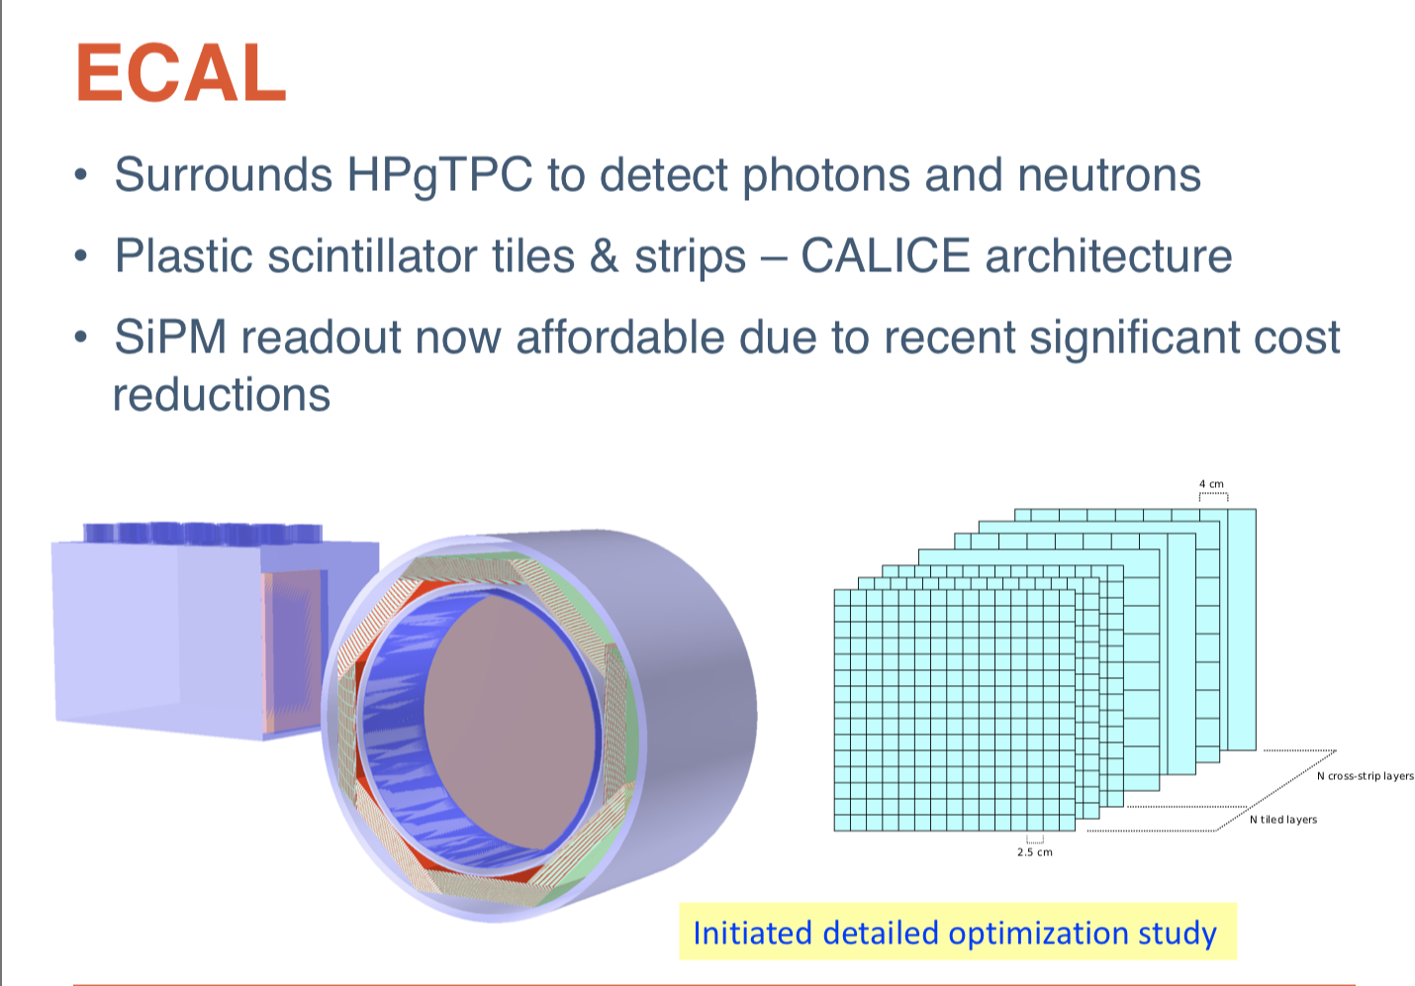

Slide 27
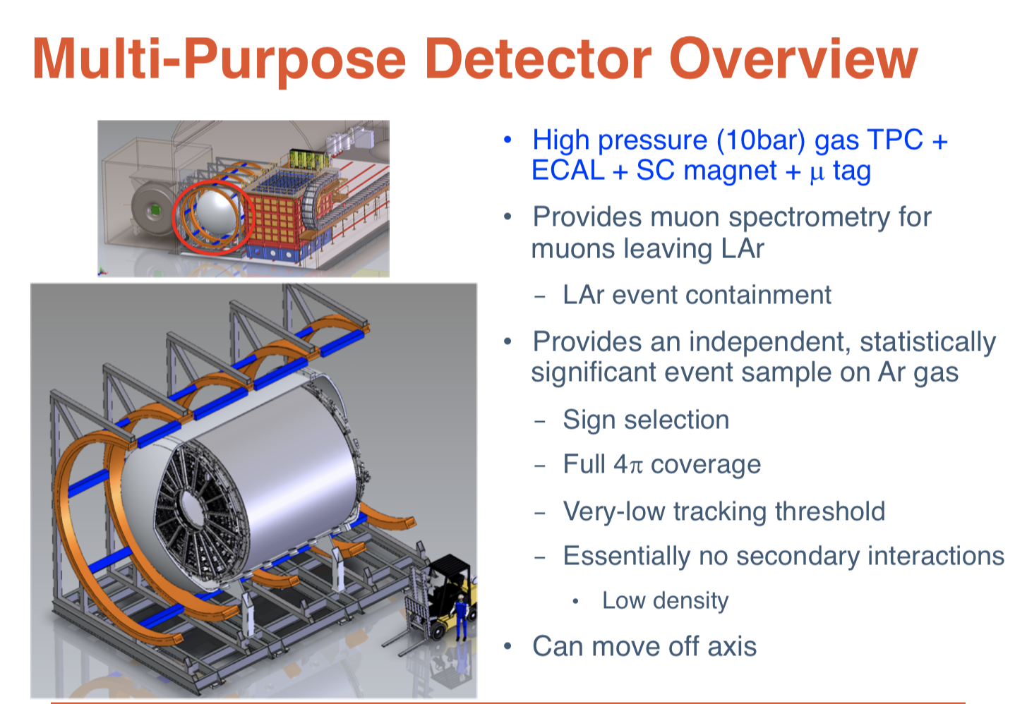

Slide 28
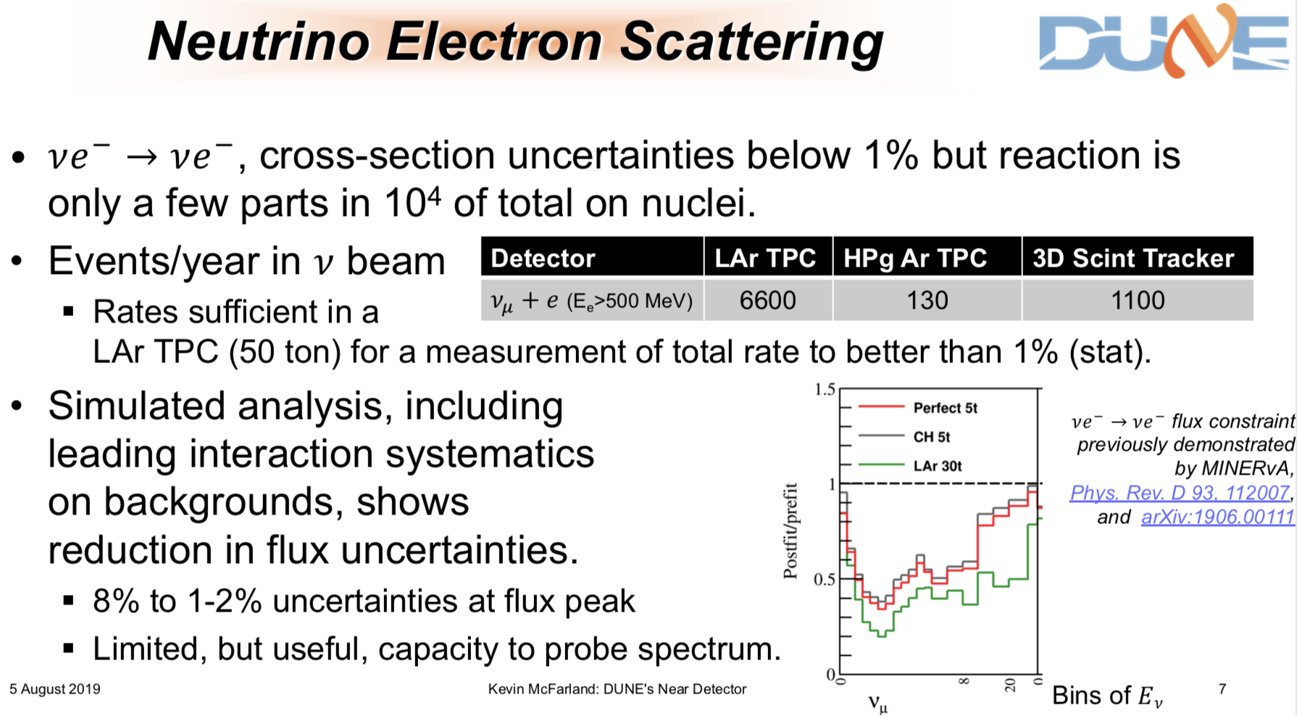

Slide 29
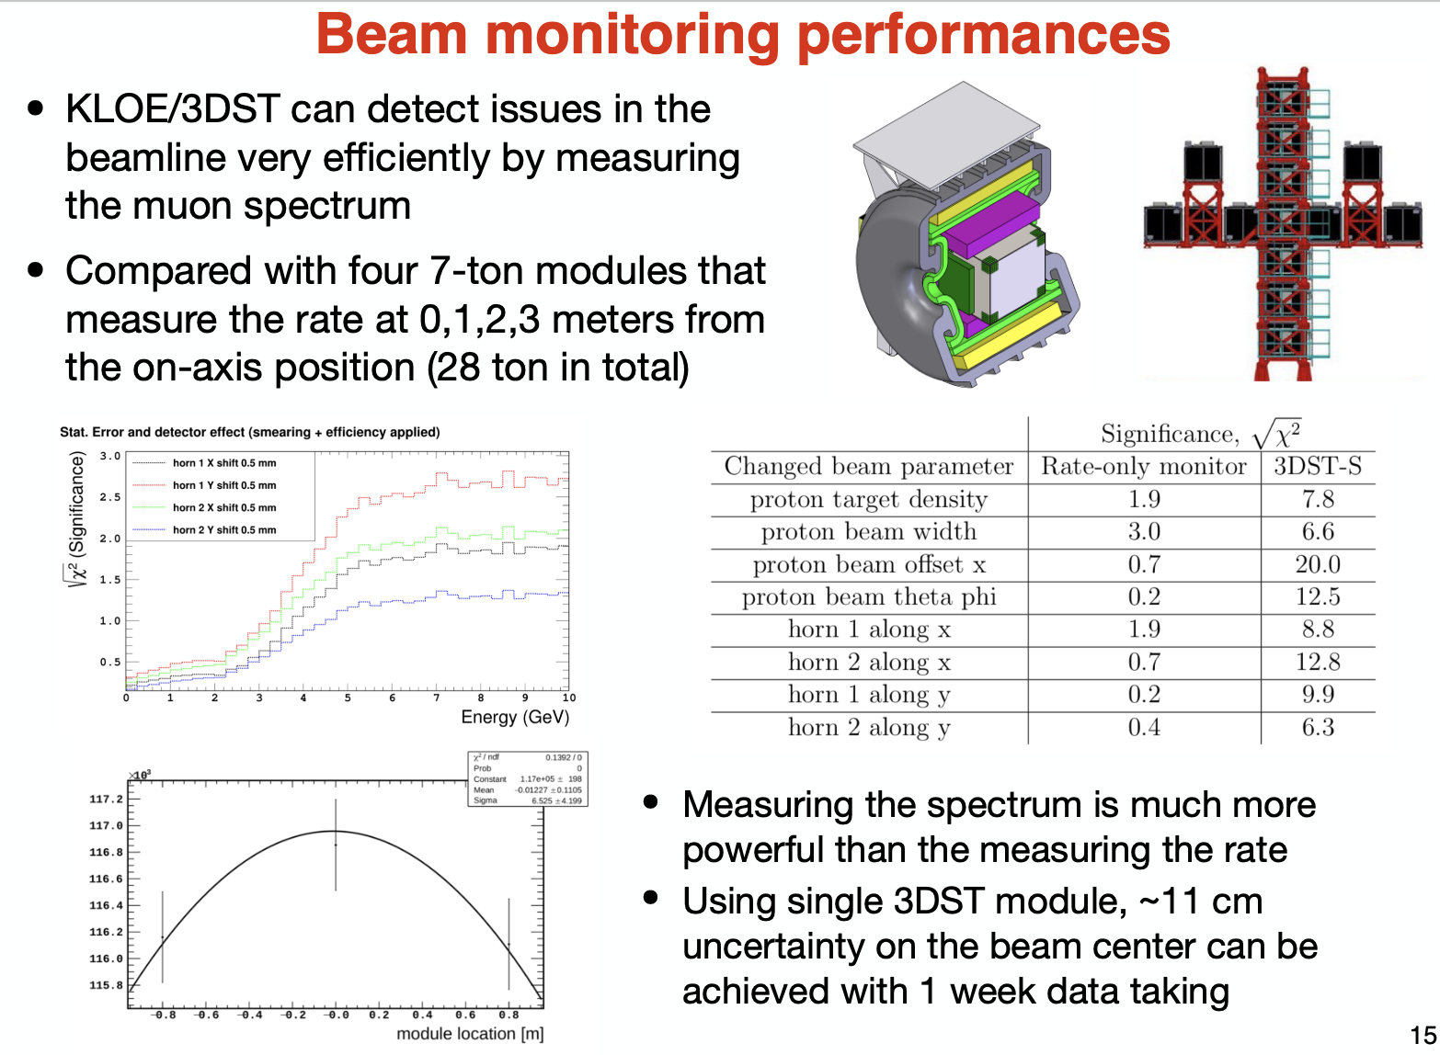

Slide 30
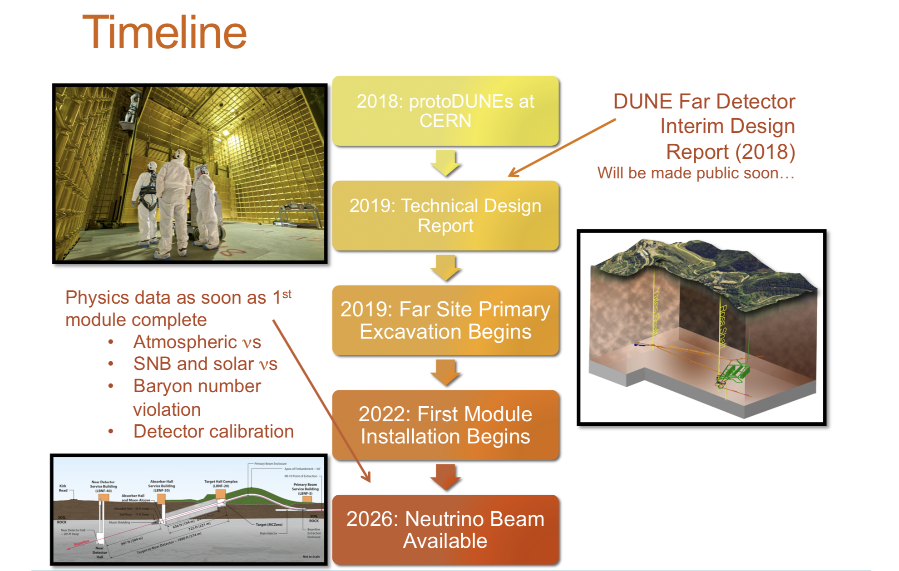
DUNE Timeline
arXiv:1807.10334
2025: first module ready

Slide 31
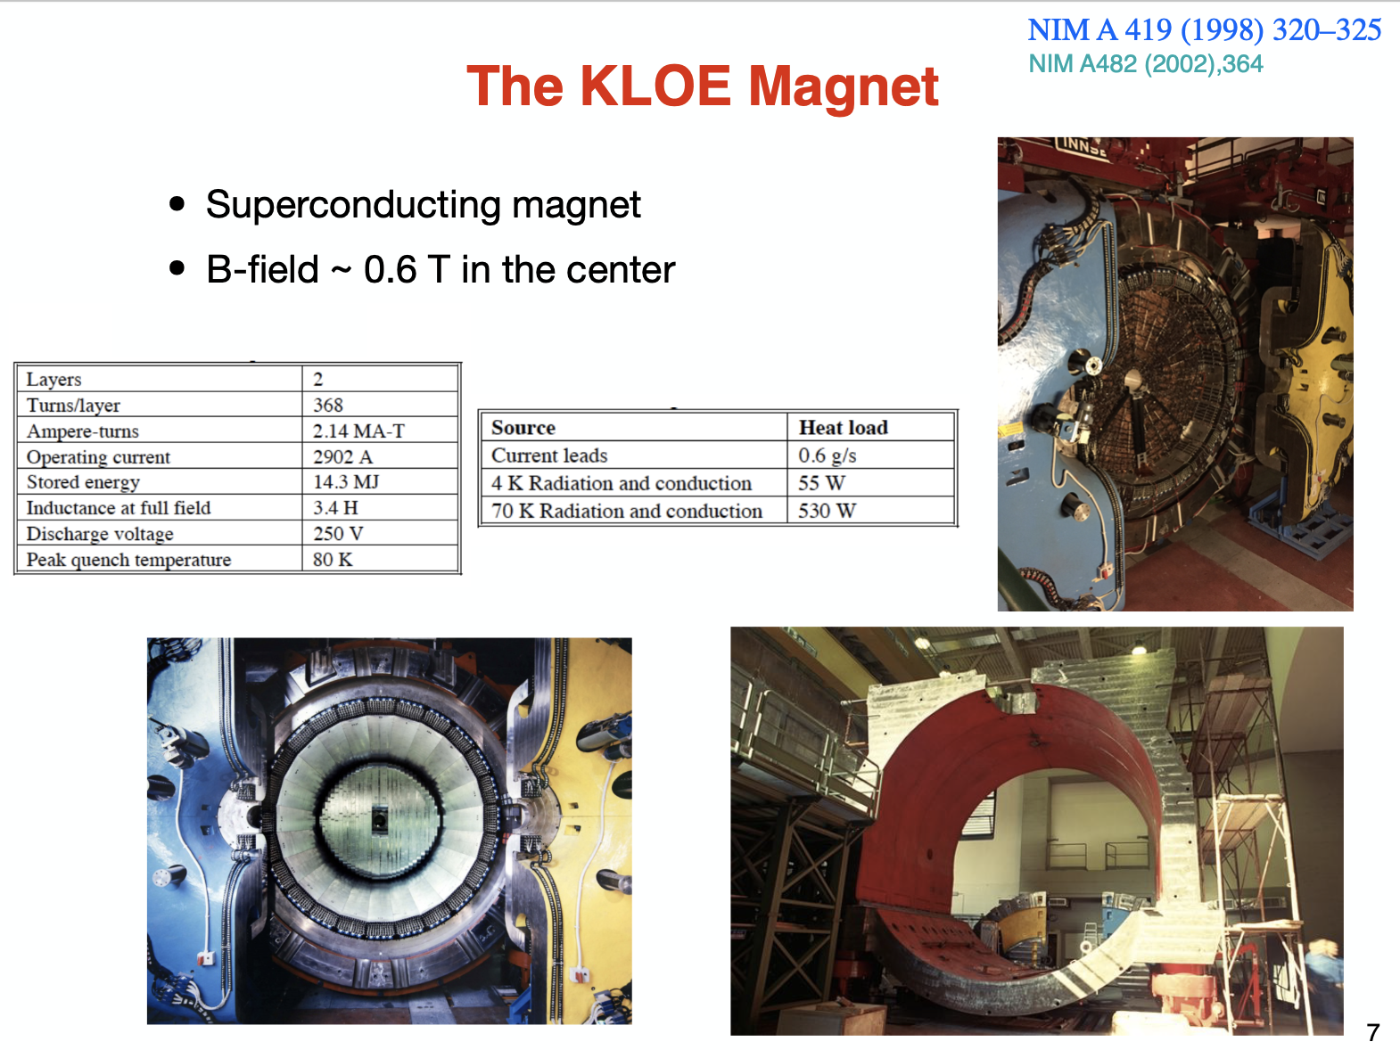

Slide 32
