Slide 1

Jonathan Gall
Chris Hunt
Claudia Ahdida
Wolfgang Bartmann
Marco Calviani
Jaroslaw Pasternak
Ken Long
Overview: PBC study group and nuSTORM at CERN
Mike Lamont

Slide 2
PBC - Brief
Maximize physics reach of existing complex
  New facilities exploiting existing complex
  Novel exploitation of existing facilities
  Provide support for novel off-site facilities
  Harness the existing technology and expertise
Within the limits posed by an already vibrant and diverse physics program
Evaluate options’ motivation and competitiveness in a world wide scape

Slide 3
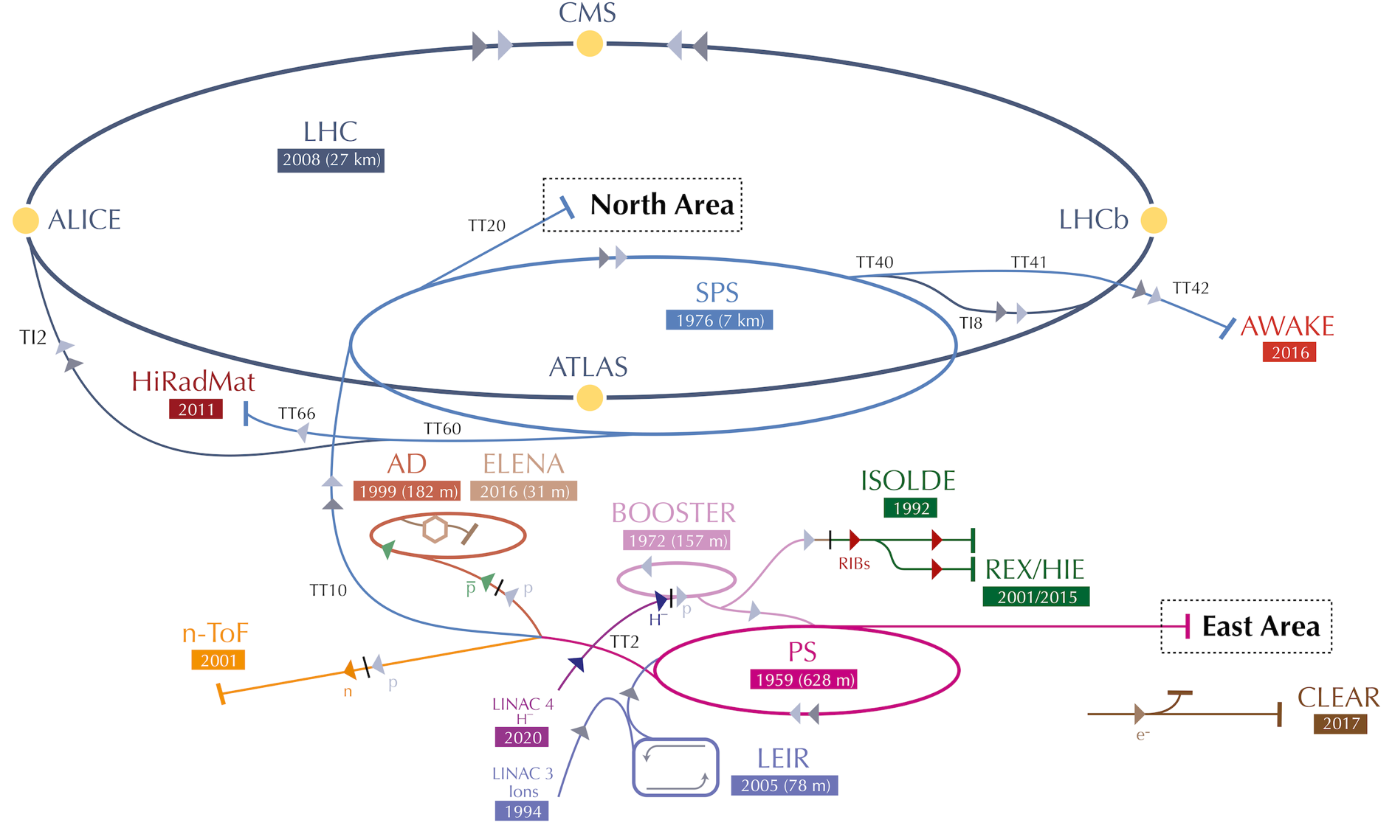

Slide 4
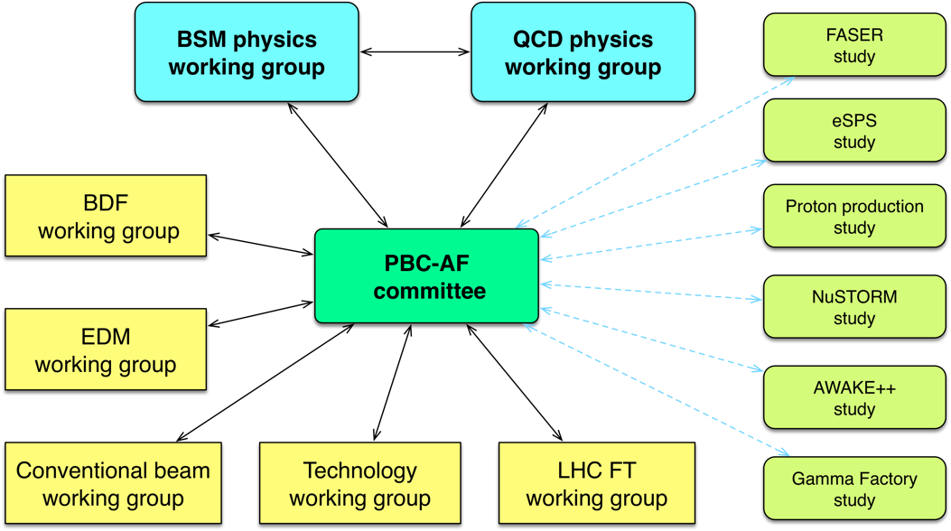
PBC structure
Evaluate proposed options in the worldwide landscape

Slide 5
PBC accelerator side - main themes
Exploitation of SPS/North Area
  Conventional North Area beams (NA62+, KLEVER, NA64+, COMPASS…)
  Beam Dump Facility for SHiP/TauFV
  eSPS for LDMX
  nuSTORM for neutrino cross-section etc.
Novel approaches
  EDM proton storage ring, Gamma Factory, AWAKE++
LHC
  LHC fixed target (gas, crystals)
  Long Lived Particles (FASER, MATHUSLA, CODEX-b, milliQan)
Technology
  Various options (Helioscopes, “light-shining-through-walls”…)

Slide 6
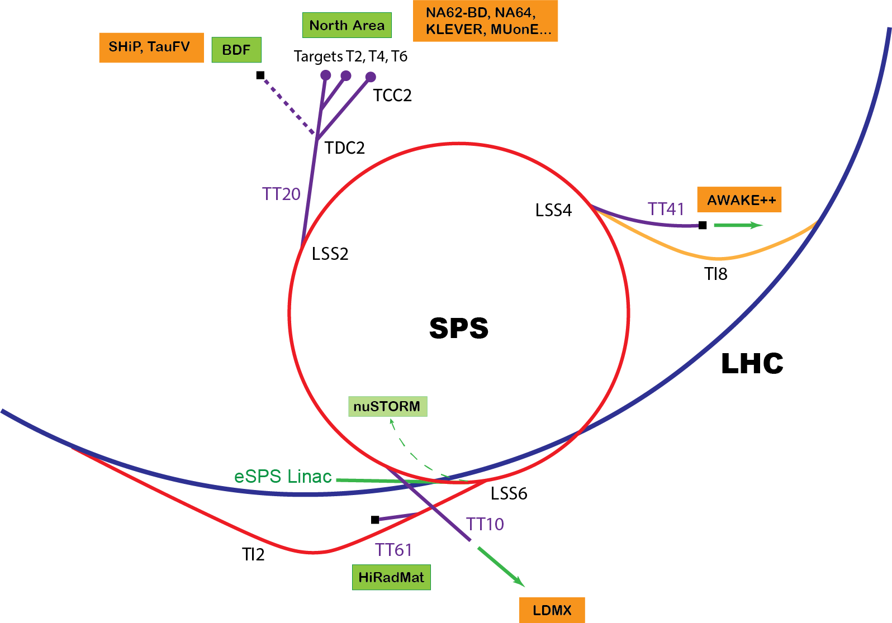

Slide 7
In practice
Budget line (fellows, material)
  PBC and the original BDF initiative
Fellows:
  Civil Engineering, Integration, Beam Transfer, Radiation Protection, CV, Target development, Accelerator physics, Magnets…
Good natured and uncosted support from a number of groups (FLUKA, Transport, Survey, )
Not sure if was foreseen but has allowed a flexible response and the support of number of initiatives

Slide 8
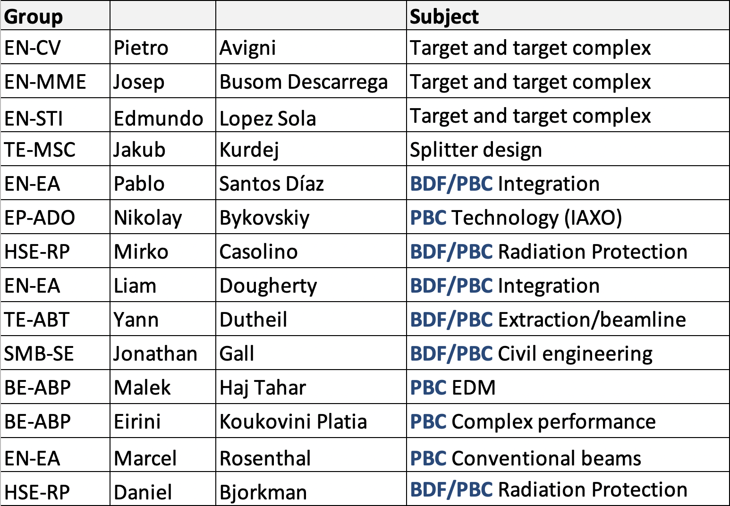
Fellows 2019
nuSTORM
good natured
uncosted
support
Jonathan Gall
Chris Hunt
Claudia Ahdida
Wolfgang Bartmann
Marco Calviani
Jaroslaw Pasternak
Ken Long

Slide 9
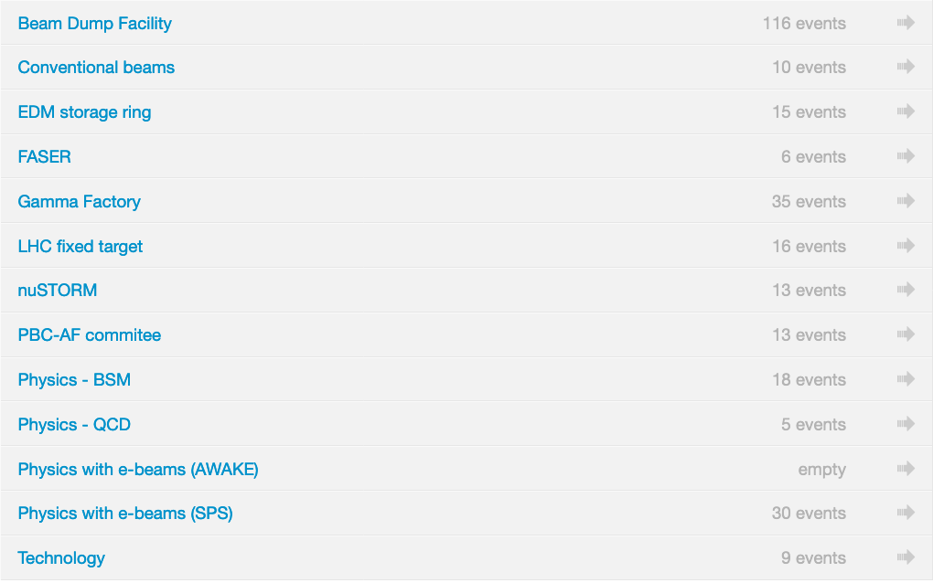
Working groups

Slide 10
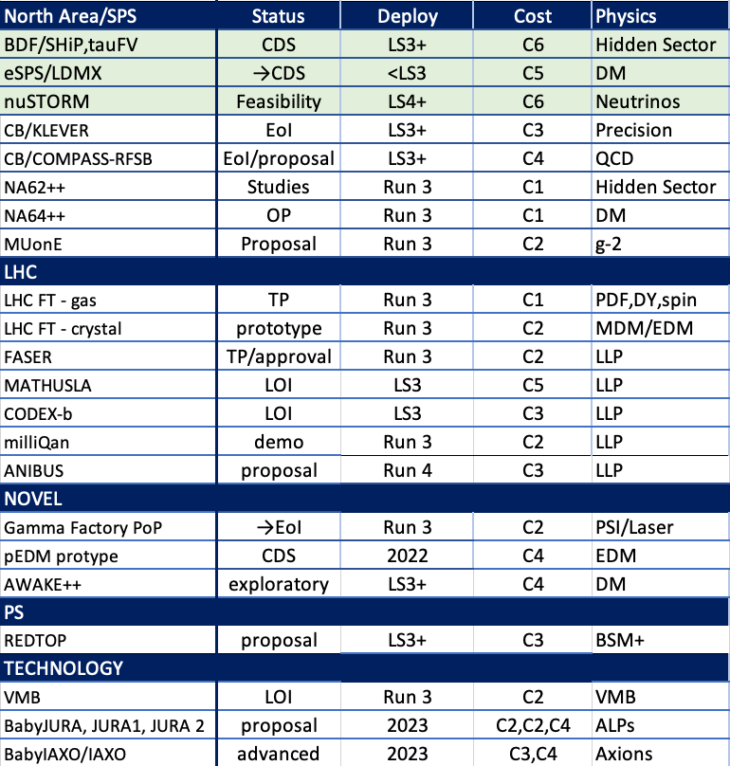
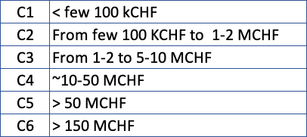

Slide 11
Schematic overview of the BSM landscape
Beam dumps, Long Lived Particles
MeV – GeV (HNL, ALPS, Light Dark Matter)
Precision experiments
>>TeV (search for NP in clean and very rare flavour processes or in EDMs)
Non-accelerator projects
Sub-eV (axions, ALPs)
For comparative sensitivity, 11 benchmarks cases considered by the BSM group

Slide 12
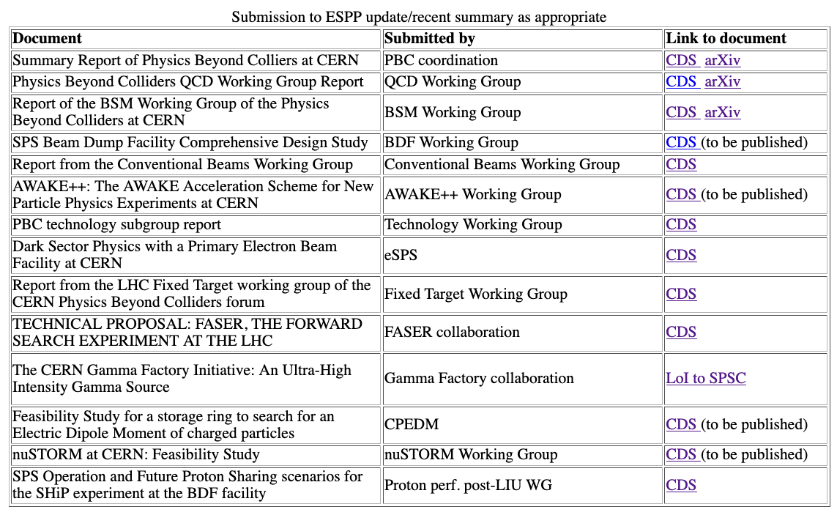
PBC to ESPP update
http://pbc.web.cern.ch/

Slide 13
PBC - Main message
Well motivated, competitive, cost-effective options, making good use of CERN’s existing complex, beams, and expertise.
Rare decays and precise measurements
KLEVER (K⁰_{L} → π⁰𝜈𝜈)
TauFV@BDF: 𝜏 → 3μ
REDTOP (𝜂 decays)
MUonE (hadronic vacuum polarization for (g-2_{μ}))
EDM proton storage ring
Long-lived particles from LHC collisions
FASER, MATHUSLA, CODEX-b, milliQAN
QCD measurements
COMPASS++, DIRAC++
NA61++, NA60++
Fixed target (gas, crystals) in ALICE & LHCb
Other facilities:
𝛾-factory from Partially Stripped Ions; nuSTORM
Hidden sector with “beam dumps”
NA64++ (e,μ)
NA62++
Beam Dump Facility at North Area (SHiP)
LDMX@eSPS
AWAKE++
Non-accelerator projects
Exploit CERN’s technology (RF, vacuum, magnets, optics, cryogenics) for
experiments possibly located in other labs.
E.g. axion searches: IAXO (helioscope), JURA (Light Shining through Wall)

Slide 14
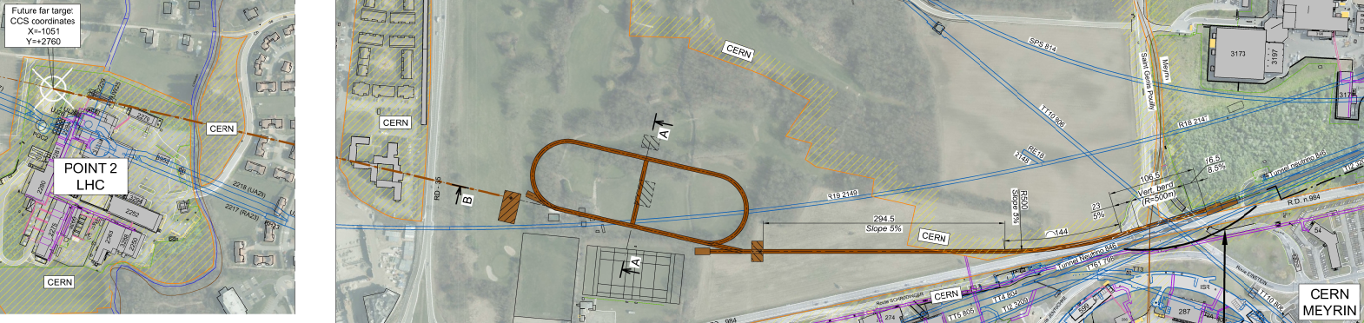
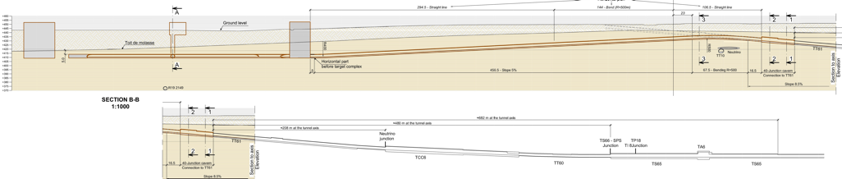
nuSTORM @CERN - Overview
Extraction from SPS through existing tunnel
Siting of storage ring:
  Allows measurements to be made ‘on or off axis’
  Preserves sterile-neutrino search option

Slide 15
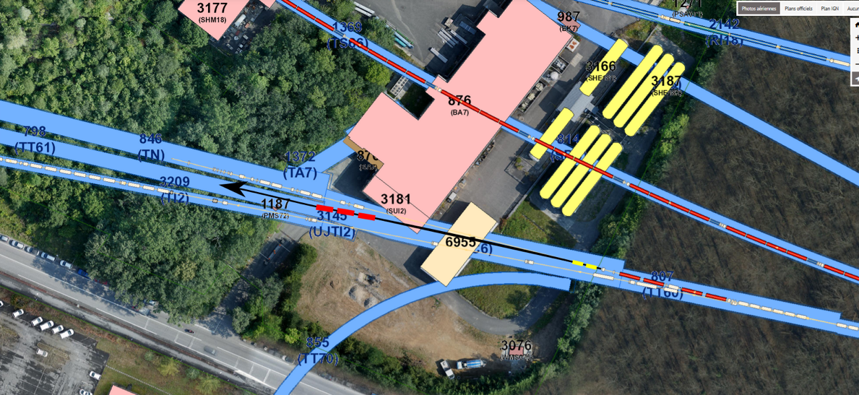
Extraction and p-beam transport to target
Fast extraction at 100 GeV:
  CNGS-like scheme adopted;
    Apertures defined by horizontal and vertical septa reasonable
    Pulse structure (2 x 10.5 ms pulses) requires kicker upgrade
Beam transport to target:
  Extraction into TT60:
    Branch from HiRadMat
    beam line at 230 m (TT61)
  Require to match elevation
  and slope
  New tunnel at junction
  cavern after 290 m
  585 m transport to target
Wolfgang Bartmann

Slide 16
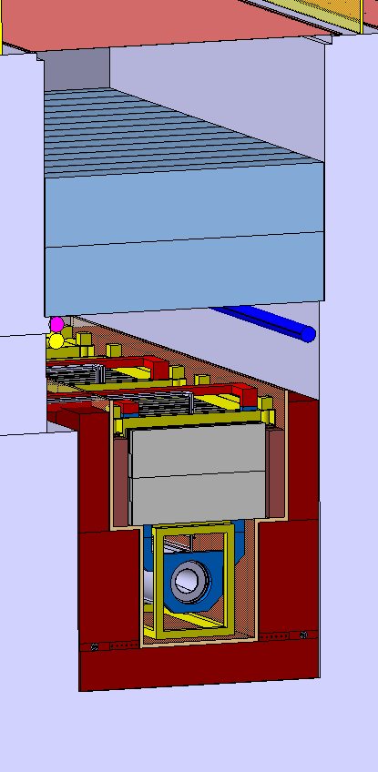
Target and capture
FNAL scheme adopted:
  Low-Z target in magnetic horn
  Pair of quadrupoles collect particles horn focused
  Target and initial focusing contained in inert helium atmosphere
Graphite target, based on CNGS experience:
  Radiation-cooled graphite target embedded in water-cooled vessel
Containment and transport of pion beam with a 10% momentum spread:
  Base on scheme used successfully for AD in PS complex
Target complex design:
  Exploit extensive work done for CENF
Marco Calviani

Slide 17
Storage ring
Jaroslaw Pasternak
New design for decay ring:
  Central momentum between 1 GeV/c and 6 GeV/c;
  Momentum acceptance of up to ±16%
Hybrid FODO/FFA concept developed:
  Maintain large momentum and transverse dynamic acceptance simultaneously
  FODO optics used in the production straight
  Zero-chromaticity FFA cells used in arcs and return straight
Hybrid ring properties:
  Zero dispersion in the quadrupole injection/production straight; and
  Zero chromaticity in the arcs and return straight
    Limits overall chromaticity of ring.
Magnets:
  Superconducting combined-function magnets (B up to 2.6 T) in arcs
  Warm combined-function magnets used in return straight
  Large-aperture warm quadrupoles used in production straight
  Mean betatron functions in production and return straights large:
    Minimise betatron oscillations to minimise spread of the neutrino beam

Slide 18
Civil engineering
Radiation protection
Major CE elements:
  40m long junction cavern
  545m long extraction tunnel
  Target complex
  625m circumference decay ring
  Near detector facility
  Support buildings and infrastructure
  Option: far detector on CERN land
Ground well understood
  Tunnelling within molasse
  ~35m vertical clearance to LHC
CE works believed to be ‘relatively straight forward’
~200 kW proton beam required:
  Radiation protection places strong constraints on facility design
  Use radiological/environmental assessments carried out for CENF
Preliminary evaluation:
  General feasibility of project established in terms of:
    Exposure of persons
    Environmental impact
  Detailed studies according to the ALARA principle required later
Initial conclusion:
  “At the present state of technological development, engineering solutions by which the radiological impact can be minimised are available.”
Jonathan Gall
Claudia Ahdida

Slide 19
nuSTORM@CERN - Conclusions
SPS can provide beam and fast extraction
Potential extraction point and site identified
Initial civil engineering sketches performed
Initial thoughts on target/horn/absorbers (considerable expertise at CERN)
Target complex concept sketched
Radiation protection – no dedicated study yet performed but at first sight, given proposed depth, should be manageable
Muon storage ring will be challenging!

