Slide 2
Radiation Protection considerations for nuSTORM
C. Ahdida, P. Vojtyla
HSE-RP
nuSTORM – the next steps
22./23. October 2019

Slide 3
Overview
General principles and guidelines of Radiation Protection
Preliminary Radiation Protection evaluation
Next steps

Slide 4
General Principles of Radiation Protection
Justification
Any exposure of persons to ionizing radiation has to be justified
Limitation
The personal doses have to be kept below the legal limits
Optimization
The personal doses and collective doses have to be kept as low as reasonably achievable (ALARA)

Slide 5
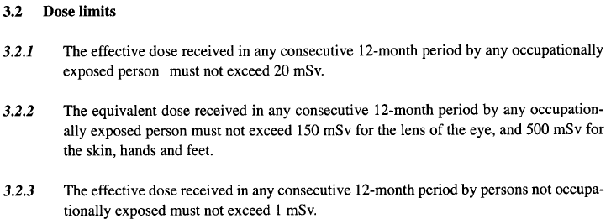
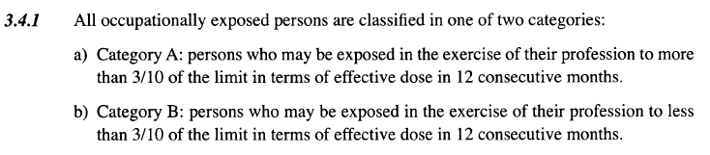
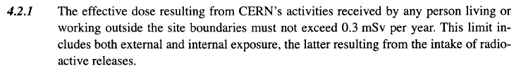
Limitation – Safety Code F
Occupationally exposed persons (Radiation Workers)
Yearly limit
A: 20 mSv/12 months ⁽*⁾
B: 6 mSv/12 months ⁽*⁾
⁽*⁾ Age 16-18: 6 mSv/12 months,
Pregnant women: 1 mSv during pregnancy
Not occupationally exposed persons
1 mSv/12 months
Environment (Public)
0.3 mSv/12 months
100 rem = 1Sv
https://edms.cern.ch/ui/file/335729/LAST_RELEASED/F_E.PDF

Slide 6
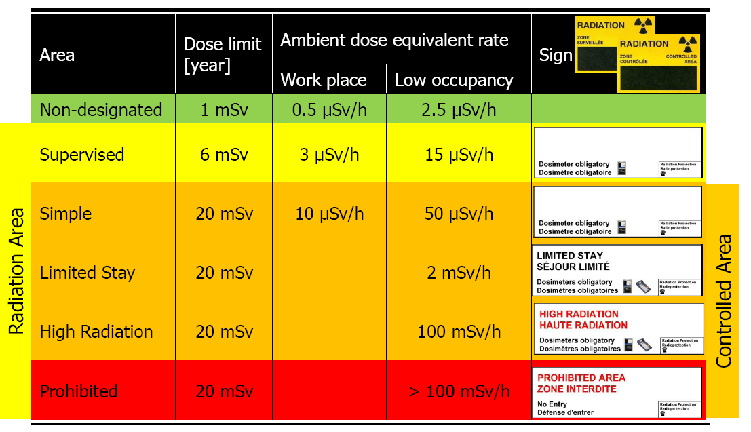
Limitation – Area Classification (external exposure)
Safety Instruction S3-GSI1 (EDMS 810149)
http://cern.ch/raisin
Total number of working hours per year: 2000 hrs
Example:
Supervised Area 3 µSv/h × 2000 hrs = 6 mSv
Low-occupancy: < 20% of working time
100 rem = 1Sv

Slide 7
Limitation – Area Classification (internal exposure)
Safety Instruction S3-GSI1 (EDMS 810149)
http://cern.ch/raisin
Specific airborne radioactivity | Specific surface contamination
0.05 CA | 1 CS
0.1 CA | 1 CS
0.1 CA | 1 CS
100 CA | 4000 CS
1000 CA | 40000 CS
> 1000 CA | > 40000 CS
CS, CA: Nuclide-specific Guidance values from Swiss legislation
Specific airborne radioactivity
1 CA = effective committed dose of 20 mSv for a stay of 2000 hours/year
Specific surface contamination
1 CS = 1/10th of dose limit to skin and/or 0.5 mSv/year for daily ingestion of contamination on 10 cm²
“No contamination”
  < 1 CS for identified isotopes
  < 1 Bq/cm² for non-identified gamma and beta emitters
  < 0.1 Bq/cm² for non-identified alpha emitters
100 rem = 1Sv

Slide 8
General Principles of Radiation Protection
Justification
Any exposure of persons to ionizing radiation has to be justified
Limitation
The personal doses have to be kept below the legal limits
Optimization
The personal doses and collective doses have to be kept as low as reasonably achievable (ALARA)

Slide 9
Dose Optimization at CERN
CERN workers
Population
Unacceptable risk
Radiation
Workers
Other
Workers
Dose limit
20 mSv/yr*
1 mSv/yr
300 µSv/yr
Tolerable risk
Dose constraint
3 mSv/yr
100 µSv/yr
10 µSv/yr
Individual risk level
Optimization process
ALARA Level
100 µSv/yr
10 µSv/yr
10 µSv/yr
Acceptable risk
* Apprentices and students (age 16-18): 6 mSv/yr
Pregnant women: 1 mSv/yr
(yr ≙ 12 consecutive months)
100 rem = 1Sv

Slide 10

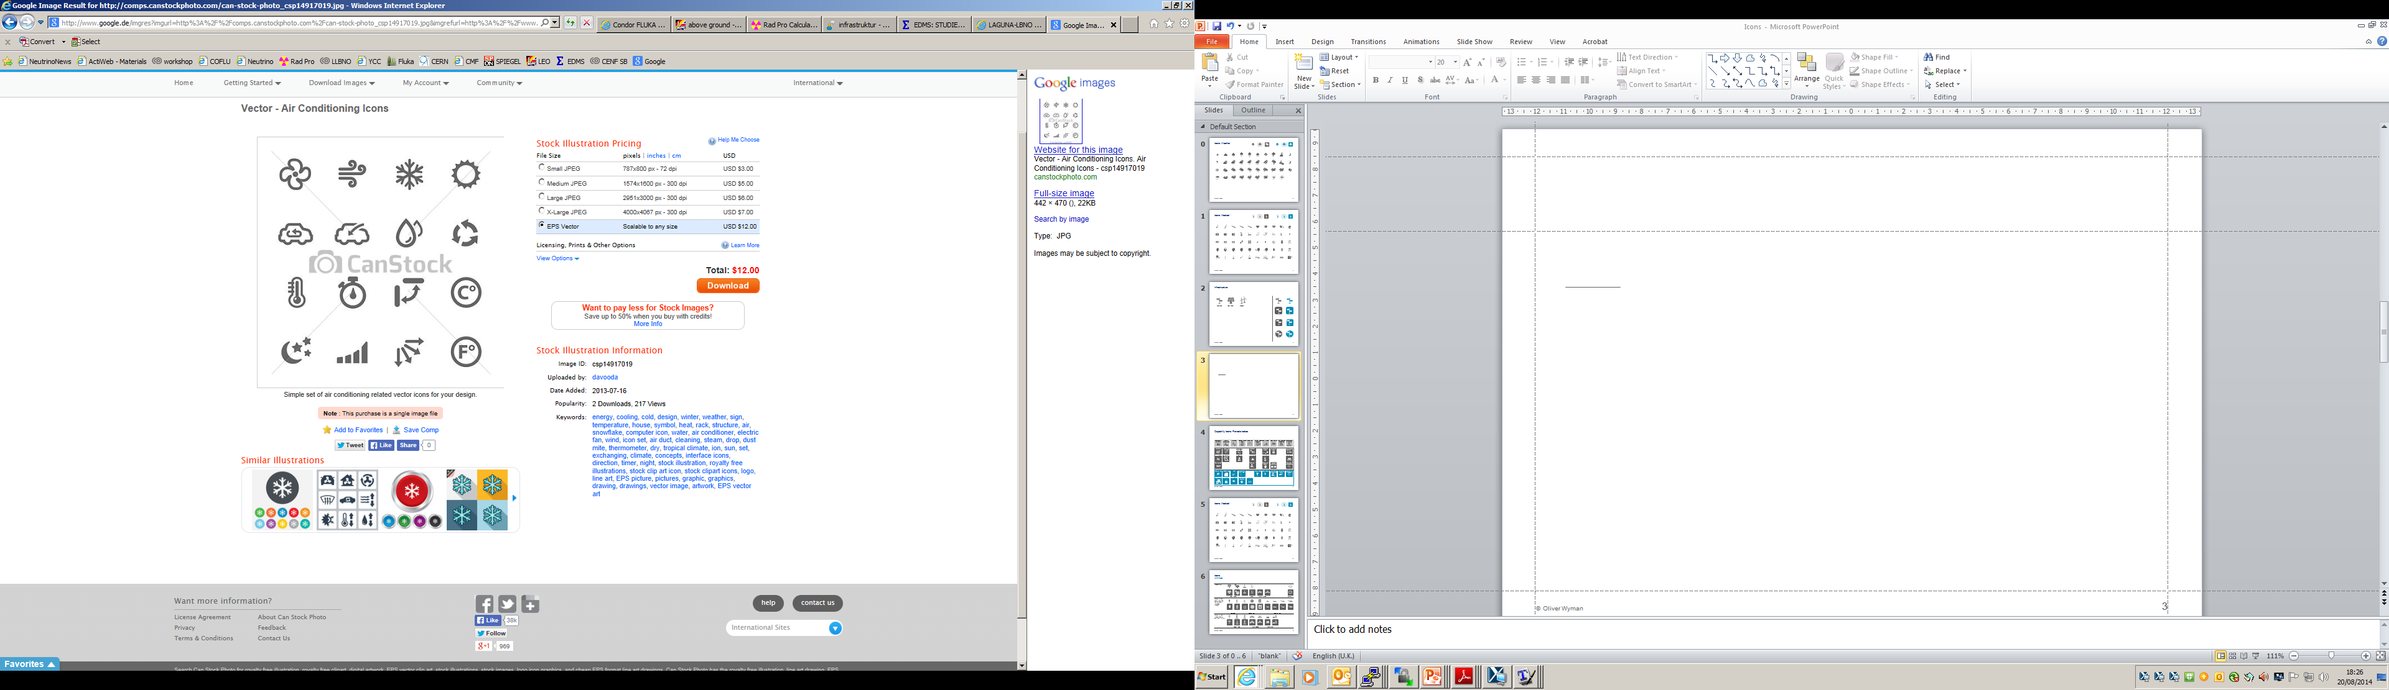

General RP considerations for nuSTORM
Prompt and residual radiation
The optimization of the individual and collective doses for workers and the public must be taken into account for commissioning, normal beam operation, maintenance and accidents
To lower prompt and residual radiation adequate shielding needs to be installed
The activation properties of the materials used in the facility must be considered during the design process as they may have a direct impact on later handling and waste disposal. For this the ActiWiz material catalogue should be consulted
Only absolutely necessary equipment should be installed in areas of high radiation levels. The higher the activation the more reliable should equipment be
Depending on residual dose levels and tasks, manual interventions should partially or completely be replaced by remote maintenance/ repair. Any component should be optimized to lower maintenance time and repair needs
Prompt and residual radiation
Prompt and residual radiation
Air and He
activation
Radiation Protection
Water and Ground activation
Radioactive waste

Slide 11
General RP considerations for nuSTORM
Air and helium activation
Air volumes should be minimized in areas of high levels of prompt radiation or even better be replaced by a helium or vacuum environment
Air volumes in which considerable air activation is expected should be separated from adjacent areas and the outside. Therefore, both static (e.g. sealing of air volumes) and dynamic (e.g. leak extraction) air confinement should be employed
A ventilation system should guarantee a pressure cascade from low to high contaminated areas
The air exhaust shall be equipped with high-efficiency particle and aerosol (HEPA) filters and an air monitoring station
Prompt and residual radiation
Air and He
activation
AIR AND He activation
Radiation Protection
Water and Ground activation
Radioactive waste

Slide 12
General RP considerations for nuSTORM
Water and soil activation
Water cooling circuits for highly radioactive elements like the target and the dump should be closed and separated from others
Water sumps should be avoided in areas with high tritium concentration
Activation and/or contamination of ground water and earth should be avoided (e.g. by adequate shielding, dedicated sumps)
The facility should not be built in a “wet” environment. A hydrological study of the envisaged site should therefore be performed
Soil samples should be taken and analysed for their chemical and radiological composition
Prompt and residual radiation
Air and He
activation
Radiation Protection
Water and Ground activation
Water and ground activation
Radioactive waste

Slide 13
General RP considerations for nuSTORM
Radioactive waste
The design must consider minimization, decommissioning and dismantling of radioactive waste
Prompt and residual radiation
Air and He
activation
Radiation Protection
Water and Ground activation
Radioactive waste
RADIOACTIVE WASTE

Slide 14
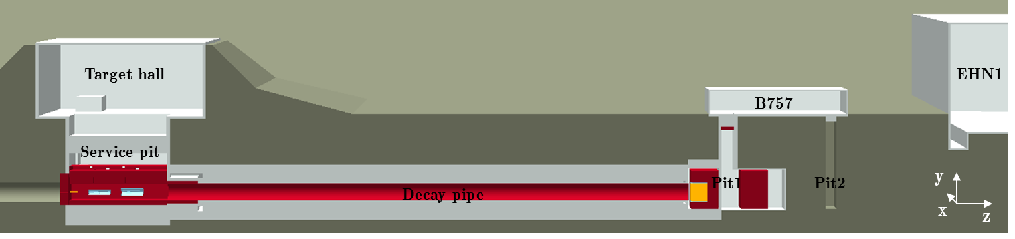
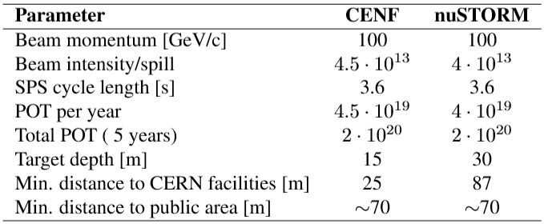
Preliminary RP assessment based on CENF
CENF
Letter of Intent for the new CERN Neutrino Facility (CENF) submitted in 2013 (CERN-EDMS-1260766)
CENF located in CERN’s North Area of the Prévessin site
Main characteristics:
  Target area ~15 m underground
  100 GeV/c protons on a graphite target with 4.5*10¹³ protons per spill with 1 spill every 3.6 s
  Target inside inside a focusing horn designed to collimate the produced charged hadrons together with a reflector
  100 m decay pipe filled, as well as target station, with He
  Two beam dumps, one water-cooled graphite core surrounded by iron and a second made of iron only
  Two muon monitors located behind the first dump and ~11 m behind the second dump
Very similar parameters as for nuSTORM

Slide 15
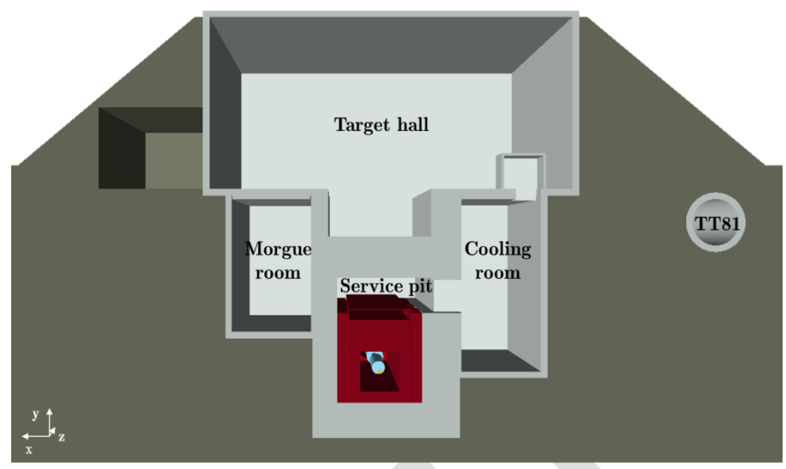
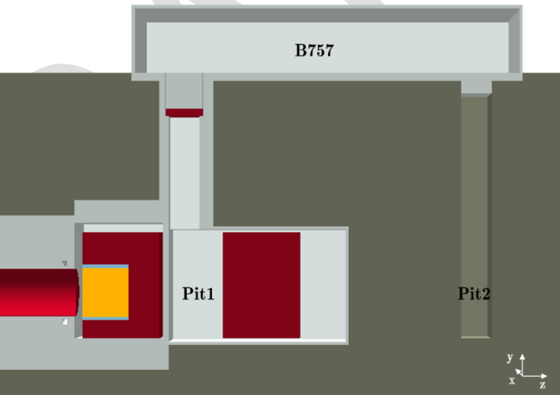
Overview of RP assessment for CENF
FLUKA model of CENF
Performed studies
  Prompt dose rates
  Residual dose rates
  Air activation
  Helium activation
  Soil activation
  Radioactive waste zoning
  Environmental impact assessment

Slide 16
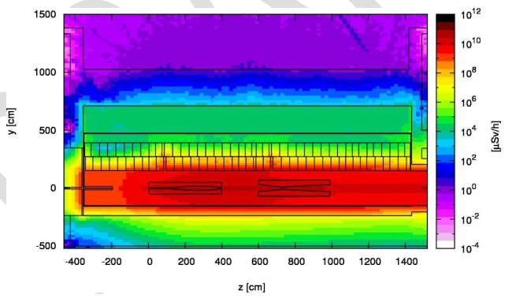
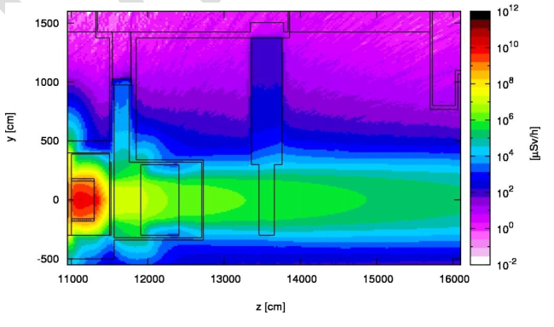
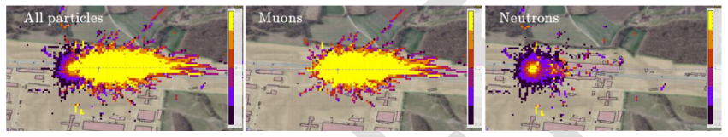
Prompt radiation at CENF
Target area
Dump area
CERN’s fence
Supervised Radiation Area
Supervised Radiation Area
Not accessible
Not accessible
1st dump
2nd dump
Iron (1.6m side, 0.8m bottom, 2.4m top)
Concrete (2-3m side, 2.6m bottom, 3.2m top)
1st dump: graphite (3.2*3.2*3m³) and iron (6*6.9*5m²)
2nd dump: iron (6*6.9*5m³)
Prompt radiation at ground-level and fence was verified to be < 5 μSv/y
→ An equivalent shielding setup for nuSTORM target / dump area can for a first estimate be expected
100 rem = 1Sv

Slide 17
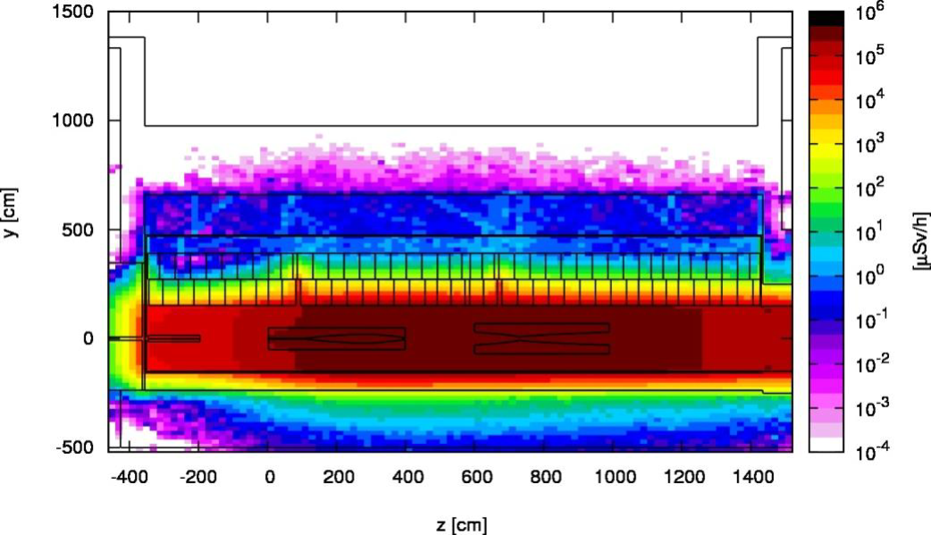
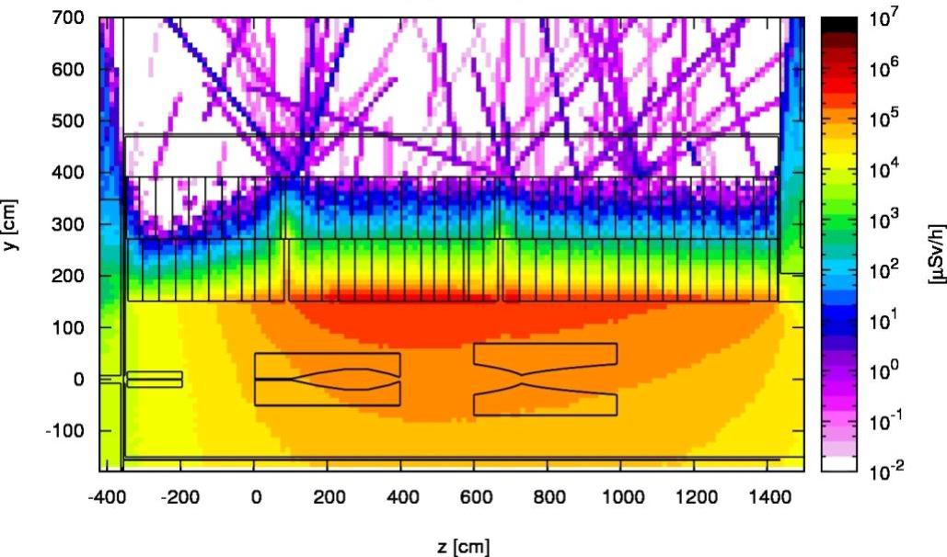
Residual radiation at CENF
Target area – 1 day cooling
Proximity shielding – 1 day cooling
Remote handling and dedicated storage areas for the removable most activated elements were foreseen
Shielding cask for transport/storage of target designed
Also shielding for demineralization cartridges of the water cooling circuits were planned
Max. 1 μSv/h
200 mSv/h
200 mSv/h
Dose rates on contact for the target is O(1) Sv/h after 1 day of cooling
Dose rates on contact for the proximity shielding is ~200 mSv/h after 1 day of cooling
→ A remote handling and storage concept for the hottest elements (target, horn , proximity shielding) is needed for nuSTORM
100 rem = 1Sv

Slide 18
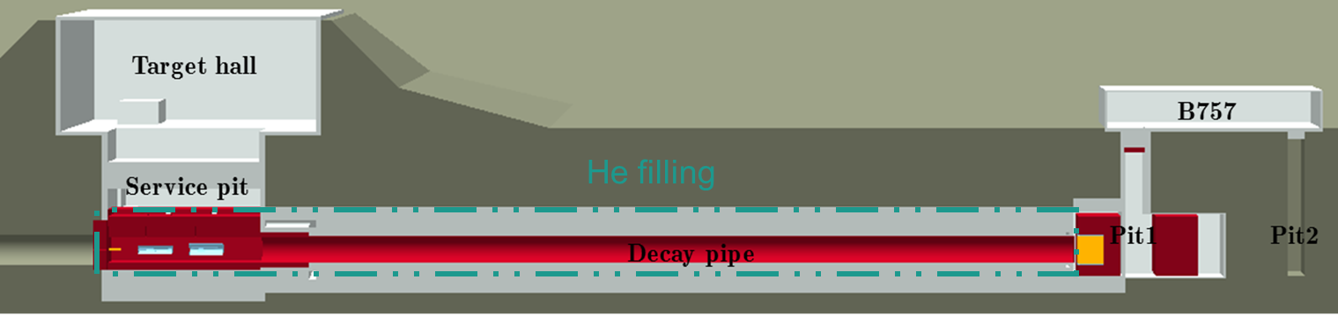
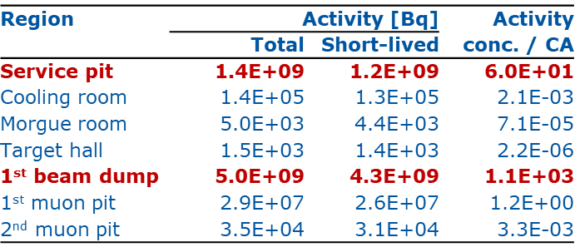
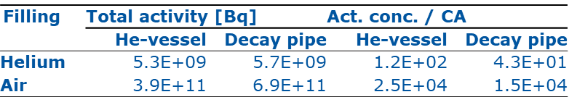
Air and He activation at CENF
Air activation
He activation
Significant contribution from short-lived radionuclides → maximum delay time before releases
Significantly lower impact of He than air → acceptable level of 0.1% of air contamination was evaluated
→ Main air activation at nuSTORM expected in target area, primary beam absorber and depending on losses eventually also in the pion transfer tunnel. Regions should ideally be filled with He or completely separated

Slide 19
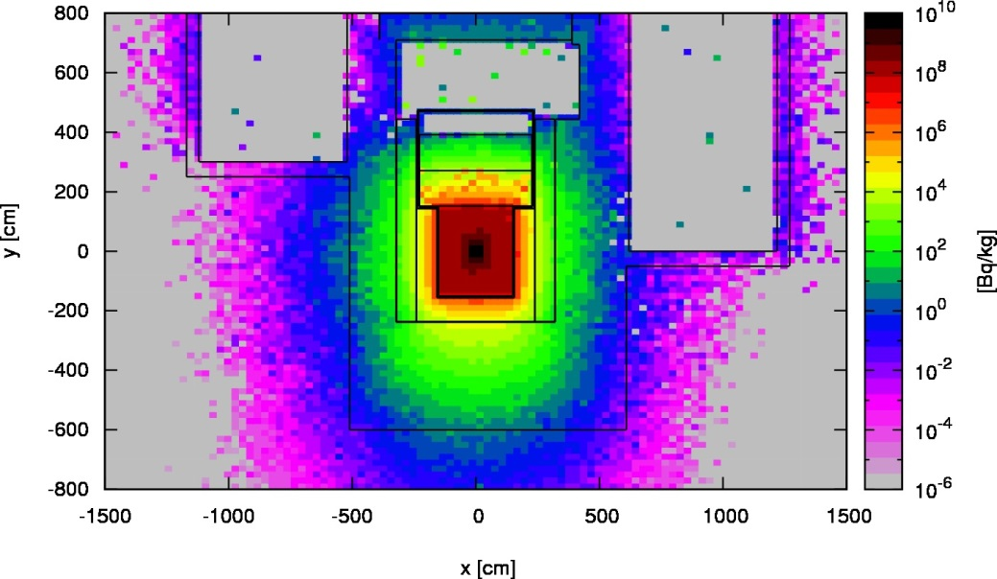
Soil activation at CENF
H-3 activation around the target area
The production of radioactivity in the soil and water is a significant environmental concern
Particularly soluble radionuclides likely to pass through the karstic system are critical for the protection of groundwater resources
To avoid this hazard, it is suggested to enclose the activated elements of the facility and surrounding soil with an impermeable envelope to avoid contact with rainwater and diffusion of tritium via atomic exchange to the outer layers of the geological structure
Such a geo-membrane shall include all zones where the specific activities of the leachable radionuclides ³H and ²²Na lie above the following limits:
³H >10 Bq/kg
²²Na > 2 Bq/kg
> ~1 mSv/h prompt dose
→ Depending on the final shielding setup for nuSTORM, slight soil activation above the given limits could also occur, for which a geo-membrane might have to be foreseen

Slide 20
Environmental considerations for CENF
Effective dose to members of the public due to stray radiation is < 0.2 μSv/y
Effective dose to members of the public due to evaporation of water contaminated with H-3 is < 0.1 μSv/y
Prompt and residual radiation
Water and Ground activation
Air and He
activation
Effective dose to members of the public due to releases of radioactive substance to the ambient air is < 0.13 μSv/y
Effective dose to members of the public remain < 0.5 μSv/y, which is well below the facility optimisation threshold of 10 μSv/y
→ Although the detailed design of the facility is not known yet, one can state, based on the CENF study, that the radiological environmental impact of nuSTORM will be manageable at the present state of technology and that engineering solutions of impact minimisation already exist

Slide 21
Summary and next steps
A preliminary RP assessment of nuSTORM has been done on the basis of the CENF studies
At the next stage of the project, detailed studies allowing a full assessment and optimisation of the facility according to the ALARA principle should be envisaged
General feasibility of such a project in terms of exposure of persons to radiation and the radiological impact on the environment has been found
Particularly the pion-transport channel to the decay ring and the decay ring itself will have to be studied
in view of the expected activation levels
Such detailed studies, as done for the CDS of BDF, would require additional manpower (~1 Fellow)

Slide 23
Optimization
Publication ICRP 103 (2007)
The Principle of Optimisation of Protection: The likelihood of incurring exposure, the number of people exposed, and the magnitude of their individual doses should all be kept as low as reasonably achievable, taking into account economic and societal factors.
The revised Recommendations emphasise the key role of the principle of optimisation. This principle should be applied in the same manner in all exposure situations. Restrictions are applied to doses to a nominal individual (the Reference Person), namely dose constraints for planned exposure situations and reference levels for emergency and existing exposure situations.
Directive 2013/59/Euratom
Planned exposure:
"dose constraint" means a constraint set as a prospective upper bound of individual doses, used to define the range of options considered in the process of optimisation for a given radiation source in a planned exposure situation;
Emergency / existing exposure:
"reference level" means in an emergency exposure situation or in an existing exposure situation, the level of effective dose or equivalent dose or activity concen­tration above which it is judged inappropriate to allow exposures to occur as a result of that exposure situation, even though it is not a limit that may not be exceeded;

Slide 24
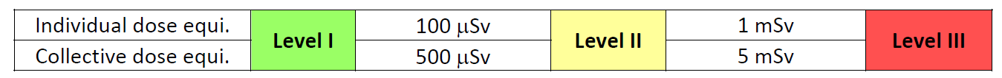
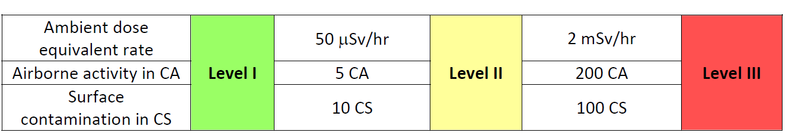
ALARA Criteria and Levels
Optimization is legal requirement if accumulated dose exceeds 100 μSv (ALARA)
Optimization includes different areas/aspects: work coordination, work procedures, handling tools, design, material choices
Reference: “ALARA Rule applied to interventions at CERN”, EDMS 1751123
Group 1 criteria define the ALARA level
ALARA Committee
Group 2 criteria are the bases of a radiological risk assessment (including accidents and incident scenarios) by the RSO and HSE-RP prior to the final ALARA level classification of the intervention.

Slide 25
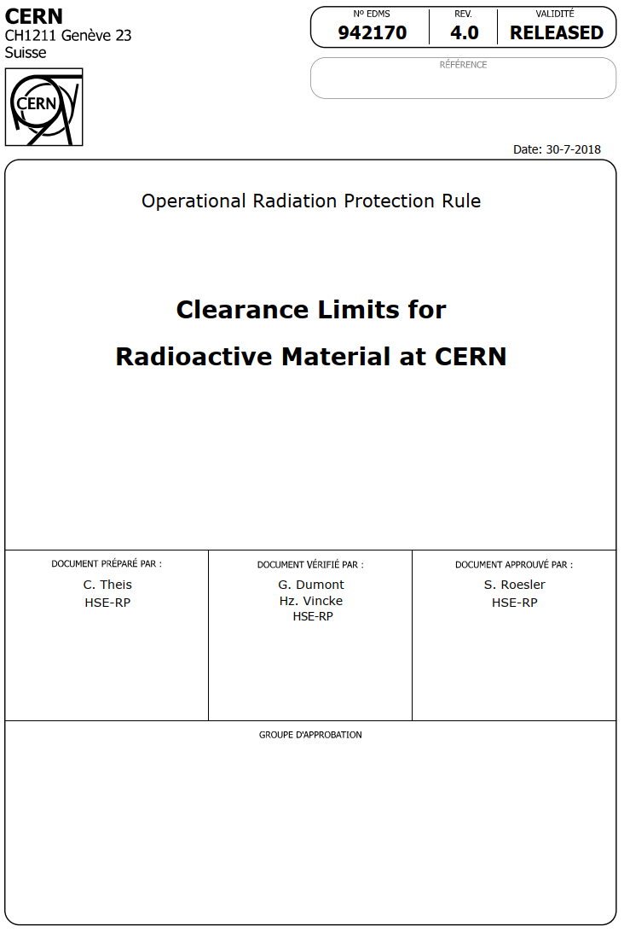
Radioactive material
When is a material radioactive?
Specific and total activity exceed clearance limits
as given in the Annex of EDMS 942170 (adopted from Swiss legislation)
OR
Net ambient dose equivalent rate > 0.1 µSv/h in 10 cm distance
OR
Surface contamination exceeds limits
as given in the Annex of EDMS 942170 (> 1 CS)

Slide 26

Radiation Protection Group
Mandate
“The Radiation Protection Group (HSE-RP) of the HSE Unit ensures that personnel on the CERN sites and the public are protected from potentially harmful effects of ionizing radiation linked to CERN activities. The HSE-RP Group fulfils its mandate in collaboration with the CERN departments owning or operating sources of ionizing radiation and having the responsibility for Radiation Safety of these sources.”
Operational Radiation Protection
  Risk assessments for personnel and public
  Definition of protective measures, authorization of operation
  Lead in implementation of ALARA principle
  Studies for projects and upgrades
  R&D for tools and methods, operation of shielding benchmark facility
Individual Dosimetry
  Monitoring of external and internal doses and reporting (CERN dosimetry service carries official accreditation in Switzerland)
  Operation of calibration facility
Instrumentation
  Development, Installation and operation of radiation monitoring system
Radioactive Waste Management
  Operation of pre-conditioning and interim storage facility
  Waste disposal towards host states
  Support to departments in radioactive waste minimization and treatment
Services
  Inter/intra-site radioactive transport
  Shipping (import/export) of radioactive goods
  Radiological characterization of material and waste, operation of analytical laboratory
  Radioactive sources service

