Slide 1
Recent aLIGO results
and implications for a space
gravitational wave observatory

Slide 2
Talk structure
Introduction to Detectors
Results from aLIGO
Extrapolate to eLISA – What can we expect?

Slide 3
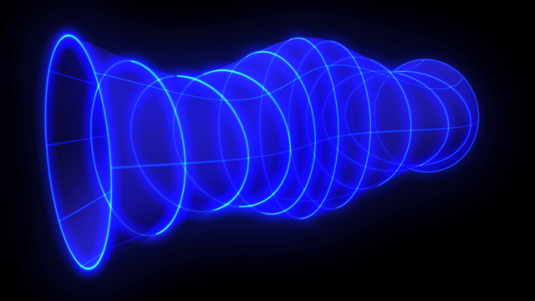
How to Detect a GW
Many sources – pick your frequency band
10^-21 typical peak strain (stellar mass BHBs)
More than one for location

Slide 4
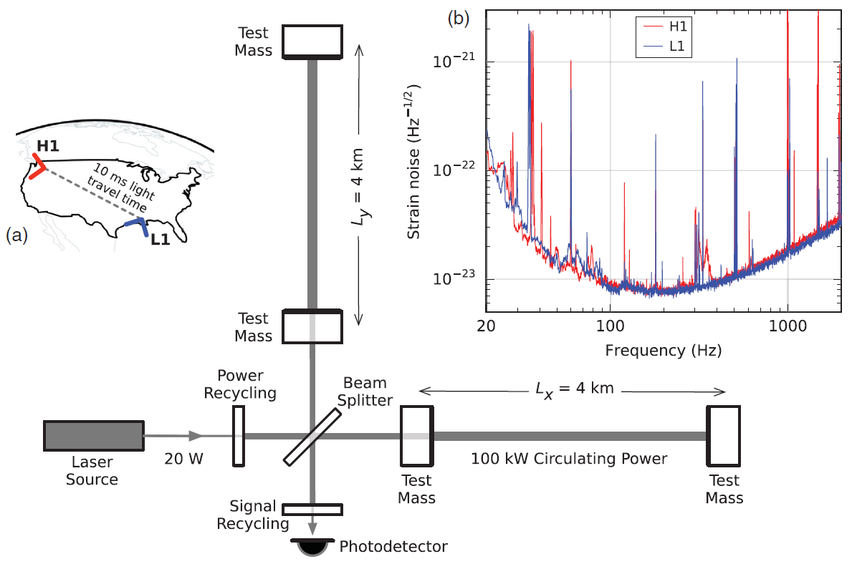
Structure of aLIGO
Two Michelson–Morley Interferometers
Time delay for source placement on sky and correlation statistics
‘Test Masses’ are complex mirrors, suspended on quadruple pendulum
Calibrated using lasers with injection signals and well understood spectral noise
Third detector proposed in India with others under upgrade / operational around the world

Slide 5
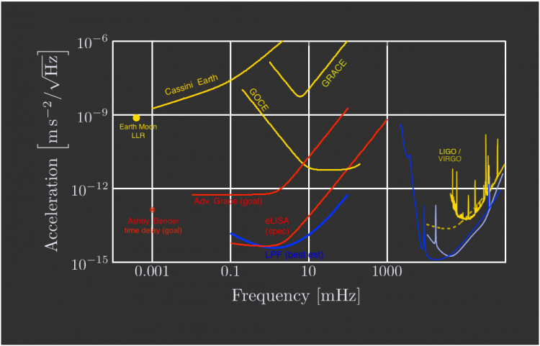
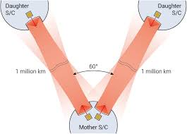
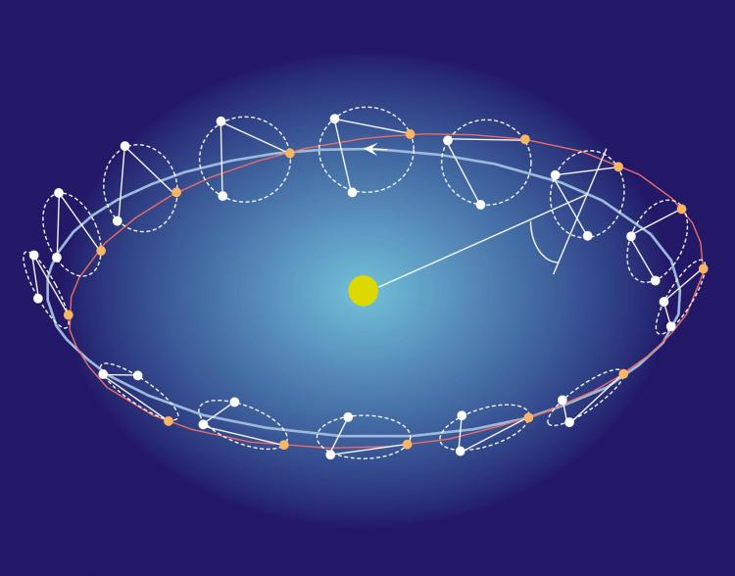
Structure of eLISA
Space GW Observatory to be ESA’s L3 Mission
Several structures proposed
Frequencies target SMBHBs and EMRIs as primary sources
Trajectory behind Earth, inclined to Sun to scan sky

Slide 6
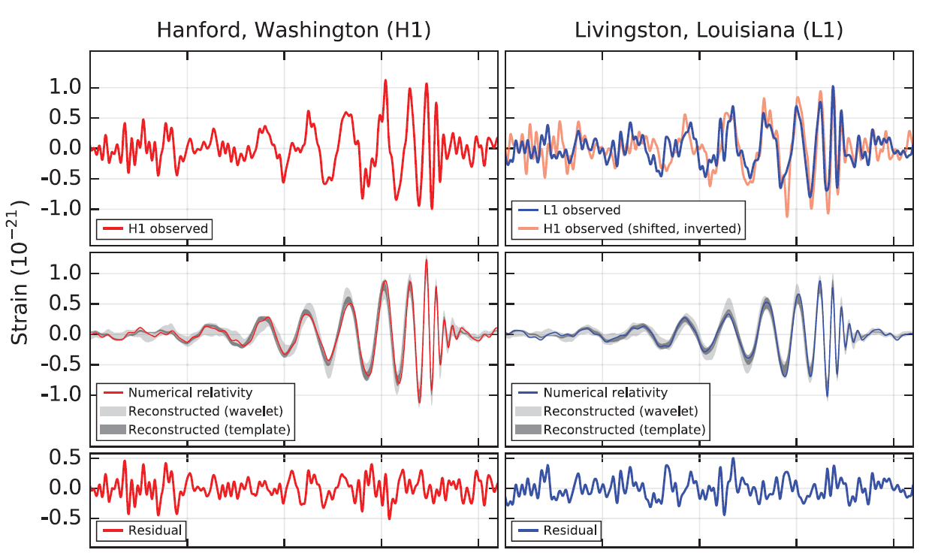
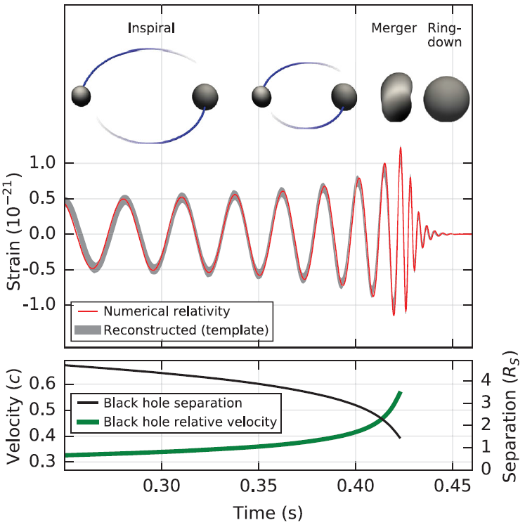

Recent aLIGO Results

Slide 7
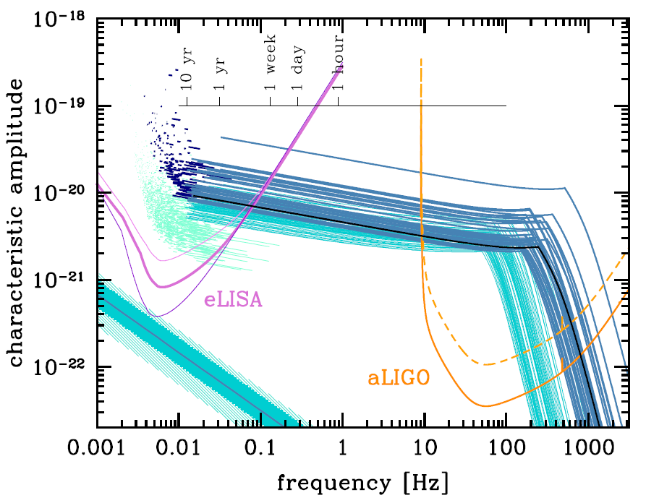
Extrapolate to eLISA
Paper by Alberto Sesana (arXiv:1602.06951v1)
Traceable sources through eLISA band to aLIGO and placement precision to 1deg^2 for EM telescopes
SNR higher, with expected increase in source rates for BHBs

Slide 8
Conclusions
Beginnings of GW Astronomy
Direct detection of Astrophysical objects that otherwise are undetectable
Awaiting results from Pathfinder to confirm necessary geodetic precision for eLISA/LISA/NGO
Congratulations to aLIGO for an impeccable detection. Let there be more!

