Slide 1

Very-Long-Baseline Atom Interferometer Networks
Jeremiah Mitchell
27 March 2023
Atom Interferometric Sensing of Earth’s Spheres

Slide 2
Outline
MAGIS-100 and AION
Long-baseline Atom Interferometer Noise
When is Noise not Noise?

Slide 3
MAGIS-100
Matter-wave Atomic Gradiometer Interferometric Sensor
Long-baseline atom interferometer being built at Fermilab US
3 strontium atom sources along vertical baseline
Test bed experiment for simultaneous atom interferometer control
Prototype 10m device at Stanford
Mahiro Abe et al 2021 Quantum Sci. Technol. 6 044003

Slide 4

MAGIS-100

Slide 5
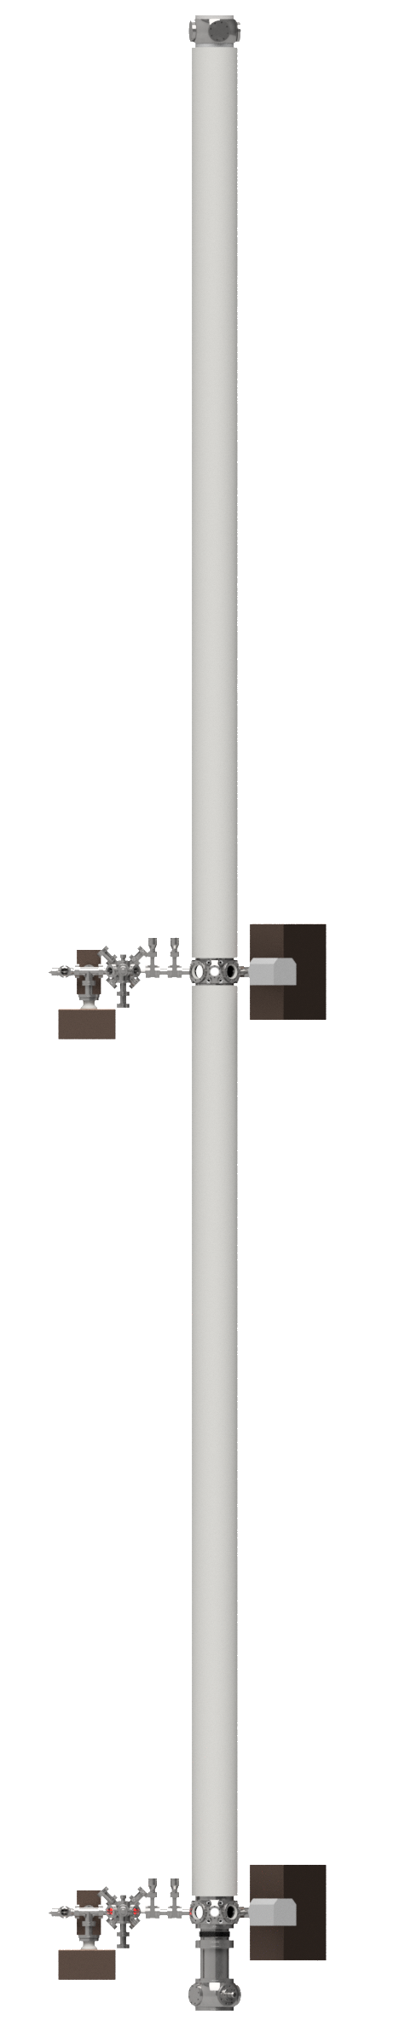
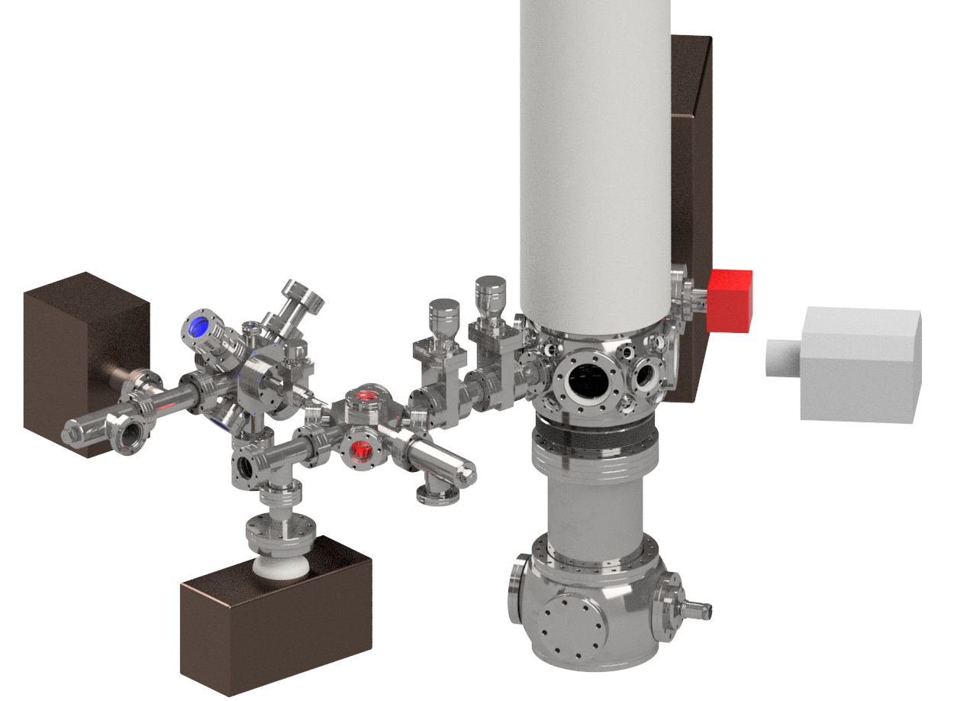
AION
Atom Interferometer Observatory and Network
King’s + Imperial Colleges: Theory and publication office
Cambridge: transport, launching, cooling atoms for AION, DAQ/analysis for MAGIS
University of Birmingham: LMT pulse sequences, Sr technology transfer
UK consortium of 7 institutions
Develop ultracold strontium laboratories in parallel
Staged project for increased baseline atom interferometers 10m -> 100m -> 1km
Investigate technology development and network with MAGIS-100 for large scale science goals
Cambridge, Imperial, B’ham: modelling system parameters
Imperial: (clock) laser stabilisation, squeezing
10m
Rutherford-Appleton Lab (STFC): Vacuum + support structure. Design AION-100
Liverpool: in-vacuum optics for MAGIS + AION
Oxford: site, cold-atom source, laser lab, construction for AION, camera system design for MAGIS
L. Badurina et al JCAP05(2020)011

Slide 6
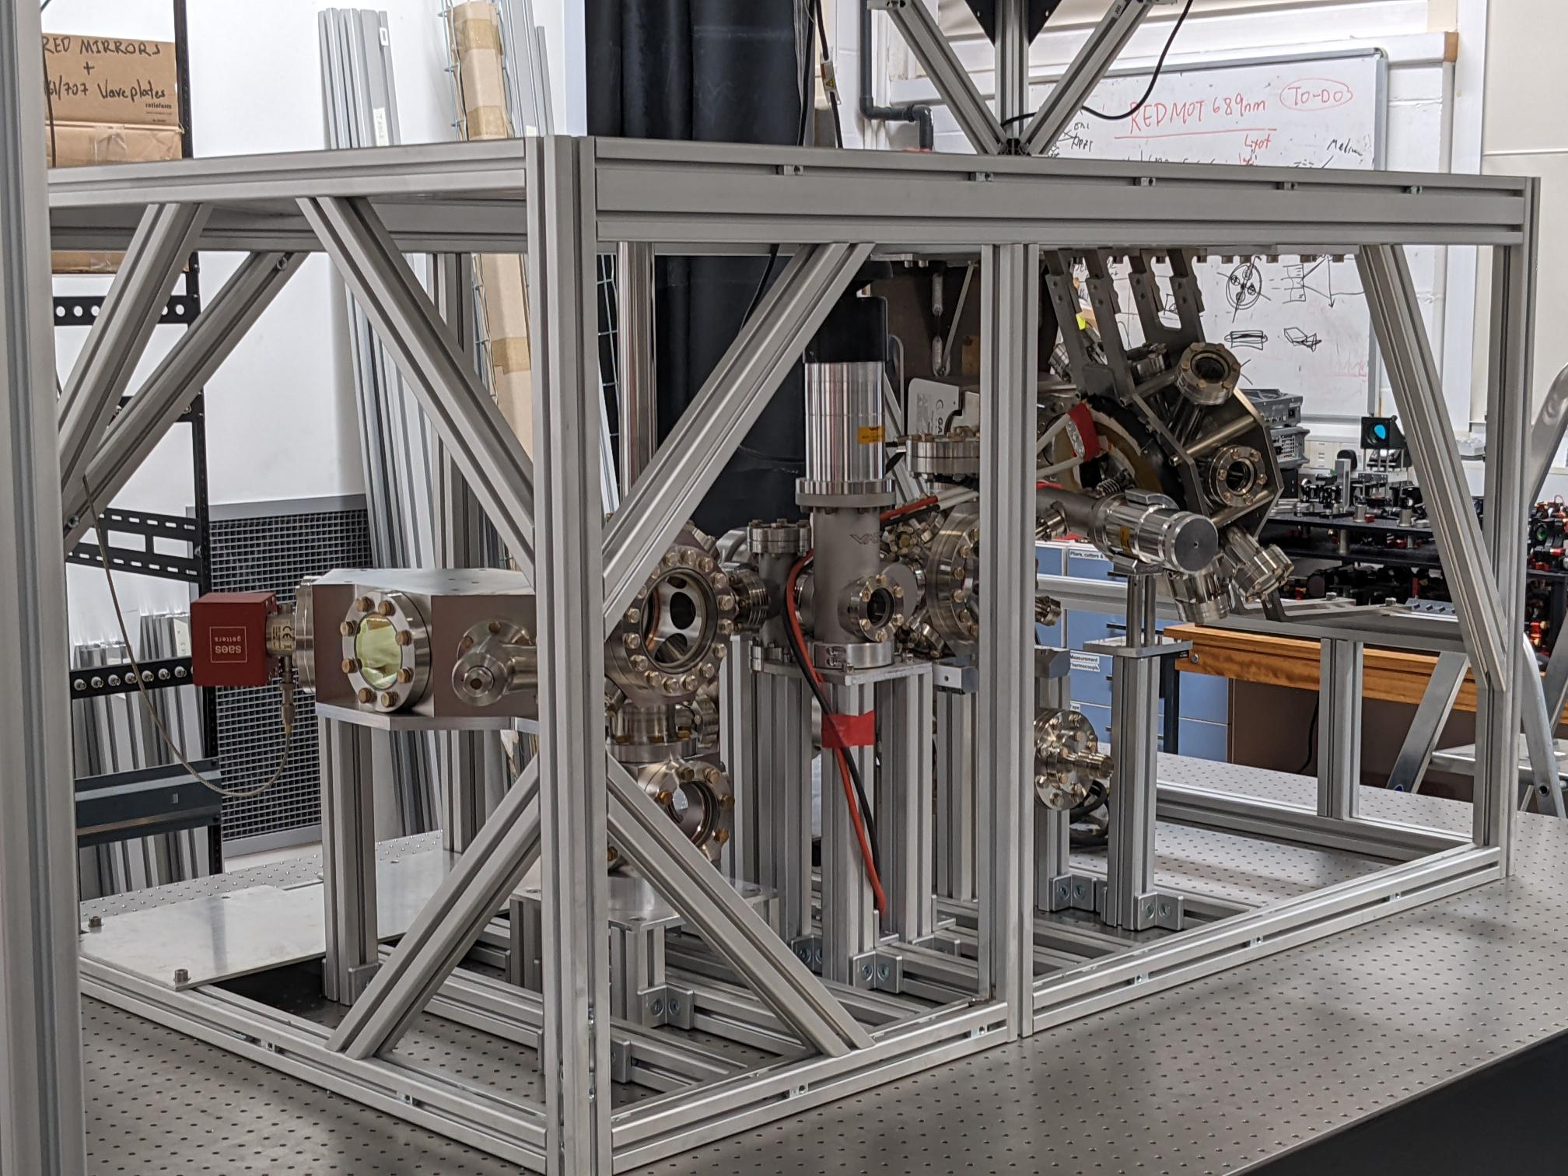

AION
Cambridge ultra high vacuum system
Image credit: Tiffany Harte

Slide 7
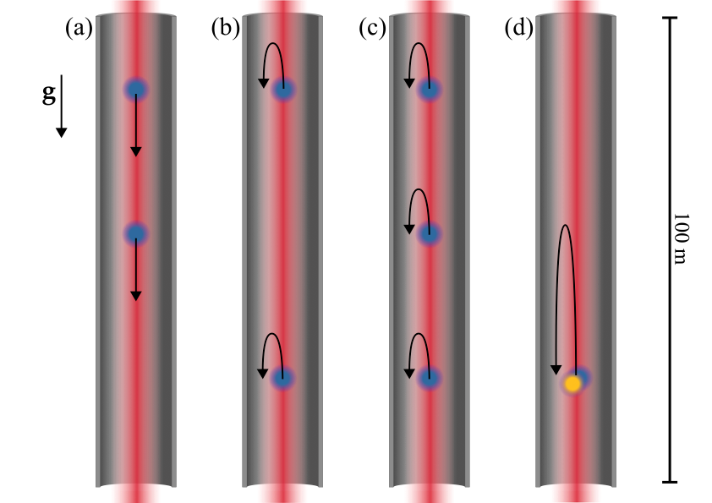
Underlying technology
Multi-loop geometries
Multiple configurations
Gradiometry
Large-momentum transfer (LMT)
Graham et al. PRL (2013)

Slide 8
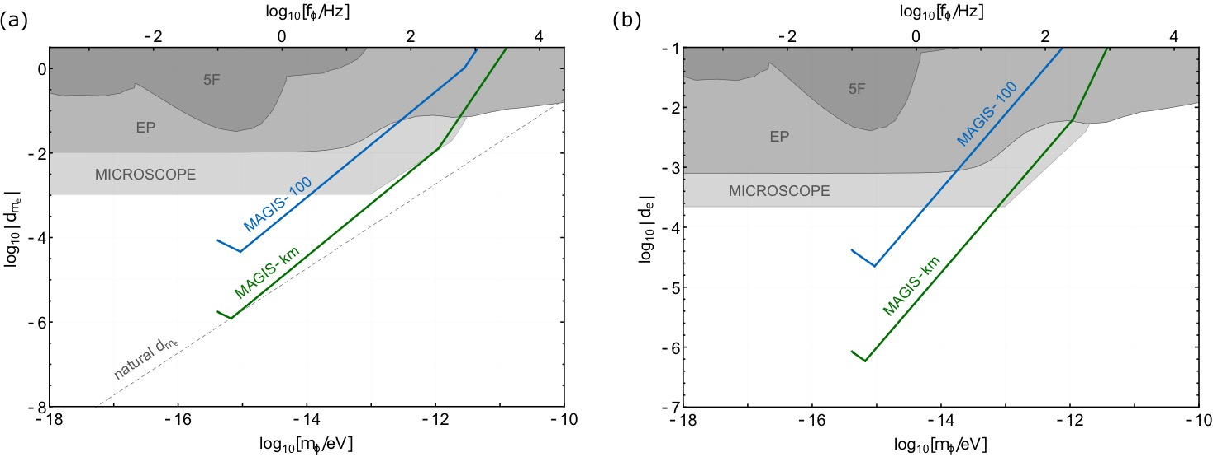
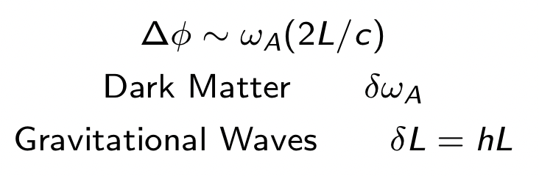
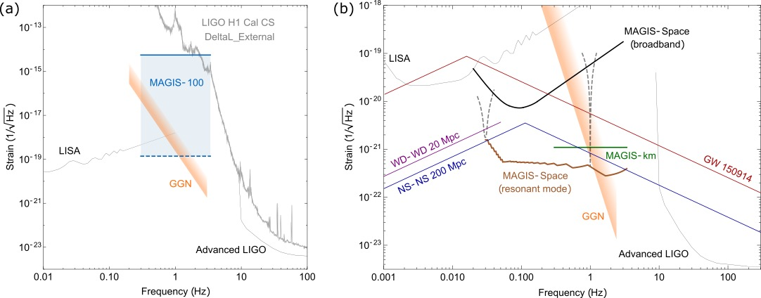
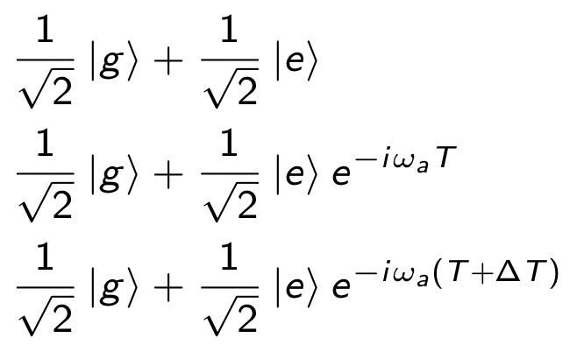
Big science goals
Ultralight dark matter searches
Gravitational wave searches
A
B
Mahiro Abe et al 2021 Quantum Sci. Technol. 6 044003

Slide 9
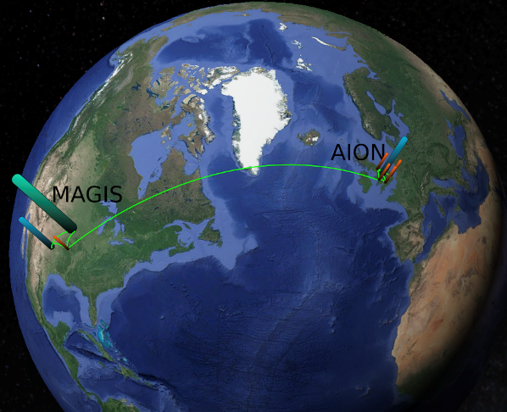
Locations and networking
With global network of detectors enhance sensitivity to signals (SNR increase with atom number increase)
Time stamping and correlation for signal verification
Uncommon background noise
Potential increased science reach
Common background noise?

Slide 10
Noise sources

Slide 11
Local noise
Local to atom interferometer systems
Laser laboratory
Atom sources
Interferometry region
Laser fluctuations
Vibrations

Slide 12
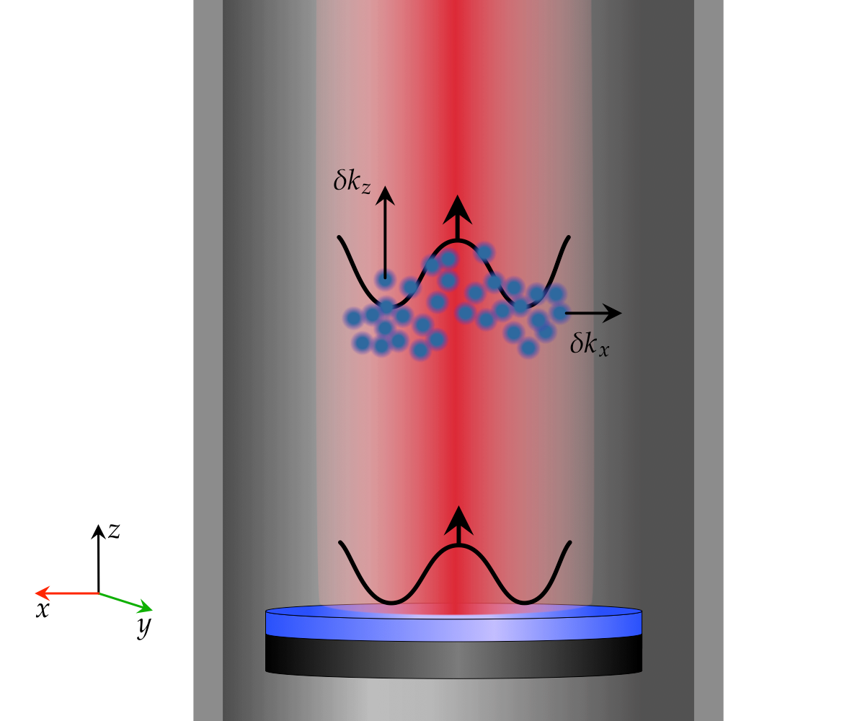
Laser noise
Effective transverse momentum
Effective longitudinal momentum

Slide 13
Vibrations
Motion of floors and walls for mounting
Connection couples into shot-shot variations of phase shift
  Steering optics and mirrors for interaction lasers, optics and systems associated with the cold atom cloud production
Mitigated through damping, isolation, or decoupling
Actively tracked through auxiliary instrumentation
2021 Quantum Sci. Technol. 6 044003

Slide 14
Ambient noise
Noise we cannot control
Site specific
Seismic
Atmospheric
Thermal

Slide 15
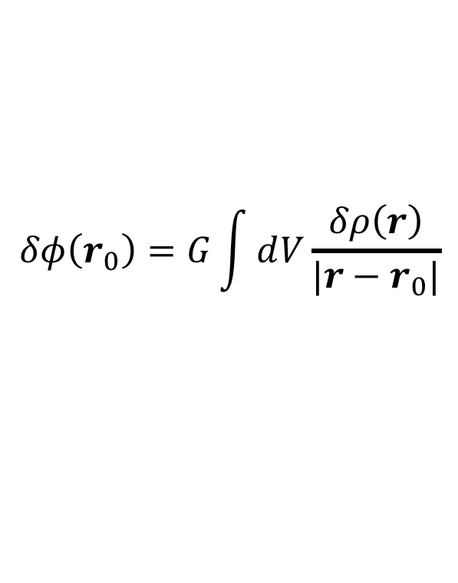
Newtonian noise
Density perturbations causing time varying gravitational potentials
Direct couplings to experimental systems e.g. support structure, optics, steering mirror
Secondary coupling of test masses (cold atom clouds) to experienced gravitational potential
$$δφ\left(r_{0}\right)=G\int{ⅆV\frac{δρ\left(r\right)}{|r−r_{0}|}}$$

Slide 16
Seismic gravity gradient noise
Vertical displacement amplitude spectral density
Rayleigh surface waves

Slide 17
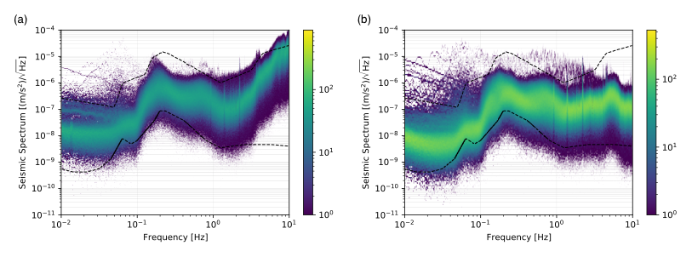
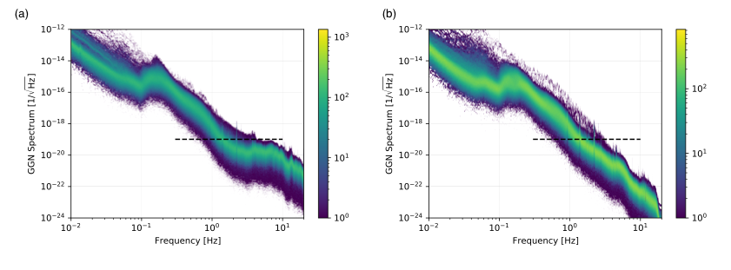
Seismic gravity gradient noise
Measurements at Fermi National Accelerator Laboratory (a) at the surface, (b) underground
Inferred GGN strain from vertical displacement amplitude spectral densities over 100 m baseline
J. Mitchell et al 2022 JINST 17 P01007, E02001

Slide 18
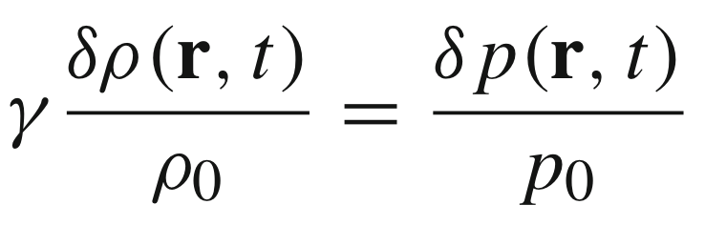
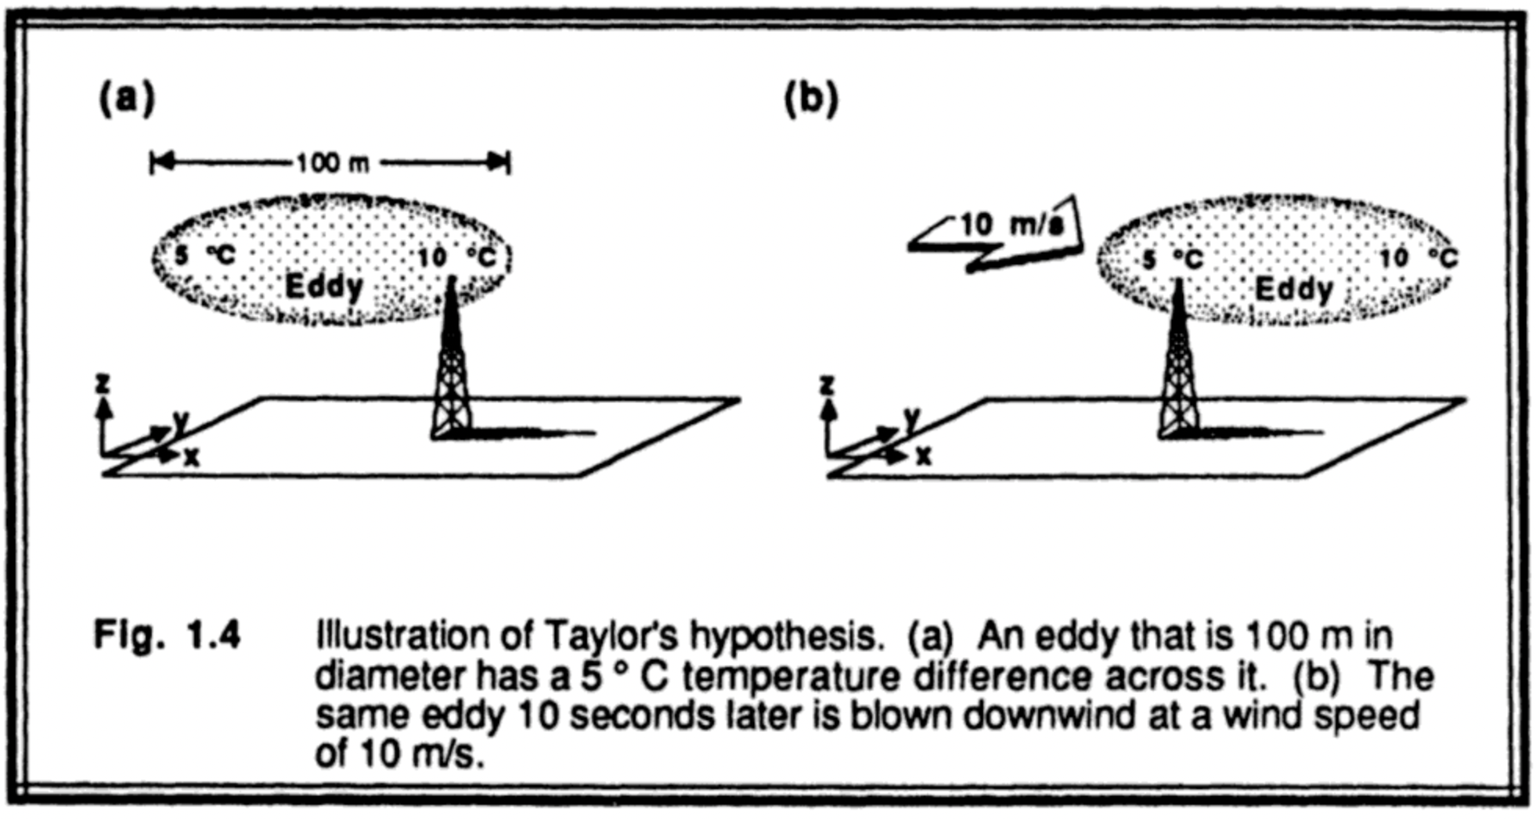
Atmospheric gravity gradient noise
Infrasound (plane pressure waves) reflecting off half-space
Advected turbulent temperature gradients following Taylor’s hypothesis
Stull, R. B. (1988). Springer Science & Business Media.

Slide 19
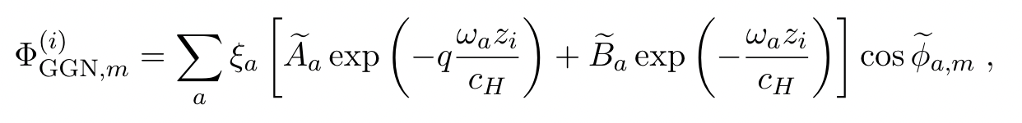
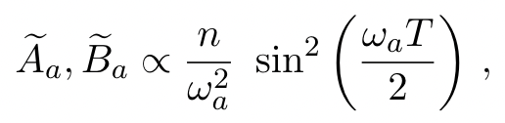
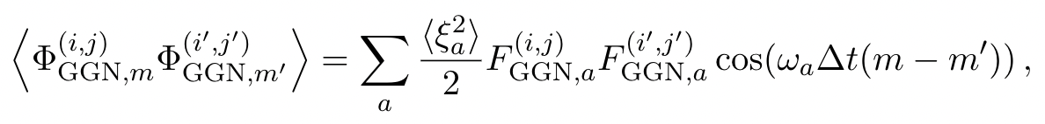
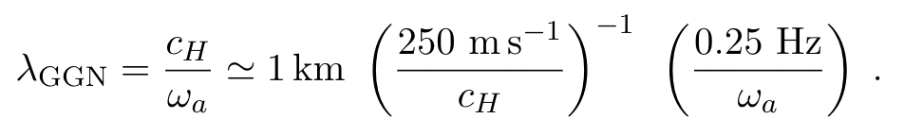
Noise in dark matter searches
Calculated via semi-classical perturbative analysis
Characteristic length scale
Badurina, et al. Phys. Rev. D 107, 055002

Slide 20
Noise in dark matter searches
DM Sensitivity gain with multi-gradiometer configuration
Earth property effects
Badurina, et al. Phys. Rev. D 107, 055002

Slide 21
When is noise not noise?
Potential of detecting GGN
Earth normal modes in sub-mHz range with network of detectors spanning globe
Micro seismicity and atmospheric fluctuations
Multiple cycles of Rayleigh modes

Slide 22
Open questions
Need better models of atmospheric sources of density perturbations
  Infrasound waves
  Advected temperature gradients
Low frequency cut-offs and limitations
Stationarity or predictability lead to better noise suppression for long-baseline detectors

Slide 23
Summary
Very-long-baseline detectors have big science reach
Potential for accessing interesting Earth science effects
Better modelling would benefit understanding
Mitigation strategies informed by Earth science instrumentation and arrays will be crucial for low-frequency sensitivity

