Slide 1
A Brief Tutorial on Sensing with Cold Atoms
Tim Kovachy
Department of Physics and Astronomy and Center for Fundamental Physics (CFP), Northwestern University
Workshop on Atom Interferometric Sensing of Earth’s Spheres
March 27-28, 2023

Slide 2
Summary
Overview of atom cooling
Introduction to the two-level atom
Ramsey interferometry and atomic clocks
Atom interferometers

Slide 3

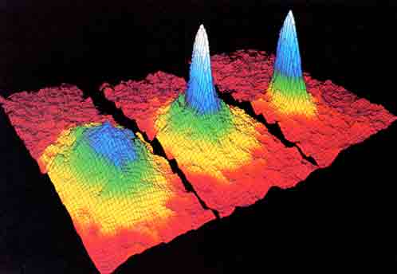
Ultracold Atoms
Why cold atoms?
  easier to manipulate: atoms remain in small, slowly expanding cloud
  Reduced Doppler shifts
  At high densities, opportunities to study interesting many-body effects
Nobel prize 1997: Laser cooling
  Temperatures ~
  No cryogenics needed
Nobel prize 2001: Bose-Einstein condensation
  Temperatures <100 nK
  Nearly all atoms occupy same quantum state
Images: http://www.nobelprize.org

Slide 4
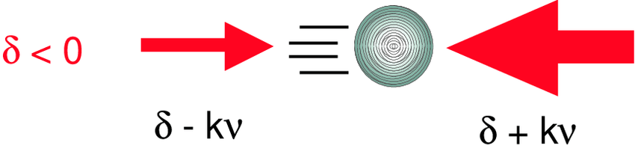
Doppler Cooling
There are a number of different atom cooling techniques. We will introduce a couple examples
One of the most important techniques: Doppler cooling
Counter-propagating beams tuned below atomic transition
Doppler shift makes atom more likely to absorb photon (and corresponding momentum kick) from direction opposing its motion
Leads to damping force that provides cooling
Maruyama, PhD Thesis 2003

Slide 5
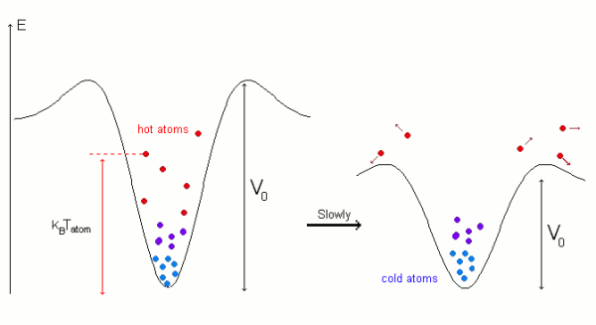
Evaporative Cooling
Evaporation: something we are familiar with from everyday life
Hotter atoms escape trap, leaving remaining atoms with less energy
Often used to create Bose-Einstein condensates
http://large.stanford.edu/courses/2009/ph376/amet1/

Slide 6

Atom Lensing
Optical Collimation:
position
Atom Collimation:
Trade off larger cloud size for reduced velocity spread
time
38 pK effective temperature reached: Deppner et al, PRL 127, 100401 (2021)
Ammann & Christensen, PRL 78, 1997

Slide 7
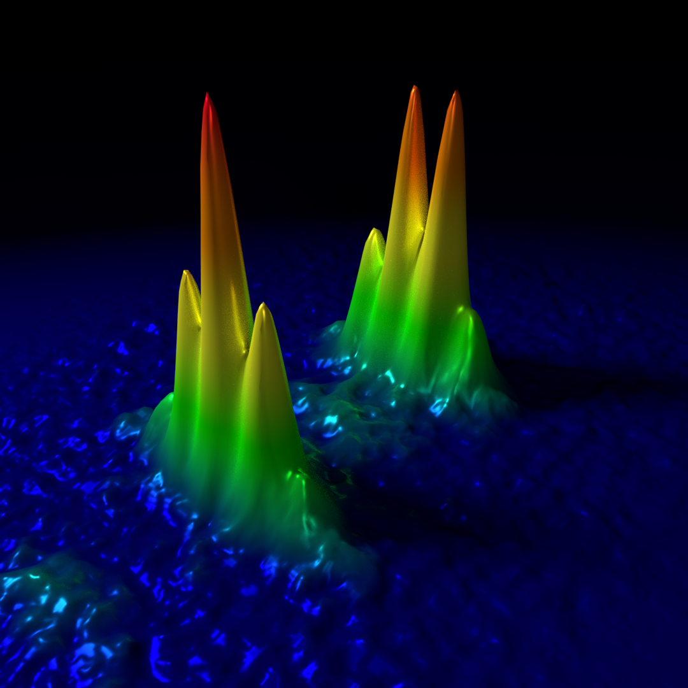
Sensing with Quantum Superpositions
Make an interference measurement between the different states in a quantum superposition
Will reveal phase that has evolved between the different states
This phase is often highly sensitive to a variety of quantities we might want to measure
A simple and broadly applicable example: Ramsey interferometry with two-level atom
  Provides a useful intuition for understanding atom interferometry
Fringes from interfering different spatial components of an atom’s wavefunction

Slide 8
The Quantum Two-Level System
Key building block for understanding quantum sensors
Two states with transition frequency
Coupling matrix element
Example: two states coupled by an electric dipole interaction, with interaction Hamiltonian term for electric dipole operator and applied time-varying electric field:
corresponds to the phase of driving electric field at the location of the two-level system

Slide 9
The Quantum Two-Level System
General form of wavefunction, where now we pull phase factors from the free evolution of the system into the definition of the states (interaction picture)
Substitute into Schroedinger equation to get dynamical equations of motion for coefficients
What approximation might we be able to make to simplify these equations, assuming that the transition frequency is much larger than the drive strength

Slide 10
The Quantum Two-Level System
Rotating wave approximation: ignore rapidly oscillating exponential terms, since the contributions from these will approximately average to 0:
Solutions to simplified equations:

Slide 11
Quantum Beam Splitters and Mirrors
Probability sinusoidally oscillates between the two states. If all probability initially in state 1, then:
Beam splitter or π/2-pulse “splits” quantum state into 50/50 superposition of the two states:

Slide 12
Quantum Beam Splitters and Mirrors
Probability sinusoidally oscillates between the two states. If all probability initially in state 1, then:
Mirror or π-pulse “reflects” quantum amplitude from one state to the other:

Slide 13
Ramsey Interferometry
Uses quantum superposition and interference to determine frequency difference between two quantum states
Important tool for atomic clocks
Depending on the system under consideration, this frequency difference can depend on variety of quantities we might want to measure, such as:
  Magnetic and electric fields
  Fundamental constants such as the fine structure constant or electron mass, which could undergo small oscillations induced by certain dark matter candidates
  Temperature
  Pressure
  Interactions with surrounding particles

Slide 14
Ramsey Sequence
Steps
  1. Initial π/2-pulse to create superposition of two states
  2. free evolution for a time T
  3. Final π/2-pulse to make quantum amplitudes in the two states interfere
  4. Measure relative populations of two states, which reveals evolved phase
Consider a driving field oscillating at frequency close to (but not necessarily identical to) the transition frequency , approximate pulses as instantaneous for simplicity
For a pulse applied at time t , imprinted phase from π/2-pulse will be
Recall that time-dependence from free evolution factored into state definitions, and that the full phase of the drive field is

Slide 15
Ramsey Sequence
Initial pulse at time t=0 creates the following superposition
Final π/2-pulse at time t= T applies the following transformation
Final State

Slide 16
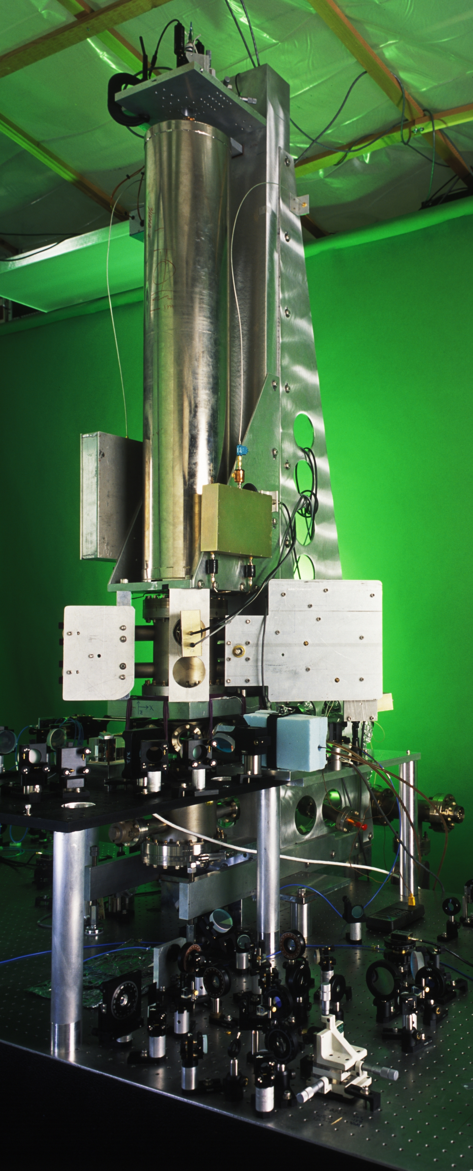
Ramsey Sequence
Measure populations in the two states. Probability of ending up in either state is:
For a well-known drive frequency, measurement of phase shift allows transition frequency to be determined
Alternatively, if transition frequency is well-known (e.g., it is a stable atomic transition), can measure and apply feedback to stabilize drive frequency
  The stable drive frequency can then serve as a stable reference for a clock
  This is the idea behind how an atomic clock works
NIST-F1 Cs Atomic Clock

Slide 17
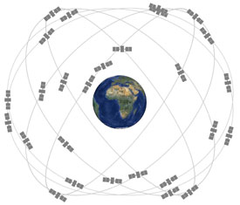
Atomic Clock Applications
Stable time reference to which clocks around the world can be synchronized
GPS
Tests of special and general relativity
  As an example of sensitivity, special relativistic and also gravitational time dilation is important to consider for GPS
Stabilizing lasers for use in precision spectroscopy, valuable for a variety of fundamental physics tests
Searches for wavelike, ultralight dark matter
Gravitational wave detection
gps.gov

Slide 18
Matter Wave Interferometry
Massive objects such as neutrons, atoms, and molecules can exist in quantum superpositions of two spatially distinct trajectories
Similar concept as Ramsey interferometry, but add a “mirror” pulse in the middle to make sure two trajectories overlap at the end
Neutral atoms are excellent inertial test masses
  Freely falling in vacuum
  Relatively insensitive to electromagnetic forces
  Atomic susceptibilities well-known and universal (Stark shifts, Zeeman shifts, etc…)
Sensitive to a variety of quantities of interest, for example:
  Accelerations and rotations, useful for inertial navigation
  Gravity: gravity mapping and fundamental tests of gravity
  Measurements of atomic and molecular polarizabilities
  Measurements of the fundamental constants
  Searches for ultralight dark matter
  Gravitational wave detection in new frequency bands
  Fundamental tests of quantum mechanics: can we create quantum superpositions arbitrarily large size, or are there fundamental limitations to this?

Slide 19
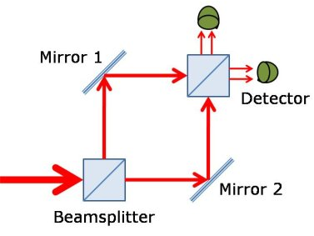
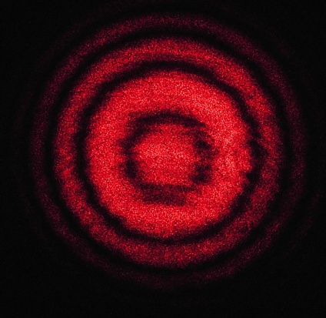
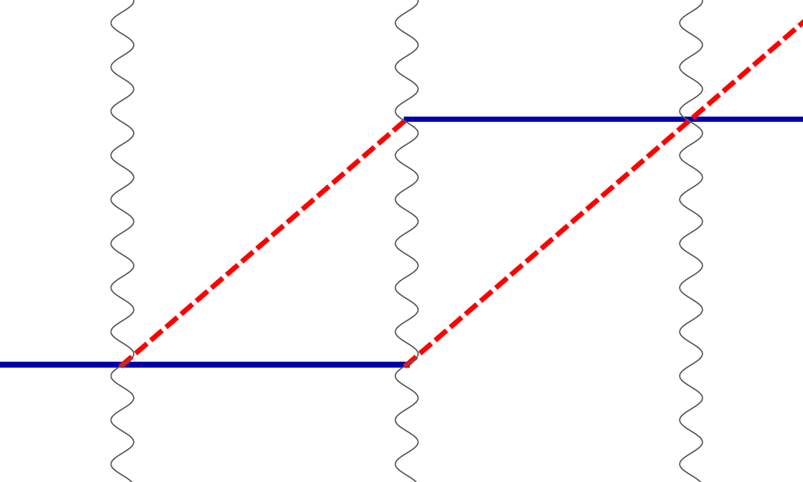
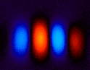
Atom interferometry
Light interferometer
Light
Light fringes
Atom interferometer
Beamsplitter
Atom fringes
Atom
Beamsplitter
Mirror
http://scienceblogs.com/principles/2013/10/22/quantum-erasure/
http://www.cobolt.se/interferometry.html

Slide 20

Atom optics using light
(1) Light absorption (transition from ground to excited state):
ħk
v = ħk/m
(2) Stimulated emission (transition from excited to ground state):
v = ħk/m
ħk

Slide 21
Atom optics using light
(1) Light absorption:
Rabi oscillations
ħk
v = ħk/m
(2) Stimulated emission:
v = ħk/m
ħk
Time

Slide 22
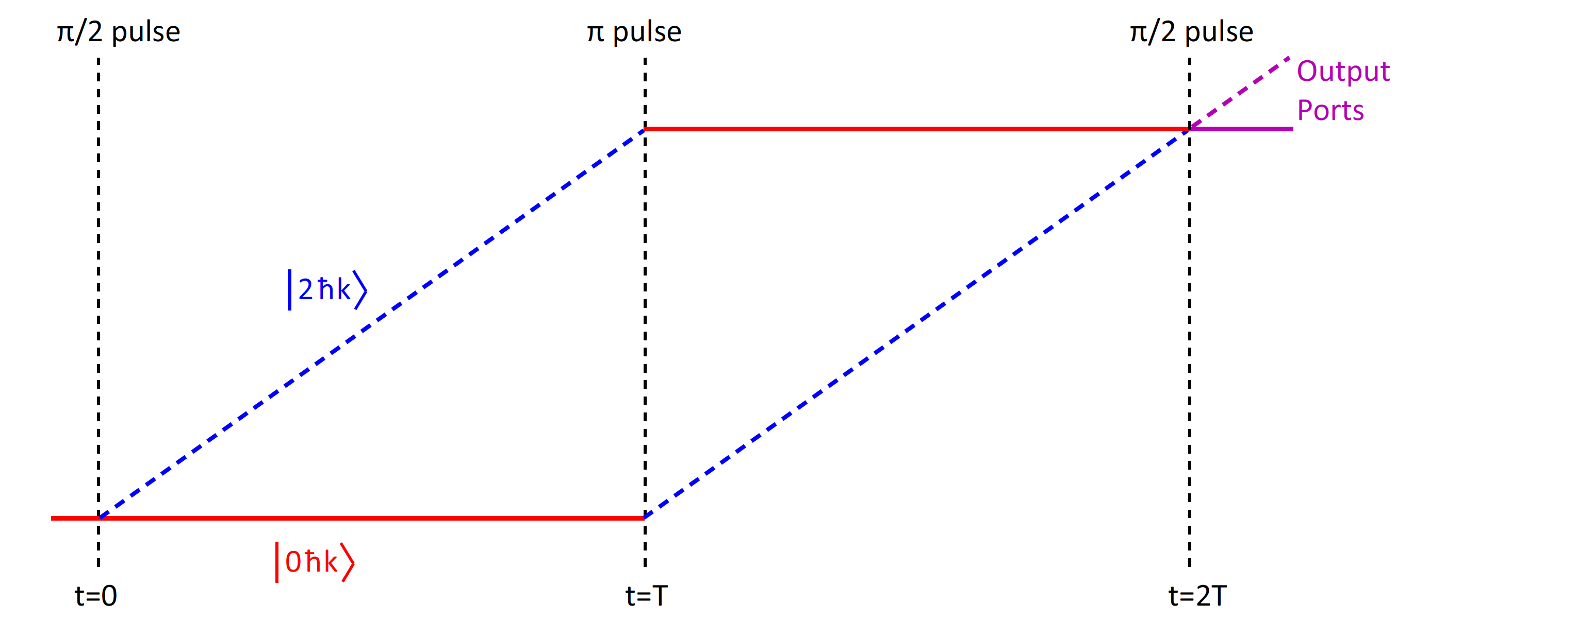
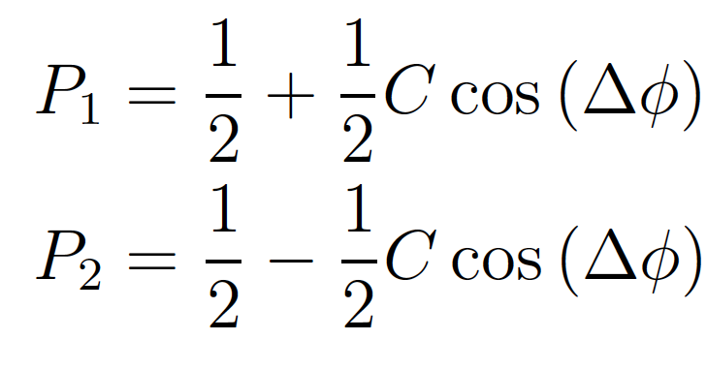
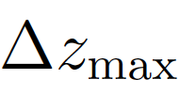
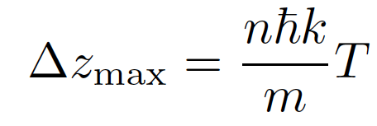

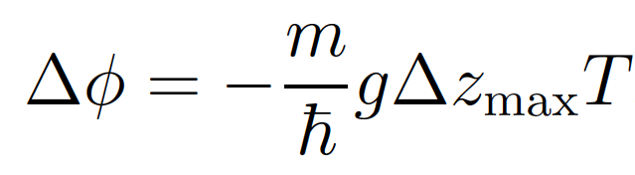

Phase Shift Sensitivity
Back-of-the-envelope phase shift calculation (not fully rigorous, but gives the right answer): look at gravitational potential energy difference between two paths
g
n
For 2ℏk atom optics and T = 1 s,
phase shift is ~2 x 10⁸ rad

Slide 23
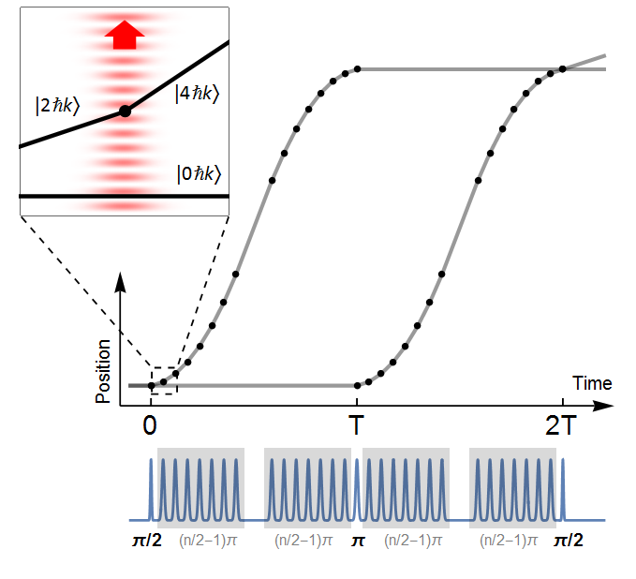
Macroscopic Scale Atom Interferometry
Long duration (2 seconds), large separation (tens of centimeters) matter wave interferometer
Sensitive enough that Earth’s gravity gradient creates a 1 radian phase shift over the millimeter size of the atom cloud
max wavepacket separation
Up to 90 photons worth of momentum: large momentum transfer (LMT)
TK, P. Asenbaum, C. Overstreet, C. Donnelly, S. Dickerson, A. Sugarbaker, J. Hogan, and M. Kasevich, Nature 2015
P. Asenbaum, C. Overstreet, TK, D. Brown, J. Hogan, and M. Kasevich, PRL 2017

Slide 24
Precision Gravity Gradiometry
Differential measurement between two interferometers separated over a baseline
Used macroscopic scale atom interferometers for enhanced sensitivity, observed common mode suppression of laser noise
See also McGuirk et al., PRA 65, 033608 (2002)
Gradiometer interference fringes
P. Asenbaum, C. Overstreet, TK, D. Brown, J. Hogan, and M. Kasevich, PRL 2017
10 ћk
30 ћk

Slide 25
Measuring Gravity from a Local Source Mass
Gradiometer response to 84 kg lead test mass
Upper interferometer
Lower interferometer
P. Asenbaum, C. Overstreet, TK, D. Brown, J. Hogan, and M. Kasevich, PRL 2017

Slide 26
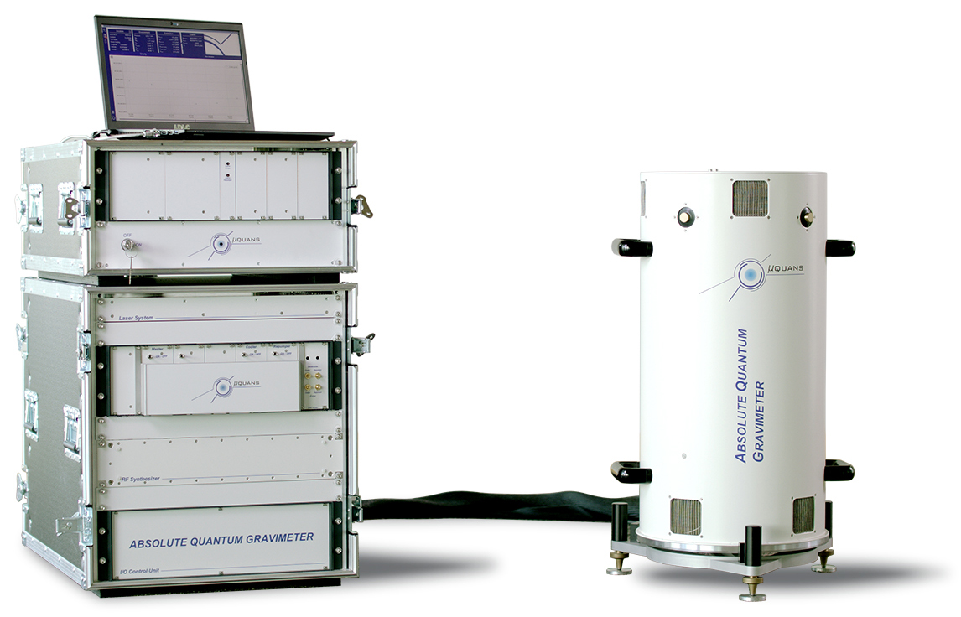
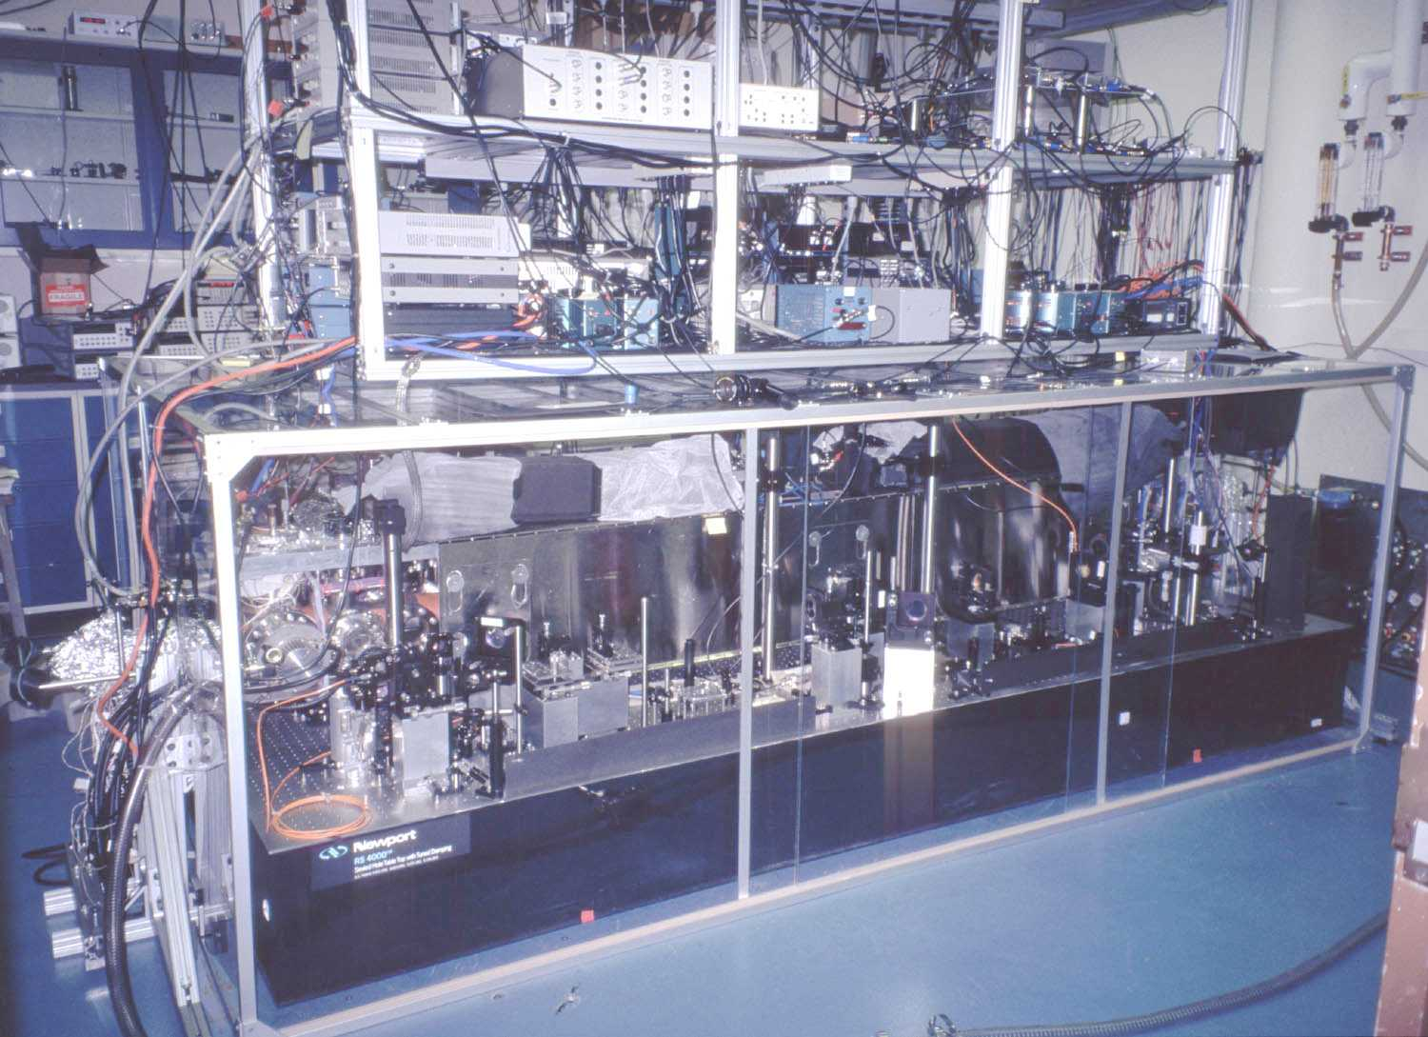
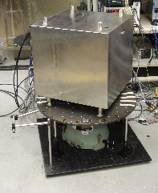
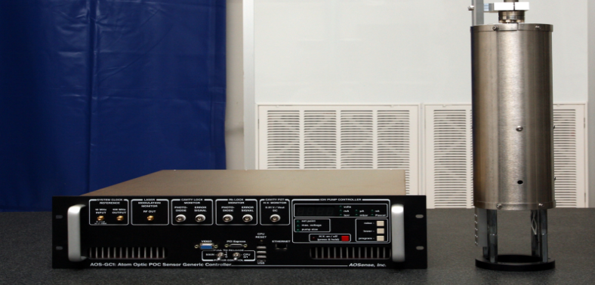
Atom Interferometry (AI)-Based Inertial Sensors
Many successful efforts to transform from lab-scale instruments to transportable sensors (only a few of many examples shown here)
Technology evolution:
Muquans commercial AI
Gravimeter
Stanford/Yale AI gyroscope (1997)
Stanford AI compact
gyroscope (2008)
AOSense commercial AI
Gravimeter
Notes:
Gustavson: 6 x 10^-10 rad/s/sqrt(Hz); 8.5 x 10^-8 rad/s/sqrt(Hz)

Slide 27
More to Come in this Workshop
Technical challenges of cold atom technology
Earth Science applications of atom interferometry
Science opportunities offered by very-long-baseline atom interferometers
The need to better understand environmental backgrounds in atom interferometers

Slide 28
Extra Slides

Slide 29
The Standard Quantum Limit
For an interferometer, we would like to estimate the phase evolved between the two branches of the wave function based on the probability of detecting a particle in one state vs. the other after the final beam splitter
Say that we perform this measurement for N uncorrelated particles, each with the same evolved phase
Probability of finding a given particle in output state 1
Mean number of particles found in state 1
Which statistical distribution should we use to describe the probabilities of finding a given number of particles in state 1?
How would we expect the uncertainty in the evolved phase to scale with N?

Slide 30
The Standard Quantum Limit
The binomial distribution is appropriate here
Based on the properties of this distribution, the standard deviation in the number of particles found in state 1 is
Applying uncertainty propagation to the equation , we obtain the additional relation
The uncertainty in the estimated phase is thus

Slide 31
Number-Phase Uncertainty Relation
It turns out that there is a general relationship between the uncertainty in the number of excitations of a quantum system and the uncertainty in the phase of the quantum state
Consider that each excitation corresponds to energy
  Could corresponds to photons each of energy
  Could correspond to how many atoms in a two-level system are in the excited state, with transition energy
Back-of-the-envelope derivation from energy-time uncertainty principle
Can also be derived more formally

Slide 32
Number-Phase Uncertainty Relation
For typical uncorrelated systems, such as nominally classical light sources or collections of uncorrelated two-level systems, the state of the system is well described as a coherent state
Coherent states reach the lower bound of the number-phase uncertainty relation, with the following balance between the uncertainty in the number of excitations and the uncertainty in the phase
Can trade off greater uncertainty in number for reduced uncertainty in phase by employing entanglement, often referred to as squeezed states
For N particles, maximum possible uncertainty in number of excitations is N
Implies the Heisenberg limit for phase resolution:

Slide 33
Squeezing Example
Entanglement between atoms used for a Ramsey sequence generated by using the interaction between atoms and light in an optical cavity
Phase uncertainty, and resulting population uncertainty in interferometer output ports, reduced by a factor of ~10 beyond standard quantum limit
Another example: squeezing used to improved sensitivity of LIGO (Aasi et al., Nature Photonics 7, 613 (2013))
Distributions from squeezed states
Distributions from unentangled state
N. Engelson, Ph.D. thesis, Stanford University

Slide 34
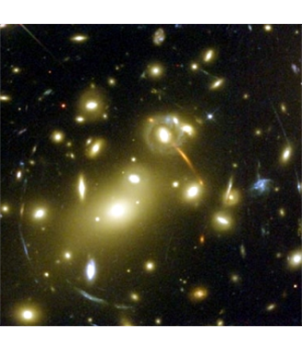
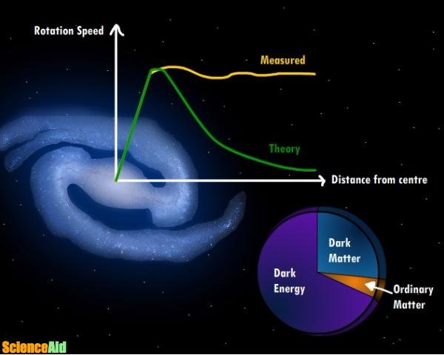
Dark Matter
We know it’s there, but what is it?
Galactic rotation curves not consistent with luminous matter only
Gravitational lensing that is not explained by luminous matter
Other evidence includes dynamics of galaxy interactions, structure of cosmic microwave background, etc…

Slide 35



Ultralight dark matter
Ultralight DM acts as a coherent, wavelike background field
Example for scalar DM field:
+ …
Electron
coupling
Photon
coupling
e.g., QCD
DM scalar field
DM mass density
DM coupling causes time-varying atomic energy levels:
DM induced oscillation
Dark matter coupling
Time

