Slide 1

Investigating a possible low energy excess of muon to electron neutrino oscillations
Imogen Camp

Slide 2
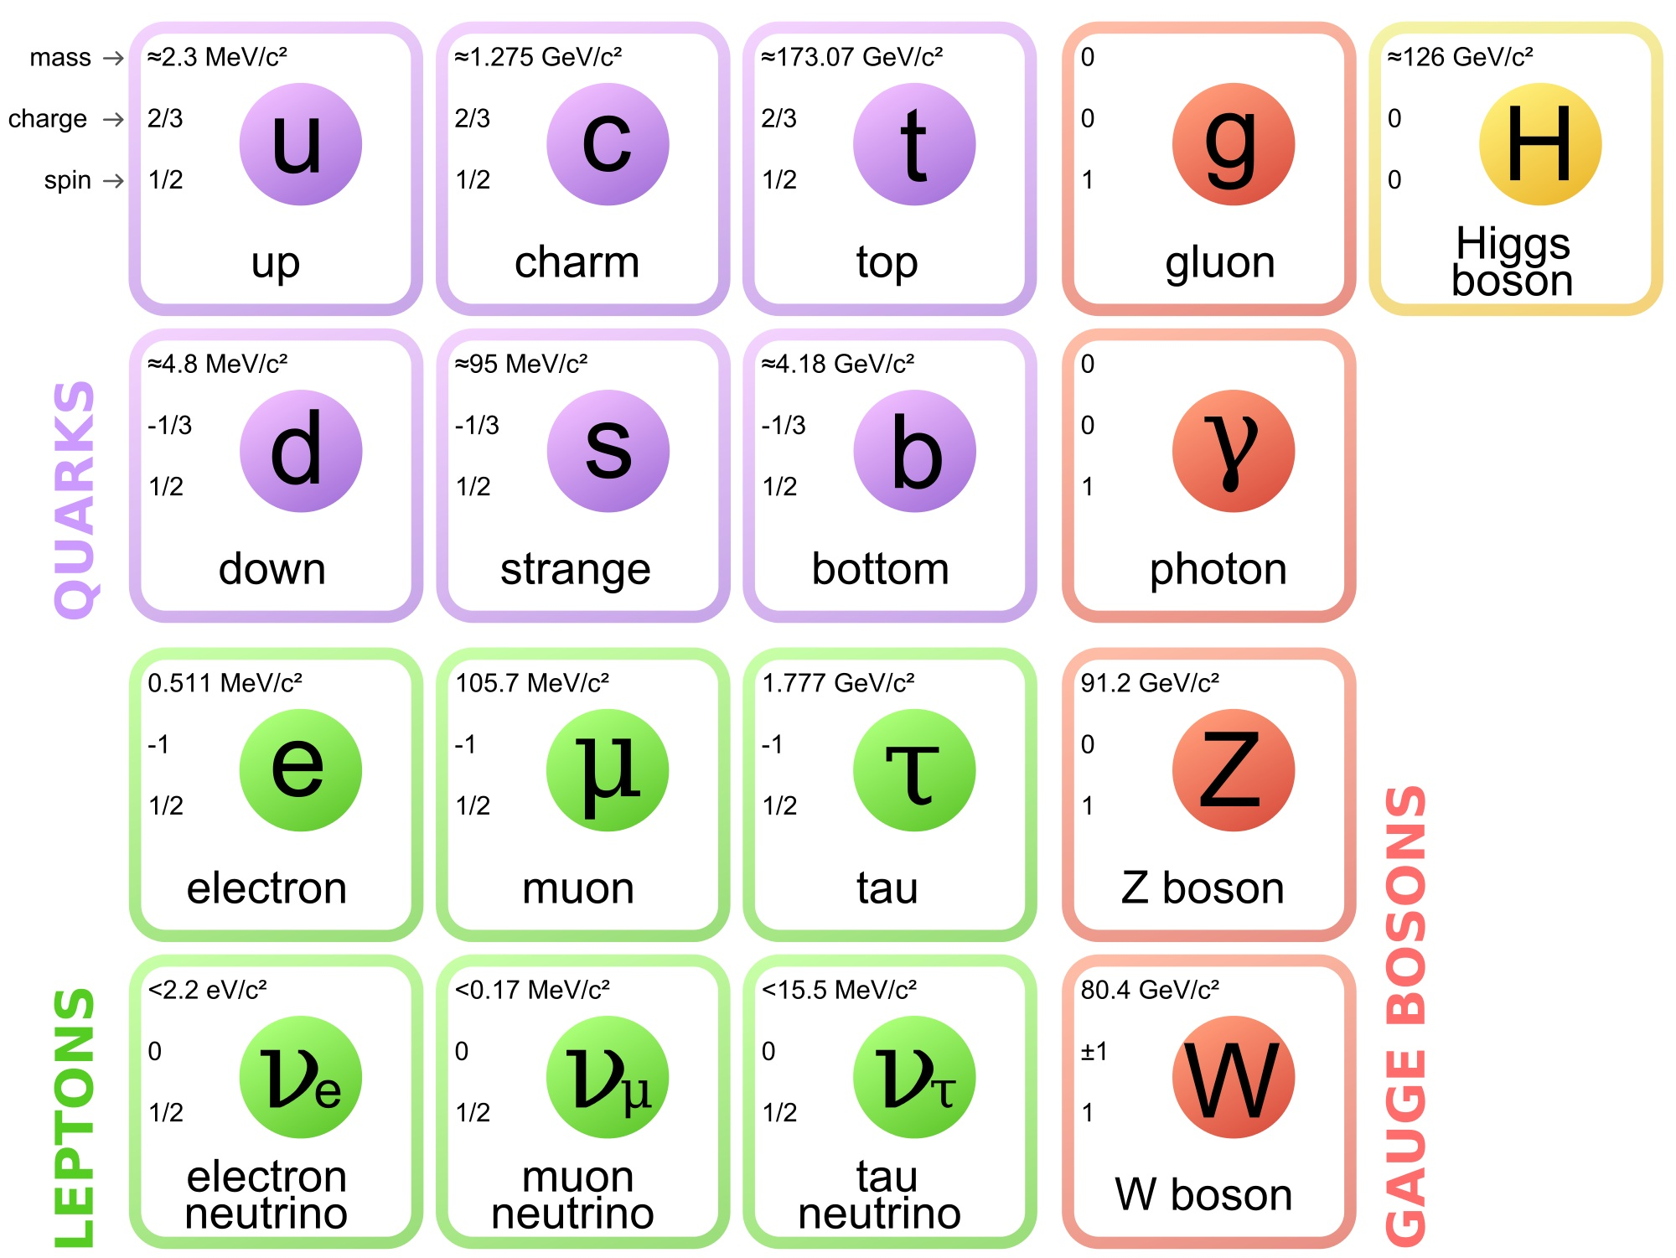
Neutrinos
Uncharged leptons
Interact only via the weak force
Difficult to detect
Standard Model (SM) predicts 3 massless flavours
Mechanism by which they gain mass is not understood
Left-handed

Slide 3
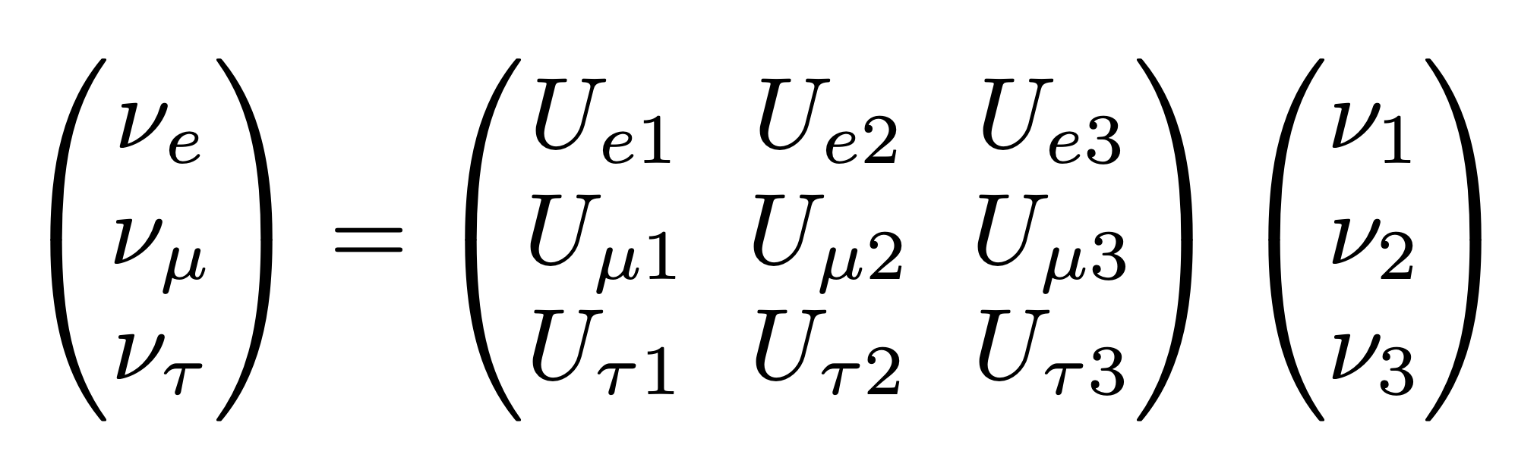
Neutrino Oscillations
Evidence for neutrino oscillations was first found in the 1960s
A deficit of solar electron neutrinos was observed in the Homestake experiment
Neutrinos cannot be massless if they oscillate between flavour states
Flavour eigenstates are a superposition of mass eigenstates
Mixing is described by a mixing matrix U

Slide 4
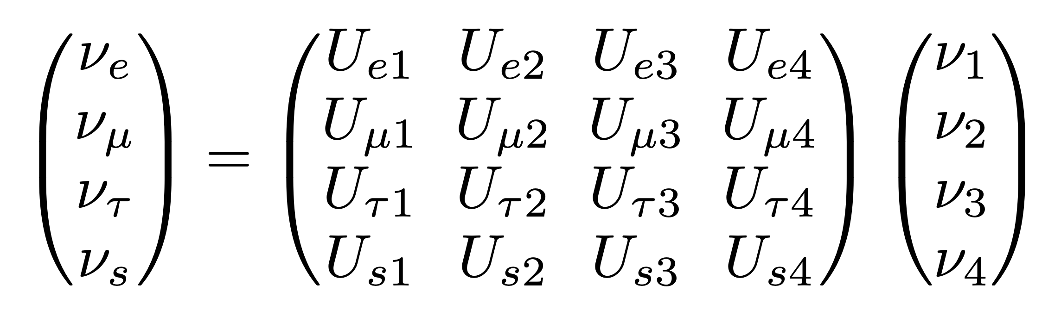
Sterile Neutrinos
SM does not prohibit additional sterile neutrinos
These neutrinos do not interact via the weak force
Not detectable if mass eigenstate aligned with flavour eigenstate
These are dark matter candidates
If not aligned, then they will mix with the other flavour eigenstates
May result in observable excesses/deficits of active neutrinos

Slide 5
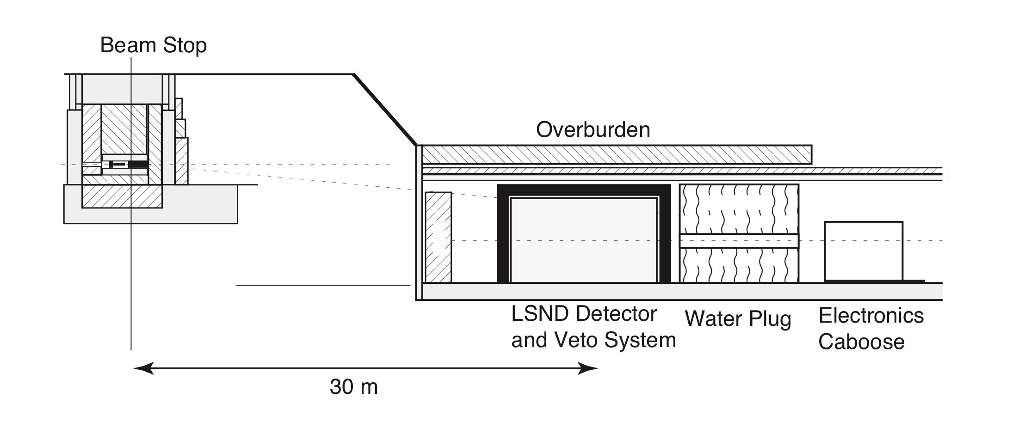

LSND
Search for $ν_{e}→ν_{μ}$ oscillations
Observed a low energy excess (LEE) of neutrinos
Significance of 3.8𝜎
Can be explained by eV-mass sterile neutrinos
arXiv: hep-ex/0104049v3

Slide 6
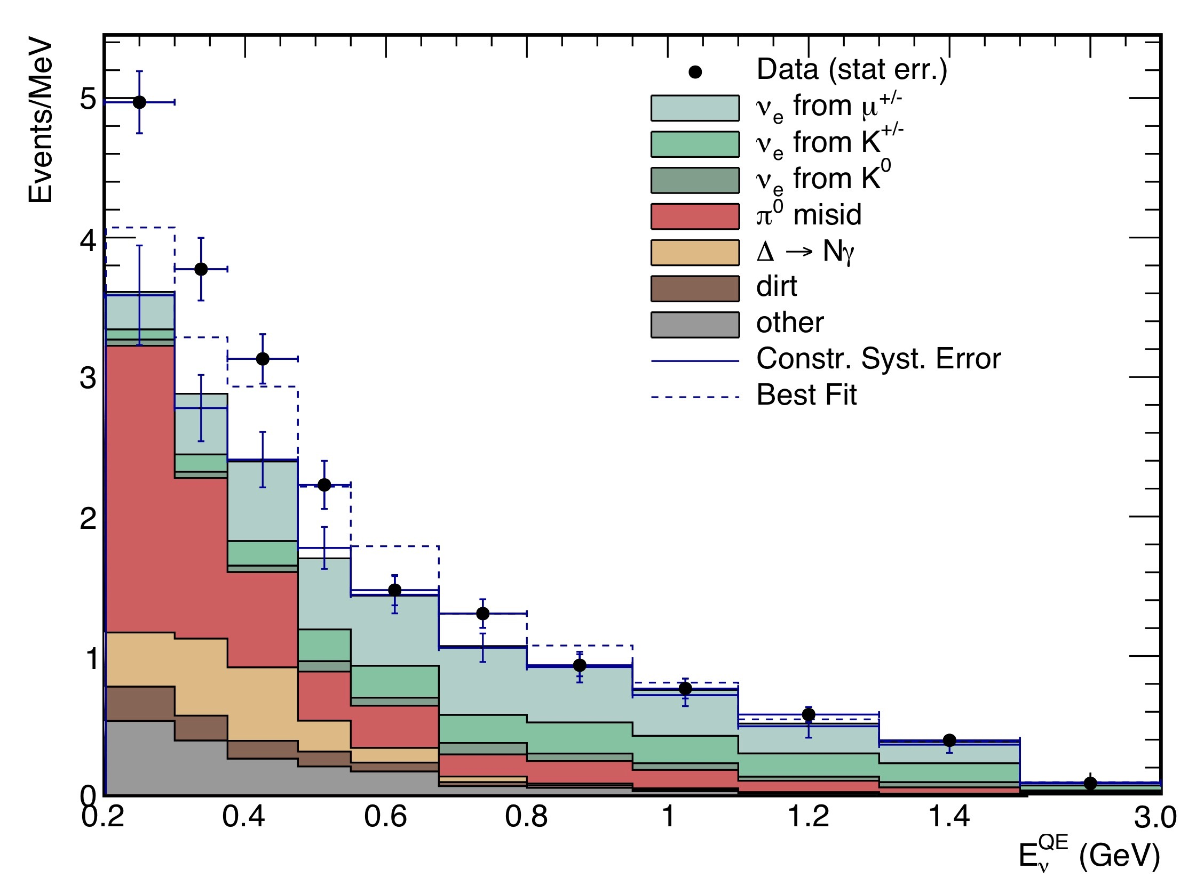
MiniBooNE
Observed a (LEE) of neutrinos
Significance 4.7𝜎
Significance of 6.0𝜎 when combined with LSND data
Can also be explained by eV-mass sterile neutrinos
Does not distinguish electrons from photons well
arXiv: 1805.12028v2 [hep-ex]

Slide 7
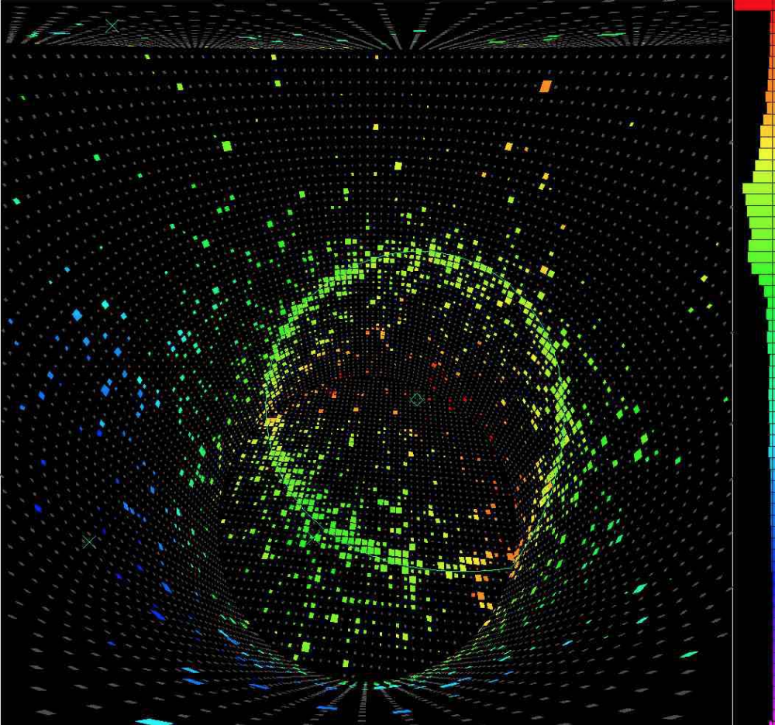
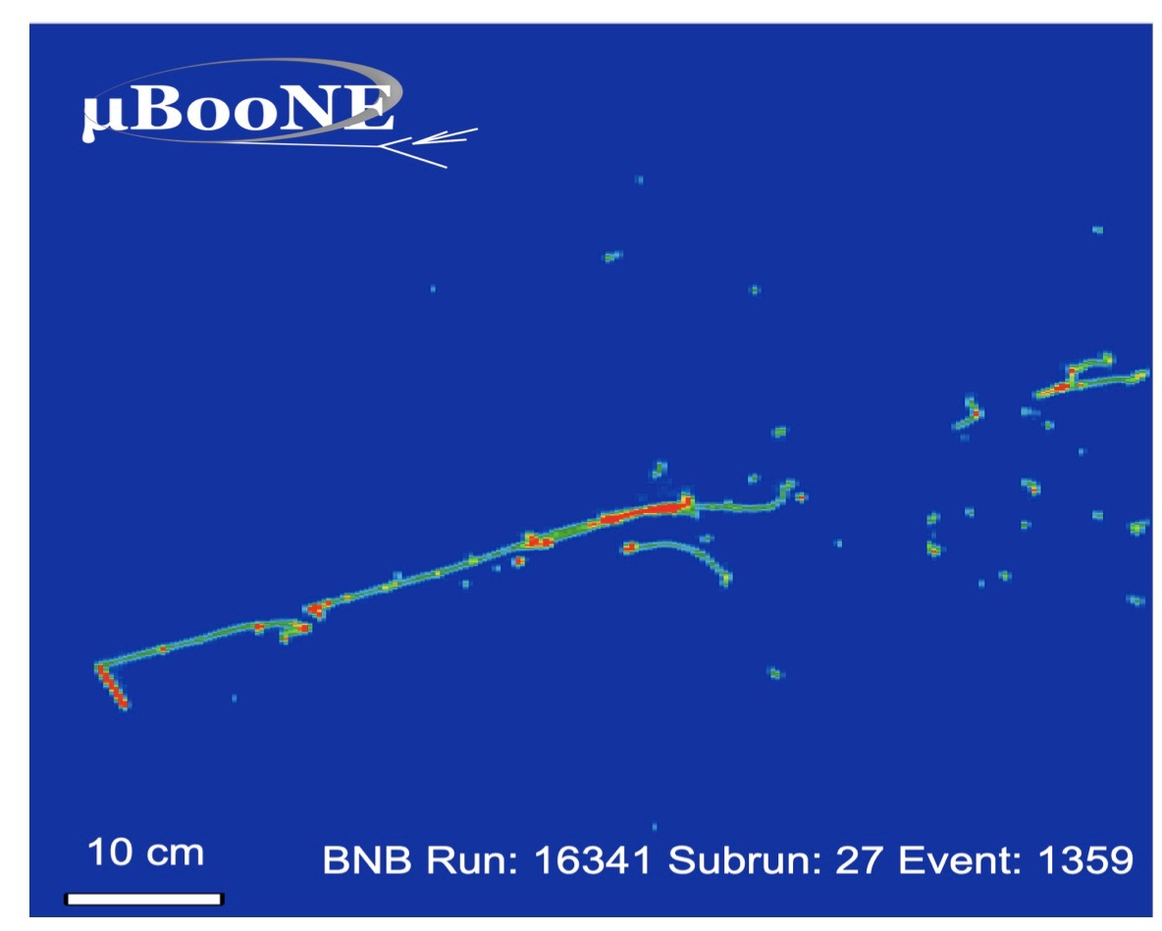
MicroBooNE
Built to explore LEE observed at MiniBooNE
Uses liquid argon time projection chamber (LArTPC) technology
This can distinguish photon-induced and electron-induced EM showers
4 different searches done
arXiv: 0907.4183v2 [hep-ex]
arXiv: 2110.14065v2 [hep-ex]

Slide 8
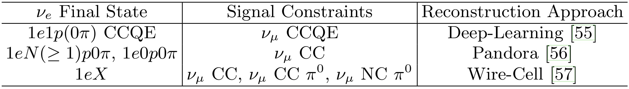
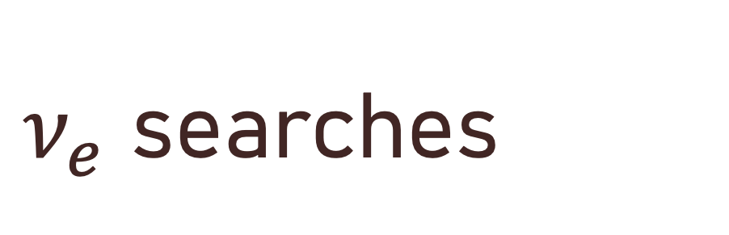
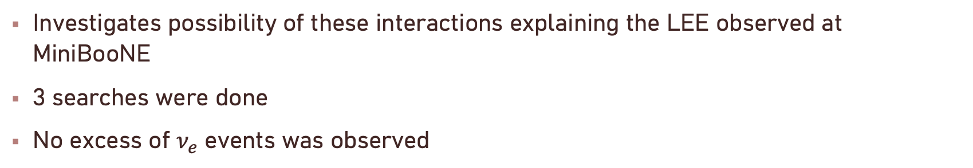
$ν_{e}$ searches
Investigates possibility of these interactions explaining the LEE observed at MiniBooNE
3 searches were done
No excess of $ν_{e}$ events was observed
arXiv: 2110.14054v2 [hep-ex]

Slide 9

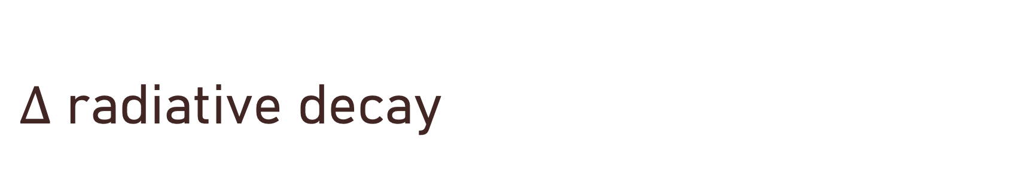
$Δ$ radiative decay
The LEE could be explained by an excess of photons rather than neutrinos
MicroBooNE searched for a factor of 3.18 enhancement to the rate of $Δ→Nγ$
The data ruled out this interpretation of the anomalous excess at the 94.8% CL

Slide 10
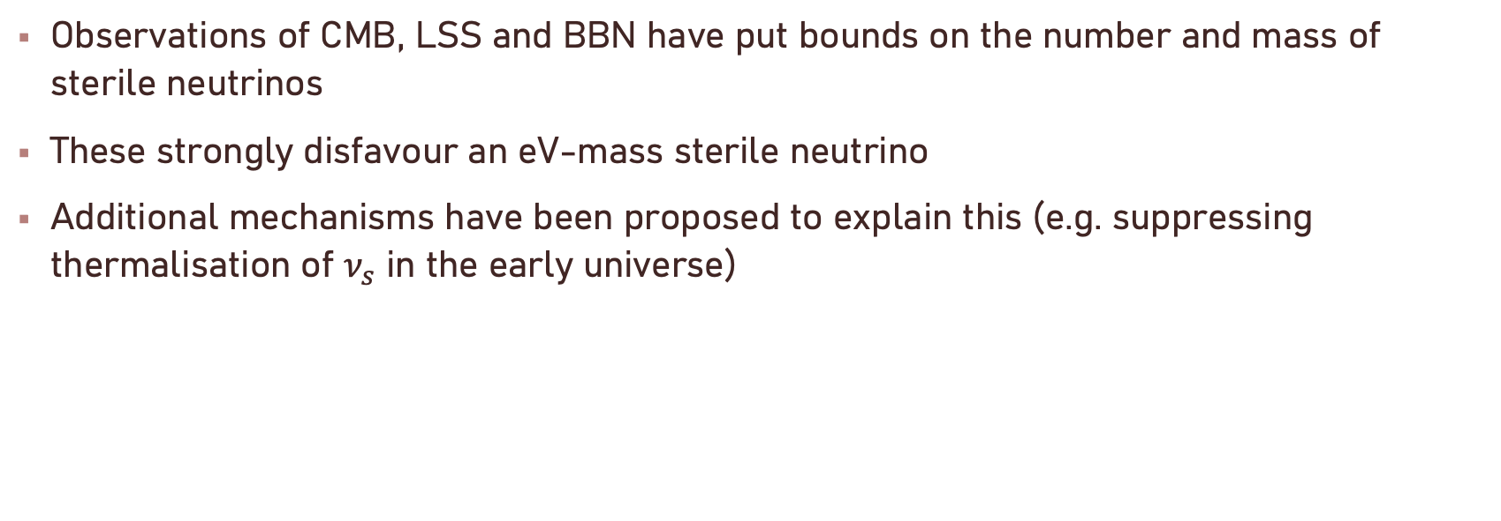
Cosmological Limitations
Observations of CMB, LSS and BBN have put bounds on the number and mass of sterile neutrinos
These strongly disfavour an eV-mass sterile neutrino
Additional mechanisms have been proposed to explain this (e.g. suppressing thermalisation of $ν_{s}$ in the early universe)

Slide 11
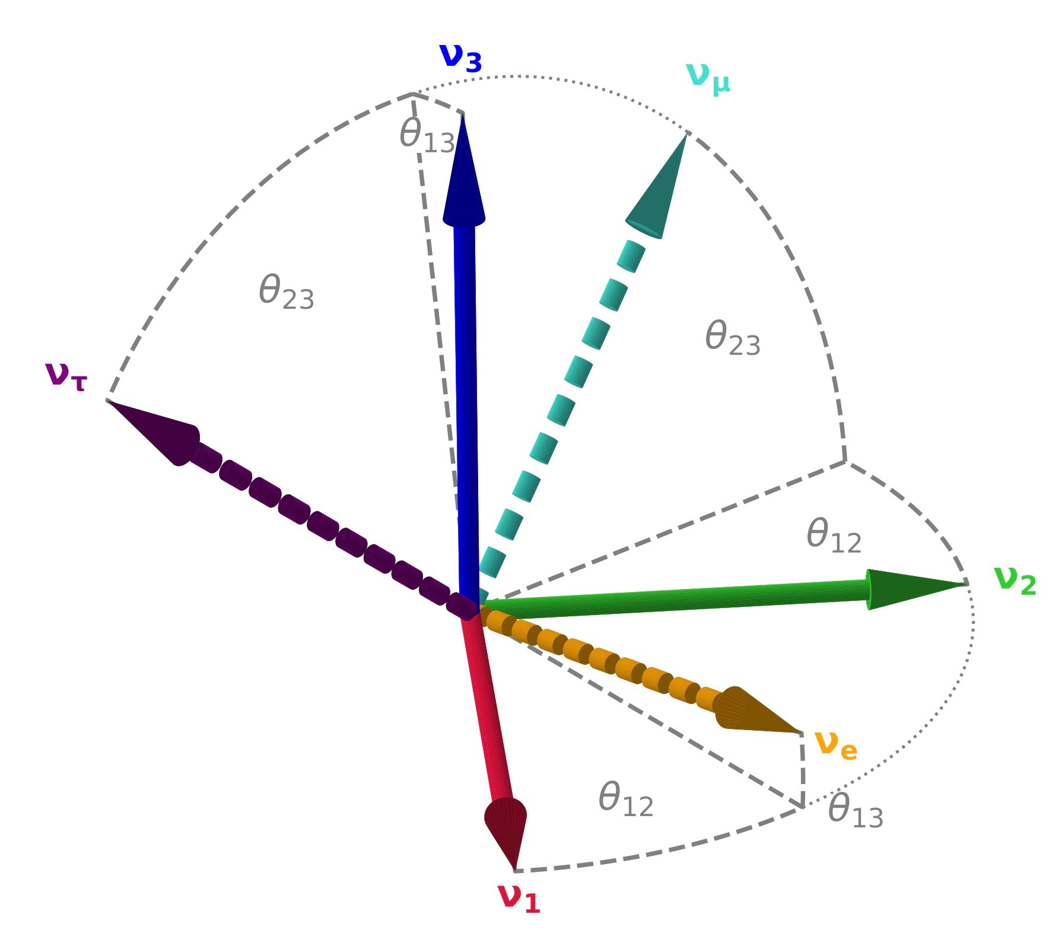

Appearance-Disappearance Tension
$ν_{e}$ disappearance experiments include Gallium experiments and probes at reactors
$ν_{μ}$ disappearance experiments include IceCube, MINOS/MINOS+ and NO𝜈A
These results are in tension with the MiniBooNE and LSND results, suggesting different regions for mixing angles
arXiv: 1906.01939v3 [hep-ex]

Slide 12
Conclusions
The results from MiniBooNE and LSND remain unexplained
MicroBooNE has ruled out the 4 most likely explanations
Could still be explained by sterile neutrinos, but 3+1 scheme is disfavoured by cosmological observations and disappearance experiments

