Slide 1
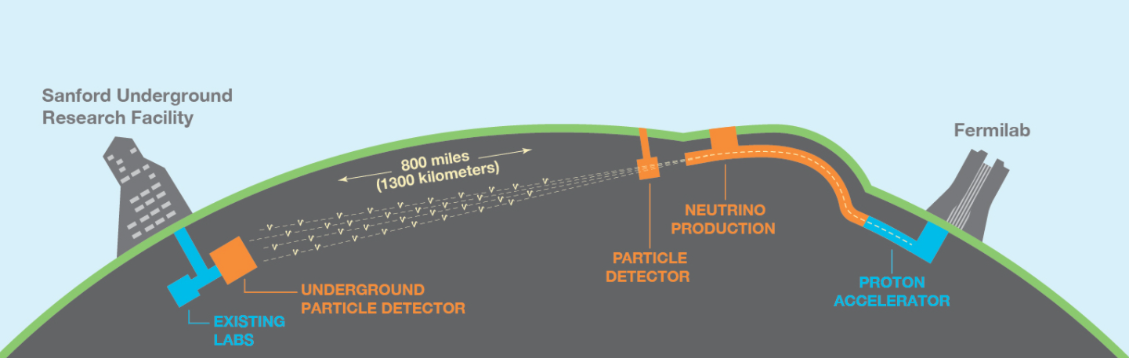
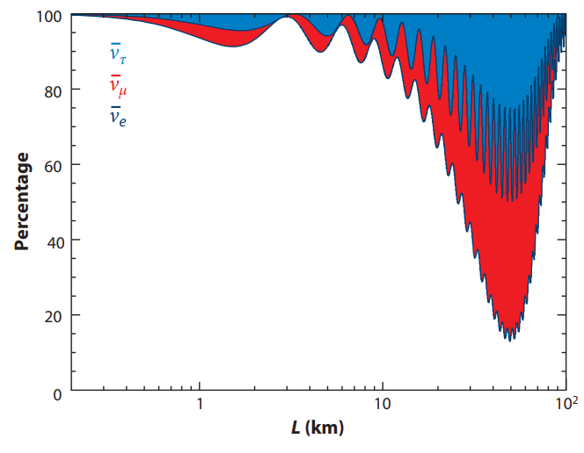
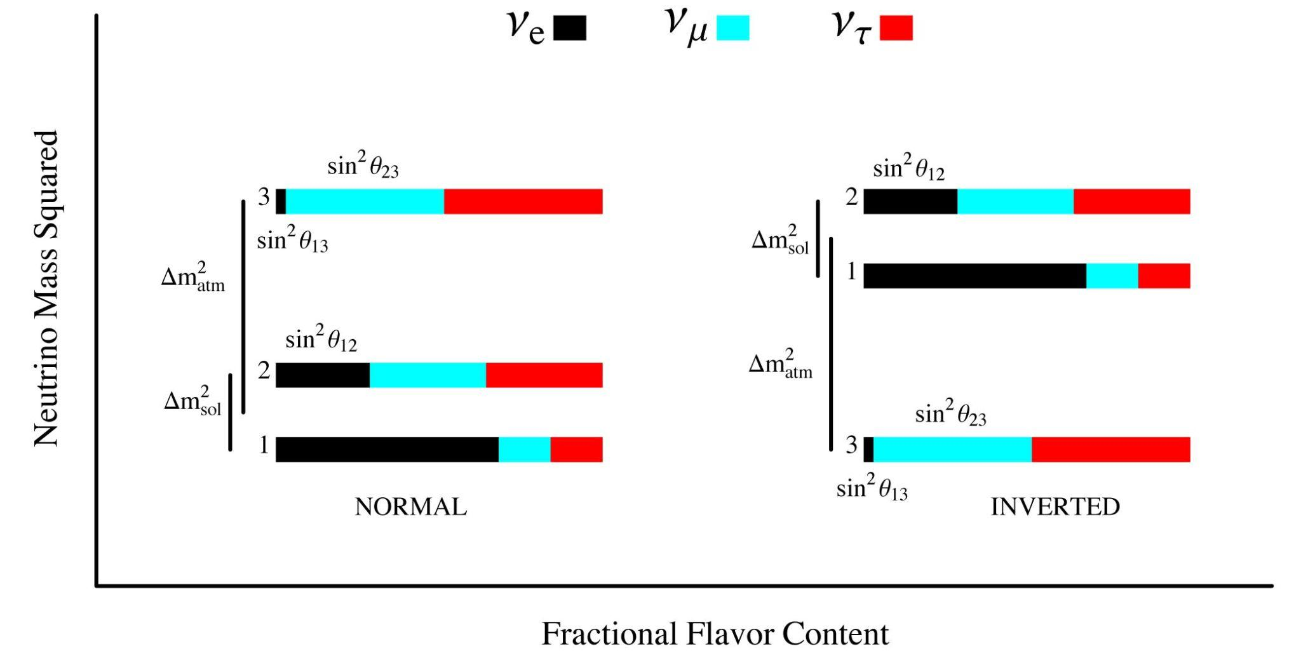
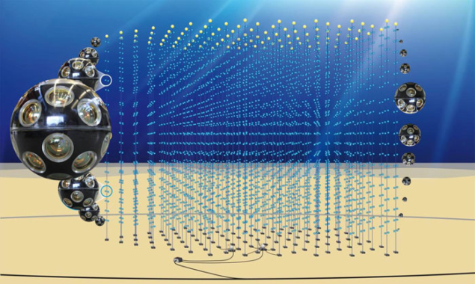
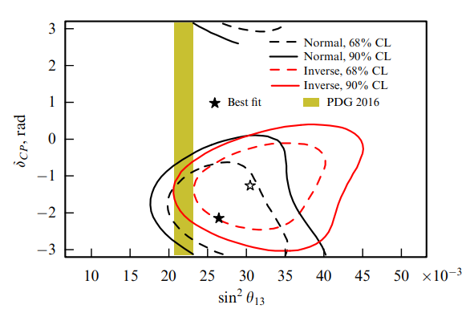
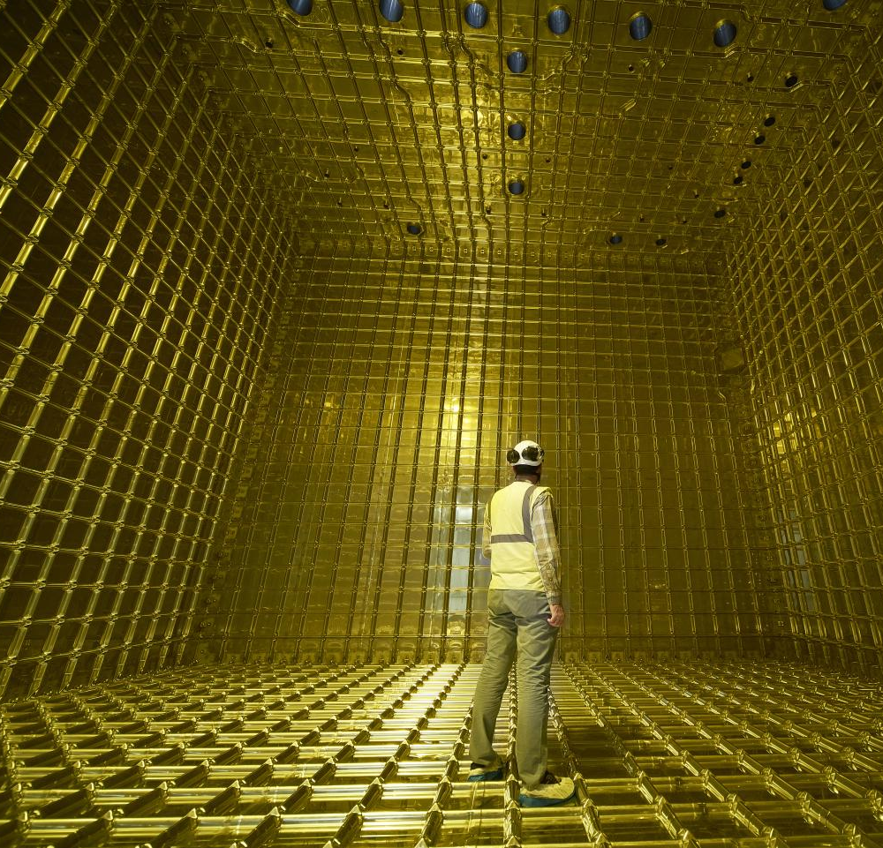
Neutrino Oscillation experiments at the Long Baseline

Slide 2
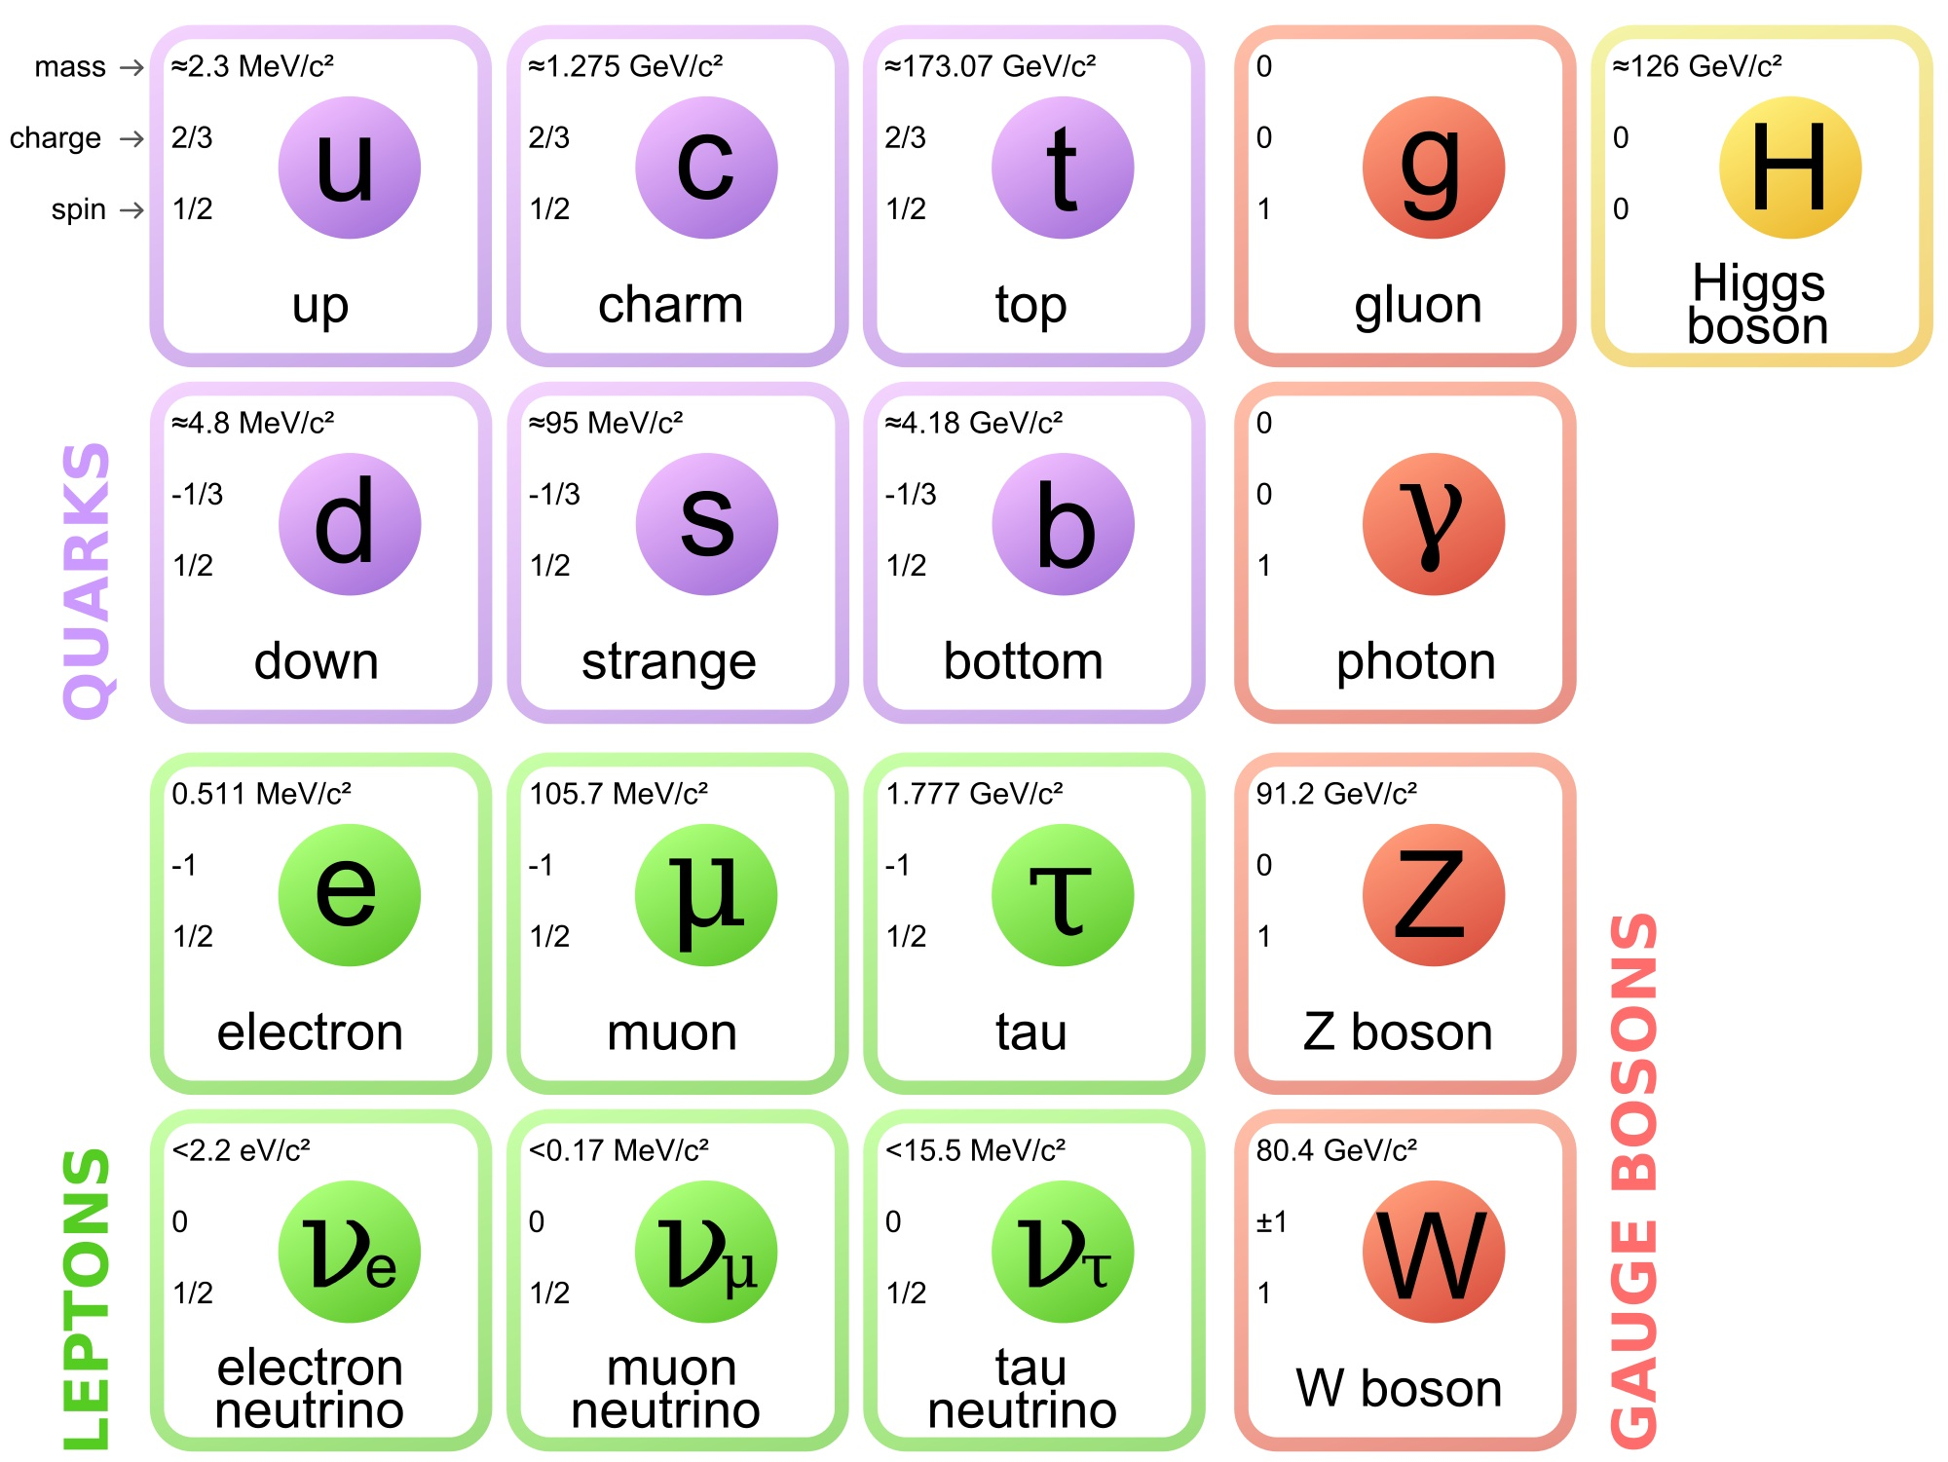
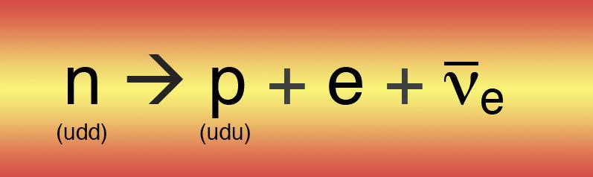
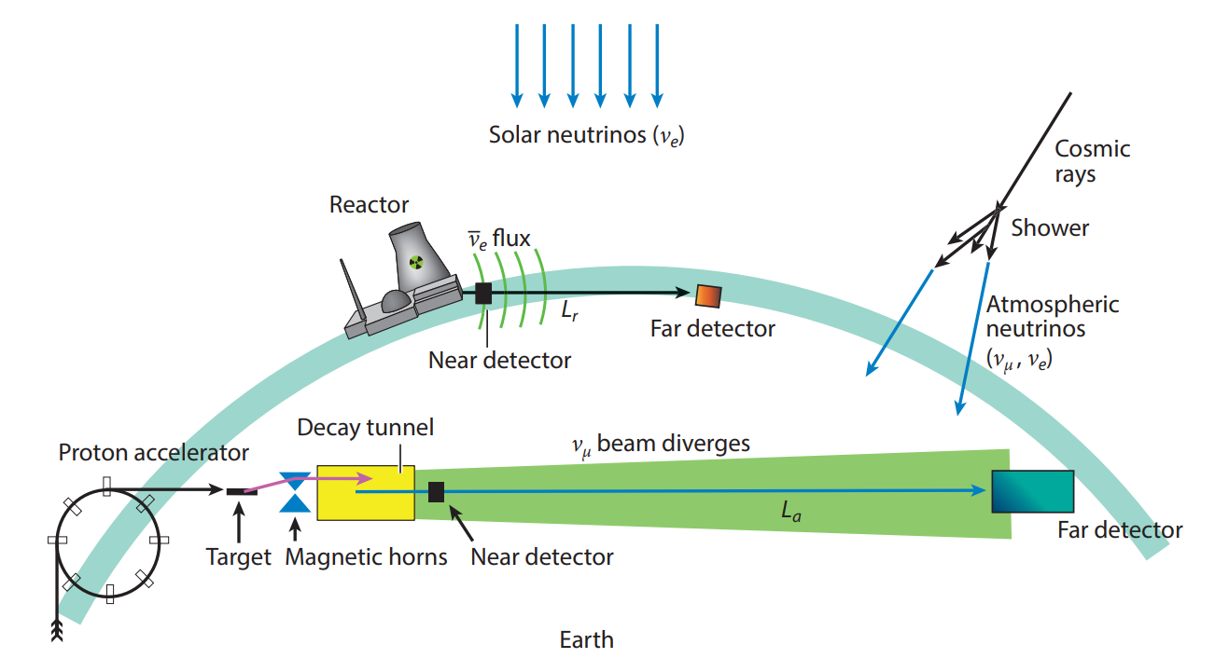
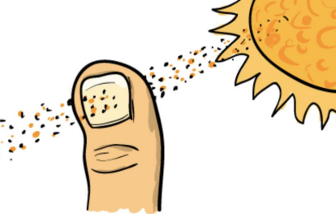
What are Neutrinos?
Originally suggested by Pauli in 1930 and theorised by Fermi in 1933 to explain how β decay could conserve energy, momentum and angular momentum
One of the fundamental particles predicted by the Standard Model: Uncharged, massless, only interact by weak force, always left-handed(right-handed antineutrinos)
Different sources of neutrinos:
Second most abundant particles in the Universe: about 65 million neutrinos pass through your thumbnail every second!
Bombarding high-energy protons into a stationary target. The emerging π and K mesons decay into muons and neutrinos.
Neutrinos emit W or Z bosons which then break apart atomic nuclei into detectable parts

Slide 3
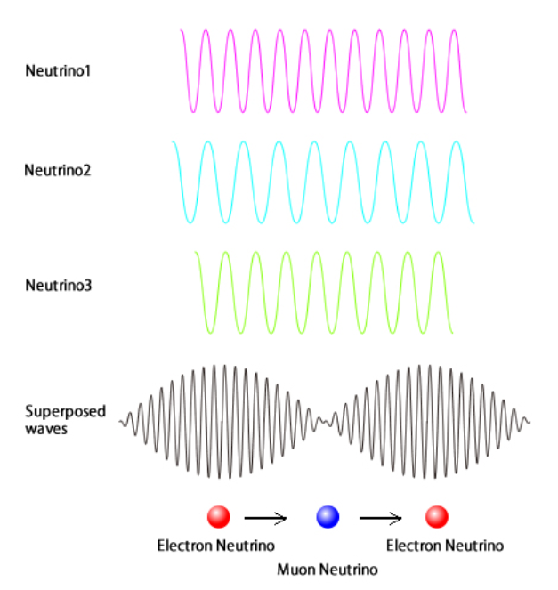
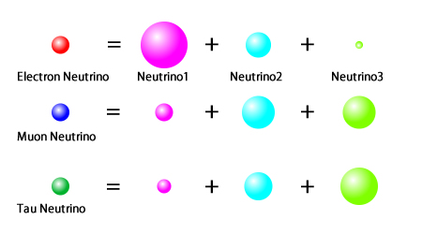
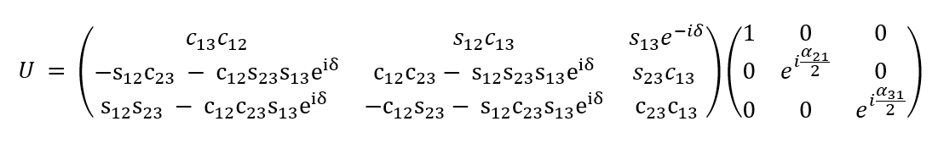
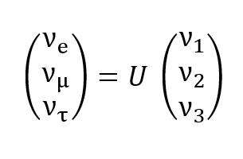
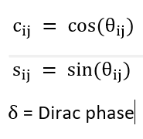
Neutrino oscillations
-Solar neutrino problem: In 1967, the solar neutrino flux was measured to be only ⅓ of the value predicted by SSM! →explained by neutrino oscillations (v_e into v_𝜇 and v_𝜏):
-The three known neutrino flavour states ν_α = (ν_e, ν_µ, ν_τ) are linear combinations of three states ν_i=(ν_1, ν_2, ν_3) with definite masses m_i=(m_1, m_2, m_3)
-Quantum mechanics: particles behave as waves
-Each neutrino state travels through space at a different frequency
-The overall phase of the wave changes, hence neutrino flavour oscillate
-The flavour states are related to the mass states through a unitary matrix, U, the Pontecorvo-Maki-Nakagawa-Sakata (PMNS) matrix:
where

Slide 4
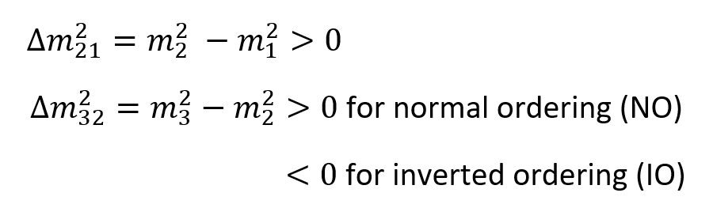
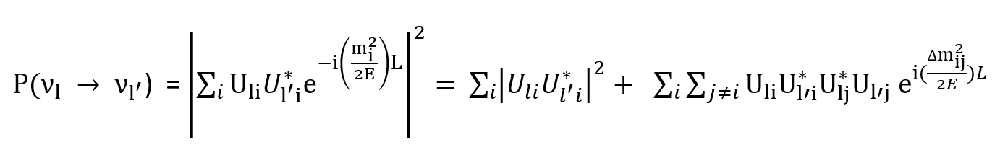
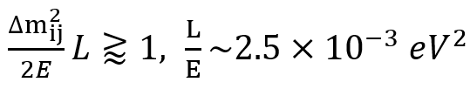

Neutrino oscillations
-The oscillations are characterised by two independent mass differences
-The probability of oscillation of flavor l to l’ is
Long baseline condition:
-Up to today many experiments around the world have measured accurate values of:
-There are still some unanswered questions and parameters that have not been possible to measure:
-Absolute neutrino masses
-Mass ordering
-CP-violation phase (𝛿)
-Do neutrinos have a Dirac or Majorana nature?
}
Physics beyond Standard Model!

Slide 5
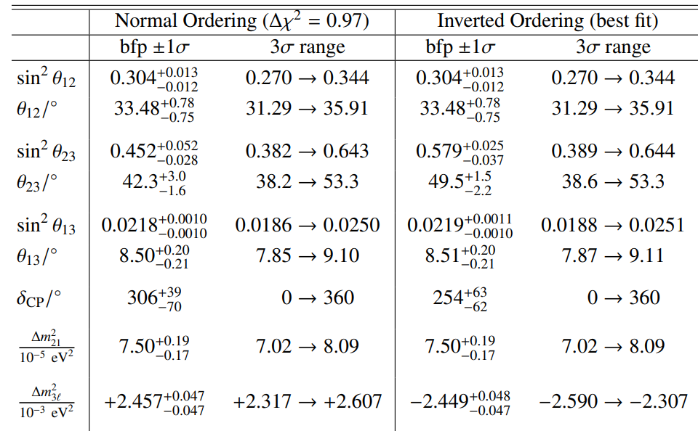
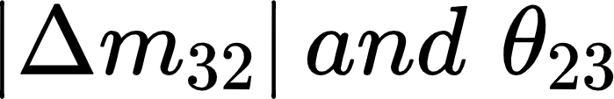
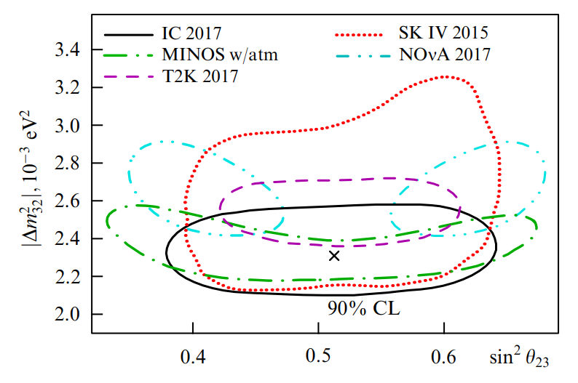
Measurements of mixing angles and mass differences
-Super-Kamiokande: first convincing evidence of neutrino oscillations by finding a deficit of v_𝜇 in atmospheric neutrinos using water cherenkov detector.
-Most precise measurements determined by
-MINOS: v_𝜇 disappearance, Fermilab beam, LB scintillator detector in Soudan
-T2K: v_𝜇 disappearance, beam from JPARK, Super-Kamiokande Cherenkov detector
-NOvA: v_e appearance, accelerator neutrino beam from Fermilab and LB liquid scintillator detector in Minnesota
-IceCube: v_𝜇 disappearance, atmospheric neutrino observatory at South Pole.
A disagreement is seen for the NOvA experiment, which rules out maximal mixing at a level of 2.6𝜎.

Slide 6

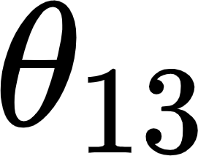
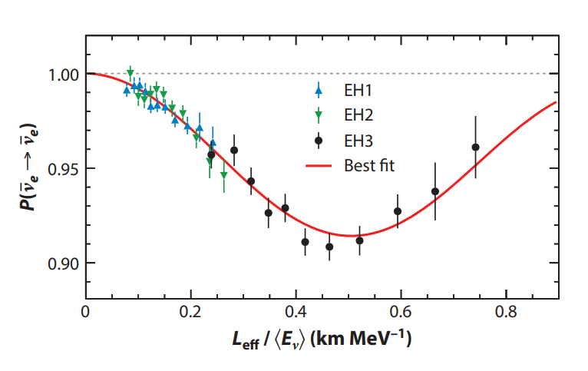
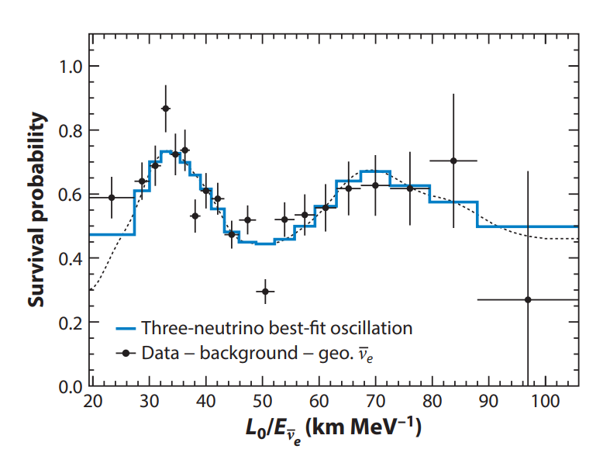
Measurements of mixing angles and mass differences
-The solar neutrino problem (v_e) findings were further confirmed by SAGE, GALLEX and Super-Kamiokande.
-KamLAND, observes v_e from reactor around the area
-T2K and the reactor experiments RENO (Korea) and Double Chooz (France): nonzero 𝜃_13 at 2.5𝜎, 4.9𝜎 and 1.6𝜎.
-Daya Bay (China): most precise value of 𝜃_13 in 2017, liquid scintillator detector of reactor neutrinos:
-RENO agrees
-DoubleChooz: discrepancy at level of 2𝜎.

Slide 7
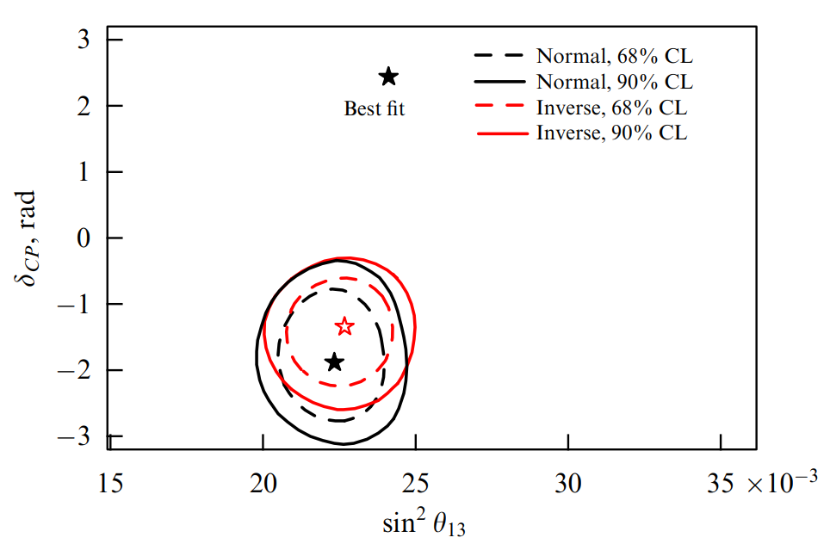
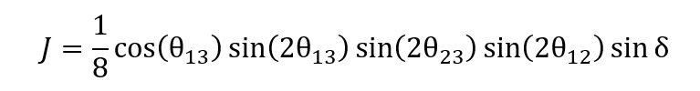
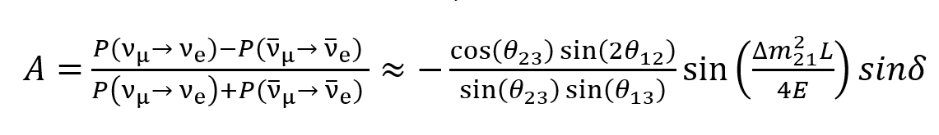
CP symmetry violation
-CP symmetry: laws of physics should be the same if a particle is interchanged with its antiparticle while its spatial coordinates are inverted.
-It is found that neutrinos violate CP symmetry!
-The Jarlskog parameter, J, is a measure of the degree of CP violation in the lepton sector:
-T2K: first experiment to study CP violation, revealed signs of maximum 𝛿 in 2013, improved s statistics of events and sensitivity in 2016 and 2017:
-Turns out J ⧣0 and nearly maximal CP phase 𝛿.
2016
2017
-In practice measure fractional asymmetry:
-NoVA: results in 2017 are in agreement with T2K data, pointing to maximum CP violation.
-In the quark sector: J=3x10-5, baryon asymmetry about 10 orders of magnitude smaller than the observed value.
-In neutrino sector: J=0.035sin𝛿, some studies in leptogenesis show that could be large enough to generate the observed baryon asymmetry of the universe.

Slide 8
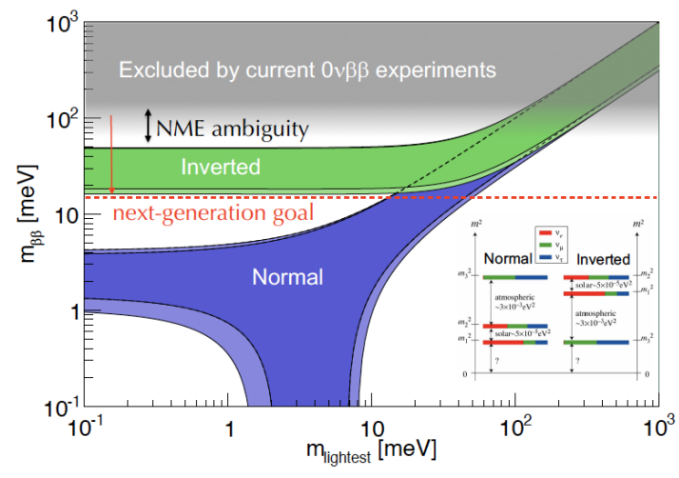
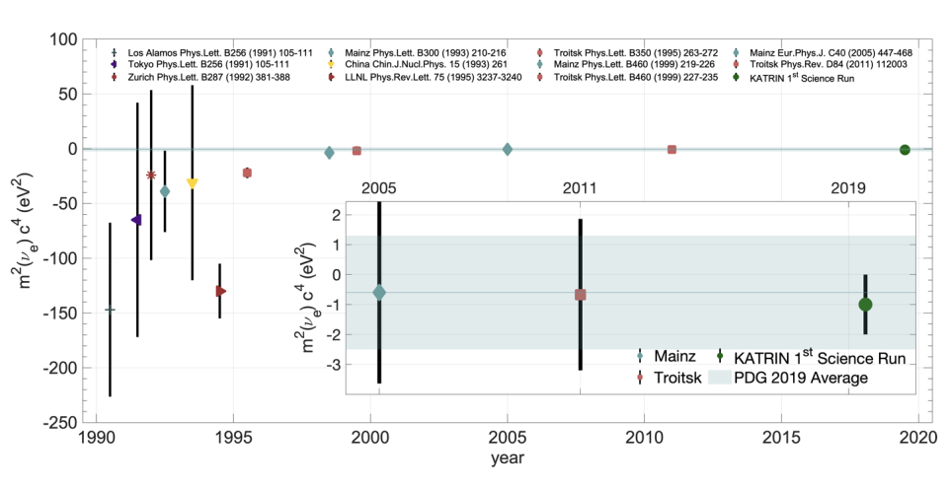
Future experiments
Dirac or Majorana nature
-Dirac fermions: v⧣ṽ, lepton number conserved
-Majorana fermions: v=ṽ, lepton number violation (LNV).
-Observation of neutrinoless double 𝛽 decay provides evidence for LNV and Majorana nature: effective Majorana mass obtained from T_1/2
-Future experiments: LEGEND-200, LEGEND-1000, KamLAND2-Zen, SuperNEMO, nEXO, CUPID, PandaX, DARWIN, and LZ are aiming for an improvement in T_1/2 of ~2 orders of magnitude along with covering the inverted mass ordering region
Absolute mass measurements
-From precision measurements of β-decay and cosmological constrains.
-KATRIN: current upper limit for v_e is < 1.1 eV at 90% CL c, goal to reach 0.2 eV in the next three years.
-Future experiments: Project8 is a Tritium β-decay that will reach 0.04eV sensitivity after 2022. ECHo and HOLMES use 163Ho decay aim to reach 0.2 eV sensitivity after 2022.

Slide 9
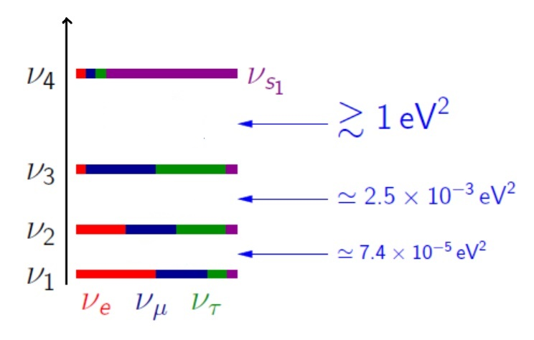
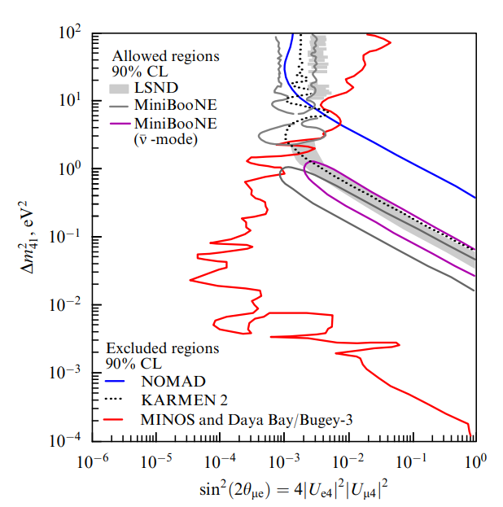
Future experiments
Light sterile neutrino
-Mass ~1eV
-Proponed to explain the following anomalies
1)The LSND (Liquid Scintillator Neutrino Detector) anomaly: found an excess of ṽ_e, confirmed by MiniBooNe.
-Recently tested by IceCube, which ruled out the allowed regions of MiniBooNe and LSND that pointed the existence of the sterile neutrino at 99% CL, and MINOS and Daya Bay, which excluded the regions of allowed parameters.
-In the next future: Fermilab will perform a new test using the MicroBooNE, the short baseline LAr-ND and the long baseline ICARUS-T600 detectors with a sensitivity of 5𝜎 and 99% CL.
(short baseline)
Regions to the right of red curve is at 90% CL
2)The Gallium anomaly: SAGE and GALLEX measured a smaller number of v_e than predicted.
-Two new experiments, SOX and BEST will perform tests for this anomaly in the upcoming years.
3)The Reactor Anomaly: the registered mean flux of ṽ_e was ~ 3% higher than expected.
-Tested by NEOS, which limited the allowed regions of the parameter, and the currently running DANSS, which has excluded the most likely values of in its preliminary results.
-Future experiments: SoLid, PROSPECT and STEREO will aim to investigate the anomaly further.

Slide 10
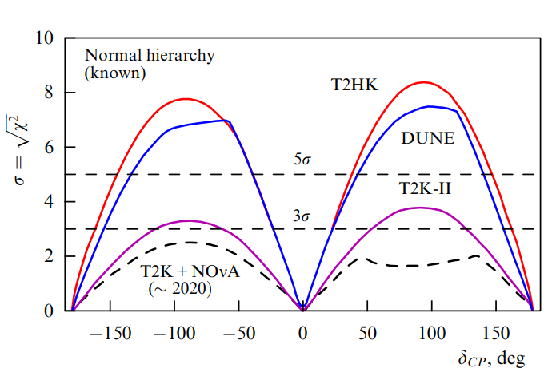
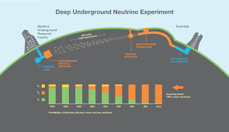
Future experiments
CP and mass hierarchy
-T2K is planning a second stage T2K-II which will collect 20 x10^21 protons on target (POT) and reach a sensitivity of 3𝜎 for 𝛿.
-NOvA will continue data taking to 2024, making upgrades to the neutrino beam power and reach 3𝜎 sensitivity for 𝛿 and 4.5𝜎 for the MH.
-DUNE (USA):
-Fermilab neutrino beam
-A near detector to record event spectra
-A large LB detector 1km underground with four liquid-argon time-projection chambers
-Proton beam gradually updated from 1.2MW to 2.4MW
-Data taking starts in 2026
-Data taking will begin in 2026.
-A sensitivity >5𝜎 for a 50% interval of possible 𝛿 values expected to be achieved after a few months if the mass and CP asymmetries are of the same sign, and after a few years if they are of opposite sign.
-Establishes the difference between NO and IO at 5𝜎 for the whole 𝛿 interval.

Slide 11
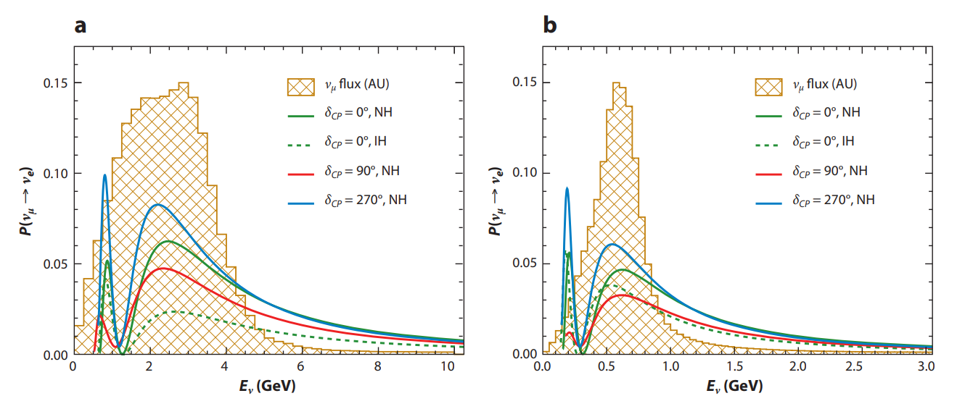
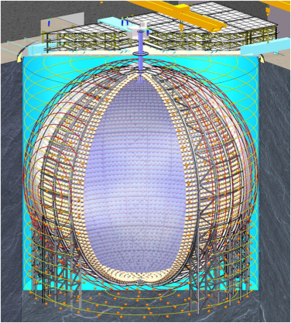
Future experiments
-Hyper-Kamiokande (Japan):
-Off-axis muon neutrino and antineutrino beam from J-PARC
-A near water Cherenkov detector to measure the off-axis angles
-Two giant water Cherenkov detectors at LB matched to first oscillation maximum
-It will begin with a 1.3MW proton beam
-Data taking starts in 2026
-Sensitivity of >5𝜎 for 57% of possible 𝛿 values after 10 years, and >8𝜎 if the sign of MH is known
a)DUNE b)Hyper-Kamiokande
-JUNO (China):
-Spherical 35m radius liquid scintillator detector
-Capable of detecting neutrinos from reactor, supernova, atmospheric, solar and geophysical sources
-Data taking starts in 2022
-Sensitivity of >3𝜎 for MH and 1% accuracy for 𝛿
-ORCA (Mediterranean sea) and PINGU (South Pole):
-Study atmospheric neutrino oscillations deep in water and ice, respectively, thus enhancing matter effects
-Measure MH with sensitivity of 3𝜎 in 3 to 4 years.

