Slide 1
The search for CP violation using long baseline neutrino experiments
Nadia Singh
16.03.22

Slide 2
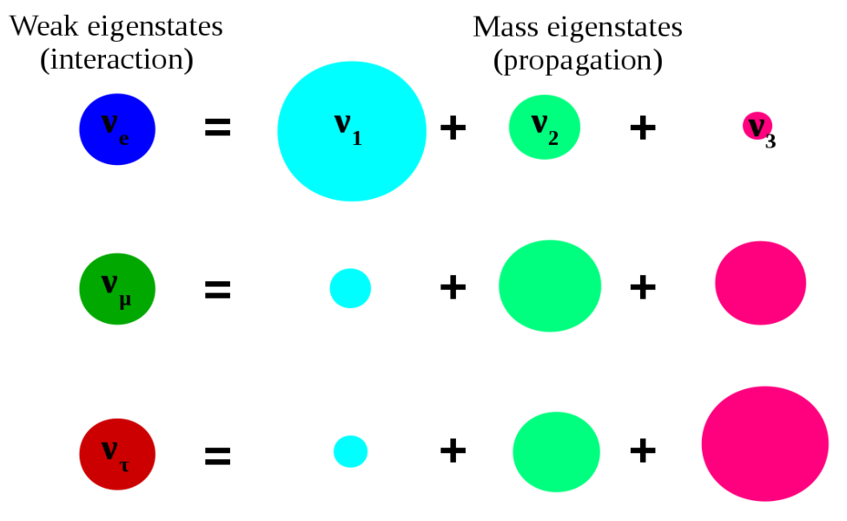
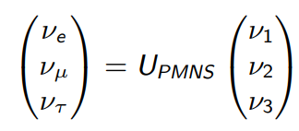
A brief introduction to neutrino oscillations
Neutrinos change flavour as they propagate through space
Each flavour is a linear combination of mass eigenstates
Neutrinos must have mass

Slide 3
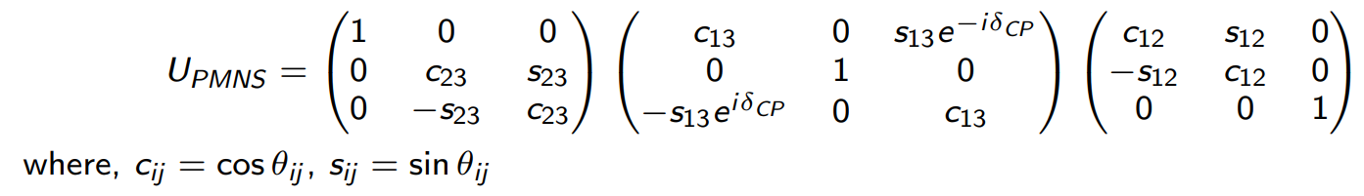
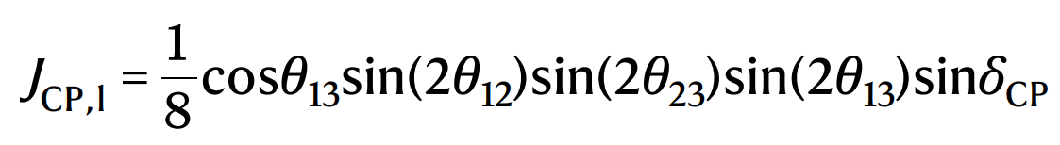
Oscillation parameters
PMNS matrix
Jarlskog invariant
Oscillation probability depends on 6 independent parameters:
3 mixing angles: θ₁₂, θ₁₃, θ₂₃
2 mass squared differences: ∆m²₂₁, ∆m²₃₁ (∆m²₃₂ = ∆m²₃₁ - ∆m²₂₁)
1 CP-violating phase δ_{CP}
Unknowns
Sign of ∆m²₃₂ – mass ordering
Octant of θ₂₃
δ_{CP}

Slide 4
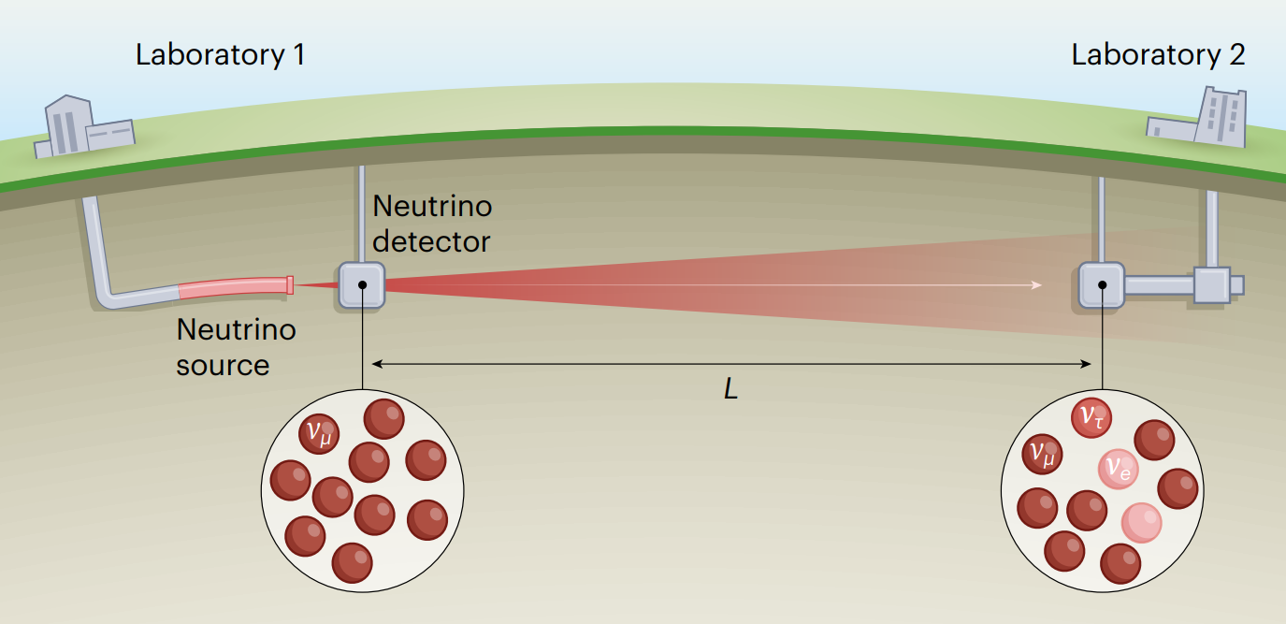
Long baseline experiments
Neutrinos detected at two detectors > 100km apart
Measure change in neutrino energy distribution with distance
Neutrino sources: fission reactors, proton accelerators
Detectors: liquid scintillator, water Cherenkov
Neutrino oscillation is a function of L/E
  L = baseline length
  E = neutrino energy
L/E lies on oscillation minimum (disappearance) or maximum (appearance)
Far detector event rates compared with oscillation predictions

Slide 5
Design considerations
Accurate energy reconstruction
Charge identification (separate leptons and antileptons)
Flavour identification (separate electrons and muons)
Background neutrino source rejection (cosmic rays, atmospheric and solar neutrinos)

Slide 6
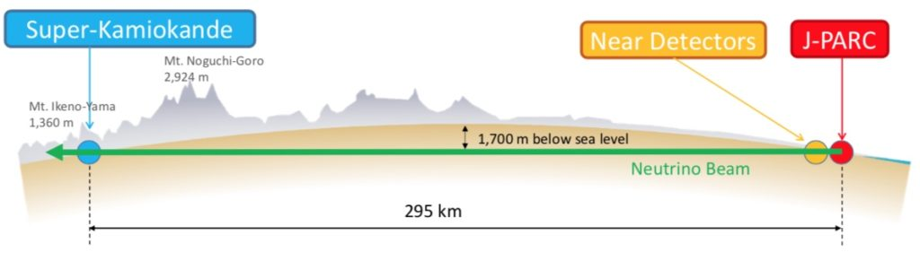
T2K (Tokai to Kamioka): ν_{μ} → ν_{e}
30 GeV proton beam fired at graphite target produces pions which decay into muons and muon neutrinos
Neutrino beam has a range of energies centred on 600 MeV (appearance maximum)
Near and far detector 2.5ᵒ off-axis from beam centre
2010–2017: 89 electron neutrinos (expected 68) and 7 electron antineutrinos detected (expected 68 and 9 assuming CP symmetry)
CP-conserving values (0, π) disfavoured at 99% confidence level (3σ)
Notes:
Super-K: Water Cherenkov detector
Use muon anti-neutrino beam for comparison
NOνA (NuMI Off-Axis Electron-Neutrino Appearance Experiment)

Slide 7
Future experiments constraining δ_{CP}
DUNE (Deep Underground Neutrino Experiment)
  Near detector at Fermilab
  Far detector is a liquid argon detector assembly
  L = 1300km
Hyper-K (Hyper-Kamiokande)
  Upgrades to J-PARC accelerator complex
  Hyper-K detector is a water Cherenkov detector
  L = 295km
L/E is similar for both

Slide 8
Thank you for listening ☺

