Slide 1
Anomalous Penguins
Violations in lepton universality and Testing the standard model using flavour

Slide 2
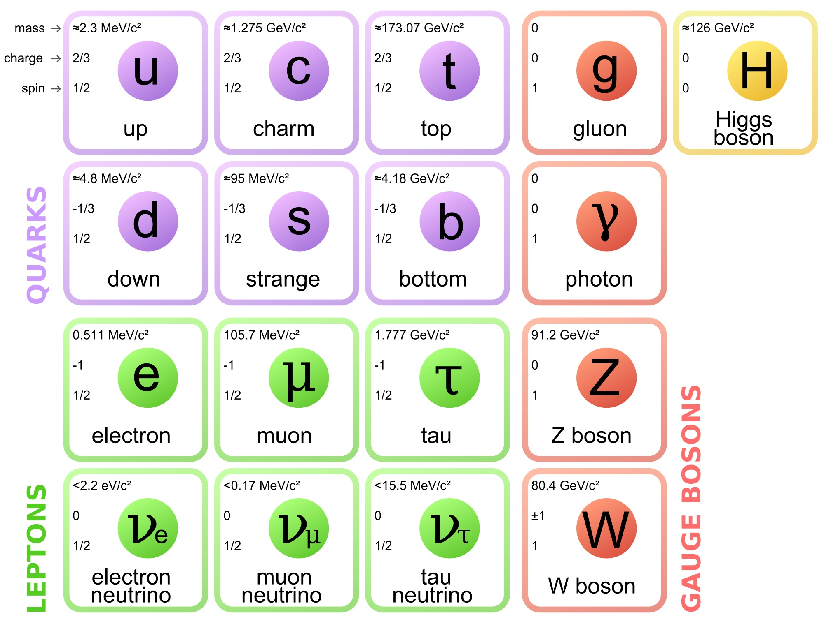
The Standard Model
Hugely successful theory that describes three out of four fundamental forces
Including the strong, weak, and electromagnetic
Gravity excluded

Slide 3
Leptons
Elementary particles with half integer spin
Do not undergo strong interactions
Three generations of leptons
Each generation having charged and uncharged particles (neutrinos)
Mediated by the W and Z bosons

Slide 4

Lepton Flavour Universality
The Standard Model currently describes the three charged leptons as identical copies of one another aside from mass differences, which are
The electroweak coupling of the gauge bosons to leptons is independent of lepton flavour
This is Lepton Flavour Universality (LFU) and is a distinctive feature of the SM
If Lepton Flavour Universality holds, the ratio between decay rates where the products are electron-positron, muon-antimuon, tau-antitau should be close to unity
Differing only via the invariant mass-squared $q^{2}$

Slide 5

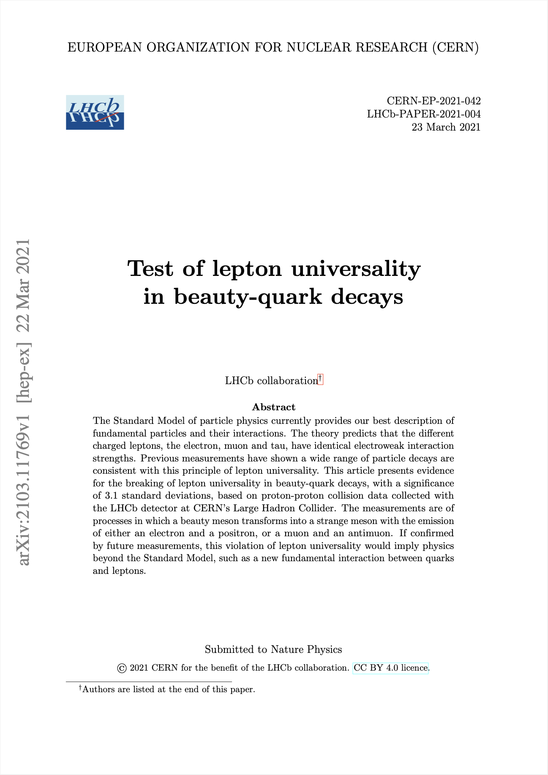
Tests of Lepton Flavour Universality
Test of lepton universality in beauty-quark decays provides evidence for breaking lepton universality with a significance of 3.1σ
Calculated double ratio of branching ratio
Anomaly not quite a 5σ discovery so systematic significance is not great enough to claim New Physics (NP)
However, provides hints for LFU violation

Slide 6
What is happening?
How to explain this

Slide 7
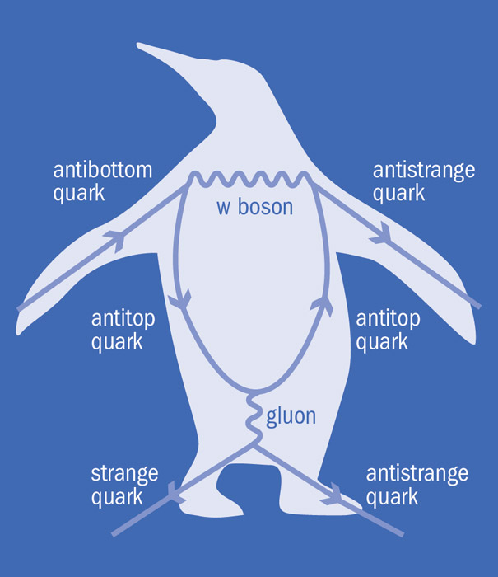
Penguin Diagrams
Class of Feynman diagrams which explain the supposed LFU violation
Named due to a game of darts in 1977 John Ellis and a student, Melissa Franklin
Investigate CP violation
Defined by one-loop processes where a quark temporarily changes flavour via a W boson
Explains difference in experimental leptonic gauge coupling between generations

Slide 8
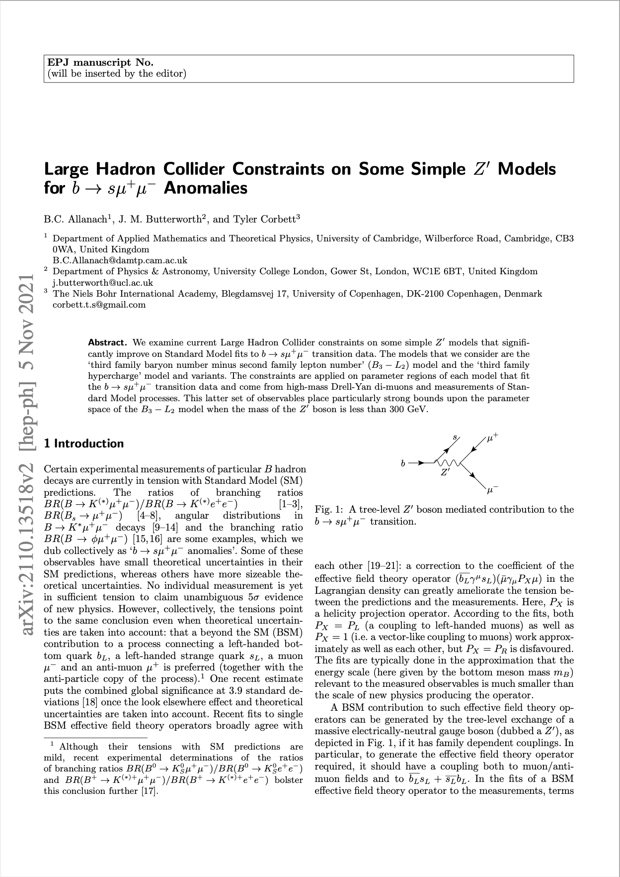
Other Explanations
Can also be explained by hypoethesising a new gauge boson Z’
Z’ has family dependent couplings to the SM fermions
Beyond-the-SM theory

