Slide 1
The Discovery of the Odderon
Marco Loncar
Supervised by Prof. Tina Potter

Slide 2
Outline of presentation
Elastic hadron scattering
Odderon’s role
Experimental evidence
Statistical analysis
Discovery
Future studies

Slide 3
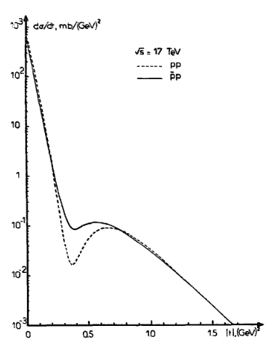
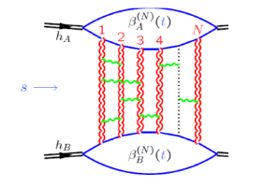
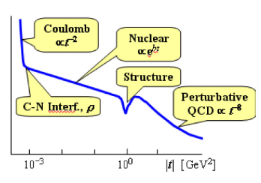

Hadron scattering
[2]
$pp$ and $\overline{p}p$ collisions
Energy regimes
Gluon interactions
Multi-gluon exchange:
  Pomeron
  Odderon
Scattering asymmetry
[1]
[1] Royon (2021). Comparison of pp and ̄pp differential elastic cross sections and observation of the exchange of a colorless c -odd gluonic compound.
[2] Basarab Nicolescu (1992). The odderon - past, present and future.

Slide 4
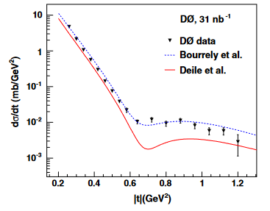
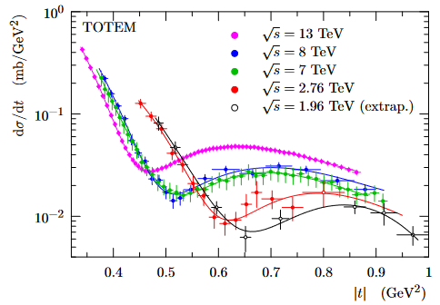
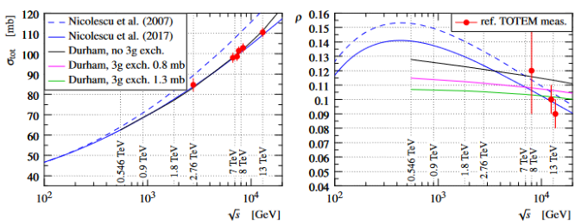

Experimental Evidence
[3]
[1]
$D∅$ collaboration
  $pp$ collisions
  Measured $σ$, $\frac{dσ}{dt}$ and $ρ$-parameter
TOTEM collaboration
  $\overline{p}p$ collisions
  Measured $\frac{dσ}{dt}$
[2]
[1] Abazov et al. (2012). Measurement of the differential cross section dσ/dt in elastic p ̄p scattering ats = 1.96TeV.
[2] Antchev et al. (2018). First determination of the ρ parameter at √s = 13 TeV – probing the existence of a colourless three-gluon bound state.
[3] Abazov et al. (2021). Odderon exchange from elastic scattering differences between pp and p ̄p data at 1.96 TeV and from pp forward scattering measurements.

Slide 5
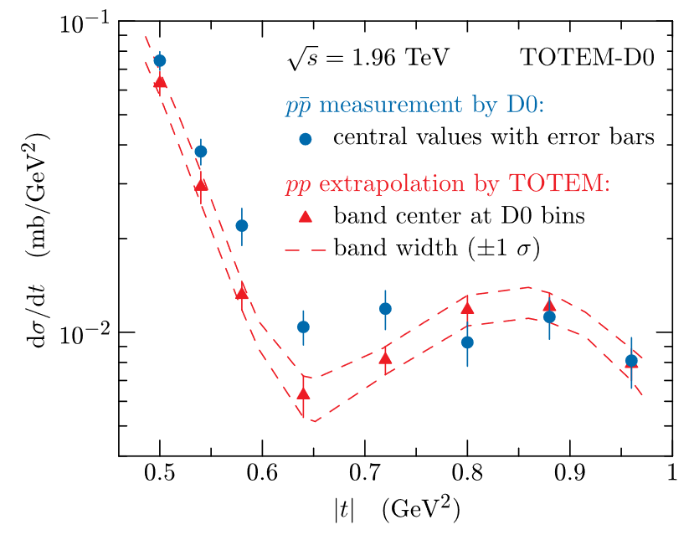

Analysis of Results
[2]
Matching $D∅$ and TOTEM data
Comparing $\frac{dσ}{dt}$ curves
$χ^{2}$ supports odderon model to $3.4σ$
Comparing $D∅$ data
Supports odderon model to $3.4−4.6σ$
[1]
[1] Abazov et al. (2021). Odderon exchange from elastic scattering differences between pp and p ̄p data at 1.96 TeV and from pp forward scattering measurements.
[2] Antchev et al. (2018). First determination of the ρ parameter at √s = 13 TeV – probing the existence of a colourless three-gluon bound state.

Slide 6
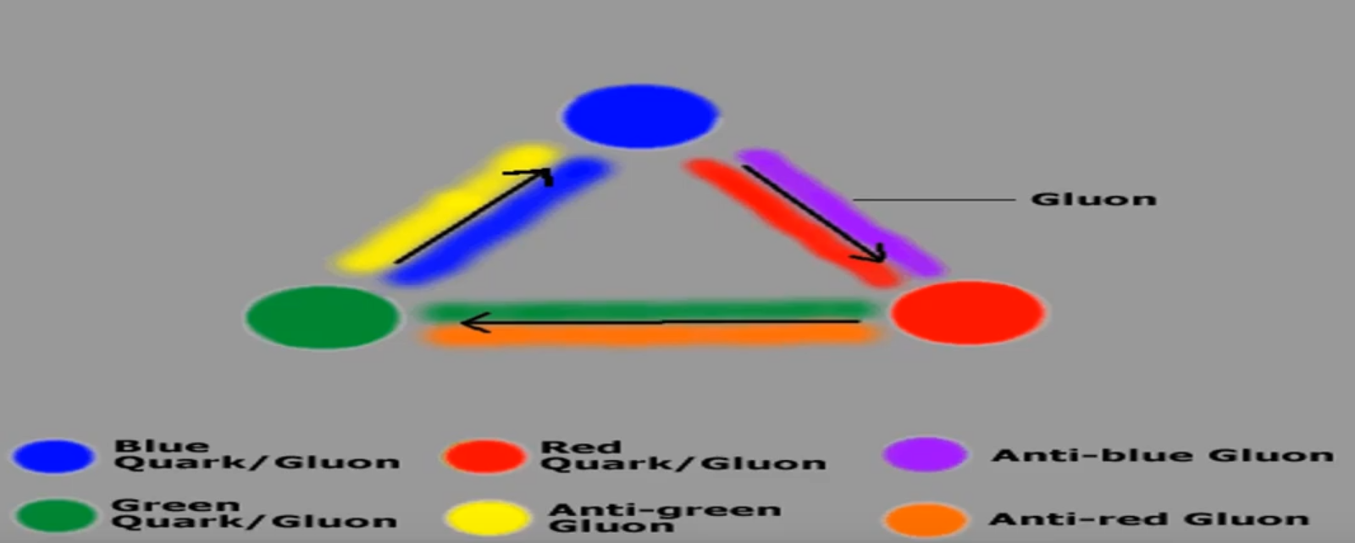
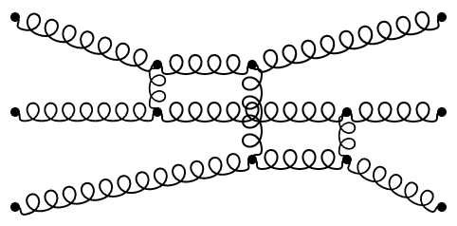

Discovery
Combining both results
Proved odderon’s existence to $5.2−5.7σ$
Significance:
  Colourless state
  Composed entirely of gauge bosons
Significant test of QCD
g
g
g
g
g
time
g

Slide 7
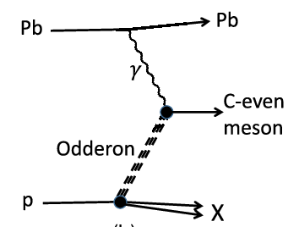
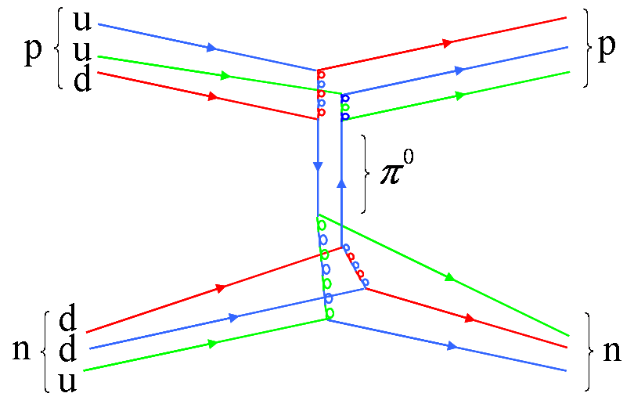
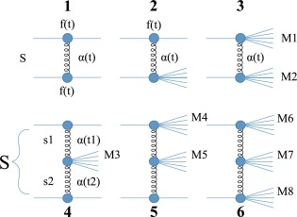
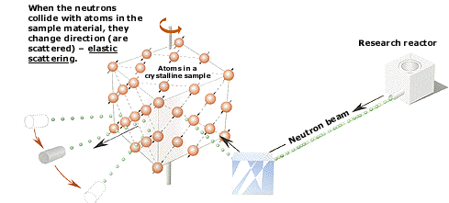
Future studies
Odderon decays ^{[1]}
Hadronic diffraction
Higher order exchange particles
d
u
d
n
n
[1] Hua-Xing Chen et al. (2021). Toward the existence of the odderon as a three-gluon bound state.

Slide 8
Conclusion
Theoretical role of odderon
Experimental data
Statistical analysis → Discovery
Future studies

Slide 9
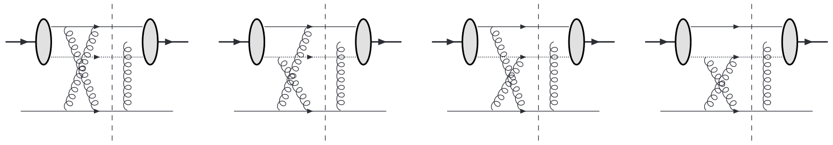
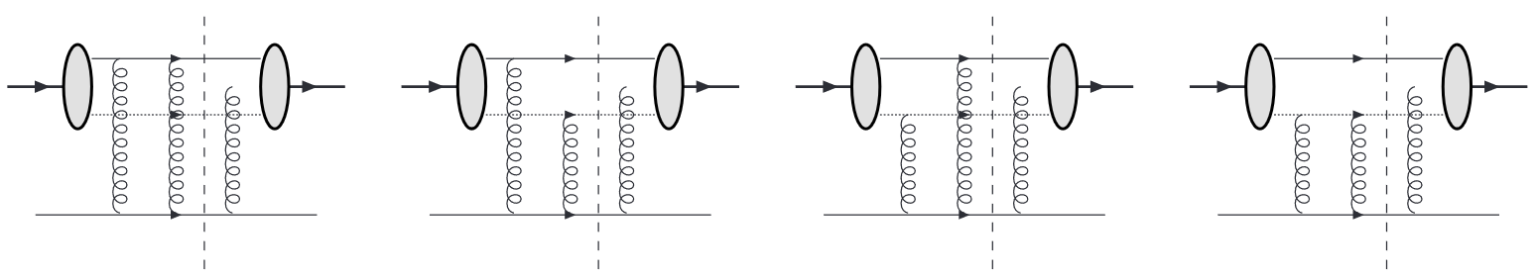
Thank you for listening
Any questions?

