Slide 1
The Flowing Fluid Model:
An Acoustic Analogue
of General Relativity?
Presented by: Aidan Joyce

Slide 2
In this Presentation:
What is Analogue Gravity?
The Flowing Fluid Analogy:
  Acoustic Metric and Equation of Motion
  Successes/Failures of the Analogy
  Acoustic “Dumb Holes” and Examples
Final Thoughts

Slide 3
What is Analogue Gravity?
We model the kinematics and dynamics of general relativity using condensed matter systems
We use these systems to perform otherwise difficult general relativity experiments
OR We use the models to try to results of general relativity in different physical contexts
In practice:
Consider the propagation of scalar fields in the system
Define a metric for this propagation
Compare to general relativity
Describe dynamics of the metric?

Slide 4
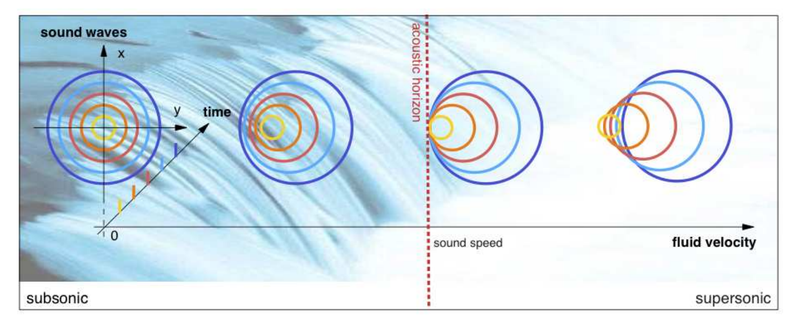
The Flowing Fluid Analogy
Consider small sound waves travelling in a moving background fluid
Sound waves distorted (similar to the Doppler effect)
Sound waves in supersonic fluid can’t propagate upstream => Acoustic analogy to black hole
Can describe the propagation of sound waves in terms of a scalar field propagating with a Lorentzian metric…
Diagram taken from: arXiv:gr-qc/0505065

Slide 5
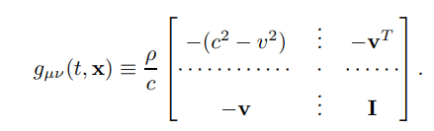

Acoustic Metric and Equation of Motion
Consider fluid equations (continuity/momentum)
Assume sound waves barotropic/inviscid/irrotational
Linearise equations for small perturbations (sound waves) about moving background
Get and equation of motion for the velocity potential of the sound waves propagating in a metric:
Velocity potential EoM
Acoustic Metric

Slide 6
Immediate Failures of the Flowing Fluid Analogy
Only 2 degrees of freedom in the acoustic metric:
Density, 𝜌, velocity potential, Δ𝜙, and sound speed, c -> 3 DoFs
Continuity equation reduces to 2 DoFs
General 4x4 Lorentzian metric is symmetric with 10 DoFs
Can only describe situations with reduced degrees of freedom
No description of the dynamics of general relativity:
No equivalent to Einstein equation for the metric
Soundwaves assumed to not affect the background fluid flow

Slide 7
Successes of the Flowing Fluid Analogy
Metric is Lorentzian and has signature (- + + +)
Can perform Lorentz transforms between different background fluid velocities
Acoustic metric inherits topology from “physical” metric
Can show fluid flow lines are geodesics of the acoustic metric
At sonic transitions, can define an event horizon…
Notes:
https://arxiv.org/pdf/gr-qc/0505065.pdf

Slide 8
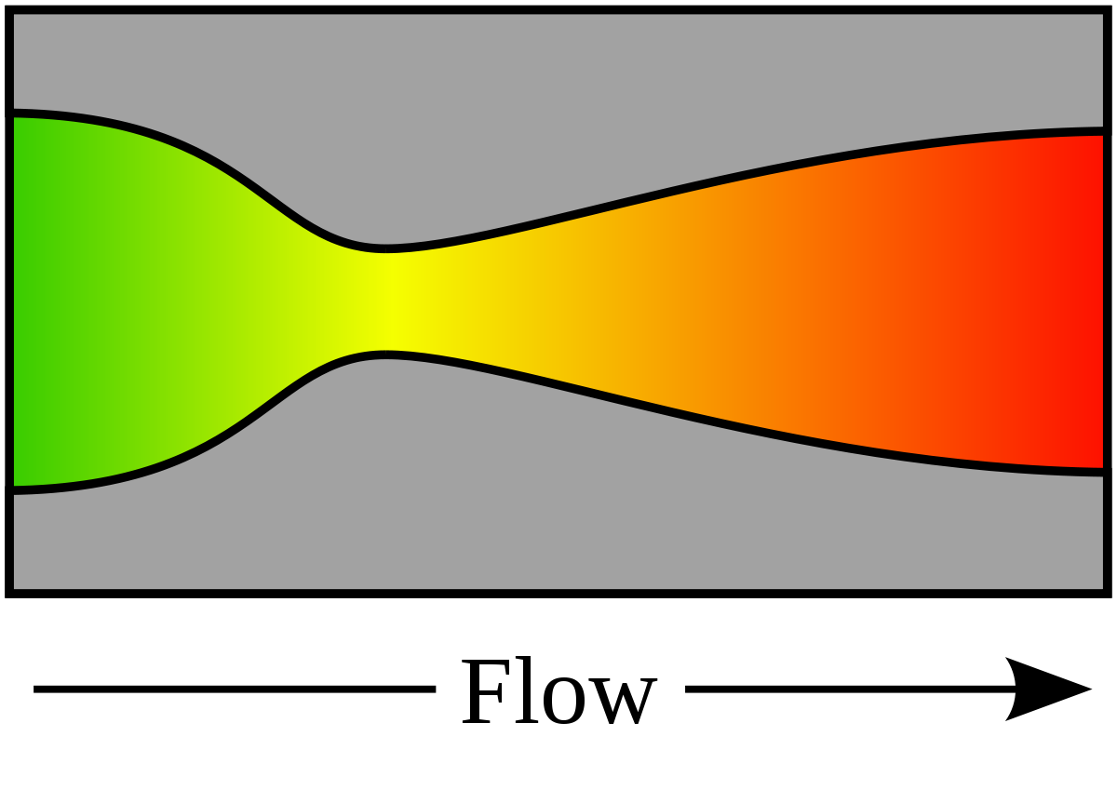
Acoustic “Dumb Holes” and De Laval Nozzle
At sonic transition sign of g_{tt} changes
Identify with sonic black hole
Sound waves can’t propagate back through sonic transition
A simple example is the De Laval Nozzle
The acoustic metric
The De Laval nozzle

Slide 9
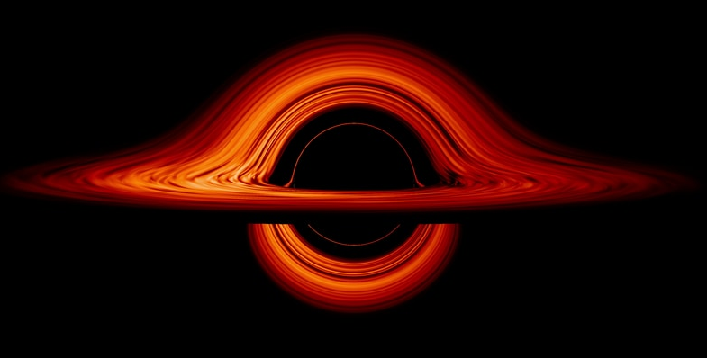
Accretion Disks Again
Acoustic metric was first derived (Moncrief, V., 1980) when considering relativistic fluid dynamics of accretion discs surrounding black holes (where the physical metric is of relevance)
Sound waves in accretion discs accelerated in towards a black hole, undergoing a sonic transition at the “sonic radius”
Means sound waves around black holes experience both black and “dumb” holes
Credit: NASA’s Goddard Space Flight Center/Jeremy Schnittman

Slide 10
Final Thoughts
Acoustic analogies try to model GR in fluids/condensed matter
Flowing fluid analogy models the kinematics of a scalar field propagating in a specific Lorentzian metric (with reduced DoFs)
Flowing fluid model fails to model the dynamics of GR
But, can model black holes and other phenomena
Experimentally useful?

